Slide 1
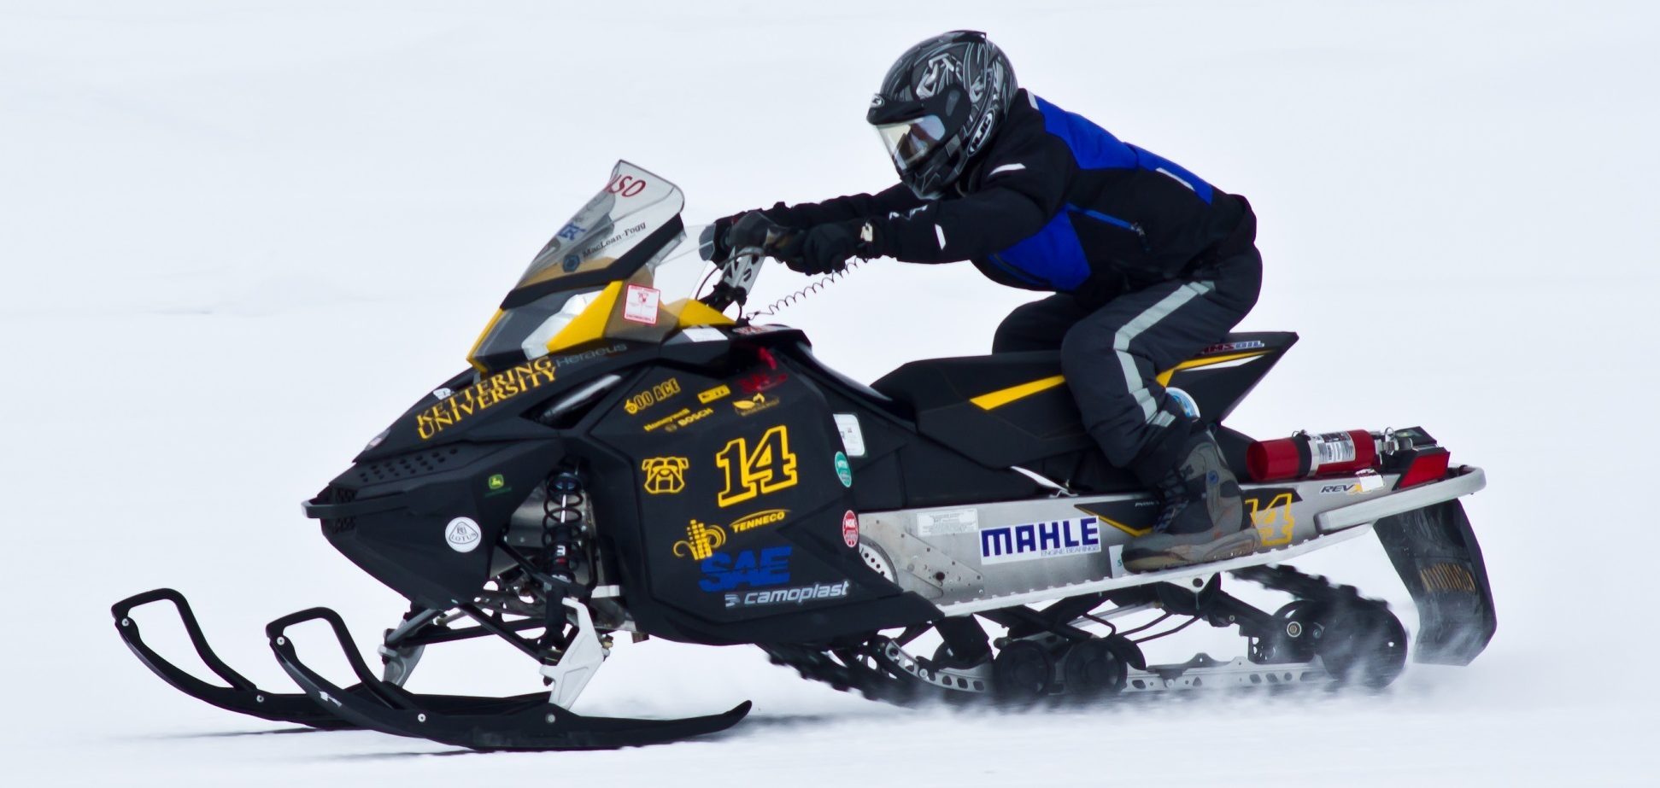
Kettering University
Development of a Flexible Fueled Snowmobile for the 2015 SAE Clean Snowmobile Challenge

Slide 2
Design Approach
Versatility
Performance 60 hp class snowmobile
All around heavy hitter
Mode switch optional
Advanced Controls
Electronic Throttle
Custom engine code
Infinite flexibility
Noise Attenuation
Affordable, lightweight silencer with acoustic valve
Automotive grade sound deadening material
4. Emissions
Three way catalyst with application-specific washcoat
Extended lean-burn calibration
5. Dynamic Performance
Performance increase over OE model with turbocharged power
Light-weight
Adaptable to riders, dealers, and outfitters

Slide 3
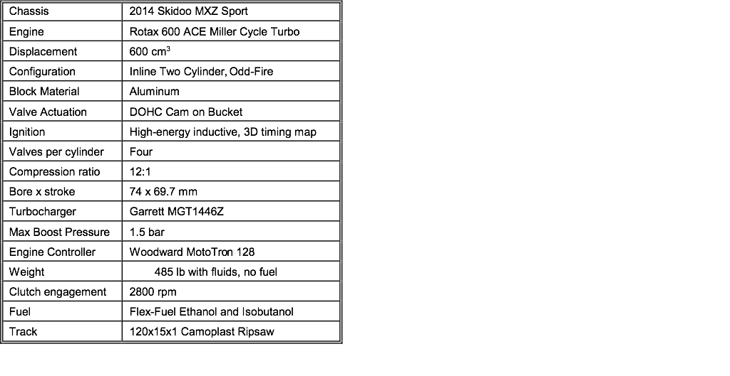
Kettering 2015 Skidoo MXZ Sport

Slide 4
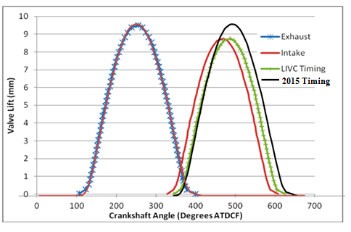
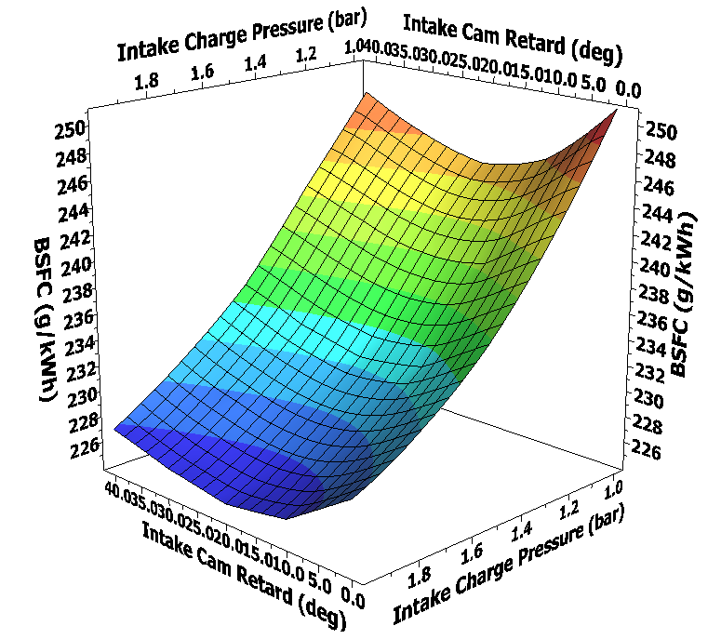
Late Intake Valve Closing
Simulation DOE shows most efficient:
20 degree intake cam retard from OE
Increasing intake charge pressure
Exhaust camshaft as intake cam: LC 126 ATDC, IVC 61 ABDC
Turbocharger provides intake charge pressure for efficiency and power

Slide 5
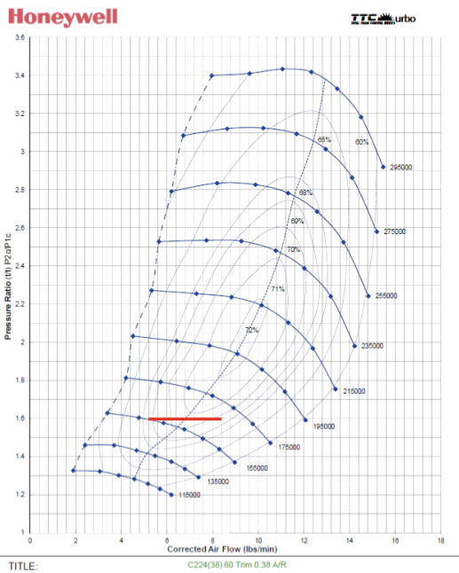
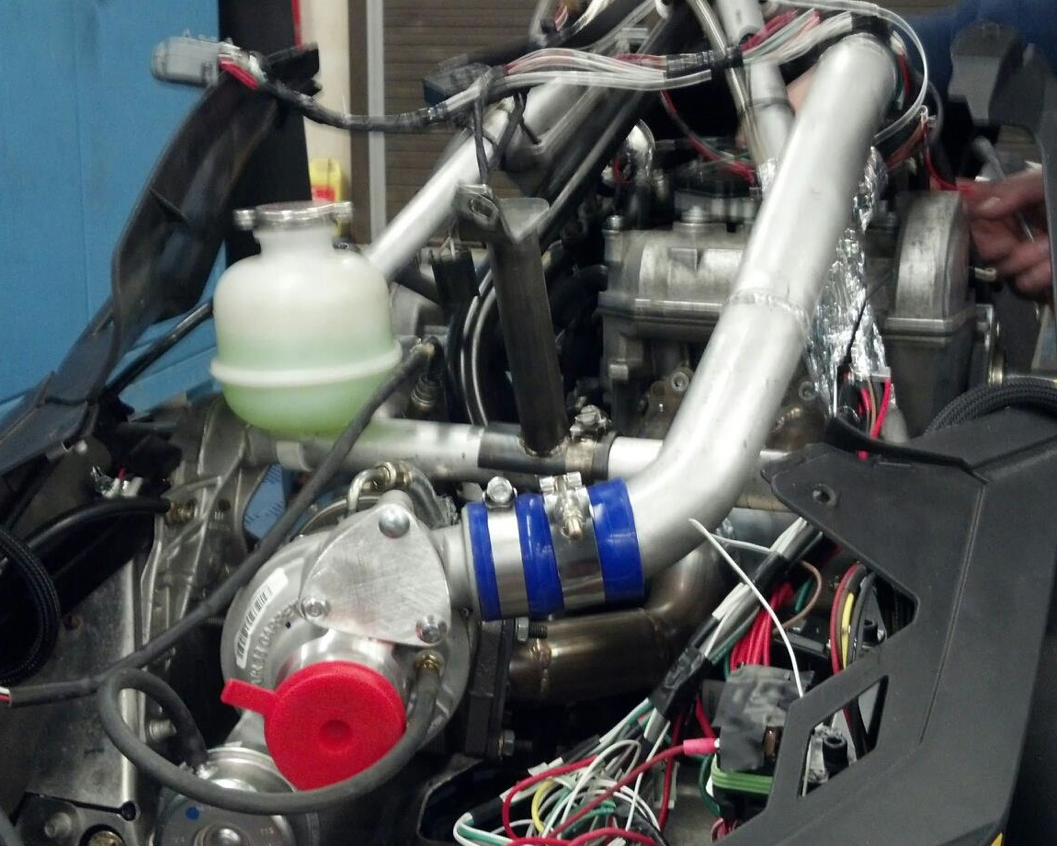
Compressor Matching
Honeywell Garrett MGT1446Z turbocharger
Larger than traditional compressor match
Odd-fire twin cylinder engine with large exhaust pulses
Large turbine wheel and housing for low backpressure

Slide 6
Miller Cycle 600 ACE Engine
Stock 12:1 compression ratio to preserve efficiency
Late intake valve closing for reduced pumping losses
Increased torque with turbocharger boost
Decreased modal BSFC from stock naturally aspirated
Improved vehicle performance—appeals to more riders

Slide 7
Dynamic Performance--Light Weight
546 lb with fluids, without fuel
Second lightest snowmobile at CSC 2015
Launch and traction control for acceleration and handling
Cost-effective at estimated $10,000 MSRP
An efficient, quiet, low-emissions performance trail sled to enjoy in fast company!

Slide 8
Thanks to our 2015 Sponsors!

