Slide 1
Kettering University Clean Snowmobile

Slide 2
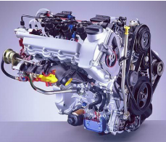
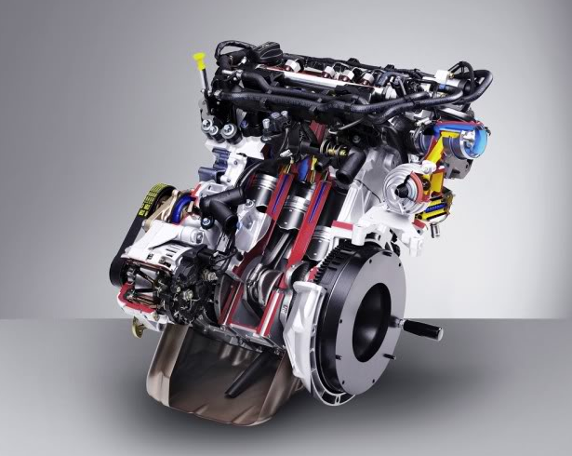
2017 Design Approach
Versatility
Hauling class snowmobile
Diesel cycle engine for high efficiency and torque
Modern, Clean Diesel Technology
Common Rail Direct Injection
Automotive-based engine
Full Authority Electronic Engine Management
Emissions
Diesel Particulate Filter
Diesel Oxidation Catalyst
Noise
Sound dampening
Catalytic Muffler
Eliminate Diesel clatter

Slide 3
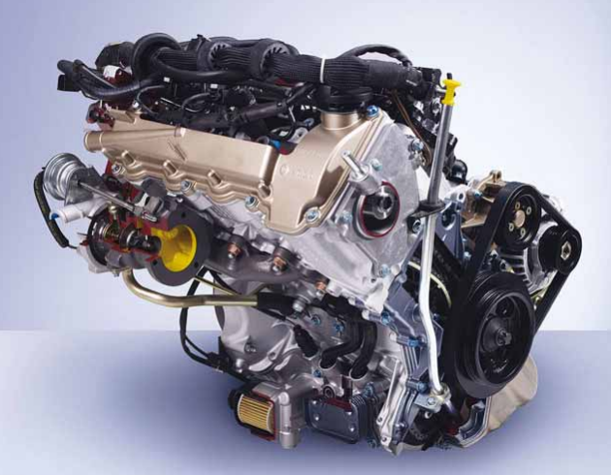
Mercedes-Benz OM660
Model | OM660
Displaced volume | 799cc
Stroke | 79mm
Bore | 65.5mm
Compression ratio | 18.0:1
Number of cylinders | 3 in-line
Dry weight | 190lb.
Combustion chamber | Direct injected
Valvetrain | Chain-driven OHV
Induction System | Turbocharged
Rated Power | 33kW @3800rpm
Rated Torque | 100Nm @2000rpm
Fuel System | Common Rail
Maximum Fuel Pressure | 1400 Bar
Fuel System Supplier | Bosch

Slide 4
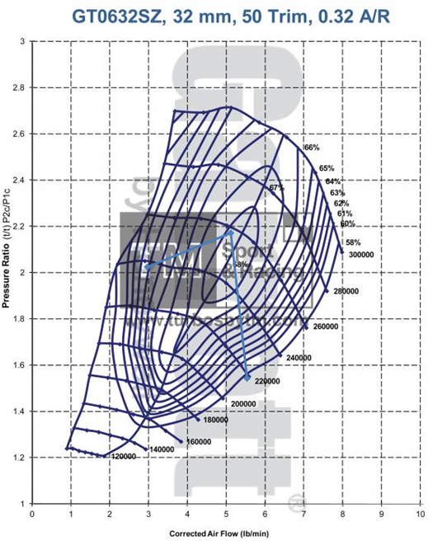
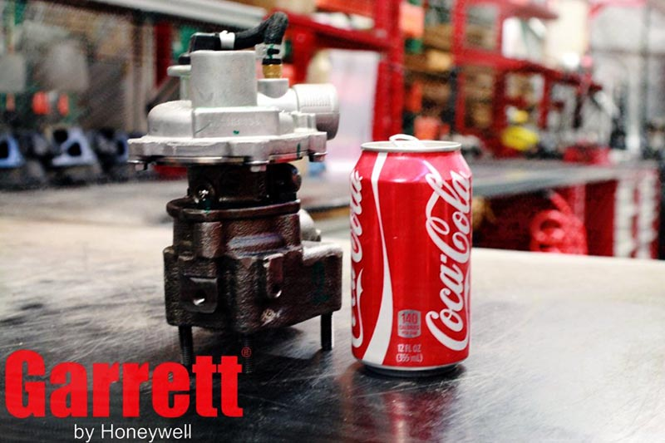
Compressor Matching
Honeywell Garrett GT06 turbocharger
Spreadsheet tool developed and used to analyze compressor match
Honeywell Garrett GT06 selected from 4 options

Slide 5
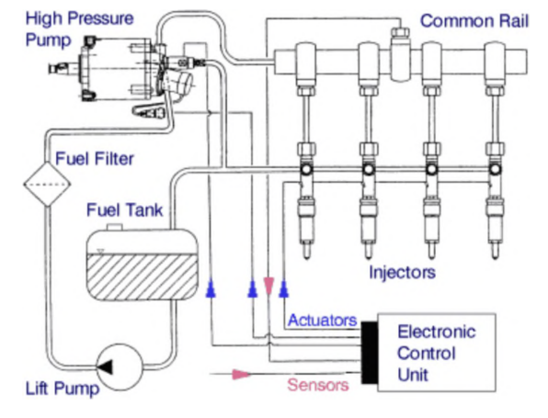
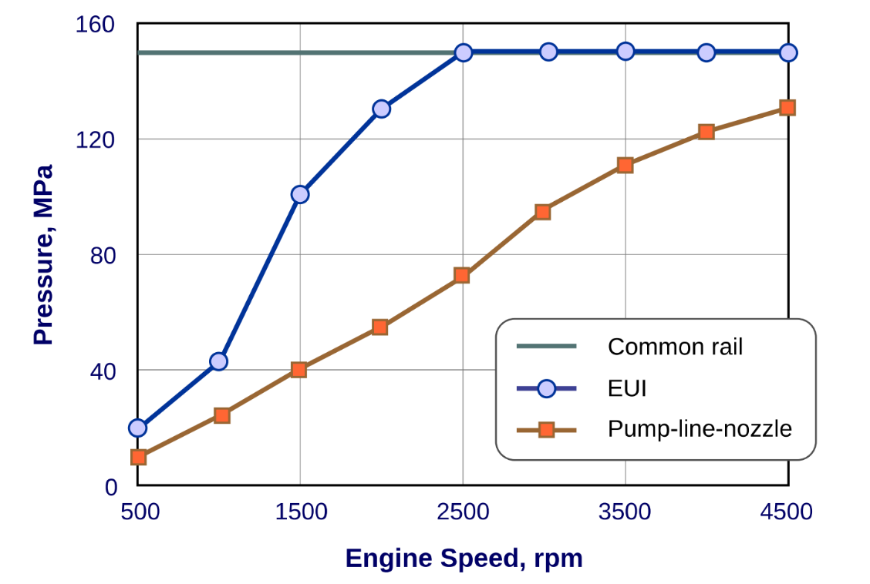
Common Rail Direct Injection
Full-authority electronic control of all injection parameters
Full injection pressure is available at any RPM
Bosch solenoid injectors and CP1 pump used

Slide 6
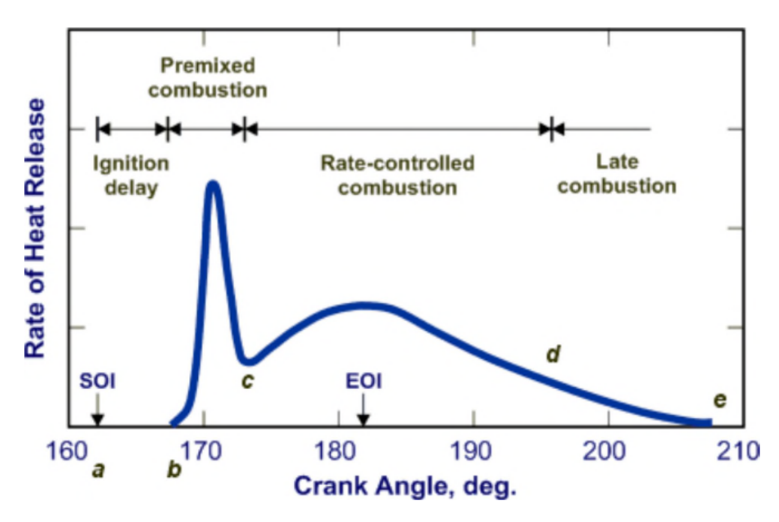
Common Rail Emissions and Noise
Multiple injections allow precise control of combustion
Reduction of Diesel ‘clatter’
Improved control of NOx vs Soot tradeoff

Slide 7
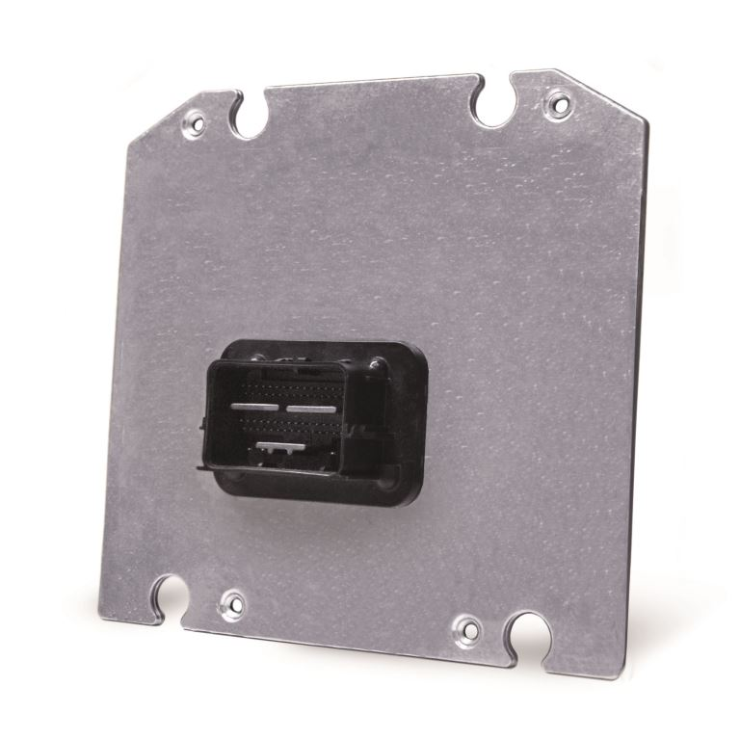
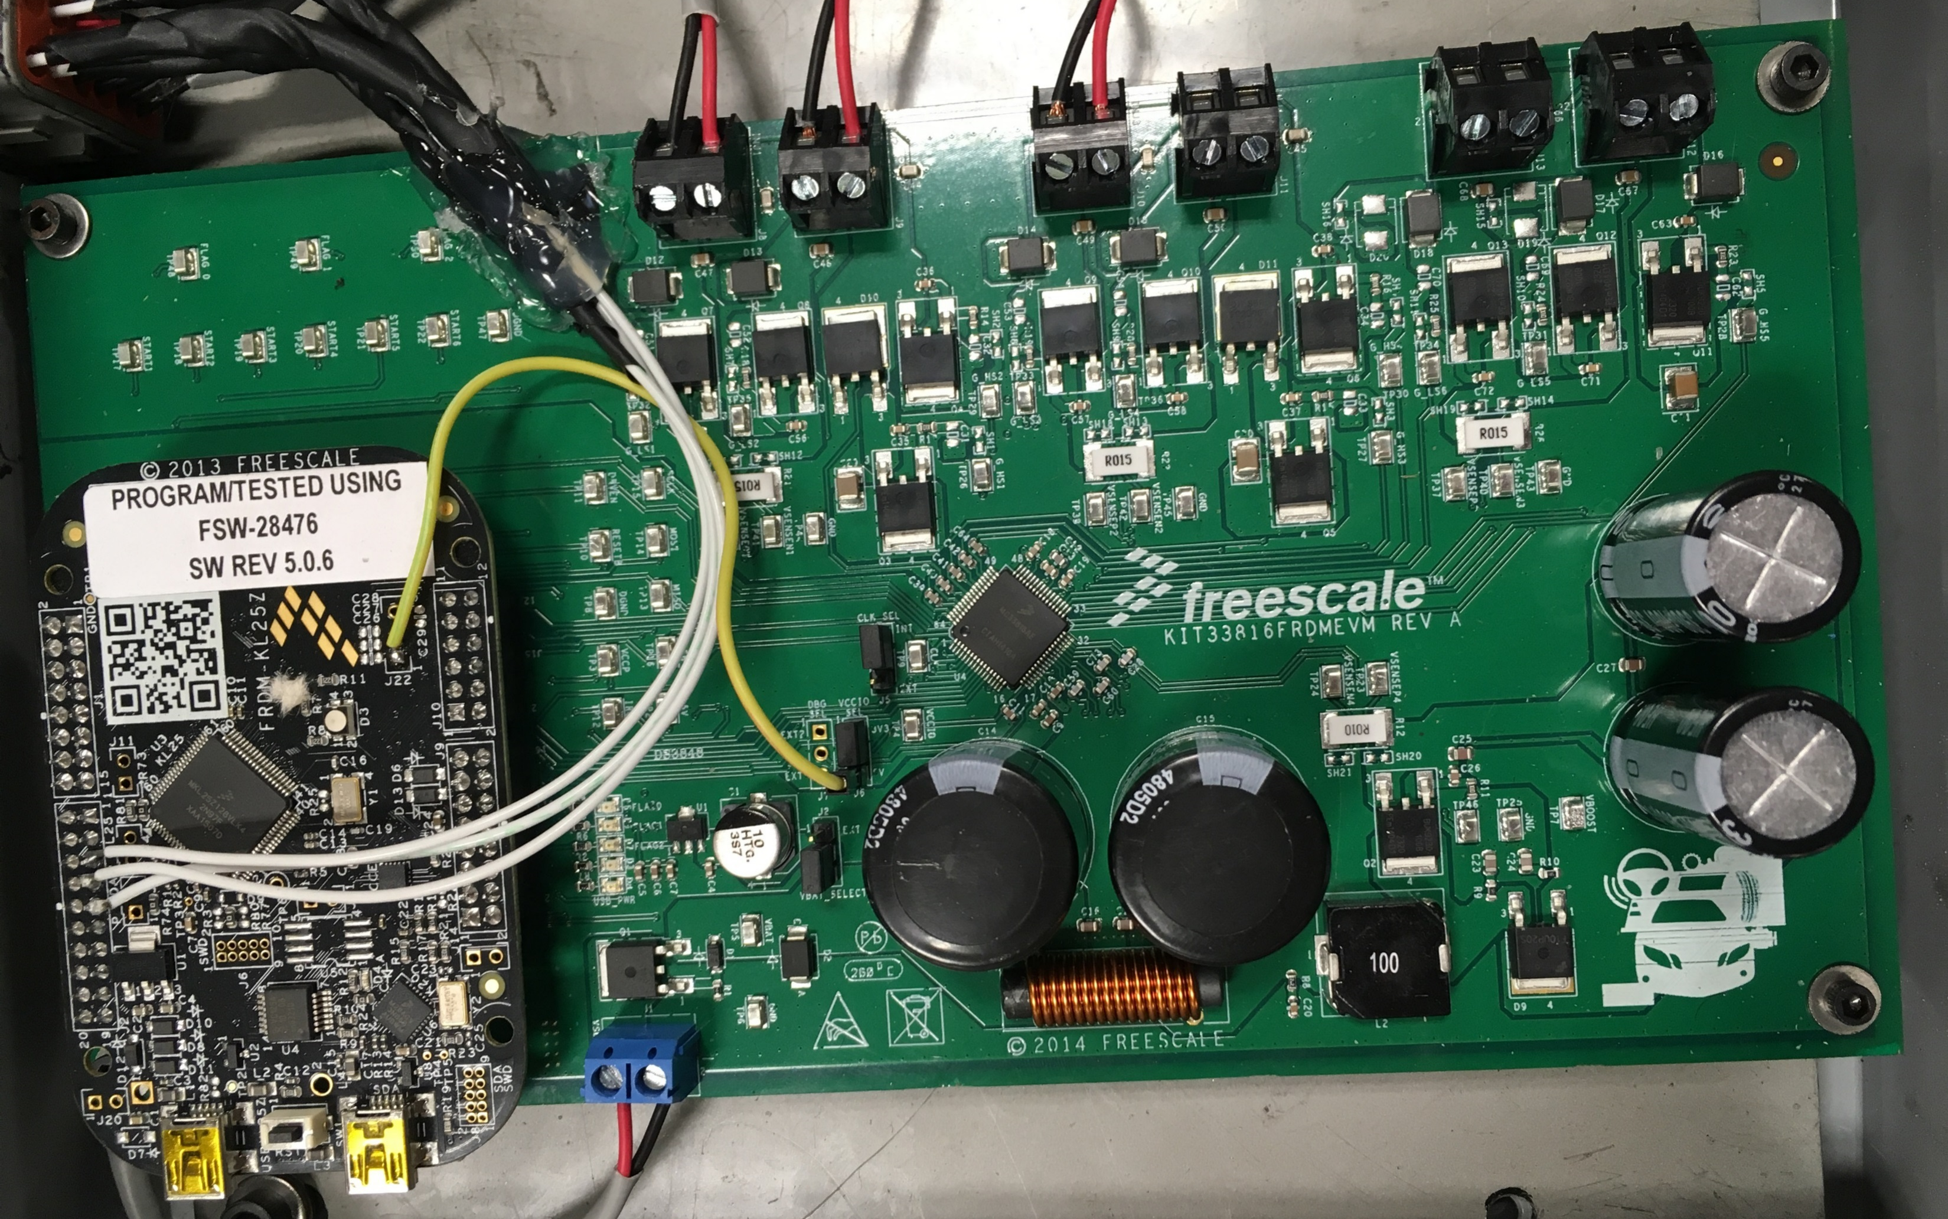
Common Rail Controls
Student-developed common rail control system
Rapid-prototype ECU hardware
Custom DI injector driver board
Student-developed engine control algorithms in Simulink

Slide 8
Common Rail Control Algorithms
Torque Requests
Combustion Manager
Pilot/Main Injections
Rail Pressure Target
Boost Pressure Target
Soot Limit
Injector Control
Driver
Engine Torque Control
Torque
Request
Idle
Common Rail Pressure Control
OverRev
Soot
Limit
Protection
Air Model
Boost Pressure Control

Slide 9
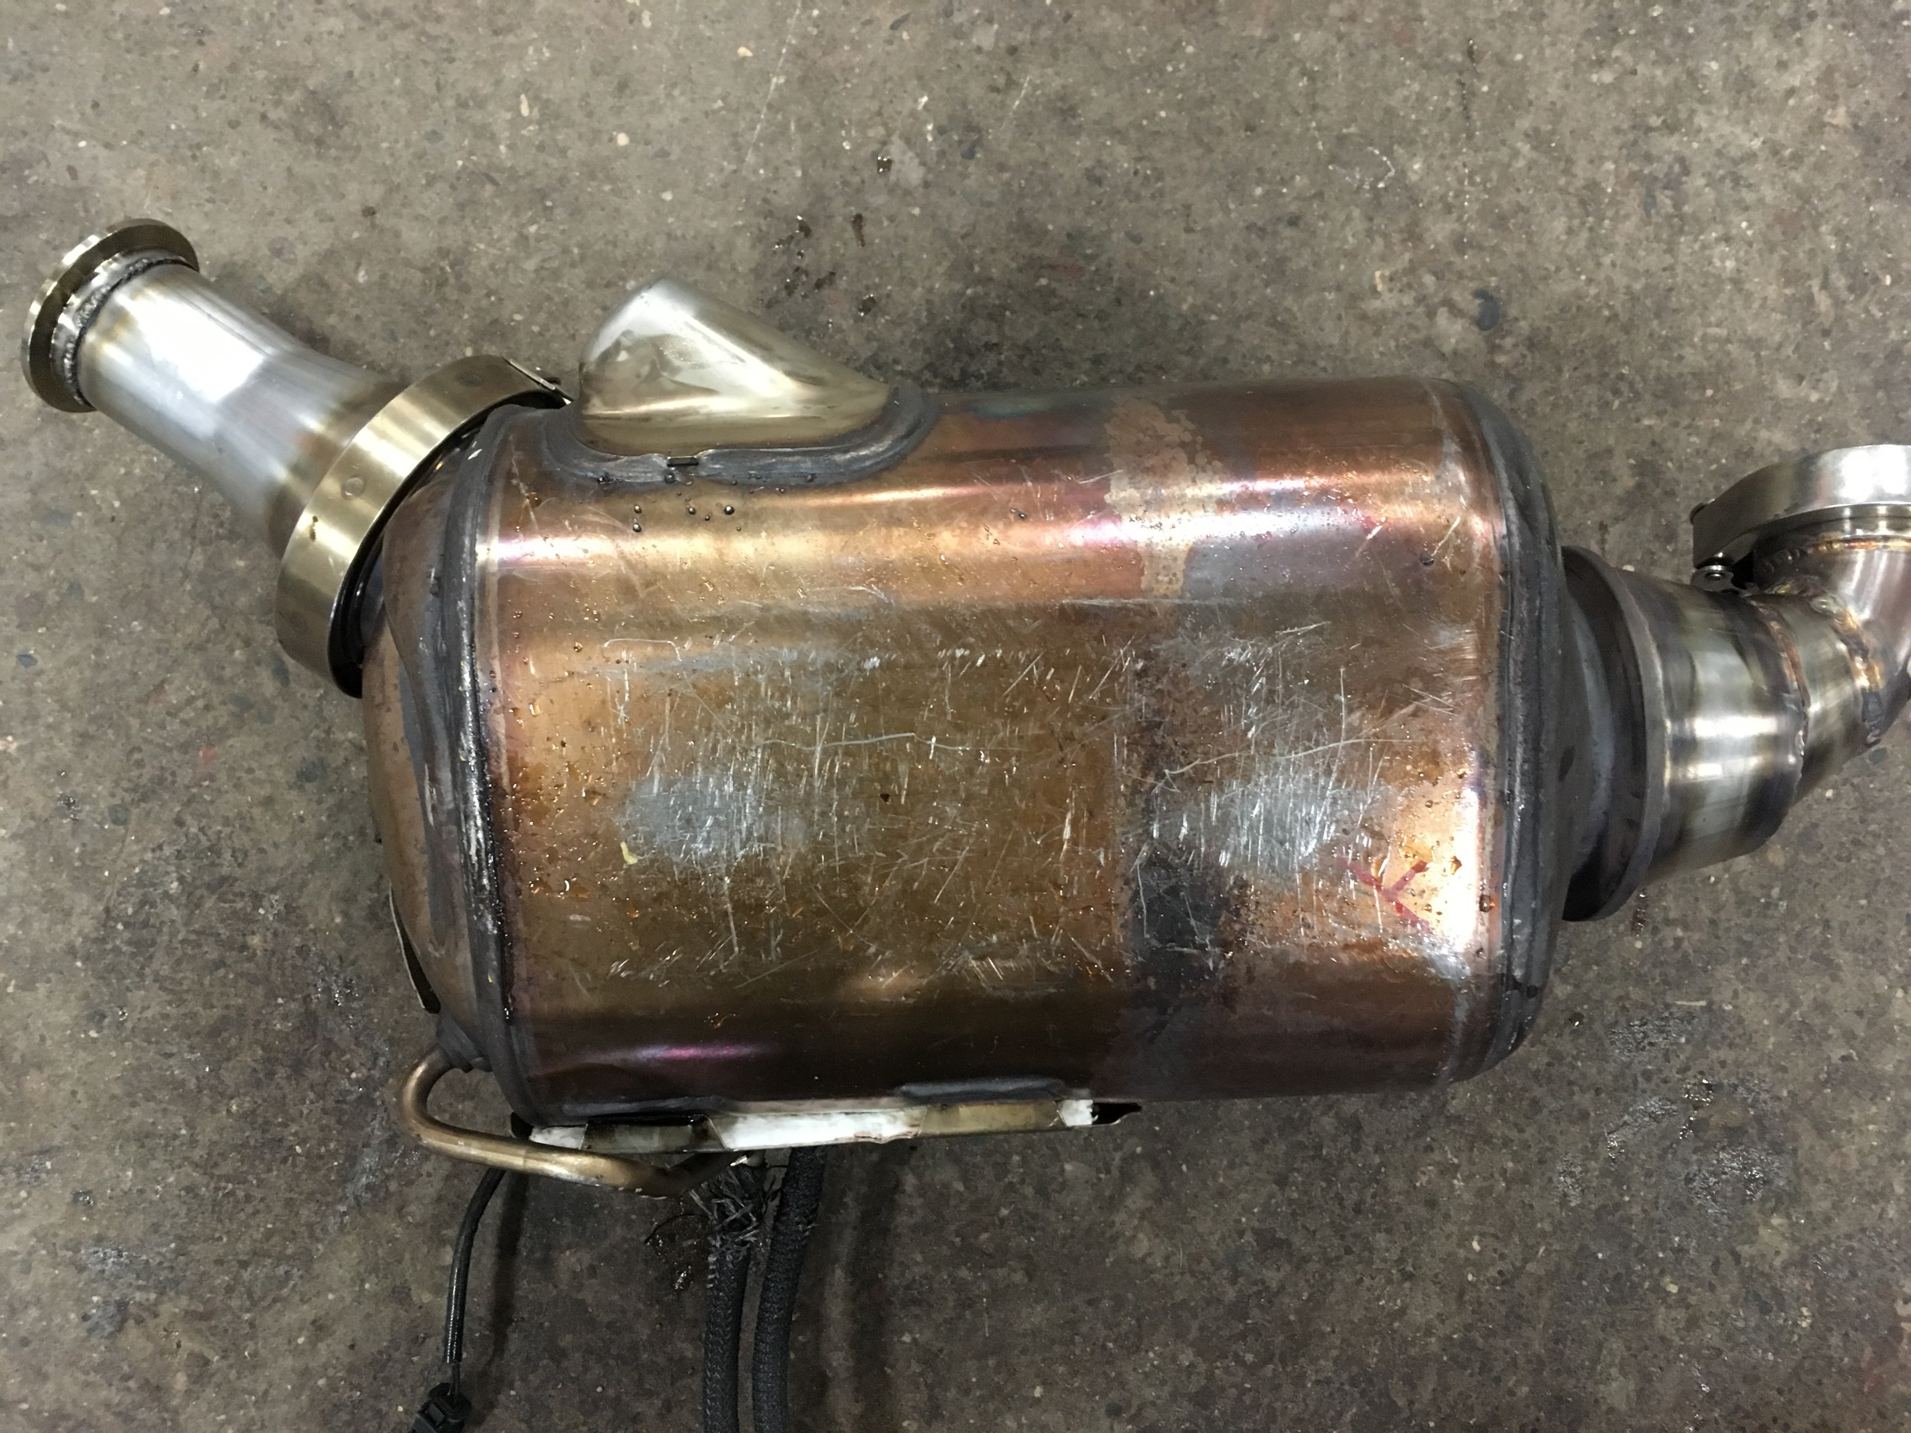
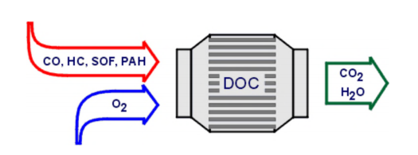
Diesel Aftertreatment
Diesel Oxidation Catalyst (DOC)
Oxidizes hydrocarbons (HC) and carbon monoxide (CO) with excess oxygen and NOx
Diesel Particulate Filter (DPF)
Traps PM/Soot particles to reduce soot emissions
Catalytic Muffler
Muffler volume and DOC+DPF integrated for low noise and emissions

Slide 10
Common Rail Calibration Process
AC Dynamometer
Engine mapped over entire speed and load range for pilot and main injection or single main injection
Cylinder pressure indicating
ATI VISION calibration software

Slide 11
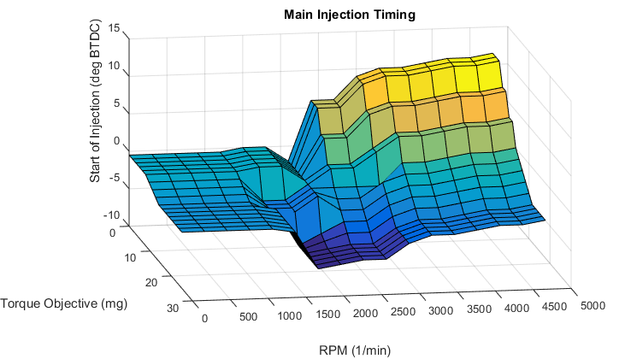
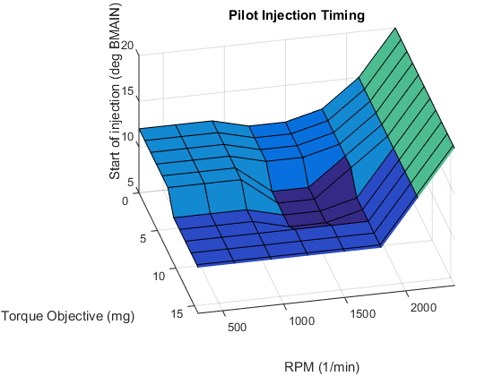
Common Rail Calibration Results
Pilot injection used up to 2100 RPM
Pilot quantity and timing, main timing calibrated for best torque (resulting in lowest BSFC)
Single injection used above 2100 RPM
Injection timing calibrated for best torque with peak pressure and location of peak pressure limits

Slide 12
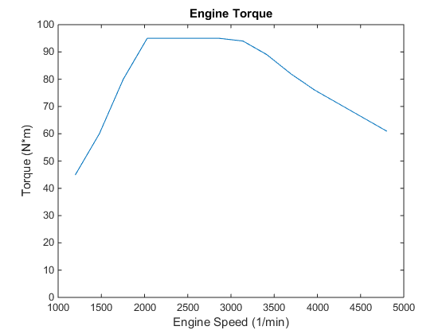
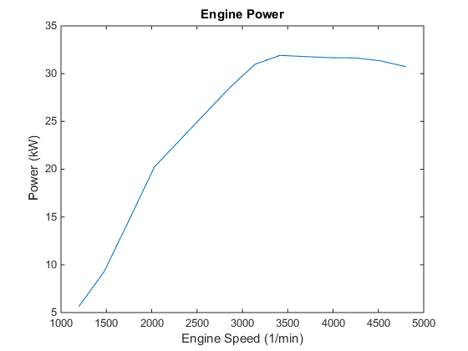
Common Rail Calibration Results
Torque curve matched to stock OM660 (97 Nm, 32 kW)
Torque increased to visible soot limit, timing adjusted to maintain safe combustion limits

Slide 13
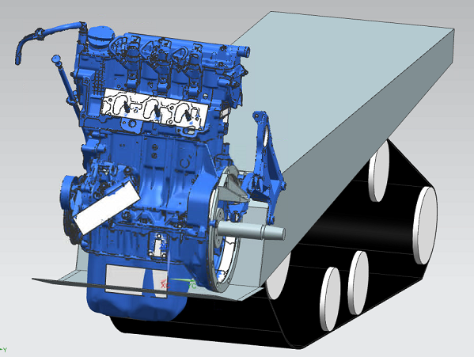
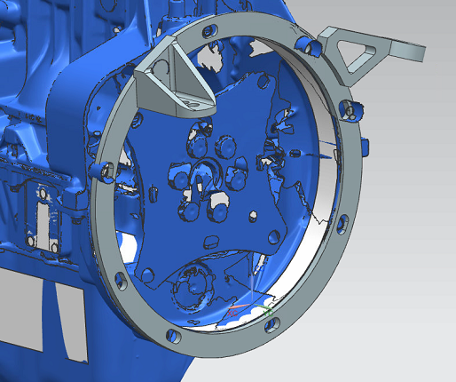
Vehicle Integration Engine Packaging
Engine mounts designed, fabricated to secure engine to chassis
Vibration isolation used to reduce noise, vibration, harshness
Steering shaft and linkage modified to package engine

Slide 14
Vehicle Integration Engine Cooling
Radiator and track heat exchanger used in series
Allows engine cooling without sufficient snow, or during extended idling and towing conditions
Intercooler used to reduce air charge temperatures in high boost conditions
Intercooler rise over ambient under 15C (Dynamometer tested)
Automatically controlled fan ensures both intercooler and radiator are kept cool
Track Heat Exchanger
Swirl Cap
Fan
Radiator
Intercooler

Slide 15
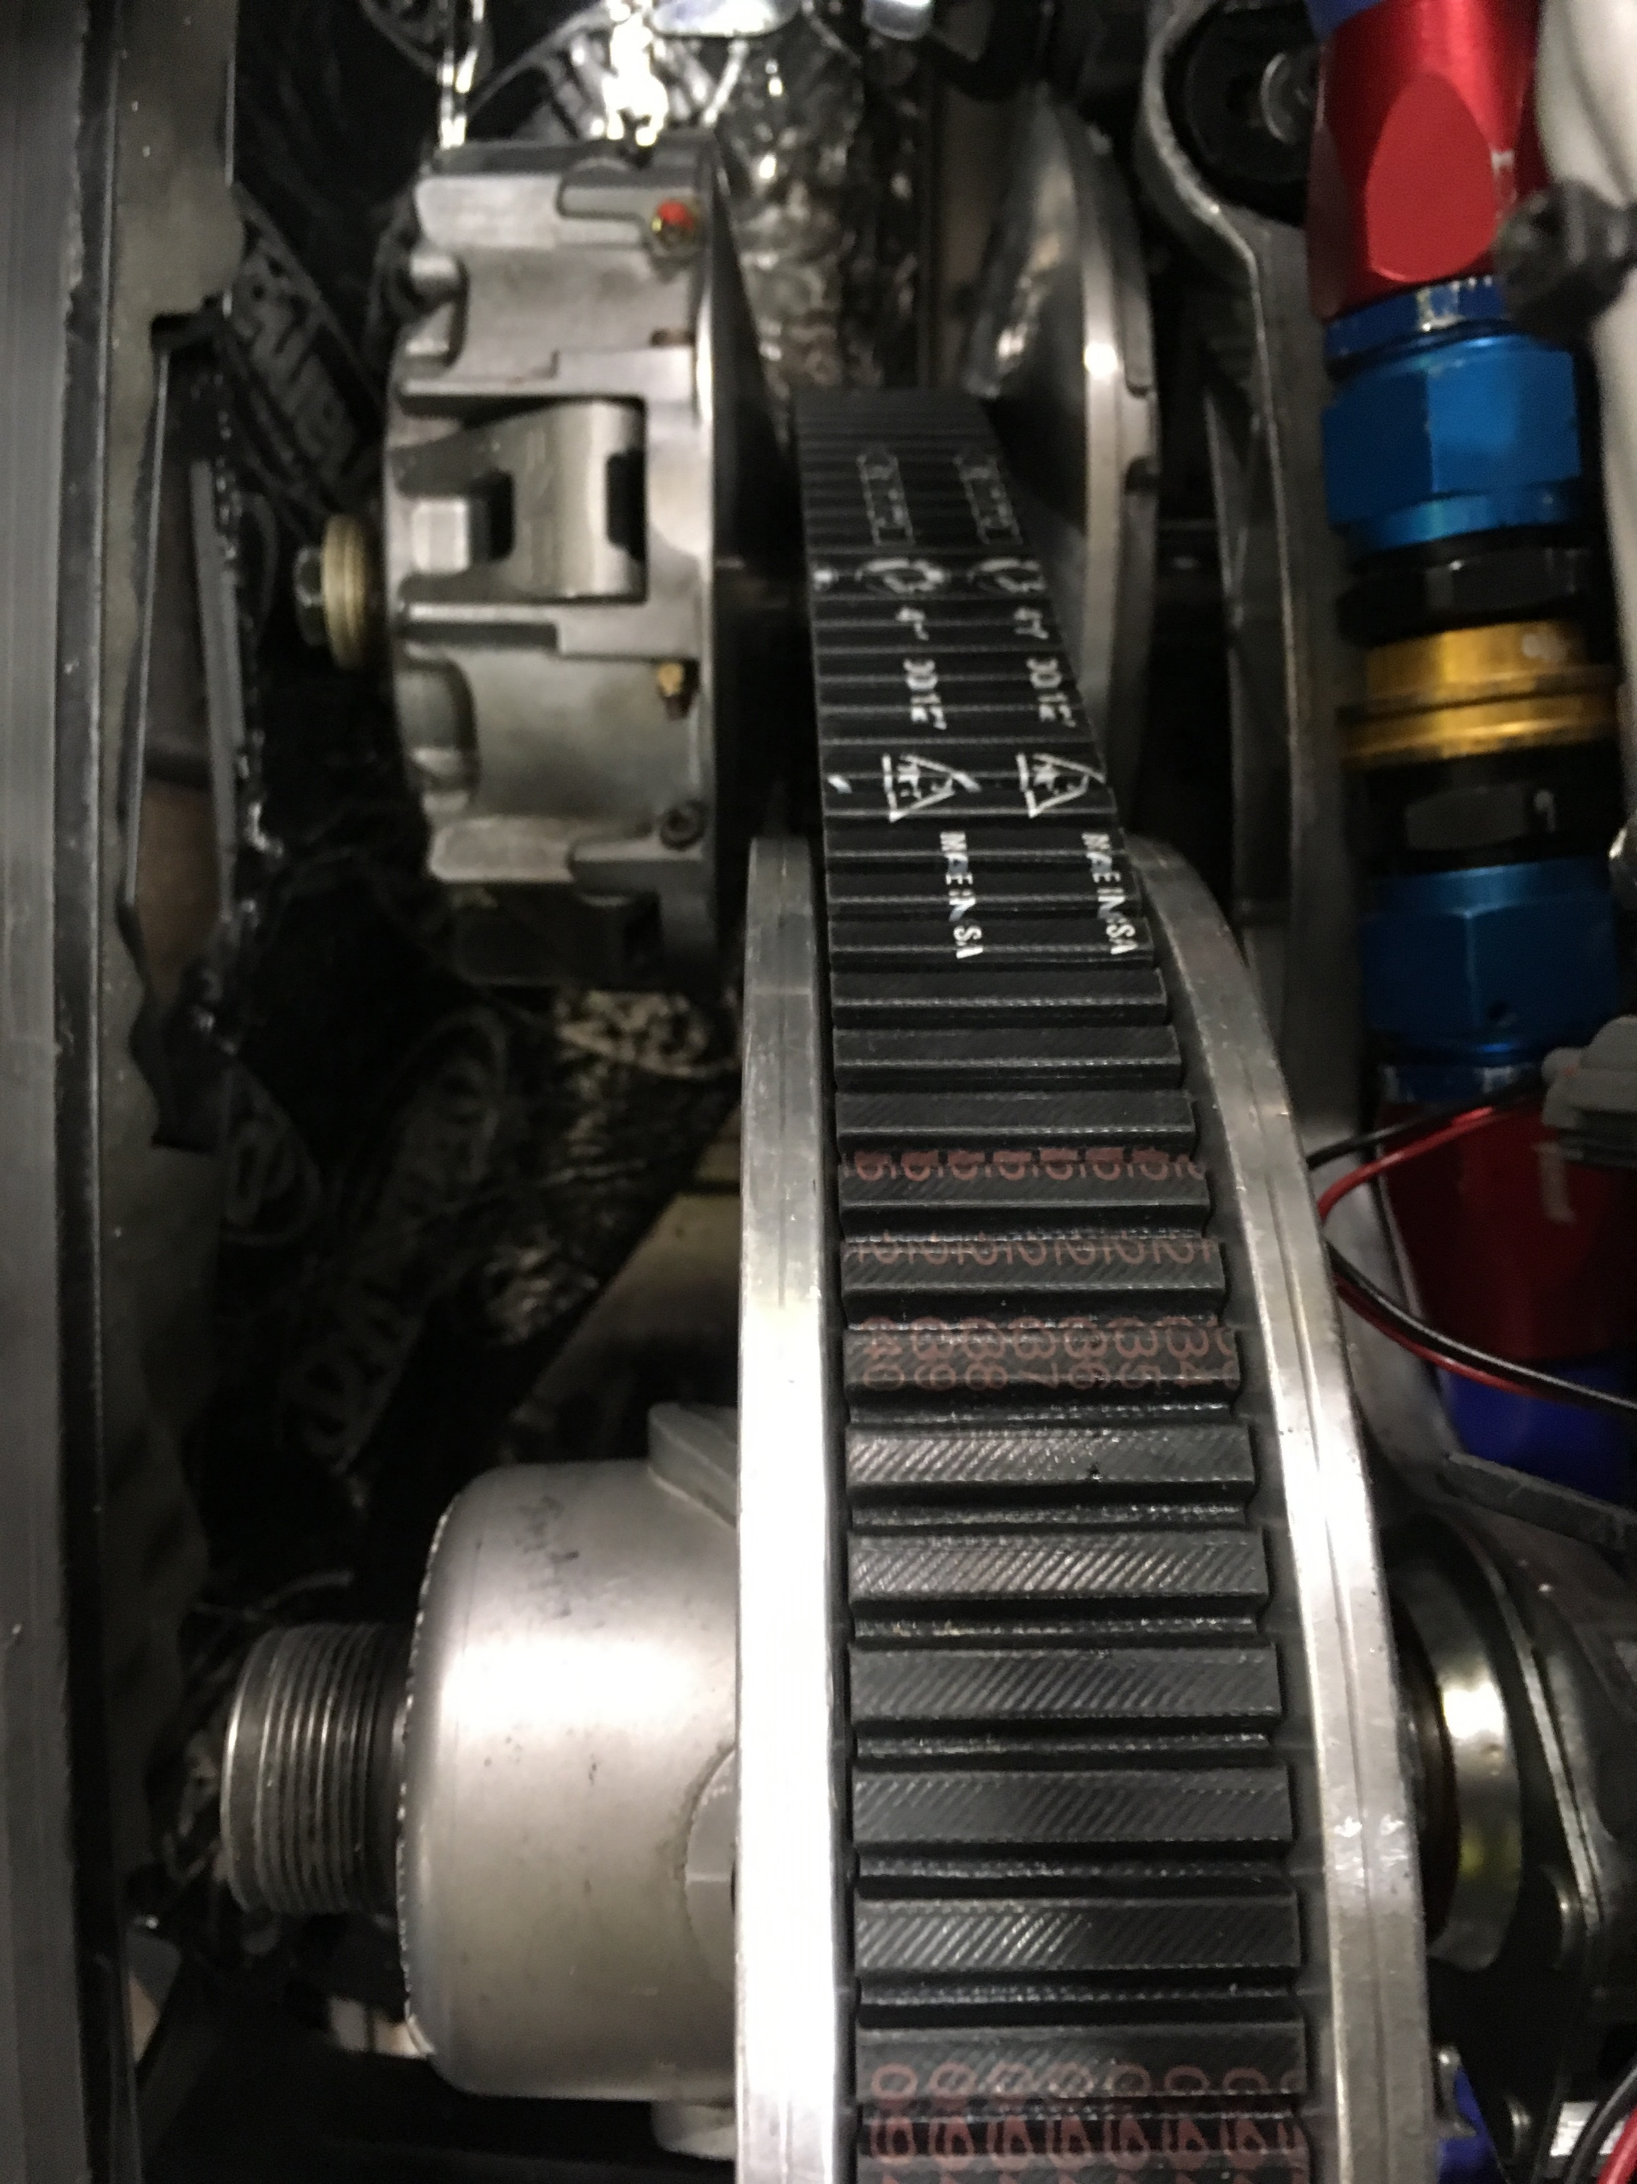
Vehicle Integration Clutching
Ski-Doo E-Drive family of 4-stroke clutches
Increased primary clutch weights 1 gram per ramp
Installed custom very light primary clutch spring
Adjusted helical spring in secondary clutch
Reduced engagement speed to match torque curve of Diesel engine - engages at 950rpm

Slide 16
Questions?
© 2012 Kettering University

