Slide 1
SAE CLEAN SNOWMOBILE CHALLENGE (CSC) 2016
Team IUPUI

Slide 2
INTRODUCTION

Slide 3



Our University,
Located in capital of Indiana, Indianapolis
2 top universities, 1 dynamic campus
Accredited by both Indiana University and Purdue University
First university in the United States to offer a bachelor's degree in Motorsports Engineering
One of the pioneer universities to offer a bachelor's degree in Energy Engineering

Slide 4
SNOWMOBILE DESIGN

Slide 5
Why Electric Snowmobile?
Lighter
Quieter
More affordable
Will not contaminate core sampling
Does not pollute the environment

Slide 6
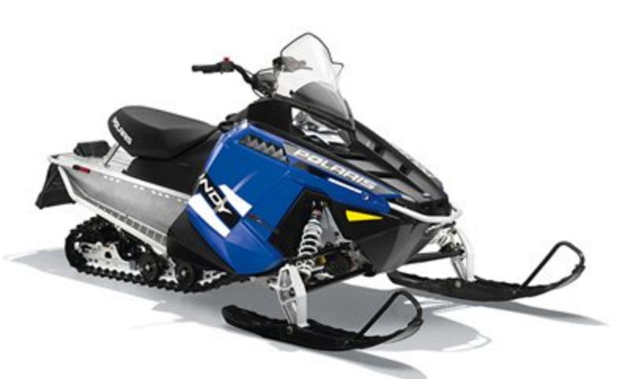
Chassis – Polaris 550 Indy
Lightweight
Entire snowmobile only weighs 450 lb

Slide 7
Frame
Aluminum construction
Track
15 inches in width
121 inches in length

Slide 8

AS AN OPERATOR

Slide 9
Converted to Electric Snowmobile
Practical choice for clean environments
15 miles range in ideal conditions.
Battery recharges in 2 hours with 220 V or 4 hours with 110 V

Slide 10

AS A DEALER

Slide 11
Minimal service required
Durable design based on Continental SilentSync belt
Low MSRP: $12,999
Easy to drive
No special switches

Slide 12
Cost Breakdown for Major Components
 | 1 Unit | 500 Units
Glider frame | $4,000 | $4,000*
Electric motor | $2000 | $550
Motor controller | $500 | $500
Battery | $3,000 | $3,000
Others | $3499 | $3,499
Total | $12,999 | $11,549
* No reduction unless partnership develops between current snowmobile manufactures.

Slide 13

AS THE ENVIRONMENT

Slide 14
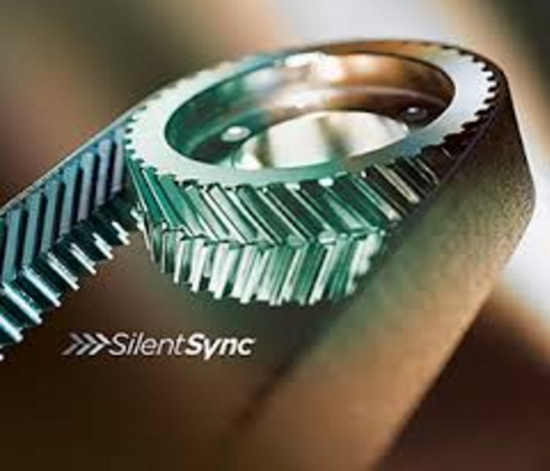
Lightweight allows for a more efficient design
The electricity power used to recharge the batteries is more efficient than gasoline, even when using dirty coal.
Using the lightest Syncho Belt available, we made the machine quiet.
The Continental belt and pulleys produces 65 decibels

Slide 15
TEST RESULTS

Slide 16
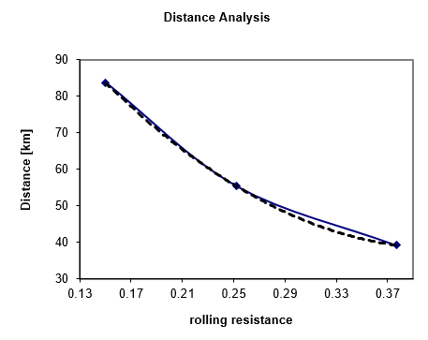
Theoretical range calculation
Battery size
  3.2volts x 19.5amp hour x 72 cells = 4492.8 watt hour
  4492.8 whr/ 250 whr/mi = 17.97 miles {Best conditions}
  4492.8 whr/ 425 whr/mi = 10.57 miles {Worst conditions}

Slide 17
Future Work
Reduce weight and increase efficiency
  More carbon fiber
  Reduce size
Increasing range and performance
  To use a higher performance lithium ion battery
Produce Reliable Phase 2 model for CSC 2017
  Pass Tech inspection
  Use of more modular components

Slide 18
QUESTIONS?

Slide 19
Thank you.

Slide 21
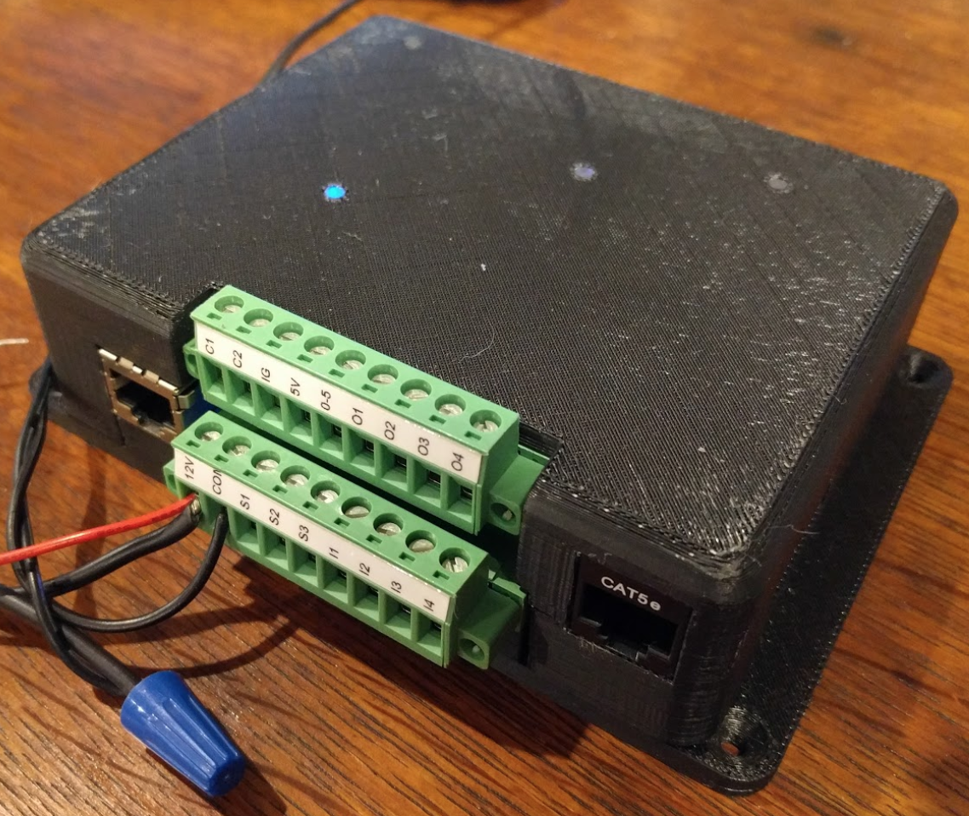
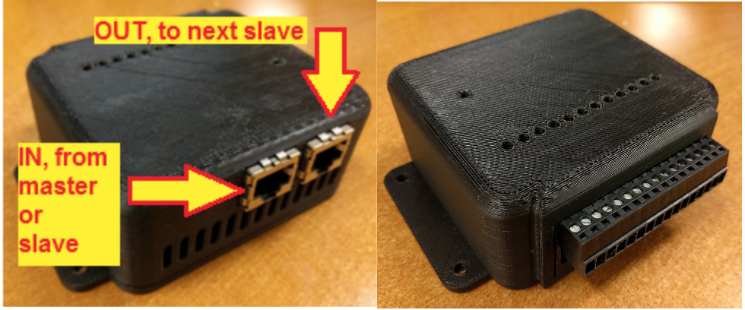
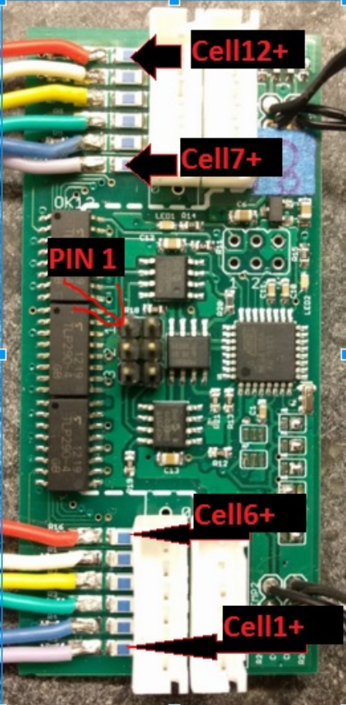
Battery Management System with Fuse Boards
BMS Master
BMS Slave
Fuse Boards

Slide 22
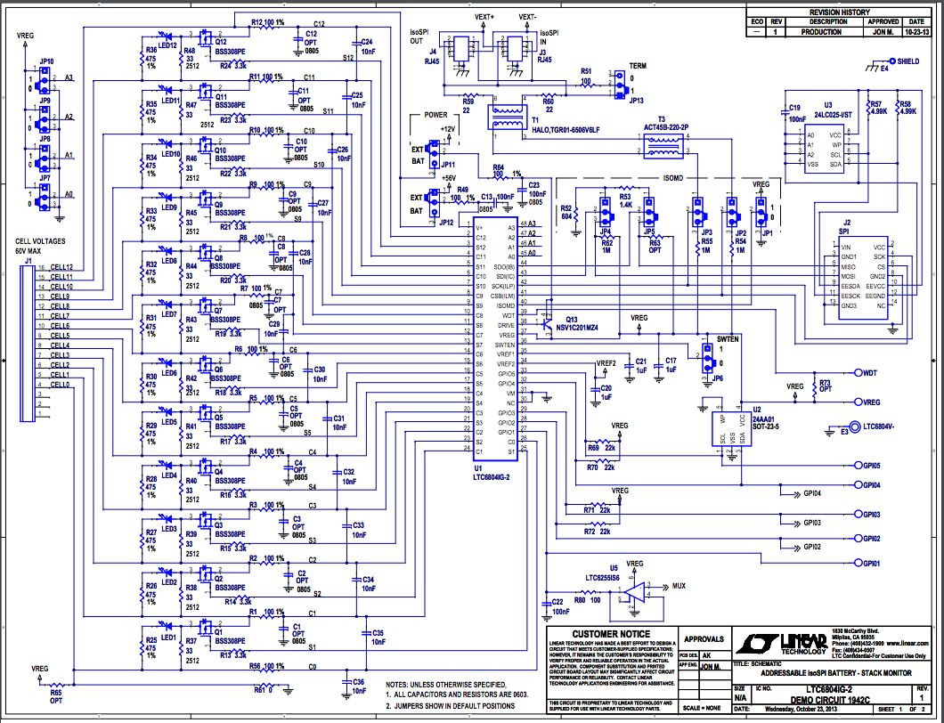
BMS Schematics (Linear LTC 6804)

Slide 23
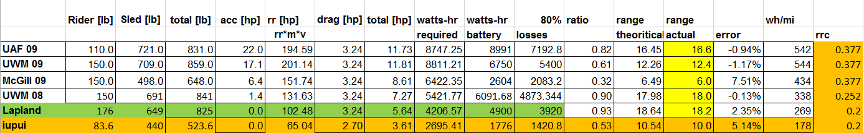
Range Calculations

