Slide 1
SAE CLEAN SNOWMOBILE CHALLENGE (CSC) 2015 Team IUPUI
Members:
Bhavesh Gandhi
Chen Guiming
Fatin Baharruddin
Michael Golub
Zhen Wei Yong

Slide 2
INTRODUCTION

Slide 3



Our University,
Located in capital of Indiana, Indianapolis
2 top universities, 1 dynamic campus
Accredited by both Indiana University and Purdue University
First university in the United States to offer a bachelor's degree in Motorsports Engineering
One of the pioneer universities to offer a bachelor's degree in Energy Engineering

Slide 4
SNOWMOBILE DESIGN

Slide 5
Why Electric Snowmobile?
Lighter
Quieter
More affordable
Will not contaminate core sampling
Does not pollute the environment

Slide 6
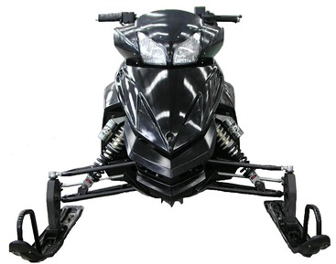
Chassis - Phantom Snowmobile (PD250LT)
The smallest and lightest sled
Entire snowmobile only weighs 400 lb

Slide 7
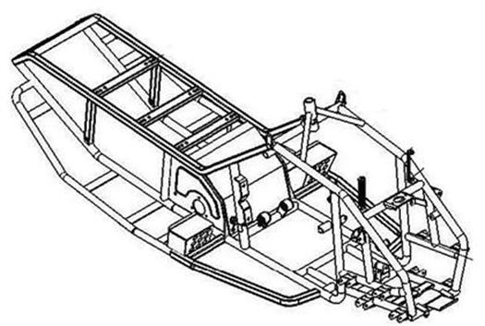
Frame
Steel frame
Weighs only 60 lb (27.2kg)
Track
10 inches in width
110 inches in length

Slide 8

AS AN OPERATOR

Slide 9
Converted to Electric Snowmobile
Practical choice for clean environments
10 miles range with current battery
Battery recharges in 2 hours
Shipping in smaller containers reduces freight costs

Slide 10

AS A DEALER

Slide 11
Minimal service required
Durable design based on Eagle NRG belt
Extremely Low MSRP: under $8000
Easy to drive
No special switches
Extremely comfortable for smaller riders

Slide 12
Cost Breakdown for Major Components
 | 1 Unit | 500 Units
Glider frame | $5300 | $2000
Electric motor | $1650 | $550
Motor controller | $500 | $500
Battery | $1500 | $1500
Others | $3000 | $3450
Total | $11950 | $8000

Slide 13

AS THE ENVIRONMENT

Slide 14
Lightweight allows for a more efficient design
The electricity power used to recharge the batteries is more efficient than gasoline, even when using dirty coal.
Using the lightest Syncho Belt available, we made the machine quiet.
The Eagle NRG belt is only 65 decibels

Slide 15
TEST RESULTS

Slide 16




Theoretical range calculation
$$total weight=rider weight+sled weight= 523.6 lb$$
$rr \left(hp\right)=rr ×m ×v$ = 65.04
$$watts hr required=total hp ×746= 2695.41$$
$$watts hr battery=1776$$
$$ratio=80\% loses ×wattrs hr battery= 0.53$$
$$thereotical range=ratio ×20$$
$$Thereotical range=0.53 ×20$$
= 10.54 miles

Slide 17
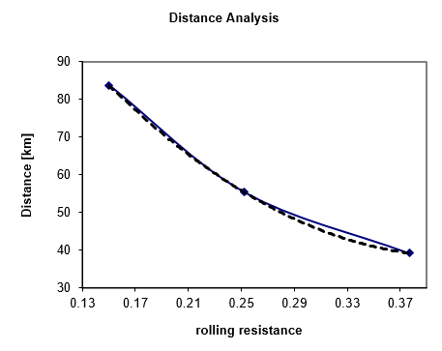
Distance Analysis

Slide 18
Future Work
Reduce weight and increase efficiency
To use new materials such as carbon fiber
Increasing range and performance
To use a higher performance lithium ion battery

Slide 19
QUESTIONS?

Slide 20
Thank you.

Slide 21
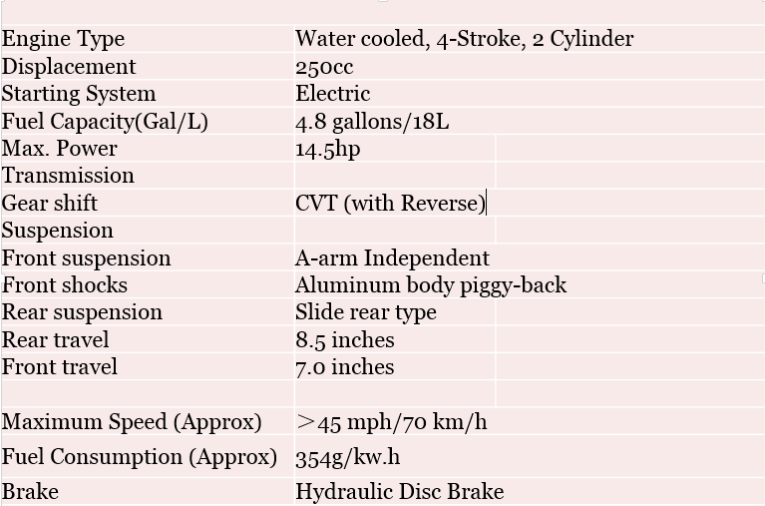
Engine Specifications

Slide 22
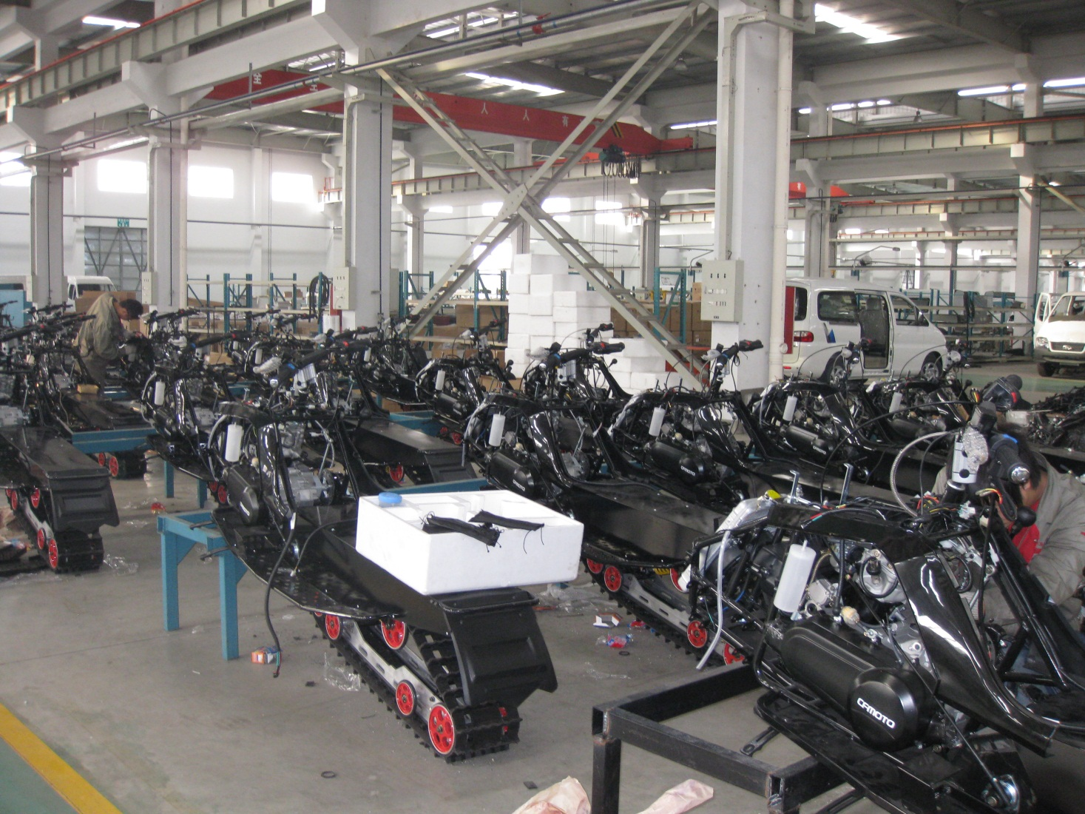
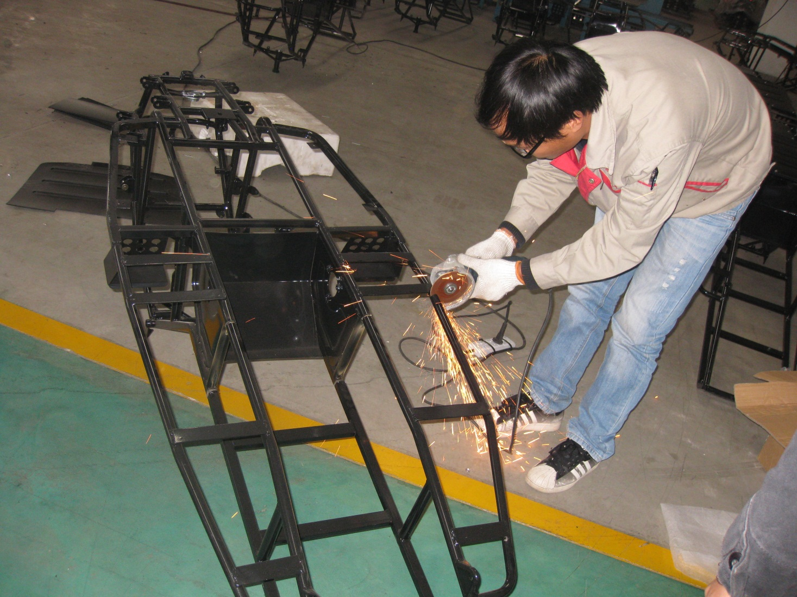
Phantom factory in
Suzhou, China
A worker performing some
touch up on the frame

Slide 23
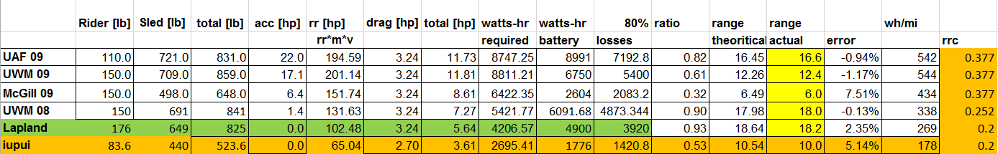
Range Calculations

