Slide 1
SAE Clean Snowmobile Challenge
Notes:
Chris

Slide 2
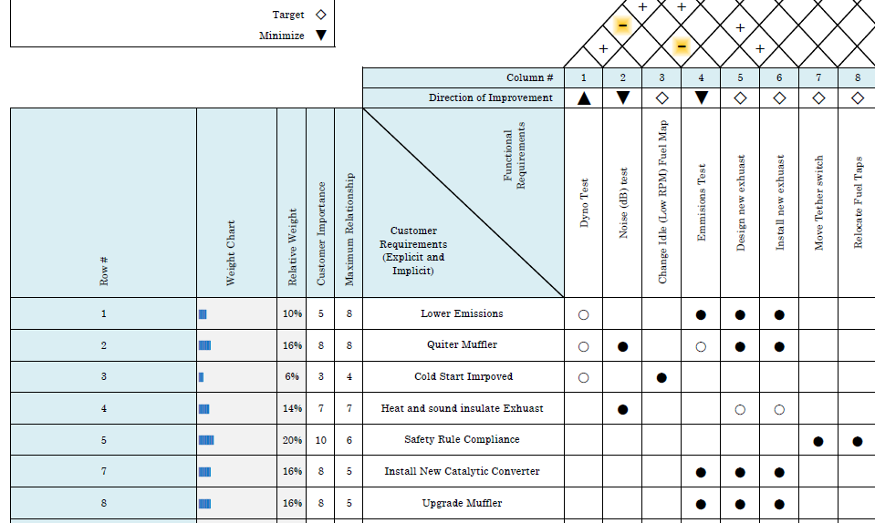
Team Organization and Management
Some strategies the IUPUI team used include:
House of Quality
Assigning leadership
Gantt Chart (For scheduling)
Excel checklist of rule compliance
Notes:
Chris

Slide 3
Design Process
Scope of the project:
Be compatible with ethanol fuel of varying ratios
Meet emission standards (E-score greater than 175)
Run quiet
Have a trail speed of 45 mph
Accelerate 500 ft in 10 seconds
Travel 100 miles on a tank of gas
Have less than 130 HP
Notes:
Chris

Slide 4
Innovation
Exhaust system
New Catalytic Converter (Provided by Faurecia)
New muffler
Exhaust piping re-routed
ECU tuning
Adjust AFR to for reduced hp and increase fuel efficiency
Ceramic Blanket Insulation for noise
Notes:
Chris

Slide 5
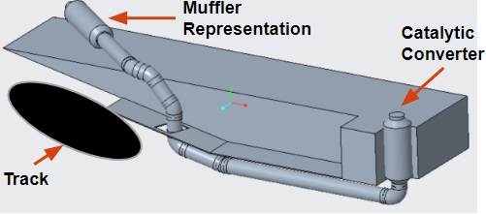
Exhaust system assembly
Exhaust flows in from the expansion chamber
Commercially Produced Automobile 3-way Catalytic converter from Faurecia
Flowmaster 70 series muffler replaced Super 10
Outlet
Notes:
Chris

Slide 6
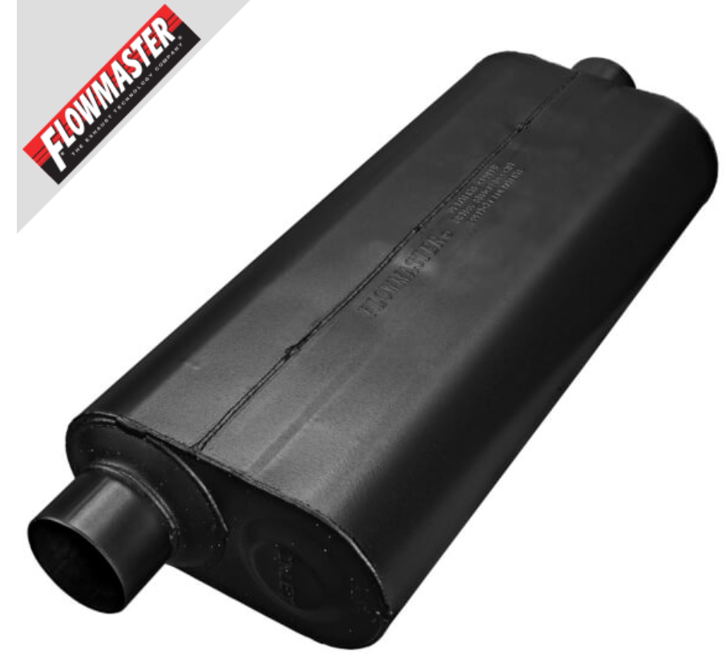
Muffler
The team considered two different mufflers for the exhaust redesign:
Building/Packing our own muffler
Flowmaster 70 series
Considered dual mufflers
Unable due to size restrictions
Retrieved from: https://www.holley.com/products/exhaust/mufflers/street_chambered_mufflers/70_series/stainless_steel/parts/53071
Notes:
Chris

Slide 7
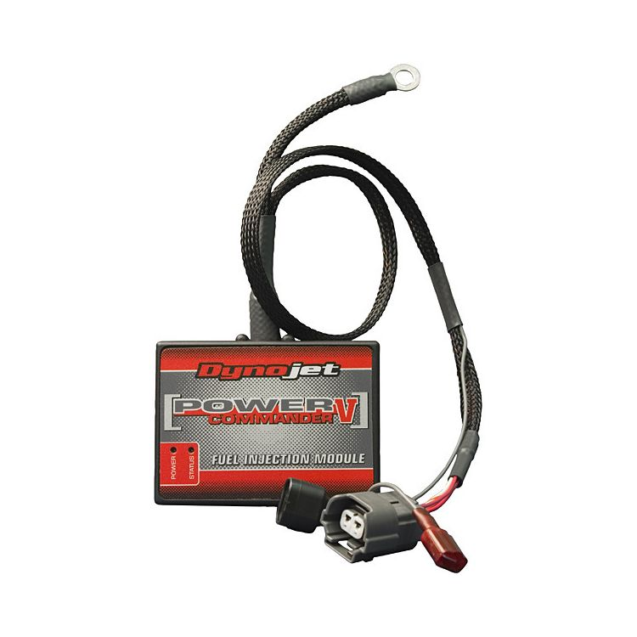
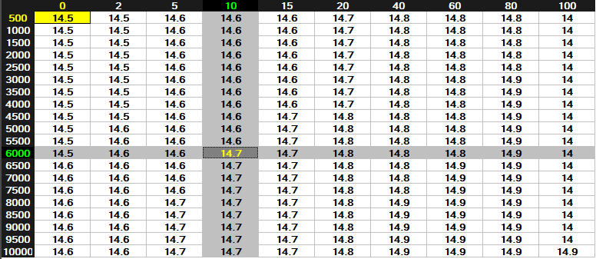
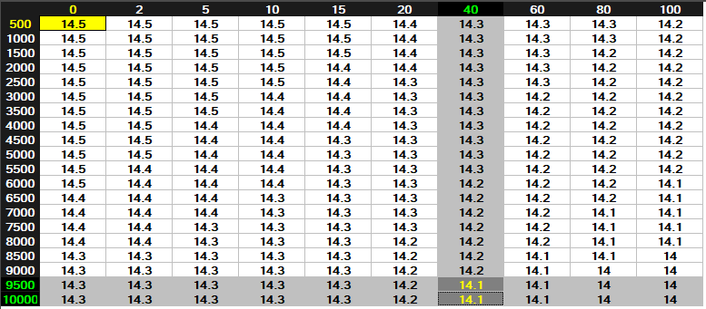
ECU Modifications
DynoJet Power Commander V
Flex-fuel Sensor
Notes:
Kieran

Slide 8
Testing
Dynamometer
HP restrictions
used air restrictor in intake
Emissions
Further testing necessary after modifications
Sound
Unable to test, due to time restrictions
Notes:
Chris

Slide 9
Conclusion
The 2019 IUPUI CSC Team re-engineered a 2017 Polaris Switchback Assault to be quieter, cleaner running, and more fuel efficient, while maintaining the practicality of the vehicle.
References
Ålander, T., Antikainen, E., Raunemaa, T., Elonen, E., et al., “Particle Emissions from a Small Two-Stroke Engine: Effects of Fuel, Lubricating Oil, and Exhaust Aftertreatment on Particle Characteristics,” Aerosol Science and Technology 39(2):151-161, 2005, doi:10.1080/027868290910224
Mitianiec, W., “COMPARISON OF PERFORMANCE OF TWO-STROKE ENGINE WITH CATALYTIC CONVERTER,” Journal of KONES Combustion Engines 8:129-137, 2001
UltraGauge Knowledgebase, “Air to Fuel Ratio (AFR),” http://www.ultra-gauge.com/customer_support/knowledgebase.php?article=29, accessed Feb. 2018
Saha, P. How to Write an SAE International Technical Paper.
SAE International, ed. 2018 SAE Clean Snowmobile Challenge Rules. USA: SAE 2017 Print.
Kimbrough, B., “Understanding Muffler Design and Sound Absorption Strategies,” http://www.rodauthority.com/tech-stories/exhaust/understanding-muffler-design-and-sound-absorption-strategies/
Haltech, “Flex Fuel Sensor Explained,” http://www.haltech.com/flex-fuel-sensor-explained/
Acknowledgments
The IUPUI CSC team would like to thank our sponsors. First, to Polaris for donating the 2017 Polaris Assault 800cc and to Dynojet for the Power Commander V Fuel Injection Kit.
Notes:
Chris

