Slide 1
SAE CLEAN SNOWMOBILE CHALLENGE
Prof. John Stang
Jag Wave
Fahad Alkoize
Yanxiang Ding
Sean Horan
Joshua Manis
Anisha Rajbhandari
Henok Tecle
Jinyun Zhou
Notes:
Title anisha

Slide 2
CUSTOMER/SPONSORS
Clean Snowmobile Challenge
Dr. Razi Nalim
(Sponsor)
Notes:
Anisha
Introduction Slide 1
Briefly describe the background of the project; clearly present the design requirements and expectations; identify project boundaries; state project objectives.
Description of customers
Customer’s requirements and expectations - judges, sponsor, and future design teams

Slide 3
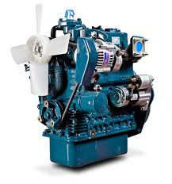
OBJECTIVES
The SAE International Clean Snowmobile Challenge main objective is to re-engineer a snowmobile with three aspects:
Fuel Economy
Emissions Reduction
Noise Reduction
Notes:
Fahad
Introduction 2
Project boundaries
Project objectives
Preliminary impact statement (Environmental, safety, and society)
state that it is our rookie year and the other design teams’ (competition) benchmarks are uncertain considering we have not competed yet. After the competition we should be able to adhere to a certain standard in the years to come.

Slide 4
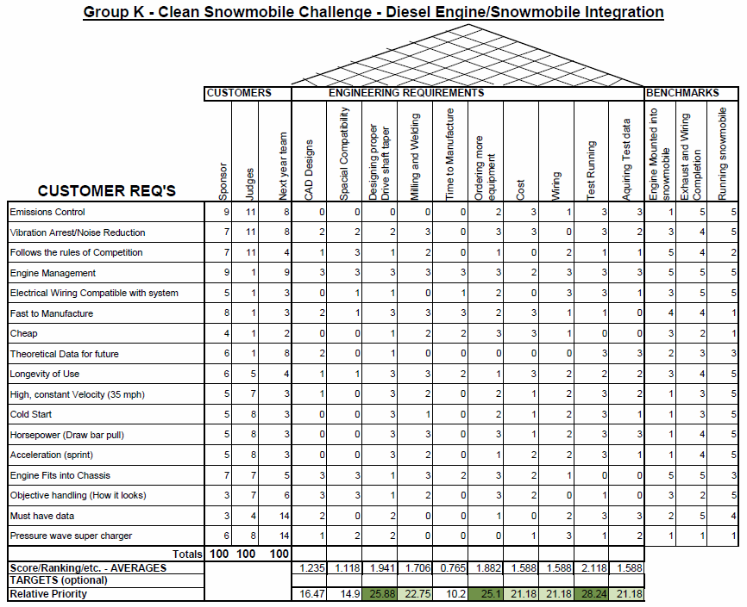
HOUSE OF QUALITY
Notes:
Sean

Slide 5
Main Requirements
Customer Requirements
Fuel Economy / Emissions Control / Noise Reduction
To pass inspections for next year’s team (Sponsor)
Adherence to the Rules of Competition (Judges)
Engineering Requirements
CAD Designs
Milling and Welling
Engine Management
Target Benchmarks
Mount Engine into Snowmobile
Exhaust and Wiring Completion
Running Snowmobile

Slide 6
FUNCTION DECOMPOSITION
3D Printing and test fit
Manufacturing
Engine Mount
Measurement on engine frame
Design in CAD
Stress Analysis
3D Printing and test fit
Manufacturing
Adaptor Taper Shaft
Measurement on the primary clutch
Design in CAD
Stress Analysis
installation of catalytic converter with NOx catalyst
Emission calculation
iInstallation of filter
2017 Clean Snowmobile
Exhaust System
Installation of motor mount rubber bushings
Noise source analysis
Installation of the muffler
Installation of the filter and catalytic converter
Wiring
Material selection and purchase
Circuits design and inplantation
Supercharger
Theoretical Study
Technical Report&MSRP
Obeying the rules of SAE
Cost recording and technical analysis
Notes:
Jinyun
Based on the engineering requirements, we came up with our function decomposition. They include: engine mount, adaptor taper shaft, exhaust system, wiring, supercharger

Slide 7
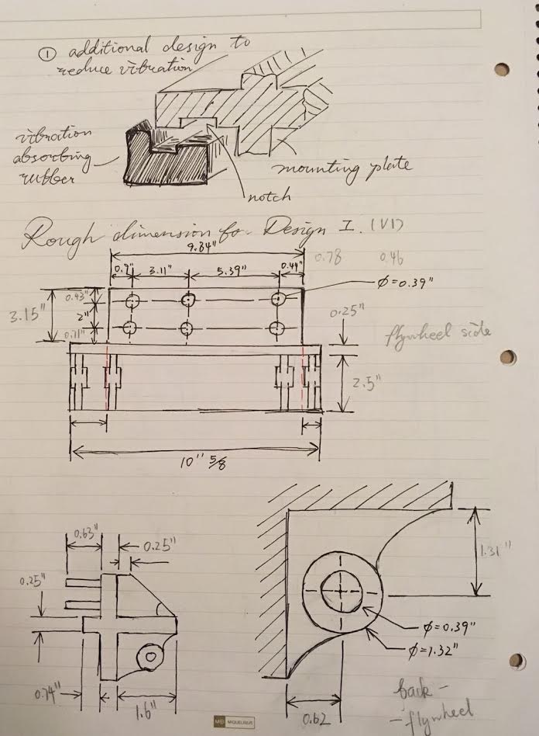
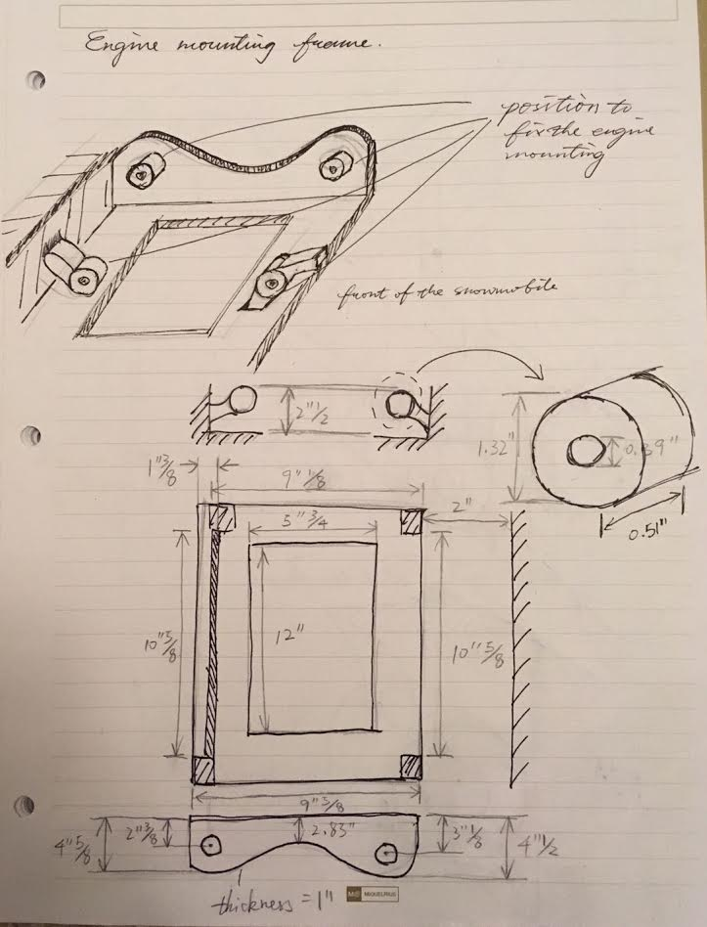
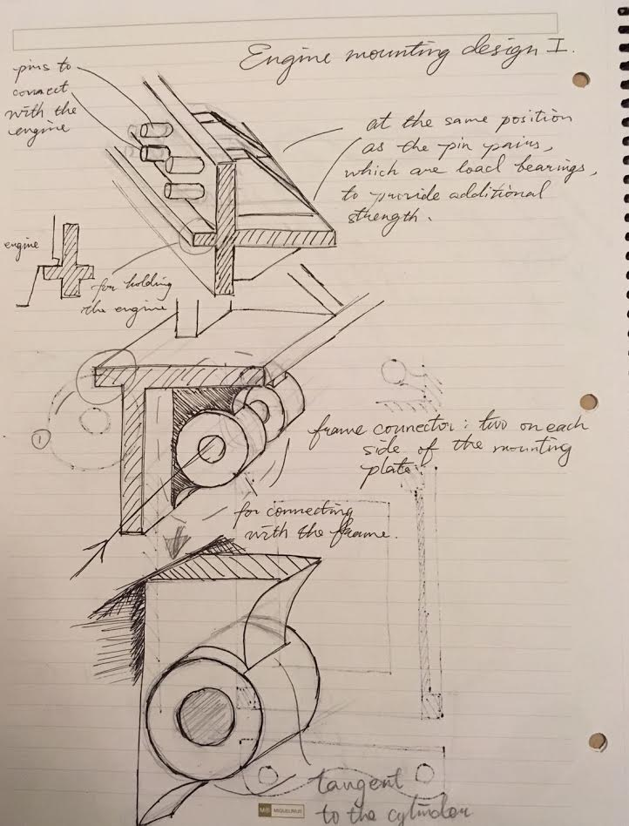
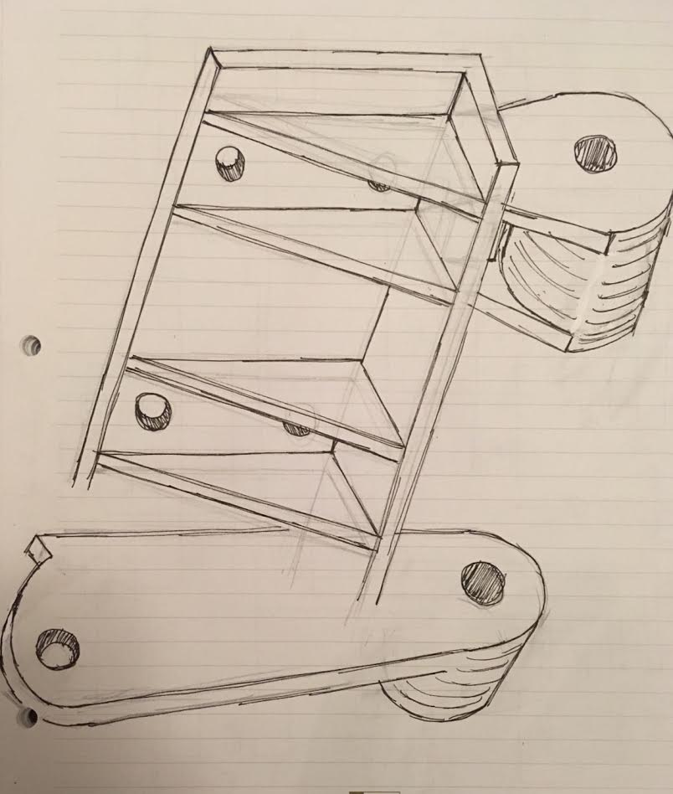
ROUGH SKETCHES
Notes:
Tin tin/Jinyun
First, let’s go through the design of the engine mount. We came up with several design concepts. Here are some sketches for our draft design. Then, we integrate our concepts into an overall design. Jinyun will introduce more about the engine mount design.

Slide 8
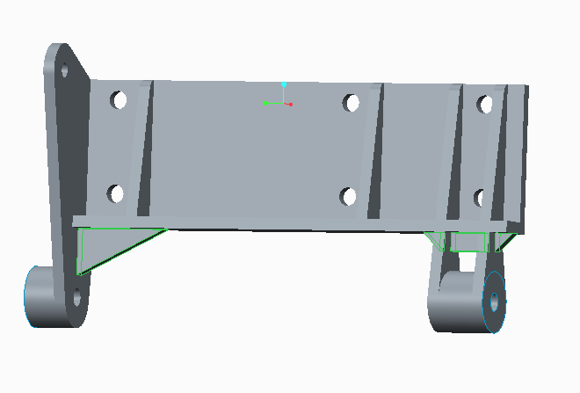
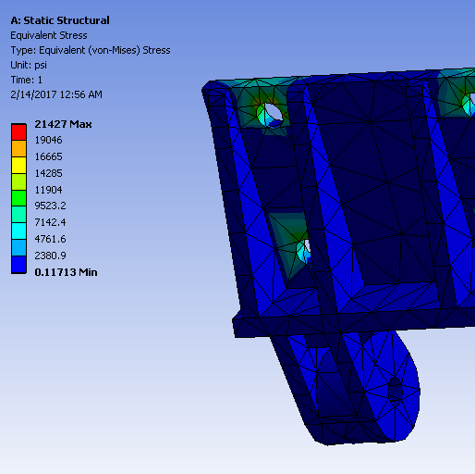
DESIGN CONCEPTS
- ENGINE MOUNT
Notes:
This is the overall design for the engine mount. The engine mount is manufactured by 1040 carbon steel. With the FEA analysis, we find the our design has a safety factor about 10.5, which proves its capability to endure both static and dynamic loading. We also add bushings to the the attaching point to isolate vibration and reduce noise.

Slide 9
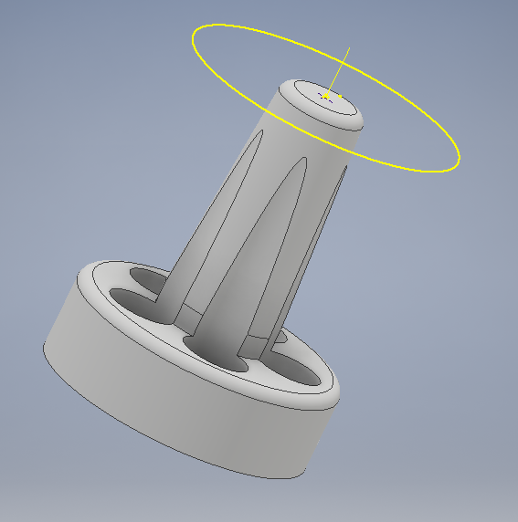
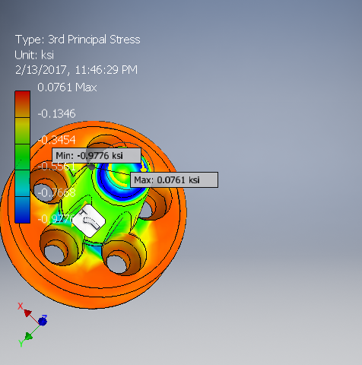
DESIGN CONCEPTS
- ADAPTOR TAPER SHAFT
Notes:
Henok
To get the snowmobile to move we needed to create an adapter
We measured the slope to be 7.5 to 1.
We then 3D printed and manufactured the piece using 1040 steel.
Initial stress strain analysis using AutoCad.
Future→ Run fatigue analysis due to variable torsional loading.
no key for safety ??? → something about won’t break CVT???

Slide 10
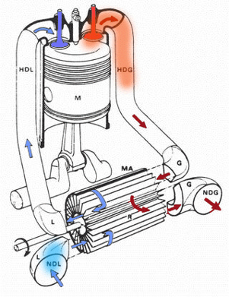
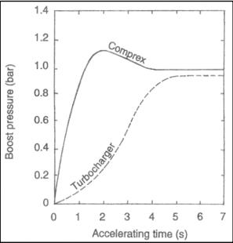
Innovations

Slide 11
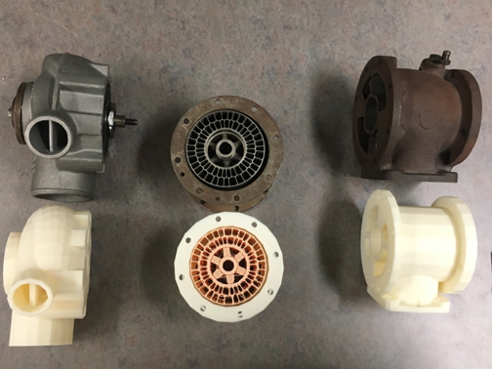
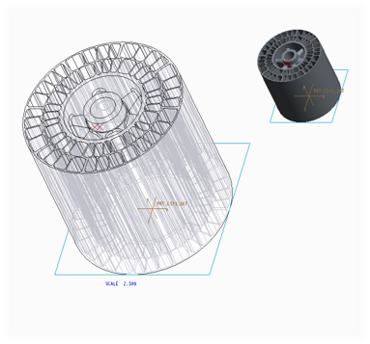
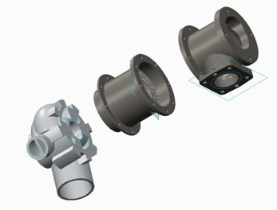

Slide 12
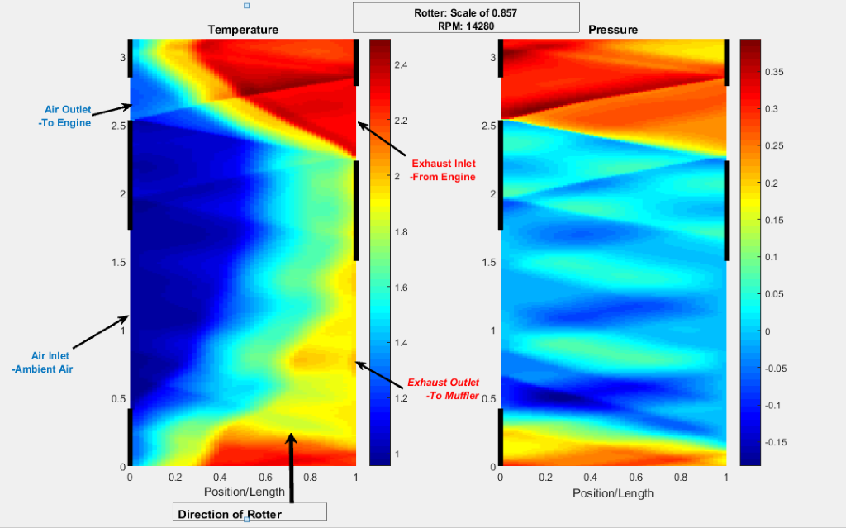

Slide 13
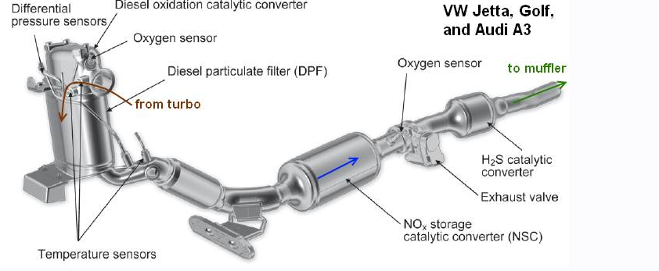
DESIGN CONCEPTS
- EXHAUST SYSTEM
Notes:
Josh
Limit Emmissions
Duel cycle engine with extremely hot combustion.
3811k
Tier 4 emissions off road
3256ppm approx 3x more than on road diesel
20 deg btdc
Diesel particulate filter

Slide 14
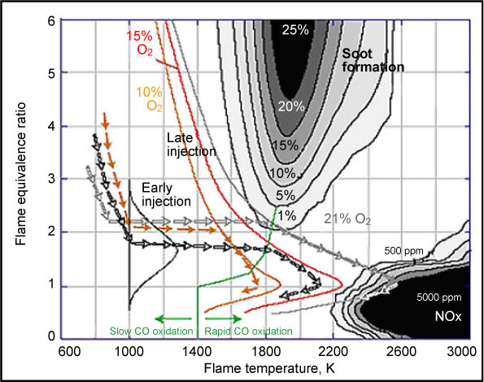
NO_{X} PRODUCTION
Tmax = 3811 K
Ignition Timing → 20 bTDC
NOx Production → 3256 PPM
Johnson, T. (2008). Diesel Engine Emissions and Their Control. Platinum Metals Rev., 52(1), 23rd ser.
Notes:
Engine has Early injection

Slide 15
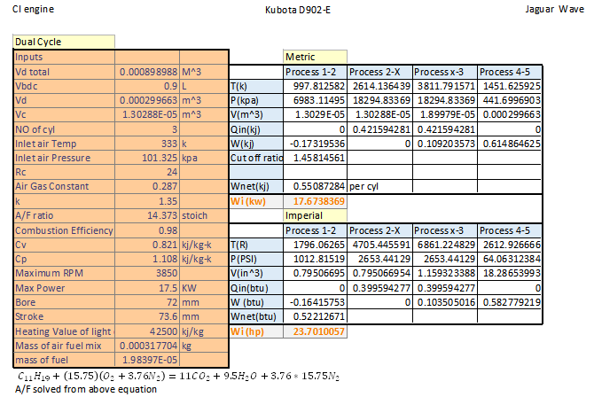
APPENDIX 1 - NO_{X} PRODUCTION
Notes:
Josh

Slide 16
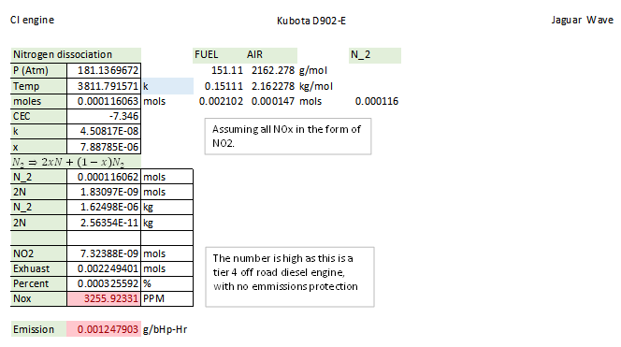
APPENDIX 1 - NO_{X} PRODUCTION (CONTINUED)
Notes:
Josh

Slide 17
THANK YOU
QUESTIONS ?
By Group K
Notes:
Sean

Slide 18
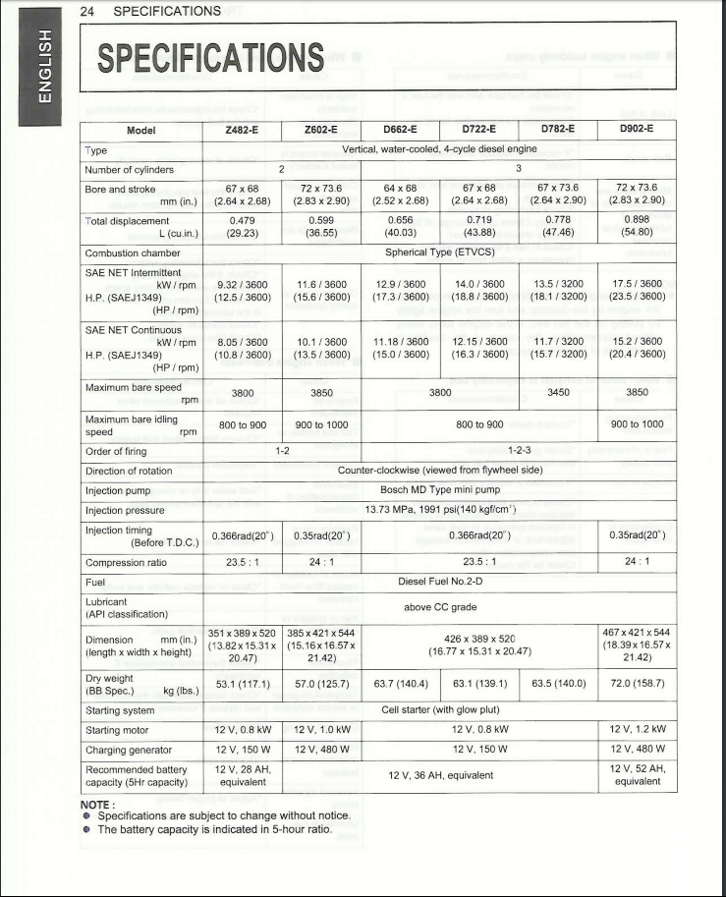
APPENDIX 2
- ENGINE SPECIFICATIONS
Notes:
Josh

Slide 19
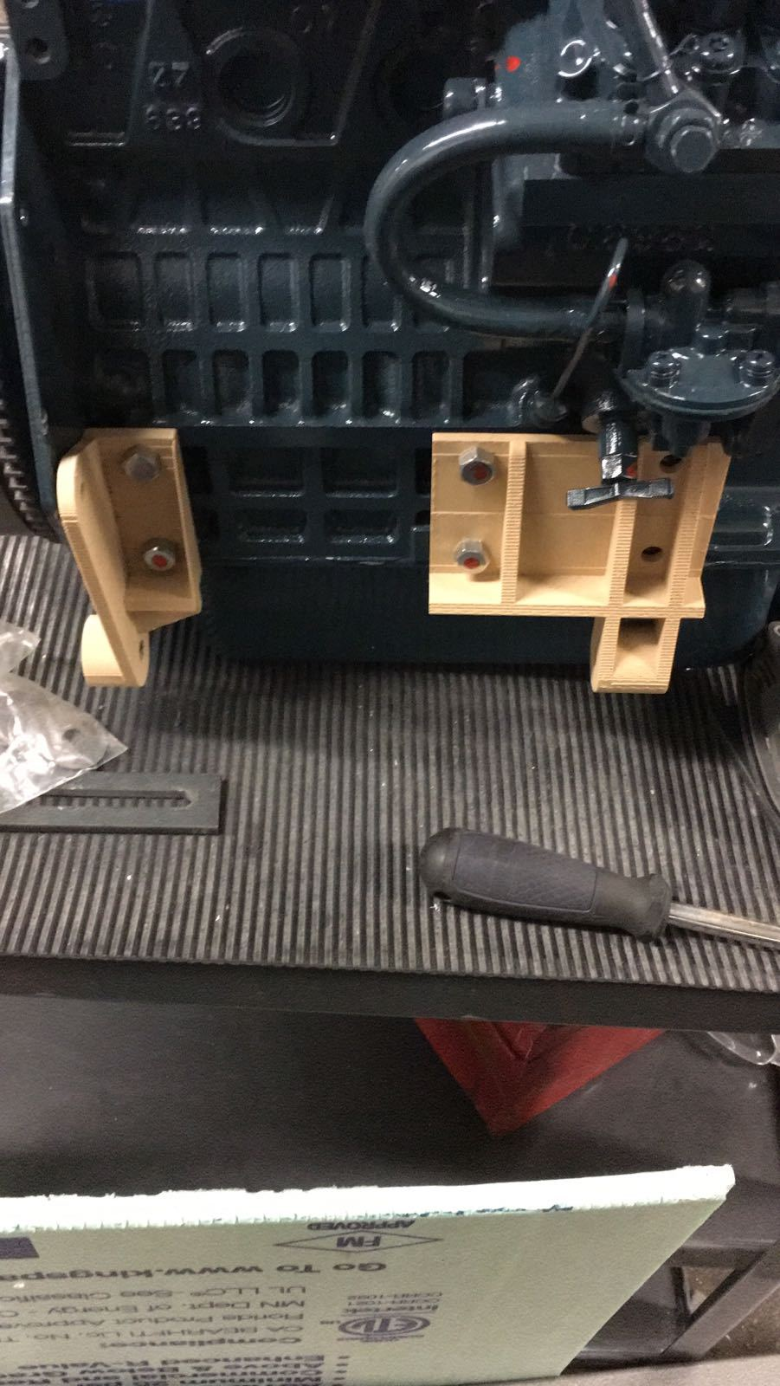
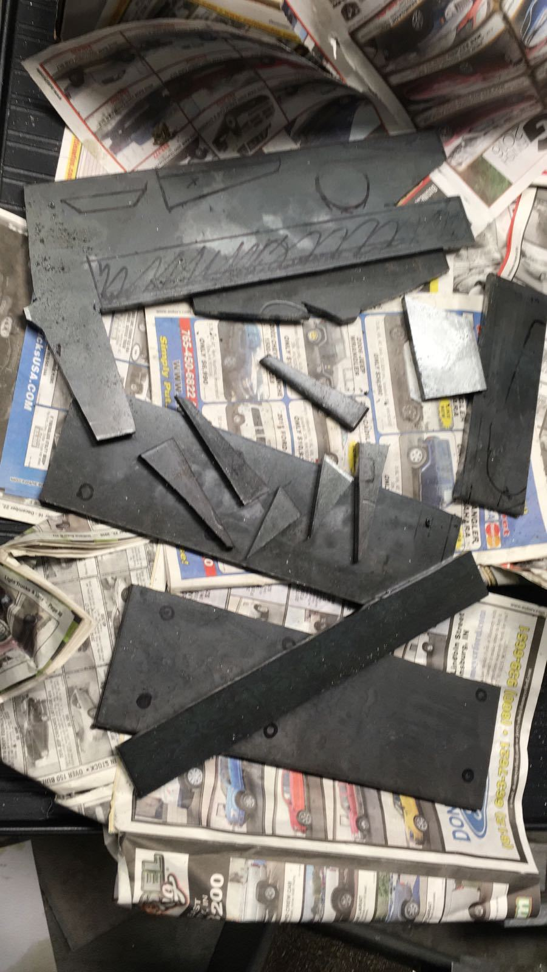
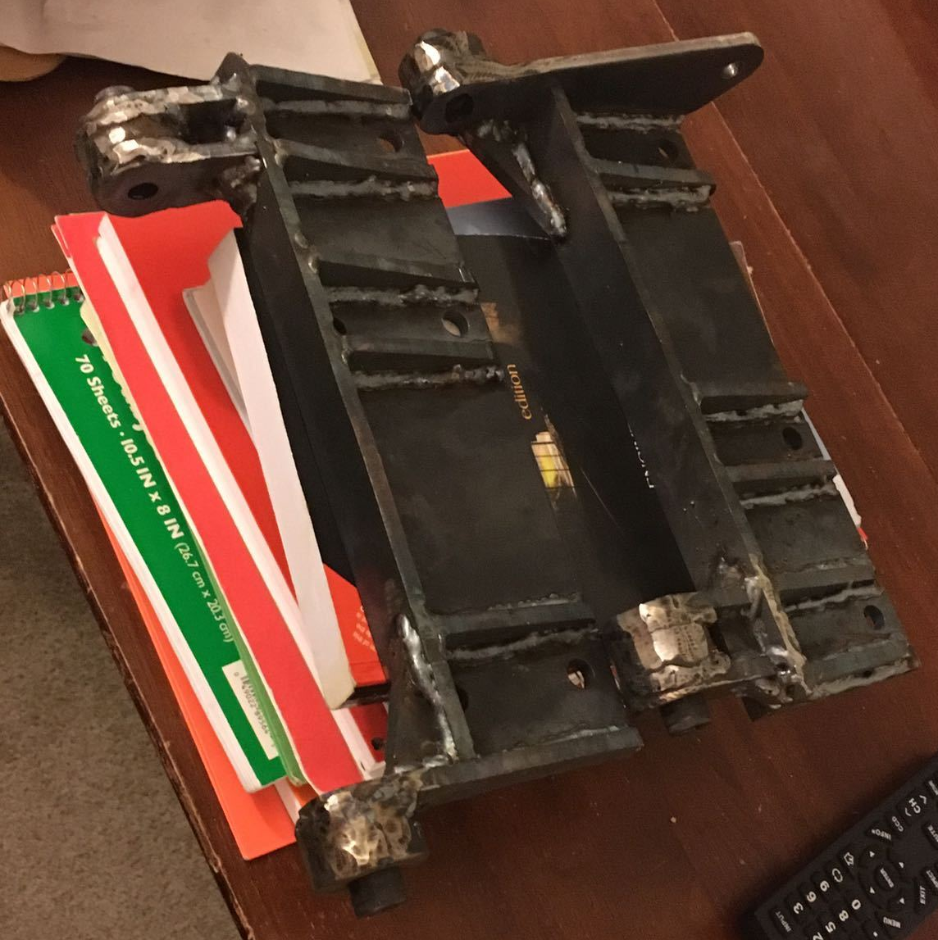
Designs carried out

Slide 20
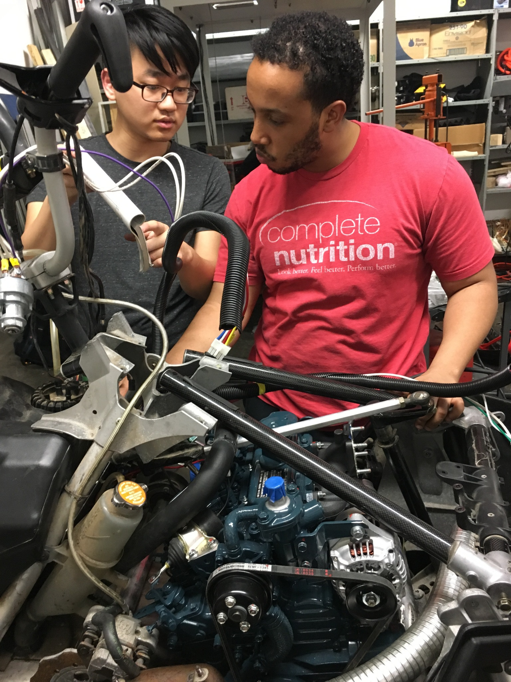
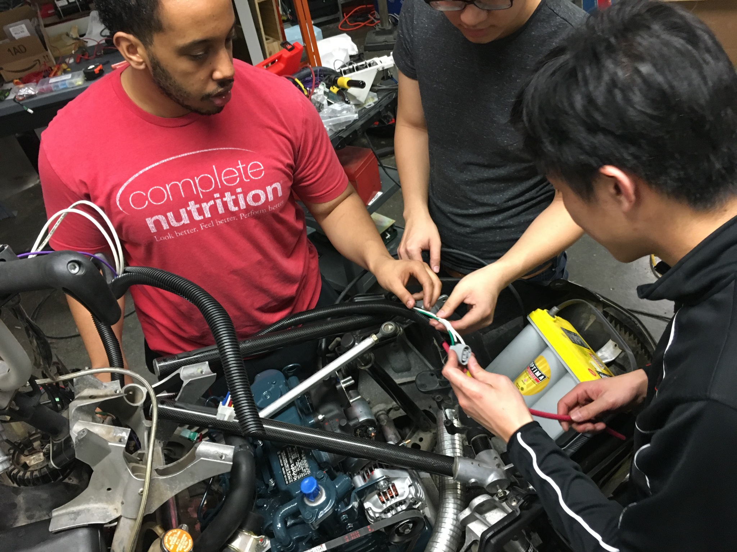
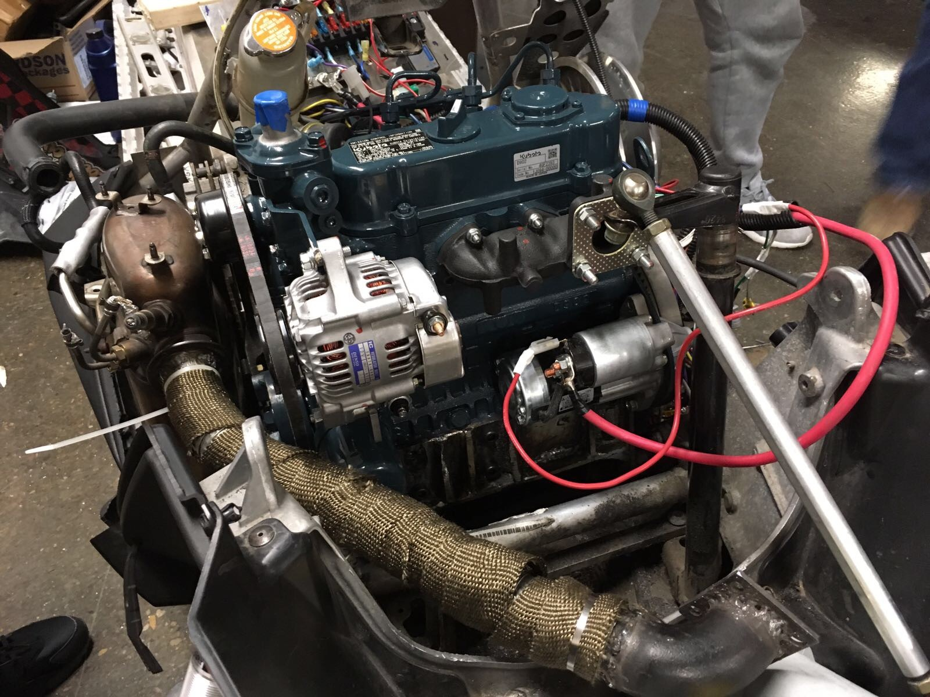
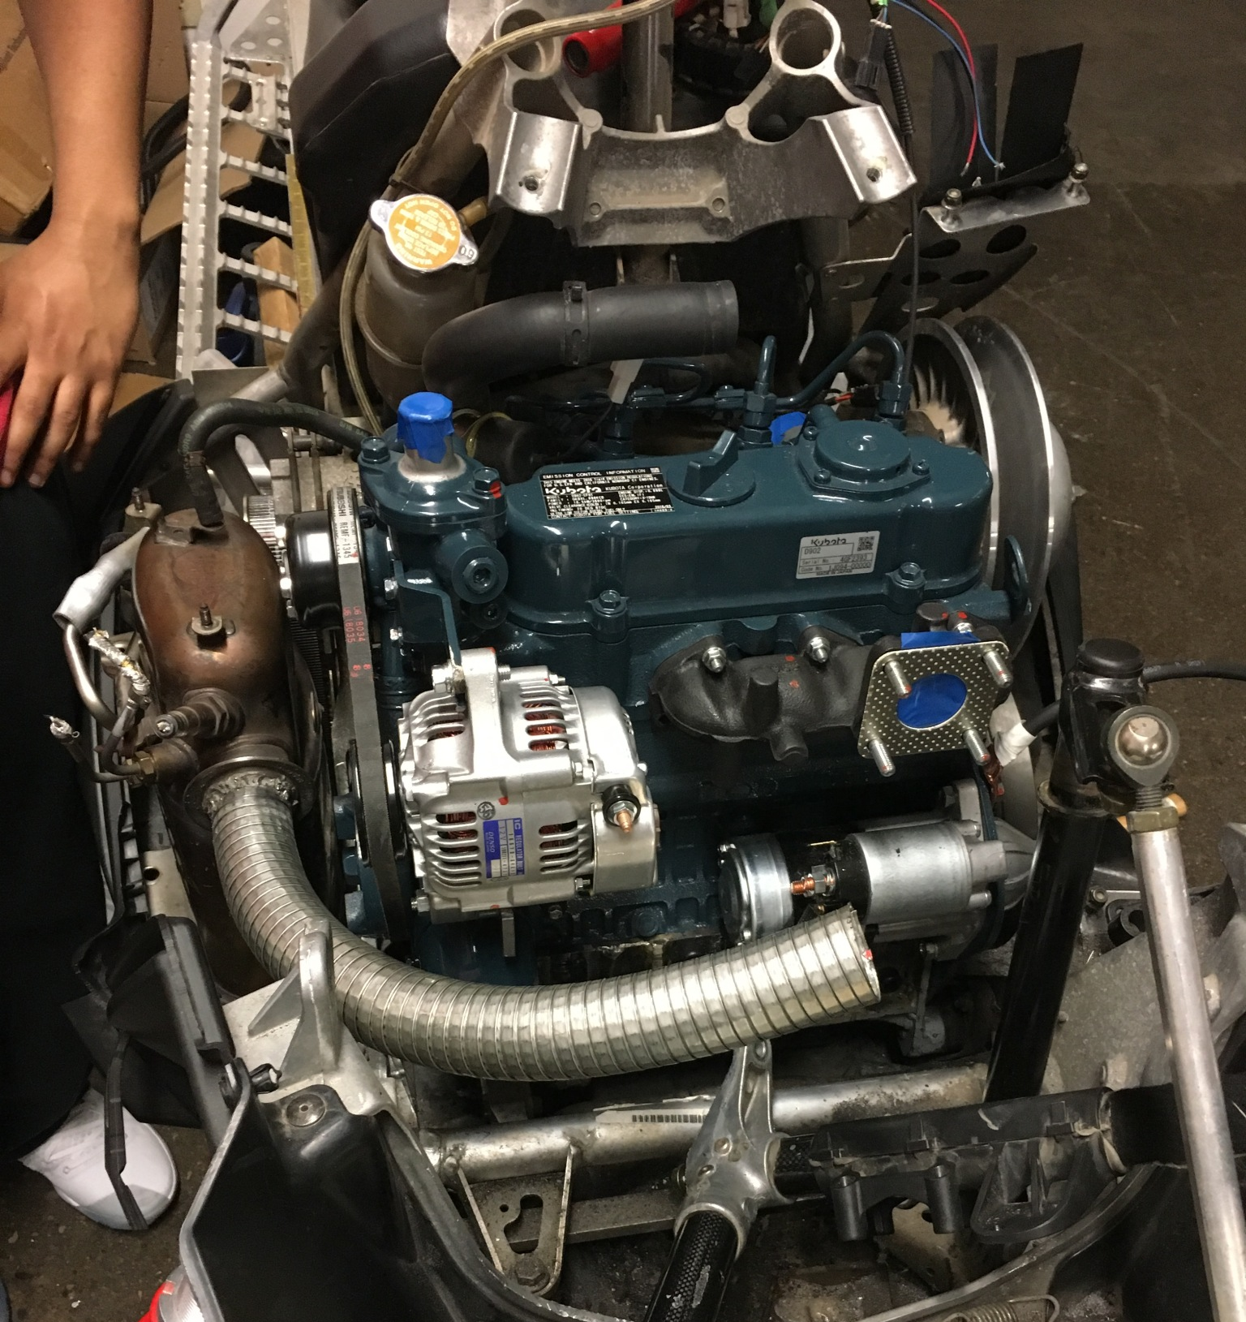
Engine Integration

