Slide 1
SAE Clean Snowmobile Challenge

Slide 2
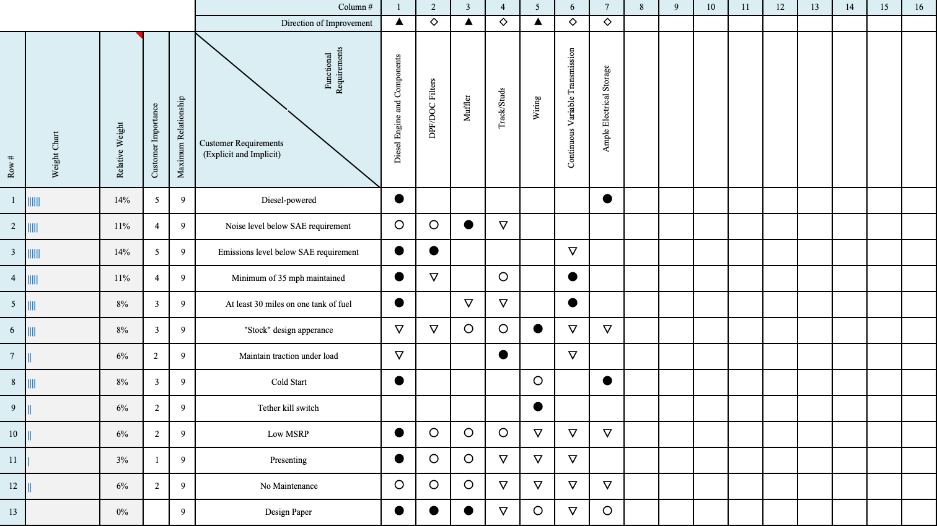
Team Organization and Management
Some strategies the IUPUI team used include:
House of Quality
Assigning leadership
Excel checklist of rule compliance
Functional Decompositions
Notes:
Chris

Slide 3
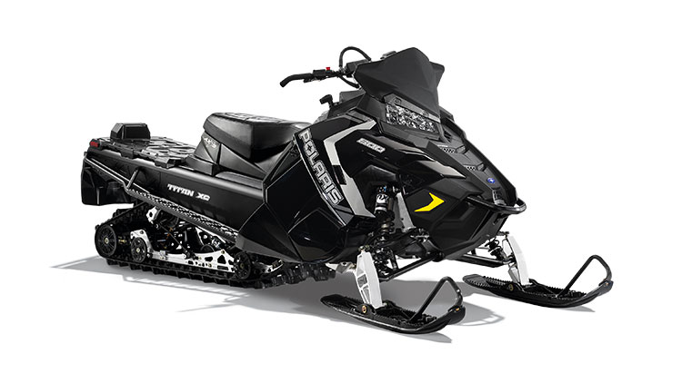
Design Process
Scope of the project:
Utility sled
Meet emission standards (E-score greater than 175)
Less than 67 db loud
Have a trail speed of 35 mph
Accelerate 500 ft in 10 seconds
Travel 100 miles on a tank of gas
Cold start capabilities
Notes:
Chris

Slide 4
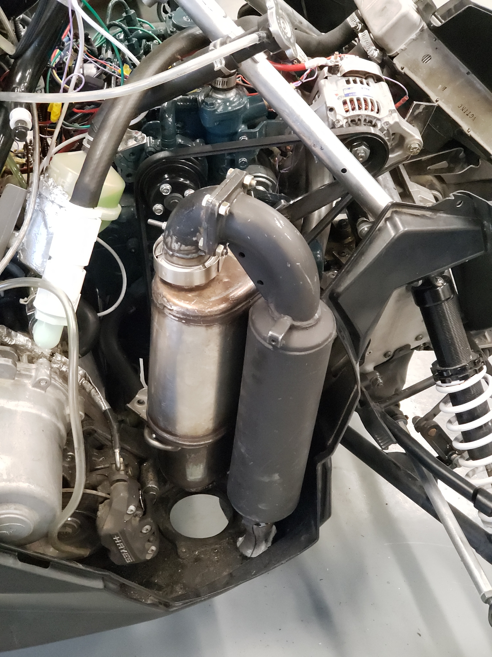
Innovation
Exhaust system
Volkswagon Jetta TDI DOC/DPF
Exhaust piping re-routed
Ceramic Blanket Insulation for noise
Pressure wave supercharger
Ski-Doo primary clutch for speed requirements
Selected proper springs
Additional custom weights
Notes:
Chris

Slide 5
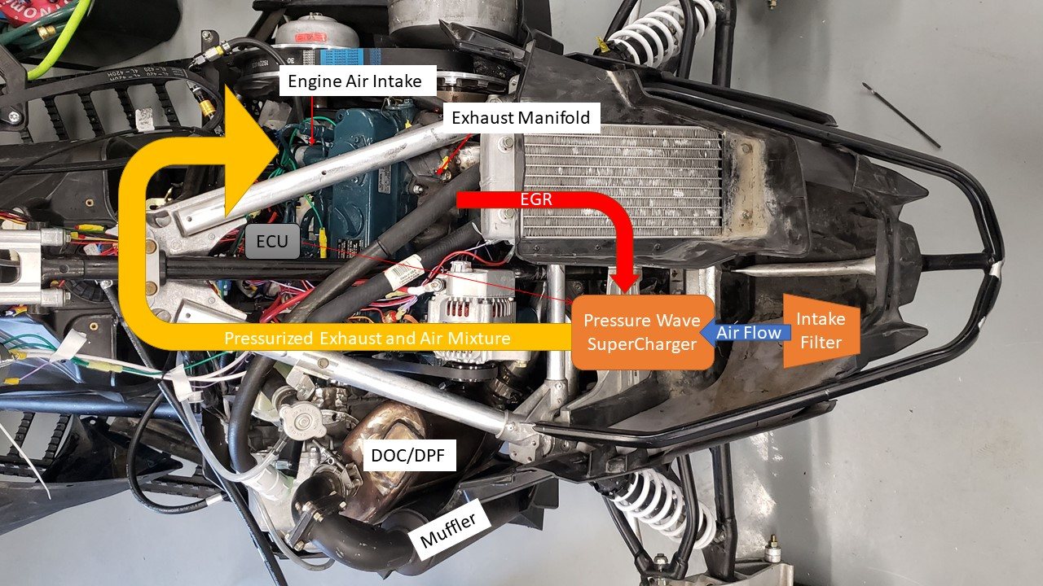
Pressure Wave Supercharger
The design is in process of being completed
The design will increase efficiency and improve performance of the engine while reducing emissions by reusing exhaust gasses.
Notes:
Chris

Slide 6
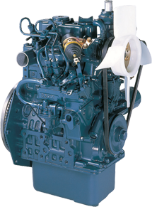
Engine Rational
Kubota D902-E3B Diesel Engine
Specs:
3 Cylinder
Indirect Injection
Displacement: 898 cc
Peak Horsepower: 20.4 HP @3000 RPM
Torque: 37.1 ft. lbs.
Indirect Injection
Weight: 72 kg
Passes Tier 4 EPA emissions regulations
Optimized Piston design
Reduced emissions
Reduced noise

Slide 7
Testing
Dynamometer
HP and Torque restrictions
Emissions
Huapeng HPC501 Automotive Exhaust Analyzer
Estimated E-score of 200.65
Sound
Benetech GM1351 Digital Sound Level Meter
Testing inconsistent with competition conditions yielded an average score of 76 dB
Mode | RPM | Torque (ft*lb) | HP
1 | 3000 | 37.1 | 21.19147
2 | 2550 | 18.921 | 9.186502
3 | 2250 | 12.243 | 5.244889
4 | 1950 | 7.049 | 2.617147
5 | 1200 | 0 | 0
Notes:
Chris

Slide 8
Current State of the Sled
Static Technical Inspection
Needed to redesign the clutch cover in order to pass static
Dynamic Technical Inspection
Were unable to run our dynamic test due to a blown gasket in the engine while trying to make up speed
Next Steps
Root Cause Analysis to identify the primary contributors to the blown gasket
Identifying different approaches to get additional speed out of the sled
Modifying the gearing of the transmission
Selecting a different primary clutch
Modifying engine mounts

Slide 9
Conclusion
The 2019 IUPUI CSC Team re-engineered a 2018 Polaris Switchback Assault to be quieter, cleaner running, and more fuel efficient, while maintaining the practicality of the vehicle.
References
Kubota, comp. "Kubota." D902-E3B: 1-2. Accessed February 18, 2019. http://www.kubotaengine.com/assets/documents/05_d902_32.pdf.
Society of Automotive Engineers International. "2019 SAE Clean Snowmobile Challenge® Rules." May 10, 2018. Accessed February 18, 2019. http://www.saecleansnowmobile.com/cdsweb/gen/DocumentResources.aspx.
Polaris. "800 TITAN™ XC 155." Polaris.com. Accessed February 18, 2019. http://www2.polaris.com/en-ca/snowmobiles/2018/800-titan-xc-155.
"Diesel Particulate Filter DPF FAQ, Repair, Cleaning, and Pictures - TDI." VW TDI Forum, Audi, Porsche, and Chevy Cruze Diesel Forum. Accessed February 18, 2019. https://www.myturbodiesel.com/wiki/diesel-particulate-filter-dpf-faq-repair-cleaning-and-pictures-tdi/.
Suzanne Drumm. “Pressure Wave Super Charger Notes,” DOCX. Indianapolis.
"Diesel Vehicles." Fuel Economy. Accessed February 18, 2019. https://www.fueleconomy.gov/feg/di_diesels.shtml.
SolidWorks®. SolidWorks® Student Edition. Computer software. Version SW2018. Vélizy-Villacoublay, France: Dassault Systèmes, 2018.
Joshua Manis et al., “Design of Diesel Snowmobile With Pressure Wave Supercharger Phase 1,” IUPUI, (February 2017).
Acknowledgments
The IUPUI CSC team would like to thank our sponsors. Especially to Polaris for donating the 2018 Polaris Titan 800cc.
Notes:
Chris

