Slide 1
Iowa State University Clean Snowmobile Challenge

Slide 2
Agenda
Season Summary
Accomplishments
Testing
Baseline
Cold Start
Innovations
Areas of Improvement
Timeline Management
Team Lead Positions

Slide 3
Season Summary
Snowmobile: 2018 Arctic Cat ZR 7000 Sno Pro
Strategy: Prioritize reducing noise pollution
Approach:
Research potential projects
Solidify season project(s)
Conduct baseline testing
Design innovations
Manufacture & Implement innovations
Conduct final testing

Slide 4
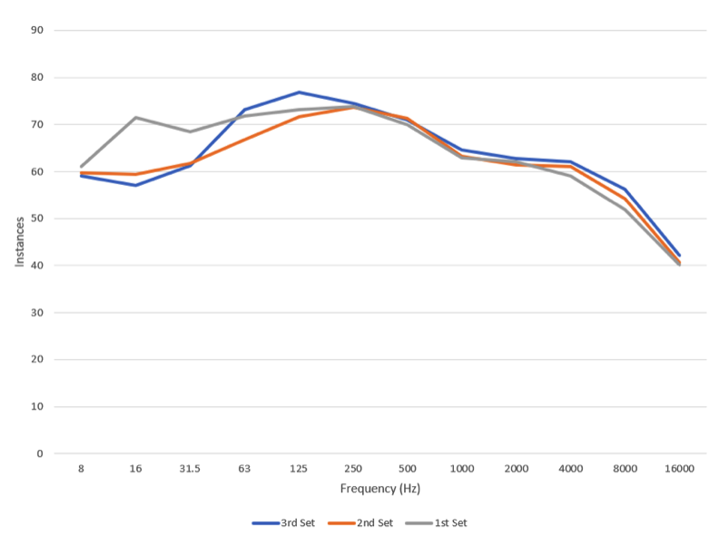
Baseline Testing - Noise
Procedure: SAE J116
Instrumentation: MTS Systems sound meter
Results: target range of 31.5 - 1000 Hz

Slide 5
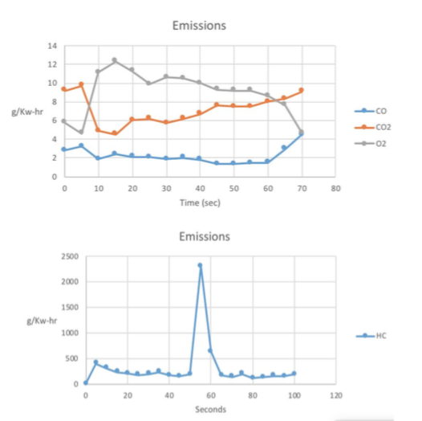
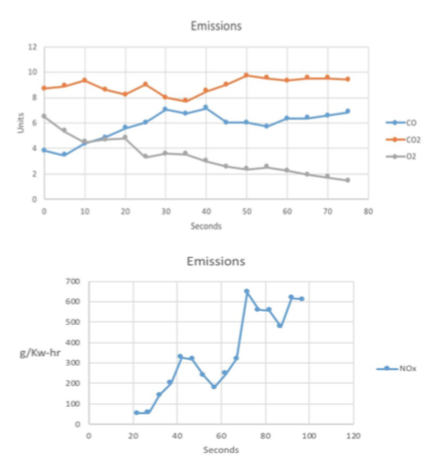
Baseline Testing - Emissions
Procedure:
EPA 40 CFR Part 1051 (Ramped Modal Cycle)
Instrumentation: Bridge 5 gas analyzer
Results:
Calculated E-Score: 120.65

Slide 6
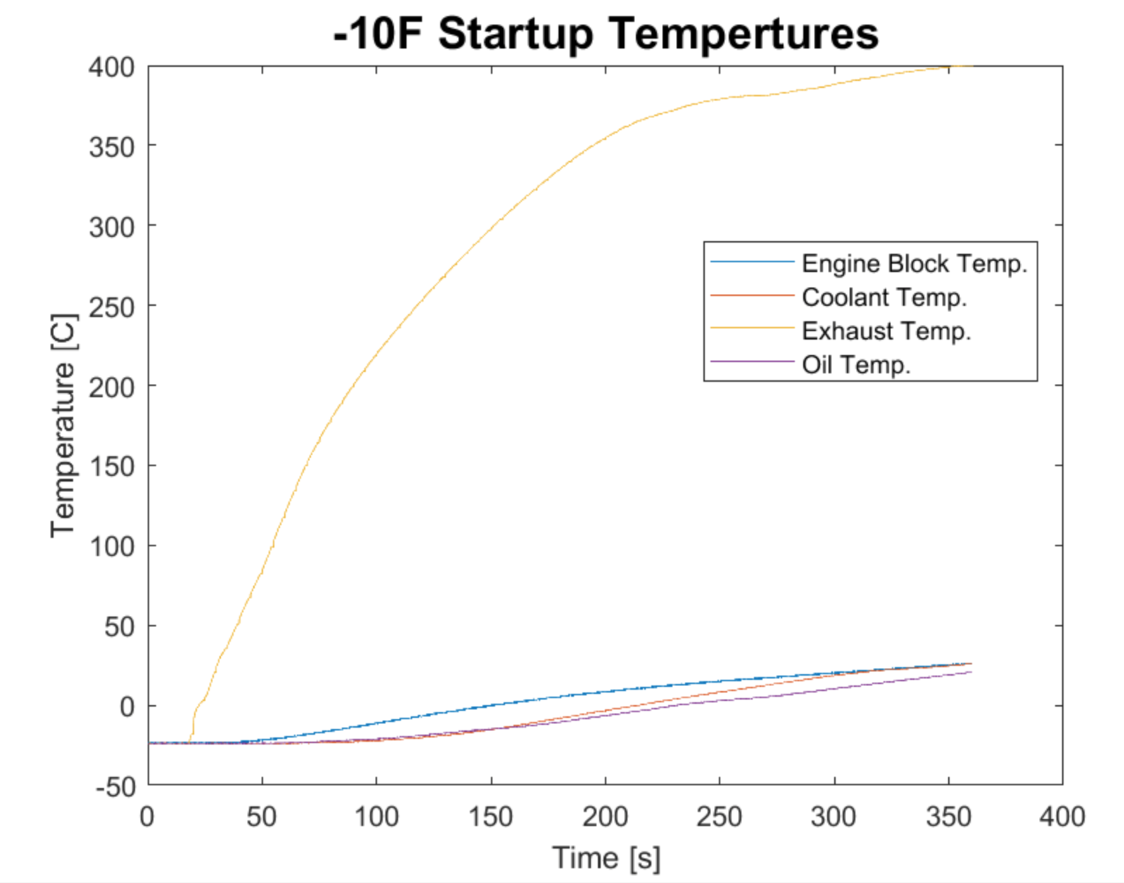
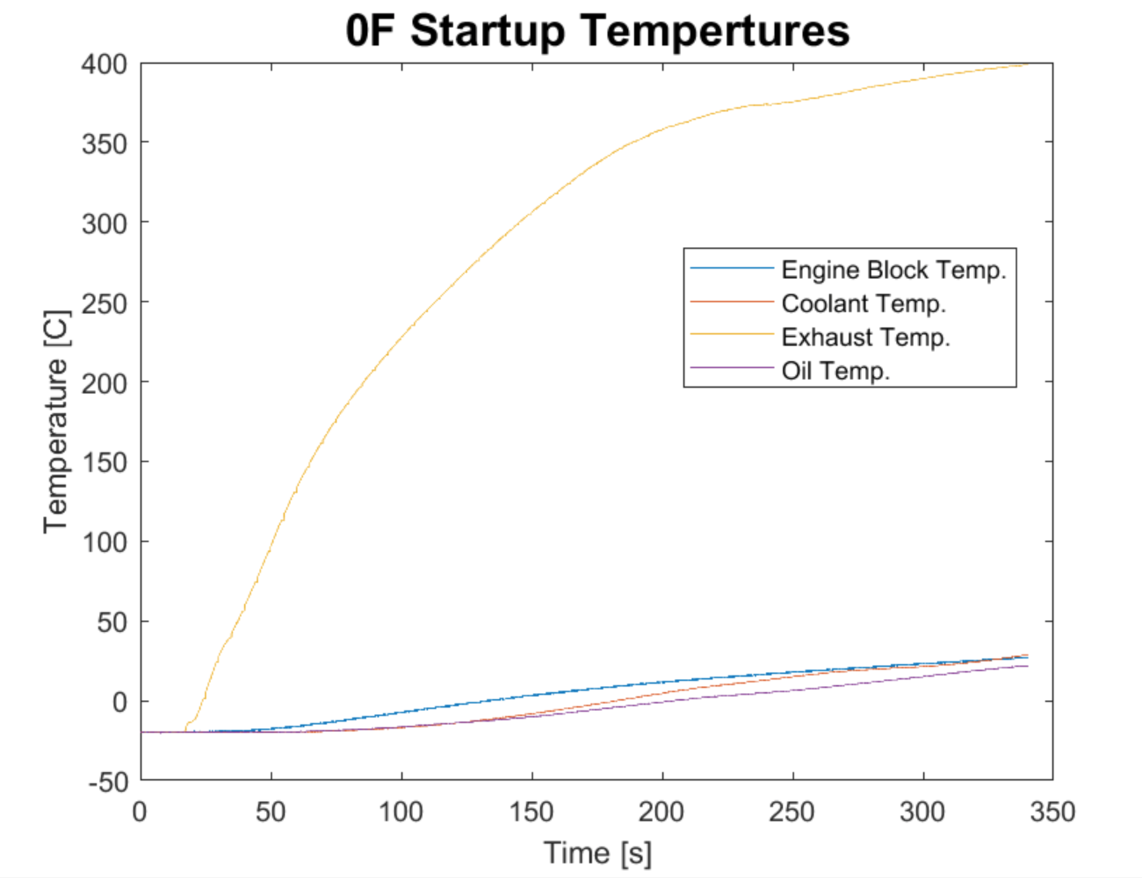
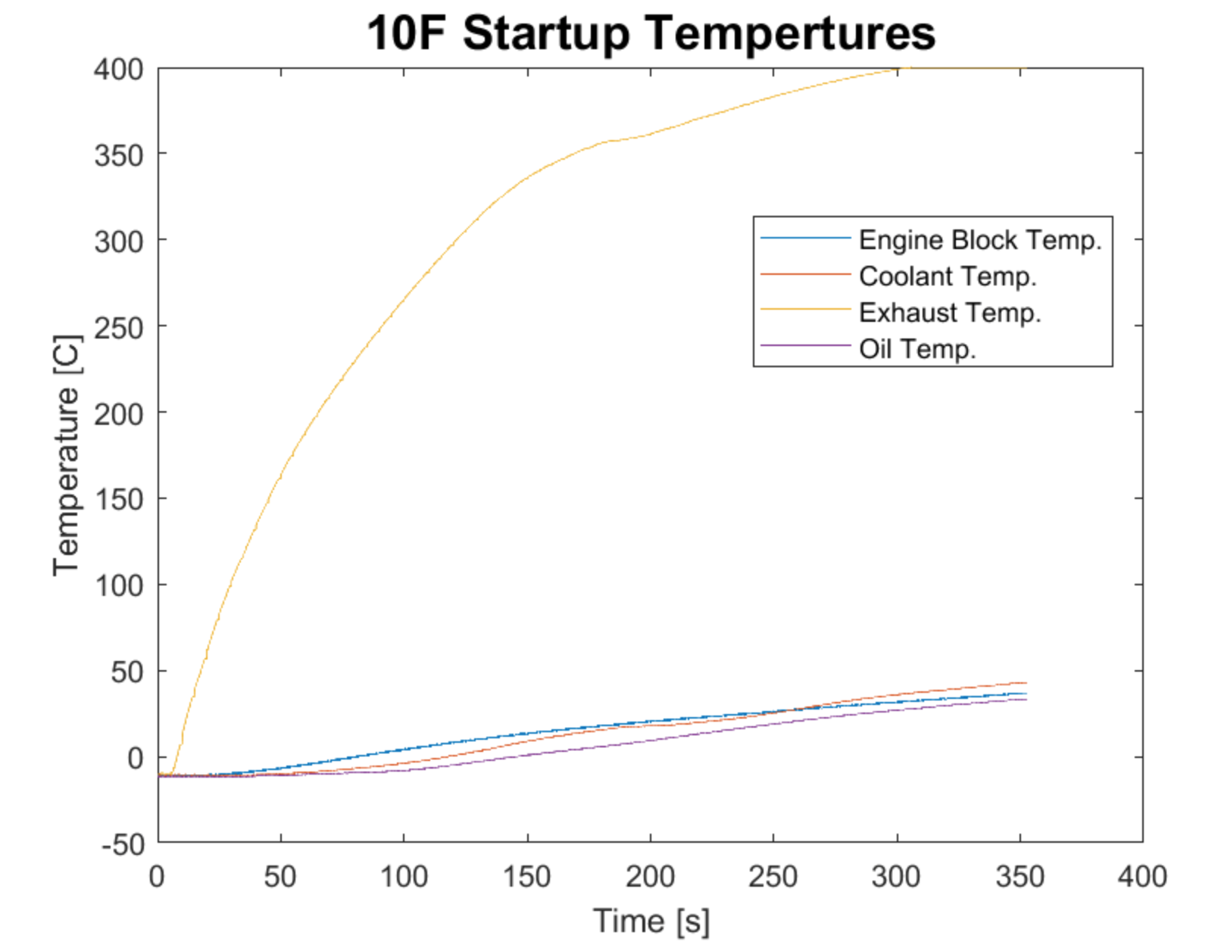
Cold Start Testing
Procedure:
Test 3 days consecutively
Day 1 = -10 $℉$
Day 2 = 0 $℉$
Day 3 = 10 $℉$
Results:
Faulty stock battery –
75% charge, 280/310
total crank amps

Slide 7
Innovations
Exhaust
Mufflers
Pipe routing
Catalyst
Heat shielding
Additional bogey wheels
3D printed support arm
ECU
G4+ Link Fury
Throttle Body Restrictors

Slide 8
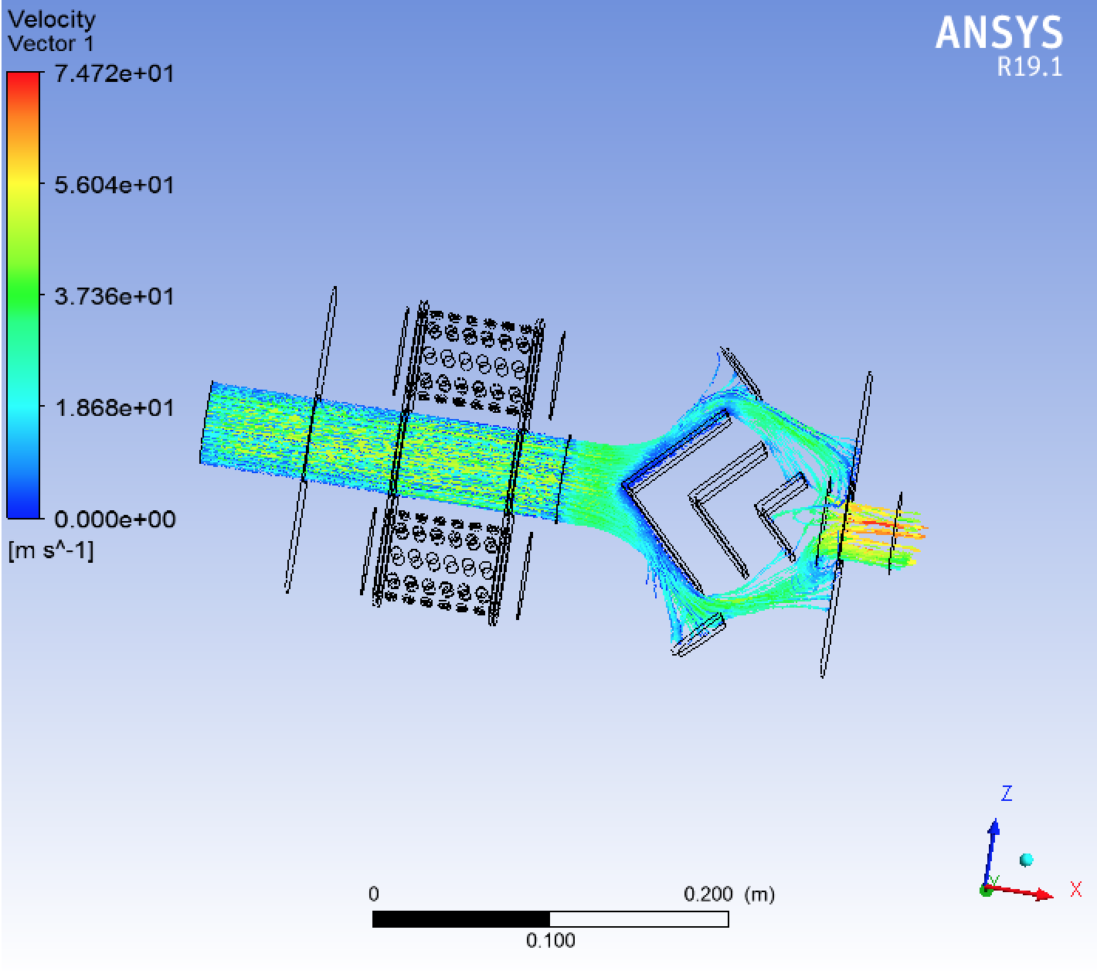
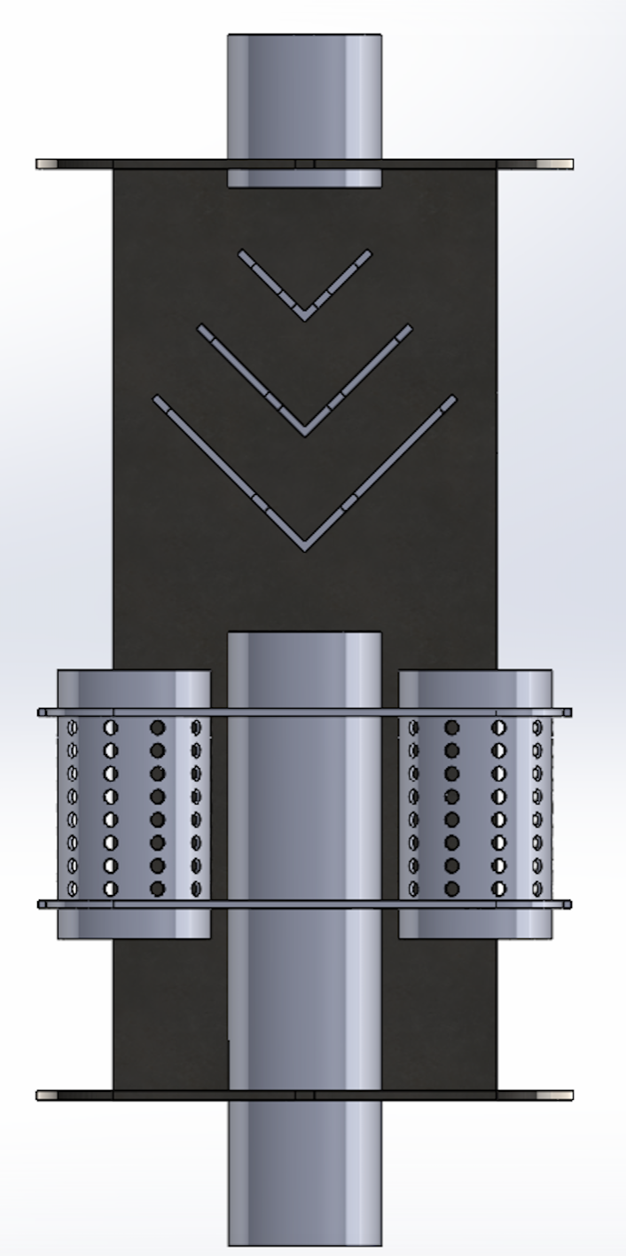
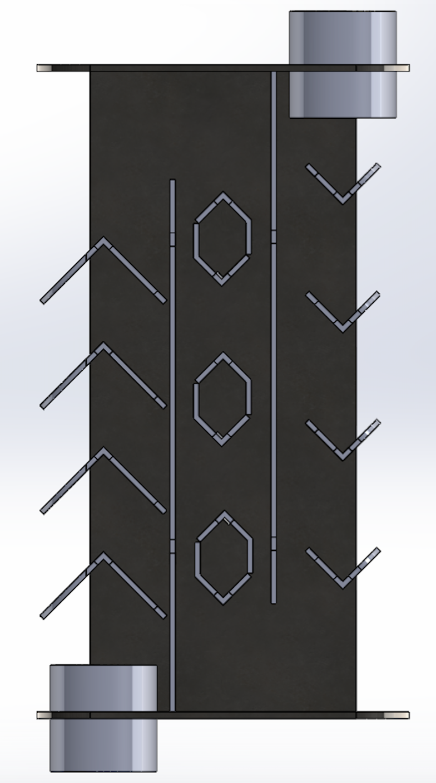
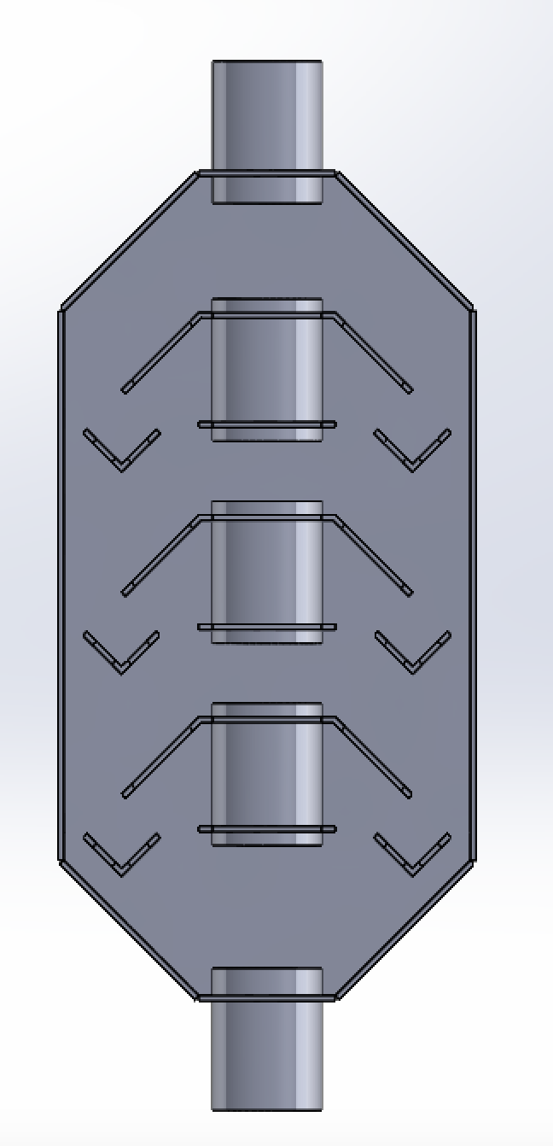
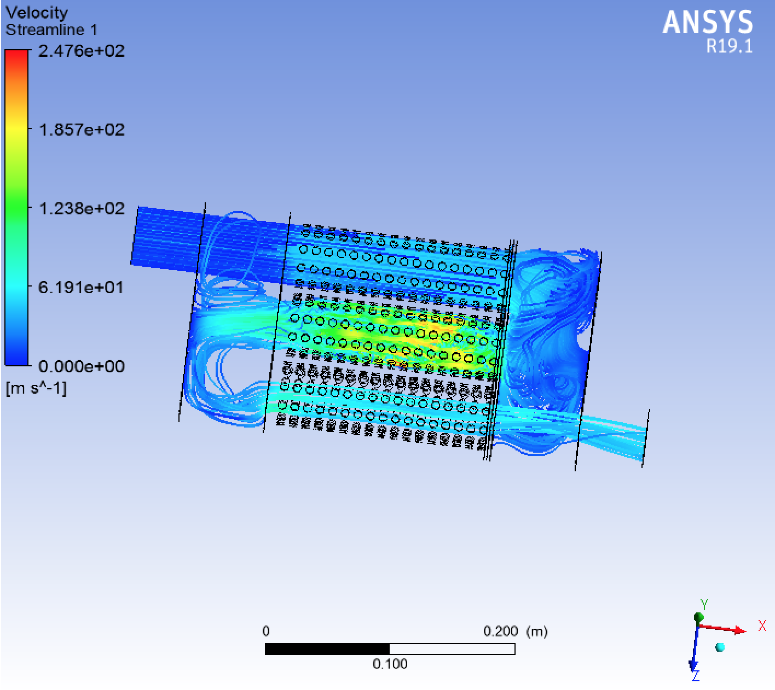
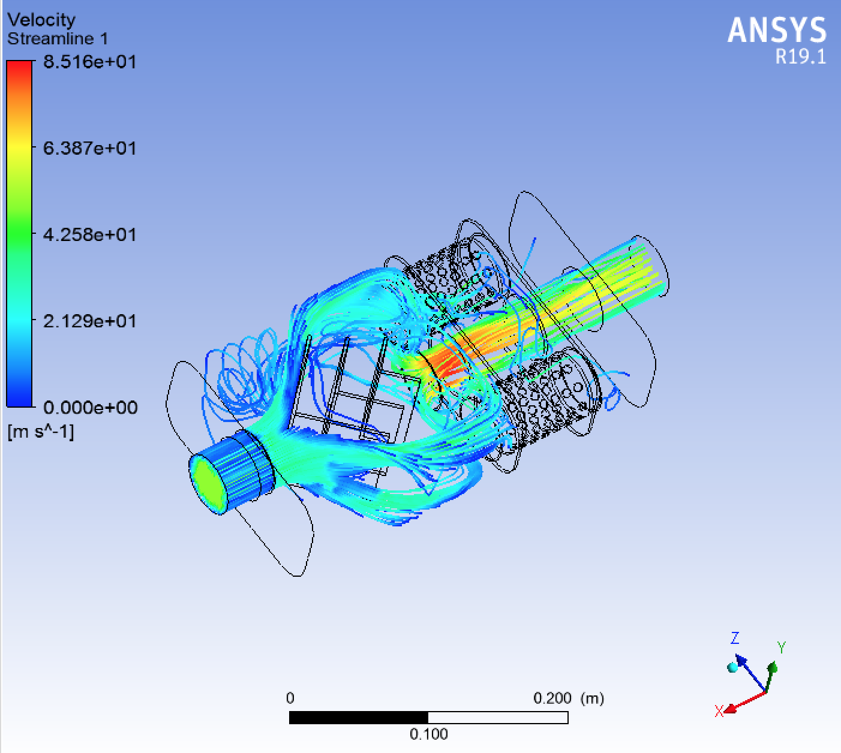
Mufflers

Slide 9
Pipe routing, Catalyst, Heat shielding
Pipe Routing
Catalyst
Heat Shielding
304 Stainless Steel
45 & 90 degree mandrel bends,
straight section
Custom bent section
Flanges & gaskets
Aristo Intelligent Catalyst Technologies
3-way oxidation with inner proprietary coating
Full contain design
16 ga. mild steel
2300 $℉$ ceramic heat blanket
Heat wrap

Slide 10
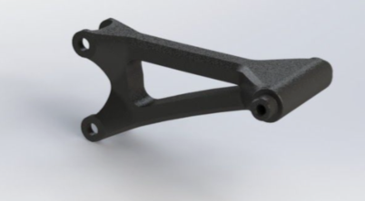
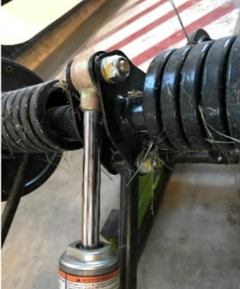
Additional Bogey Wheels
3D printed upper tension arm
Printed at Viking Pump with Markforged 3D printer
chopped carbon fiber (“Onyx”)
& reinforced fiberglass
Additional set of bogey wheels on lower skid rail

Slide 11
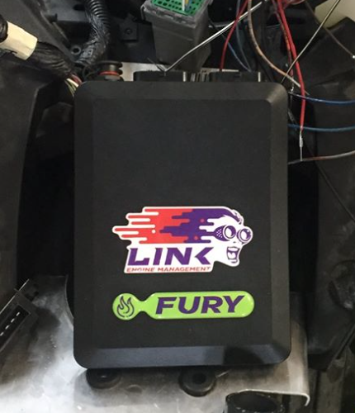
ECU
G4+ Link Fury
Complete stand alone
Custom wiring harness

Slide 12
Time Line Management
October 14th - Initial baseline testing
completed
October 20th - Begin innovation design and
integration
December 17th - Final design selected for
additional team designed muffler
January 19th - Begin ECU tuning
February 3rd - All innovations fully
integrated
and tuned, sled is competition ready

Slide 13
Team Lead Positions
Iowa State SAE
Project Director
Engine Team Lead
Exhaust Team Lead
Testing Team Lead
Tech Director
Chassis and Suspension Team Lead
Outreach Team Lead
Safety Officer
New positions to incorporate
Selection based off of passion and available time rather than knowledge

Slide 14
Citations
SAE International. “2019_SAE_CSC_rules_FINAL_Draft_10.5.2018.Pdf.” SAE International, 2018.

