Slide 1
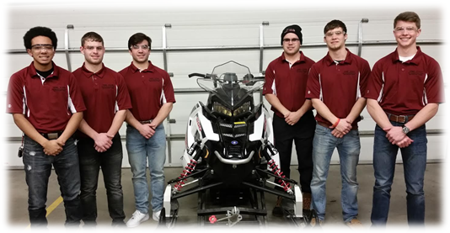
Iowa State Clean Snowmobile Challenge
2017

Slide 2
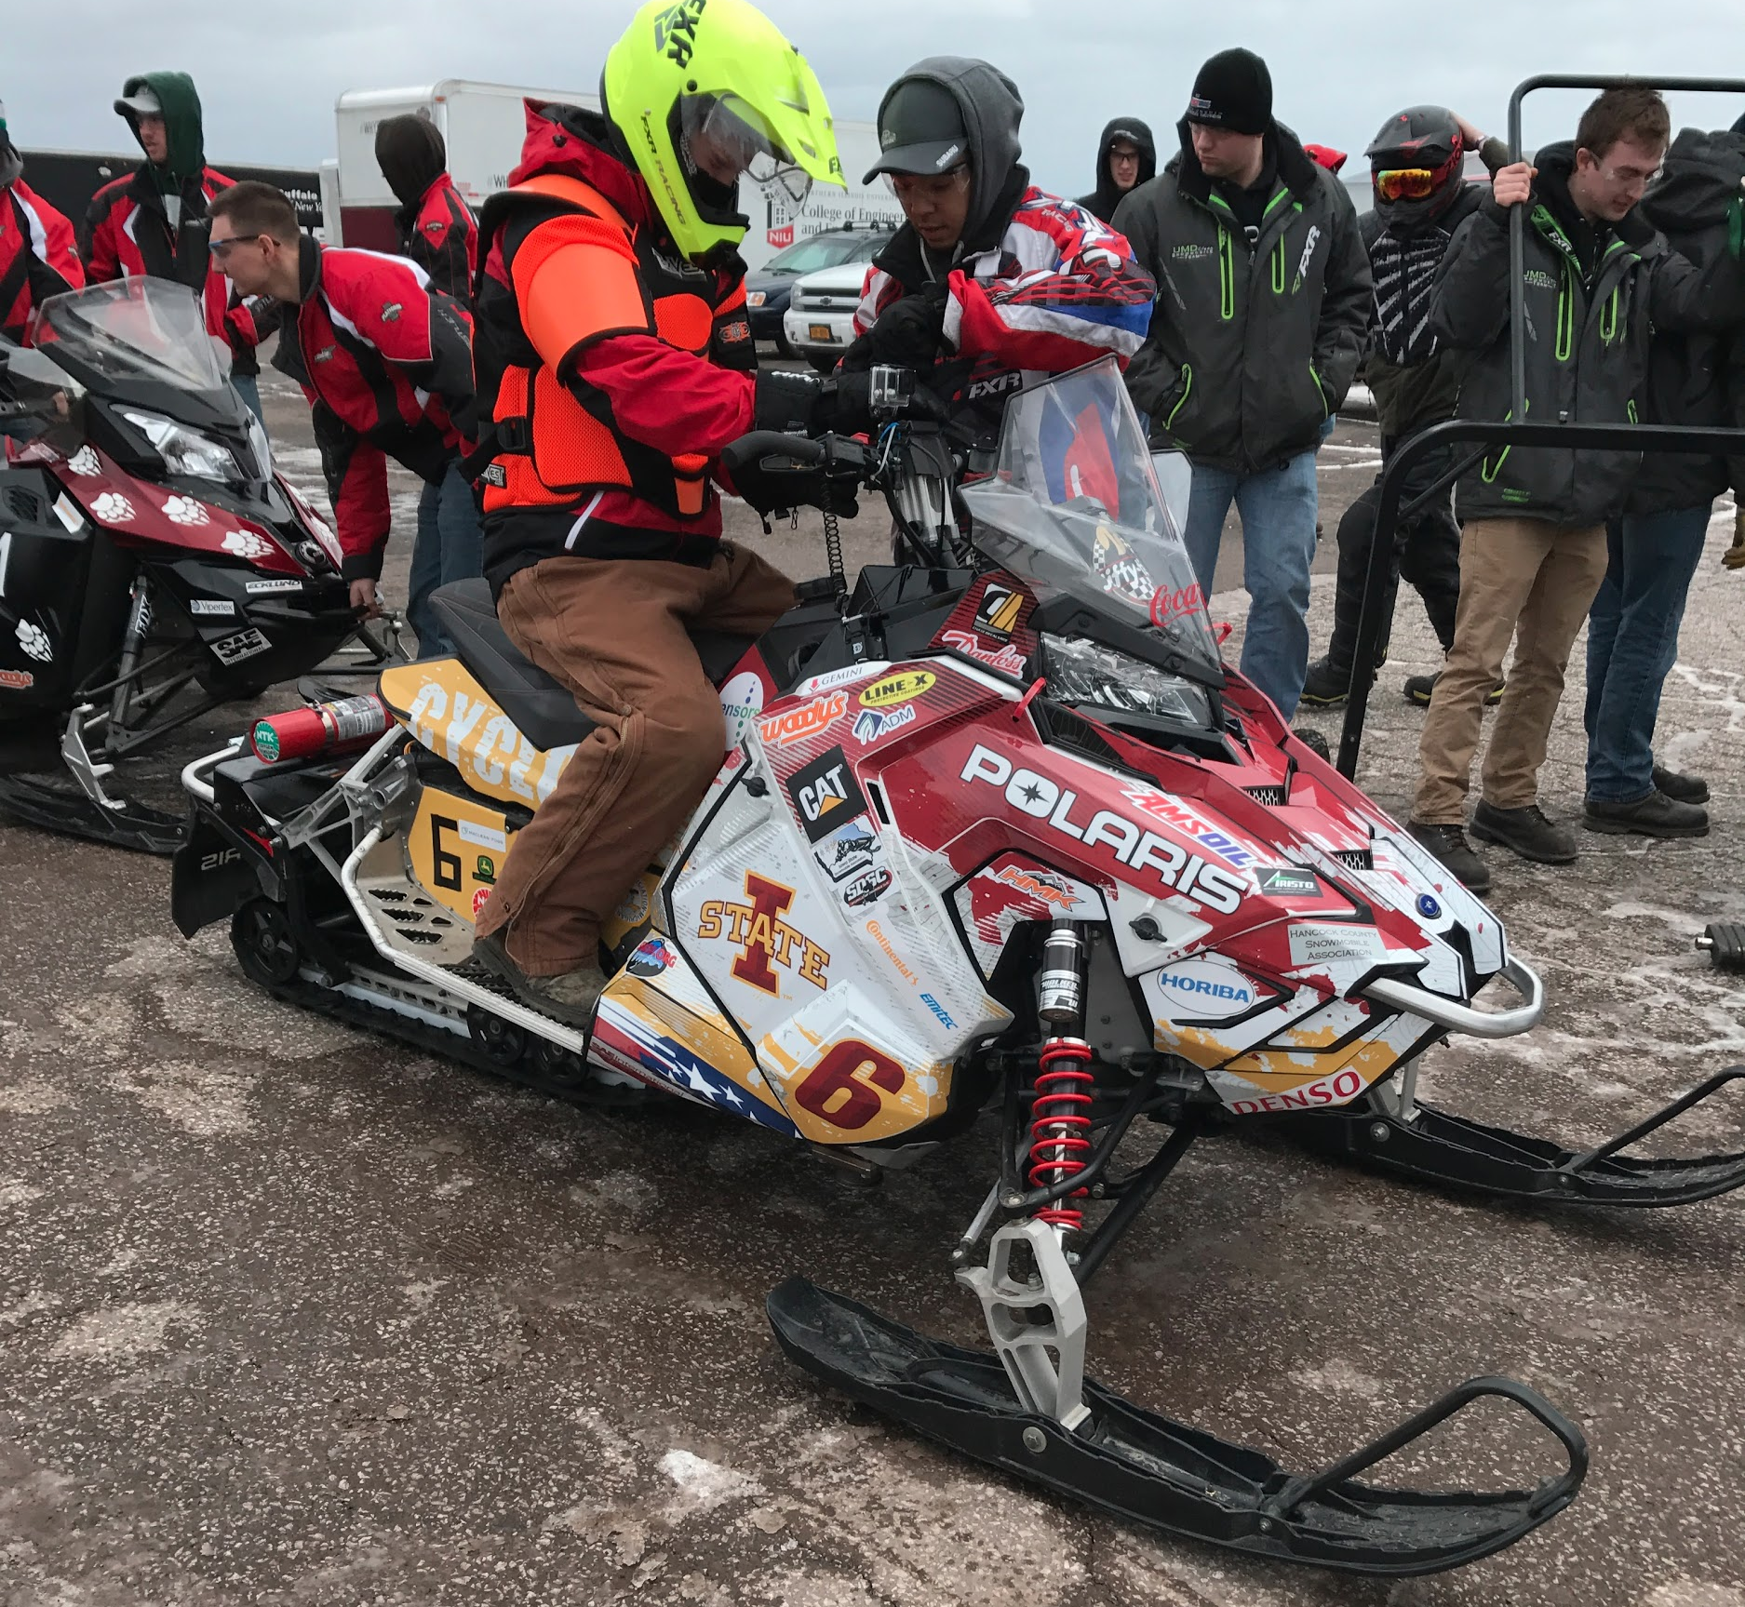
Overview
Snowmobile Selection
Traction
Sound
Exhaust
Tuning
Oil Selection

Slide 3
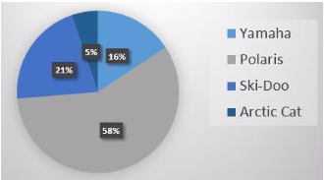
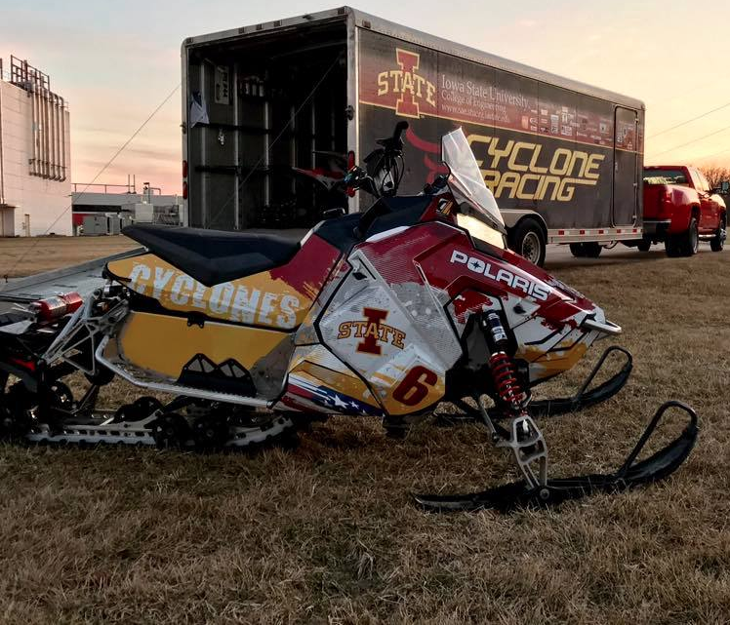
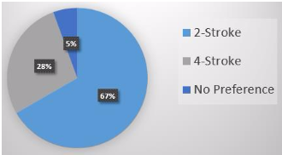
Snowmobile Selection
2015 Polaris 600 Rush Pro-X
Trail rider
Engine displacement
Handling
Reliability
600 Liberty

Slide 4
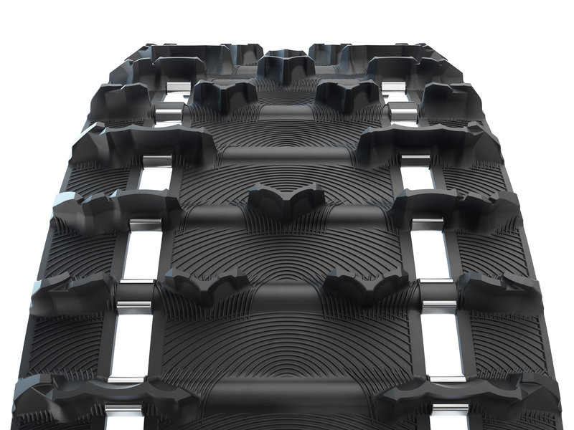
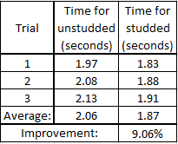
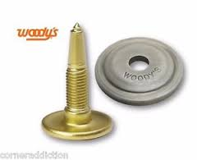
Traction
120 x 1.25” Ripsaw II Track
1.325” 60˚ carbide tip Gold Digger studs
84 single pattern
Reduced to 42 for weight minimization

Slide 5
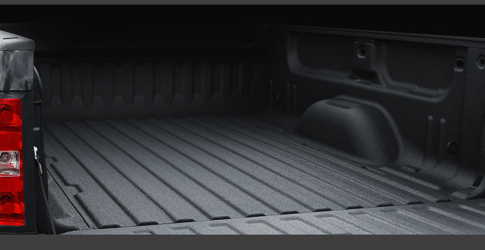
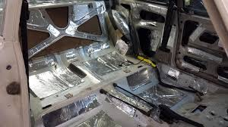
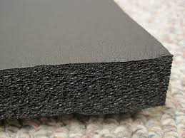
Sound
Two primary materials tested
Linex (1/16” and 1/8”)
Raam Matting
Ensolite foam tested as a complementary treatment
Analyzed at 3 frequencies
1000 hz (High)
600 hz (Mid)
200 hz (Low)
1/8” Linex with Ensolite Foam chosen
Notes:
High- 93.5 Dba
Mid- 84.7 Dba
Low- 75.6 Dba

Slide 6
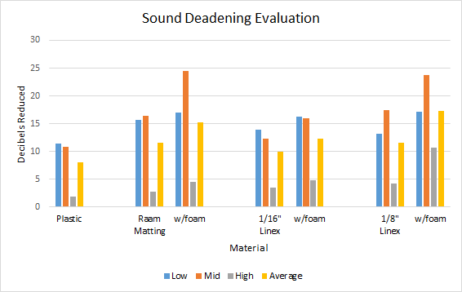
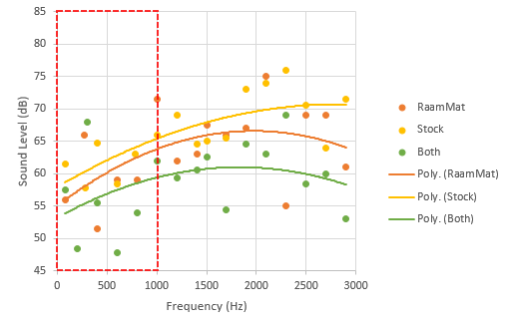
Sound
Notes:
High- 93.5 Dba
Mid- 84.7 Dba
Low- 75.6 Dba

Slide 7
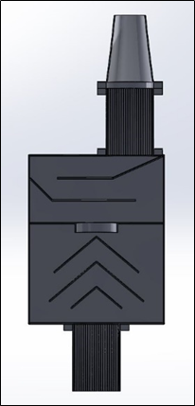
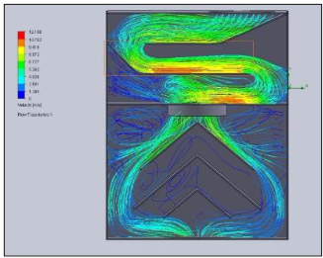
Exhaust
Destructive interference
Reduce sound pressure levels
Chosen over an absorptive muffler
Flow simulation conducted
Ensure proper flow
Validate exhaust gas velocity
Notes:
Reactive is more restrictive, but still is able to reduce sound levels
To run the flow simulation we calculated the theoretical mass flow rate by using engine displacement, engine RPM, and volumetric efficiency of 65% - two stroke.

Slide 8
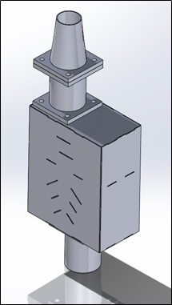
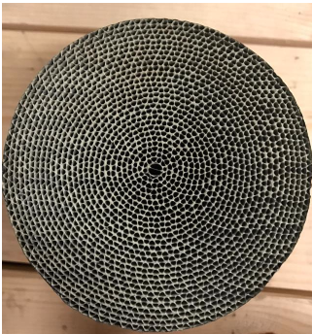
Emissions
Implemented 2 catalysts
3-way catalysts
200 cells per square inch
Palladium and Rhodium coating filters out
HC
CO
NOx
Lean Tune
Oxidize HC and CO
Notes:
Main emissions harmful to environment.

Slide 9
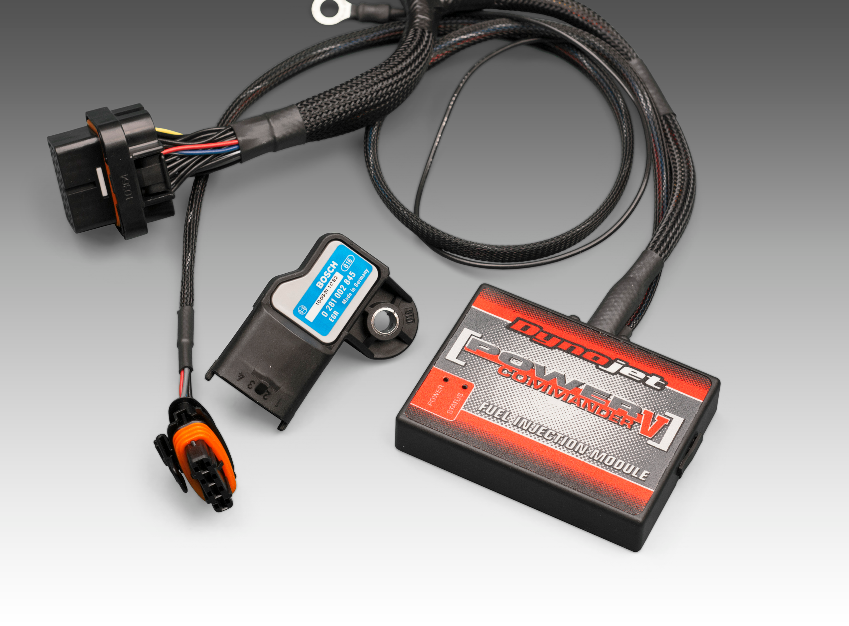
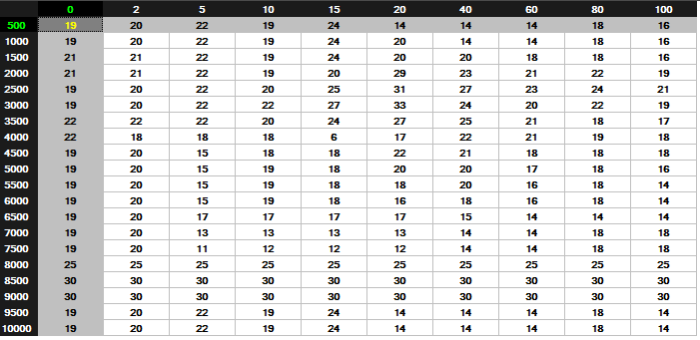
Tuning Hardware
Power Commander V
Zeithronix Ethanol Analyzer
NGK Afr Gauge

Slide 10
Tuning Strategy
Perfect stoich - 1.00 Lambda
Idle/Cruise - 1.08 Lambda
WOT (wide open throttle) - 0.87 Lambda

Slide 11
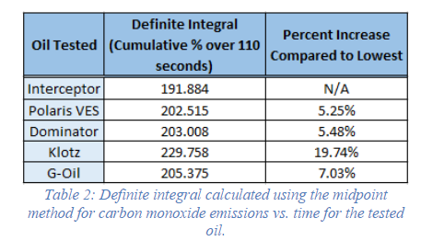
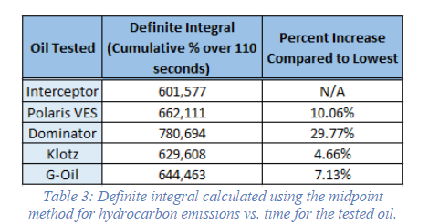
Oils
Carbon Monoxide
Hydrocarbon

Slide 12
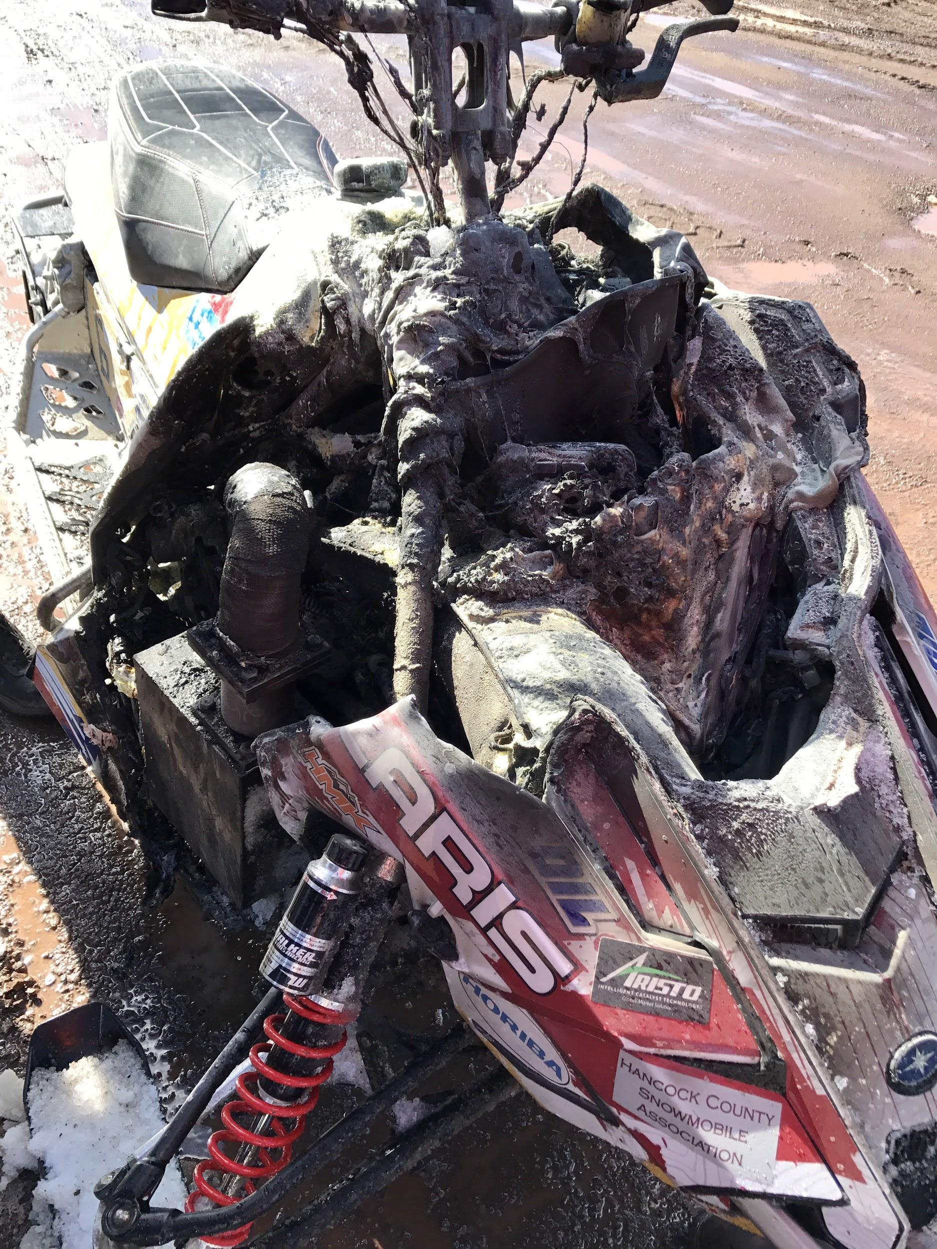
Questions?

