Slide 1
Iowa State University
2016 Clean Snowmobile Challenge

Slide 2
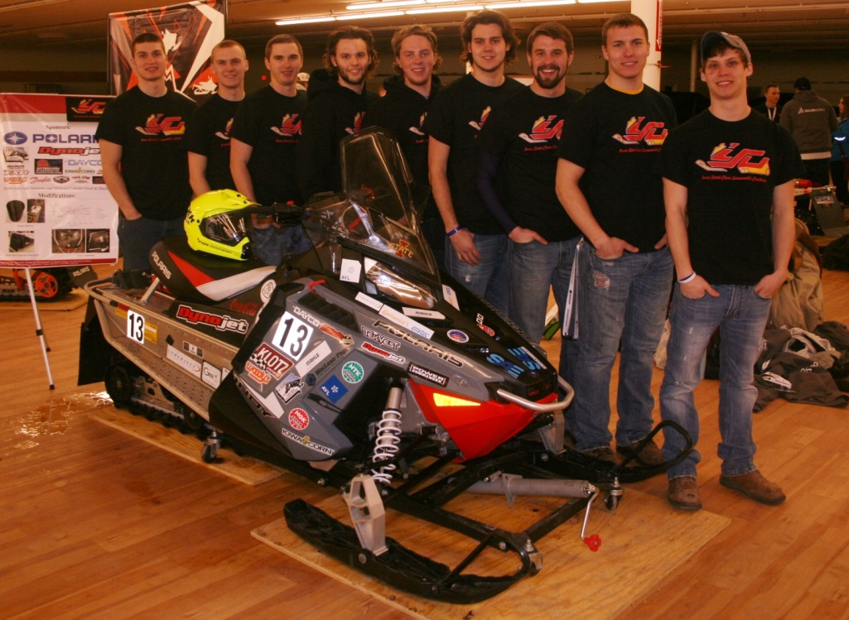
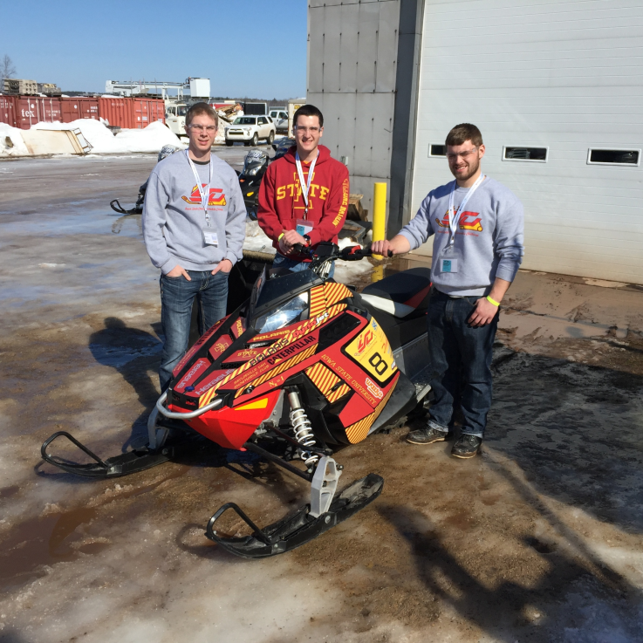
Agenda
Chassis Selection
Chassis Improvements
Exhaust Treatment
Engine Calibration
Questions

Slide 3
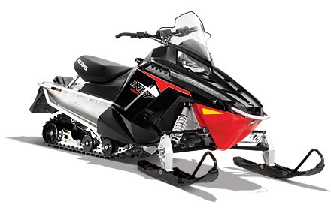
Chassis Selection
2014 Polaris Indy 800SP
795cc Cleanfire Liberty 2-stroke
Aluminum ProRide Chassis

Slide 4
Chassis Selection
Buyer brand preference

Slide 5
Chassis Selection
Buyer engine displacement preference

Slide 6
Chassis Selection
Importance of fuel economy to buyers when purchasing snowmobile

Slide 7
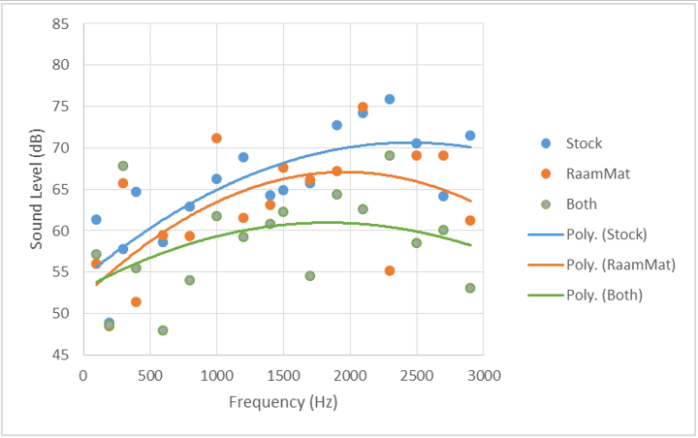
Chassis Improvements
Sound Deadening Material:
RAAMmat BXT II
Placed in engine bay
Significantly reduced noise levels from engine

Slide 8
Chassis Improvements
Buyer riding conditions preference

Slide 9
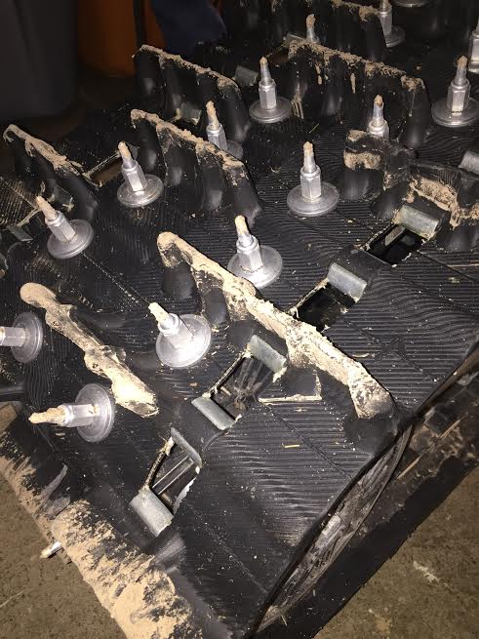
Chassis Improvements
Track Selection:
Ripsaw 1.5
1.5” lugs
96 1-5/8” Woody’s Traction Studs

Slide 10
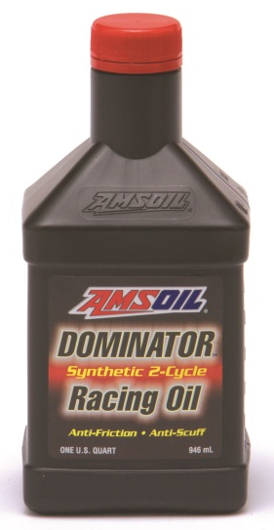
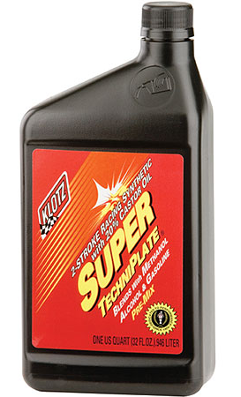
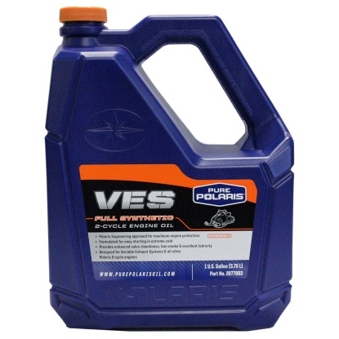
Exhaust Treatment
Emission Analysis of 2-stroke oils:
Five oils analyzed
Test run by intervals of 500rpm between 3000rpm and 5000rpm
Oil system flushed between samples

Slide 11
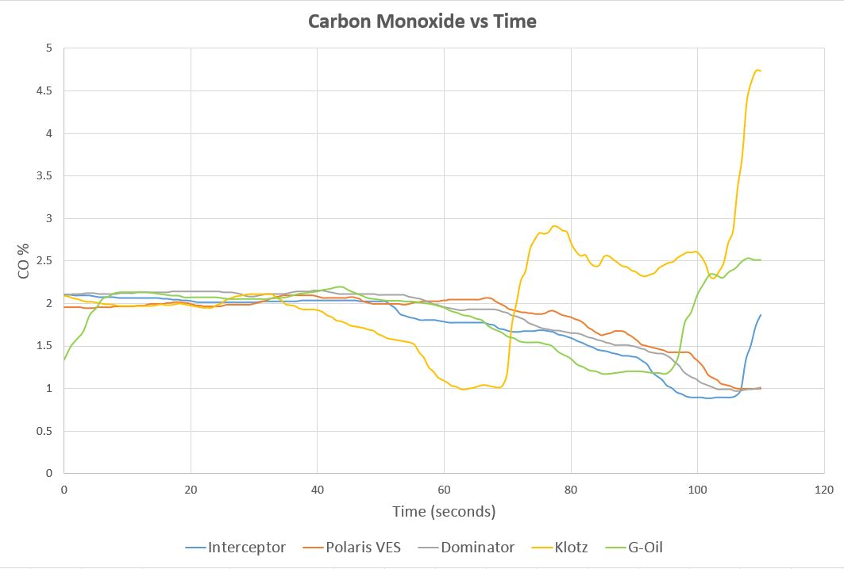

Slide 12
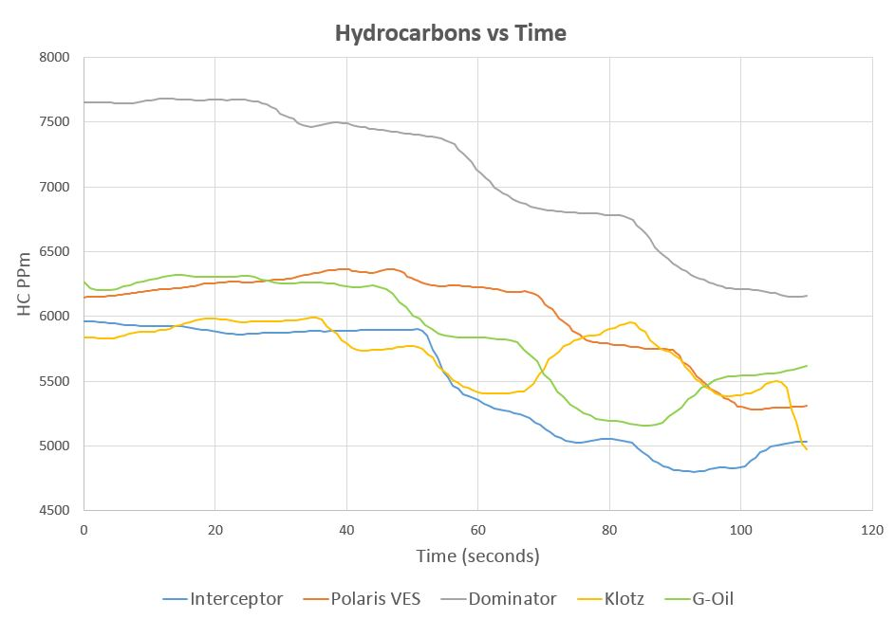

Slide 13
Exhaust Treatment
Oil Name | Definite Integral (Cumulative % over 110 seconds) | Percent Increase Compared to Lowest
Interceptor | 191.884 | N/A
Polaris VES | 202.515 | 5.25%
Dominator | 203.008 | 5.48%
Klotz | 229.758 | 19.74%
G-Oil | 205.375 | 7.03%
Amsoil Interceptor proved to be best candidate
Carbon Monoxide
Oil | Definite Integral (HC parts per million cumulative over 110 seconds) | Percent Increase Compared to Lowest
Interceptor | 601,577 | N/A
Polaris VES | 662,111 | 10.06%
Dominator | 780,694 | 29.77%
Klotz | 629,608 | 4.66%
G-Oil | 644,463 | 7.13%
Hydrocarbons

Slide 14
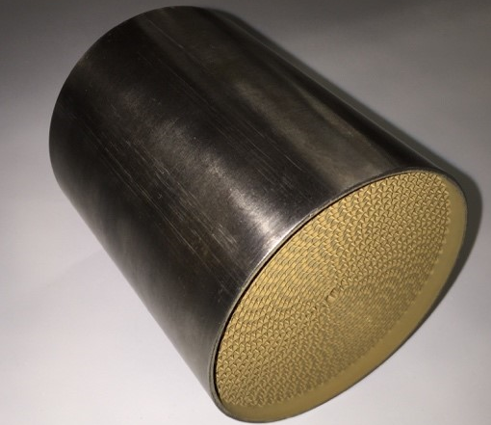
Exhaust Treatment
Catalytic Converter:
400cpsi Heraeus catalyst
Targets constituents of carbon monoxide and excess hydrocarbons
Composition
Platinum, Palladium, Rhodium (1:20:1)

Slide 15
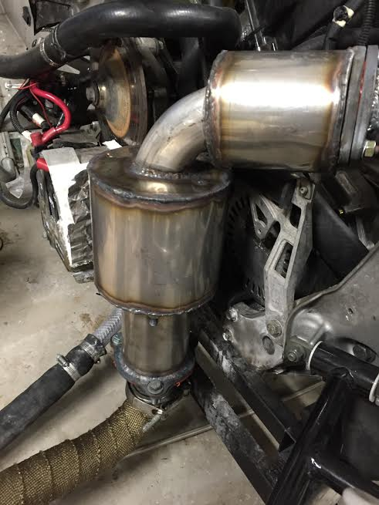
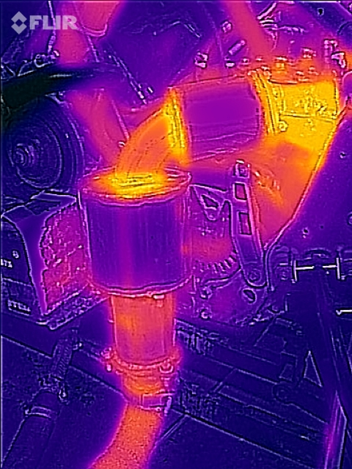
Exhaust Treatment
Sound Treatment:
Twin high-flow mufflers
Stainless steel wool packing for heat resistance
Manufactured primarily for space restrictions and catalyst installation

Slide 16
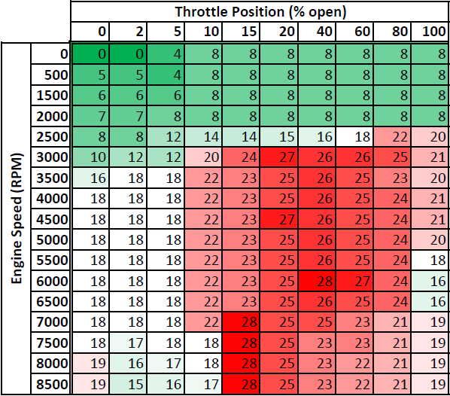
Engine Calibration
Engine Management:
Power Commander V (PCV)
Fuel Mapping
Ignition timing
GM Flex Fuel Sensor
Ethanol compensation
0-5V signal to PCV

Slide 17
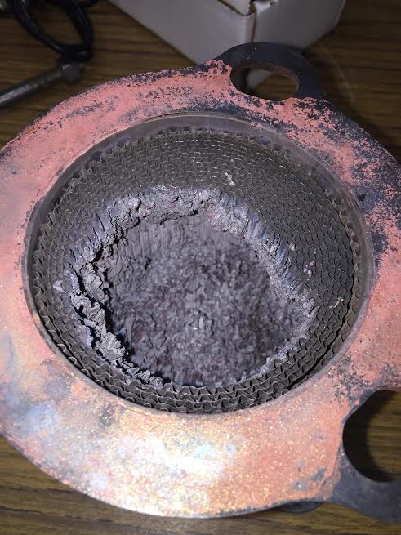
Engine Calibration
Adjustment to catalyst:
First catalyst struggled with short-circuited fuel
Adjusted system to move catalyst further downstream
Progressive tune implemented
Throttle Position (% Open) | Target Lambda Value
0-40 | 1.3
41-60 | 1.1
61-80 | 1.0
81-100 | 0.9

Slide 18
Questions?

