Slide 1
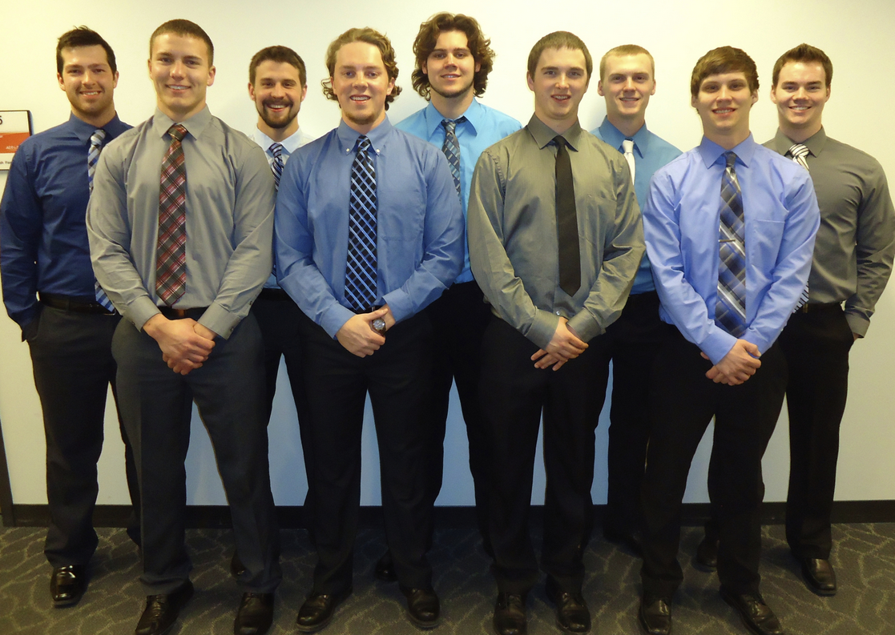
Iowa State University
2014 Polaris Indy® 800 SP
2015 SAE International Clean Snowmobile Challenge

Slide 2
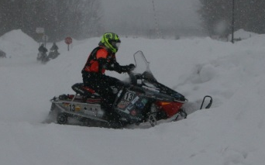
Overview
2014 Polaris Indy® 800 SP
Engine Rebuild
Fuel Management
Noise Reduction
Weight Reduction
MSRP

Slide 3
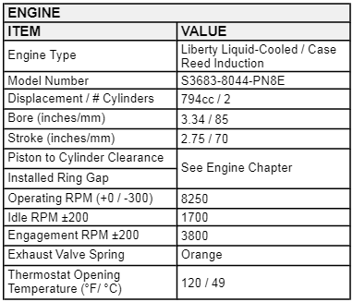
2014 Polaris Indy® 800 SP
Pro-Ride Chassis
  Lightweight
  Rideability
Liberty Liquid-Cooled Engine
  Cleanfire® Technology
  Power-to-weight ratio

Slide 4
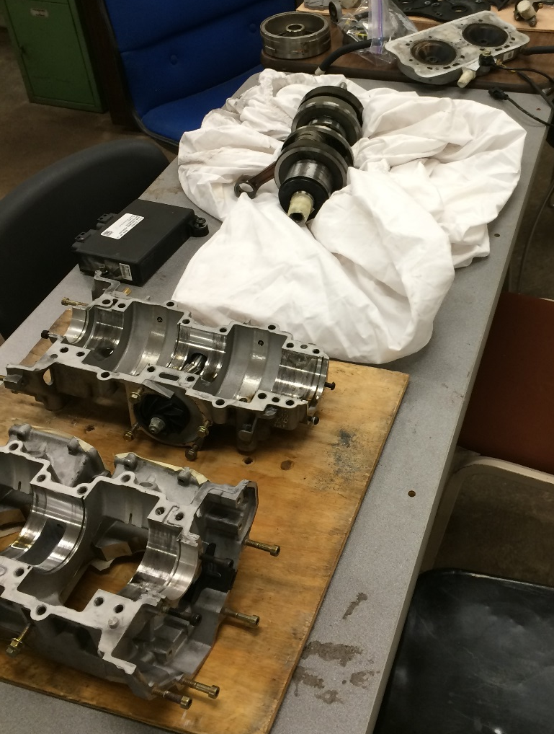
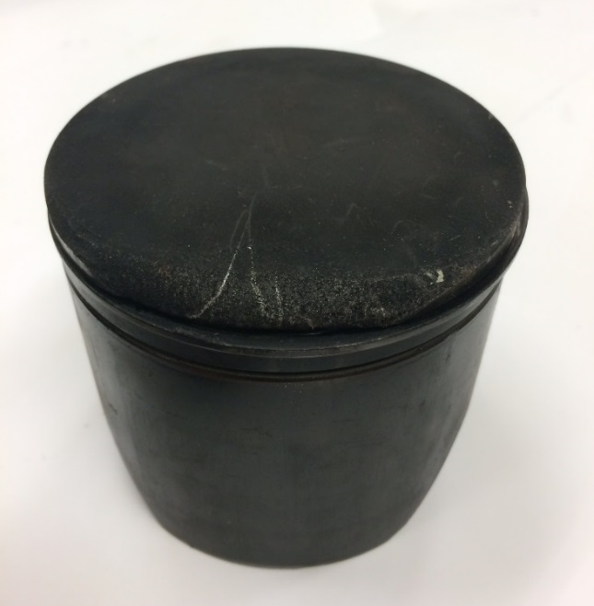
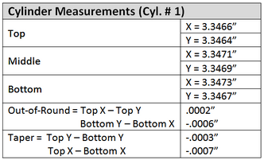
Engine Rebuild
Overheated pistons
2009 modifications to fit 2014 chassis
Engine Inspections

Slide 5
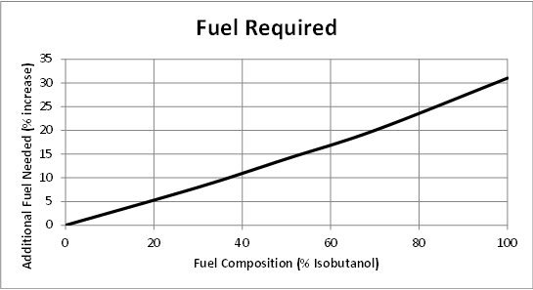
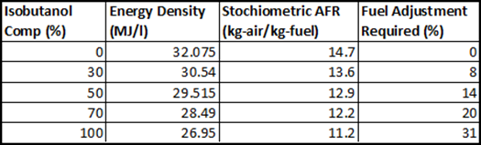

Fuel Management
Power Commander V (PCV)
  Autotune
  POD-300
$$\frac{{AFR}_{gasoline}}{{AFR}_{Fuel used}} x 100\%= \frac{14.7}{{AFR}_{Fuel used}} x 100\%$$
*“Air-Fuel h-x Diagrams for Gasoline-Isobutanol Blends,” “Politehnica” University of Timişoara, last modified 2010.

Slide 6
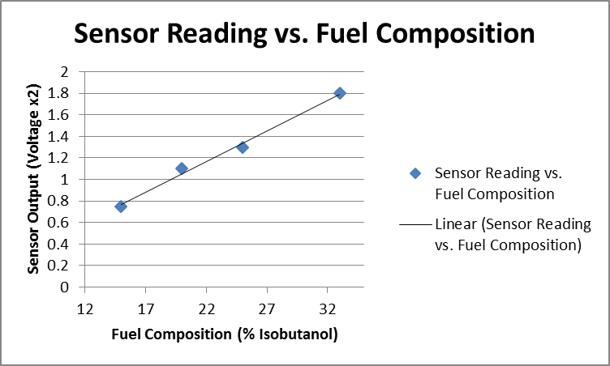
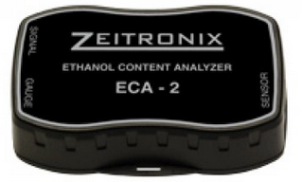
Fuel Management
GM Flex Fuel Sensor
Zeitronix ECA-2

Slide 7
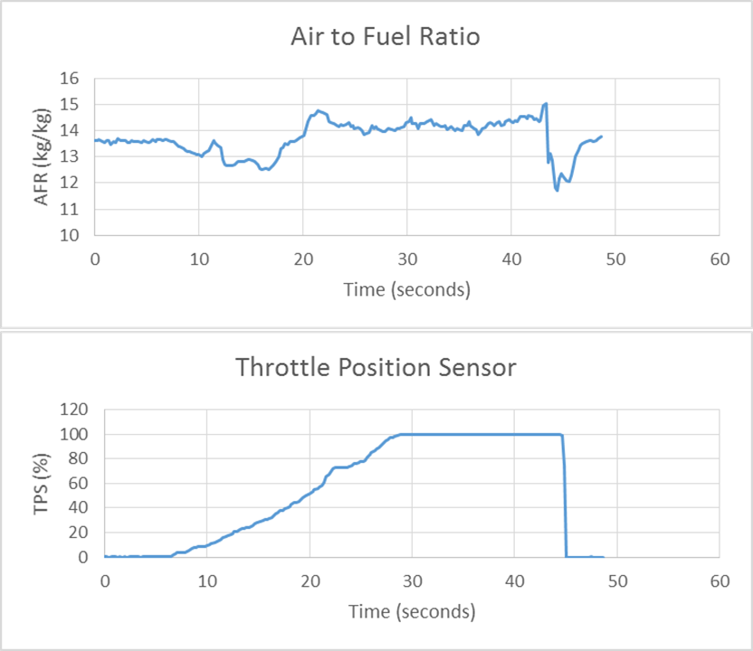
Engine Tuning
Tuning based off 20% gasoline-isobutanol mixture
Conservative tune
Datalogging from PCV during practice runs

Slide 8
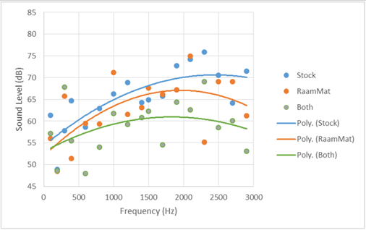
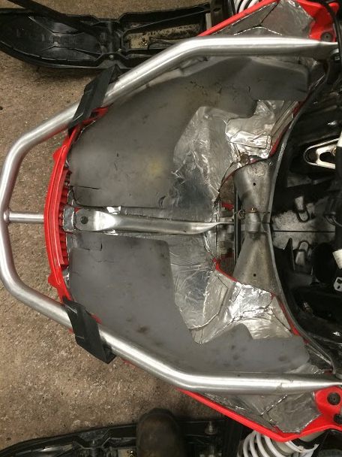
Noise Reduction
Installed RAAMmat
  Engine Bay
  Side Panels
  Hood

Slide 9
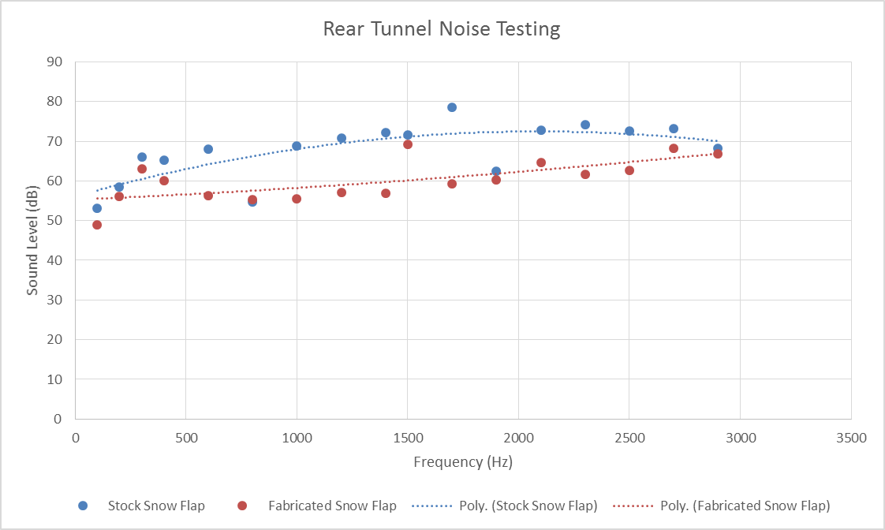
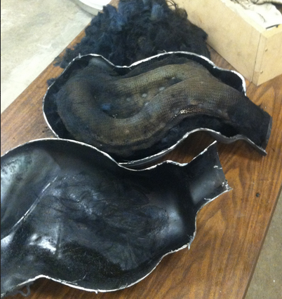
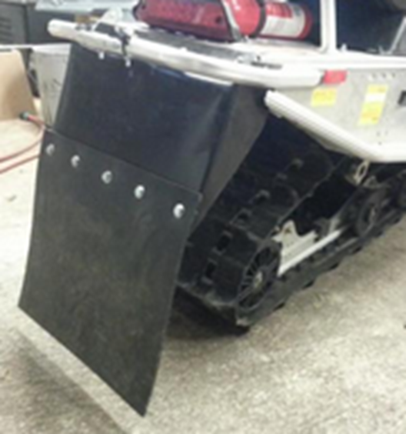
Noise Reduction
Repacked muffler
Snow flap Design

Slide 10
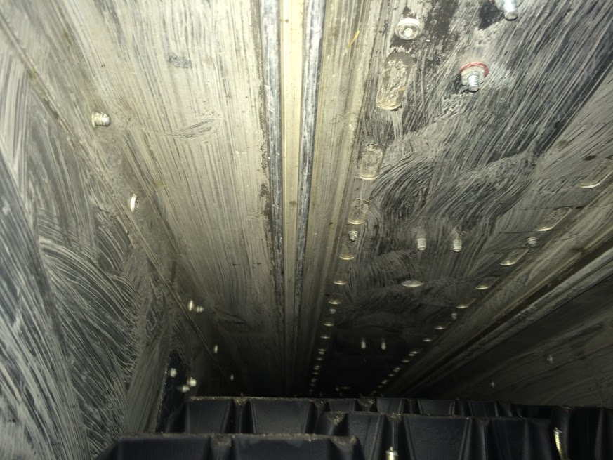
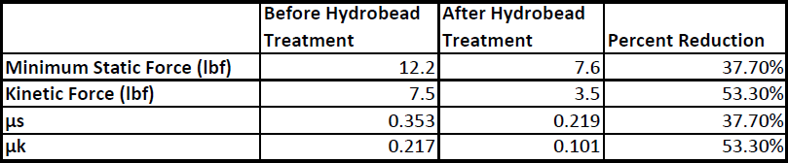
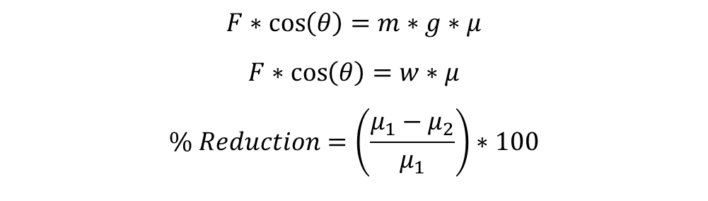
Weight Reduction
Starter motor removal
Hydrobead
$$F∗\cos\left(θ\right)=m∗g∗μ$$
$$F∗\cos\left(θ\right)=w∗μ$$
$$\% Reduction=\left(\frac{μ_{1}−μ_{2}}{μ_{1}}\right)∗100$$

Slide 11
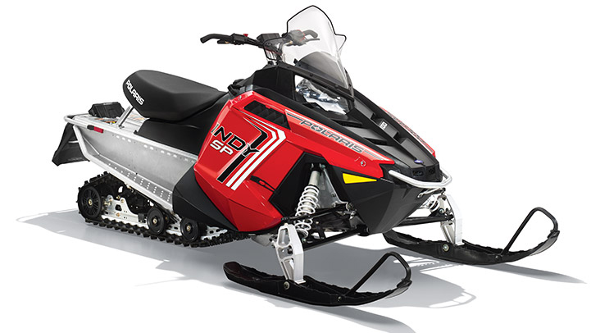
MSRP
RAAMmat
Hydrobead
Woody’s Studs
Flex Fuel Sensor
Ethanol Content Analyzer
DynoJet Power Commander V
Total Price - $12,695

Slide 12

Thanks for all of your Support
Iowa State College of Engineering
Iowa State Mechanical Engineering
Dr. Emmanuel Agba (Adviser)
Dr. Gary Mirka (Associate Dean CoE)
Sponsors
2015 SAE CSC Staff/Volunteers
And all of our other supporters

