Slide 1
Presented By:
Jared Kellerer,
Steven Gasseling
Notes:
STEVE

Slide 2
Overview
Project management
UICSC goals & platform
Past work
Engine and sound testing
Silent Drive & Silent Track
Notes:
STEVE

Slide 3
Team management
structure
Faculty Advisor
Senior Captain
Graduate Students
Upperclassmen
New Members
Junior Captain
Alumni
Notes:
STEVE
The team structure

Slide 4
Team management
Project Management
Gantt Chart
Effectively tracked large projects
Difficult to maintain accountability
Kanban Method
Promotes individual accountability
Increased small team progress monitoring
To Do
In Progress
Completed
Notes:
Steven
Gantt
Strengths: Good for managing timeline of multiple projects macro scale
Weakness: fine project management, small team, individual, not as well
Kanban
Strengths: Promotes individual accountability, and small scale progress monitoring
Downside: Implementing a new method of management can be unfamiliar and we are still learning how to use it

Slide 5
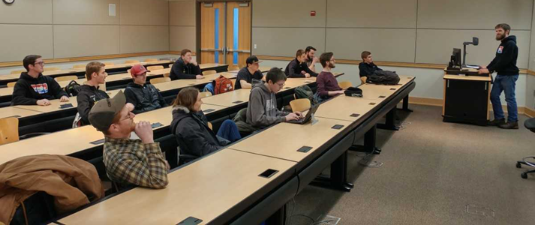
Team management
Course
Curriculum
CSC introduction
Engineering topics
Professional development
Student led
Presentations by senior members
Notes:
STEVE
Major overhaul carried out by senior
Using knowledge of senior team members
Presentations

Slide 6
UICSC Goals
Produce an NPS certified two-stroke
E-Score > 175
Sound output < 67 dBA
Fun to ride
Improved testing & validation
Notes:
STEVE
As always the UICSC strives to…
Fun to ride AND marketable

Slide 7
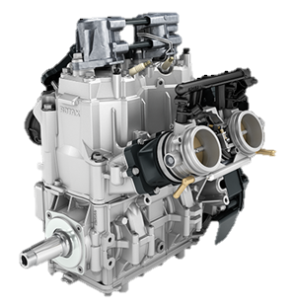
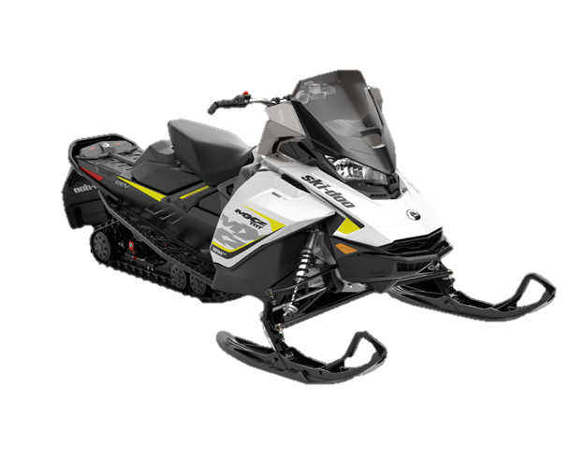
UICSC Platform
2017 Ski-Doo MXZ TNT
REV GEN4 Chassis
850 E-TEC Engine
Notes:
STEVE
Produce an NPS certified two-stroke
E-Score > 175
Sound output < 67 dBA
Fun to ride
Improved testing & validation

Slide 8
Prior modifications
Reduced engine speed
3 way catalyst
Sound material
Absorption
Damping
Increased diameter rear idler wheels

Slide 9
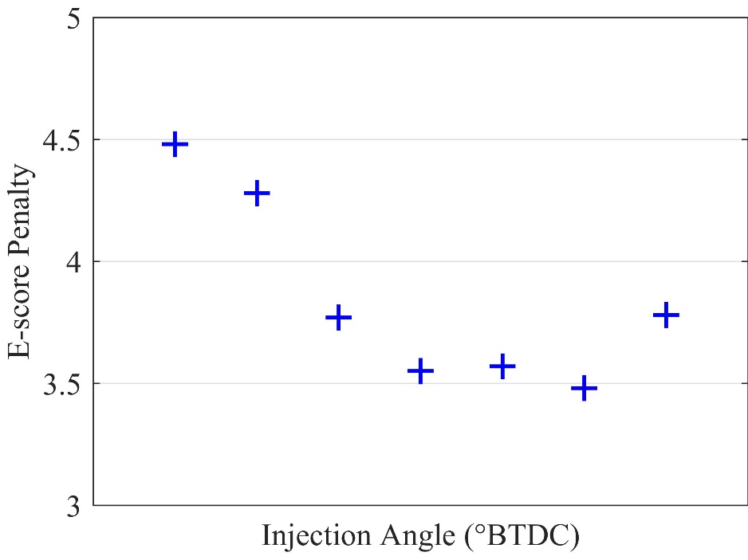
Engine calibration
Maintain survivability
Minimize emissions
Target BSFC in appropriate areas
Swept parameters
Fuel injection timing
Fuel injection quantity
Throttle body/E-TEC ratio
Ignition timing
$$f(x)=W_{m}∗ \frac{\left(\frac{\left(UHC+ {NO}_{x}\right)}{1.5}+\frac{CO}{4}\right)}{P}$$

Slide 10
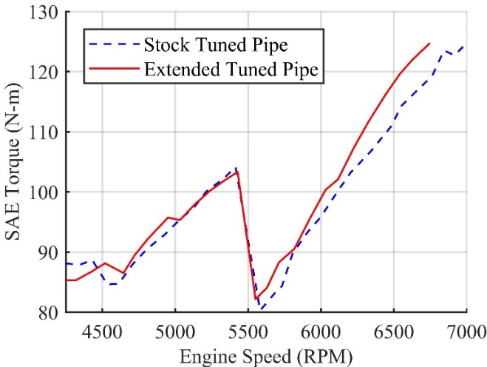
Snowmobile Design
Prior work
$$L_{T}= \frac{ED × 42545}{RPM}$$
Reduced engine speed
6850 RPM
118 hp
Extended tuned pipe
Optimized length for BSFC
Empirical calculation and simulation
3-way catalyst
1:20:1 Platinum:Palladium:Rhodium
Dual substrate
Notes:
JARED
Downsped large displacement on basis of reducing sound production in J1161 with lower engine speed and smaller throttle angle than small displacement
At reduced engine speed, trapping pulses no longer timed correctly. To determine new length, used empirical and GT simulation.
1201 ppr at exit of muffler to reduce emissions
Reduced speed 850 to produce similar power to a 600. Our theory: during j1161, lower engine speeds > lower frequencies produced by engine (A weight); reduced throttle opening > lower exhaust pressures (reduce amplitude of sound produced)
Use 850, stock: produces significantly more than competition limit of 130 hp. We downspeed the engine to meet comp requirements and approximately match the performance of a 600 cc engine. Running a downsped 850 provides a few advantages over just a 600. the lower engine speeds required to produce similar output result in reduced sound pressure measured on the A-weighted scale. At common cruise speeds, we are able to shift the operating range of the engine to more efficient areas
Focus on explaining why we use an large displacement engine
sound -> we see reduced dBA with reduced engine speed
efficiencies -> shift engine operation to more efficient points

Slide 11
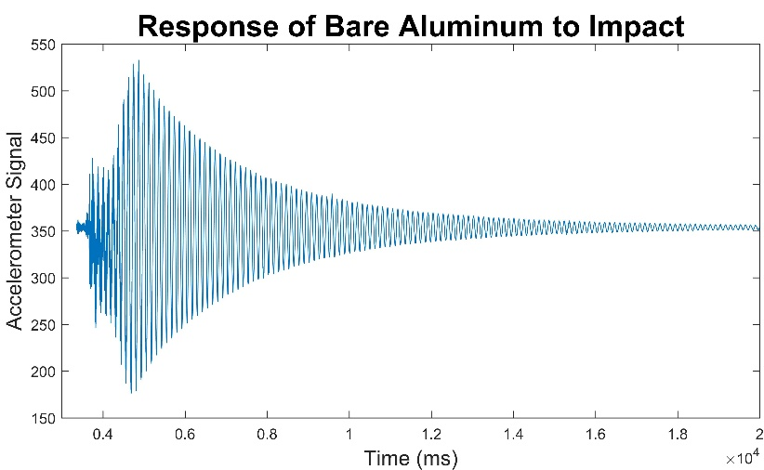
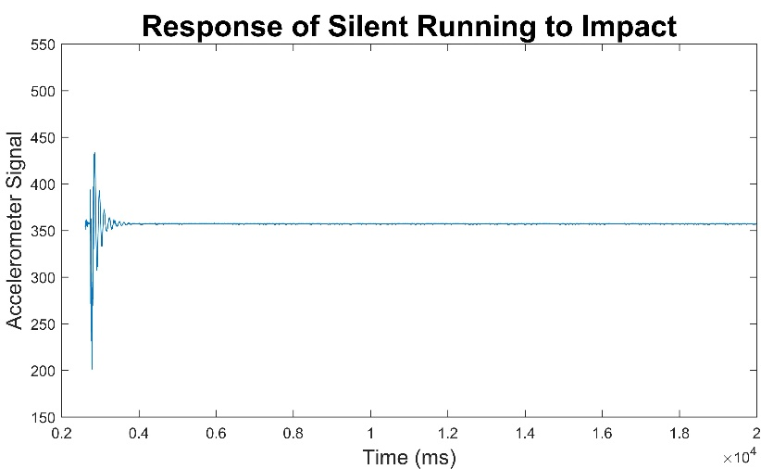
Snowmobile Design
Prior work
Tunnel sound damping
Damping ratio
Polymer Technologies Silent Running
Sound absorption
Power transmission coefficient
Polymer Technologies Melamine 3-Layer foam
Increased diameter idler wheels
Reduced dynamic rolling resistance
Facilitate new track
Damping ratio: $ζ = \frac{ln{\frac{x_{1}}{x_{2}}}}{2π}$
Notes:
JARED
Sound produced by tunnel vibrations is addressed with damping material. Various matls tested to determine silent running had the best damping ratio – applied.
Sound from the engine and cvt is attenuated with absorption material. Melamine 3 layer found to have best ptc, applied.
BWK yielded reduced dynamic rolling resistance and allows use of new track

Slide 12
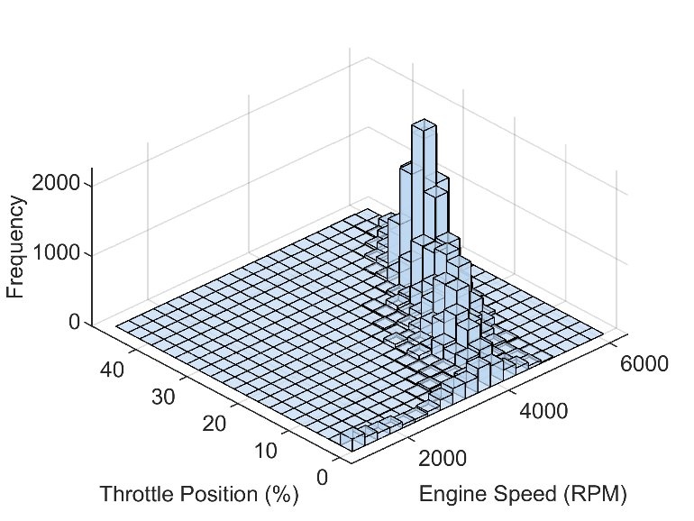
Innovations
In-service testing
ECU data collected during operation
Influences calibration and design
Examples
Engine operating point frequencies
Calculated fuel consumption
Track & engine speed
Notes:
JARED
Engine frequency -> BSFC focal areas in calibration
MPG -> efficiency testing, e.g. Silent Track II
Track/Engine speed -> Acoustic testing, clutch: as aftermarket components became available for P Drive, able to test & tune with in-service data (speeds as well as fuel consumption)

Slide 13
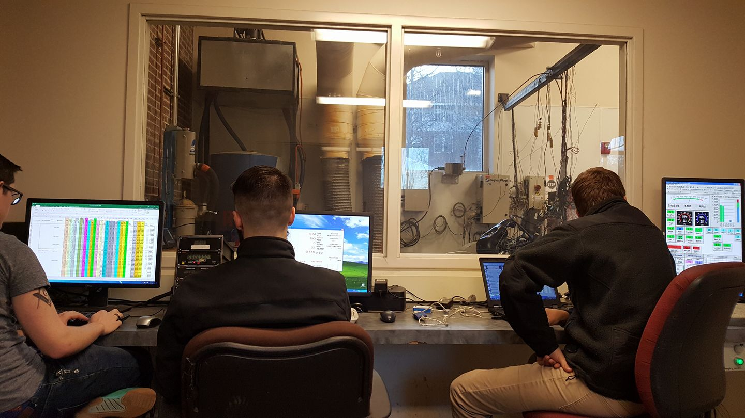
Innovations
Dynamometer updates
Improved data acquisition
Centralized
Time synchronous
Time averaged
Ramped Modal Cycle testing
Replicating CSC environment
Evaluating transient performance
Notes:
JARED
State that we aren’t yet using this to its fullest potential

Slide 14
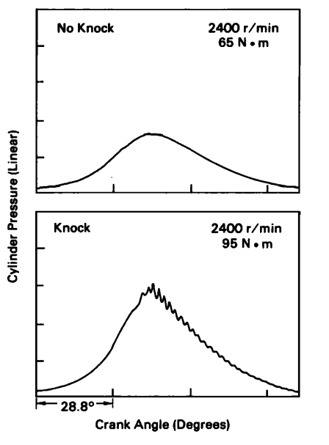
innovations
Combustion analysis
In development
Goals
In-cylinder pressure
IMEP & PMEP
Mass fraction burned
Pressure
Volume
$$FMEP=IMEP−BMEP−PMEP$$
Taken from: Robert Hickling, Douglas A. Feldmaier, Francis H. K. Chen, et al., “Cavity Resonances In Engine Combustion Chambers And Some Applications” The Journal of the Acoustical Society of America 74, no. 4 (1983): 1171
50%
MFB
$$MFB=\frac{p^{1/n}V−{p_{0}}^{1/n}V_{o}}{{p_{f}}^{1/n}V_{f}−{p_{0}}^{1/n}V_{o}}$$
Crankshaft Angle from TDC
Notes:
JARED
McCuiston, Lavoie and Kauffman (MLK) model
With IMEP and PMEP, calculate frictional losses
Use mfb to determine appropriate spark timing at different operating points
Gamma – ratio of specific heats
N – polytropic exponent, 1.3 for conventional fluids
MFB plot, Blair pdf pg316
See knock, IMEP discussion, CA10,50,90
Equipment
0.35° encoder
Head mounted pressure transducer
Crankcase absolute pressure sensor
High speed DAQ

Slide 15
innovations
Order analysis
Identifies major sources of noise
Vibration data
Process
Decompose signal
Determine order
Relate order
Address
Notes:
STEVE

Slide 16
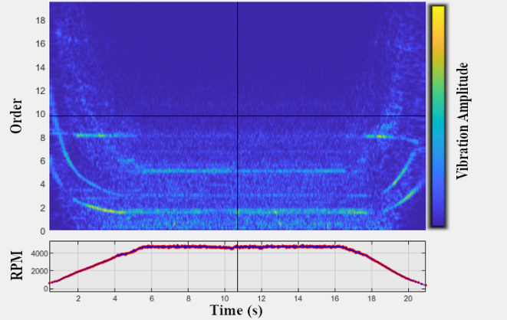

Slide 17
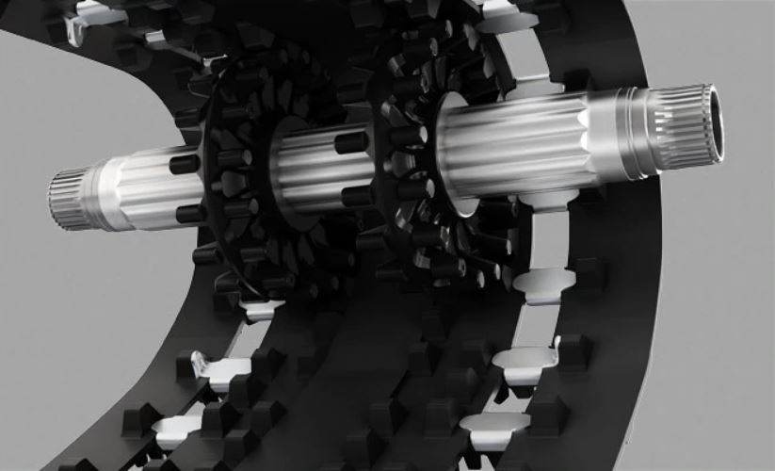
Innovations
Track
Ski-Doo Silent Drive & Silent Track II implemented
Irregular contact pattern
Plastic-rubber contact
Results
0.9 dBA reduction from 2018 configuration
8% decrease in roll-out distance
Notes:
JARED
What track did we run in 2018?
69.2
Rollout data in aux slides
Reference slide: paper for acoustic impact response

Slide 18
results
 | Stock | 2019 UICSC
E-Score | 133 | 180
J1161 Sound Pressure | 70 dBA | 67.7 dBA
Fuel Consumption | 13.8 mpg | 18.6 mpg (+35%)
Power | 165 hp | 118 hp (-28%)
Notes:
JARED

Slide 19
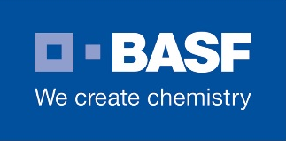
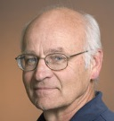
Thank you to our sponsors
Dr. Dan, Dr. Hess, Dr. Anderson, Dr. Beyerlein, Rob Patton, Bill Magnie

Slide 20
Auxiliary slides

Slide 21
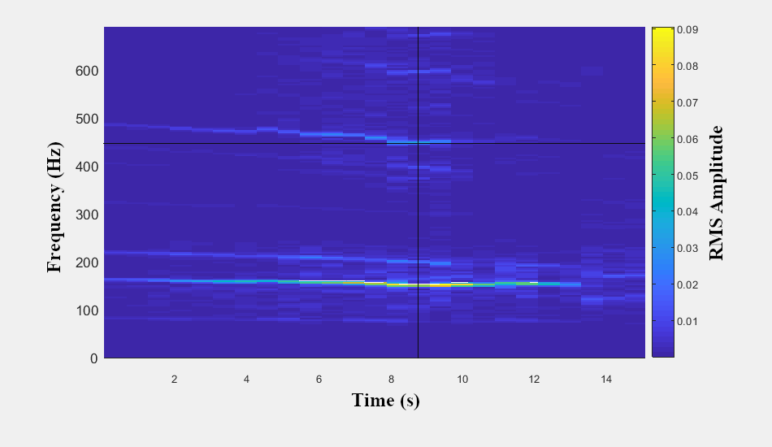

Slide 22
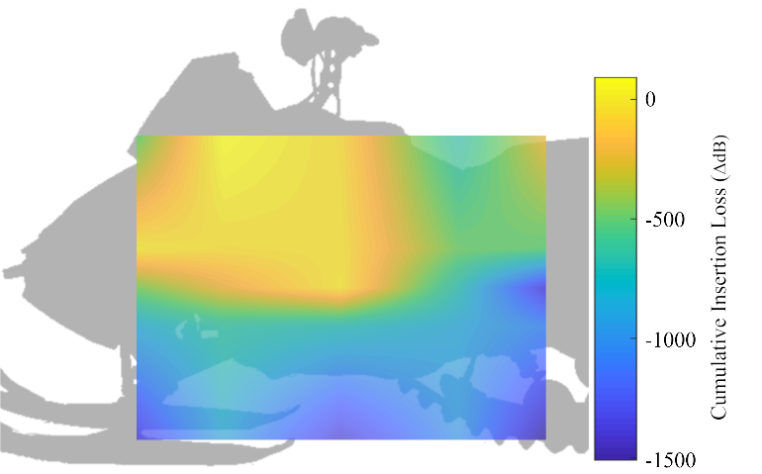
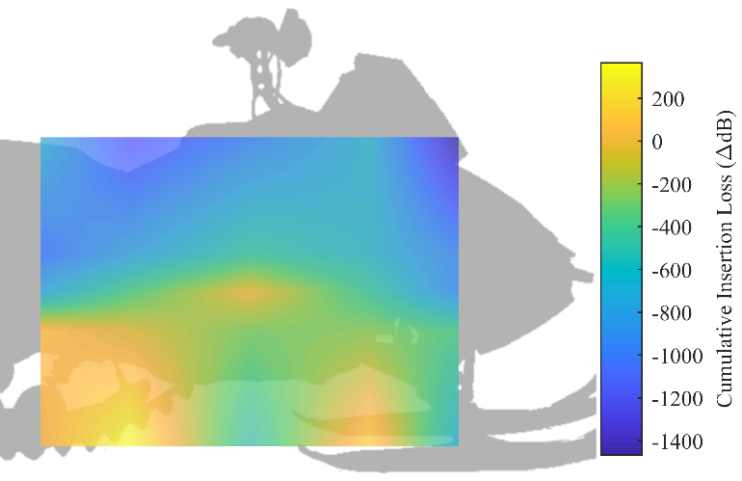
innovations
Sound vectoring
Identify areas of noise production
Improved data processing
$$IL=20∙\log{\frac{p_{i}}{p_{c}}}$$
Notes:
STEVE
The UICSC team can only address noise if we know where its coming from.
Sound vectoring is the process we have used in the past and continue using because it offers a
relatively unbiased picture of where sound is being produced on our chassis.
Testing procedure:
Our testing procedure as remained unchanged as well
We place a wire grid is 3ft away, snowmobile run on a stand at 4100 rpm (similar speed as seen in J1161)
A control mic is placed at the center, with 16 outer points measured with a test mic
Allowig us to
Innovation
Previously we could only look at one frequency at a time, due to our data processing. (notes into excel into matlab, back into excel)
This year we focused on more accurately representing insertion loss over frequencies from 86 to 21946 Hz (essentially, the range of human hearing)
Superimposed all the data on one image
Pictures
These are the photos resulting from the entire frequency spectrum (up to 21000 Hz)
And interpolated between the points

Slide 23
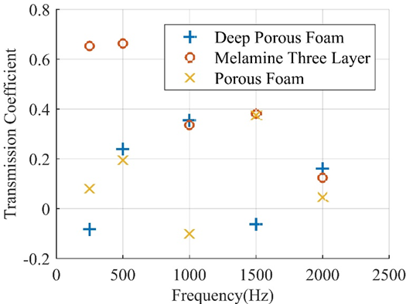
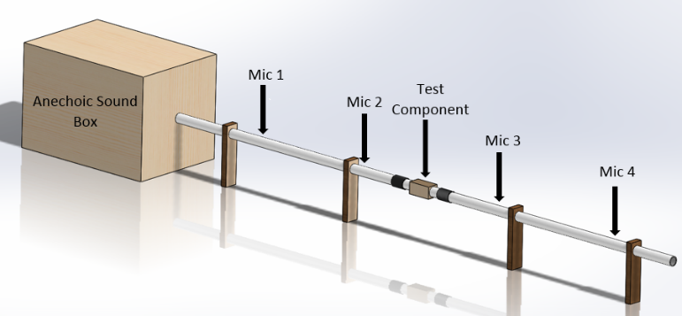
Sound Material Testing
Anechoic Sound Box Results
Power transmission coefficients
Best: Melamine Three Layer

Slide 24
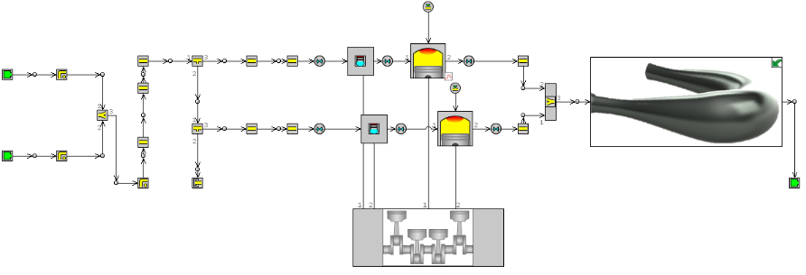
GT Suite: Tuned Pipe Model

Slide 25
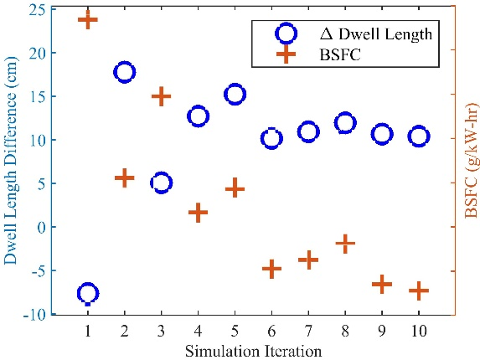
GT Suite Specifications
Engine speed | 6800 RPM
Optimization method | Local minima
Design variable | Dwell length
Factor range | -10 to 20 cm [-3.9 to 7.9 in.]
Output variable | BSFC
Resolution | 0.3 cm [0.1 in.]

Slide 26
Catalyst Comparison
Blank and coated catalysts of two styles were compared
Used dual substrate with three-way 1:20:1 Platinum:Palladium:Rhodium coating
Tested E-score of 180
Catalyst | E-score
Stock/No Catalyst | 133
Blank Single | 141
Blank Dual | 149
1:20:1 Single | 165
1:20:1 Dual | 180

Slide 27
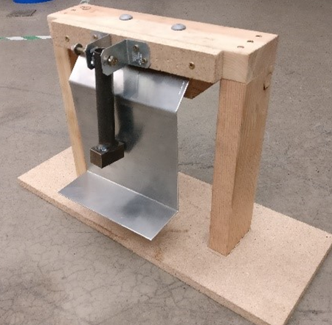
Damping Material Testing
Damping Ratio Results
Material | Average Damping Ratio
Bare aluminum | 0.010
PolyDamp single side | 0.034
PolyDamp both sides | 0.045
Silent Running single side | 0.063
PolyDamp + Silent Running | 0.082
Silent Running both sides | 0.142

Slide 28
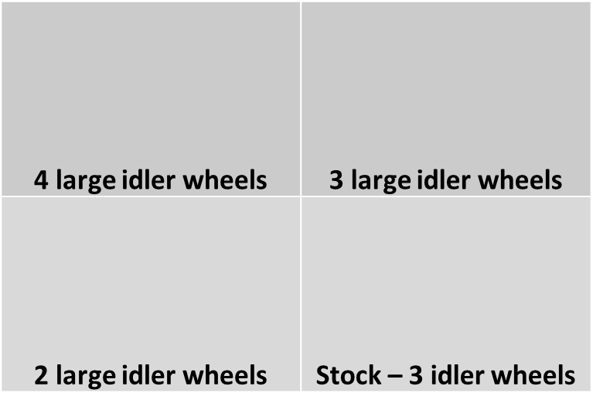
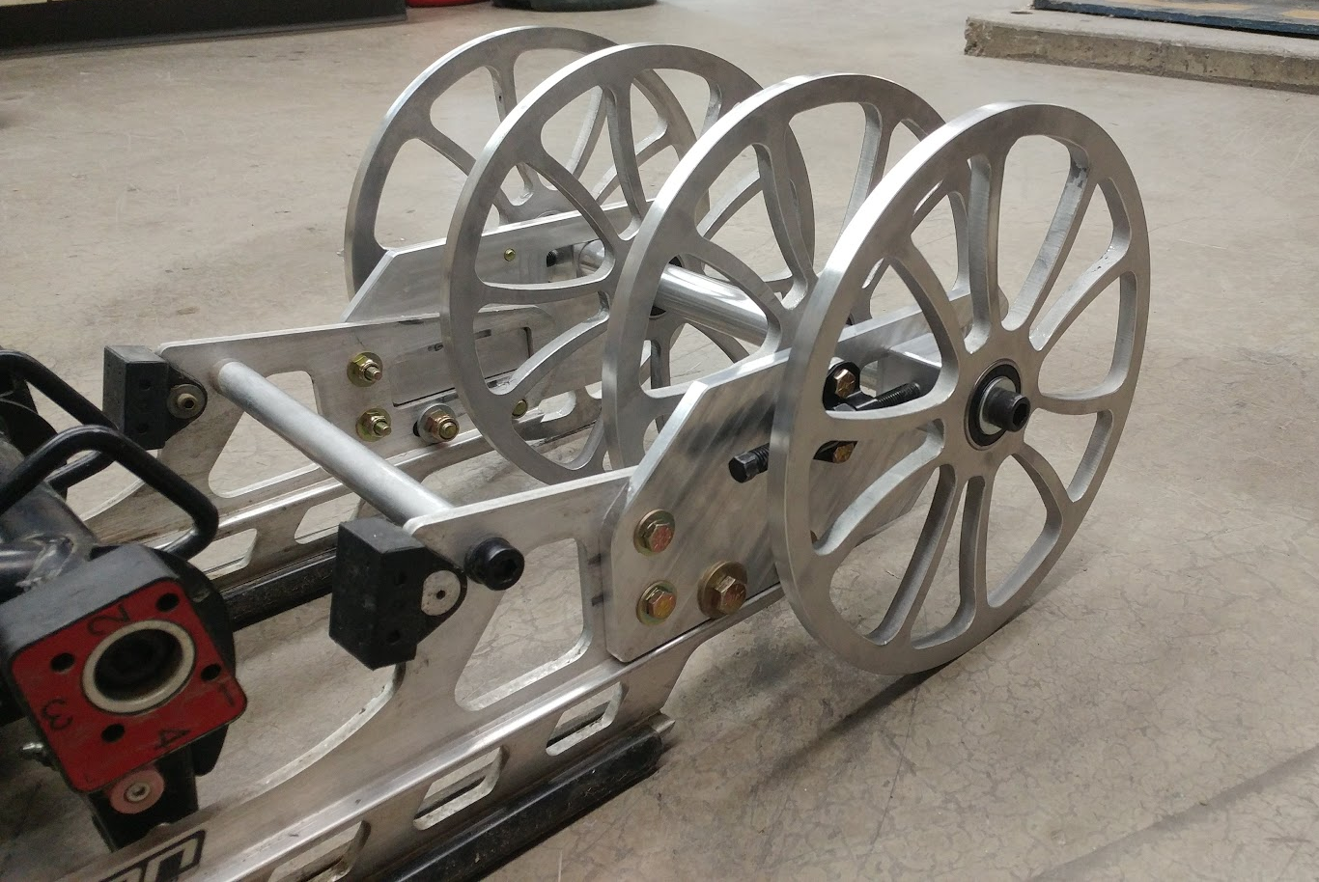
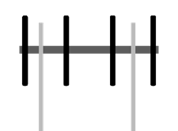
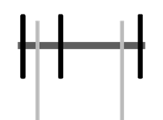
Larger Rear Idlers
Configurations
10 in. idler wheels for improved efficiency
Multiple configurations tested

Slide 29
Larger Rear Idlers
Testing Results
Component | Roll-Down Angle (°)
Stock idler wheels | 11.4
4 large idler wheels | 11.5
3 large idler wheels | 11.6
2 large idler wheels | 12.2
Tested Component | Roll-Out Distance (m [ft])
 | 80 kmph [50 mph] | 64 kmph [40 mph] | 48 kmph [30 mph]
Stock idler wheels | 94.8 [311] | 62.2 [204] | 43.9 [144]
4 large idler wheels | 95.1 [312] | 69.2 [227] | 44.8 [147]

Slide 30
ReferenceS
Metal vs Plastic Impact
Sarlin, E., Liu, Y., Vippola, M., Zogg, M., Ermanni, P., Vuorinen, J., & Lepistö, T., “Vibration damping properties of steel/rubber/composite hybrid structures.” Composite Structures, (94), 3327-3335. DOI: 10.1016/j.compstruct.2012.04.035

