Slide 1
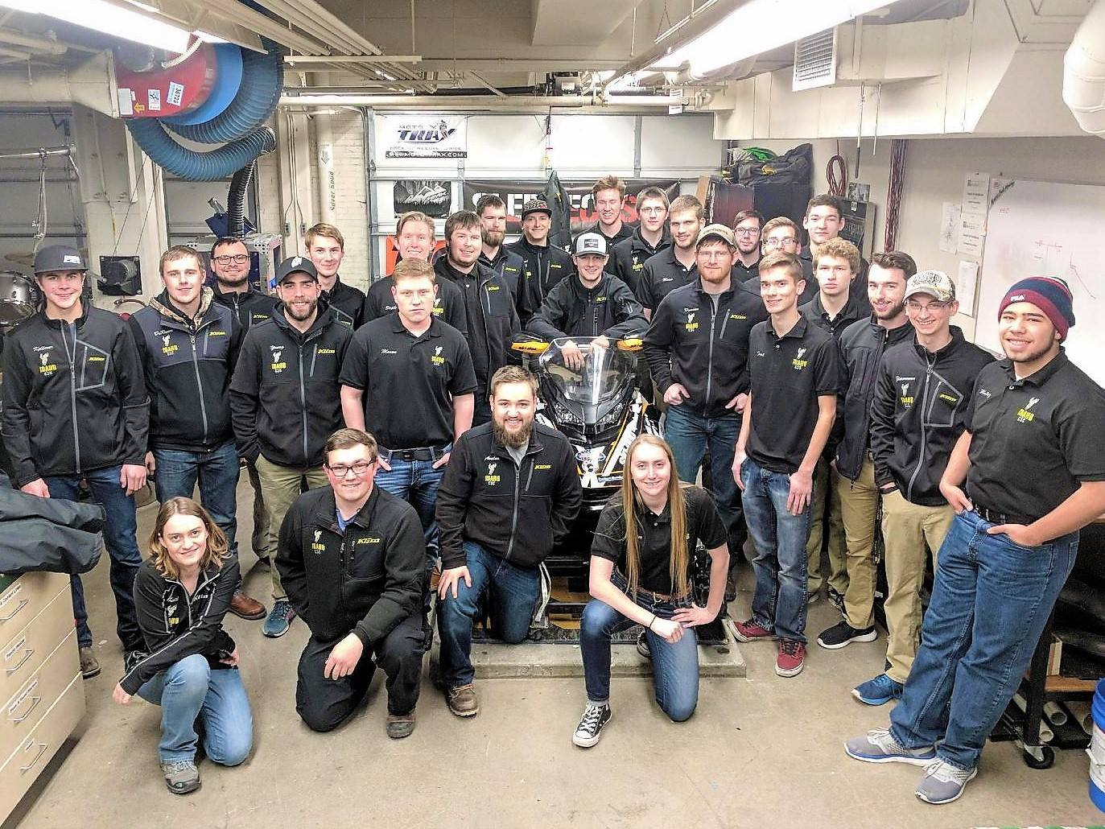
University of Idaho 2018 Clean Snowmobile Challenge Team
Presented By:
Alex Kiss, Ian Sullivan, Zach Lipple
Notes:
Kiss

Slide 2
Overview
Team Structure and Management
Team Goals
Innovations
Catalyst Selection
Sound Reduction
Conclusion
Questions
Notes:
Kiss Tell a story
U of I has been at the CSC since 2001
Learned as much about managing a team as designing a snowmobile
We will talk about everything that went into this year’s entry, from project management to how we engineered a clean/quiet/efficient snowmobile

Slide 3
Team Structure
Leadership
Two captains
Upperclassmen lead sub-group projects
Team management
Bi-weekly meetings
Action register linked to Gantt chart
CSC Class
Student-led
Weekly assignments
Notes:
Leadership
- Senior deals with overall project management
- Junior is responsible for administrative procedures and training to replace the senior captain
- More experienced members lead sub-groups of underclassmen
Team management
- We meet twice a week to log progress and come up with action items
- The action register dynamically updates a Gantt chart
- Sub-groups meet independently to help keep members accountable for work
CSC Class
- The more experienced members lead lectures on topics such as combustion strategy and data acquisition
- Every member must complete assignments such as reading questions for alumni theses or an ethanol compensation map in Excel
- Additionally, logbooks are graded as part of the class

Slide 4
UICSC Goals
Create an NPS certified two-stroke snowmobile
E-score > 175
Sound output < 67 dBA
Fun to ride
Power > 100 hp
Lightweight
2 > 4
Notes:
Ian
Original UICSC snowmobile was heavy 4 stroke… not good for the mountains… everyone in Idaho uses two strokes… we want to make them clean and rideable/fun

Slide 5
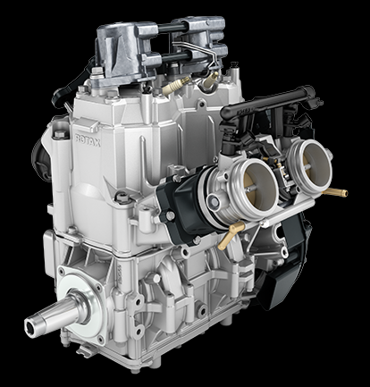
Innovations – Platform
2017 Ski-Doo MXZ TNT
REV GEN4 chassis
850cc E-TEC engine
Notes:
Ian
New platform
DI + TBI

Slide 6
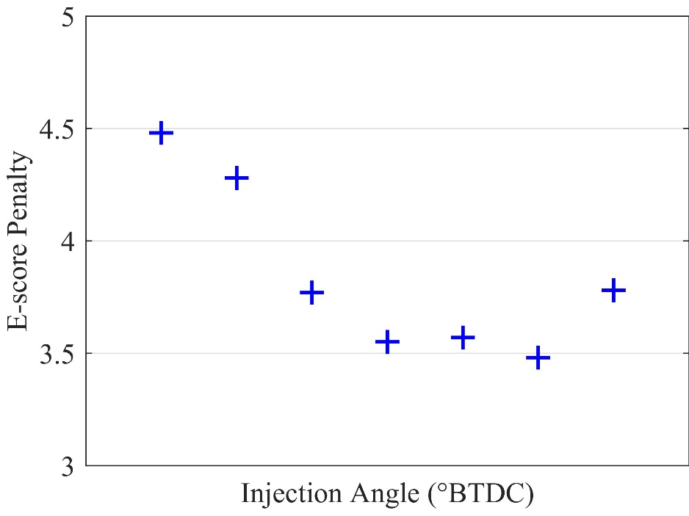
Innovations – Engine Calibration
Reduced speed (7900 → 6800 RPM)
Comparable to 600cc two-stroke @ 118 hp
Shift mode points
Reduce emissions and fuel consumption
5 step calibration process
$$f(x)=W_{m}∗ \frac{\left(\frac{\left(UHC+ {NO}_{x}\right)}{1.5}+\frac{CO}{4}\right)}{P}$$
Notes:
Ian
First choice for 2 stroke would be 600 because it meets power requirements of competition
Instead -> downspeed 850
Compared to 600cc Hgher torque – lower throttle/RPM and peak cylinder pressures result in lower emissions and higher fuel efficiency.
Compared to stock, the mode points are shifted

Slide 7
Innovations – Tuned Pipe
Empirical equation from Blair
Increase by 4 inches
GT Suite optimization
BSFC vs tuned length
Increase by 4.1 inches
$$L_{T}= \frac{ED × 42545}{RPM}$$
Notes:
Ian
Better figure
Change wording on slide… dwell vs tuned pipe length
BSFC minimized vs dwell length which influences total length

Slide 8
Results – Calibration & Tuned Pipe
15-point increase in E-score
17.5% reduction in weighted BSFC
6.8 N-m [5 ft-lb] increase at 6800 RPM
1.5 dBA reduction in sound pressure
Notes:
Ian
Bar graph of emissions

Slide 9
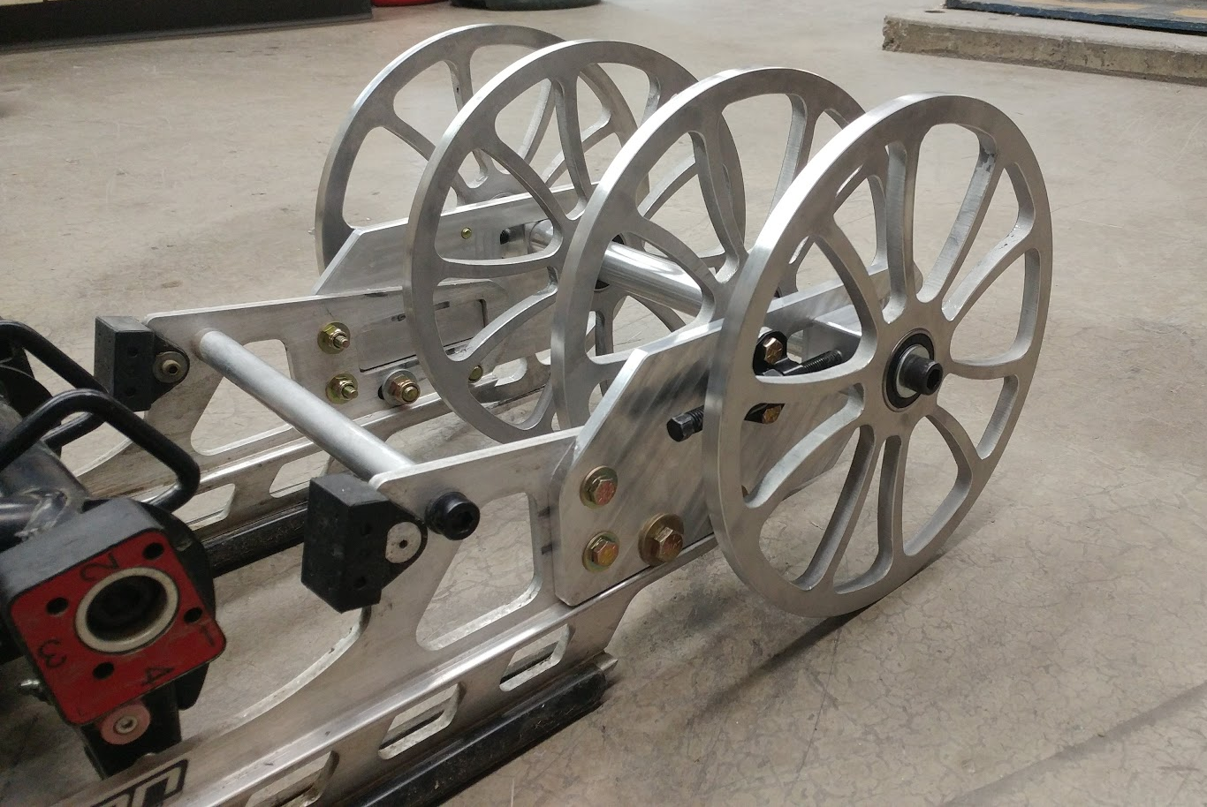
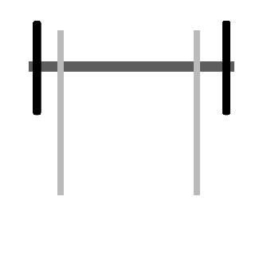
Innovations – Drivetrain
10 inch idler wheels
Multiple configurations tested
4 large idler wheels | 3 large idler wheels
2 large idler wheels | Stock – 3 idler wheels
Notes:
Kiss

Slide 10
Results – Drivetrain
Component | Roll-Down Angle (°)
Stock idler wheels | 11.4
4 large idler wheels | 11.5
3 large idler wheels | 11.6
2 large idler wheels | 12.2
Tested Component | Roll-Out Distance (m [ft])
 | 80 kmph [50 mph] | 64 kmph [40 mph] | 48 kmph [30 mph]
Stock idler wheels | 94.8 [311] | 62.2 [204] | 43.9 [144]
4 large idler wheels | 95.1 [312] | 69.2 [227] | 44.8 [147]
Notes:
Kiss
If time is short, combine results into previous slide and disregard configurations.

Slide 11
Emissions Reduction
Blank and coated catalysts of two styles were compared
Used dual substrate with three-way 1:20:1 Platinum:Palladium:Rhodium coating
Tested E-score of 180
Catalyst | E-score
Stock/No Catalyst | 133
Blank Single | 141
Blank Dual | 149
1:20:1 Single | 165
1:20:1 Dual | 180
Notes:
Ian
Update after clean up of mode 1
Change graph to 180 E-score

Slide 12
Noise Reduction – Tunnel Damping
Damping ratio found from accelerometer testing
Material | Average Damping Ratio
Bare aluminum | 0.010
PolyDamp single side | 0.034
PolyDamp both sides | 0.045
Silent Running single side | 0.063
PolyDamp + Silent Running | 0.082
Silent Running both sides | 0.142
Notes:
Ian

Slide 13
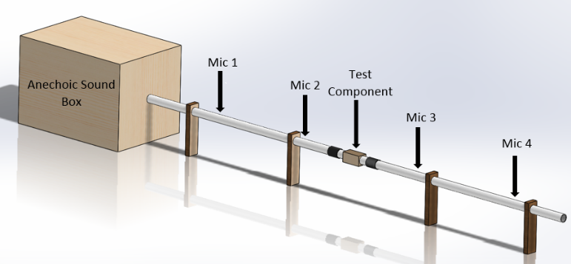
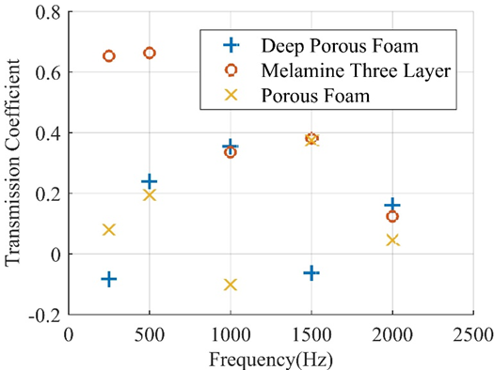
Noise Reduction – Absorption
Anechoic sound box
Body panel materials
Notes:
Kiss

Slide 14
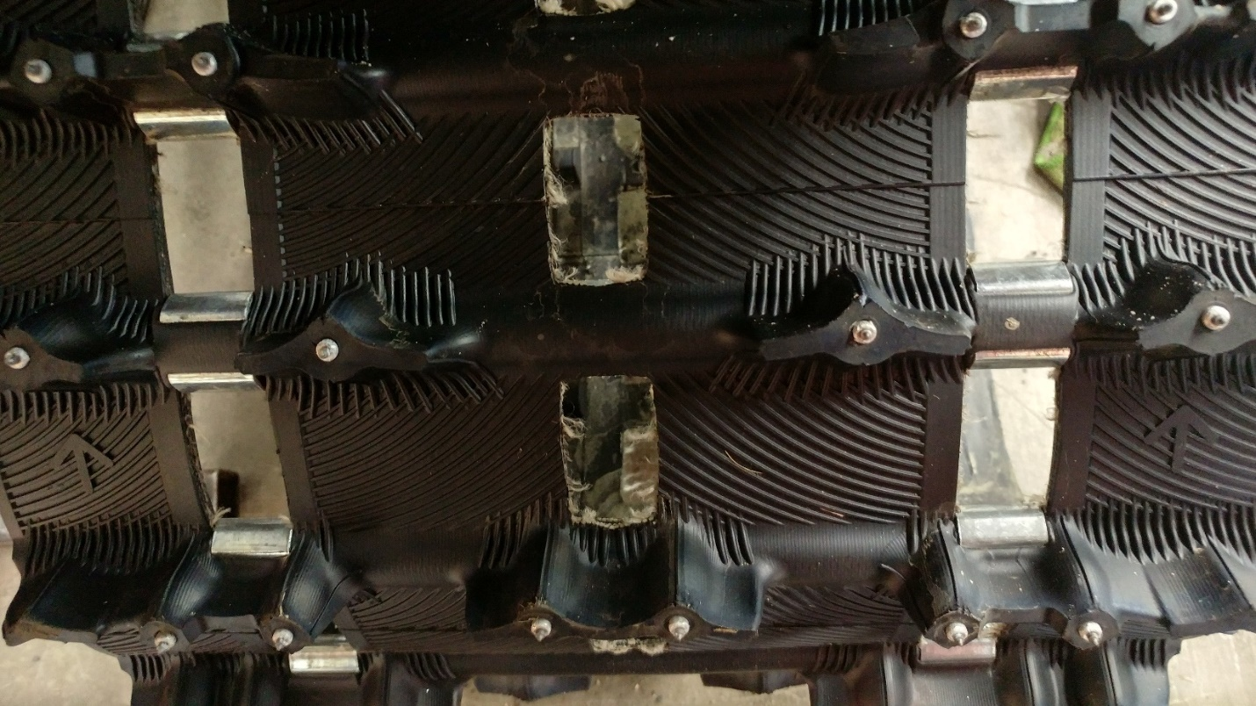
Drivetrain Noise
Ported Track
0.5 dBA decrease from stock
Notes:
Kiss

Slide 15
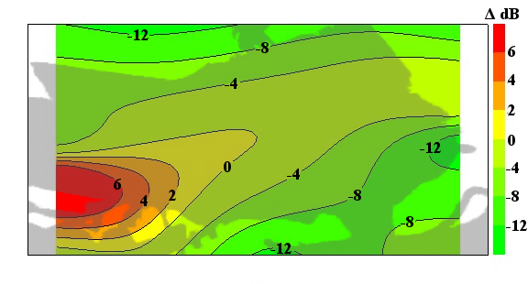
Noise Vectoring
Sound pressures evaluated at 4100 RPM (35 MPH equivalent)
Loudest area: track
$$IL=20∗\log{\frac{p_{i}}{p_{c}}}$$
Notes:
Kiss

Slide 16
Summary/Conclusions
 | Stock 850 | 2018 UICSC
E-Score | 133 | 180 (+35%)
J1161 Sound Pressure | 70 dBA | 67.5 dBA
Fuel Efficiency | 13.8 mpg | 17.5 mpg (+27%)
Power | 165 hp | 118 hp (-28%)
Torque @ 6800 RPM | 87 ft-lb | 92 ft-lb (+6%)
Notes:
Ian
Add comparisons to stock
Fun figure with snowmobile

Slide 17
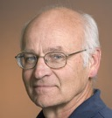
Thank you to our supporters!!!
Dr. Dan, Dr. Hess, Dr. Beyerlein, Rob Patton, Bill Magnie
Notes:
Ian

Slide 18
Build Sheet
Chassis | 2017 Ski-Doo MXZ-TNT with strategically placed sound damping and absorbing materials
Engine | Rotax, reduced speed, spark ignition (SI), 850cc 2-stroke E-TEC. 88 kW [118 hp] measured peak power
Track | Camso Ice Attak XT 328 cm [137 in.] with port windows
Exhaust piping/muffler | Extended tuned pipe, stock muffler modified to accept catalyst
Catalytic converter | Heraeus 3-way catalyst, 1:20:1 Platinum:Palladium:Rhodium coating
Skis | Stock
Skid | Custom 25.4 cm [10 in.] idler wheels
Notes:
Ian

Slide 19
Innovations – Muffler
Revision of 2017 muffler
Improved durability
Fully sealed chambers
Materials with higher heat limits
Reduced backpressure
2.4% reduction on flow bench
Revision | Label | Calculated Back-pressure | Back-pressure Reduction
2017 UICSC | - | 0.043 bar [0.62 psi] | 0
Removed small flap | 1 | 0.040 bar [0.57 psi] | 9%
Increased diameter from 2 in. to 2.5 in. | 2 | 0.037 bar [0.54 psi] | 14%
80 mm outlet diameter | 3 | 0.032 bar [0.47 psi] | 26%
Final configuration | - | 0.021 bar [0.31 psi] | 51%
Notes:
Kiss

Slide 20
GT Suite

Slide 21
GT Suite: Specifications/Results
Engine speed | 6800 RPM
Optimization method | Local minima
Design variable | Dwell length
Factor range | -10 to 20 cm [-3.9 to 7.9 in.]
Output variable | BSFC
Resolution | 0.3 cm [0.1 in.]

Slide 22
Tuned Pipe

Slide 23
Damping Ratio
$$ζ = \frac{ln{\frac{x_{1}}{x_{2}}}}{2π}$$

Slide 24
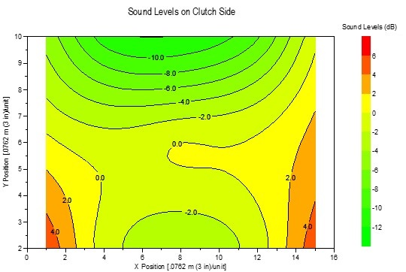
Noise Vectoring: Before
Exhaust side
Clutch side

Slide 25
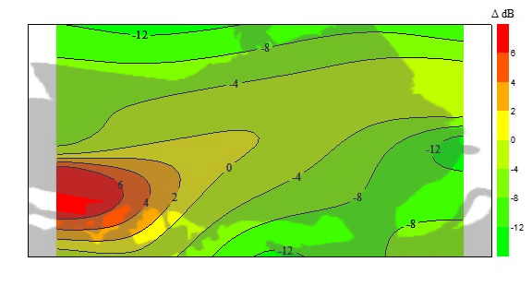
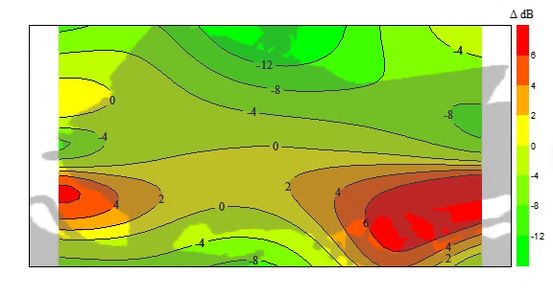
Noise Vectoring: After
Exhaust side
Clutch side

Slide 26
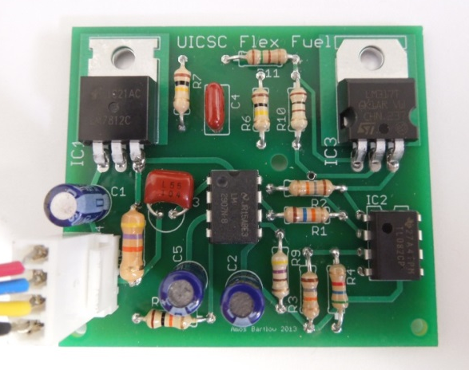
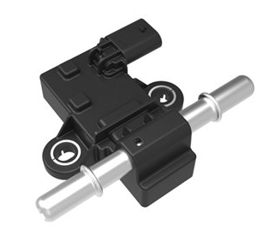
Flex Fuel Circuit
Continental sensor
Custom circuit developed in 2012
Notes:
Kiss

Slide 27
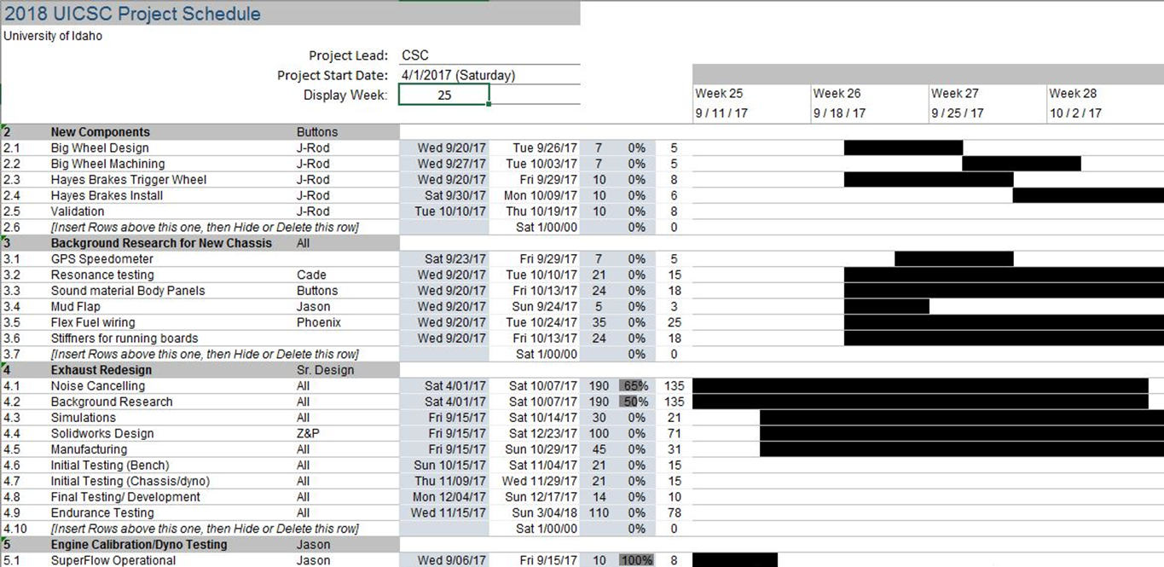
Gantt Chart

Slide 28
Action Register

Slide 29
Outreach
Snowmobile shows
Puyallup, WA
Spokane, WA
Boise, ID
Facility tours
Uidaho Engineering Expo

Slide 30
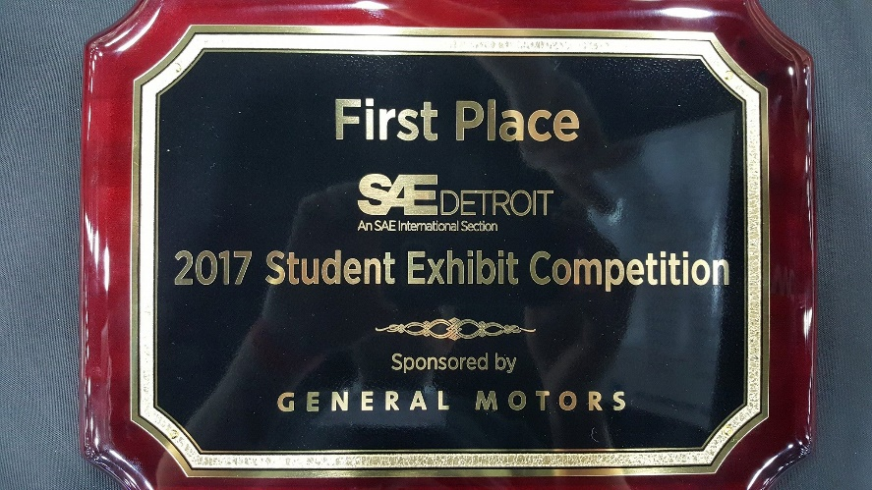
Outreach SAE WCX17
Support from NIATT, ME Department, and Office of Undergraduate Research
Student Exhibit Competition
1st Place
Presented SAE paper about project management and best practices for CDS teams
Spread awareness
Network
Build sponsor relationships
Industry tours
Notes:
Ian
After competition, 5 of us went to Detroit for SAE World Congress. We were only able to do this because of the support from NIATT, the ME Department and the Office of Undergraduate Research.

