Slide 1
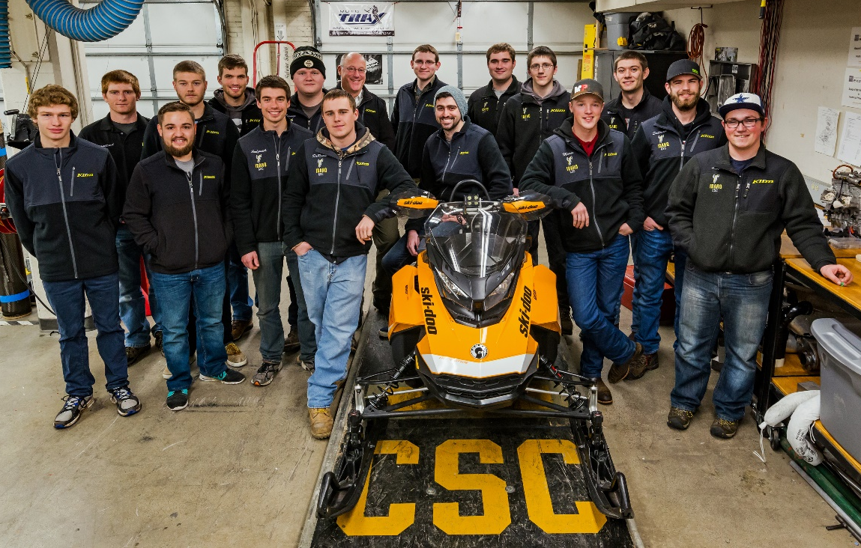
University of Idaho
Direct-Injection Two-Stroke with Custom Muffler and Static Sound Reduction
Presented By:
Aaron EliasoN, Dillon Savage, Mark Woodland,
& Zachary lipple
Notes:
Zach
Hello, say names (Me, Aaron, Mark, Barbie)

Slide 2
Overview
Competition Goals
Team Goals
Base Platform
Design and Testing Strategy
Chassis and Engine Modifications
Summary and Conclusions
Questions
Notes:
Zach
We’ll be talking about competition and team goals, as well as the modification we’ve made to improve efficiency and decrease noise production of our current chassis.

Slide 3

Competition Goals
Eco-friendly, economical, performance trail snowmobiles
Meet National Park Service (NPS) exhaust and noise emissions standards
Design a platform able to run ethanol-blended fuels
Provide university students with real world engineering and project management experience
Notes:
Zach
Story:
Why I joined the competition
What I’ve gotten out of it
Find transition to UICSC goals

Slide 4
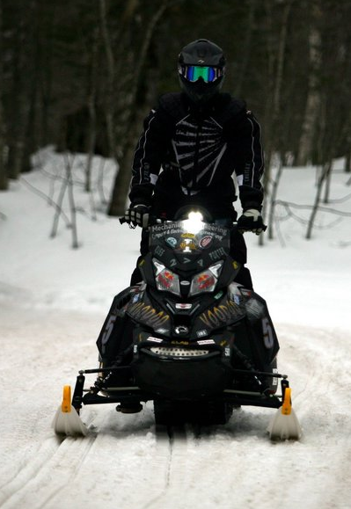
UICSC Goals
Create a NPS certified two-stroke snowmobile
  E-score > 170, SAE J-1161 score < 67 dBA
Powerful
  100+ hp
Components that can be retrofitted to any
snowmobile
Economic solutions with OEM level packaging
Bring new ideas to industry
Notes:
Zach
Story as transition, the goal is to make a fun snowmobile (fun to ride), packaging is important

Slide 5
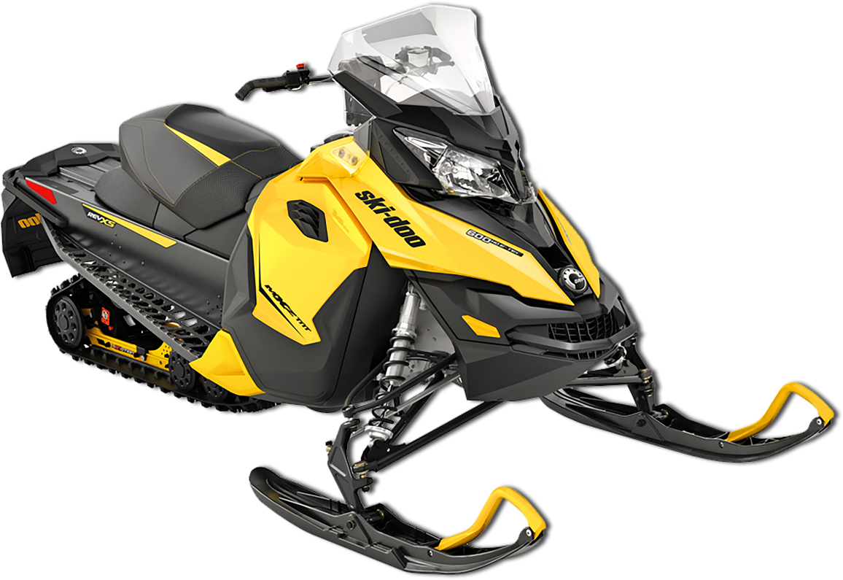
Engine and Chassis
Engine
  Reduced speed Rotax 800cc two-stroke
  E-TEC direct-injection
  Variable exhaust ports with tuned pipe
  High power-to-weight ratio
Chassis
  2013 Ski-Doo MXZ-TNT
  Performance-oriented
  Improved handling
  rMotion suspension
Notes:
Zach
We’re using a 2013 MXZ-TNT with an 800 cc two-stroke, direct-injection engine, as well as a 129” track. We decided to use this snowmobile due to its high power-to-weight ratio, as well as proven performance. This characteristics made it something we wanted to ride, as well as something that we could improve upon.
.

Slide 6

Testing:
Engine Calibration
4-step calibration using an eddy current dynamometer
  E-Score objective function
  Water brake to ensure survivability during dyno event
Objective Function:
$$F\left(x\right)= W_{m}∗\frac{\left(\frac{6∗UHC+NO_{x}}{150}+\frac{CO}{400}\right)}{P}$$
Notes:
Aaron
CHANGE GRAPH
Tested on a water brake dynamometer to ensure survivability during in-lab emissions event
Say 4 steps of calibration
BSFC map is a relationship between power created and fuel consumed.

Slide 7
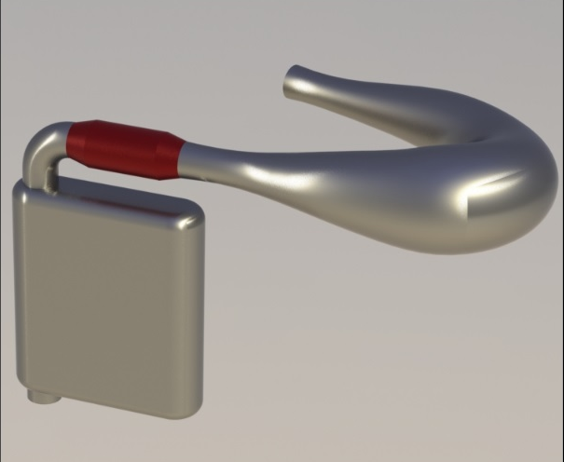
Clean:
Three-Way Catalyst
Selection
  A 1:25:2 three-way catalyst was used
  Expected E-score of 190
Packaging
  Maintains conversion at low-load
  Cones allow uniform flow
Notes:
Aaron

Slide 8
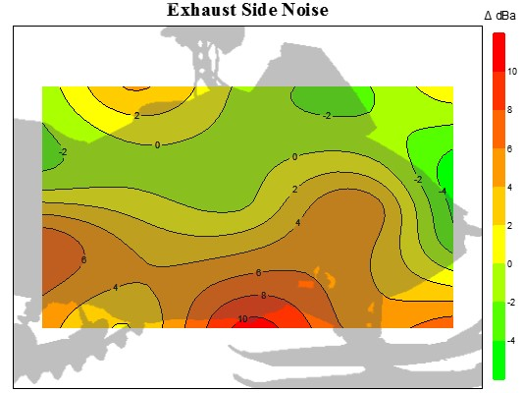
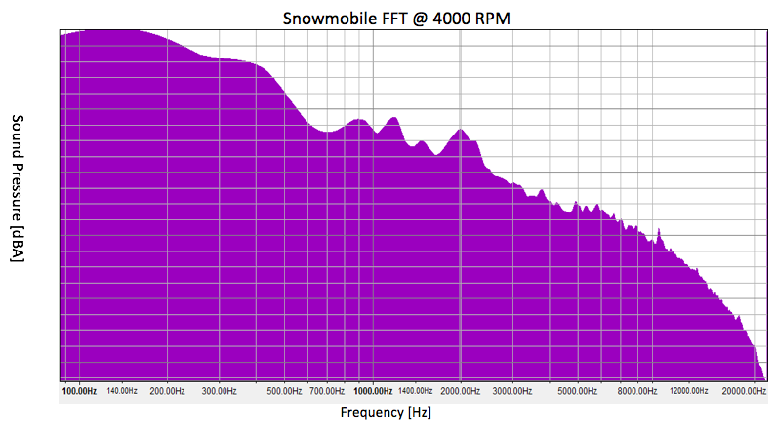
Testing:
Noise Vectoring
Sound pressures evaluated at 172 Hz
Loudest areas
  CVT, intake, track, and muffler outlet
Notes:
Aaron

Slide 9
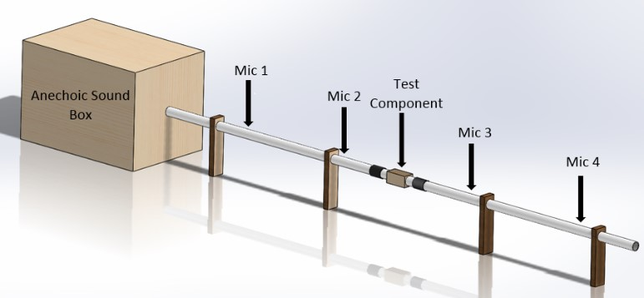


Testing:
Anechoic Sound Box
Objectively compare various acoustic components and materials
Testing range of 80-4000 Hz
$λ=\frac{c}{f}$
[1]
$$λ> 1.71∗D$$
[2]
1 ft
Notes:
Aaron

Slide 10
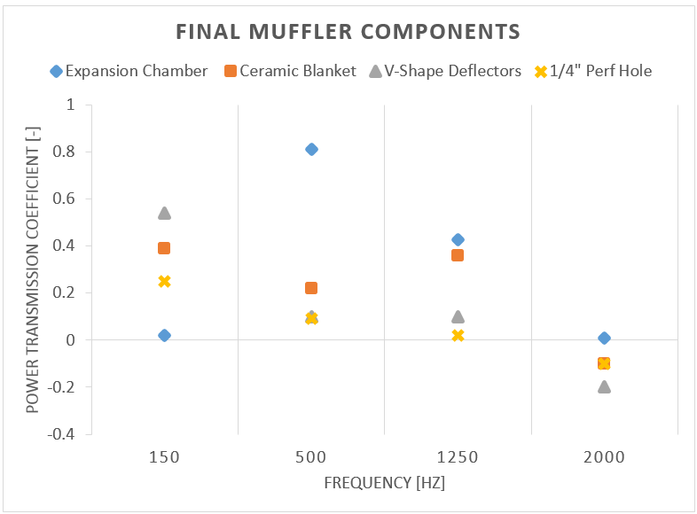
Quiet:
Sound Box Testing
Power transmission coefficients
Sound material
  Material 1 was selected, 2 dBA loss during snow testing
Power Transmission Coefficient
Sound Material | 150 Hz | 400 Hz | 1200 Hz | 2000 Hz
Material 1 | 0.334 | 0.202 | -0.016 | 0.690
Material 1 with heat shield | 0.259 | 0.143 | 0.333 | 0.133
Material 2 | 0.134 | 0.433 | 0.331 | 0.221
Material 2 with heat shield | -0.283 | 0.131 | 0.166 | -0.056
Notes:
Zach
Using the sound box,
Describe power transmission coefficient (bottom of page)
Positive → good
Negative → phase shift and resonance
Describe sound material (bottom of page)
Describe muffler components (Right of page)

Slide 11
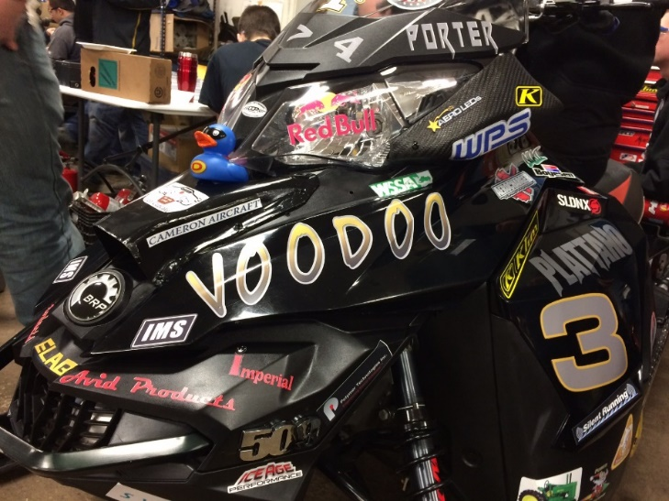
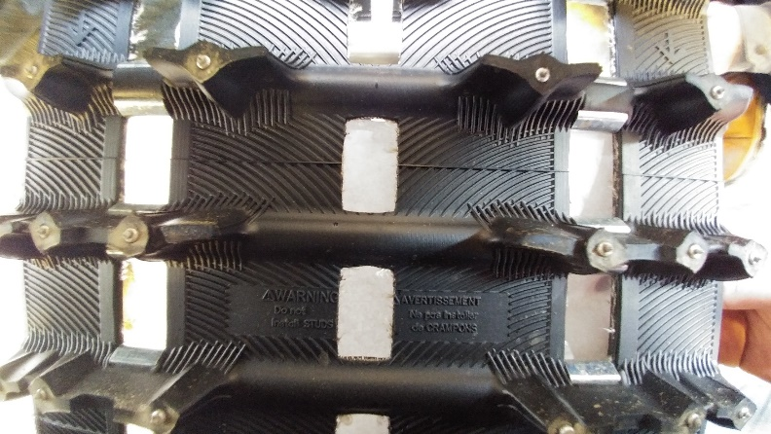
Quiet:
Out of Lab Testing
Deflectors and foam
  1 dBA reduction
Helmholtz
  Attached to intake
  1 dBA reduction
Track
  Ported and studded track
  1.5 dBA reduction
Notes:
Zach
For components that couldn’t be tested on the sound box, we used on-snow testing and the J1161.
Tested deflectors, track, and resonators to ensure their noise reduction.
Each component was tested independently with a final configuration tested before competition

Slide 12
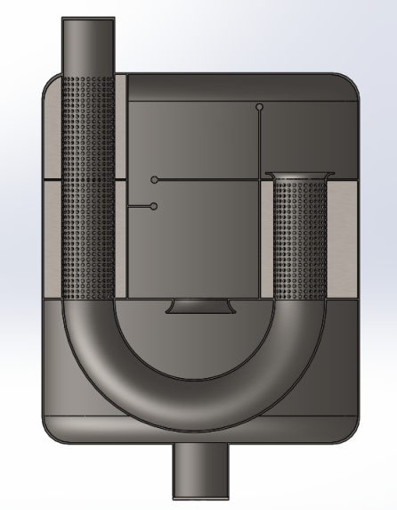
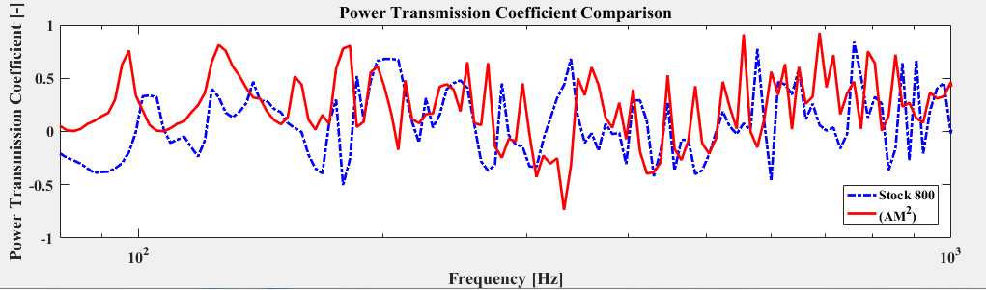
Quiet:
Muffler Red Dawn (AM)²
1 dBA loss during J1161
2 lb reduction without catalyst, compared to stock
Notes:
Aaron

Slide 13
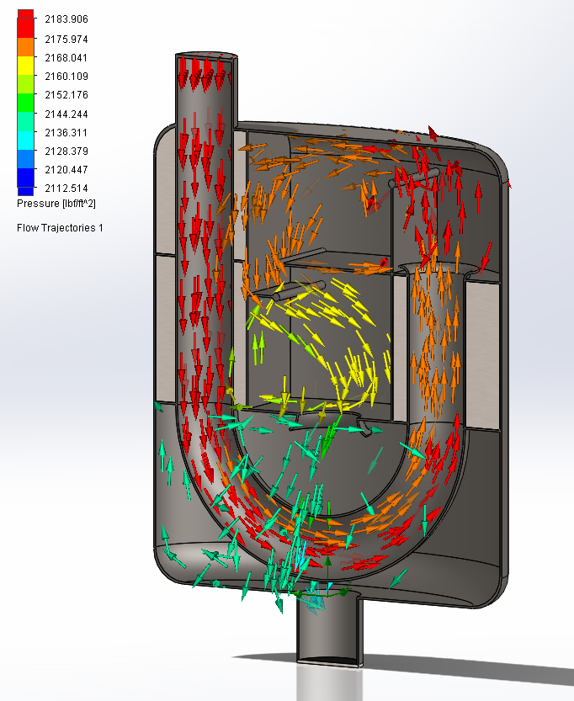
Performance:
Muffler Red Dawn (AM)²
Configuration | Back Pressure | Change from Stock
Stock | .043 bar (.63 psi) | 0%
2016 Configuration | .050 bar (.73 psi) | 16%
(AM)² | .052 bar (.76 psi) | 21%
(AM)² With Catalyst | .066 bar (.96 psi) | 52%
Notes:
Aaron

Slide 14
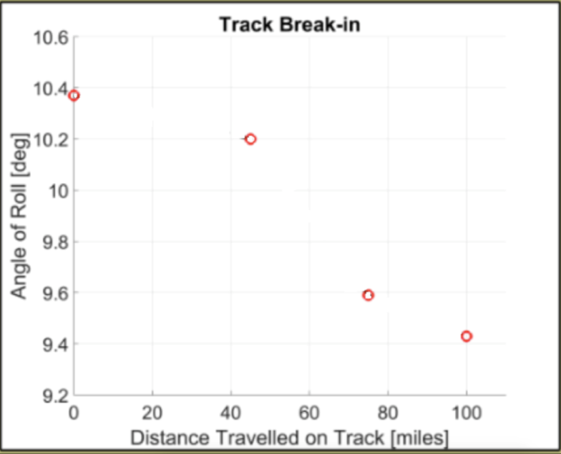
Efficient:
Drivetrain
Effects of ported track on efficiency
  5 lb weight reduction from stock
  Increased efficiency
10 in rear idler wheels
Configuration | Angle of Roll | Percent Change From Stock | Track Weight (lb.)
Stock Configuration | 12.5 ° | 0% | 41
2016 Competition | 12.0 ° | -5% | 40
2017 Competition | 9.5 ° | -25% | 36
Notes:
Zach
Start with problem; we got a new track
Made to decrease noise, also increased drivetrain efficiency

Slide 15

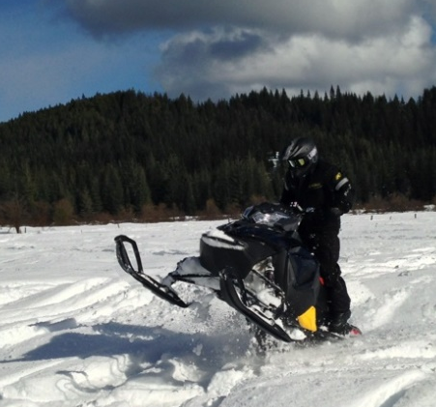
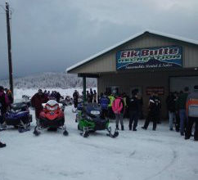
Sustainability
Environmental
Low impact
Efficient
Minimize waste
Social
Performance
Land access
Comfort
Fun
Economic
Low maintenance
Affordable
High MPG
Notes:
Aaron

Slide 16
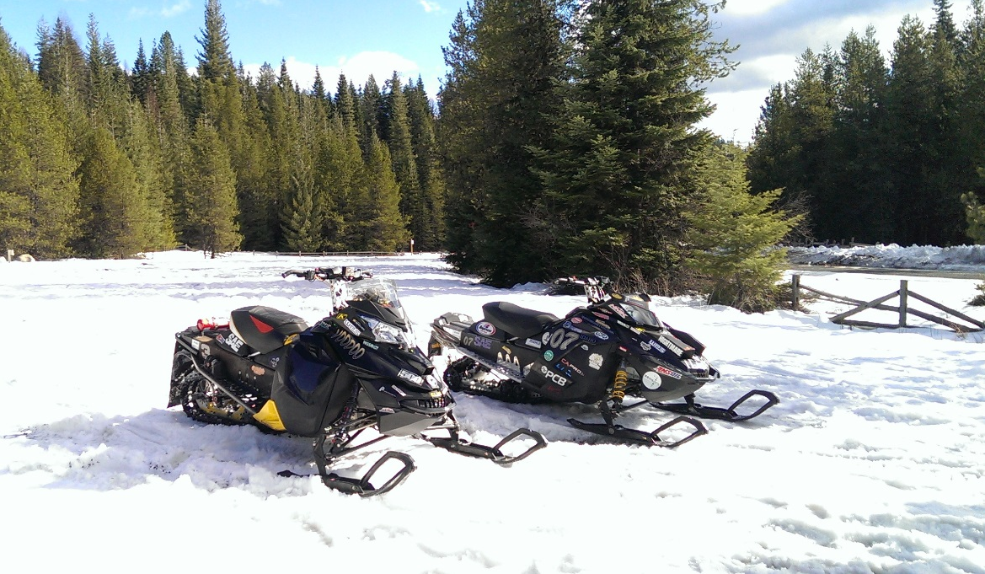
Conclusions
Clean
  E-score: 190
Quiet
  67.5 dBA using J1161
Efficient
  21 MPG
Affordable
  $12,699
Enjoyable two-stroke riding experience
Notes:
Zach

Slide 17


































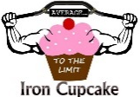





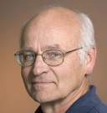




Questions?
Thank You KRC Staff and Volunteers
Bill Magnie
Rob Patton
Dr. Dan, Dr. Santora, Dr. Anderson, Dr. Beyerlein
Notes:
Aaron

Slide 18
Comparisons
Noise
  Results not tested on same day
  Stock: 72.5 dBA
  Calibrated: 67.5 dBA
Brake Specific emissions
  Stock: ~60 g/kW-hr HC
  ~220 g/kW-hr CO
  Calibrate: ~3 g/kW-hr HC
  ~90 g/kW-hr CO
Notes:
Aaron

Slide 19
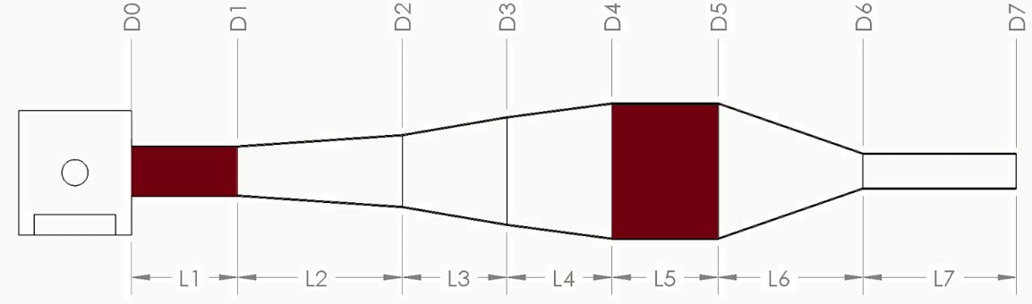
Correction
Increase of 4 hp throughout range
More low end torque
Increased efficiency
Water brake wasn’t operational since 2011
Problems at competition led to restart of water brake usage
Notes:
Aaron

Slide 20


Tuned Pipe Equations
$BMEP [bar]=\frac{T \left[N−m\right]×2π}{100V_{D} [L]}$
L $=\frac{ED x 42545}{rpm}$
L= tuned length in mm
ED= exhaust duration in degrees
D2 $=\left(\frac{LH x 2}{Cot H}\right)+D1$
D1= header pipe minor inside diameter
LH= header pipe length minus the length of the exhaust port and flange
Cot H= cotangent of header pipe’s angle of taper
$LD=\left(\frac{D3−D2}{2}\right)×Cot D$
LD= Diffuser Length
D3= diffuser inside diameter
D2= Header pipe major inside diameter
Cot D= cotangent of the diffuser’s angle of taper
$OLB= \frac{D3}{2}×Cot B$
OLB= Overall length of baffle cone
D3= baffle major inside diameter
Cot B= cotangent of the baffle's angle of taper
$LP=L−(LH+LD+\frac{OLB}{2})$

Slide 21
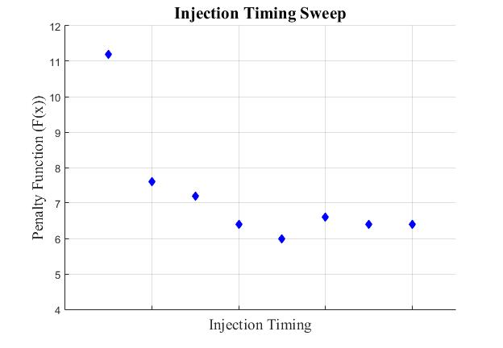


Calibration Strategy

Slide 22
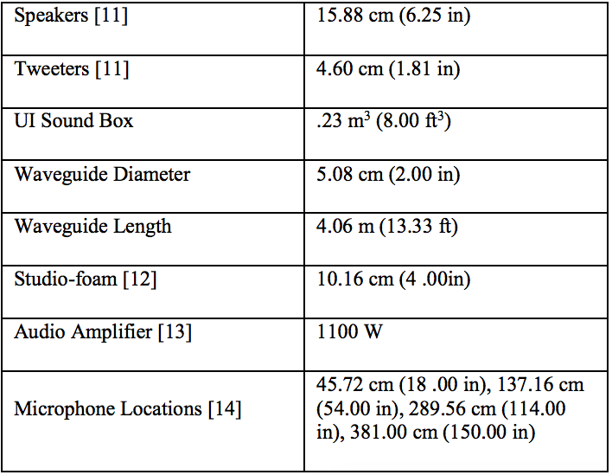
Sound Box Design
Components used in sound box final configuration

Slide 23
Emissions
Low emission output throughout majority of map
190 E-score

Slide 24
Flow Bench
Validation of sound box compared to Solidworks
Test Component | Solidworks | Flow Bench
Simple Expansion | .006 bar (.09 psi) | .02 bar (.23 psi)
Stock | .03 bar (.39 psi) | .04 bar (.63 psi)
Red Dawn (AM)² | .04 bar (.51 psi) | .05 bar (.76 psi)

Slide 25
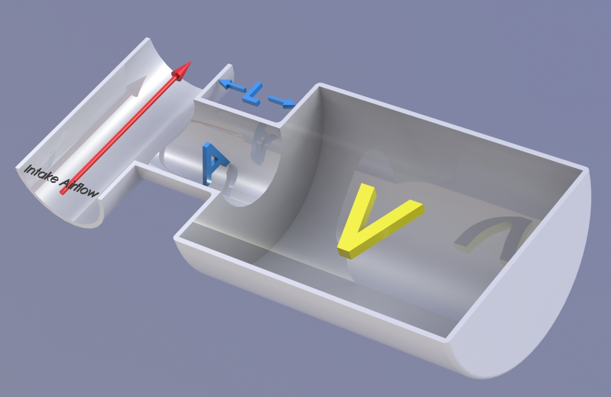


Helmholtz
$f_{H}=\frac{V}{2∗π}\sqrt{\frac{A}{V×L}}$
$$f=\frac{RPM}{60}N_{c}$$

