Slide 1
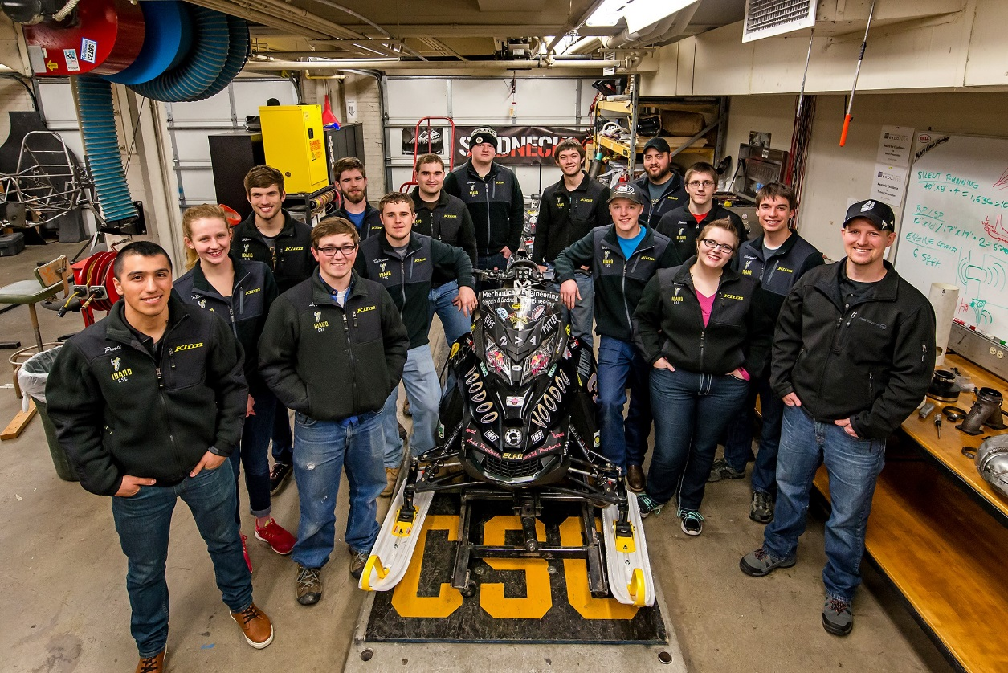
University of Idaho
Direct Injection Two-Stroke with
Exhaust and Intake Redesigns
Presented By
Aaron Eliason & Mark Woodland

Slide 2
Overview
Competition Goals
Design Goals and Target Audience
Design Strategy
Chassis and Engine Modifications
Testing Results
Summary and Conclusions
Questions

Slide 3

Competition Goals
Create clean, quiet and economical trail snowmobiles while maintaining or improving performance
Meet EPA exhaust and noise emissions standards
Build a platform capable of running 0-85 percent ethanol
Provide university students with real world engineering experience

Slide 4
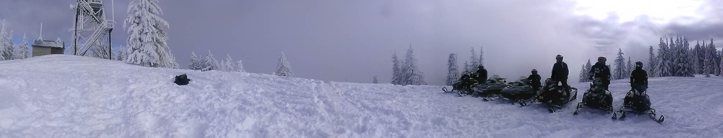
UICSC Design Goals
Create a national park certified two-stroke snowmobile
  E-score > 170, SAE J-1161 score < 67 dBA
Generate 100-130 hp
Deliver original equipment manufacturer level packaging
Raise industry standard with economical solutions
Notes:
Aaron
- Along with comp rules
-a enjoyable and balanced snowmobile
-create economic solutions that can be placed on any platform
-Crash and Boom

Slide 5
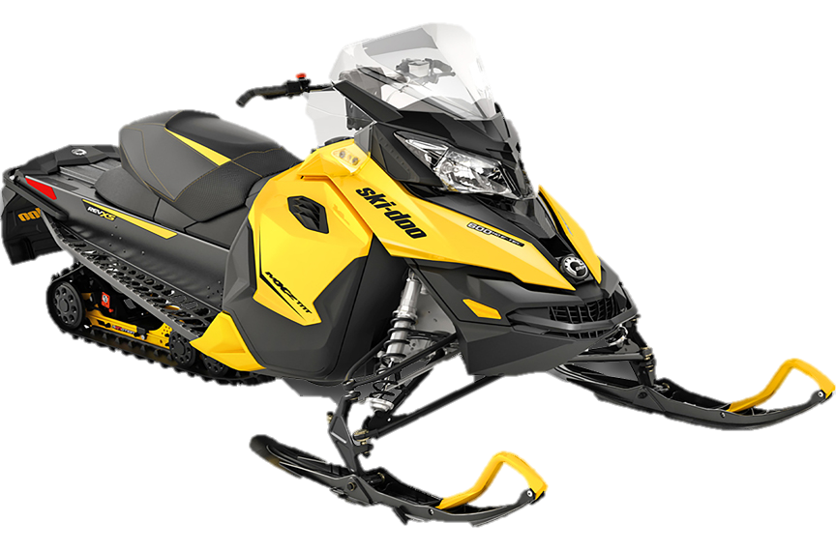
Chassis and Engine
Chassis
  2013 Ski-Doo MXZ-TNT
  Performance oriented
  Improved handling
  r-Motion suspension
Engine
  Rotax 797cc two-stroke
  E-Tec direct injection
  RAVE 2 variable exhaust with tuned pipe
  High power-to-weight ratio
Notes:
Aaron
-When picking a sled
We wanted something that fit our requirements…
We want comfort and handling the 2013 Ski-Doo MXZ TNT gives us this
We want power which the 800 E-Tec provides

Slide 6

Design Strategy
Quiet
  Low speed 797 cc engine
  Sound deadening material in key areas
  Mechanically Active Quarter-wave Resonator (MAQR) in exhaust system
  Helmholtz implemented into intake
Clean and Efficient
  Capability of 85% ethanol
  Three-way catalyst for after treatment
  Tuned pipe modification
  RAVE calibration for run quality

Slide 7
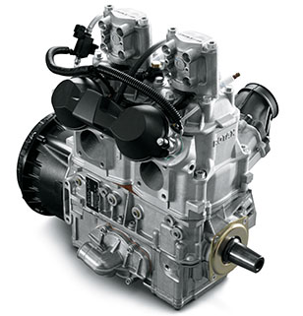
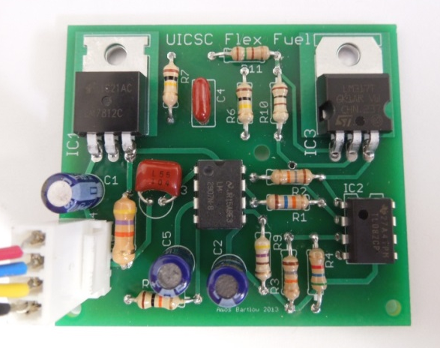
Powertrain:
2012 Solution
Low Speed
  Reduction in engine RPM decreases noise levels and emissions, while increasing fuel efficiency
Three-way catalytic converter
  Reduces exhaust emissions
  Little impact on power
Flex Fuel
  Custom analog circuit
  Fuel correction based on the
  stoichiometric AFR of ethanol
Noise Deflectors
  Keeps noise on the trail
Sound material
  Strategically placed

Slide 8
Powertrain Problem 1:
Loud Exhaust
Mechanically Active Quarter-wave Resonator (MAQR)
  Active noise cancelation
  Infinitely variable band of quieted frequencies
  18 cm (7 in) in 2.33 seconds
  Improved gear box
Efficiency:
  No efficiency loss
Power:
  No power loss
Sound:
  0.5 dBA loss across range
MSRP:
  $75
Notes:
Aaron
Last year we created a mechanically active quarter wave resonator. A quarter wave resonator creates a destructive sound wave at a specific frequency… This process is similar to head phones
My creating a active resonator you can adjust the length of the pipe to cancel sound waves at any engine speed. The graph shows the sound loss at one specific point. The valley you see at 200 Hz will adjust as our engine speed changes

Slide 9

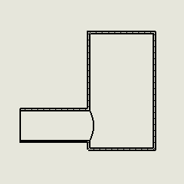
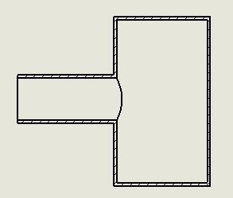

Powertrain Problem 2:
Intake Noise
Helmholtz
  Implemented onto intake
  Works by phenomenon of air resonance in a cavity
  $f_{H}=\frac{V}{2∗π}\sqrt{\frac{A}{V×L}}$
Name | Configuration
Configuration 1
Configuration 2
Configuration 3
Notes:
Aaron
Due to our past work on the exhaust.
-intake loudest side
-tried using a quarterwave
-helmholtz better
-works same
-tested several config…
-graph shows which is better

Slide 10
Helmholtz Power
Efficiency:
  Volumetric efficiency increased
Power :
  3% increased torque at targeted frequency
Sound:
  0.5 dBA loss at targeted frequency
MSRP:
  $10
Notes:
Aaron
As college students we enjoy free lunch especiallh two of us…. Rarely do we get a solution without a consequence, but a helmotx is one exception…..
not only does the Helmholtz reduce sound but it also increase power and volumetric efficiency. This graph shows the torque gain of each configuration and

Slide 11
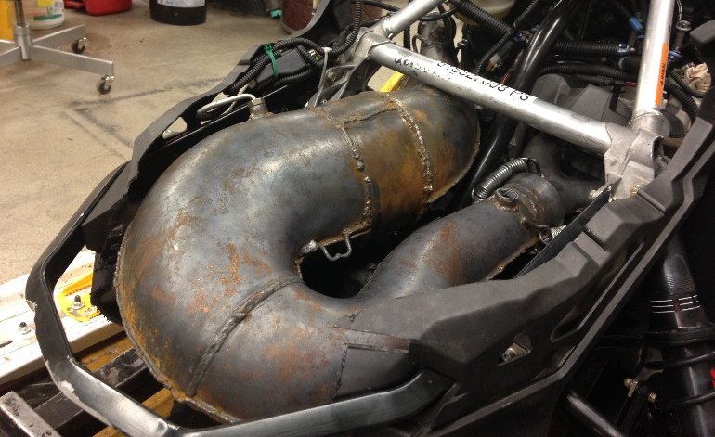
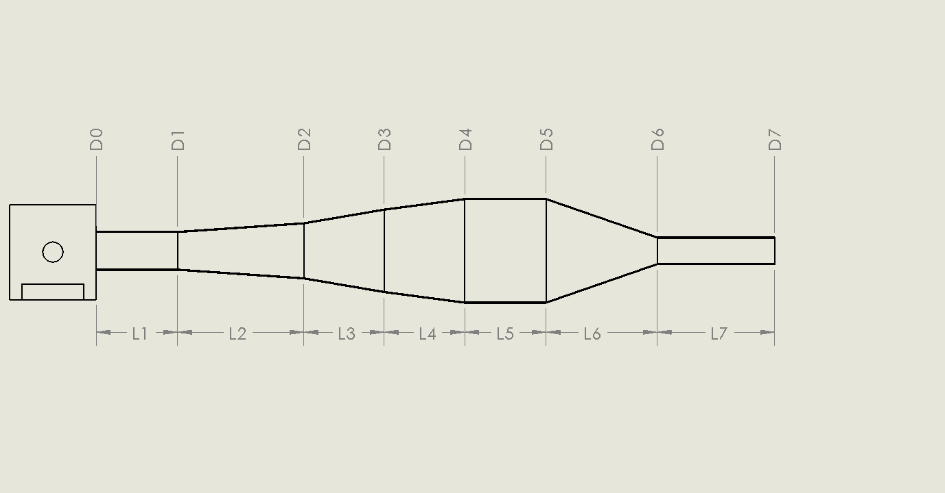
Powertrain Problem 3:
Improper Tuned Length
Customized Tuned Pipe
  Each section realize on the previous section’s geometry.
  10.16 cm (4 in) added to diffusion chamber
  2.54 cm (1 in) added to header
  Shifts tuned length closer to operating speeds of the engine
Efficiency:
  Increased efficiency
Power:
  Increased average of 4 hp
  Peak power gain of 10 hp

Slide 12
Exhaust Testing
Brake Specific Fuel Consumption Map
Rotax Adujustable Variable Exhaust (RAVE) Calibration

Slide 13
Tuned Pipe Noise
A weighted scale focuesed on high frequency noise
Extended tune pipe shifts spectrum down to lower frequencies
Notes:
Aaron
By adjsuting the tune length we increaed the time it takes for a pulse to go and return from the tune pipe . This causes a lower frequency sound which is quieter.

Slide 14

Dealer/Outfitter Viewpoint
Low Maintenance
  Little cost and low time to maintain
Low Vehicle Cost
  MSRP $12,223
  $268 more than 2015 UICSC Design
Meets Consumer Demand
  Power plant high sales volume
Environmentally Conscious
  Exceeds current emissions and noise standards*
*Meets NPS noise standards under some test conditions

Slide 15

Rider Viewpoint
Measured Specifications
  104 hp
  588 lb
Fuel Efficient
  21 mpg
Comfort
  Position & handling
  Rider-forward position
  r-Motion suspension

Slide 16
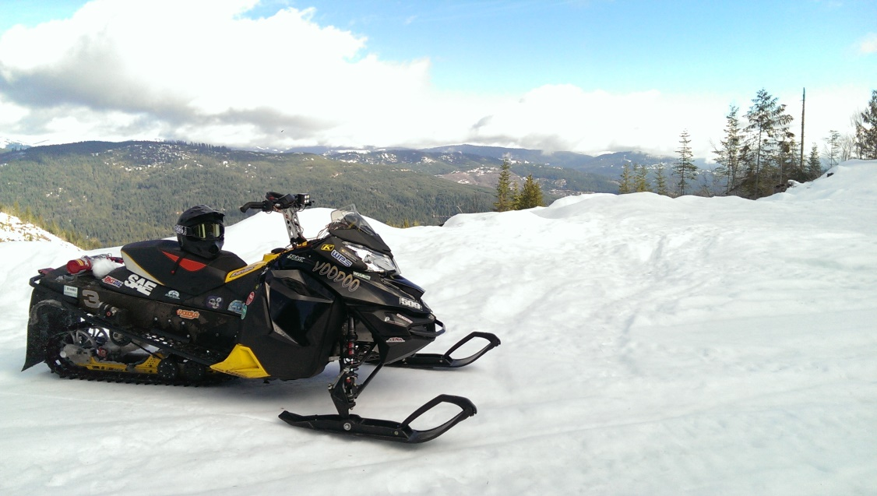
Conclusion
Clean
  Exceeds NPS
Quiet
  70 dBA using J-1161
Efficient
  21 MPG
Affordable
  $12,223
Enjoyable two-stroke riding experience

Slide 17





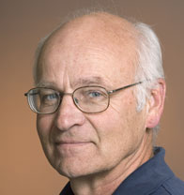























Questions?
Thank You KRC Staff and Volunteers

Slide 18
Emissions
Low emission output throughout majority of map
186 E-score

Slide 19


Calibration Stragety

Slide 20


Tuned Pipe Equations
$BMEP [bar]=\frac{T \left[N−m\right]×2π}{100V_{D} [L]}$
L $=\frac{ED x 42545}{rpm}$
L= tuned length in mm
ED= exhaust duration in degrees
D2 $=\left(\frac{LH x 2}{Cot H}\right)+D1$
D1= header pipe minor inside diameter
LH= header pipe length minus the length of the exhaust port and flange
Cot H= cotangent of header pipe’s angle of taper
$LD=\left(\frac{D3−D2}{2}\right)×Cot D$
LD= Diffuser Length
D3= diffuser inside diameter
D2= Header pipe major inside diameter
Cot D= cotangent of the diffuser’s angle of taper
$OLB= \frac{D3}{2}×Cot B$
OLB= Overall length of baffle cone
D3= baffle major inside diameter
Cot B= cotangent of the baffle's angle of taper
$LP=L−(LH+LD+\frac{OLB}{2})$

Slide 21

Quarter-wave Resonator
$f=\frac{RPM}{60}N_{c}$
$f= \frac{c}{4L}$ (Hz)
$c=\frac{\sqrt{γRT}}{M}$ $\left(\frac{m}{s}\right)$

Slide 22
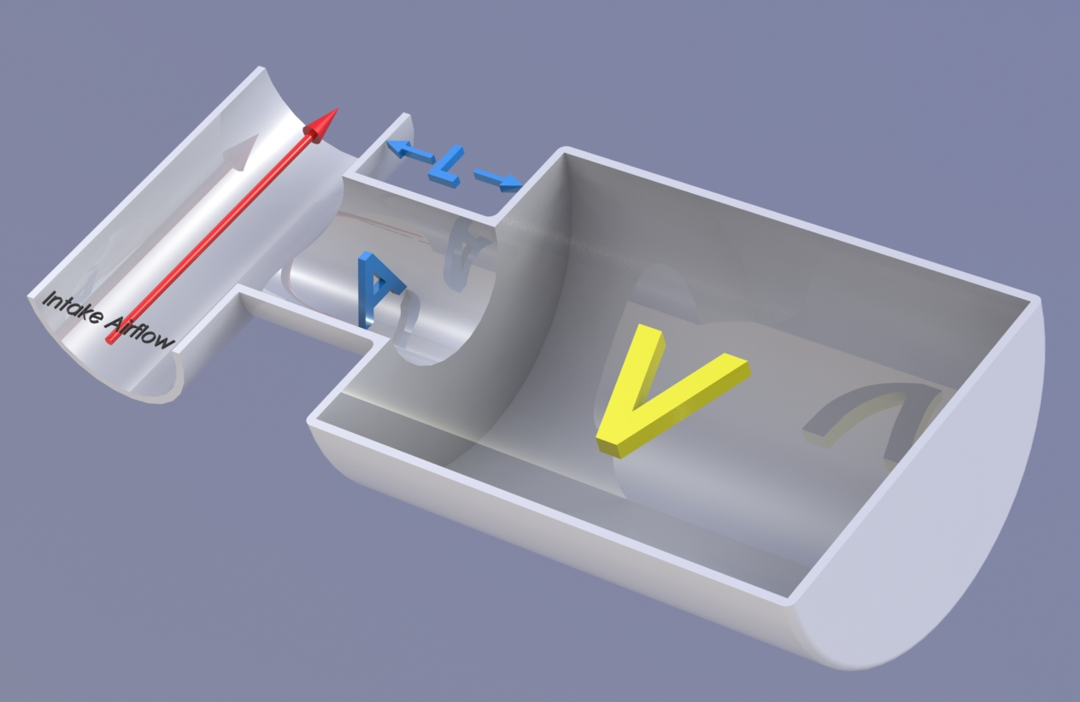


Helmholtz
$f_{H}=\frac{V}{2∗π}\sqrt{\frac{A}{V×L}}$
$$f=\frac{RPM}{60}N_{c}$$

