Slide 1
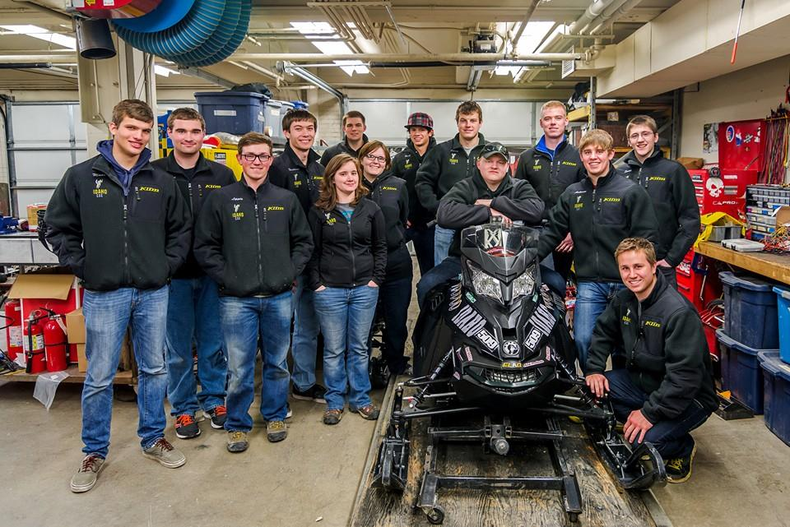
University of Idaho Direct Injection Two-Stroke With Active Noise Cancellation
Presented By
Crystal Green & Mark Woodland
Notes:
Crystal
“Good morning Ladies and Gentlemen. We represent the University of Idaho Clean Snowmobile Competition team. I am Crystal Green, this is Mark Woodland and Dillon Savage”

Slide 2
Overview
Competition Goals
Design Goals and Target Audience
Design Strategy
Chassis and Engine Modifications
Testing Results
Summary and Conclusions
Questions
Notes:
Crystal
The clean snowmobile challenge started in 2000 with the intent of keeping snowmobiles in National Parks. Industry now produces snowmobiles that meet National Park Standards. The team believes that the focus has now shifted to trail access. Many of you here live in the Midwest and many of your trails are accessed through private lands. It is our intent to produce a snowmobile that will be welcome to ride across private land at 6 am.

Slide 3
Competition Goals
Create clean, quiet and economical trail snowmobiles while maintaining or improving performance
Meet EPA exhaust and noise emissions standards
Build a platform capable of running 16-32 percent isobutanol
Provide university students with real world engineering experience
Notes:
Crystal
In this competition all the teams are lost in a forest and are traveling down different trails that can lead us to our destination. Along these trails are obstacles. The obstacles that we have to face are running with up to 32% iso while meeting EPA exhaust and emissions standards. As students we choose to ride the trail rather than drive the highway. It is this adventure that turns us into quality engineers.

Slide 4
UICSC Design Goals
Create a national park certified two-stroke snowmobile
E-score > 170, SAE J192 score <73 dBA
Generate 110-130 hp
Deliver original equipment manufacturer level packaging
Raise industry standard with economical solutions
Notes:
Crystal
It is our goal as a team to create a snowmobile that we would want to ride that is great for the environment. We want to push industry standards with cost effective solutions and we chose do this with a high performance two-stroke snowmobile.

Slide 5
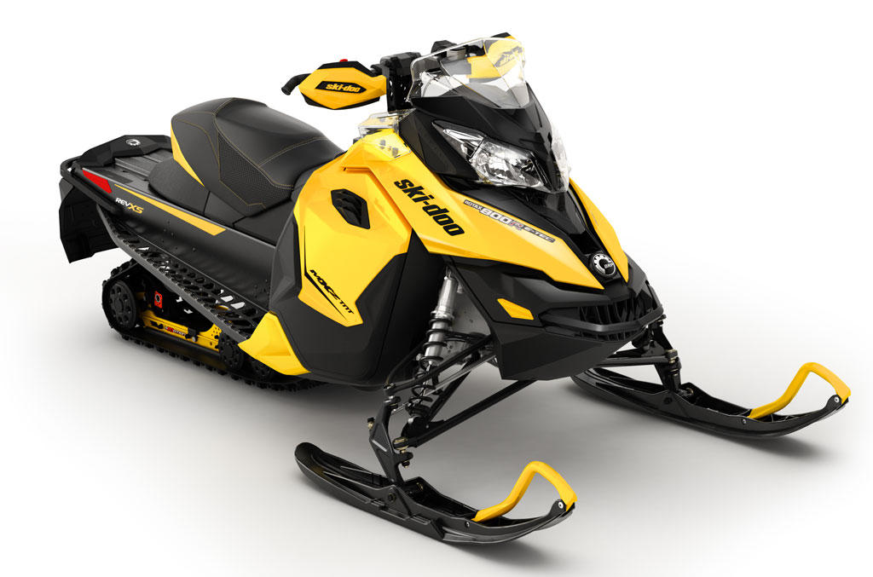
Chassis and Engine
Chassis
2014 Ski-Doo MXZ-TNT
Performance oriented
Improved handling
r-Motion suspension
Engine
Rotax 797cc two-stroke
E-Tec direct injection
RAVE 2 variable exhaust with tuned pipe
High power-to-weight ratio
Notes:
Mark
bring a snowmobile we want to ride
We do this with a two-stroke
Ski-doo MXZ-TNT with r-motion suspension and rider forward
800 etec with three position exhaust valves and high power-to-weight

Slide 6
Design Strategy
Clean and Efficient
Injection timing and quantity optimized for reduced emissions
Capability to use upwards of 40% Isobutanol
Economy-mode with limited throttle for reduced fuel consumption
Three-way reduction exhaust catalyst after treatment
Drivetrain experimentally optimized for efficiency and coasting
Y-pipe extension used to move tune length to operational band of engine
Quiet
Low speed 797 cc engine
Selectively applied sound deadening material in key areas
Mechanically Active Quarter-wave Resonator (MAQR) in exhaust system
Electronic Throttle Control (ETC) on throttle bodies
Notes:
Mark
We know that two-strokes are dirty, eat gas and loud
And smelly, two-stroke smell
Cleaner and more effiecent
ETC
Y-Pipe
Drivetrain
To lose our goal of 5 decibels we run our engine at lower speed and apply sound deadening material to key areas. A mechanically active quarter wave resonator was added onto the exhaust system and deflectors where attached to body panels to direct engine noise. The limited throttle was also used to quiet the intake.

Slide 7
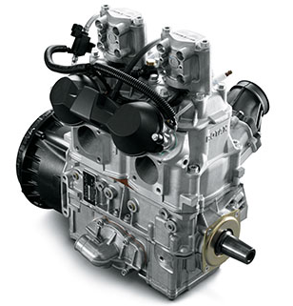
Engine Modifications
Low Speed
Reduction in engine RPM decreases noise levels and emissions, while increasing fuel efficiency
Implemented economy switch to create a dual mode snowmobile
Three way catalytic converter
Reduces exhaust emissions
Little impact on power
Notes:
Mark
By having the engine run at lower rpms the noise levels are lowered since since running at lower speeds results in less vibrations.
We also improve our fuel efficiency because by having a reduced top end the amount of fuel injected can be decreased. Along with having less fuel consumption a decrease in emissions occur. Then by adding a catalyst into the exhaust system to do after treatment on the rest of the emissions while having little effect on our power. Furthering improvements with inect later due to reduced speed
Inject later
More complete burn
Fewer hydrocarbons
Cat at the end for aftertreatment

Slide 8
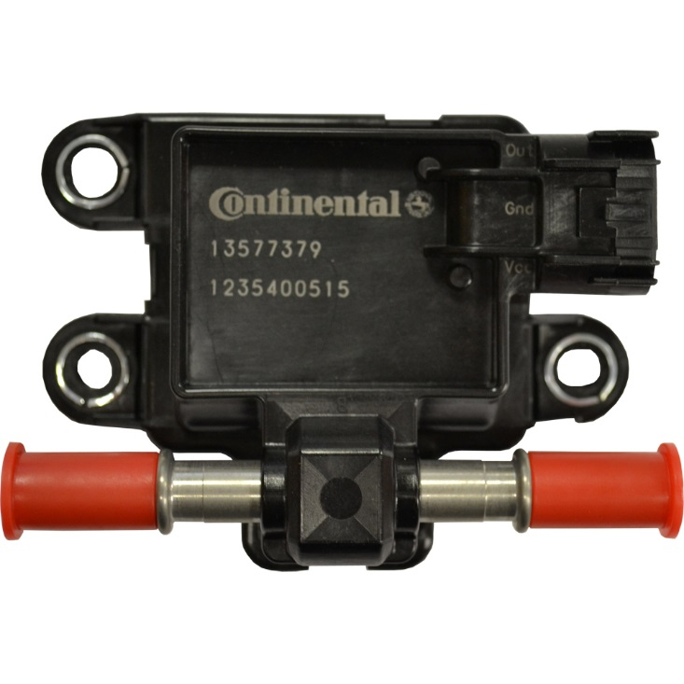
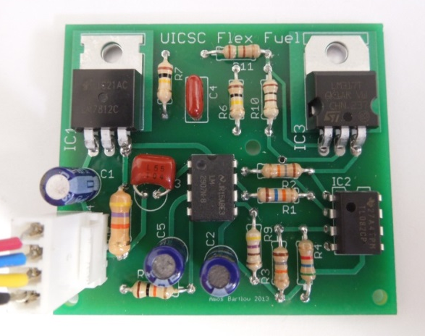
Flex Fuel
New GM flex fuel sensor
Custom analog circuit
Fuel correction based on the stoichiometric AFR of isobutanol
Notes:
Mark
Runs up to 40% iso
Using new gm sensor

Slide 9
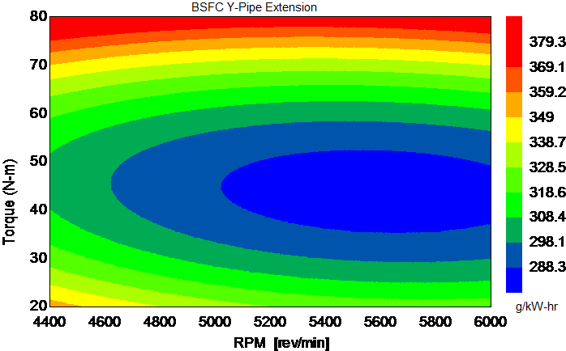
Brake Specific Fuel Consumption Mapping
BSFC
60 Points were take at the five mode points
Map used for calibrating ETC and assist in clutching
Improvements to BSFC by implementing Y-pipe extensions and ETC
Notes:
Mark
Collected data referencing 5 mode test excluding idle
Calibrated ETC off of map
Used to modify the drivetrain
By implementing the y-pipe saw improvements to bsfc

Slide 10
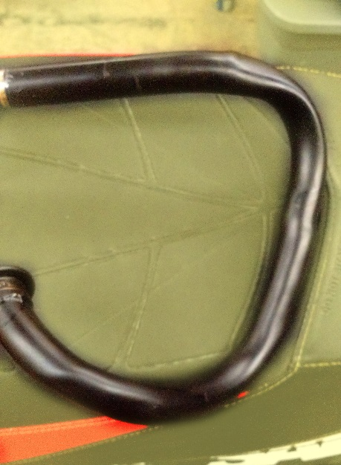
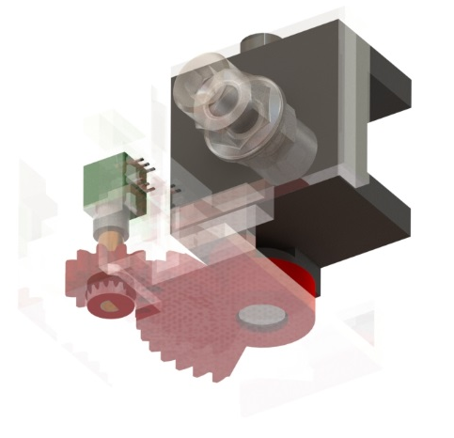
Electromechanical Design
Electronic Throttle Control (ETC)
Compact, gearing at throttle lever
Protected servo pulley at throttle bodies
Mechanically Active Quarter-wave Resonator (MAQR)
Active noise cancelation
Infinitely variable band of quieted frequencies
Notes:
Crystal
We know that when we enter industry we will not be working with just mechanical engineers. We will be working with engineers of other disciplines and people of all skill sets. It was goal this year to have interdisciplinary projects. The projects we chose were an Electronic Throttle Control and a Mechanically Active Quarter-wave Resonator.

Slide 11
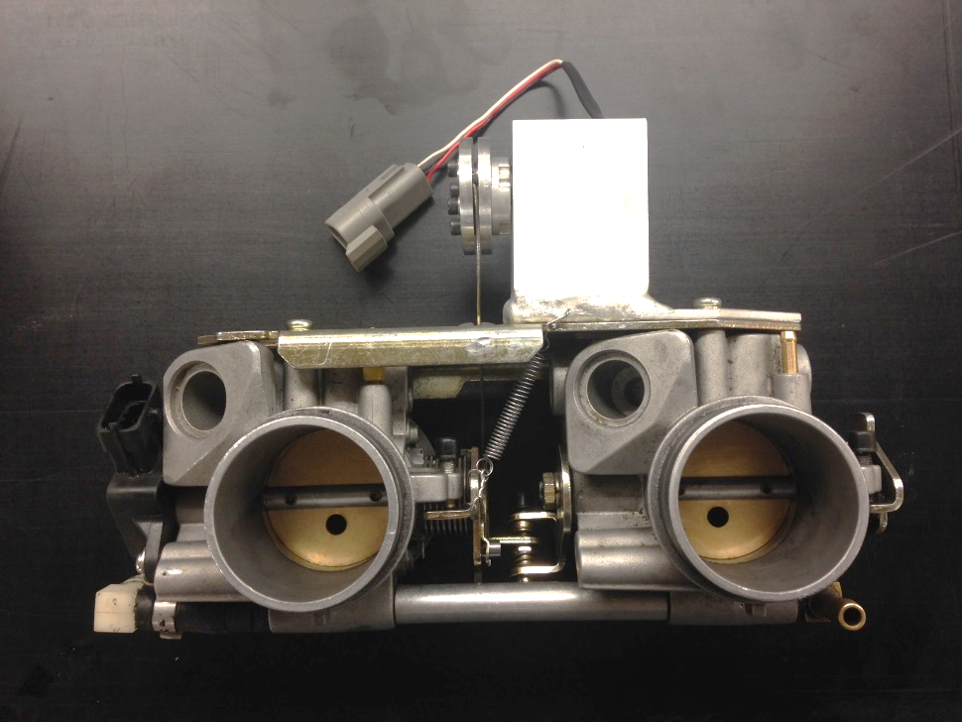
Electronic Throttle Control
ETC
.5 sec travel time to WOT
Slightly reduced throttle reactivity
Sport-Mode
100% Wide Open Throttle
Eco-Mode
50% Wide Open Throttle
Reduced pumping losses
Notes:
Crystal
In order to increase the efficiency of our snowmobile we chose to implement an Electronic Throttle Control. This gives us the ability to limit our throttle in Eco mode to fifty percent to reduce pumping losses while running at 100 percent in sport to not sacrifice power. We are aware that many experience riders do not support electronic throttles. It was our desire to create an ETC that only differed slightly from a mechanical throttle and already some competitors have commented on how similar it feels. With the electrical components it allows smoother throttle control over rough terrain.

Slide 12
Mechanically Active Quarter-wave Resonator
Reduced by 1 dB at 400 Hz
23 cm (9 in) in 5 seconds
Notes:
Crystal
A quarter wave resonator works by producing destructive sound waves which reduces noise in the exhaust. Last year we saw significant gains from our quarter wave resonator but we determined that since it was only effective at one engine speed it was not marketable. The mechanically active quarter-wave resonator was designed to reduce noise at a wider range of engine speeds. This is similar to noise cancellation of high end headphones.

Slide 13
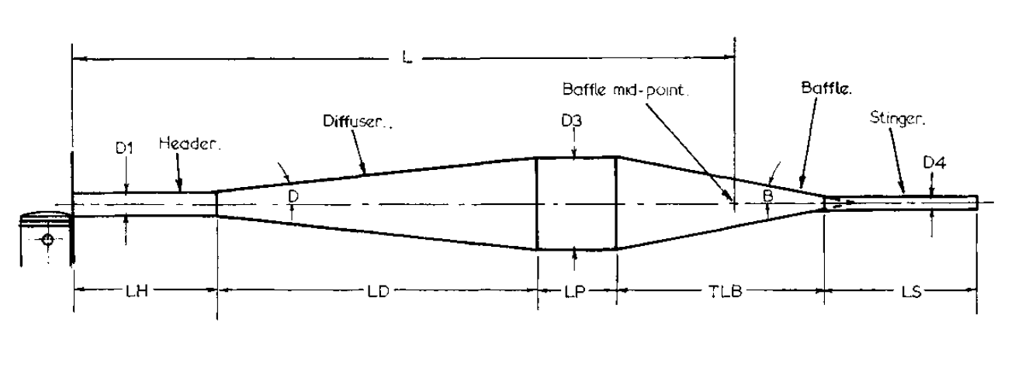
Tuned Pipe Modifications
Y-Pipe Extension
Tune pipe relies on each component
Shifted towards the tune of the engine
19mm(0.75in) extension
Notes:
Mark
Each component in the tune pipe relies on the other
Tune length is identified as the total L in photo
By modifying any of the components changes the tune length
We modified the head first with a 2 in y-pipe extension
Saw results showing an increase in power, better trapping effieciency, and an improvement in emissions
Due to packaging constrants could only implement .75 in extension which showed similar results

Slide 14
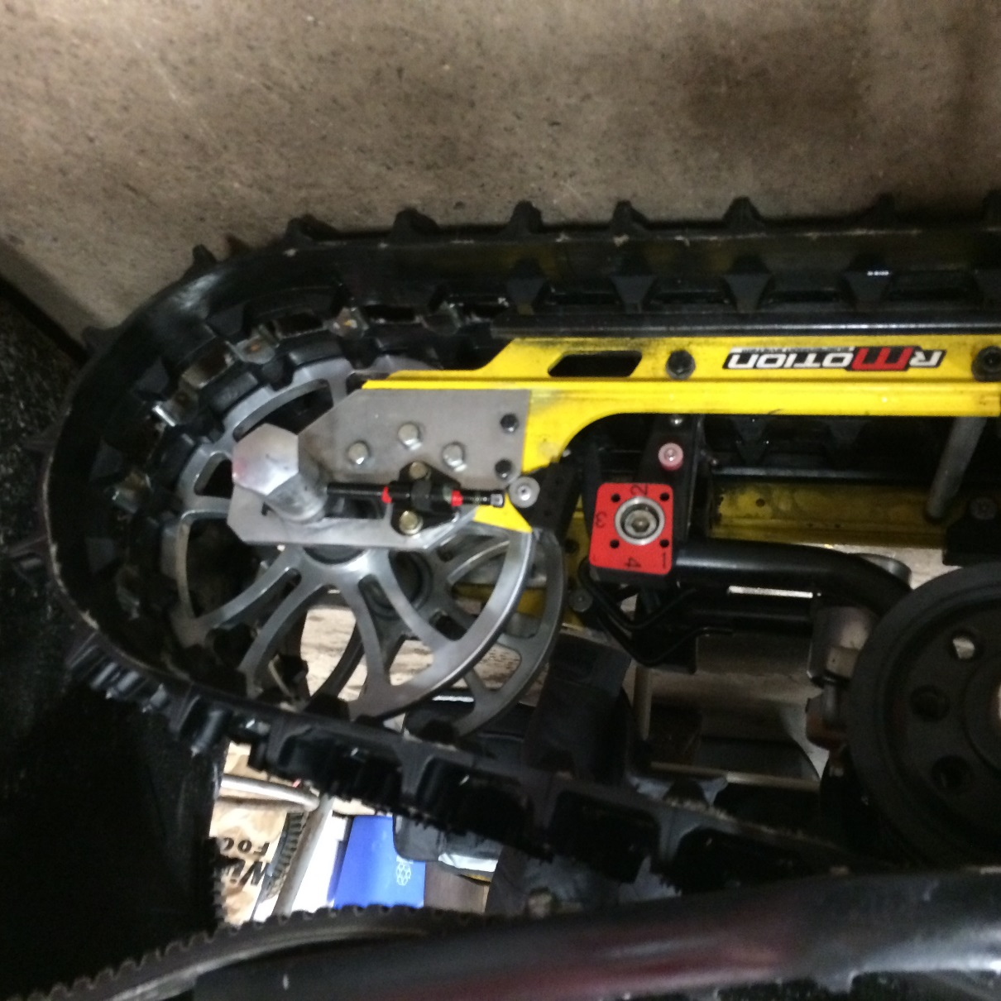
Powertrain Modifications
Clutching
Softer Secondary Spring
Reduced Belt Temperature
Driver and Rear Wheels
Driver increased from 7.2 in to 8 in
Bogey wheels increased from 6 in to 10 in
Increased track length from 121 in to 128 in
Notes:
Mark
Referenced bsfc map to match best bsfc with common cruising speeds
Modified clutching to improve coasting
Planned on using water trench test (ran out of time)
Instead used roll down and force pull test

Slide 15
Emissions
Sport-Mode
2015: 199 E-score
2014: 157 E-score
Eco-Mode
203 E-score
Passes EPA and NPS standards
EPA 5-mode test used
210 is max score
Notes:
Crystal
A 5-mode emissions test is an industry standard for snowmobiles. A maximum e-score is a 210 which means you are only emitting air and water from your exhaust. A big change in the rules this year is that all teams will be scored by their worst emissions score of their two modes. In our worst mode, during our own testing we achieved and e score of 199. Shown on this graphs is kettering, Platville, last years configuration and this years. As you can see we are very competitive, with a highly advanced four-stroke and a comparably powered four-stroke, and have improved from last year.

Slide 16
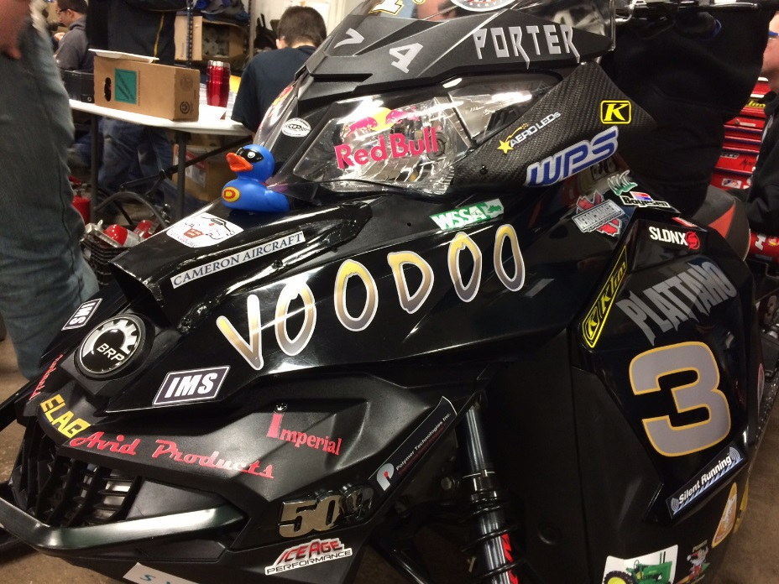
Noise Deflectors
Deflectors were added to redirect sound
Air intake
Cooling port on hood
Sound is directed to the front and rear of snowmobile
Notes:
Crystal
For a snowmobile the sound level is tested by a full throttle pass by sound test called the J-192. The measurement is taken from the side of the vehicle. In order to reduce noise in this event we put deflectors on our intakes. It was our desire to redirect noise to the front and the back of the snowmobiles effectively keeping sound on the trail.

Slide 17
Sound Damping
2014 tunnel material compared to different material
2015 configuration 11.5% reduction
A paint on sound damping material was applied to both sides
Frequency (hz) | Silent | PS | SS
25.0 | 4.7 | -9.9 | 1.7
143.0 | 20.9 | 11.3 | 22.3
504.0 | -11.7 | -0.7 | 10.4
Avg. Reduction | 4.6 | 0.2 | 11.5
Notes:
Crystal
Metals vibrate. This means that the metal on our tunnel vibrates. In the past we have used an adhesive sound damping material but this year we explore the option of using a paint on damping material. In order to test different configurations we took a z-channel to represent the tunnel and recorded the vibrations after hitting it with a hammer. The configurations we tried were the paint on only on one side of the tunnel, the adhesive and paint on, on either side of the tunnel and the paint on on both sides. With this test we found that the paint on damping material on both sides increased the damping ratio by 11.5 percent compared to the adhesive material. This means the vibrations will have less power and stop sooner.

Slide 18
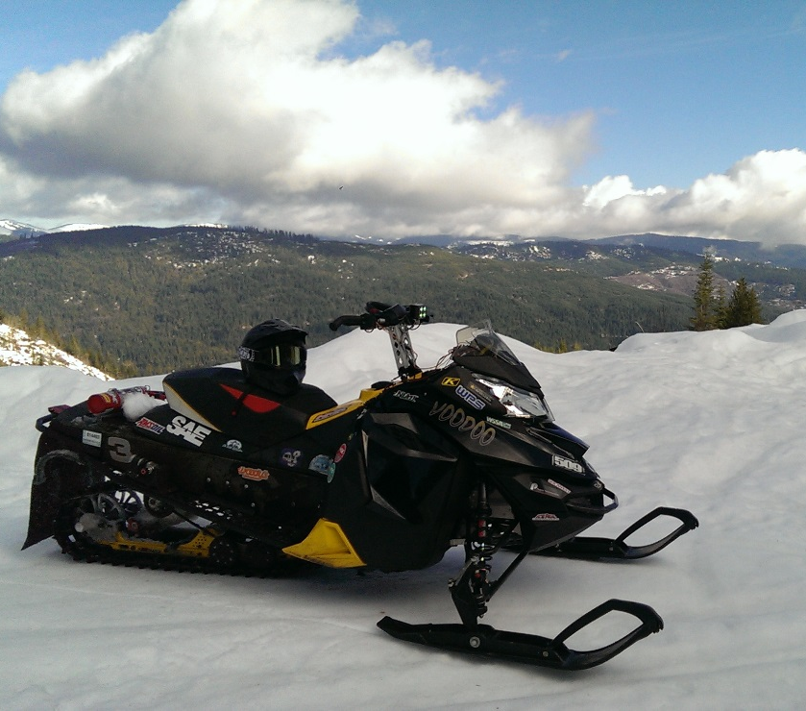
Dealer/Outfitter Viewpoint
Low Maintenance
Little cost and low time to maintain
Low Vehicle Cost
MSRP $11,955
$127 more than 2014 UICSC Design
Meets Consumer Demand
High sales volume
Environmentally Conscious
Exceeds current emissions and noise standards*
*Meets NPS noise standards under some test conditions
Notes:
Mark
“When a dealer or outfitter looks at a snowmobile they want something that people want to rent and costs them little to no money in maintenance. The only required yearly maintenance on an e-tec is to check and clean the RAVE valves every year. The components that the team added will add no yearly maintenance. The dual mode capabilities of the snowmobile gives the dealer an opportunity to rent the snowmobile to all types of riders due to the varying horsepower.”

Slide 19
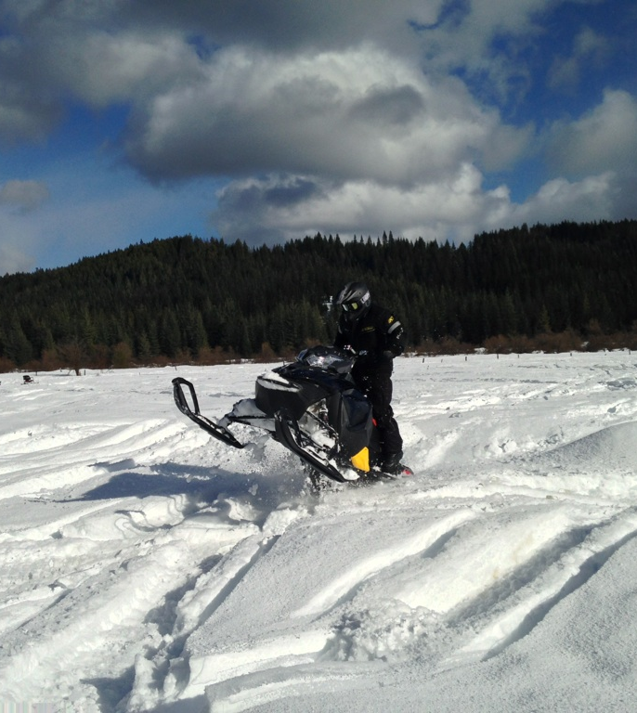
Rider Viewpoint
Measured Specifications
115 hp
585 lb
Fuel Efficient
23 mpg
Comfort
Position & handling
Rider-forward position
r-Motion suspension
Notes:
Mark
Move the snowmobile
Get where you are going
Have more miles between fill ups
Light, easy handling, powerful
23 mpg

Slide 20
Results
ETC
Efficiency:
117 g/kW-hr BSFC (30%) reduction at peak power
Sound
Clutch – 1 dBA
Exhaust – 1 dBA
MSRP
$40
MAQR
Sound
Exhaust – 3 dBA
MSRP
$20
Y-Pipe Extension
Efficiency
48 BSFC (12%) reduction at peak power
Power
Increase 5 hp at peak power
Sound
Clutch – 4 dBA
Exhaust – 1 dBA
MSRP
$10
Powertrain
Efficiency
21 % reduction in rolling resistance
MSRP
$150
Notes:
Crystal and Mark being awesome together

Slide 21
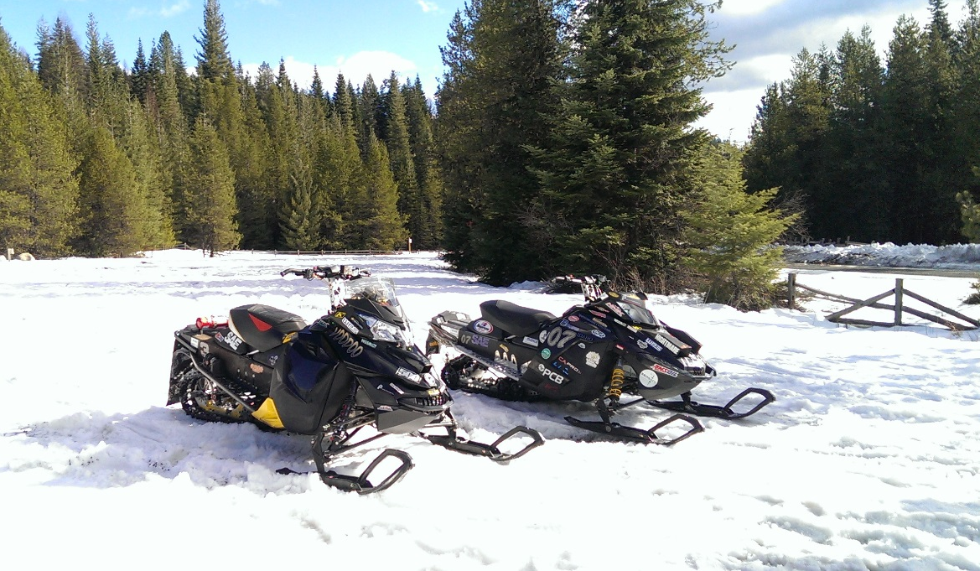
Conclusions
Clean
Exceeds NPS
Quiet
73.5 dBA using J-192
Efficient
23 MPG
Affordable
$11,955
Enjoyable two-stroke riding experience
Notes:
Crystal
With all of our modifications I believe that we have design a snowmobile that is fun to ride while being clean, quiet and fuel efficient. Our emissions score exceeds National Park Standards. In some conditions our noise meets national parks standards. We get 23 mpg while riding in mountainous terrain which is an improvement of 2 miles per gallon. We have a two mode snowmobile where in one mode you can climb up to the highest peak and in the other mode you can teach your kid how to drive. We did all of this while only adding about a thousand dollars to our snowmobile. I love riding this snowmobile. I would steal this sled if I could get away from it.

Slide 22
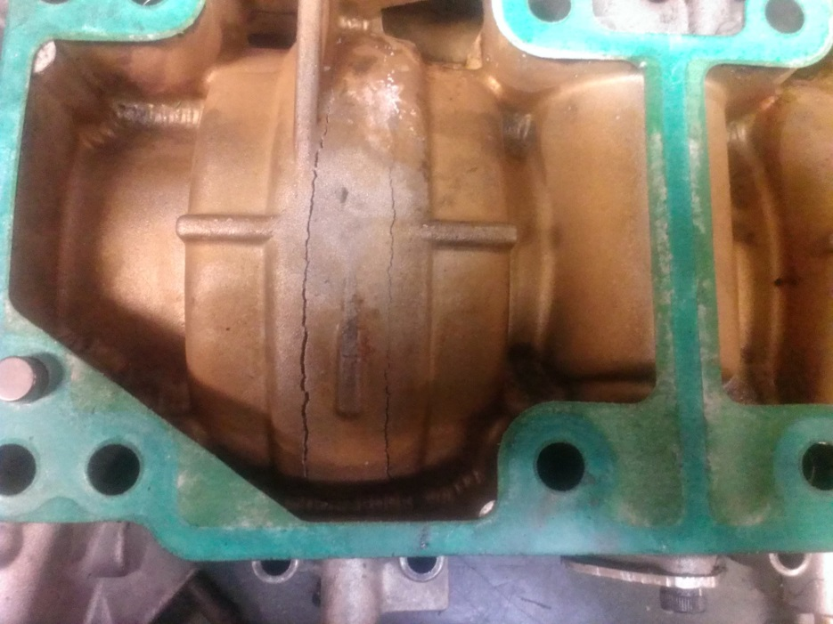
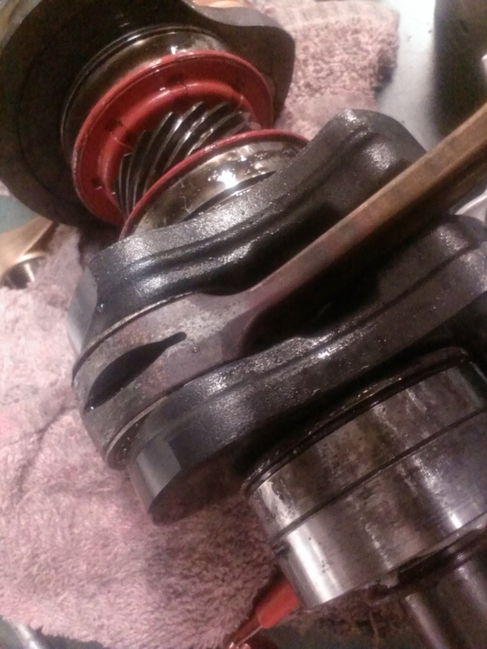
QUESTIONS?
Notes:
Crystal

Slide 23
Calibration Strategy
Notes:
Crystal

Slide 24
Tuned Pipe Equations
L $=\frac{ED x 42545}{rpm}$
L= tuned length in mm
ED= exhaust duration in degrees
D2 $=\left(\frac{LH x 2}{Cot H}\right)+D1$
D1= header pipe minor inside diameter
LH= header pipe length minus the length of the exhaust port and flange
Cot H= cotangent of header pipe’s angle of taper
$LD=\left(\frac{D3−D2}{2}\right)×Cot D$
LD= Diffuser Length
D3= diffuser inside diameter
D2= Header pipe major inside diameter
Cot D= cotangent of the diffuser’s angle of taper
$OLB= \frac{D3}{2}×Cot B$
OLB= Overall length of baffle cone
D3= baffle major inside diameter
Cot B= cotangent of the baffle's angle of taper
$LP=L−(LH+LD+\frac{OLB}{2})$

Slide 25
Quarter-wave Resonator
$f=\frac{RPM}{60}N_{c}$
$f= \frac{c}{4L}$ (Hz)
$c=\frac{\sqrt{γRT}}{M}$ $\left(\frac{m}{s}\right)$

