Slide 1
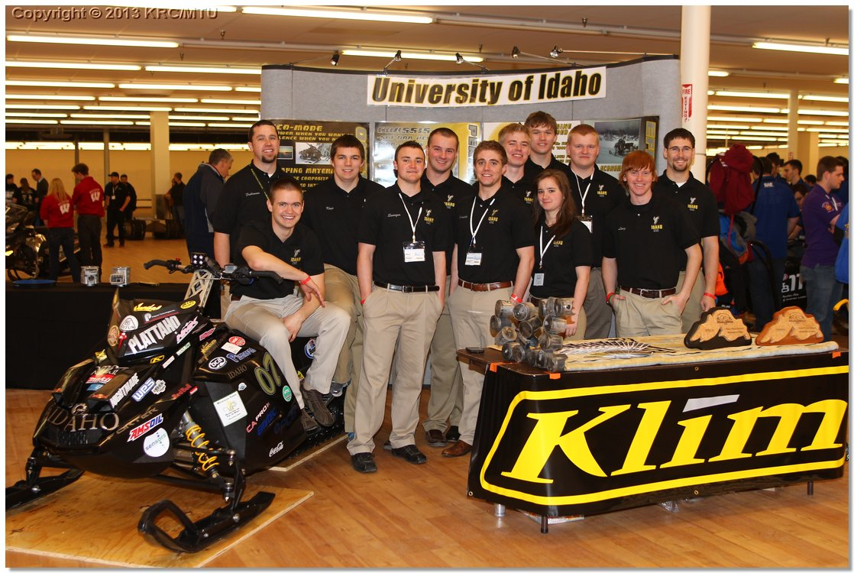
University of Idaho TWO-STROKE WITH Direct Injection and sound reduction
Presented By
Dillon Savage & Crystal Green
Notes:
Dillion

Slide 2
Overview
Competition Goals
Design Goals and Target Audience
Design Strategy
Chassis and Engine Modifications
Testing Results
Summary and Conclusions
Questions
Notes:
Dillion

Slide 3
Competition Goals
Create clean, quiet and economical trail snowmobiles while maintaining or improving performance
Meet EPA exhaust and noise emissions standards
Build a platform capable of running 16-32 percent isobutanol
Provide university students with real world engineering experience
Notes:
Crystal

Slide 4
UICSC Design Goals
Create a national park certified two-stroke snowmobile
E-score > 170, SAE J192 score <73 dBA
Produce a reliable and accurate flex fuel system
Generate 110-130 hp
Deliver original equipment manufacturer level packaging
Raise industry standard with economical solutions
Notes:
Crystal

Slide 5
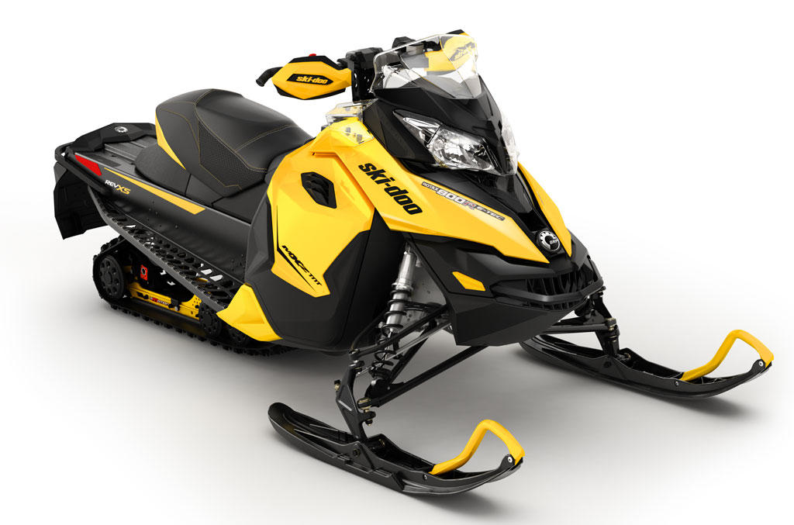
Chassis and engine
Chassis
2013 Ski-Doo MXZ-TNT
Performance oriented
Improved handling
r-Motion suspension
Engine
Rotax 797cc R two-stroke
E-Tec direct injection
RAVE 2 variable exhaust with tuned pipe
High power-to-weight ratio
Notes:
Dillion

Slide 6
Design strategy
Clean and Efficient
Injection timing and quantity optimized for reduced emissions
Capability to use upwards of 40% Isobutanol
DI allows reduced quantity of oil used in total loss oiling system
Economy switch with reduced fuel consumption
Three-way reduction exhaust catalyst after treatment
Clutch was optimized for lower RPM and improved coasting
Quiet
Low speed 797 cc engine
Selectively applied sound insulation in key areas
Quarter wave resonator in exhaust system
Notes:
Dillion

Slide 7
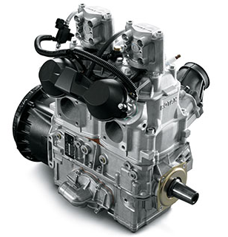
Engine Modifications
Low Speed
Reduction in engine RPM decreases noise levels and emissions, while increasing fuel efficiency
Implemented economy switch to create a dual mode snowmobile
Aristo supplied catalytic converter
Reduces exhaust emissions
Little impact on power
Notes:
Dillion

Slide 8
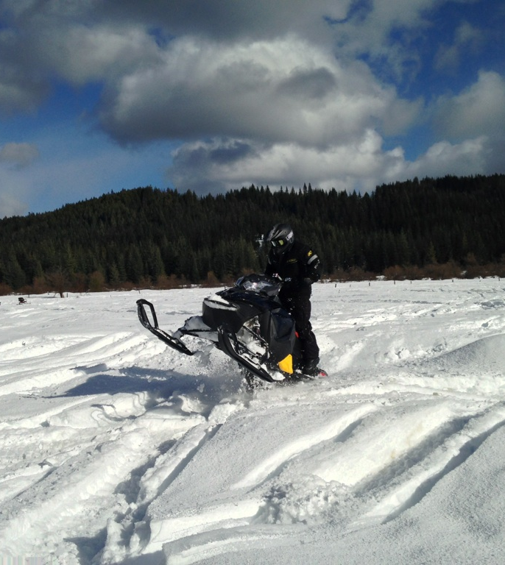
Rider viewpoint
Measured Specifications
115 hp
540 lb
40 lbs less than the 2013 UICSC model
Fuel Efficient
21 mpg (GGE) on B-32
Comfort
Position & handling
Rider-forward position
r-Motion suspension
Notes:
Crystal

Slide 9
Dealer/Outfitter Viewpoint
Low Maintenance
Little cost and low time to maintain
Low Vehicle Cost
MSRP $11,765
Meets Consumer Demand
High sales volume
Environmentally Conscious
Exceeds current emissions and noise standards*
*Meets NPS noise standards under some test conditions
Notes:
Crystal

Slide 10
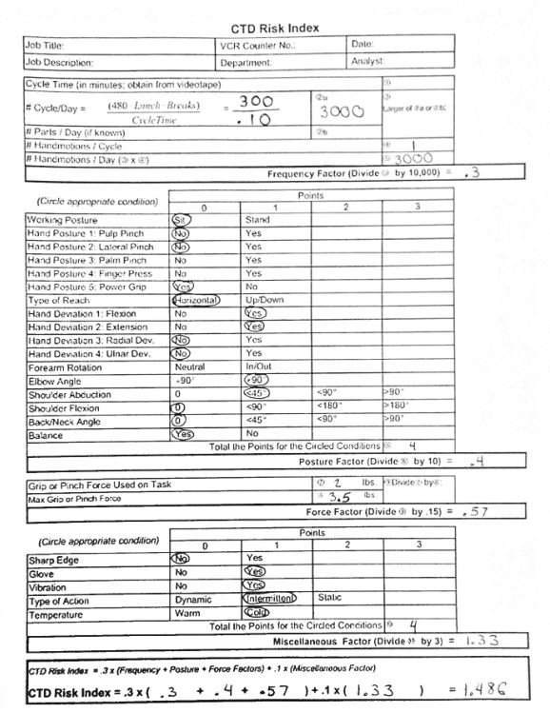
Ergonomics
Continuing research was done on how different riding positions affects the body
Handlebar height increased by four inches
With taller risers risk of cumulative trauma disorder decreases
4% less over a 5 hour day
Notes:
Crystal

Slide 11
Calibration Strategy
Notes:
Dillion

Slide 12
Emissions
Eco-mode
2014: 204 E-score
2013: 203 E-score
Passes EPA and NPS standards
EPA 5-mode test used
210 is max score
Notes:
Dillion

Slide 13
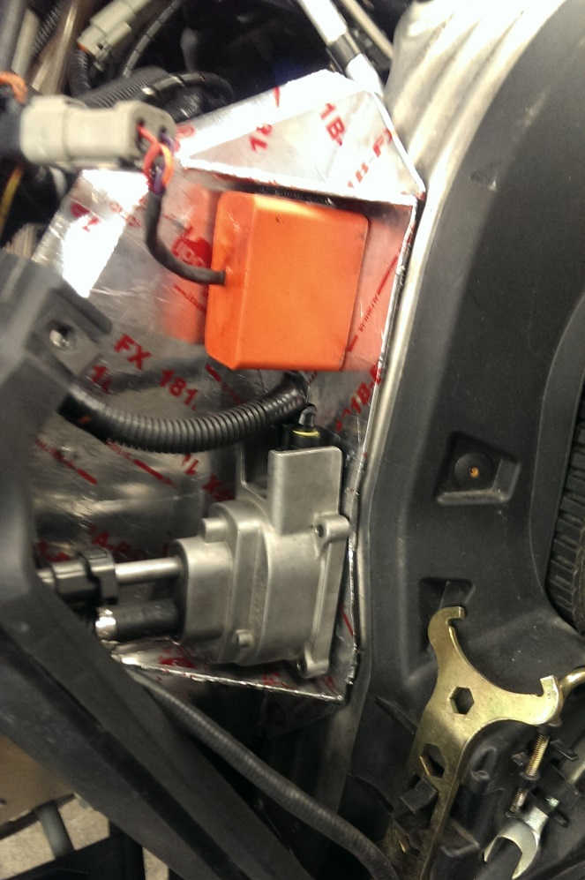
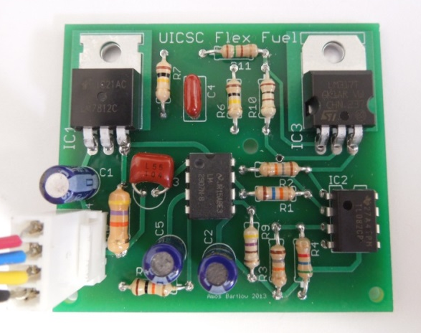
Flex Fuel
GM flex fuel sensor
Custom analog circuit
Fuel correction based on the stoichiometric AFR of isobutanol
Notes:
Dillion

Slide 14
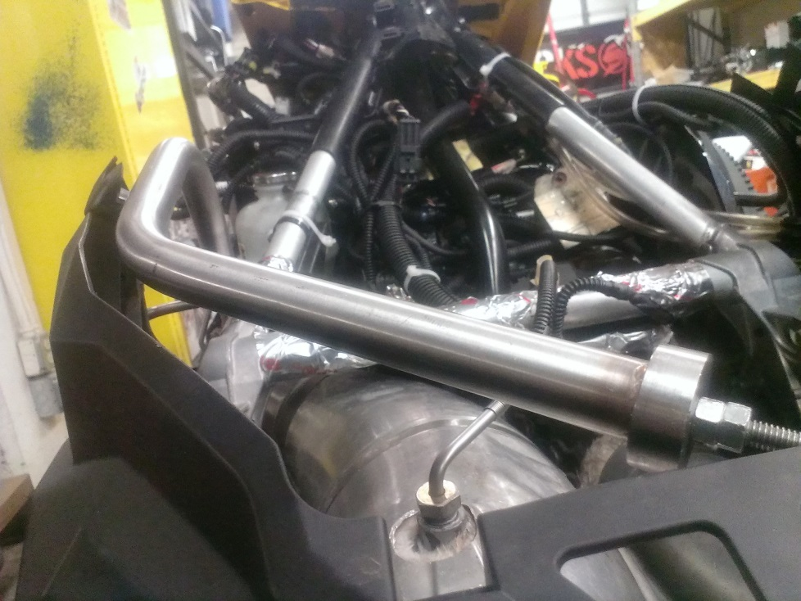
Noise Reduction
Exhaust
Quarter wave resonator
Exhaust valves lowered
Intake
Attached sound deflectors to intake
Inserted a foam pre-filter in secondary air box
Mechanical
Lowered engine speeds
Attached sound material to panels, tunnel, and injectors
Notes:
Crystal

Slide 15
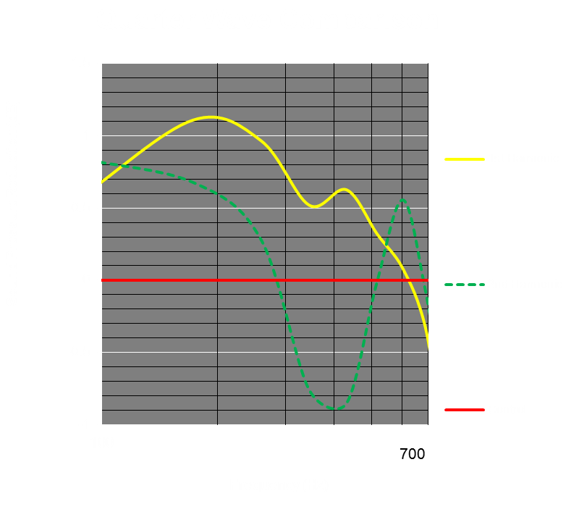
Quarter Wave Resonator
1st harmonic reduces by .5 dB at 400 Hz
2nd harmonic magnifies the sound by nearly 1 dB
Notes:
Crystal

Slide 16
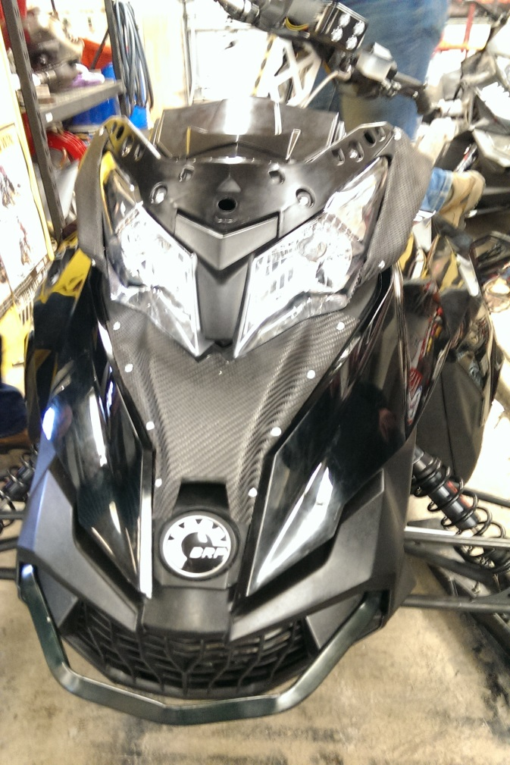
Noise Deflectors
Deflectors were added to redirect sound
Air intake
Cooling port on hood
Sound is directed to the front and rear of snowmobile
Notes:
Crystal

Slide 17
Sound deadening Materials
2013 material was compared to many other configurations
2014 showed average reduction of 1.4 dB from 2013
Consists of melamine, plastic, and an ether type damping material
Notes:
Dillion

Slide 18
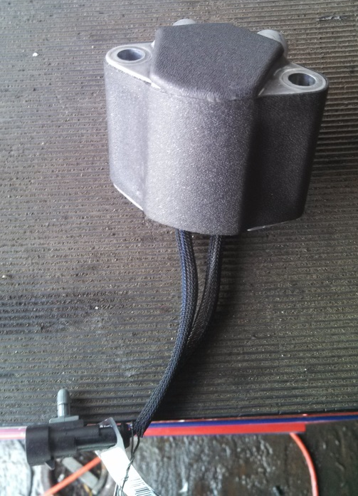
Material Application
Polydamp sound material was applied to tunnel, injectors, and chain case
Three layer insulation applied to side panels
Applied at source to reduce weight addition
Clean application looks OEM
Notes:
Dillion

Slide 19
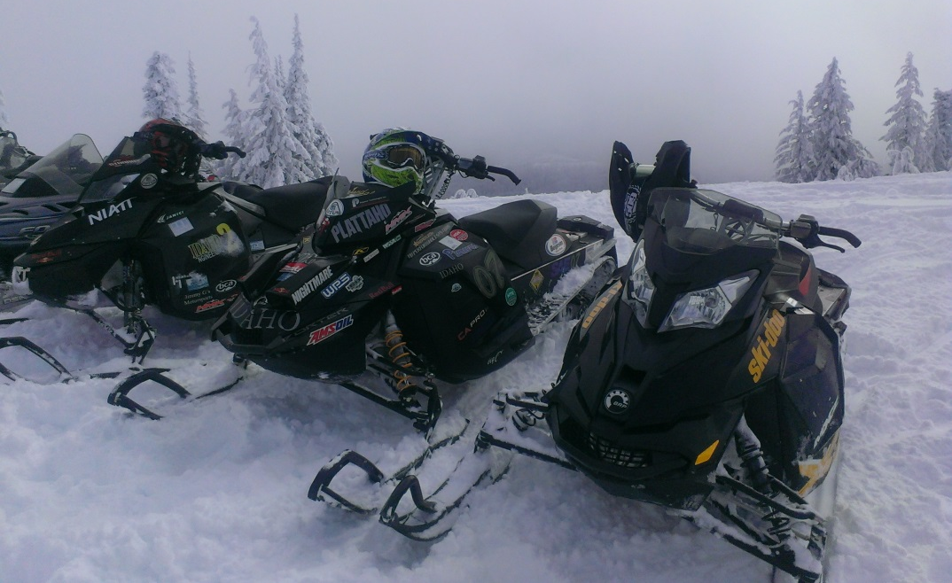
Conclusions
Clean
Exceeds NPS
Quiet
Expected to meet NPS
Efficient
21 MPG GGE
Affordable
$11,765
Enjoyable two-stroke riding experience
Notes:
Dillion

Slide 20
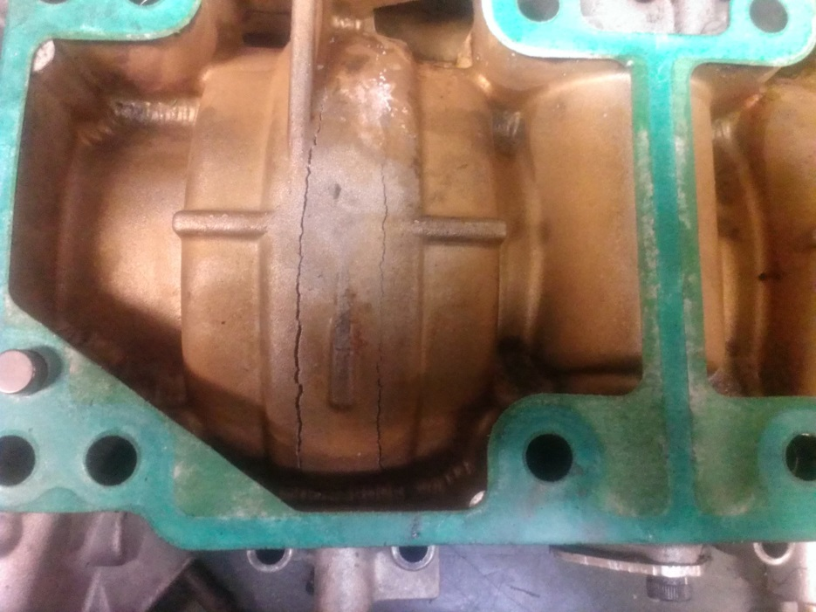
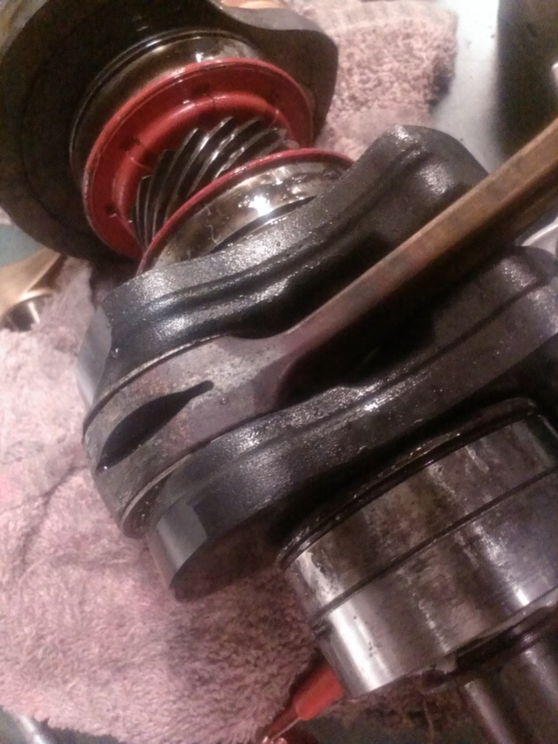
QUESTIONS?
Notes:
dillon

Slide 21
Insertion Loss
Notes:
Dillion

