Slide 1
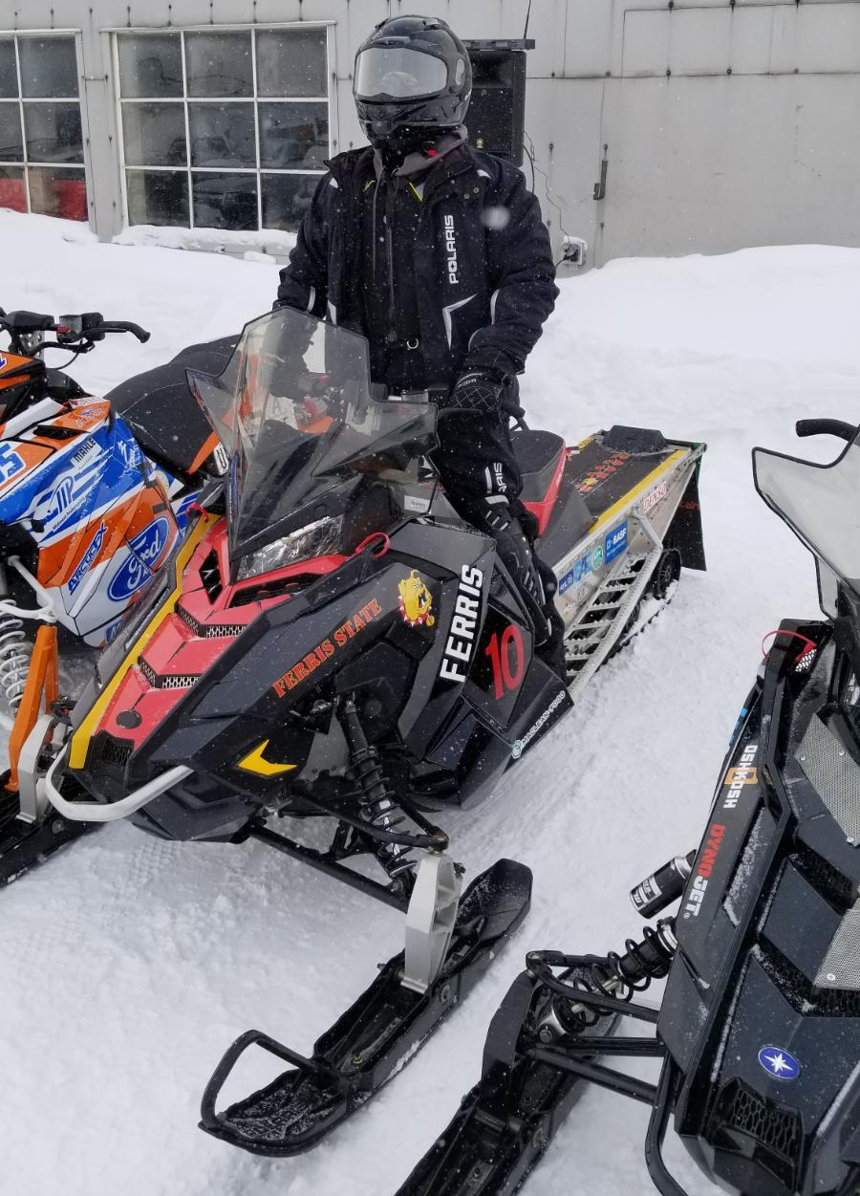
2019 SAE CLEAN SNOWMOBILE CHALLENGE DESIGN PRESENTATION
Ferris State Clean Snowmobile

Slide 2
Overview
Team Organization and Time Management
Fuel Management
Catalytic Converter
Muffler
Other Modifications

Slide 3
Team Organization and Time Management
Research and sponsorship outreach
Establish projects
Design
Fabrication
Testing
2019 CSC Challenge

Slide 4
Continued Systems
2017 800cc Polaris Switchback Assault
Still within eligibility
Reflective and barrier insulation
Utilizing a combination as approptiate
Clutch weights
Quicker engagement

Slide 5
Continued Systems
Track studs
Fully utilize 144 track
Three-way catalytic converter
Insert reasoning here
Ski runners

Slide 6
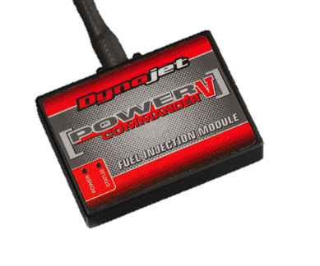
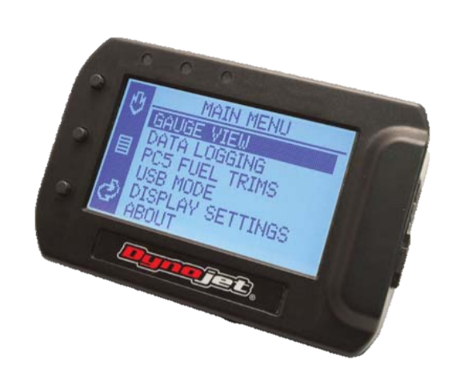
Fuel Management
Ethanol compatibility
Ethanol content display
Air/fuel mixture control
Heads-up display

Slide 7
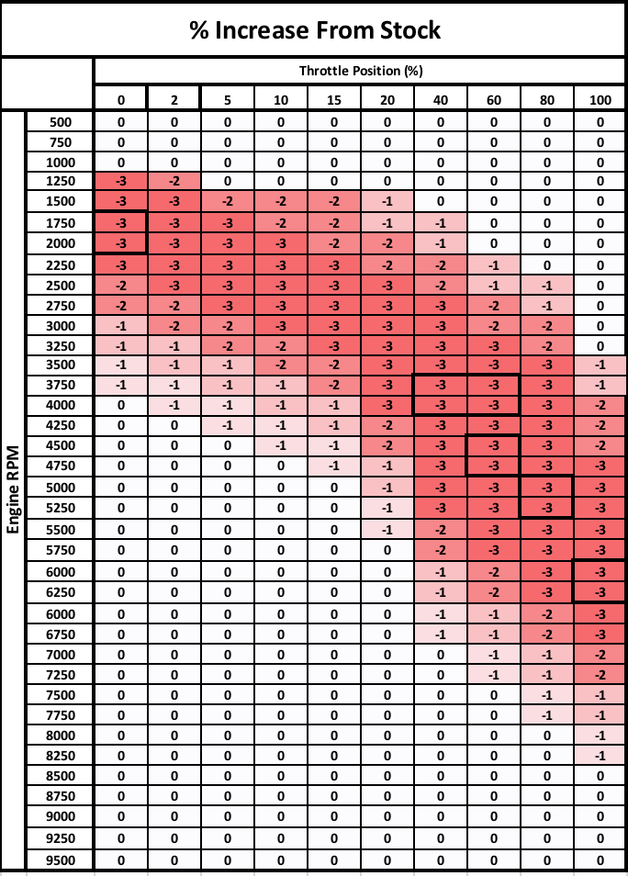
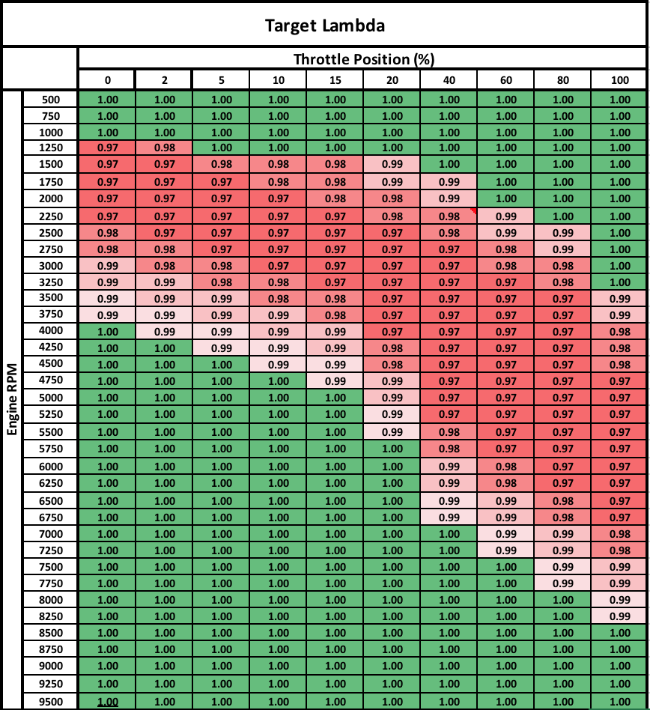
Fuel Management

Slide 8
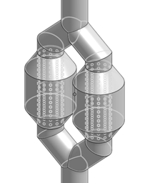
Custom Muffler Design
Muffler Choices
Two large expansion chambers
two pipes with baffles
center plug between both
fiberglass packing
Simple design for easy fabrication
Gain data to create and improve design based on data and performance

