Slide 1
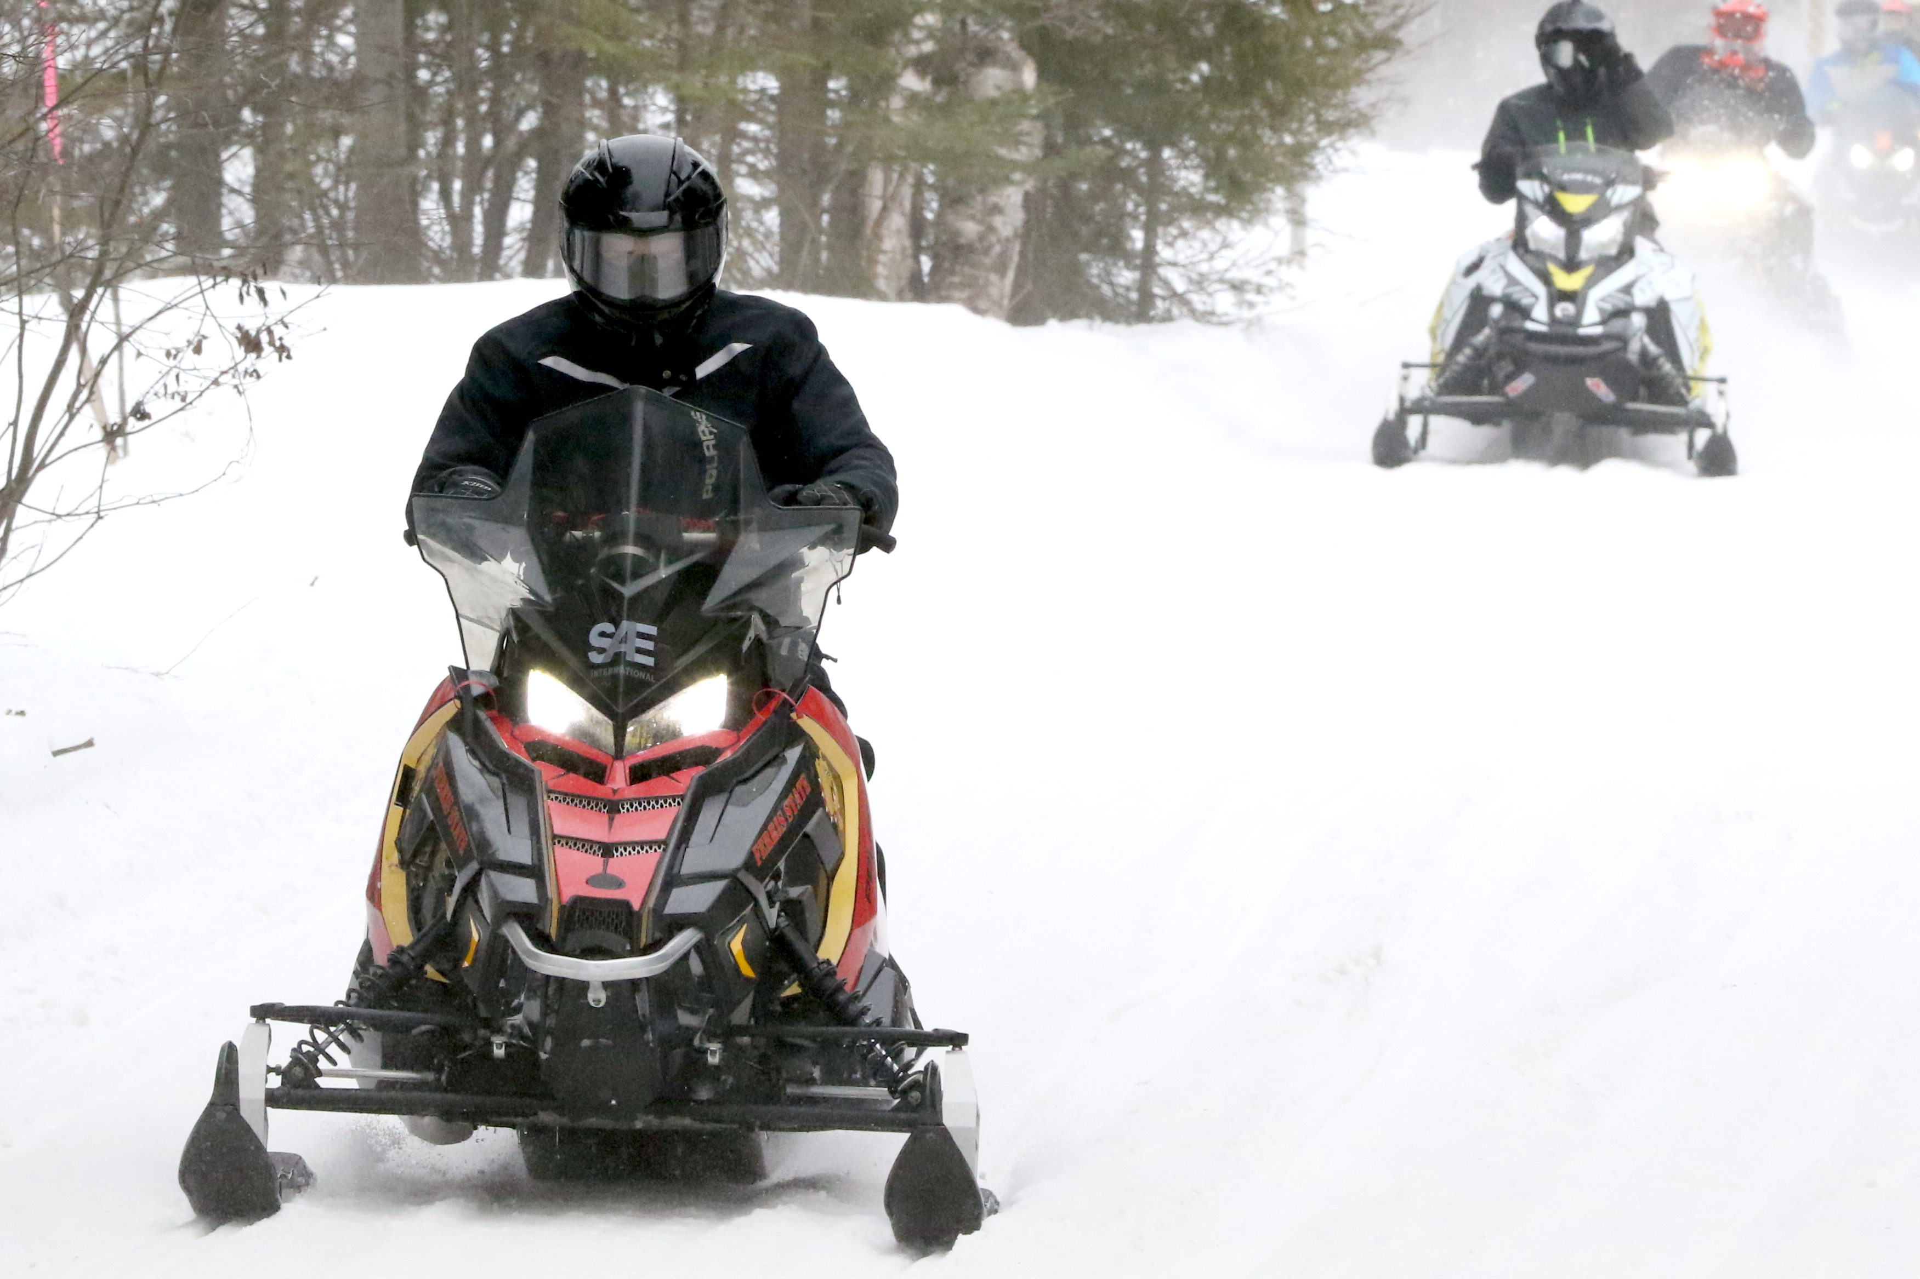
2018 SAE Clean Snowmobile Challenge Design Presentation
Ferris State
Clean Snowmobile

Slide 2
Overview
Team Goals
Design Process
Fuel Management
Muffler
Catalytic Converter
Other Modifications
MSRP

Slide 3
Team Goals
Qualify for CSC 2018
Complete All Events
Prove Reliability
Improve Noise Quality
Reduce Emissions
Maintain Rider Experience
Learn from Mistakes

Slide 4
Design Process
2017 SAE CSC Visit
Polaris Sled Donation
Formation of Project Groups
Design and Simulations
Fabrication
Testing
2018 SAE CSC

Slide 5
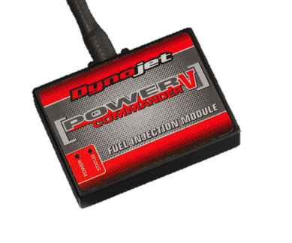
Fuel Management
Ethanol Sensor
Engine Tuning

Slide 6
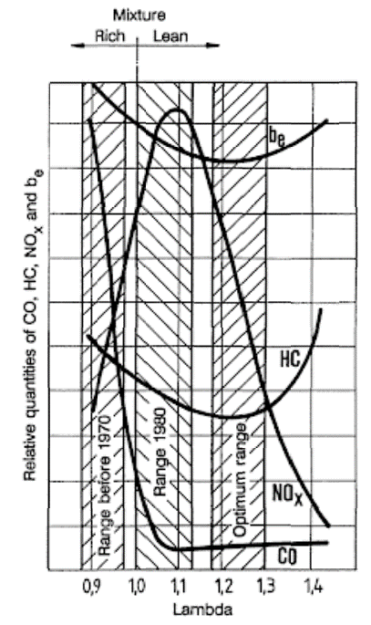
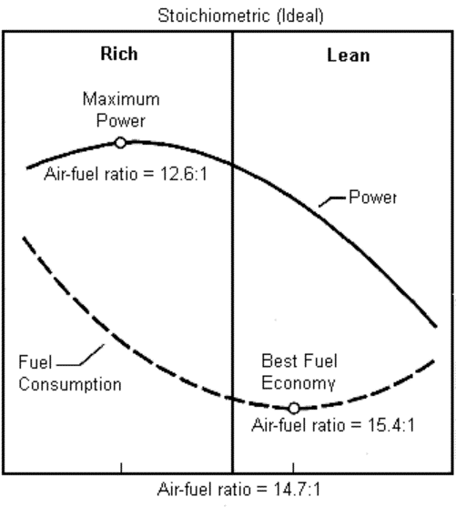
Fuel Management
Strategy
Lean AFR Targets
Too Lean Causes Knock
Engine Enters Limp Mode
1.05 for Efficiency
1.2-1.3 for Emissions
Unrealistic for a 2-Stroke
Much More Research Needs to be Done

Slide 7
Fuel Management
Lambda (Assuming Stock Map at Pure Stoich)
 |  | Throttle Position (%)
 |  | 0 | 2 | 5 | 10 | 15 | 20 | 40 | 60 | 80 | 100
Engine RPM | 500 | 1.00 | 1.00 | 1.00 | 1.00 | 1.00 | 1.00 | 1.00 | 1.00 | 1.00 | 1.00
 | 750 | 1.00 | 1.00 | 1.00 | 1.00 | 1.00 | 1.00 | 1.00 | 1.00 | 1.00 | 1.00
 | 1000 | 1.00 | 1.00 | 1.00 | 1.00 | 1.00 | 1.00 | 1.00 | 1.00 | 1.00 | 1.00
 | 1250 | 1.15 | 1.15 | 1.00 | 1.00 | 0.97 | 0.94 | 0.91 | 0.91 | 0.91 | 0.91
 | 1500 | 1.15 | 1.15 | 1.00 | 1.00 | 0.94 | 0.91 | 0.88 | 0.88 | 0.88 | 0.88
 | 1750 | 1.15 | 1.15 | 1.09 | 1.00 | 0.91 | 0.88 | 0.85 | 0.85 | 0.85 | 0.85
 | 2000 | 1.15 | 1.15 | 1.09 | 1.00 | 0.94 | 0.91 | 0.88 | 0.85 | 0.85 | 0.85
 | 2250 | 1.15 | 1.15 | 1.15 | 1.09 | 1.00 | 0.94 | 0.91 | 0.88 | 0.85 | 0.85
 | 2500 | 1.15 | 1.15 | 1.15 | 1.09 | 1.00 | 0.97 | 0.91 | 0.91 | 0.88 | 0.85
 | 2750 | 1.09 | 1.12 | 1.15 | 1.15 | 1.09 | 1.00 | 0.94 | 0.91 | 0.91 | 0.88
 | 3000 | 1.09 | 1.12 | 1.15 | 1.15 | 1.09 | 1.00 | 0.97 | 0.94 | 0.91 | 0.91
 | 3250 | 1.09 | 1.12 | 1.15 | 1.15 | 1.15 | 1.09 | 1.00 | 0.94 | 0.94 | 0.91
 | 3500 | 1.09 | 1.09 | 1.12 | 1.15 | 1.15 | 1.09 | 1.00 | 0.97 | 0.94 | 0.94
 | 3750 | 1.06 | 1.09 | 1.12 | 1.15 | 1.15 | 1.15 | 1.09 | 0.97 | 0.97 | 0.94
 | 4000 | 1.06 | 1.09 | 1.09 | 1.12 | 1.15 | 1.15 | 1.09 | 1.00 | 0.97 | 0.97
 | 4250 | 1.00 | 1.09 | 1.09 | 1.12 | 1.15 | 1.15 | 1.15 | 1.00 | 1.00 | 0.97
 | 4500 | 1.00 | 1.06 | 1.09 | 1.09 | 1.12 | 1.15 | 1.15 | 1.09 | 1.00 | 1.00
 | 4750 | 1.00 | 1.06 | 1.09 | 1.09 | 1.12 | 1.15 | 1.15 | 1.15 | 1.09 | 1.00
 | 5000 | 1.00 | 1.00 | 1.06 | 1.09 | 1.12 | 1.12 | 1.15 | 1.15 | 1.09 | 1.00
 | 5250 | 1.00 | 1.00 | 1.06 | 1.09 | 1.09 | 1.12 | 1.15 | 1.15 | 1.15 | 1.09
 | 5500 | 1.00 | 1.00 | 1.00 | 1.06 | 1.09 | 1.12 | 1.15 | 1.15 | 1.15 | 1.09
 | 5750 | 1.00 | 1.00 | 1.00 | 1.06 | 1.09 | 1.09 | 1.15 | 1.15 | 1.15 | 1.15
 | 6000 | 1.00 | 1.00 | 1.00 | 1.00 | 1.09 | 1.09 | 1.12 | 1.15 | 1.15 | 1.15
 | 6250 | 1.00 | 1.00 | 1.00 | 1.00 | 1.06 | 1.09 | 1.12 | 1.15 | 1.15 | 1.15
 | 6500 | 1.00 | 1.00 | 1.00 | 1.00 | 1.06 | 1.09 | 1.12 | 1.12 | 1.15 | 1.15
 | 6750 | 1.00 | 1.00 | 1.00 | 1.00 | 1.00 | 1.06 | 1.09 | 1.12 | 1.15 | 1.15
 | 7000 | 1.00 | 1.00 | 1.00 | 1.00 | 1.00 | 1.06 | 1.09 | 1.12 | 1.15 | 1.15
 | 7250 | 1.00 | 1.00 | 1.00 | 1.00 | 1.00 | 1.00 | 1.06 | 1.09 | 1.12 | 1.12
 | 7500 | 1.00 | 1.00 | 1.00 | 1.00 | 1.00 | 1.00 | 1.06 | 1.09 | 1.12 | 1.12
 | 7750 | 1.00 | 1.00 | 1.00 | 1.00 | 1.00 | 1.00 | 1.00 | 1.06 | 1.09 | 1.12
 | 8000 | 1.00 | 1.00 | 1.00 | 1.00 | 1.00 | 1.00 | 1.00 | 1.06 | 1.09 | 1.12
 | 8250 | 1.00 | 1.00 | 1.00 | 1.00 | 1.00 | 1.00 | 1.00 | 1.00 | 1.06 | 1.09
 | 8500 | 1.00 | 1.00 | 1.00 | 1.00 | 1.00 | 1.00 | 1.00 | 1.00 | 1.06 | 1.09
 | 8750 | 1.00 | 1.00 | 1.00 | 1.00 | 1.00 | 1.00 | 1.00 | 1.00 | 1.00 | 1.06
 | 9000 | 1.00 | 1.00 | 1.00 | 1.00 | 1.00 | 1.00 | 1.00 | 1.00 | 1.00 | 1.06
 | 9250 | 1.00 | 1.00 | 1.00 | 1.00 | 1.00 | 1.00 | 1.00 | 1.00 | 1.00 | 1.00
 | 9500 | 1.00 | 1.00 | 1.00 | 1.00 | 1.00 | 1.00 | 1.00 | 1.00 | 1.00 | 1.00
Mode 1
Very Poor
Limp Mode
Mode 2
Good
Mode 3
Good
Mode 4
Good
Mode 5
Poor

Slide 8
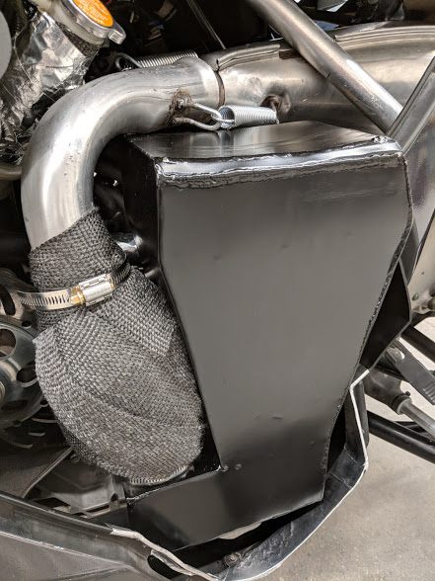
Custom Muffler
Shell Development
Original volume conservation with addition of catalyst
Ease of fabrication
Internal Geometry
Designs simulated to predict best Insertion Loss

Slide 9
Simulations
Attenuation Targets High Frequencies
Above 500 Hz
Unpleasant to Human Ear
Perforate Location on Pipes Optimized for High Frequencies

Slide 10
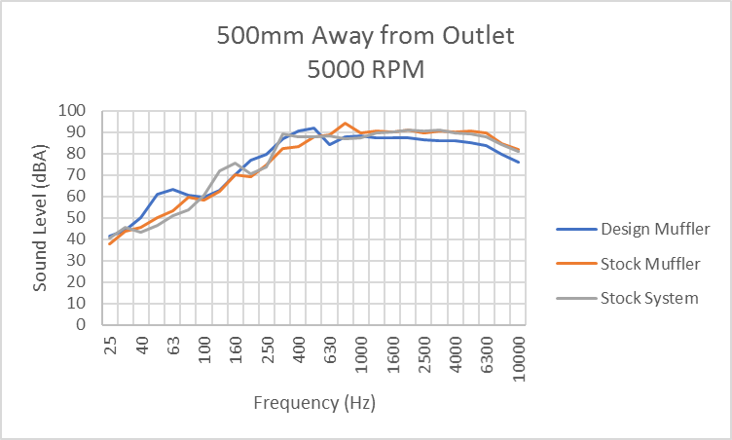
Final Design
Sound Cancelling Geometry
Perforated Baffle
Perforated Pipe
3.56 dBA Reduction on Average
Above 500 Hz

Slide 11
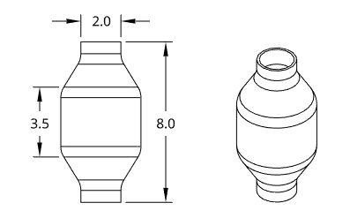
Emissions Treatment
Rationale
Cost Effective
Feasibility
Design Considerations
Space Constraints and Heat
Dissipates Heat Quickly
Durable Against Mechanical Vibrations
Backpressure
Low Cell Density
Emissions

Slide 12
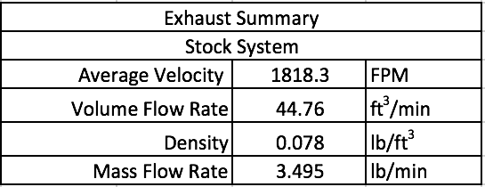
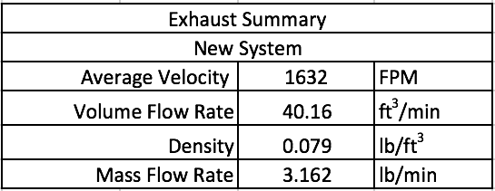
Stock and Custom Flow Comparison
Flow characteristics were a primary consideration so that engine performance and operation were not drastically effected

Slide 13
Simulated Backpressure
Stock:
95.1 kg/hr
New System:
86.1 kg/hr

Slide 14
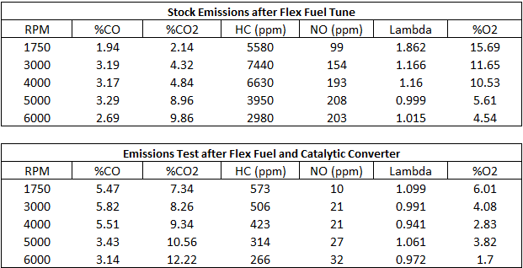
Emissions
Average Percent Difference:
92.2% decrease in HC, 87.0% decrease in NO,
58.4% increase in CO₂ , and a 61.6% decrease in O₂

Slide 15
MSRP
Component | Cost | Comments
Stock Sled | $13,999
Muffler | $1,200 | Estimated including hourly wage of welder
Catalyst | $97.71
Ethanol Sensor | $349
Traction Studs | $228
Runners | $60
Resonator Removal | (-703.99) | PN: 1262701
Total | 15,299.72

Slide 16
Lessons Learned
AFR is too Lean
Run Closer to Stoich
Improve Catalyst Insulation Method
Tune Suspension for Improved Handling
Use Emissions Data to Improve Catalyst Substrate
Perform Engine Dyno Tests Before Competition

Slide 17
Thank You Sponsors
College of Engineering and Computing Technology Dean’s Office

Slide 19
2018 SAE Clean Snowmobile MSRP Presentation
Ferris State
Clean Snowmobile

Slide 20
Overview
Stock Sled
Custom Muffler
Catalytic Converter
Ethanol Sensor
Traction Control
Deleted Parts

Slide 21
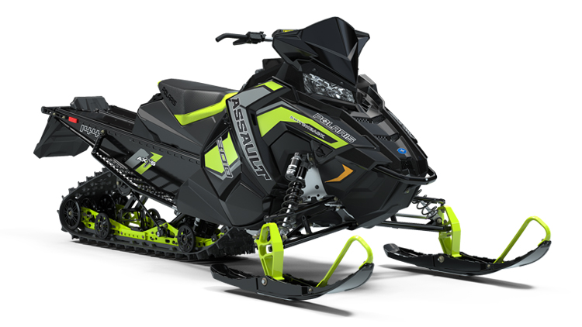
Stock Sled
2017 Polaris 800 Switchback Assault 144
$13,999

Slide 22
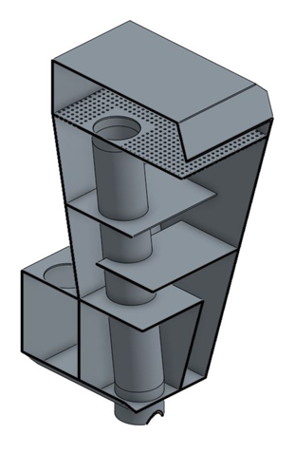
Muffler
Wholesale Cost
304 Stainless Steel and Heat Wrap
$300
Welding Man-Hours
$500
Retail Cost
$800 x 1.5 Multiplier
$1200

Slide 23
Catalyst
MagnaFlow Universal Spun Catalyst
Metallic Substrate
200 CPI
$97.71

Slide 24
Ethanol Sensor
Zeitronix ECA-2
Heads-up Display
$349

Slide 25
Traction Control
Studs
$228
Runners
$60

Slide 26
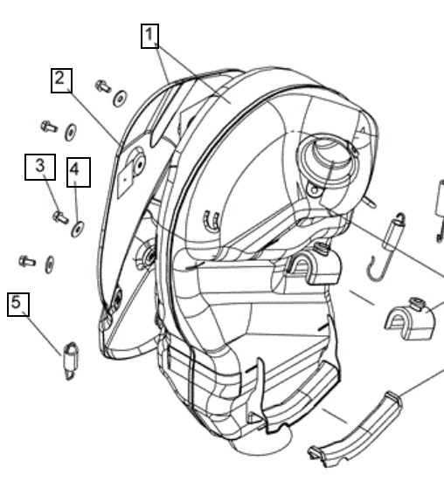
Stock Resonator Removal
AXYS Resonator
(-$703.99)
PN: 1262701

Slide 27
Total
Component | Cost | Comments
Stock Sled | $13,999
Muffler | $1,200 | Estimated including hourly wage of welder
Catalyst | $97.71
Ethanol Sensor | $349
Traction Studs | $228
Runners | $60
Resonator Removal | (-703.99) | PN: 1262701
Total | 15,299.72

Slide 28
Questions?

