Slide 1
TEAM QUIETS #04 École de technologie supérieure 2019 SAE CSC DESIGN PRESENTATION
By:
Mathieu Verner
Quentin Gravel

Slide 2
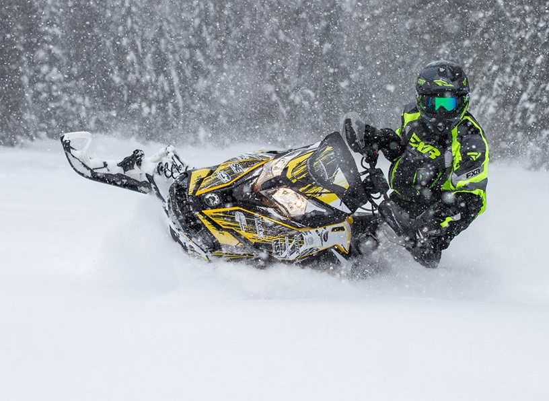
Presentation content
600 ACE turbo
Noise and efficiency
Additional features

Slide 3
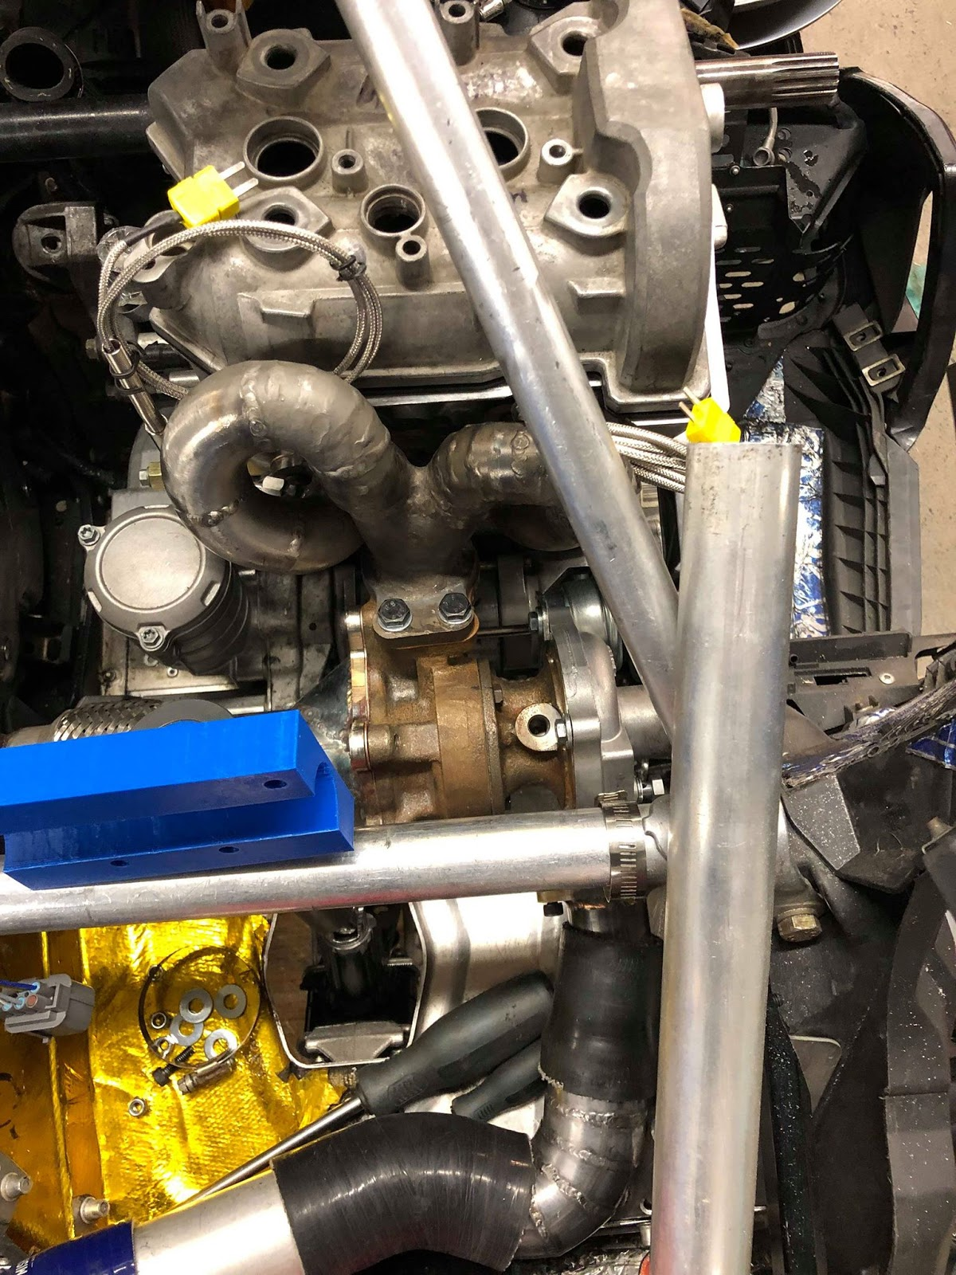
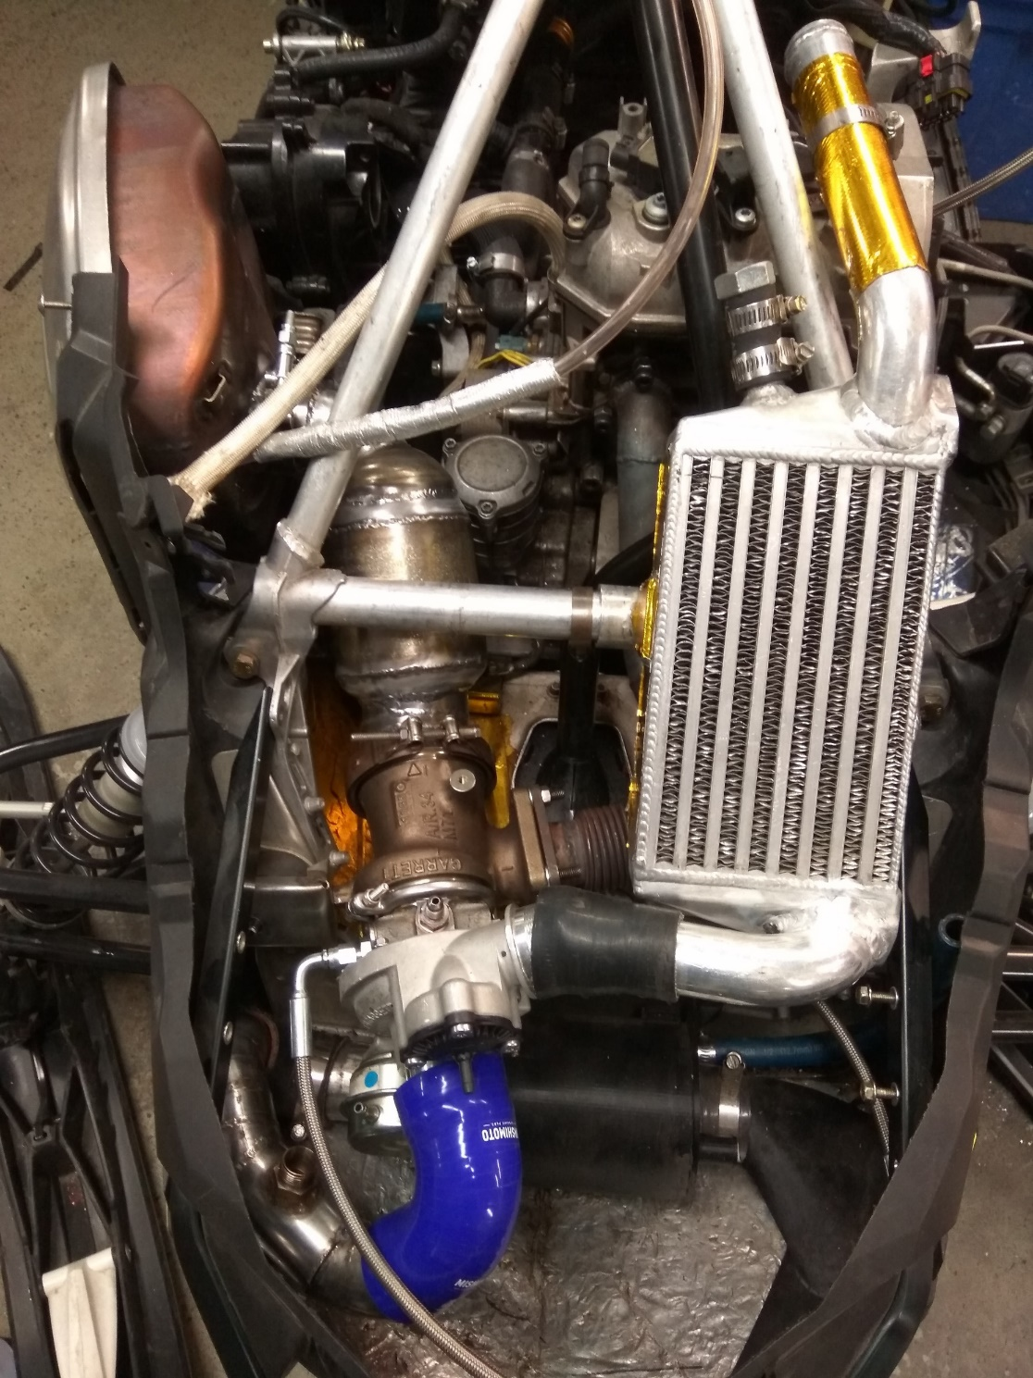
600 Ace Turbo
2019
New turbo location and exhaust manifold
2018

Slide 4
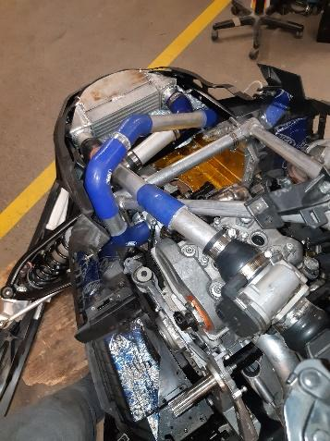
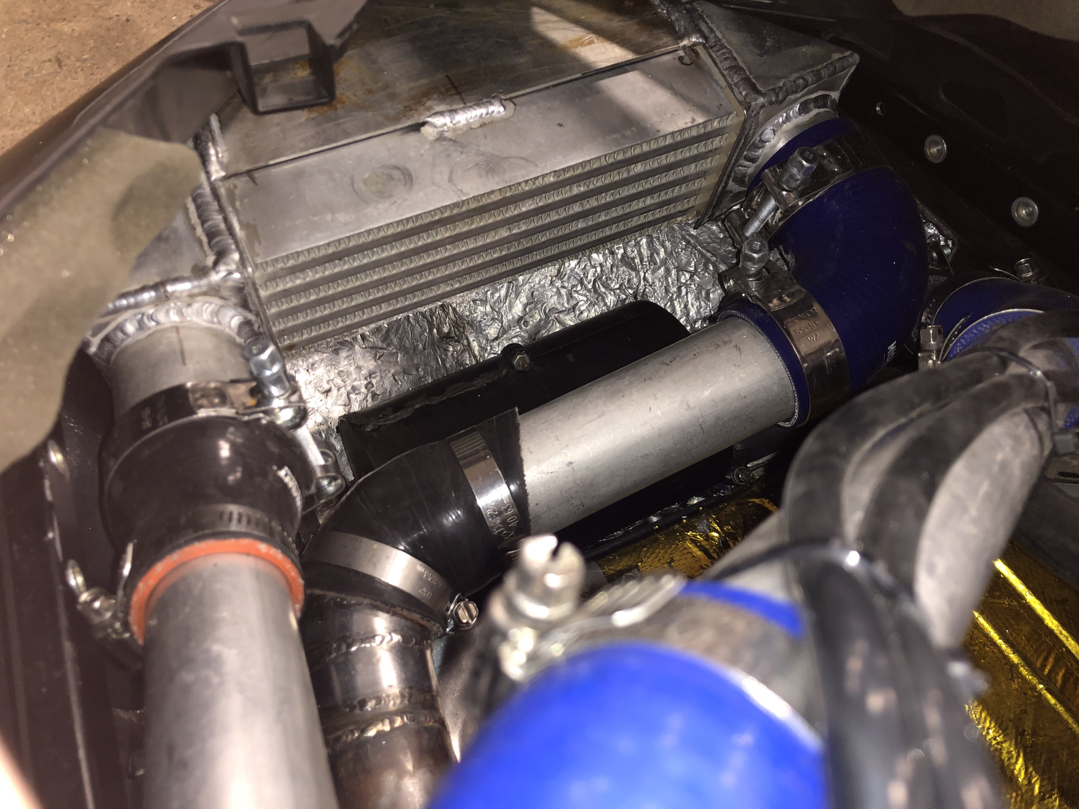
600 Ace Turbo
Intercooler

Slide 5
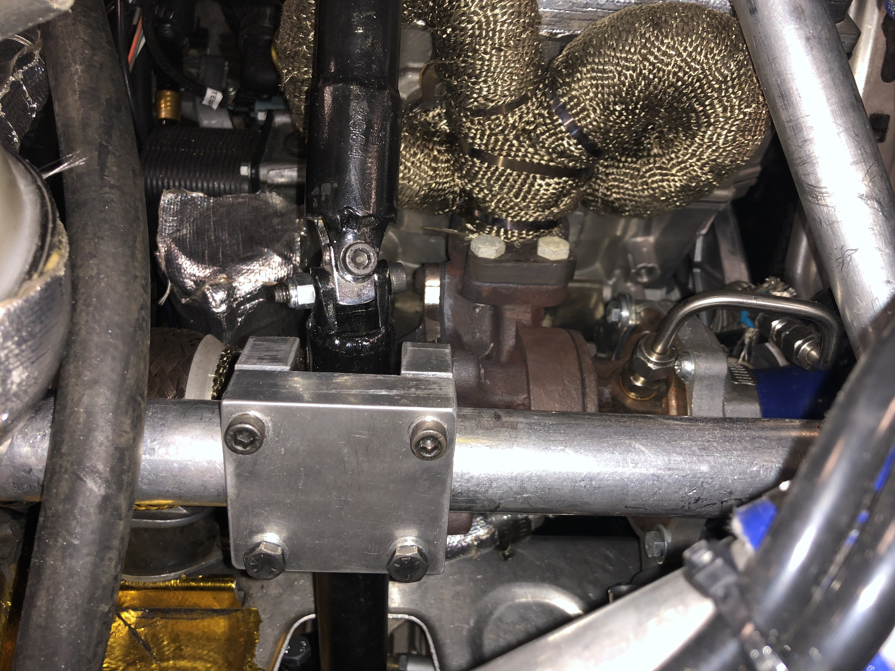
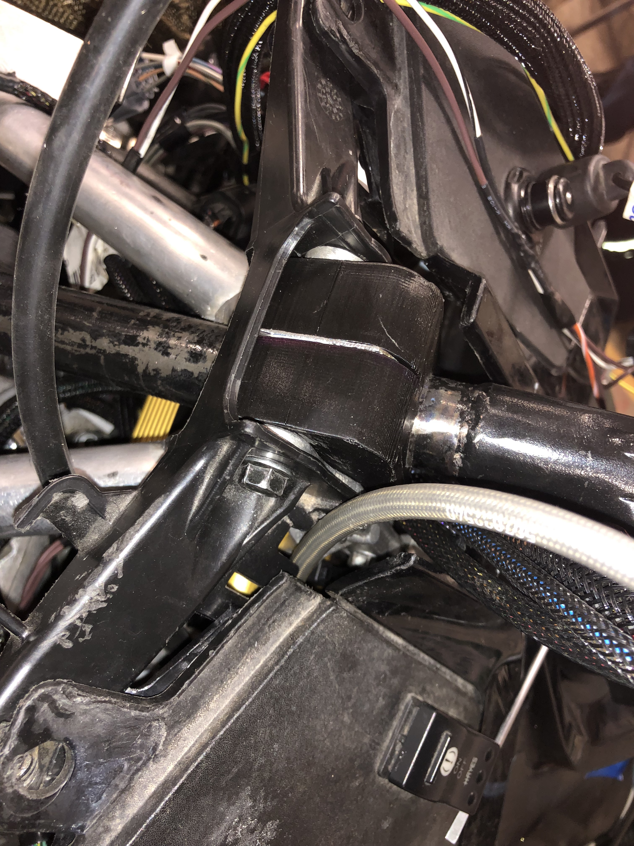
600 Ace Turbo
Steering column

Slide 6
600 ACE Turbo
2018 specifications
2019 specifications (estimations)
E20.2
79.5 hp
60.3 ft.-lbs
BSFC : 490 g/kW-hr
87 octane
90 hp
68.3 ft.-lbs
BSFC : 490 g/kW-hr

Slide 7
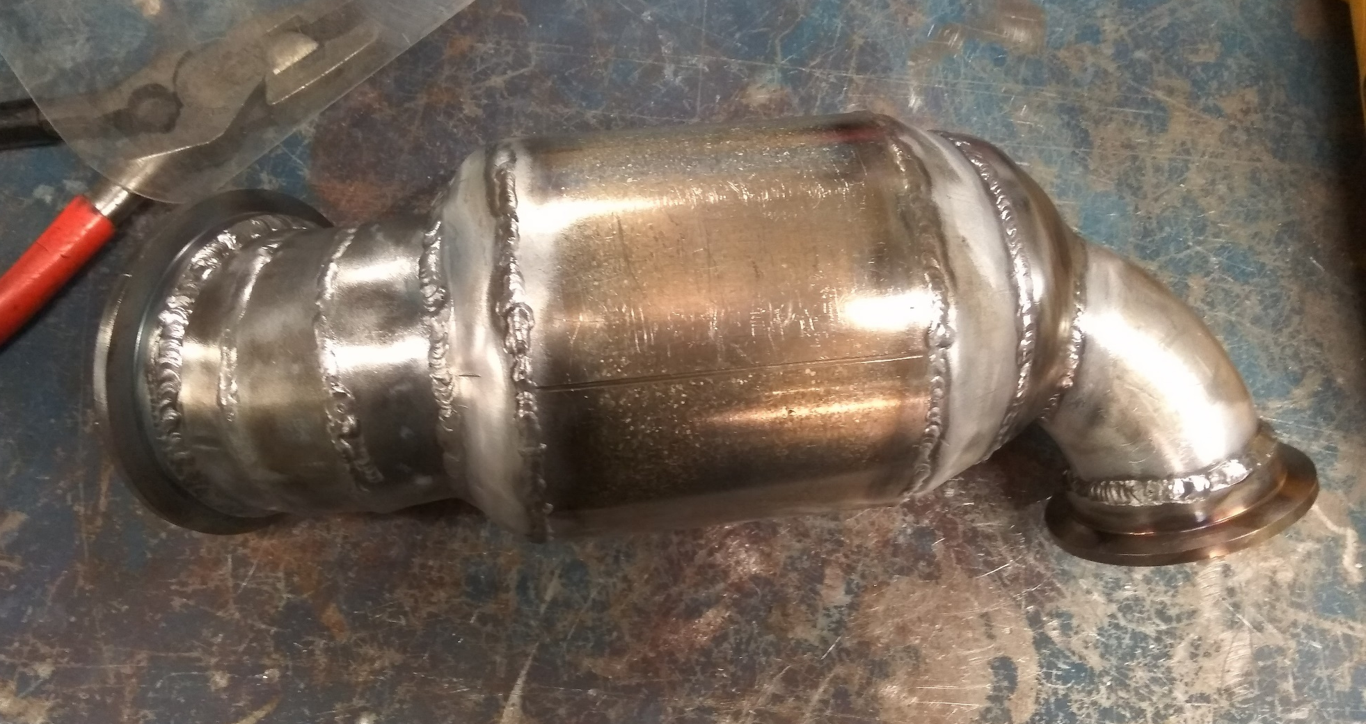
600 ACE Turbo
Catalytic converter
Larger diameter
Better flow
Lower emissions

Slide 8
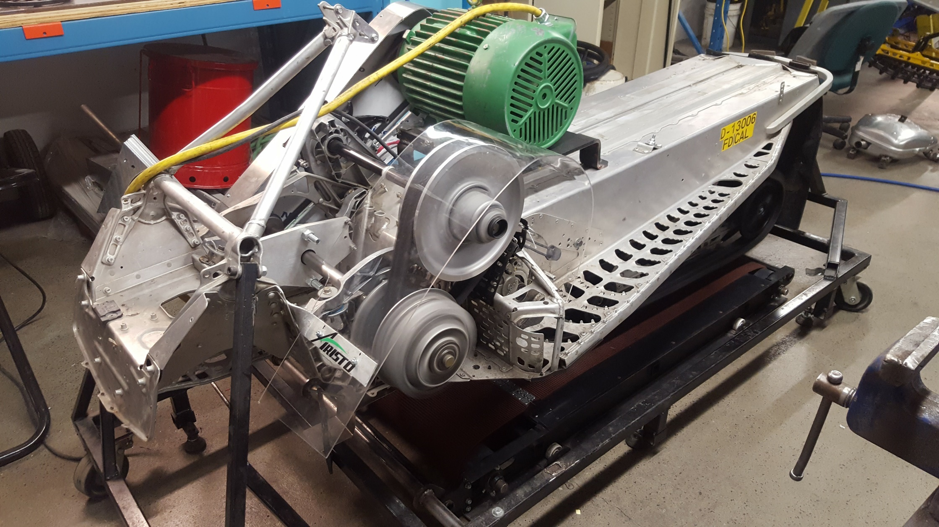
Noise and efficiency

Slide 9
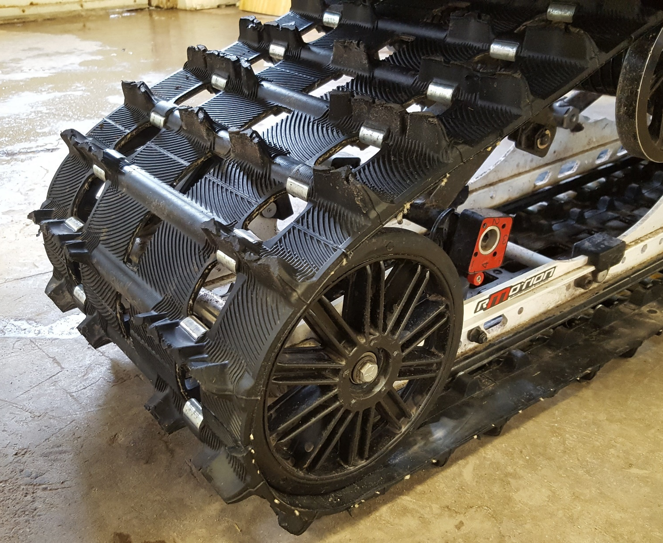
Noise and efficiency
Big wheels and track
Modified track structure
8” plastic/rubber big wheels
15% amperage draw reduction

Slide 10
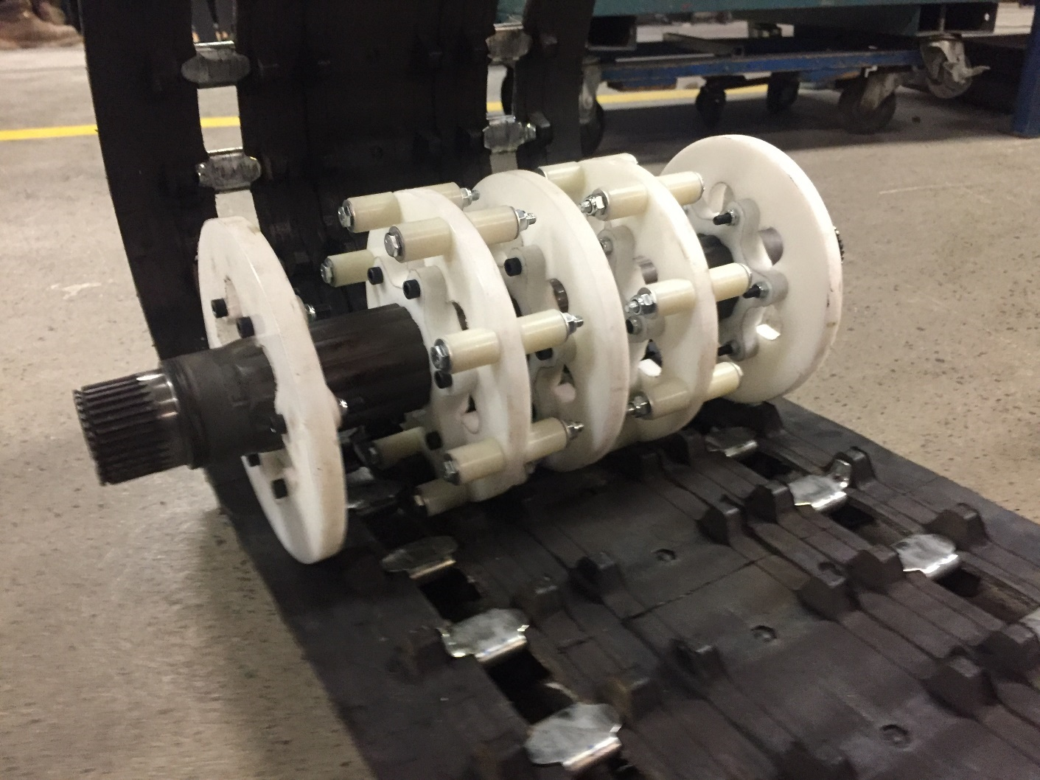
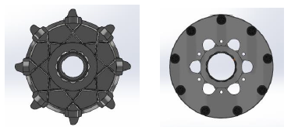
Noise and efficiency
Custom drive sprocket design
9 tooth
Constant contact
Drive rollers
4% amperage draw reduction

Slide 11
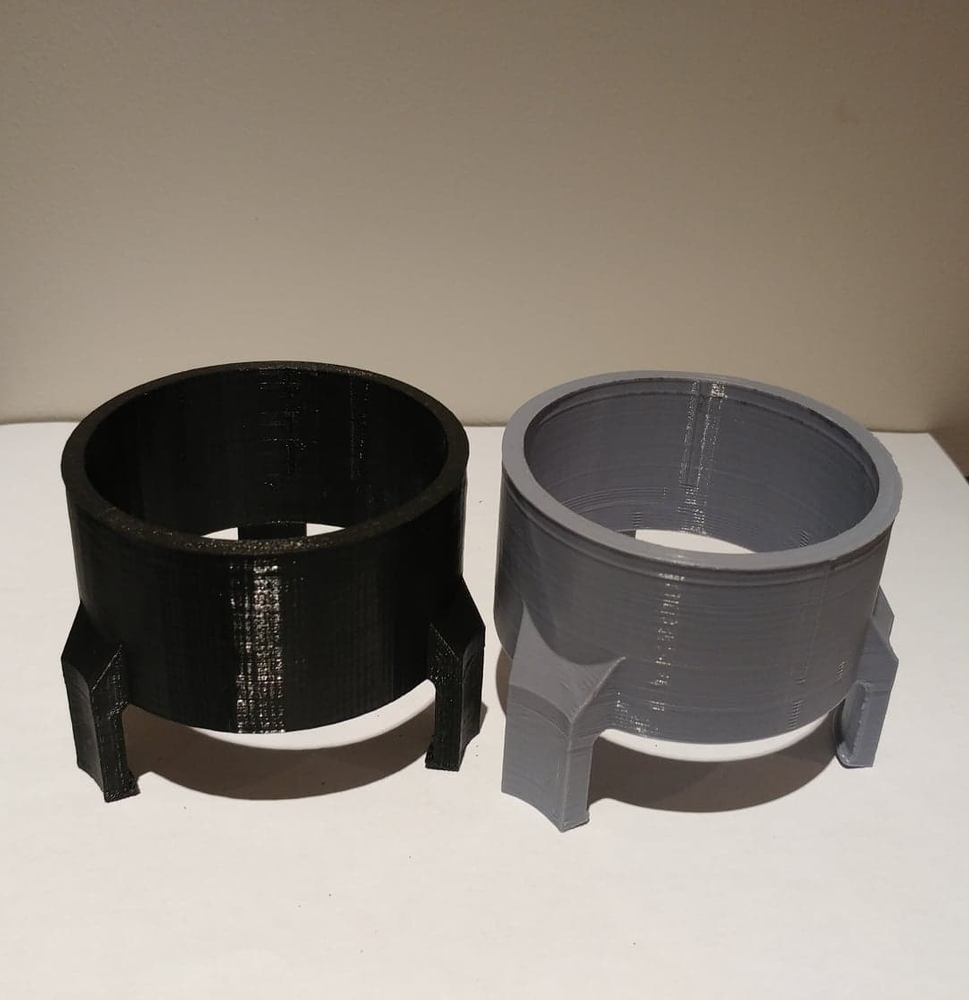
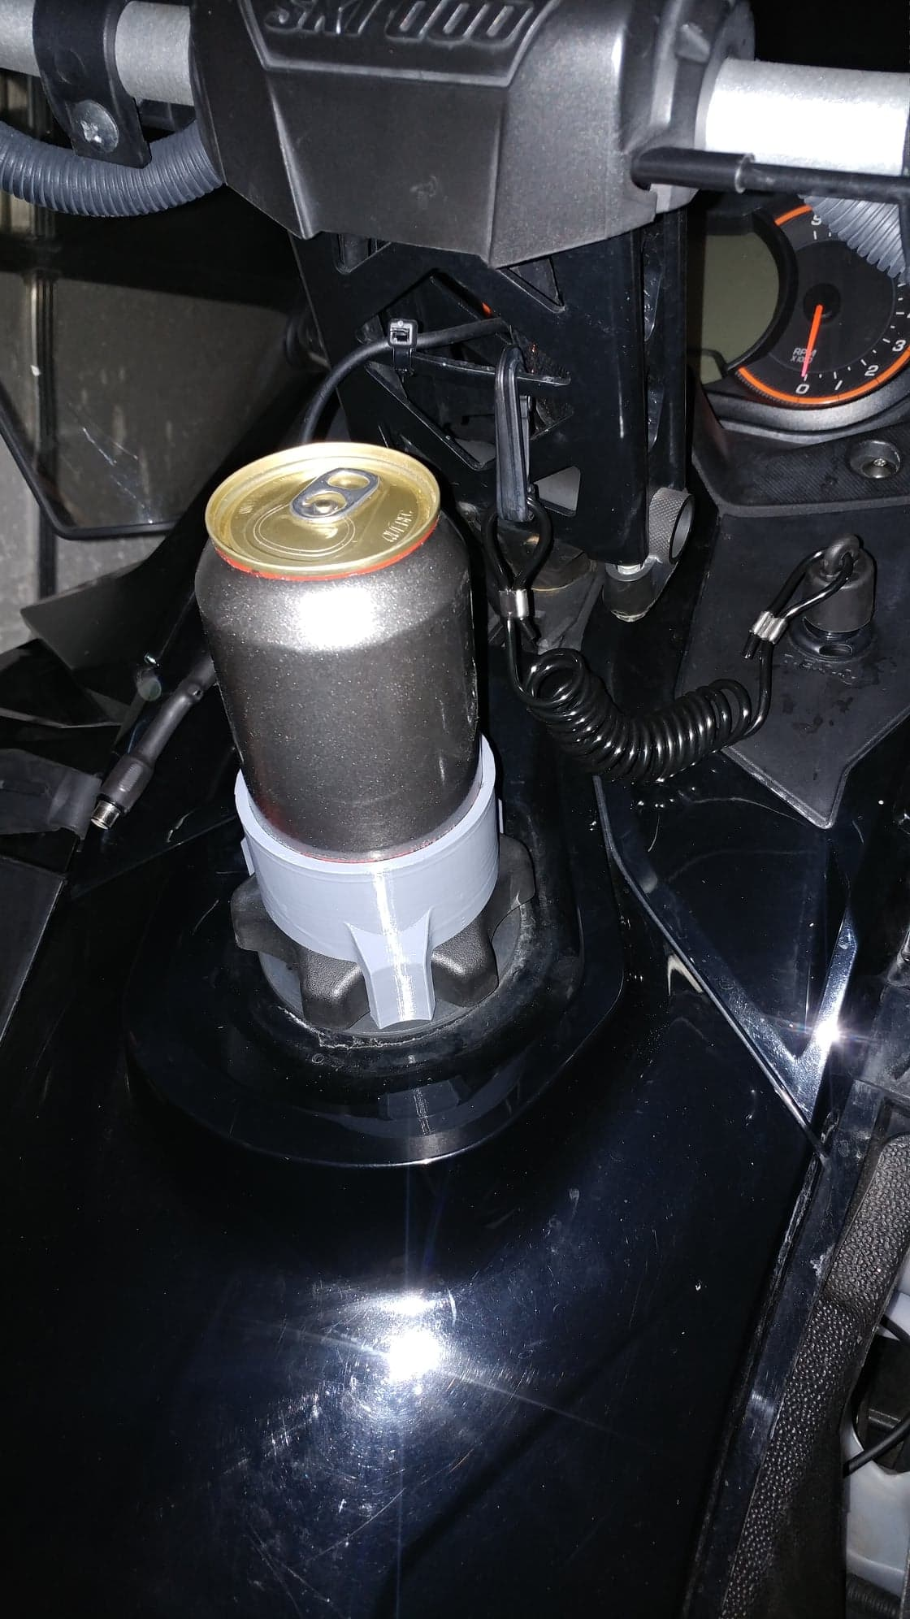
Additional features
Roller ski
Auto retractable ski wheel system
Reverse
Because every snowmobile should have a reverse
Ice scratcher
Lubricate the track clips to reduce friction
Reduce coolant temperature on icy conditions
Adjustable ski runner depth
Adapt to all snow conditions
3D printed can holder!
Coca-Cola and Redbull version available

Slide 12
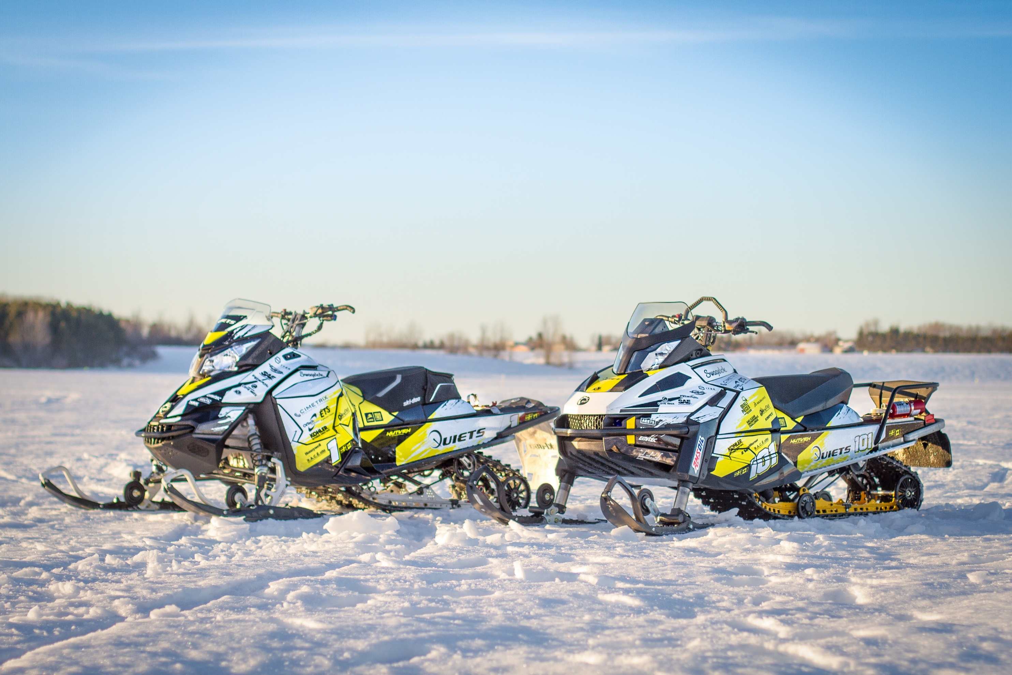
Questions?

