Slide 1

TEAM QUIETS
2018
SAE CSC DESIGN PRESENTATION
By:
Pierre-Olivier Langlois
Guillaume Verner

Slide 2
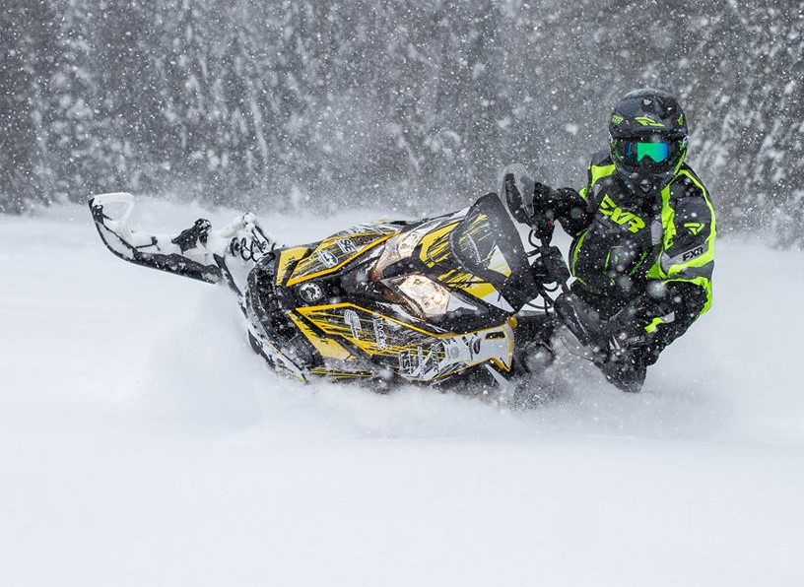
Presentation content
2018 HPDI 600 ACE
2018 600 ACE turbo
Noise and efficiency
Additional features

Slide 3
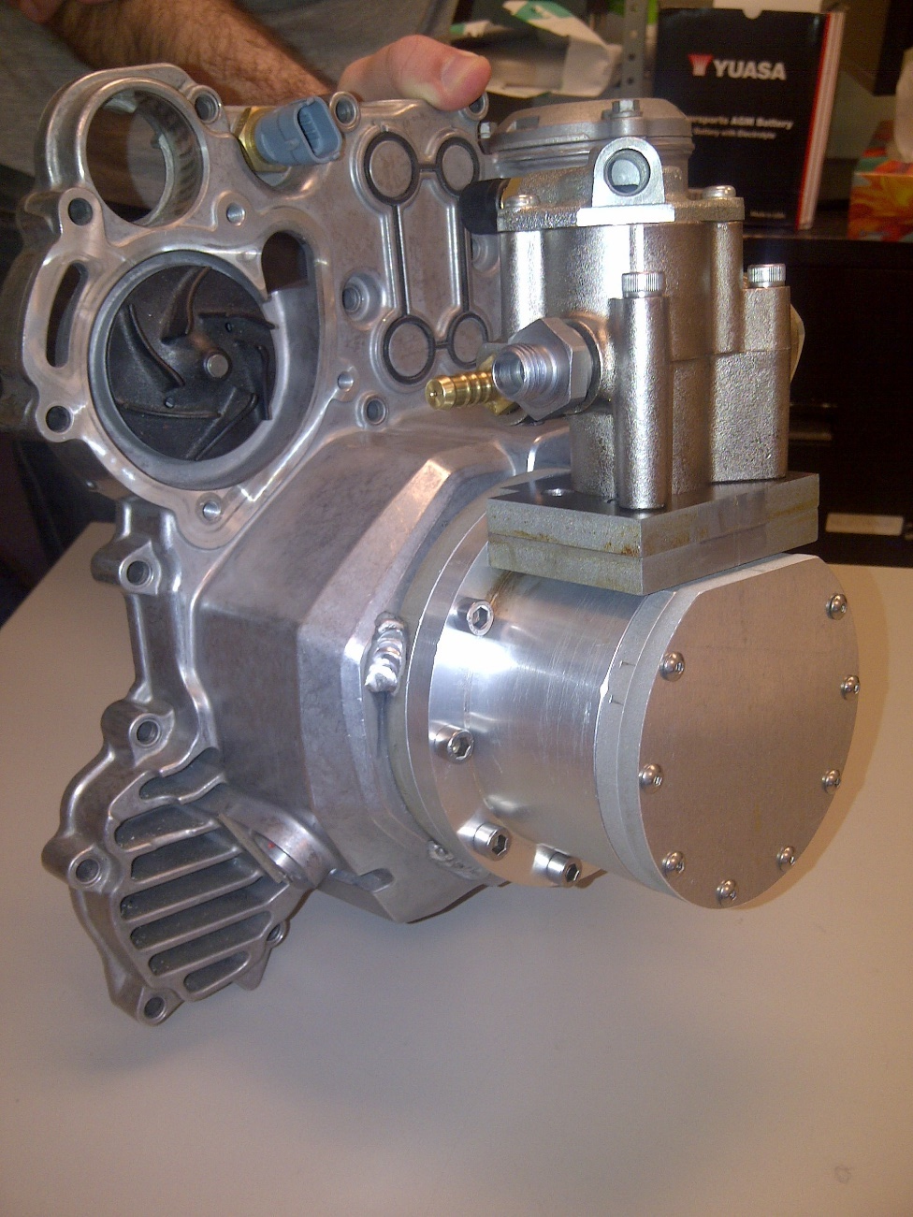
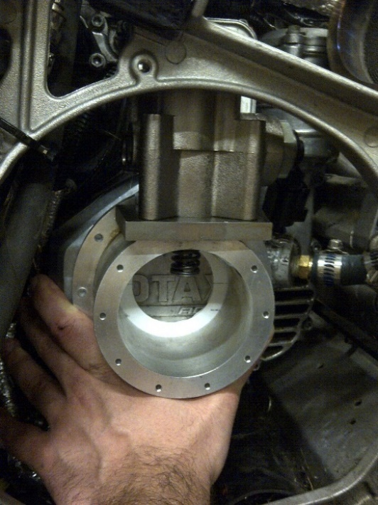
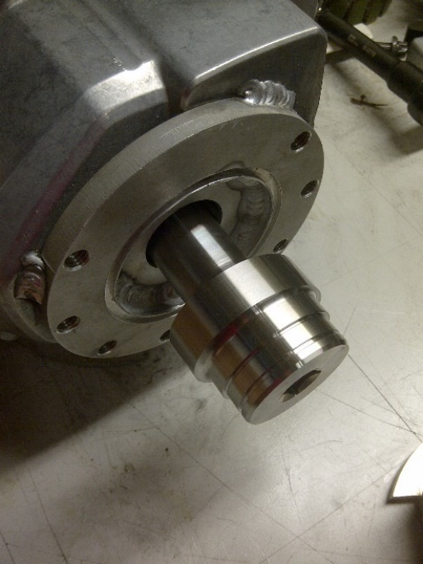
HPDI
High pressure mechanical fuel pump
  Automotive fuel pump
  Pressure range : 500 – 2500 PSI
Custom designed cam

Slide 4
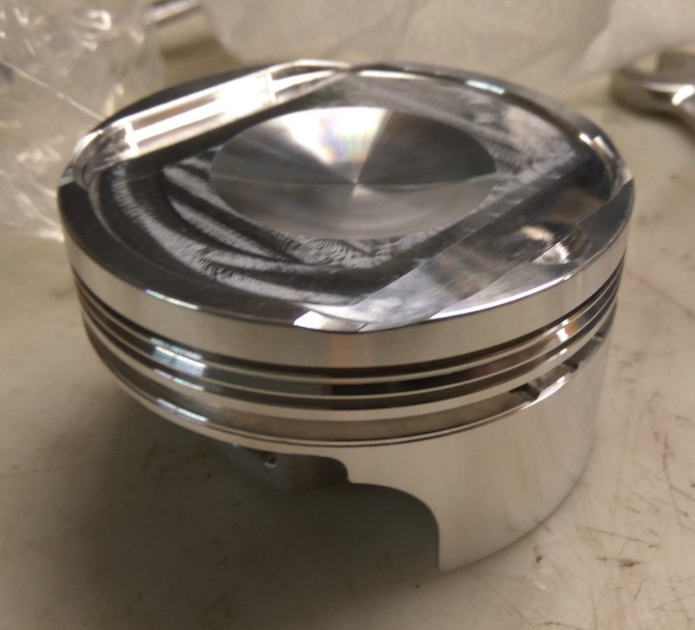
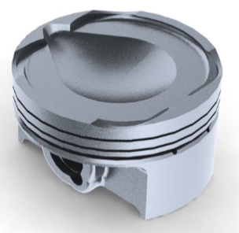
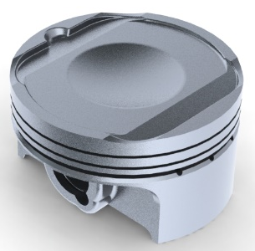
HPDI
DI optimized piston shape
  Forged aluminum
  Increased compression ratio (12.6:1)
  Optimized shape
  Maximize fuel atomization
  Prevent cylinder wall wetting
2017
2018

Slide 5
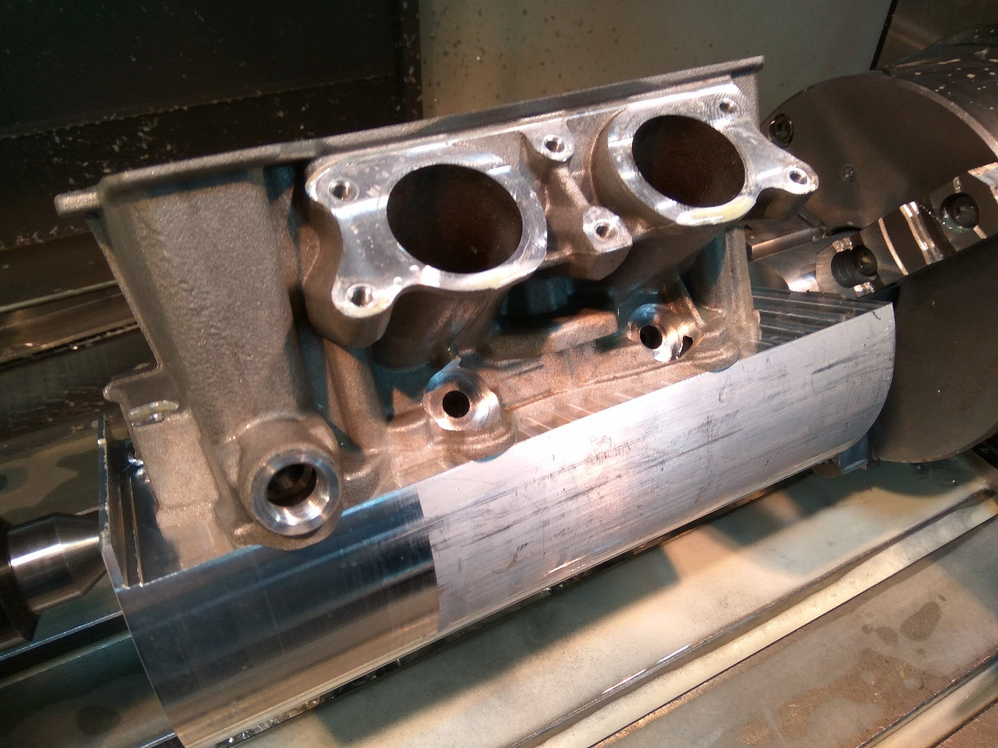
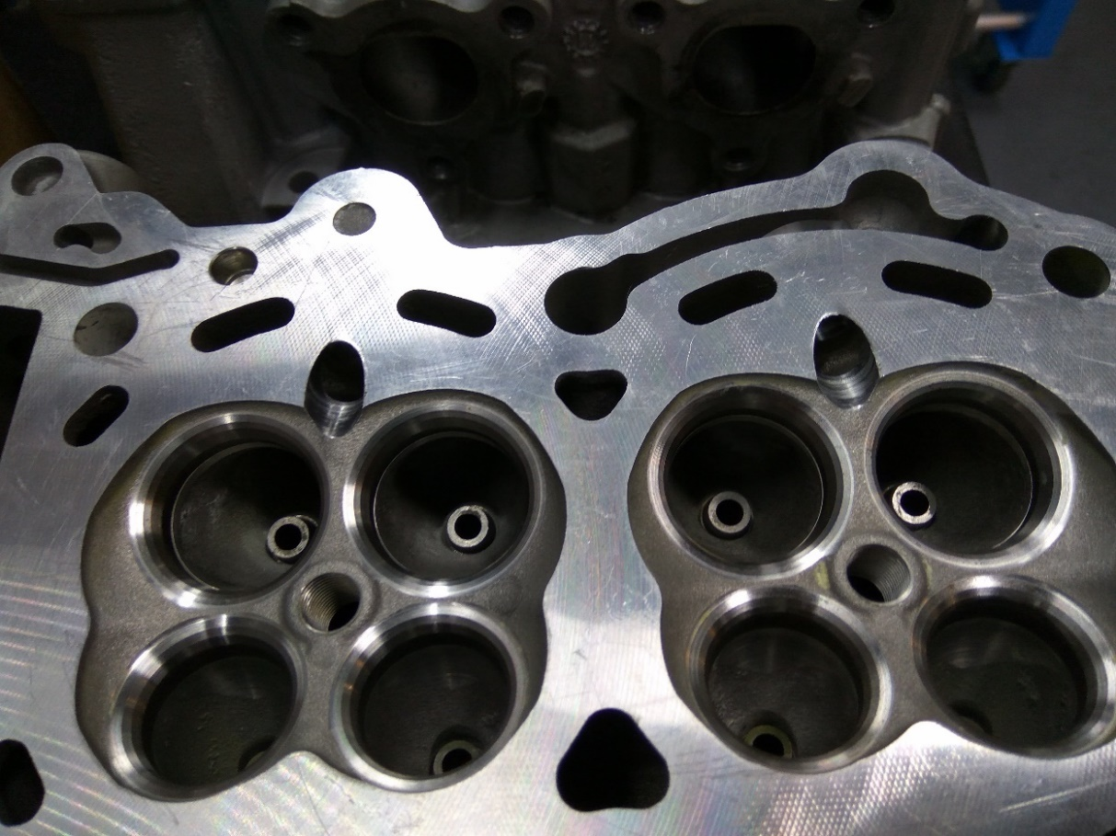
HPDI
New cylinder head design
Modified head to install DI injectors

Slide 6
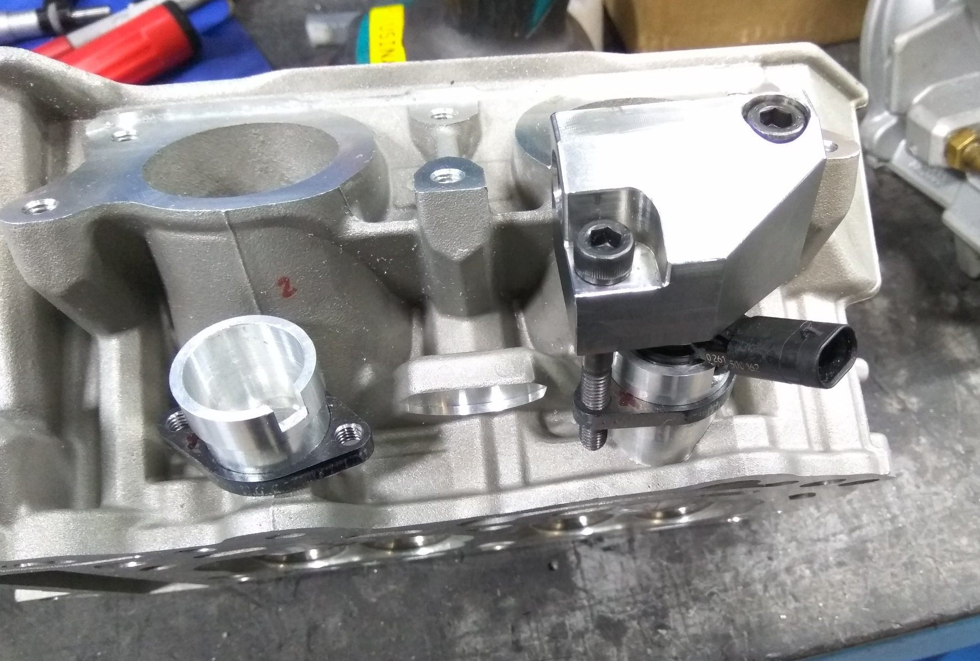
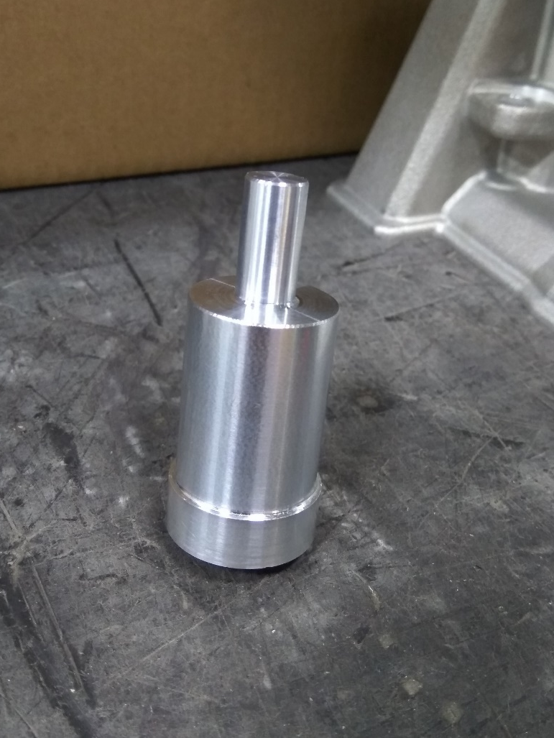
HPDI

Slide 7
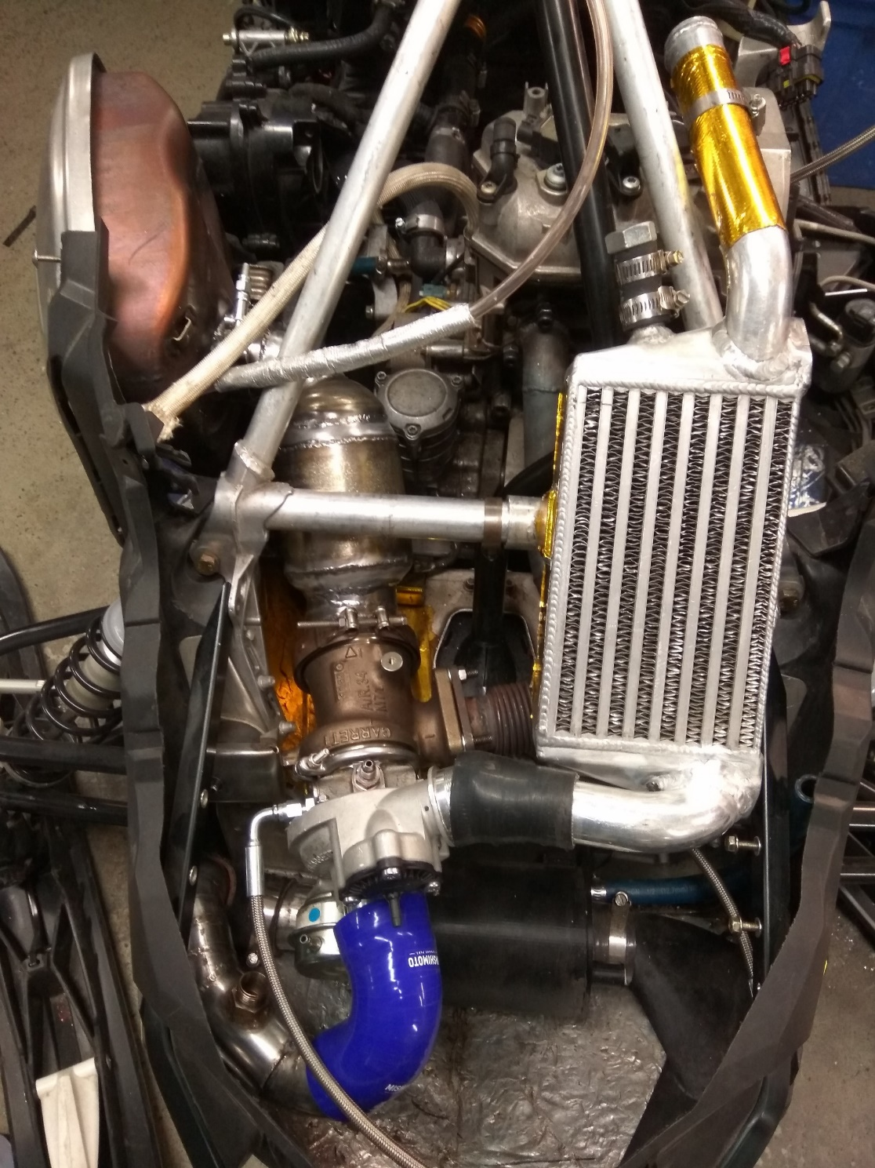
600 ACE Turbo
Specifications
87 octane
85 hp
60 ft.-lbs
BSFC : 375 g/kW-hr
E85
110 hp
80 ft.-lbs
BSFC : 450 g/kW-hr

Slide 8
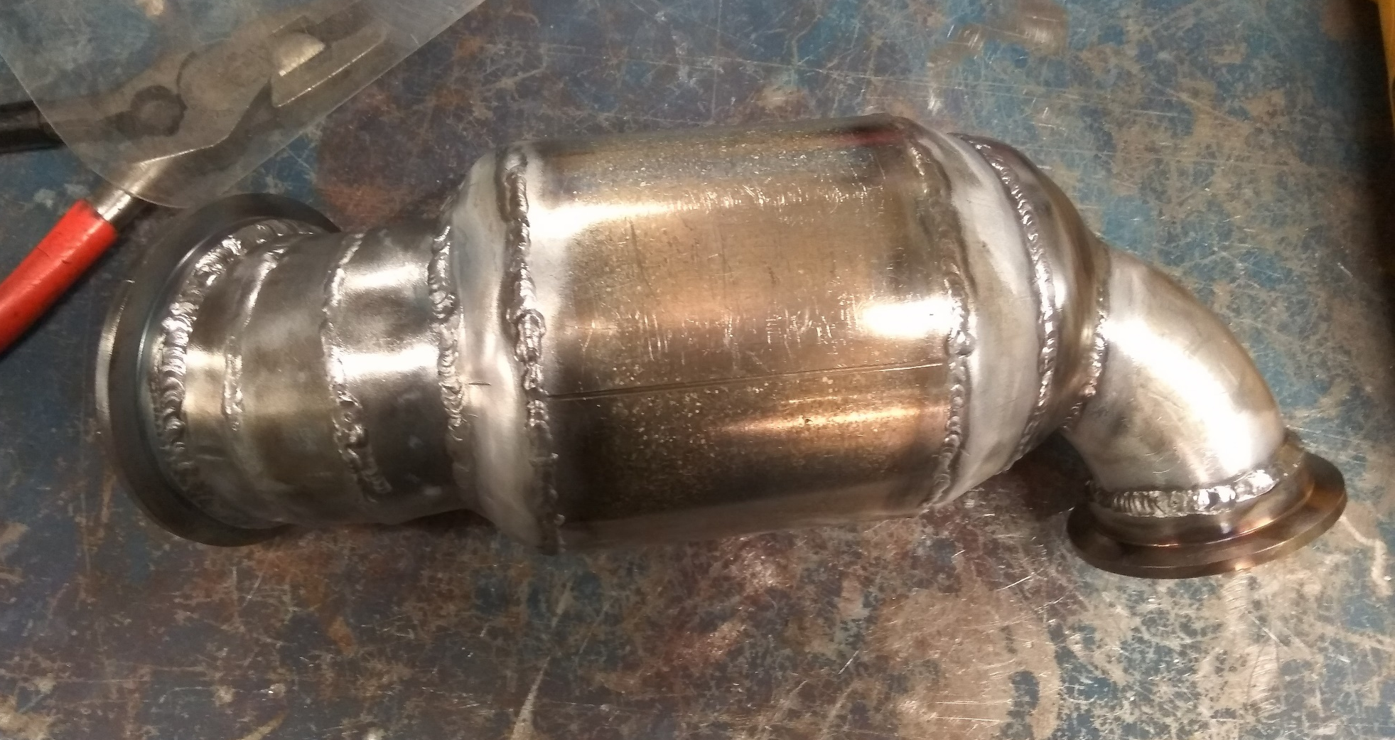
600 ACE Turbo
New catalytic converter
  Larger diameter
  Better flow
  Lower emissions

Slide 9
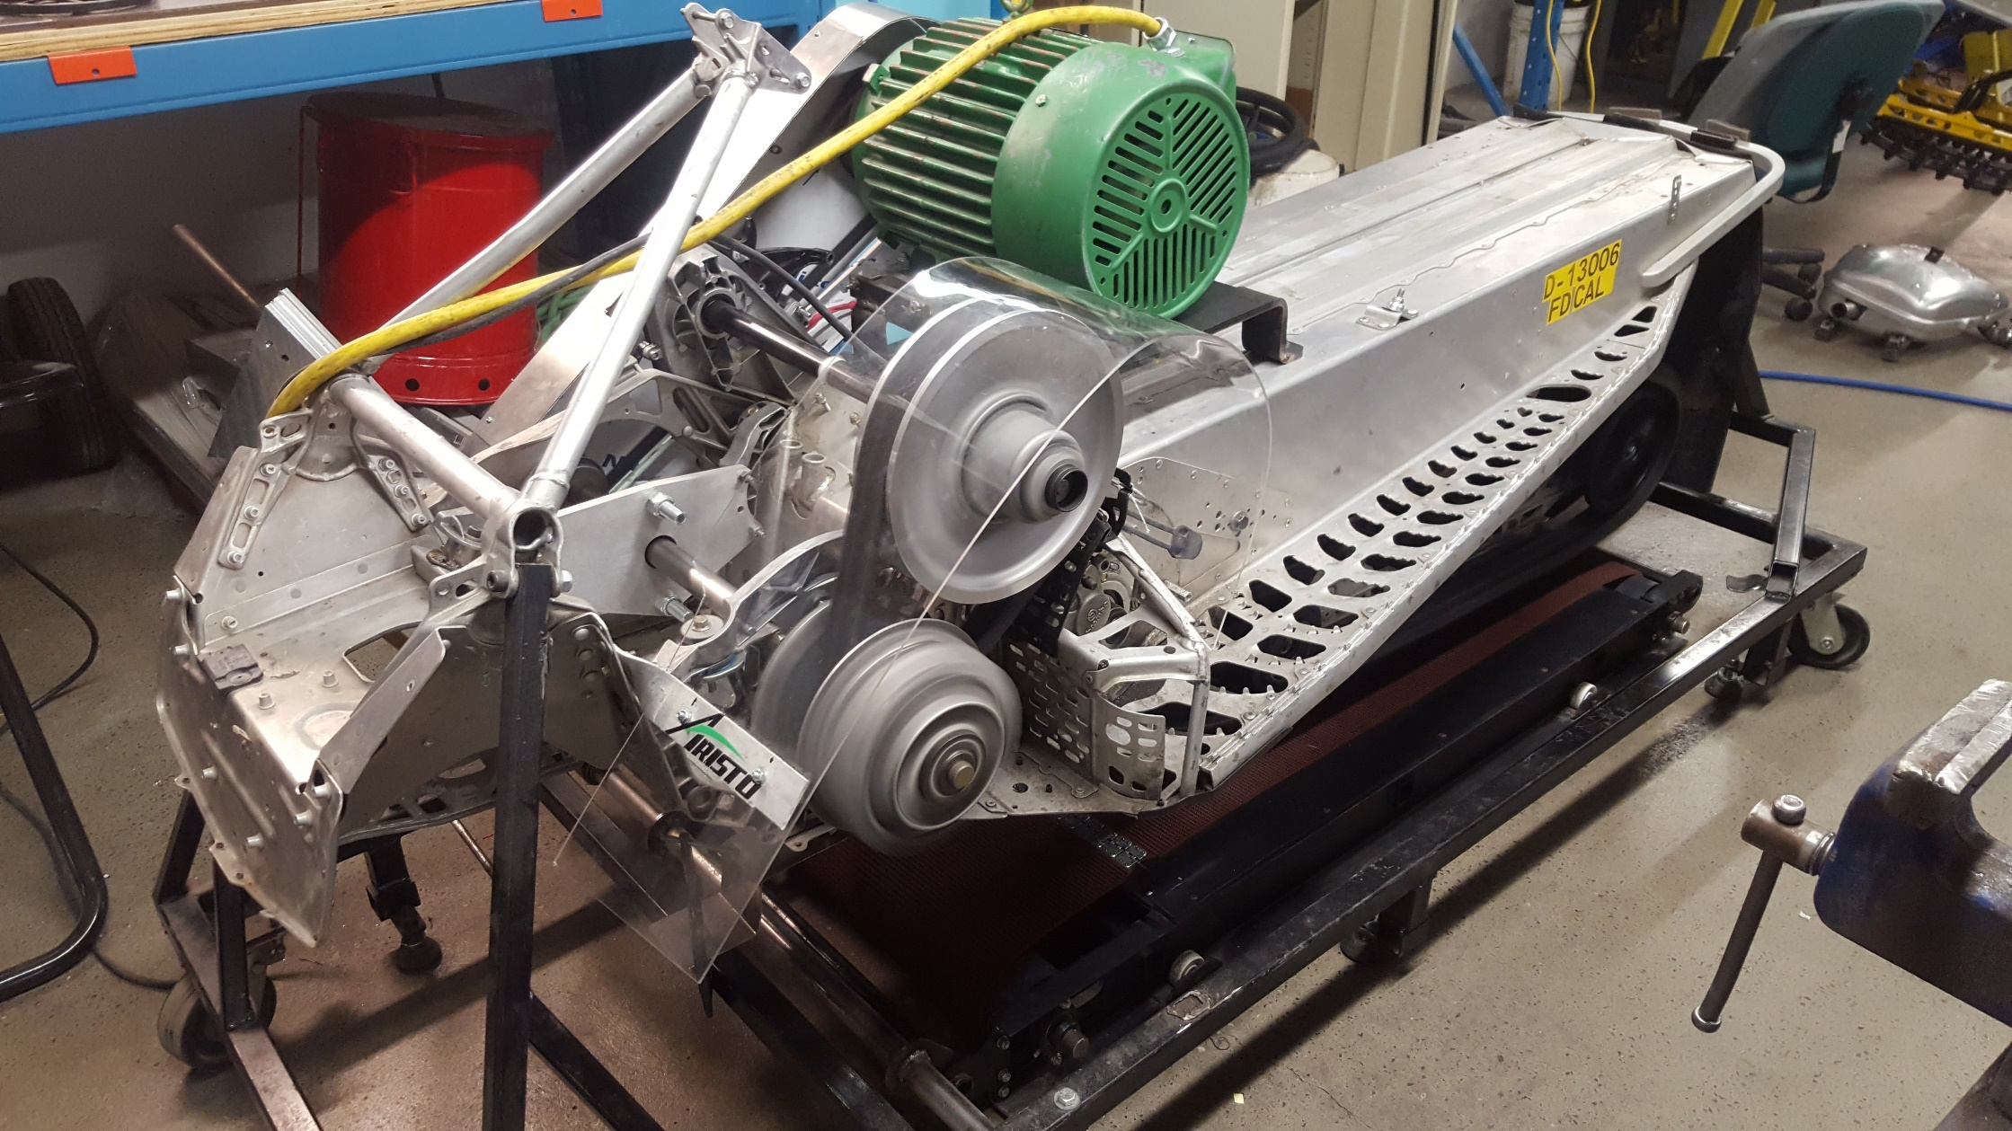
Noise and efficiency

Slide 10
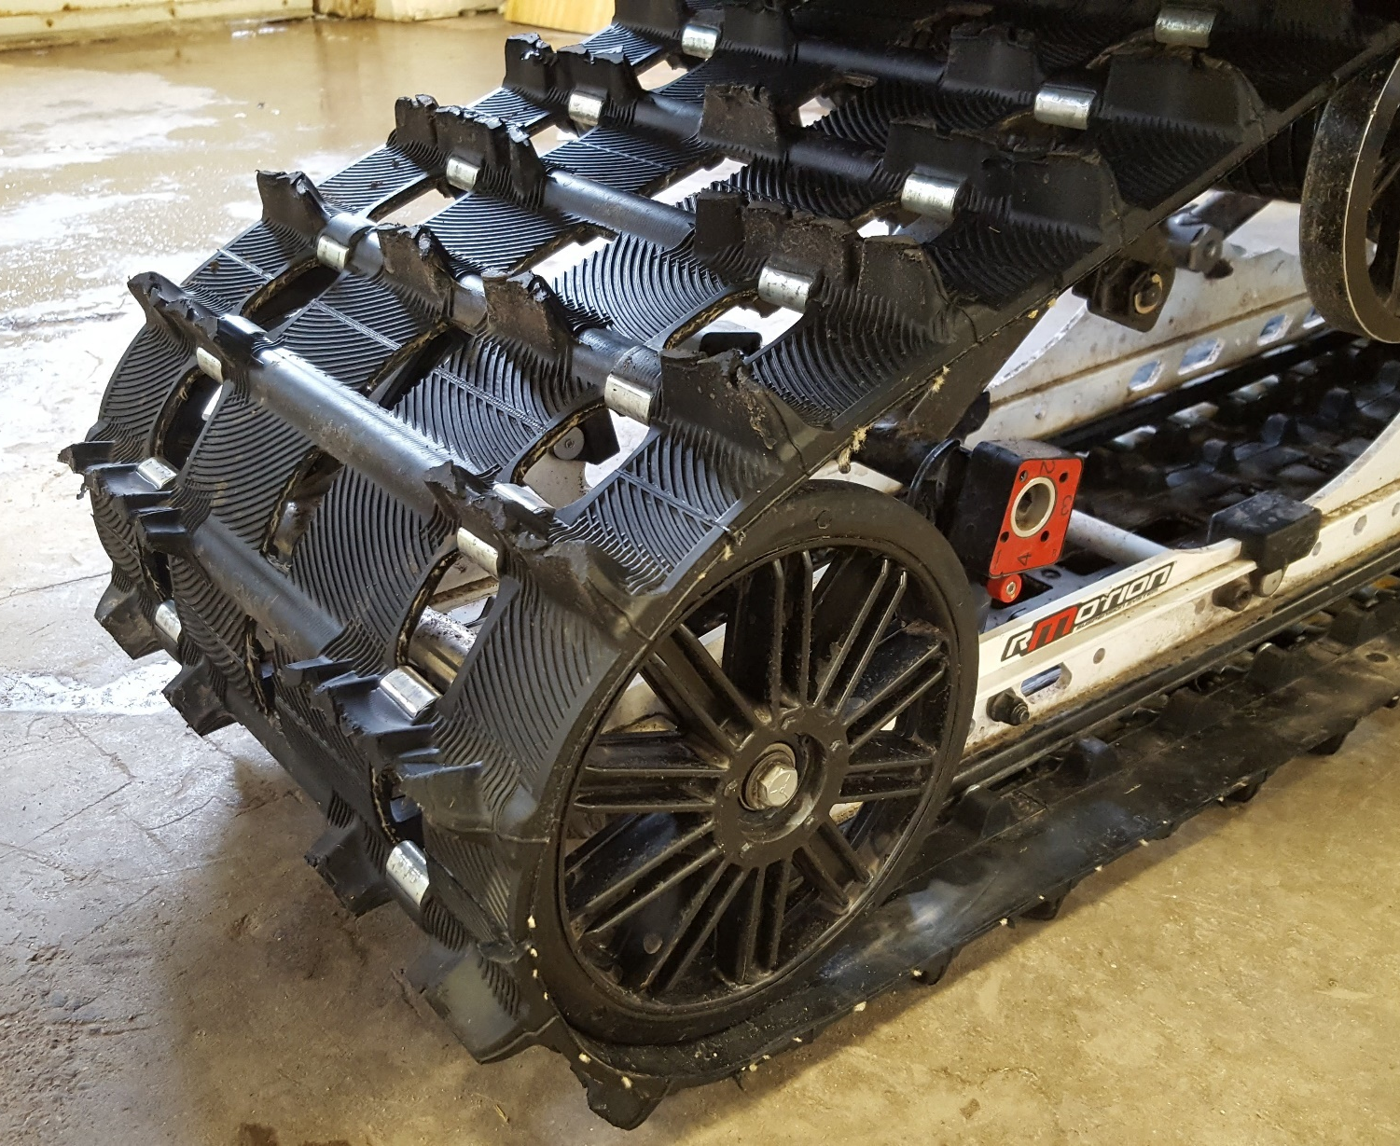
Noise and efficiency
Big wheels and track
  Modified track structure
  8” plastic/rubber big wheels
  15% amperage draw reduction

Slide 11
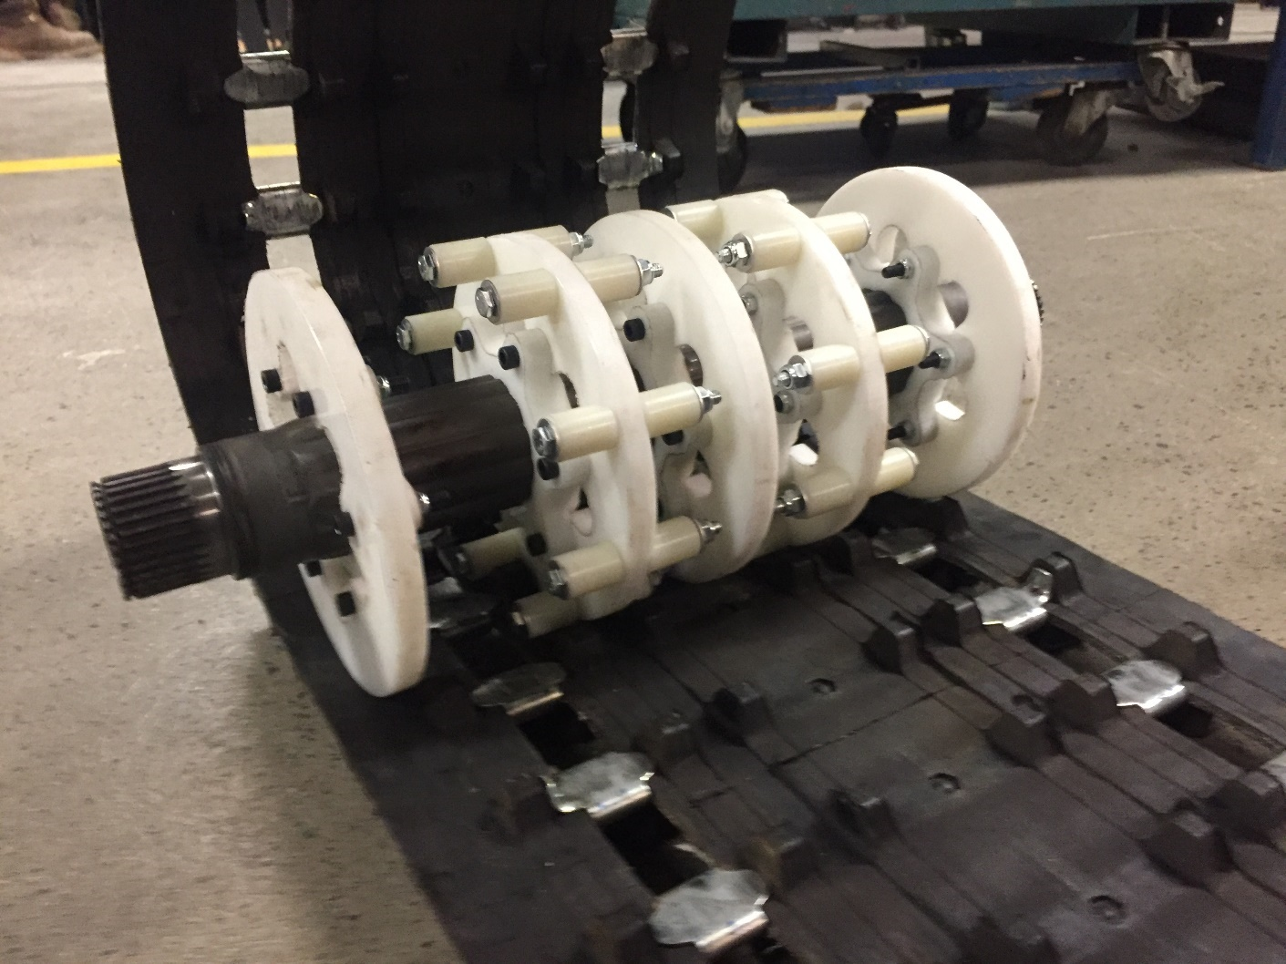
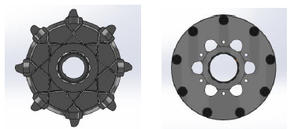
Noise and efficiency
New drive sprocket design
  9 tooth
  Constant contact
  Drive rollers
  4% amperage draw reduction

Slide 12
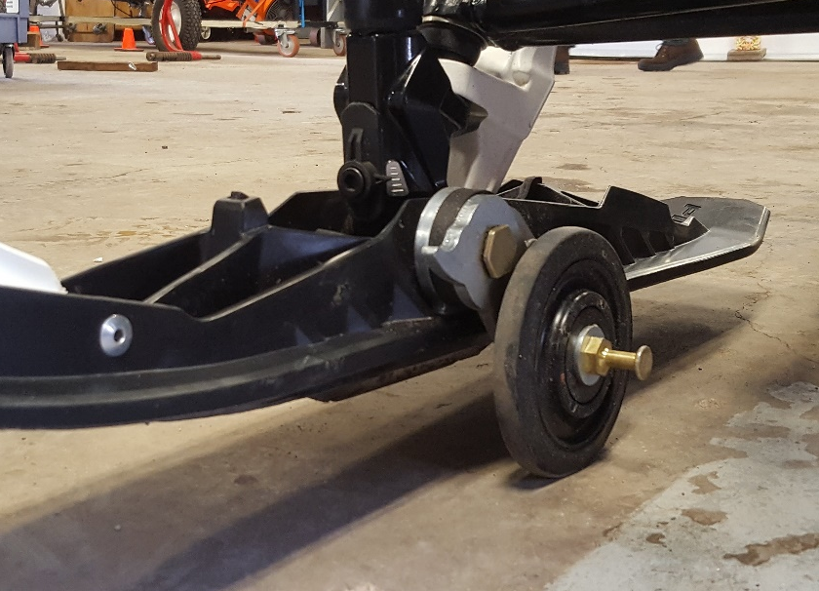
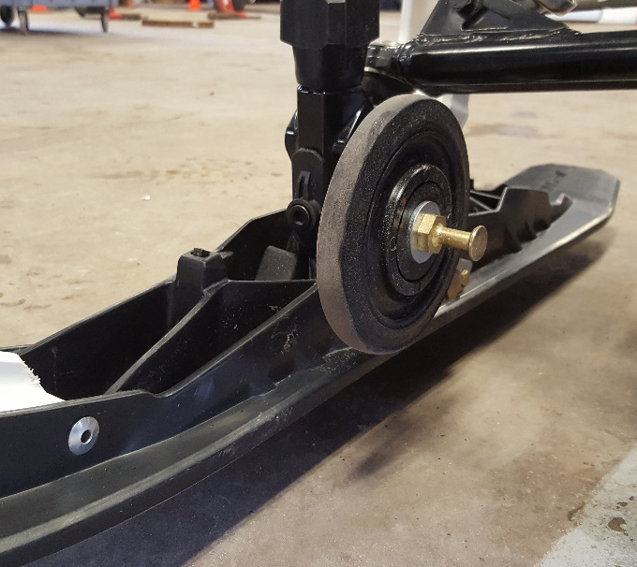
Additional features
Roller ski
  Auto retractable ski wheel system
Reverse
  Because every snowmobile should have a reverse
Ice scratcher
  Lubricate the track clips to reduce friction
  Reduce coolant temperature on icy conditions
Adjustable ski runner depth
  Adapt to all snow conditions

Slide 13
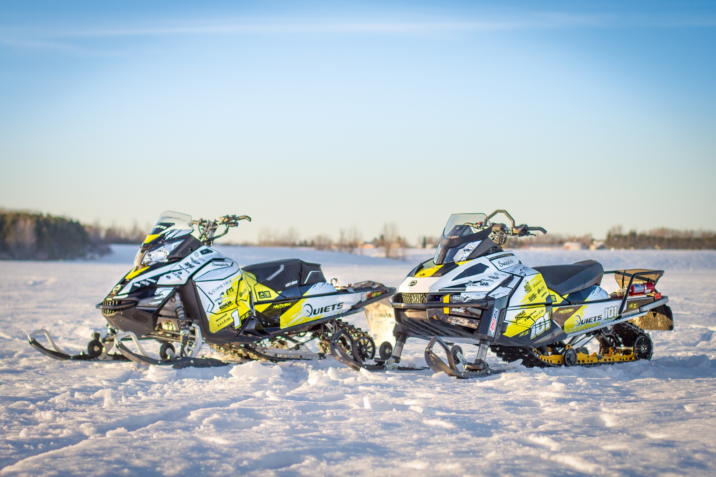
Questions?

Slide 14

Noise Reduction
Big wheels and track

