Slide 1
TEAM QUIETS 2017 SAE CSC DESIGN PRESENTATION
By:
Marc-Antoine Fitzgerald
Édouard Levesque

Slide 2
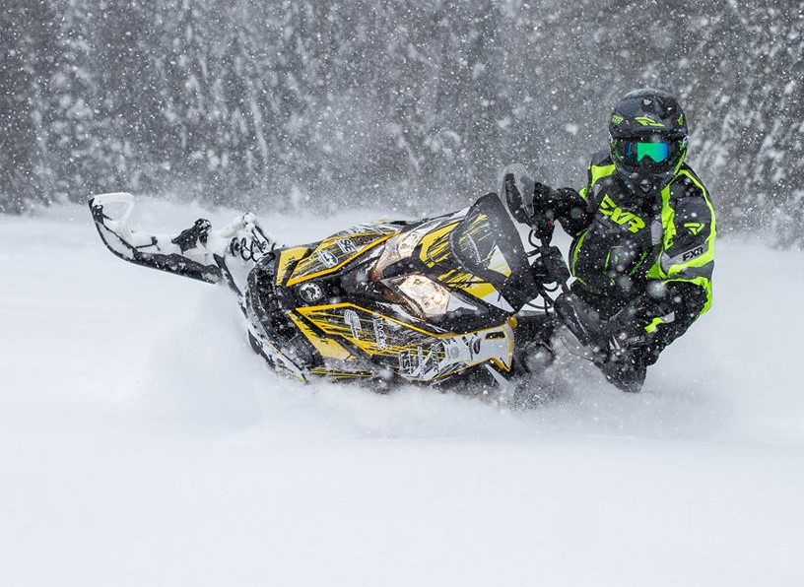
Presentation content
2017 HPDI 600 ACE
Noise Reduction
Drivetrain efficiency increase
Conclusion

Slide 3
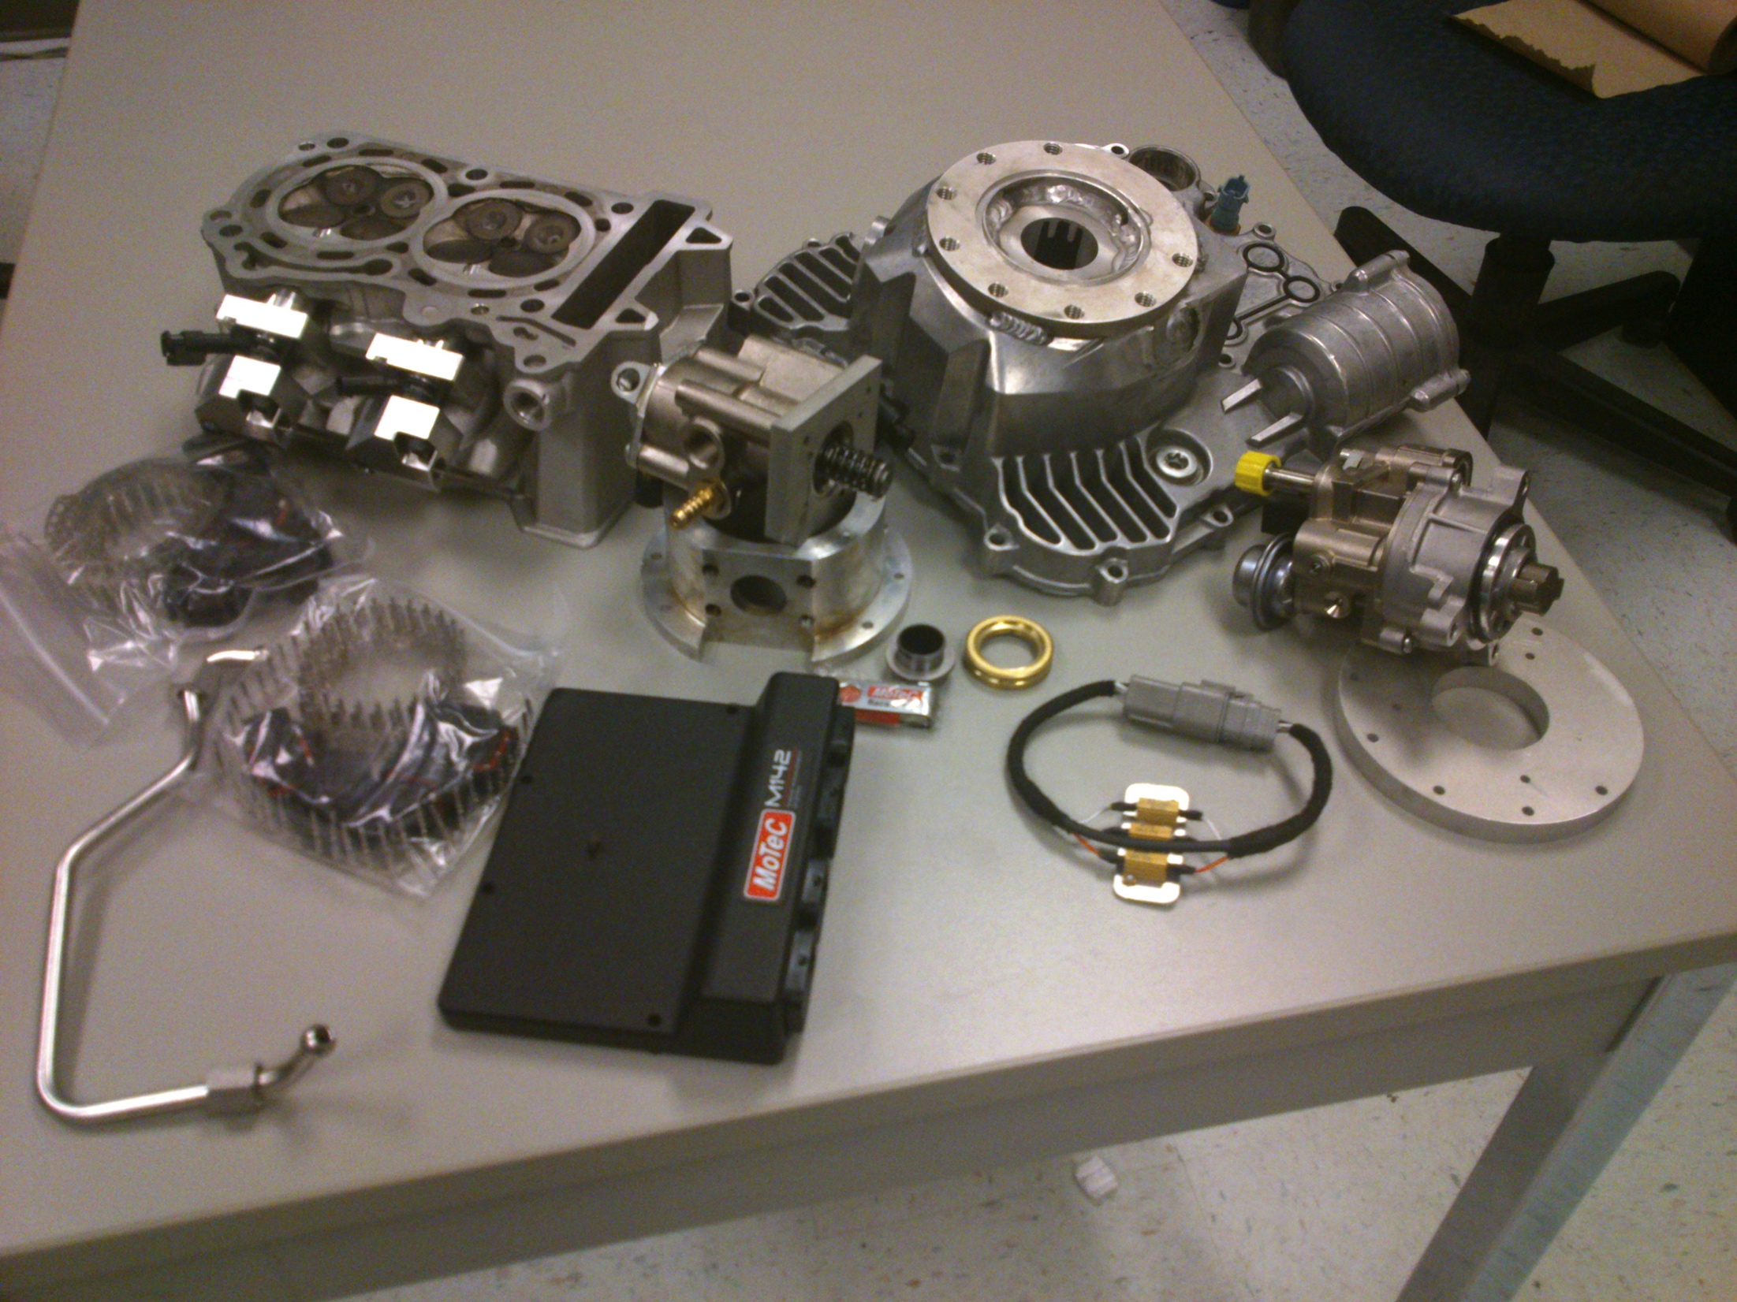
HPDI
High pressure direct injection design
Parts needed:
DI injectors
High pressure fuel pump
Modified pistons
Motec M142

Slide 4
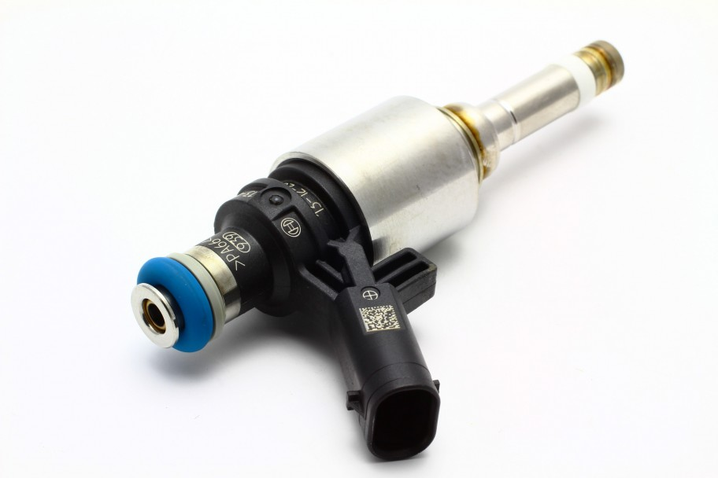
HPDI
DI injectors
Bosch model: 0 261 500 162 (found on VW 2.0 TSI)
Programming requirements:
Spray pattern
Injection curve

Slide 5
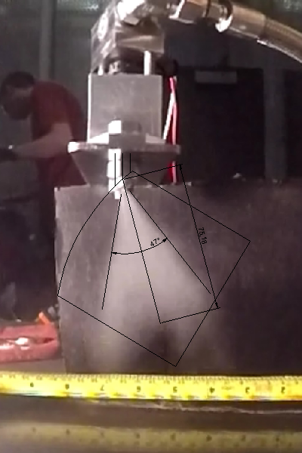
HPDI
Injection pattern
Required for cylinder head drilling and pistons design

Slide 6
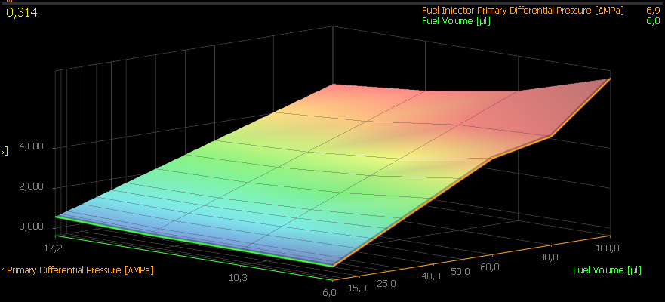
HPDI
Injection curve

Slide 7
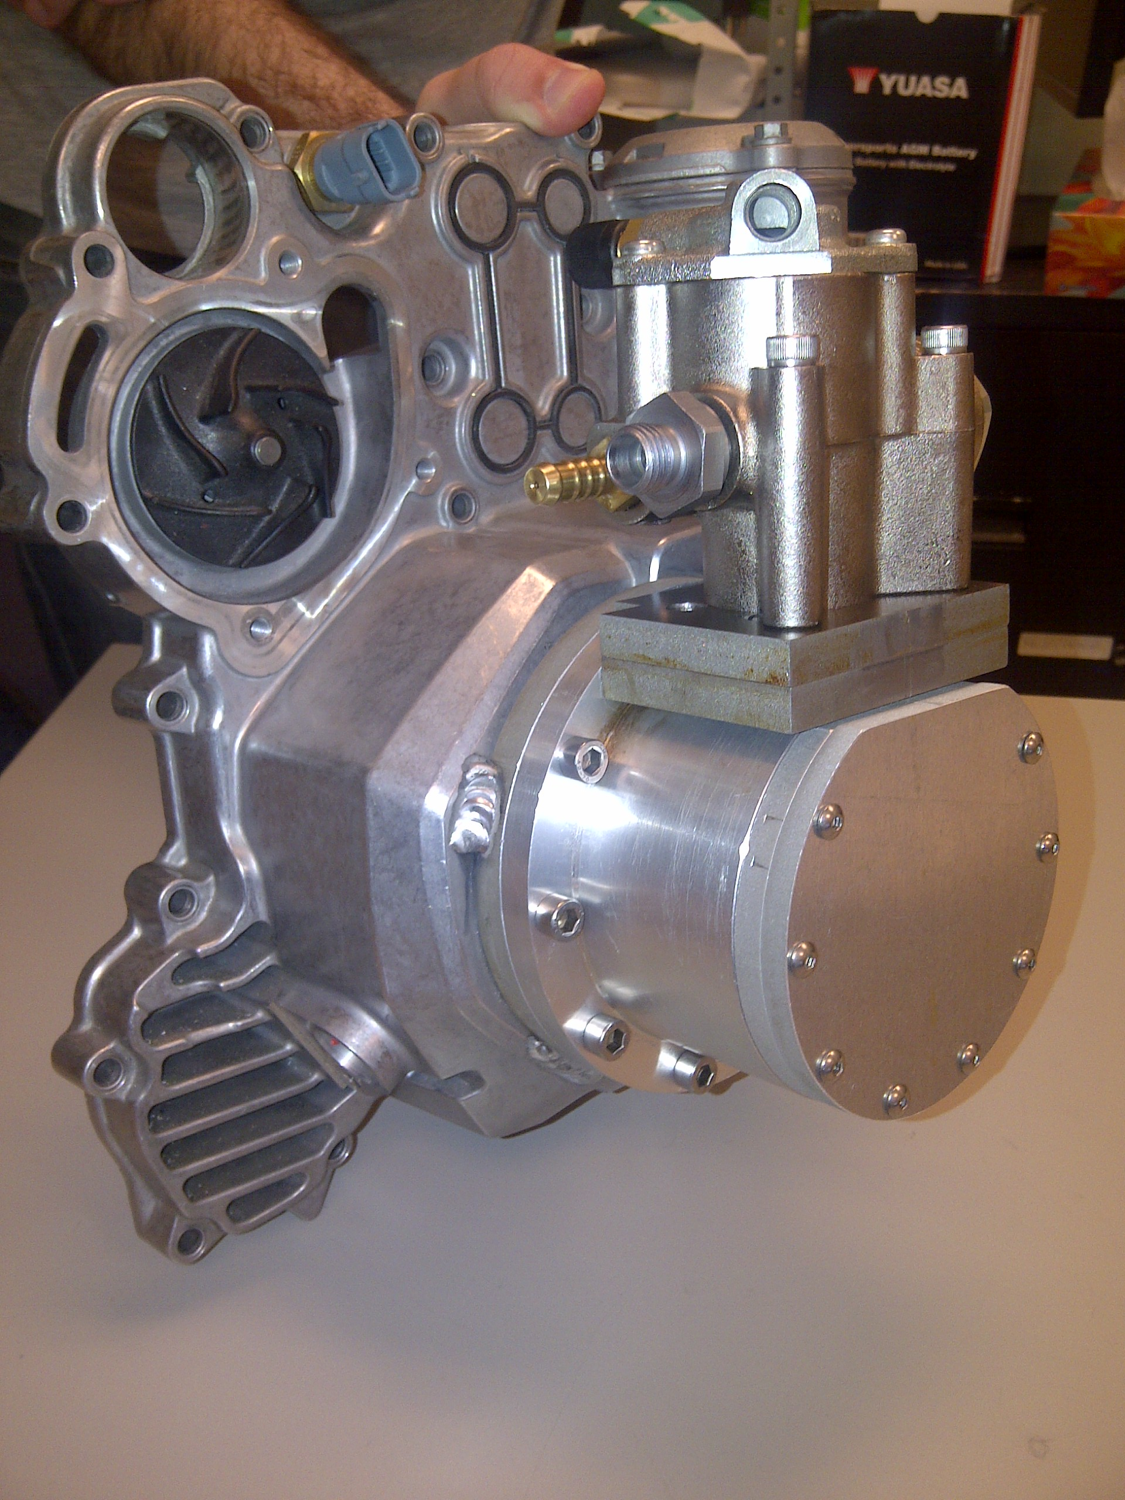
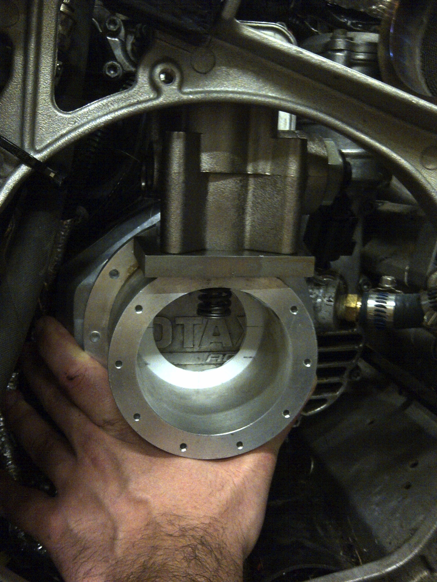
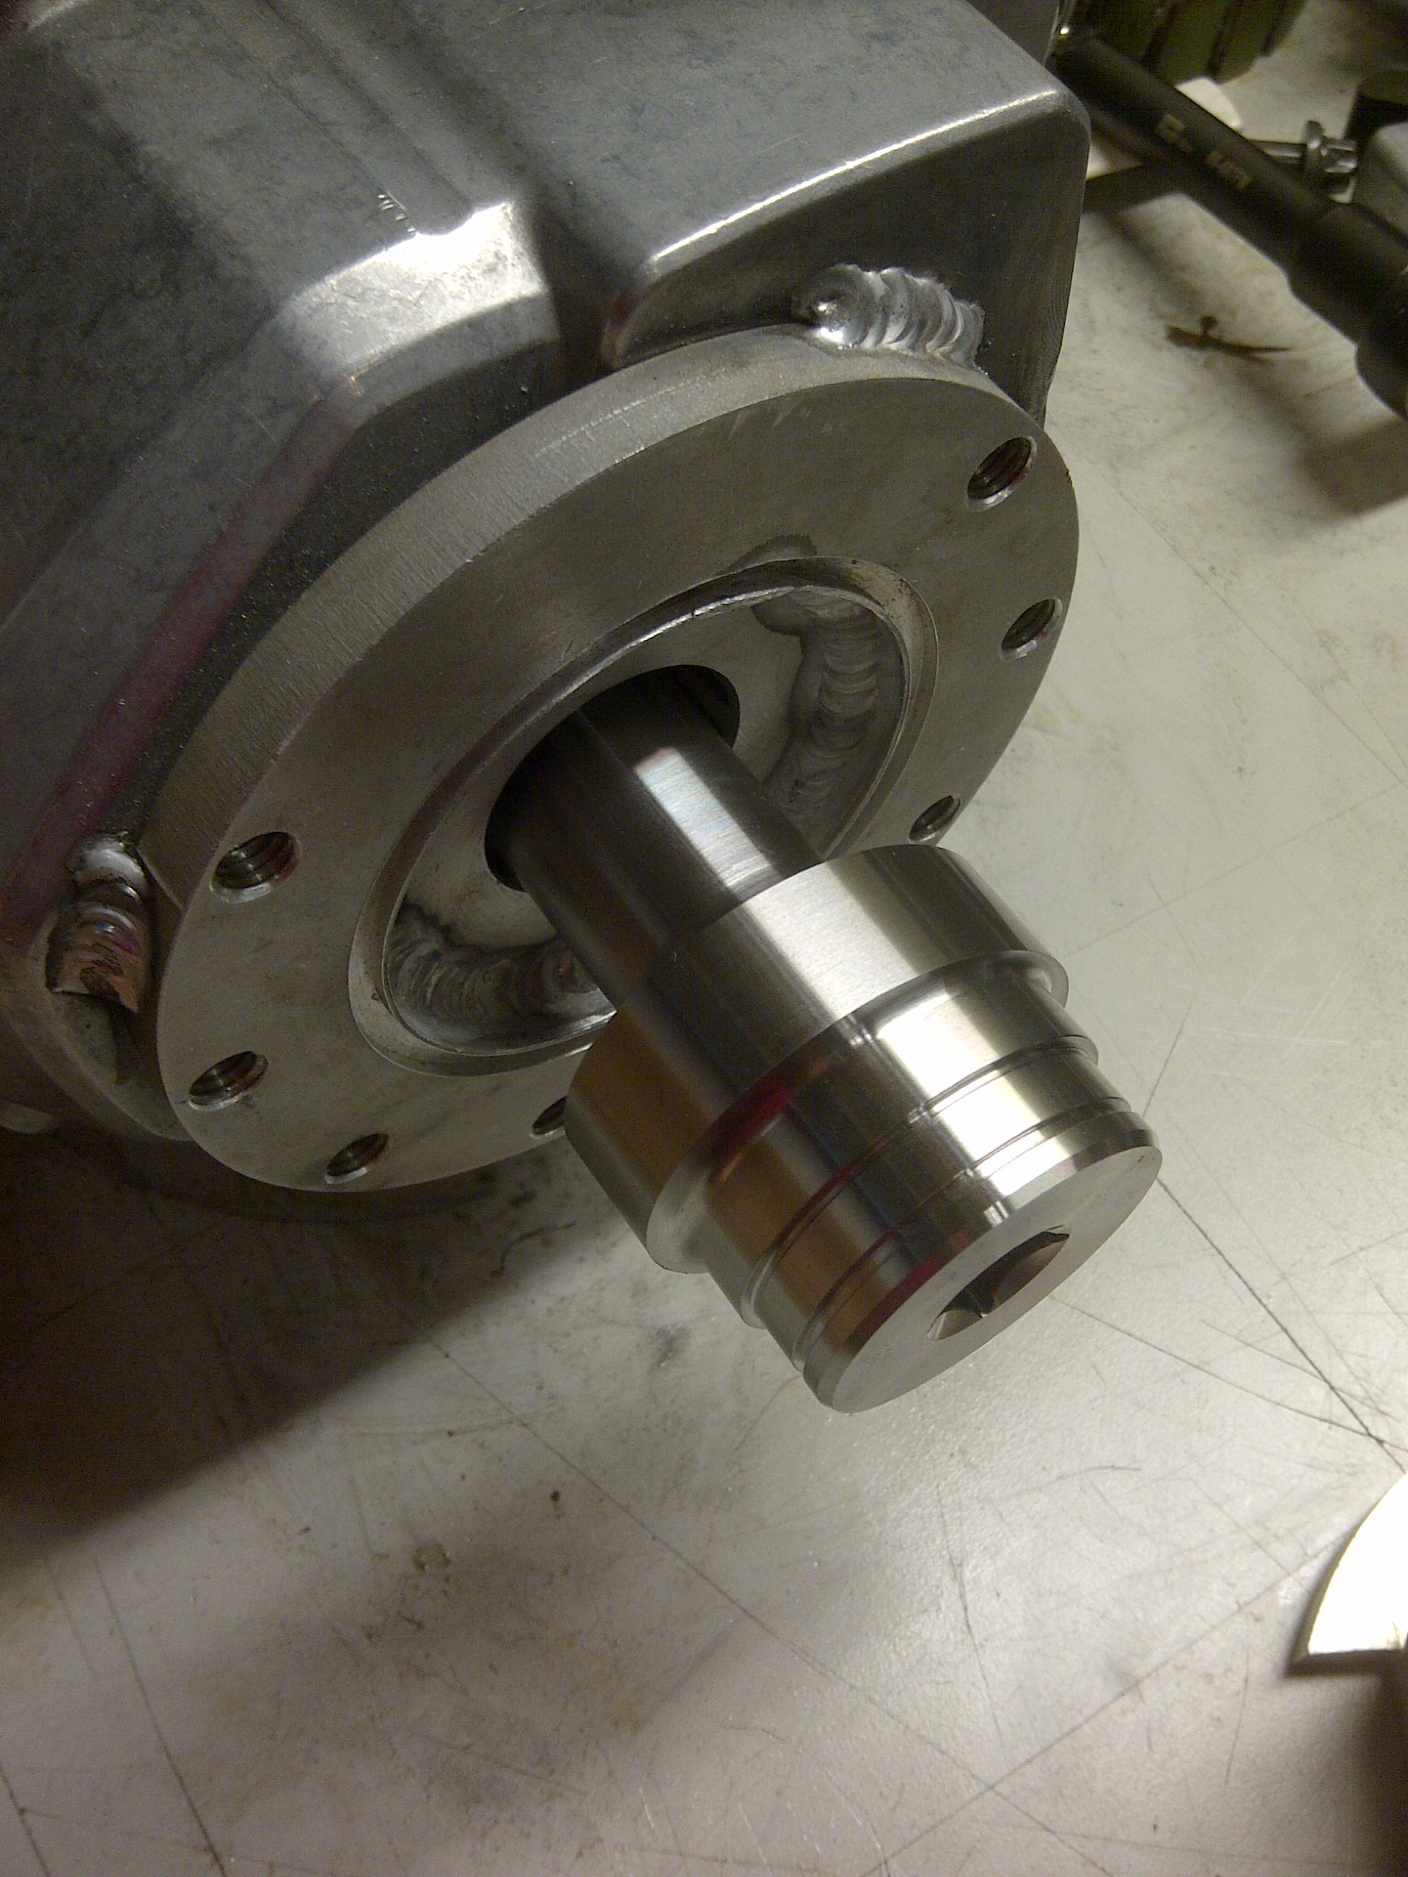
HPDI
High pressure mechanical fuel pump
Pump model: Hitachi HPP0004 (found on VW 2.0 TSI)
Pressure range: 500-2500 PSI
Optimized cam lobes for flow requirement

Slide 8
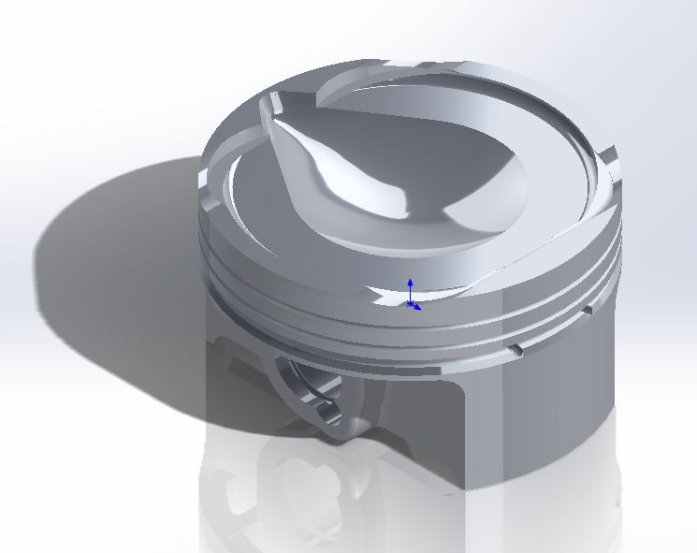
HPDI
DI optimized piston shape
Optimized shape for injector angle and clearance
Maximize fuel atomization
Prevent cylinder wall wetting

Slide 9
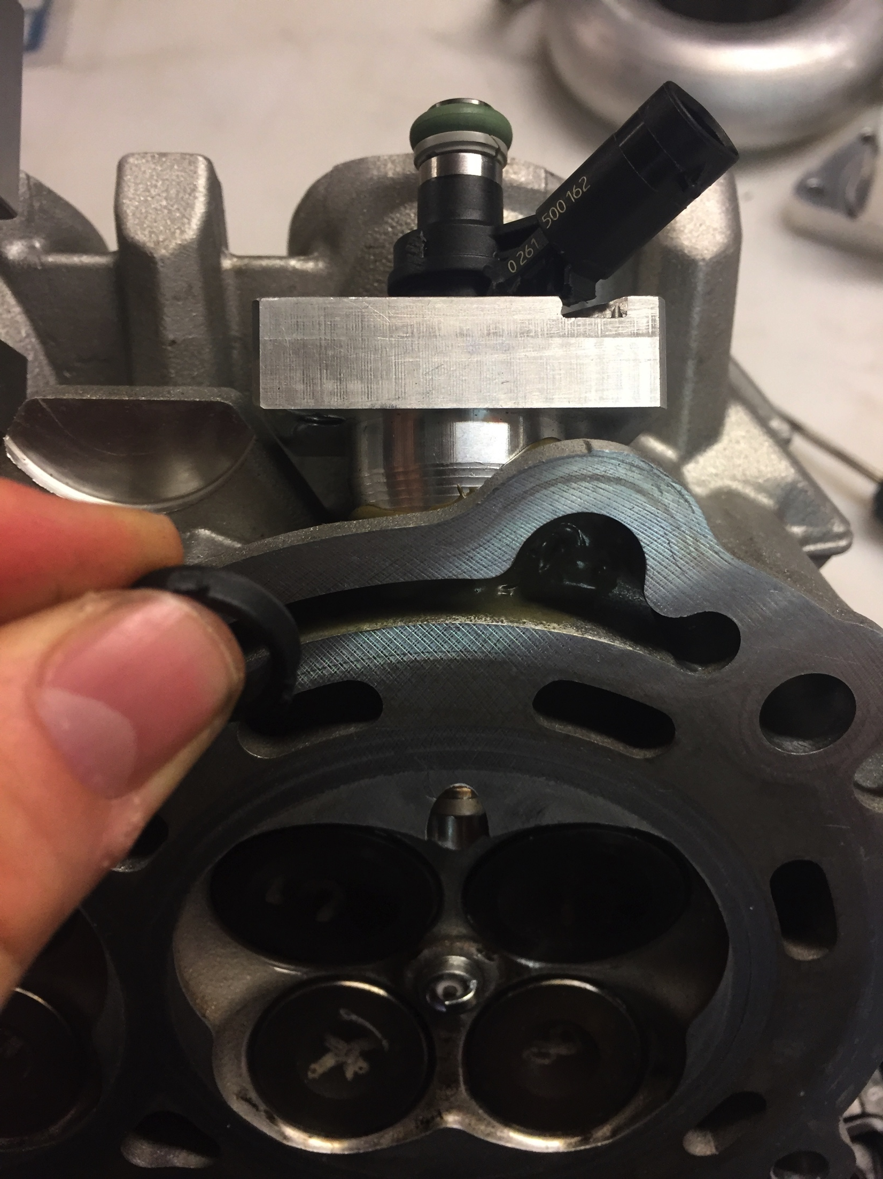
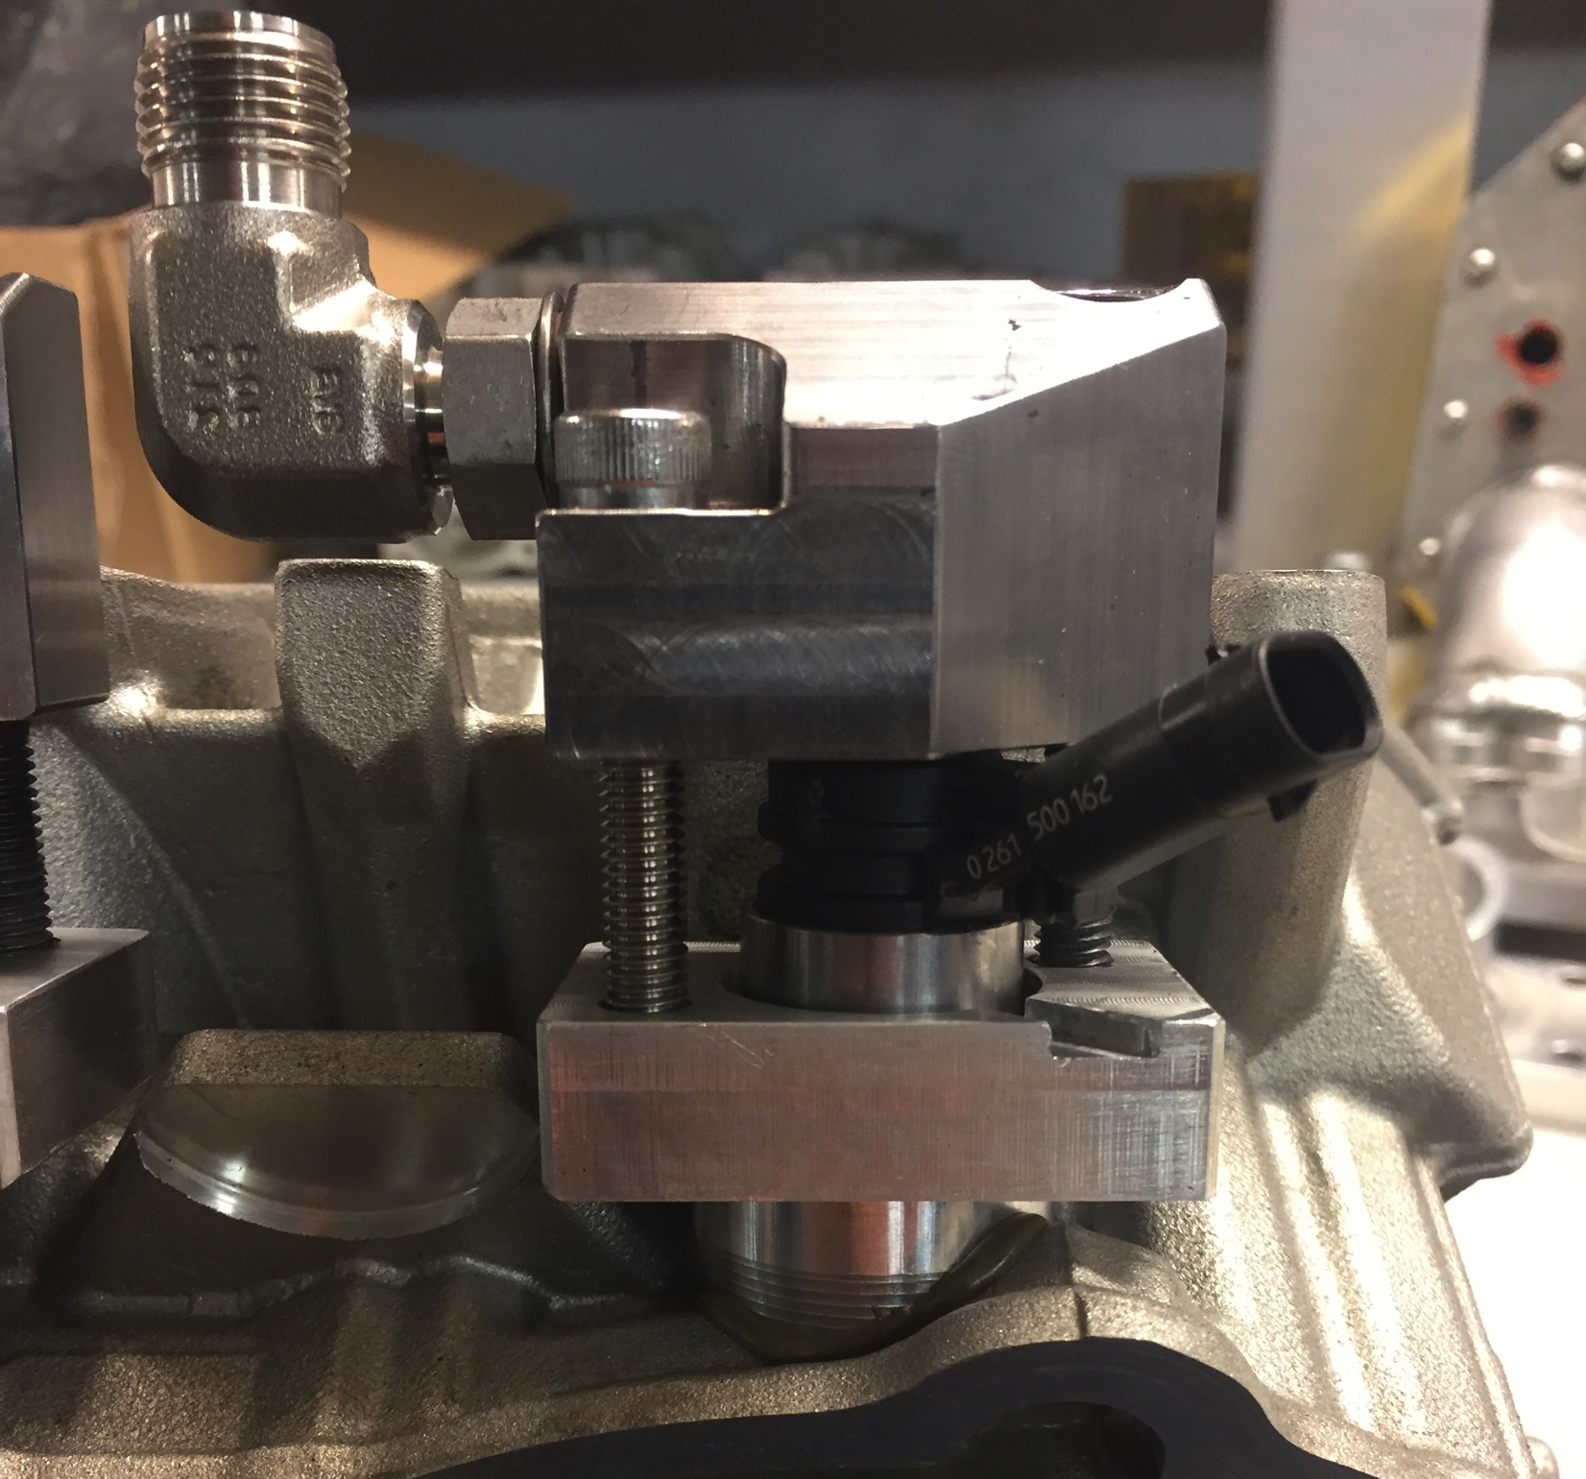
HPDI
New cylinder head design
Modified head to install DI injectors

Slide 10
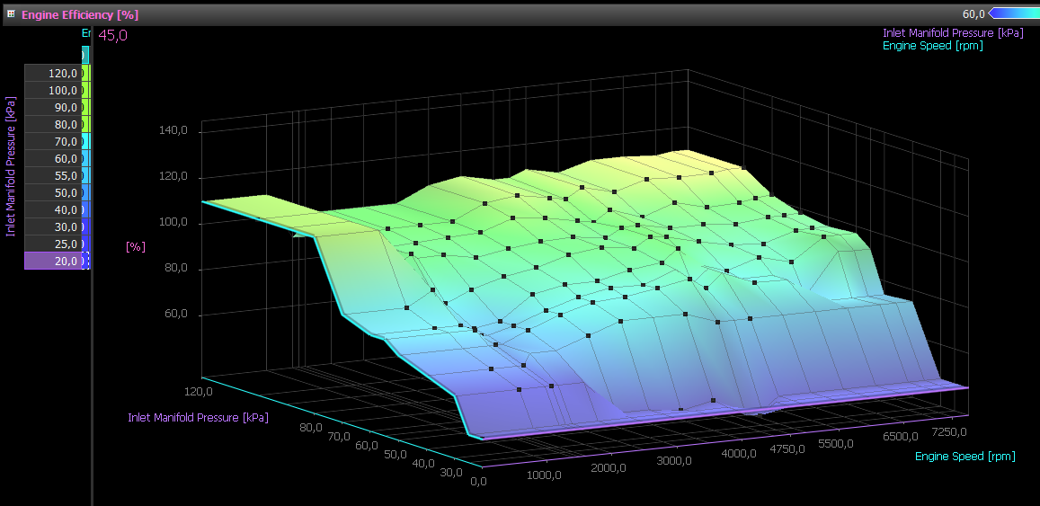
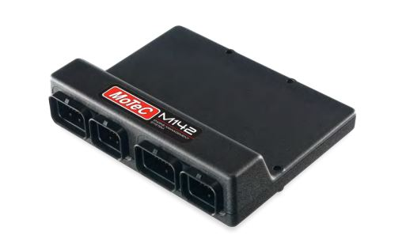
HPDI
Motec M142 ECU
V.E. (Volumetric efficiency) engine based map

Slide 11
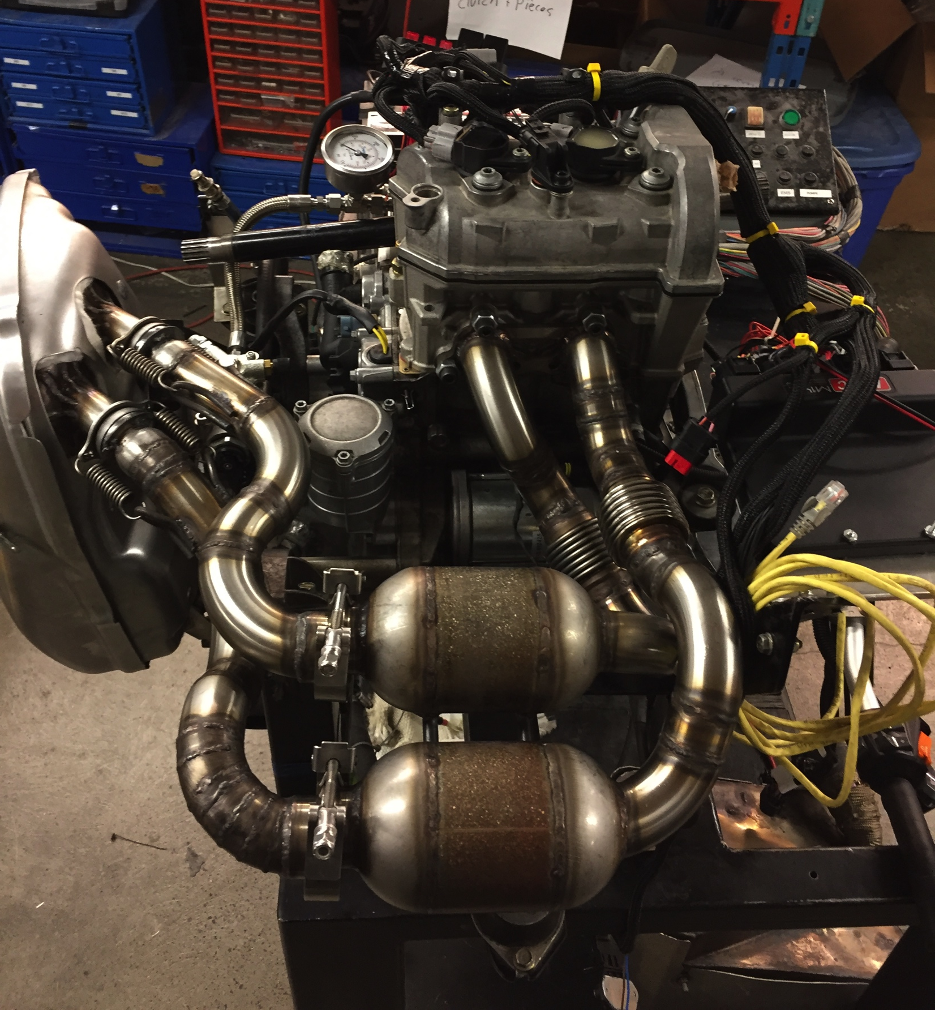
Dyno and Emissions Control
Catalytic converters
Equal length individual exhaust tubes
Pre-cat wide bands
After cat narrow bands

Slide 12
Noise Reduction
Big wheels and track

Slide 13
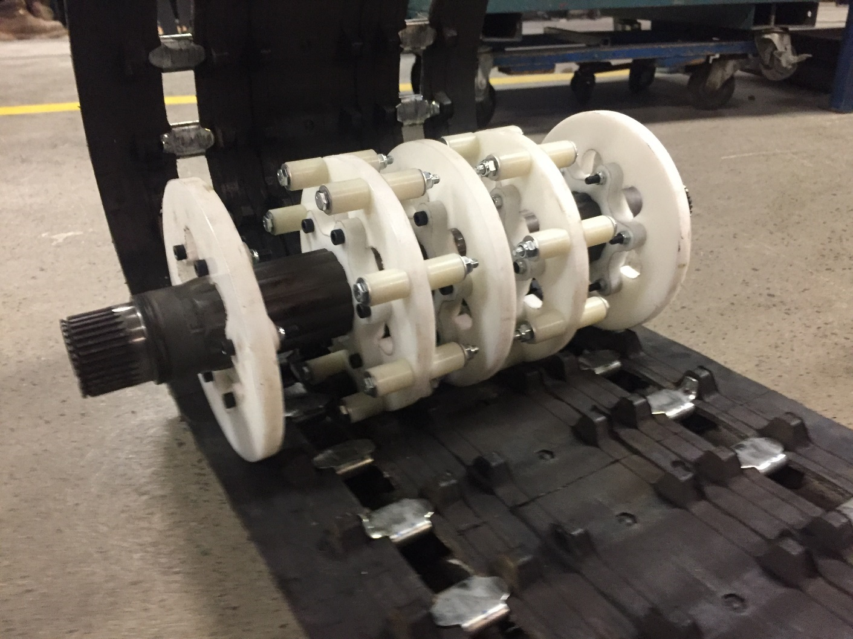
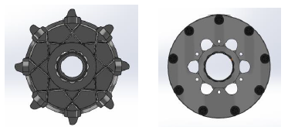
Noise Reduction
New drive gear design
9 tooth design
Constant contact point
Rotating drive rollers
Separate hub from sprocket
-4% amp draw

Slide 14
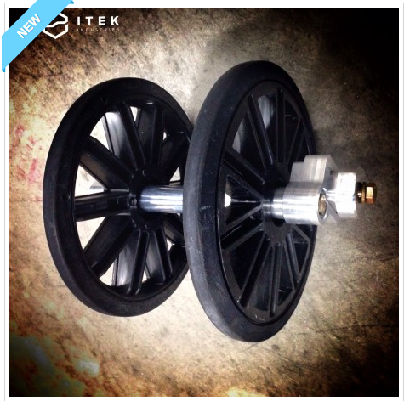
Noise Reduction
Big wheels and track
Modified track structure
8’’ plastic/rubber big wheels (-1dB from aluminum to rubber big wheels)

Slide 15
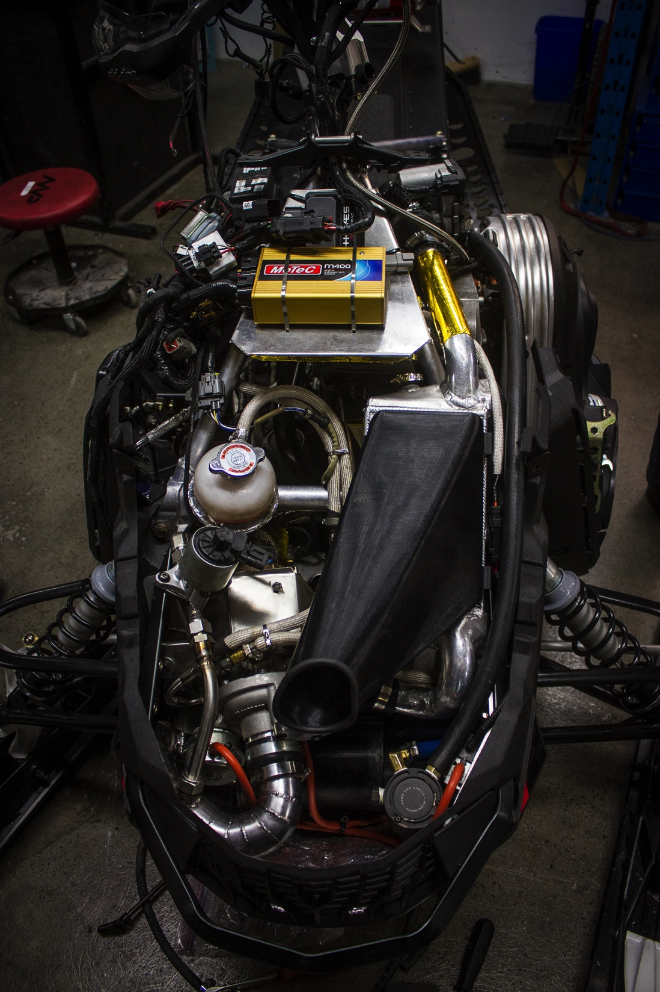
Conclusion
MXZ Blizzard 600 ACE Turbo
Same power plant as last year
Slightly modified tune

Slide 16
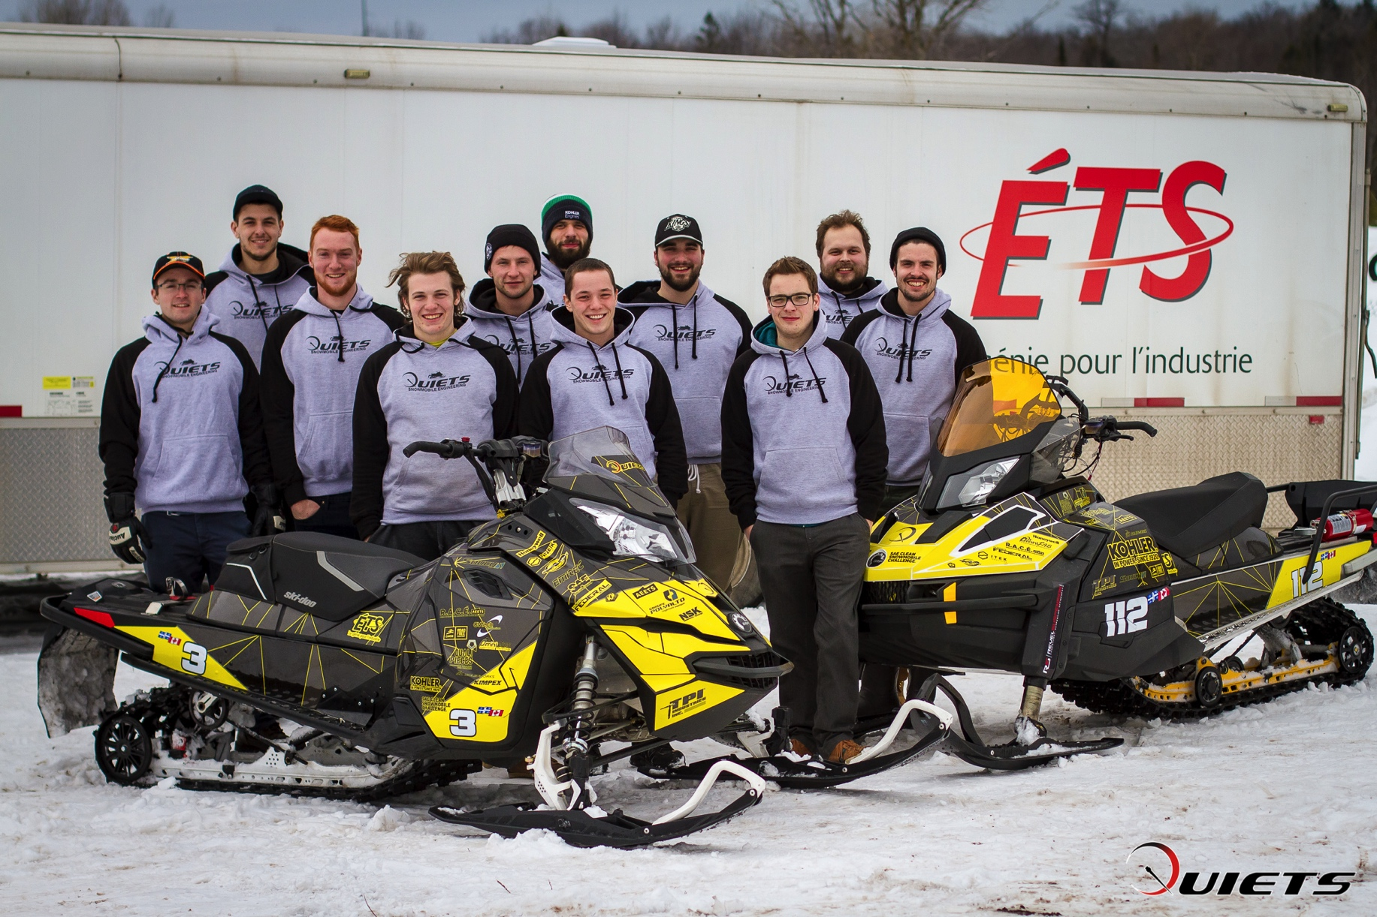
Questions?

