Slide 1
TEAM QUIETS 2015 SAE CSC DESIGN PRESENTATION
By: Pierre-Olivier Langlois

Slide 2
Presentation content
Snowmobile Modifications
Appeal to Snowmobile Enthusiasts
Emissions Control
Noise Reduction
Conclusion

Slide 3
Snowmobile Modifications
Plug and Play Conversion
Standalone engine management (Motec m400)
Turbocharged Engine
Modified Exhaust System
Catalytic Converter
Electronic Throttle
Track and Suspension Improvements

Slide 4
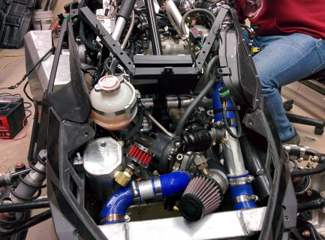
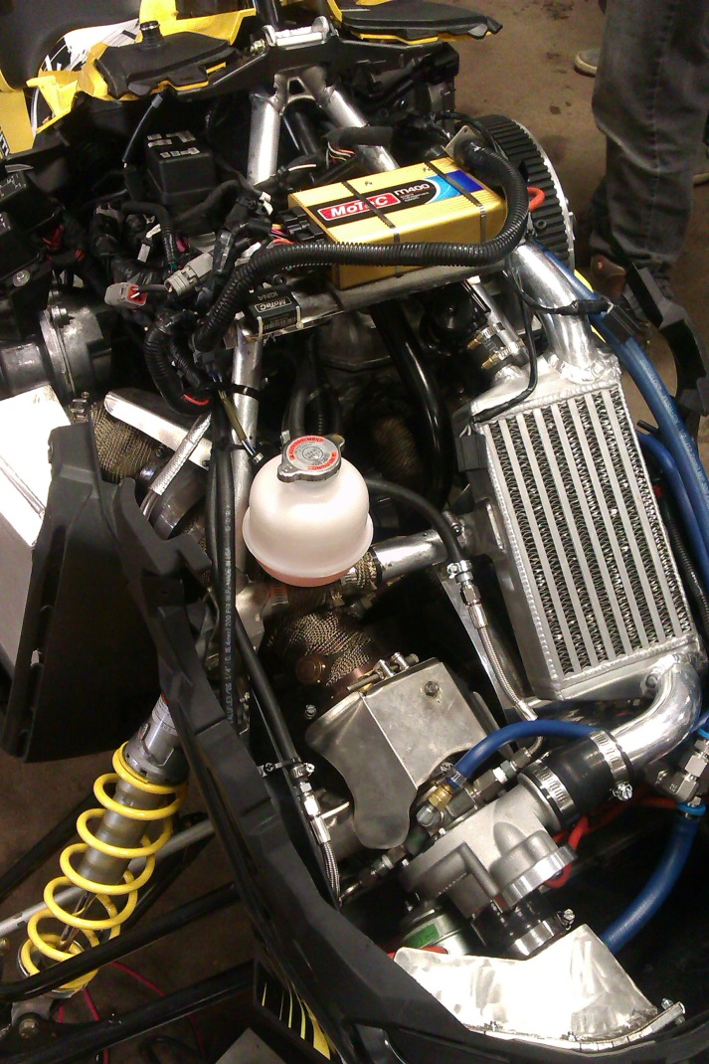
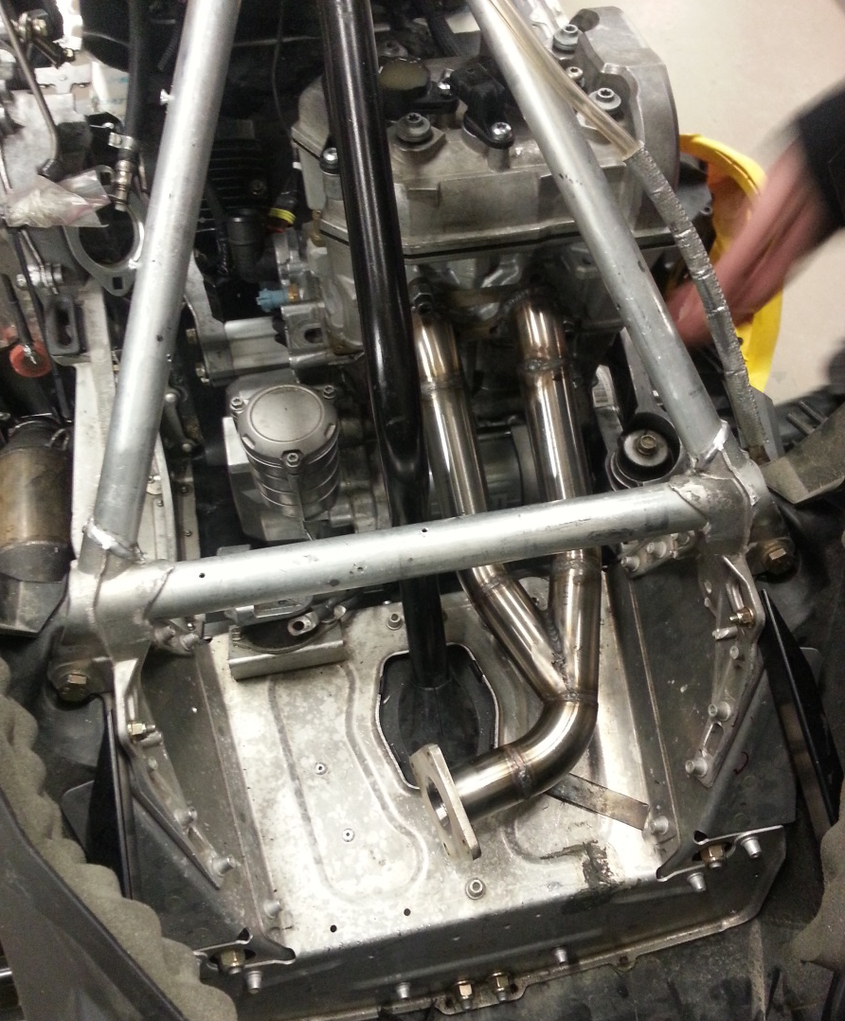
Snowmobile Modifications
Figures 1 and 2. Turbocharger setup

Slide 5
Appeal to Snowmobile Enthusiasts
Good Fuel Economy (in eco mode)
1.95 GPH at 45 MPH = 23 MPG (4900 rpm)
Noise reduction
Improved engine response (in sport mode)
And…

Slide 6
Appeal to Snowmobile Enthusiasts
More Power
82.58 hp
64 lbs-ft
Graph 1. 2015 prototype power sweep

Slide 7
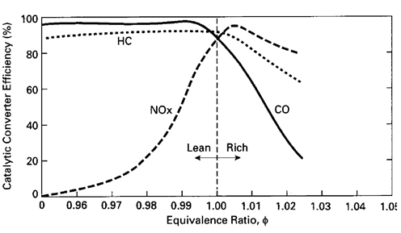
Emissions Control
Catalytic converter
Graph 2. Catalytic Converter Efficiency vs Air/Fuel Ratio

Slide 8
Emissions Control
Lean calibration at low load
Table 1. Closed loop lambda aim table

Slide 9
Emissions Control
Table 2. Mode specific emissions

Slide 10
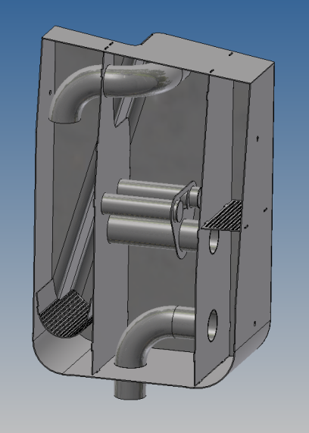
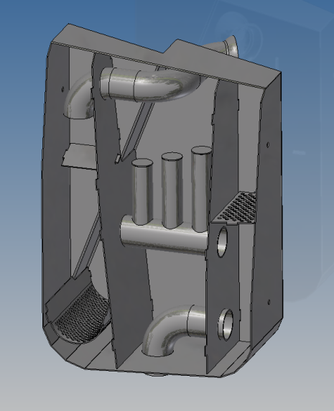
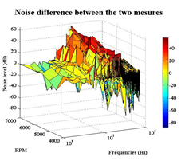
Noise Reduction
New exhaust system design
2013
Actual
Figures 2 and 3. Muffler's Interior Design
Graph 3. Sound test results

Slide 11
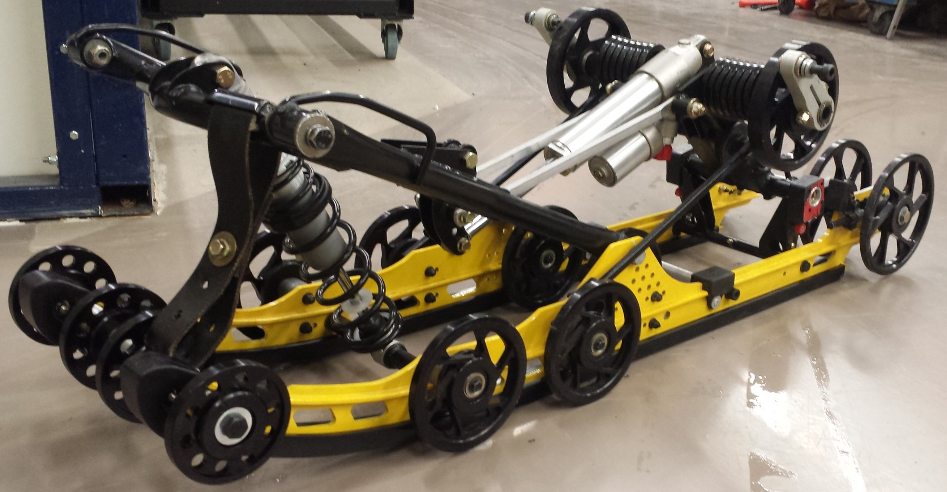
Noise Reduction
Suspension rework
Figure 4. Modified R-Motion suspension system

Slide 12
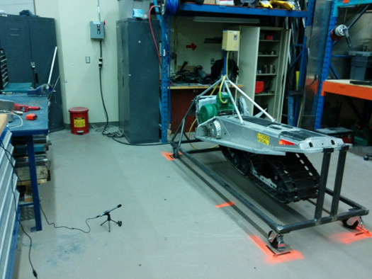
Noise Reduction
Test results
Figure 5. Track Acoustic Test bench
Graph 4. Sound test results

Slide 13
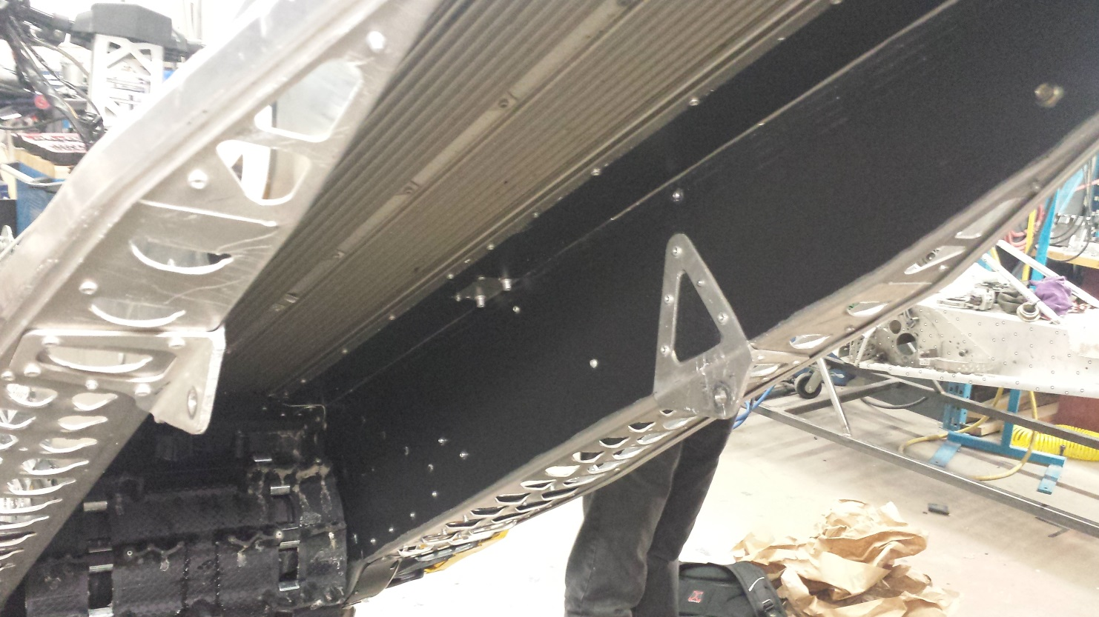
Noise Reduction
Acoustic dampening material
Figure 6. Soundproofed tunnel

Slide 14
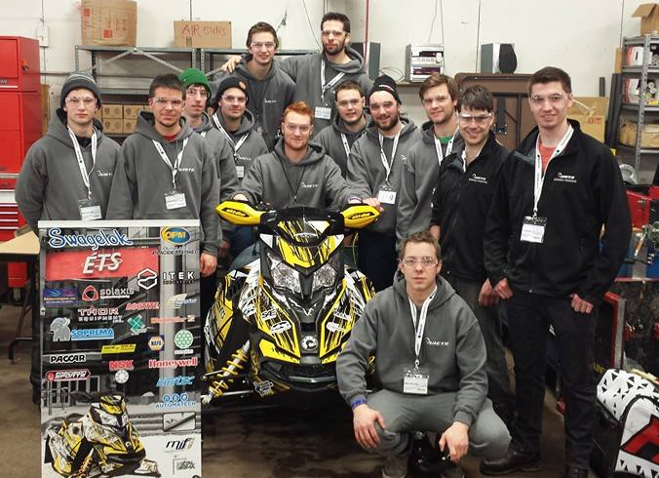
Conclusion

