Slide 1


TEAM QUIETS
2014
SAE CSC DESIGN PRESENTATION

Slide 2
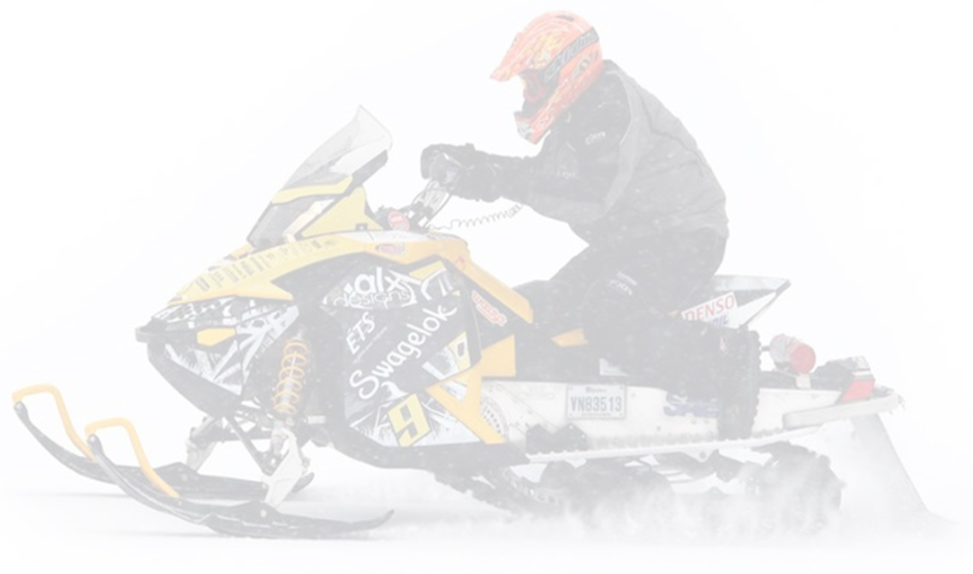
Presentation content
Snowmobile Modifications
Appeal to Snowmobile Enthusiasts
Dealer’s Perspective
Engine Control Strategy
Emissions Control
Noise Reduction
Conclusion

Slide 3
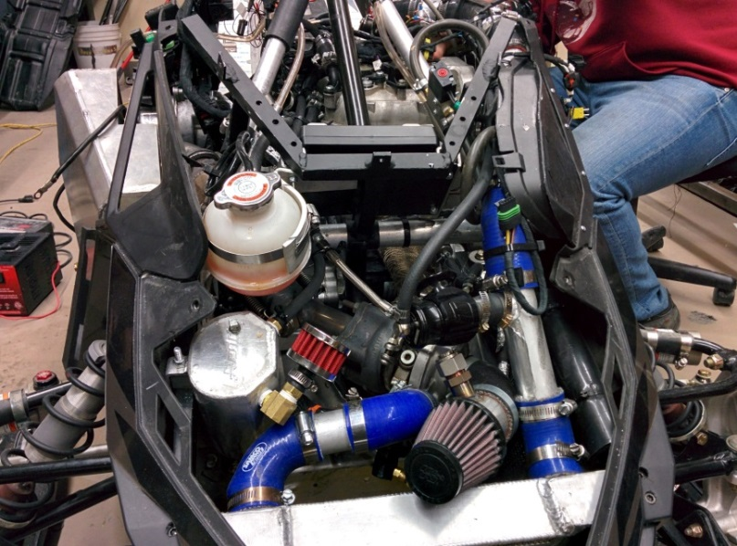
Snowmobile Modifications
Plug and Play Harness
Turbo Charged Engine
Modified Exhaust System
Catalytic Converter
EGR System

Slide 4
Appeal to Snowmobile Enthusiasts
Poll results from the FCMQ (Fédération des clubs de motoneigistes du Québec)
Reduction of irritating noise frequencies (namely 600, 700, 850 Hz)

Slide 5
Appeal to Snowmobile Enthusiasts
Good Fuel Economy
1.95 GPH at 45 MPH = 23 MPG (4900 rpm)
 |  | 600 Ace | Etec | 600 Ace Turbo
Displacement |  | 600 cc | 600 cc | 600 cc
Stroke |  | 4 Stroke | 2 Stroke | 4 Stroke
Hp |  | 60 | 121 | 80
Fuel Consumption |  | 26 mpg | 21 mpg | 23 mpg

Slide 6
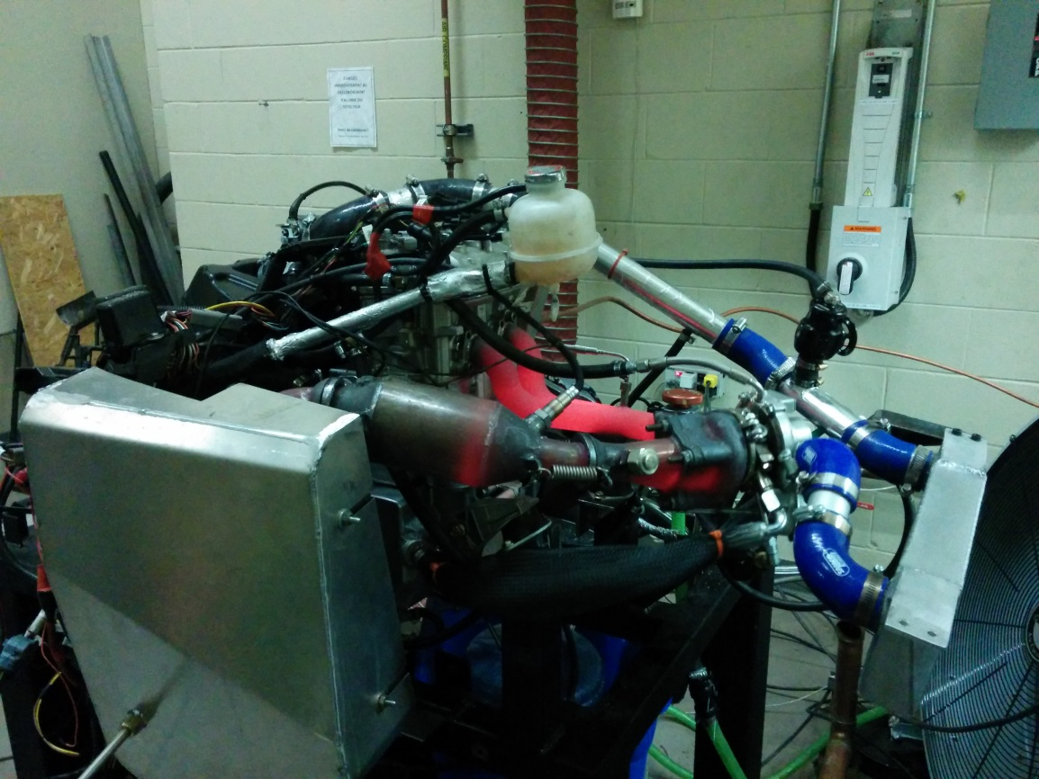
Appeal to Snowmobile Enthusiasts
+19 hp for a total of 79 hp and 60 ft-lbs of torque

Slide 7
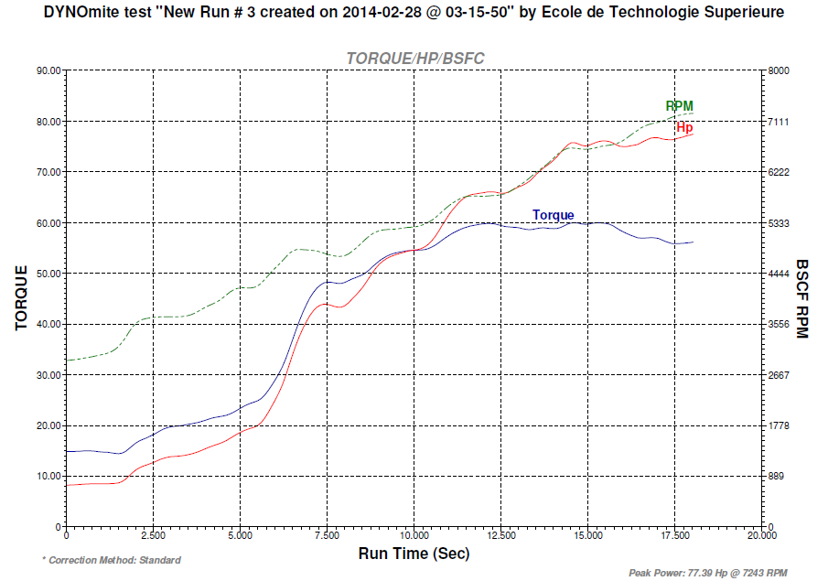
Appeal to Snowmobile Enthusiasts (follow up)

Slide 8


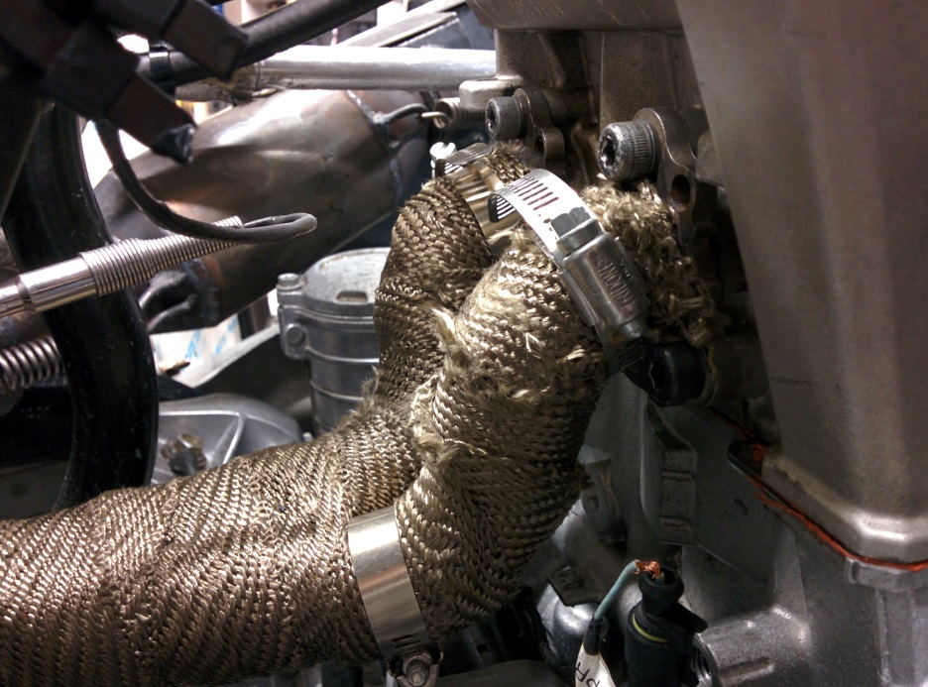
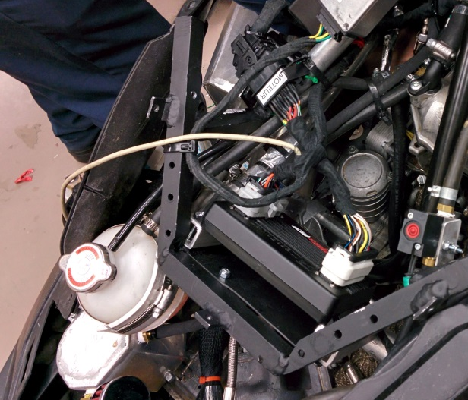
Dealer’s Perspective
Bolt On System
Bolt on turbo and headers
Quick connect harness

Slide 9
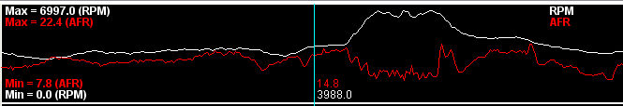
Engine Control Strategy
Closed loop AFR control

Slide 10
Engine Control Strategy (Follow up)
Lean burning combustion
Calculating SFC (g/kW-hr)

Slide 11
Engine Control Strategy (Follow up)

Slide 12
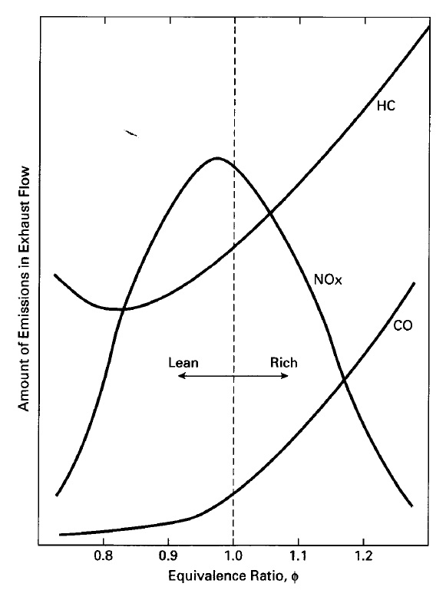
Emission Control
Managing HC, CO and NOx emissions

Slide 13
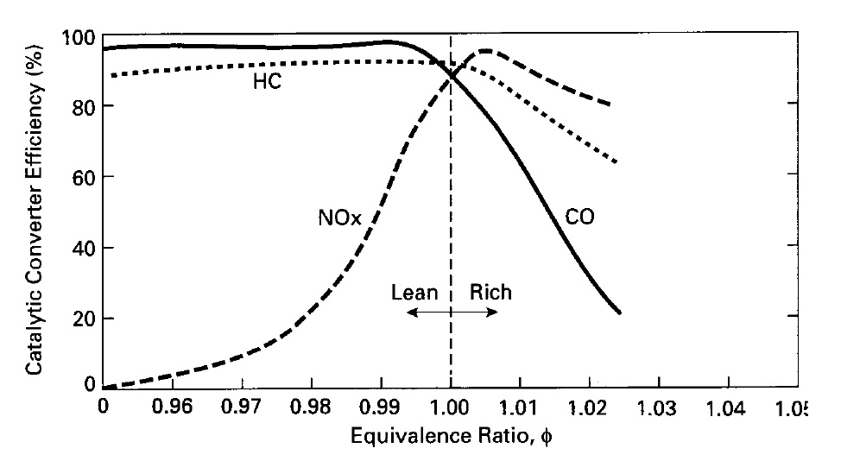
Emission Control (Follow up)
Three way catalytic converter efficiency

Slide 14
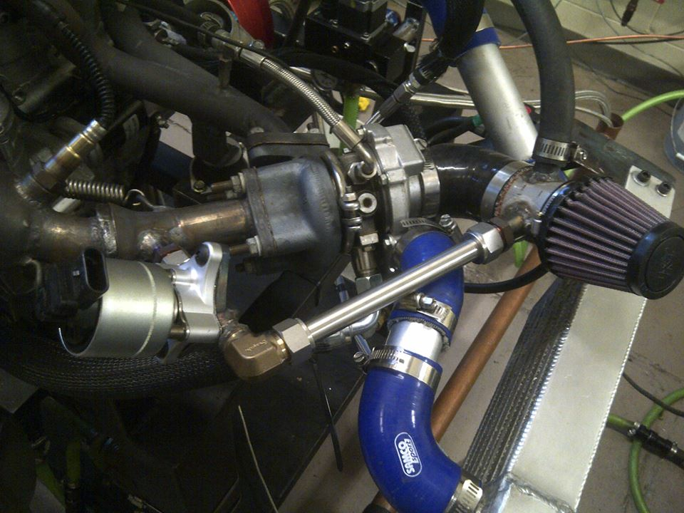
Emission Control (Follow up)
EGR system development

Slide 15
Emission Control (Follow up)
EGR System Intergration

Slide 16
Emission Control (Follow up)

Slide 17
Emission Control (Follow up)
Final EPA Score 190

Slide 18
Noise Reduction
New exhaust system design

Slide 19
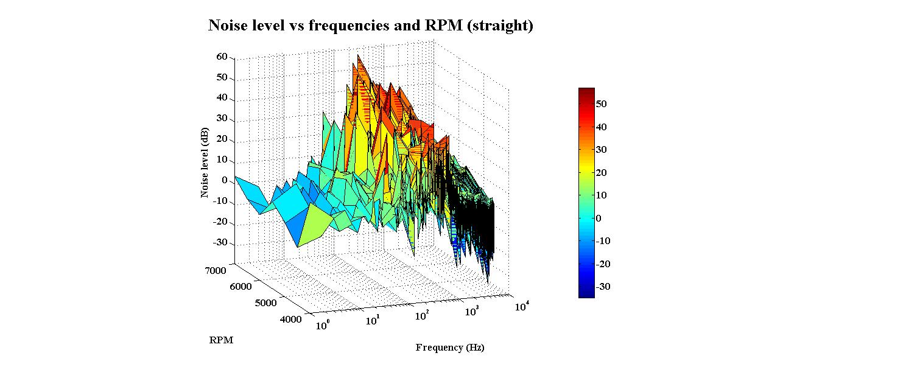
Noise Reduction (Follow up)
Targeted frequencys: 600Hz 750Hz 800Hz

Slide 20
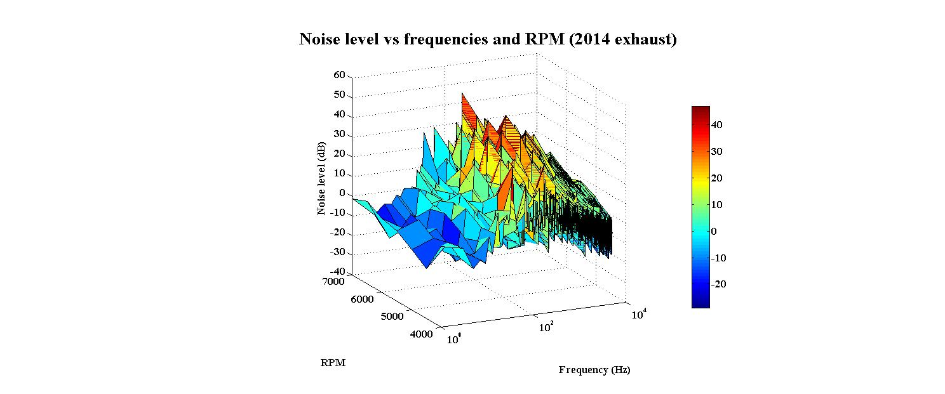
Noise Reduction (Follow up)

Slide 21
Conclusion and Future Improvements
Track Acoustic Improvements
Direct Injection
Drive by Wire Throttle
Clutch and Transmission Upgrade

Slide 22
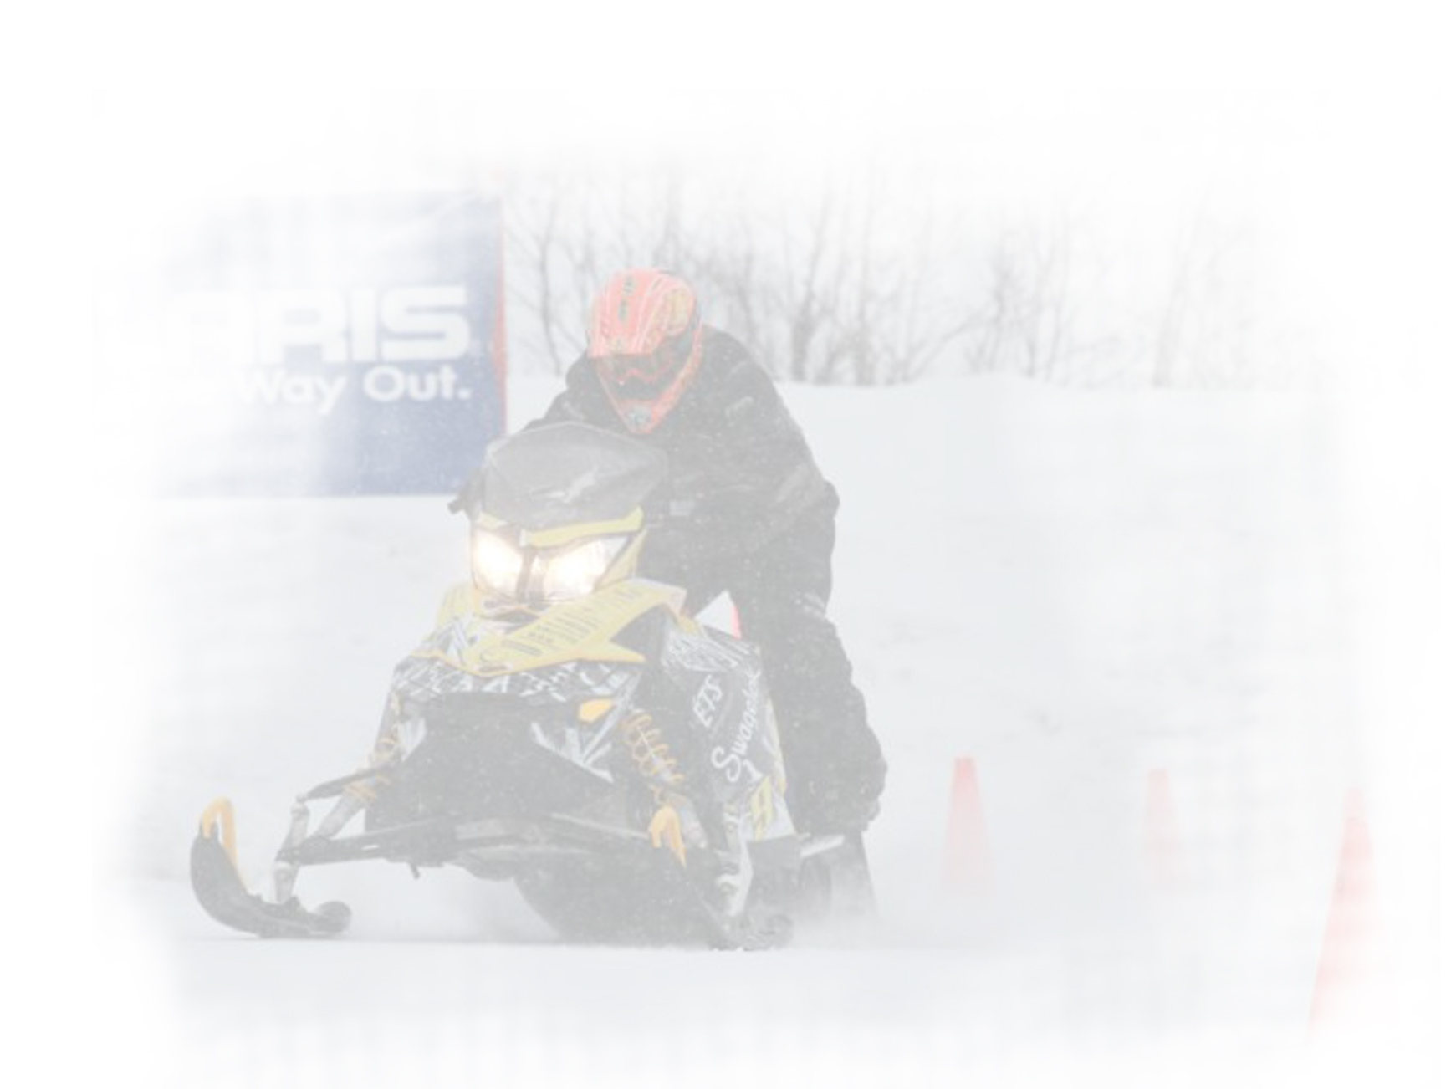
Thank You
Questions?

