Slide 1

TEAM QUIETS-DUC
2017
SAE CSC DESIGN PRESENTATION
By: Dominic Mathieu and Guillaume Verner

Slide 2
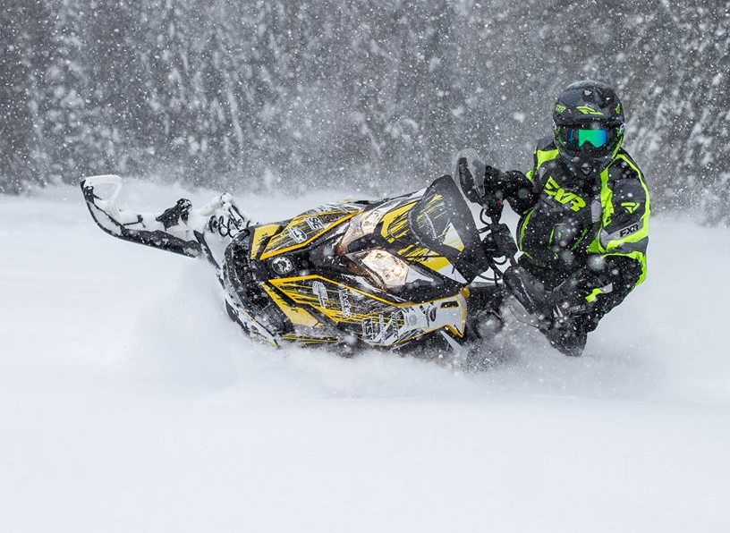
Presentation content
Overall packaging
Chassis modifications
Drivetrain modifications
Powerplant
Other modifications
Testing
Notes:
Do

Slide 3
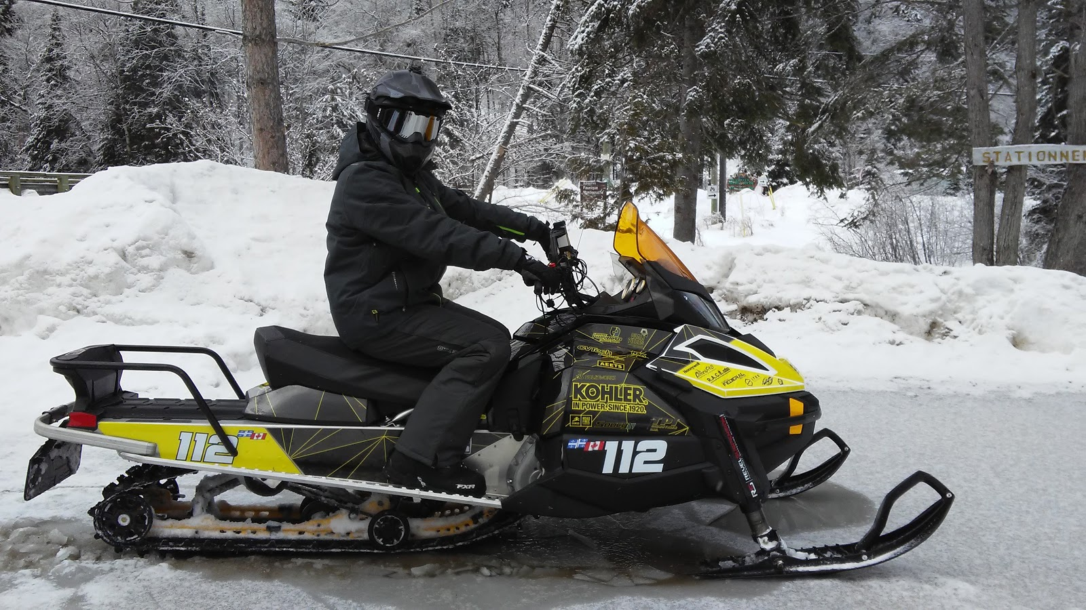
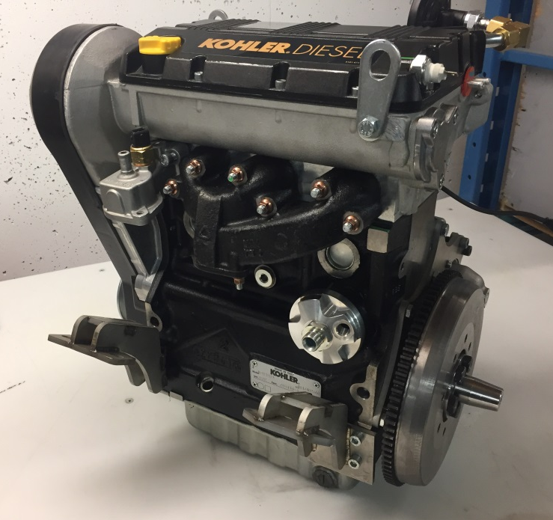
Overall packaging
Objective : Marketable work snowmobile
Ski-Doo Tundra Sport
Kohler KDW1003
Notes:
Do

Slide 4
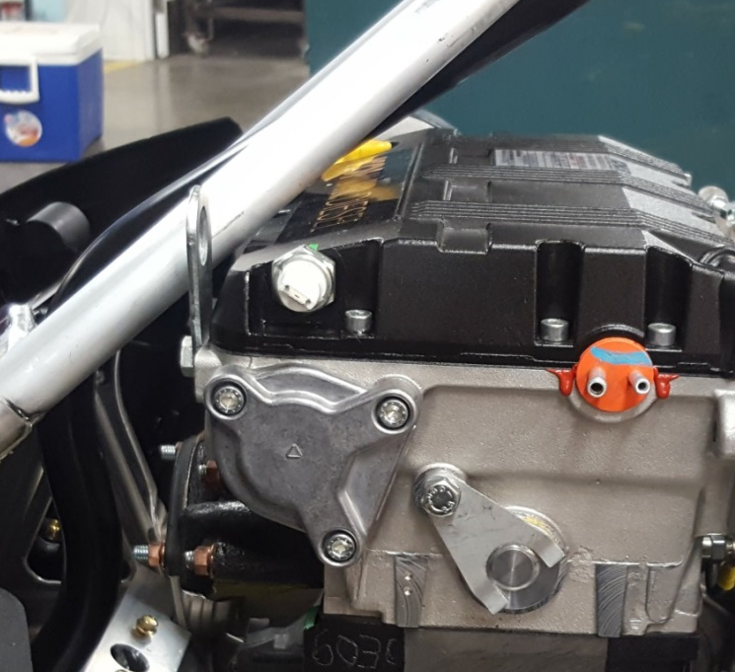
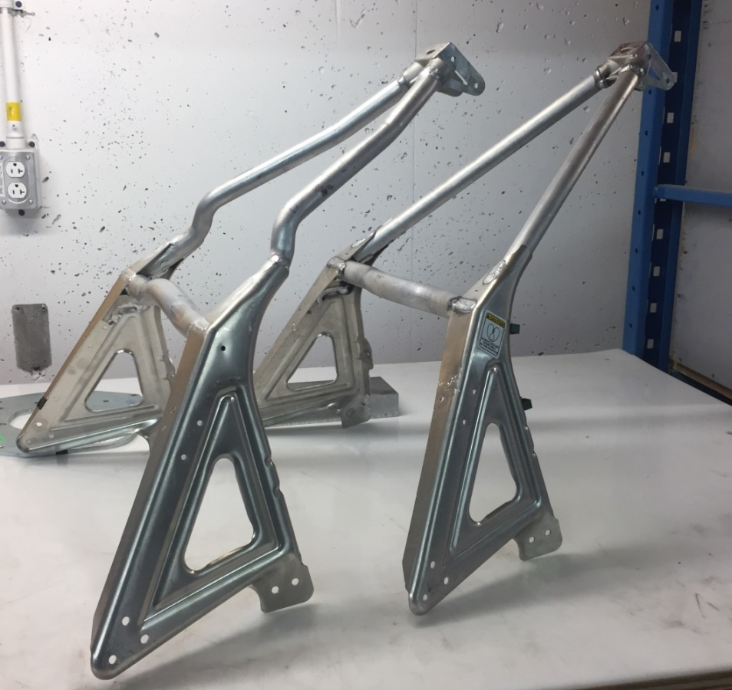
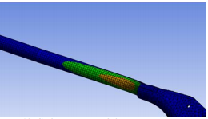
Chassis modifications
New S-module design
Simulated at 765 lbs
Notes:
Gui

Slide 5
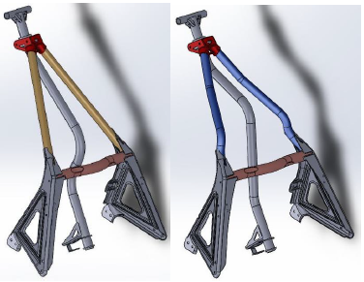
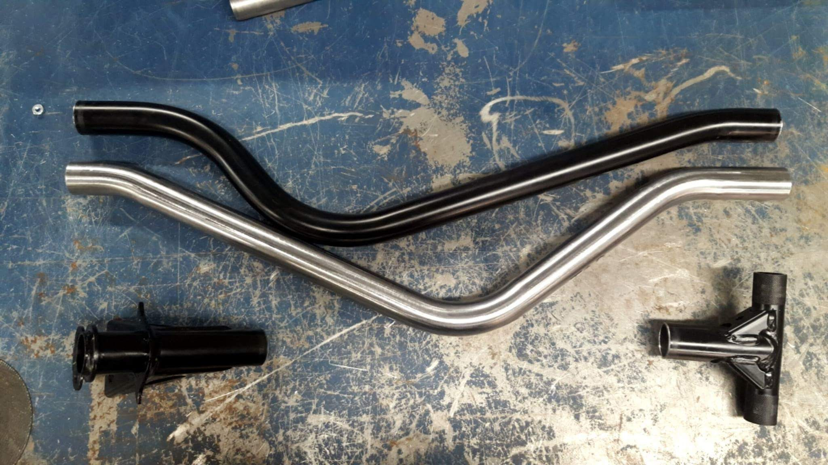
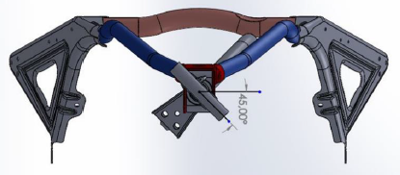
Chassis modifications
Steering column redesign
Notes:
Gui

Slide 6
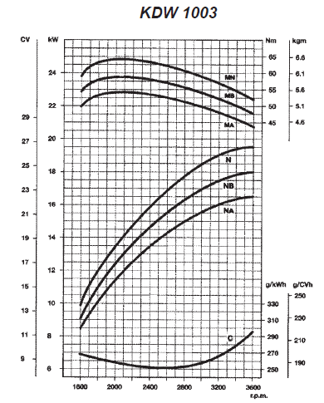
Powerplant
Stock engine specifications :
  Inline 3 cylinders
  1028 cc
  Mechanical fuel injection
  23.4 HP
  36.8 ft-lbs
Current engine specifications* :
  30 HP
  46 ft-lbs
* Based on dyno run at CSC 2017
Notes:
Do

Slide 7
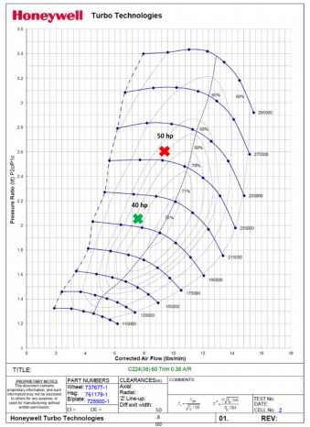
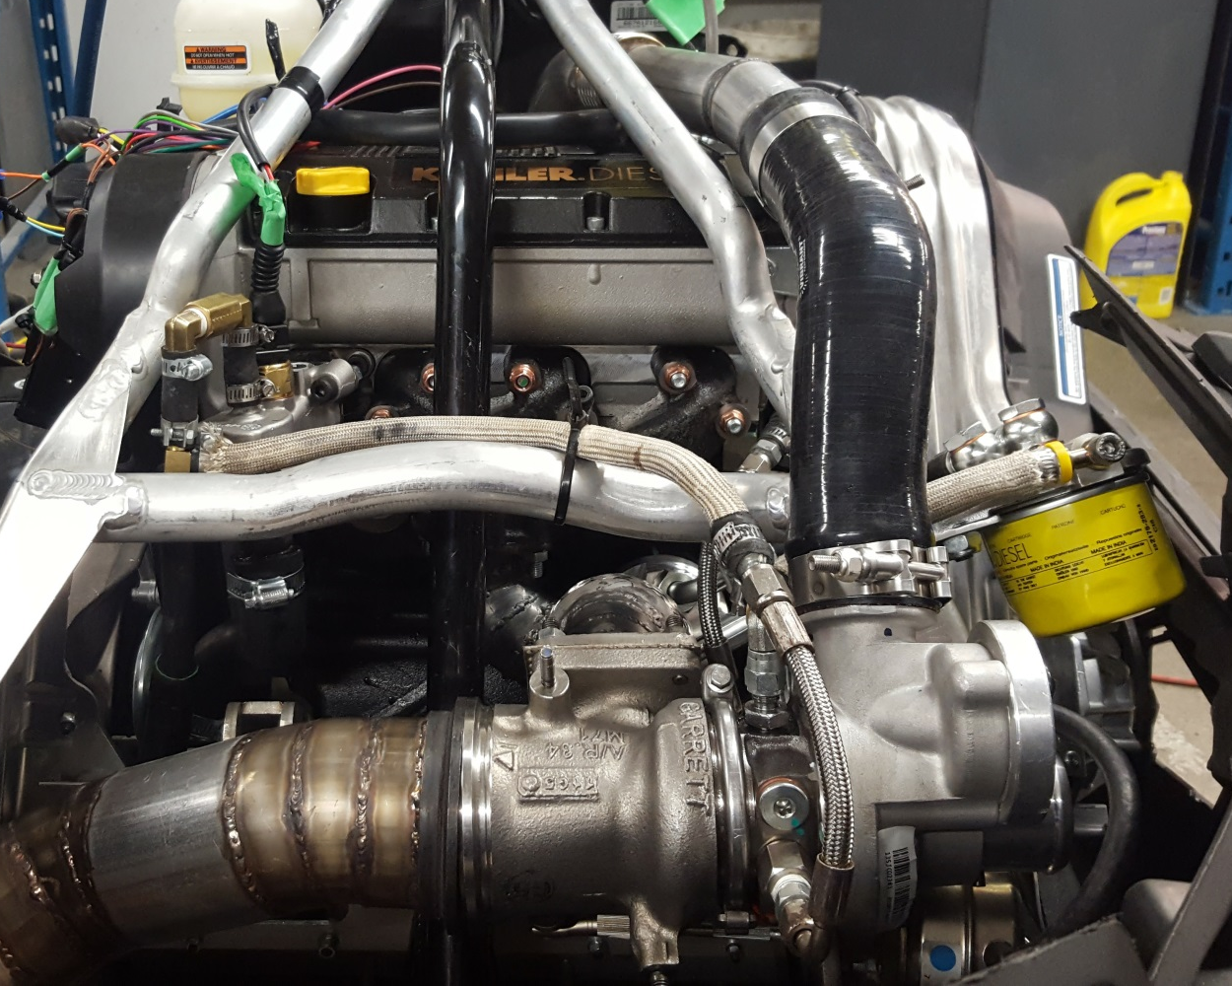
Powerplant
Turbo selection : Garrett MGT1238
Notes:
Do

Slide 8
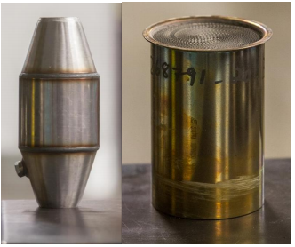
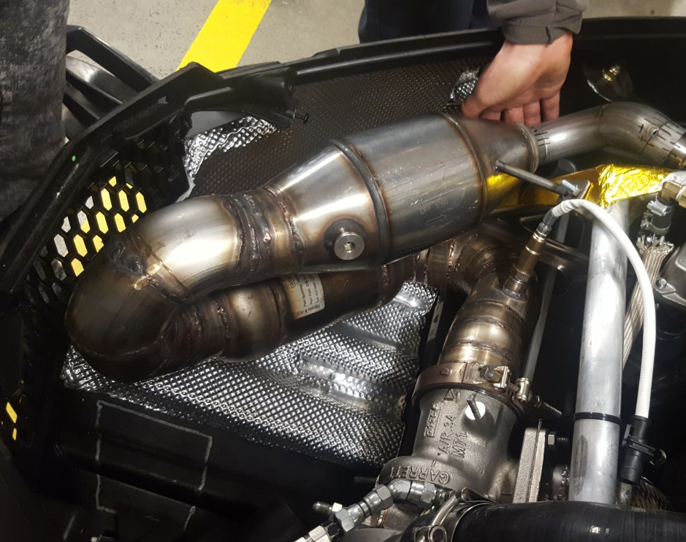
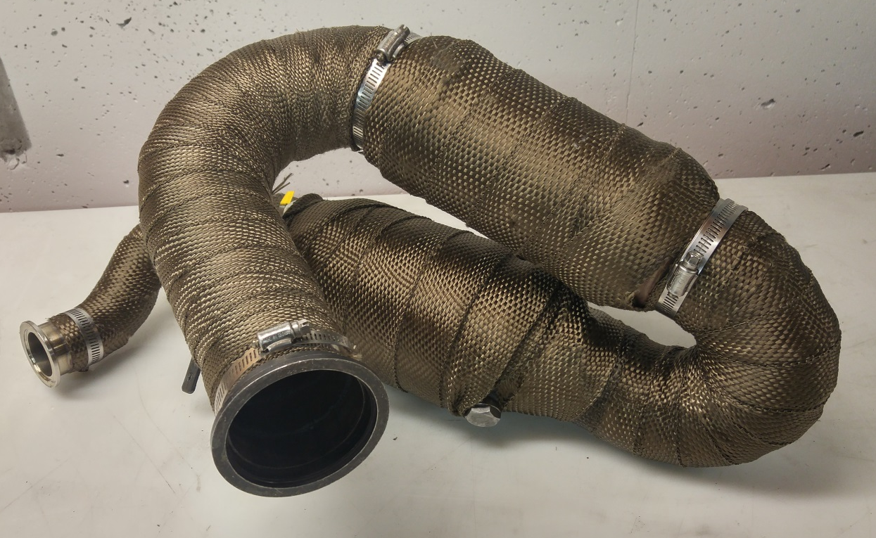
Powerplant
Exhaust design :
  DOC/DPF
  Muffler
Notes:
Do

Slide 9
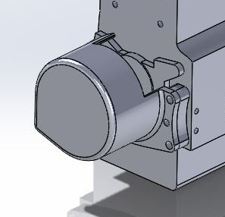
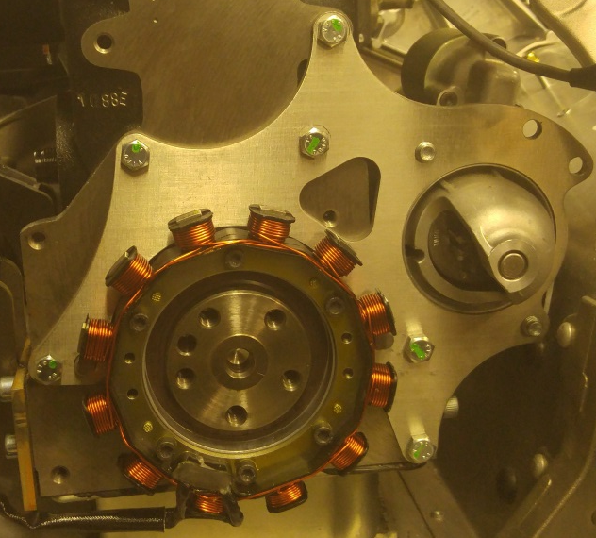
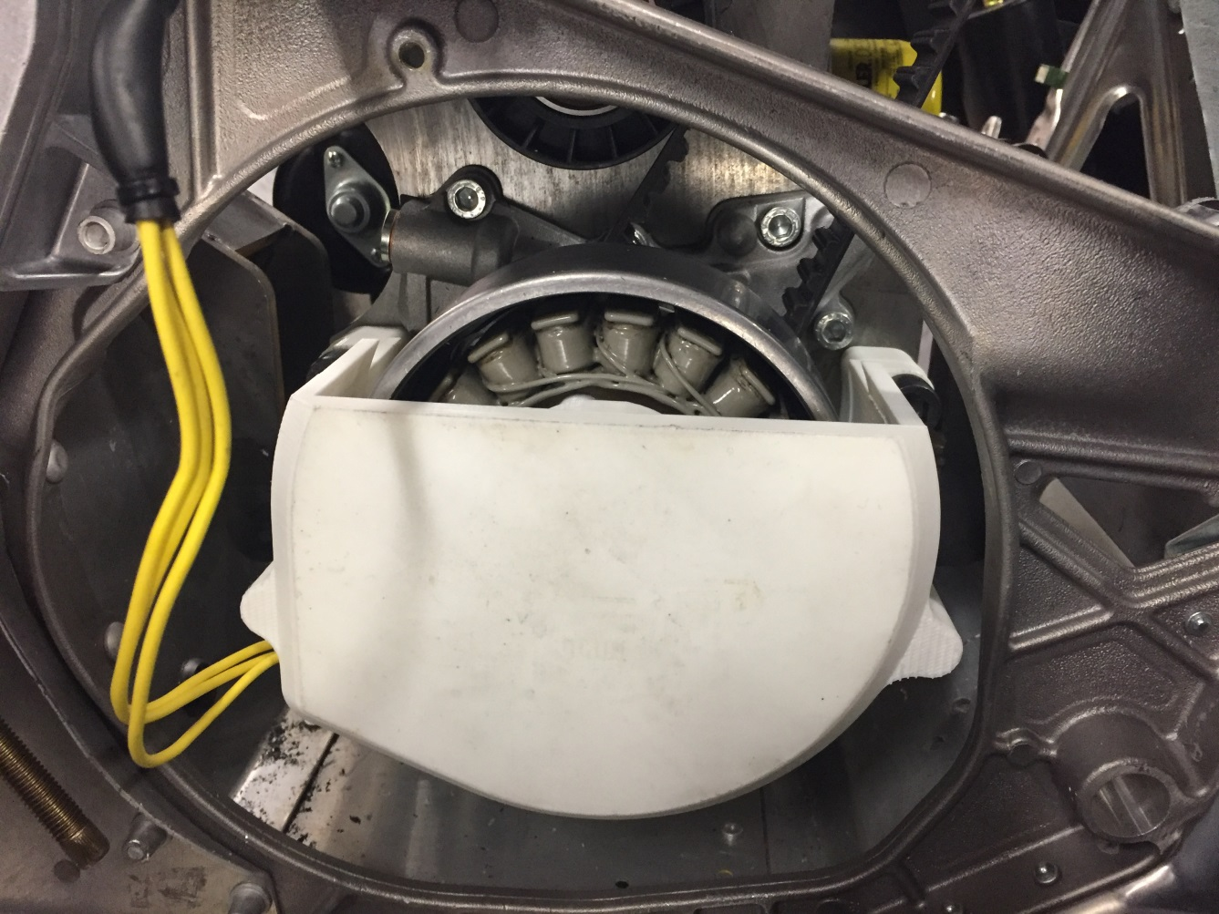
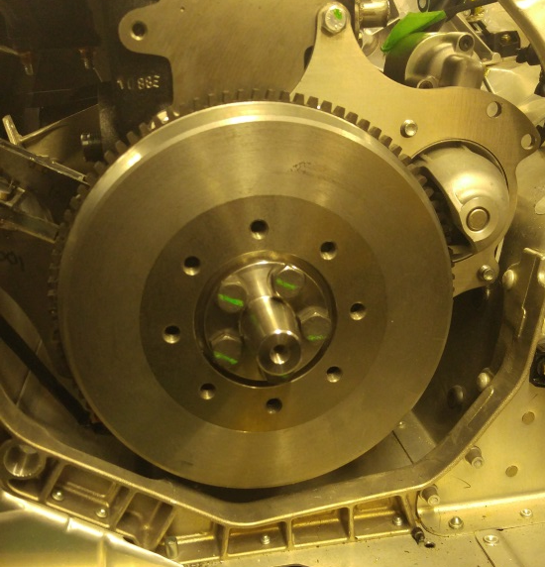
Powerplant
Flywheel alternator
Notes:
Do

Slide 10

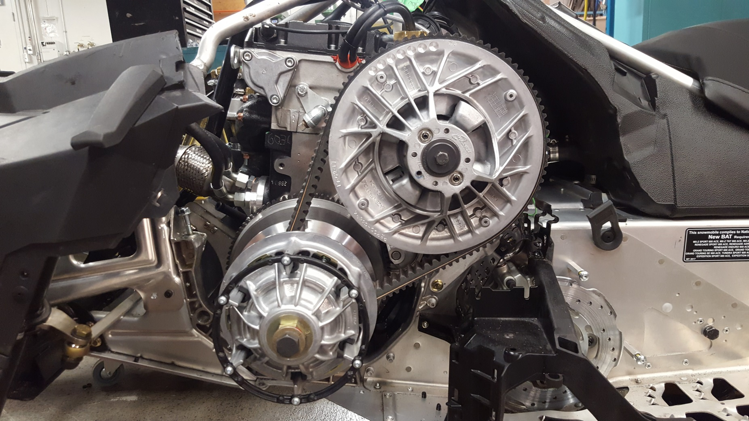
Drivetrain modifications
Clutches :
  Specially designed
  for our application
  Operating range :
  900 to 3600 RPM
  Driving ratio :
  4:1 to 0.75:1
  Heavier weights
  and stiffer spring
Notes:
Gui

Slide 11
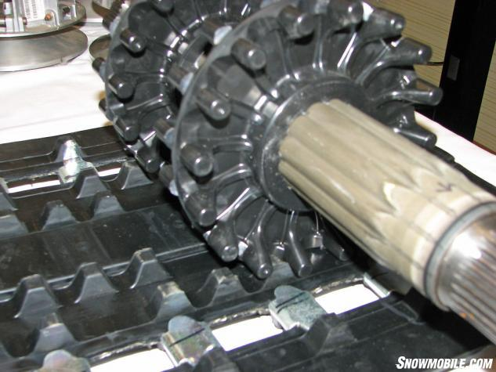
Drivetrain modifications
Drive sprocket Chaincase ratio
Bottom chaincase gear:
  Stock : 51 tooth
    Top Speed = 45 mph
    RPM @ 35 mph = 3000
  New : 43 tooth
    Top Speed = 55 mph
    RPM @ 35 mph = 2500
Notes:
Gui

Slide 12
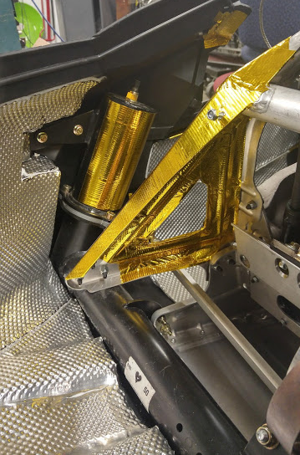
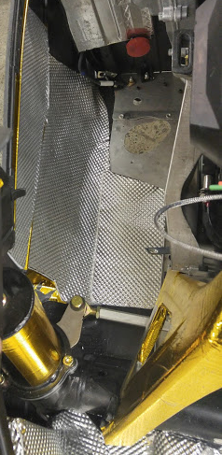
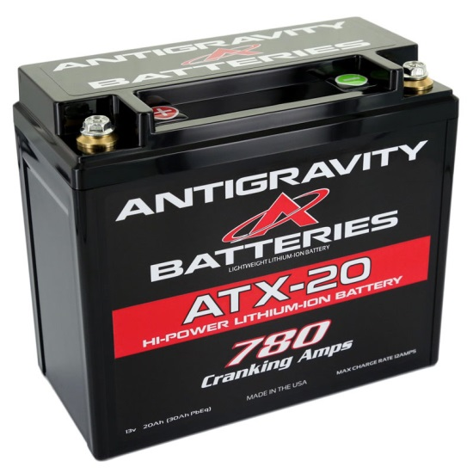
Other modifications
Heat management
Soundproofing
Stiffer front springs
Battery
Notes:
Gui

Slide 13
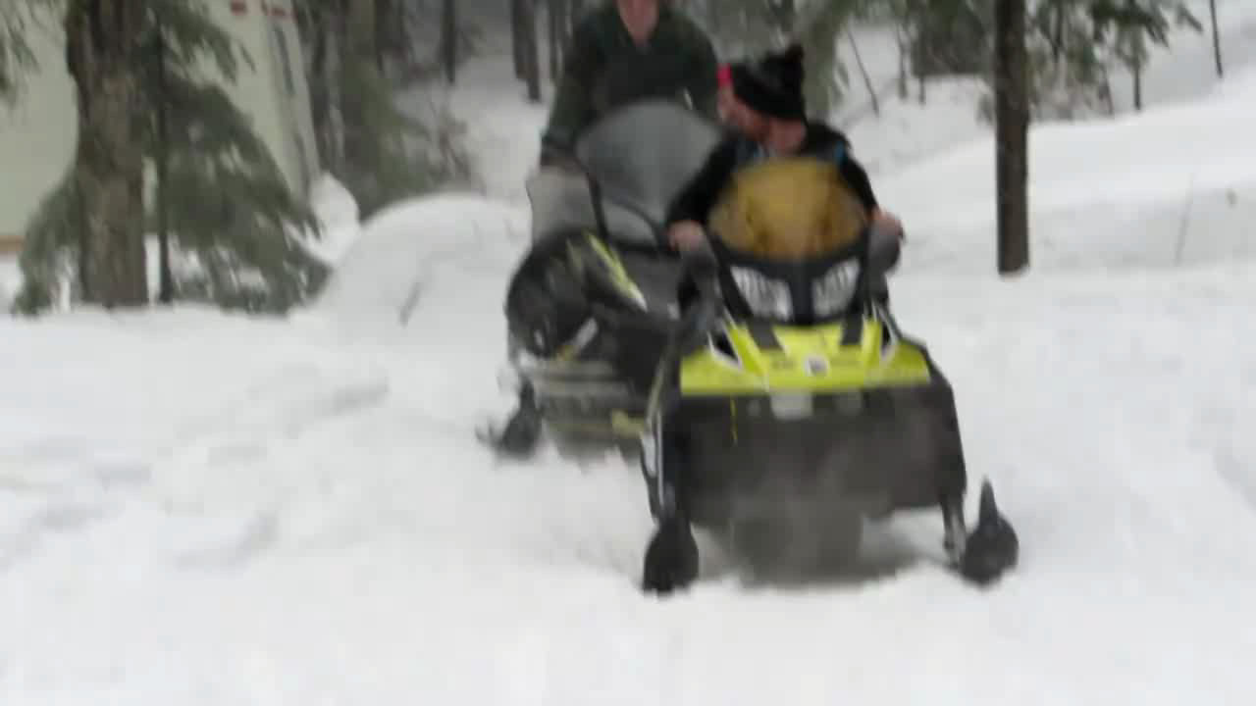
Testing
Air Fuel Ratio at :
  Full load & full throttle : 17.5 : 1
  Trail speed (35 mph) :
  25 to 30 : 1
Notes:
Gui

Slide 14
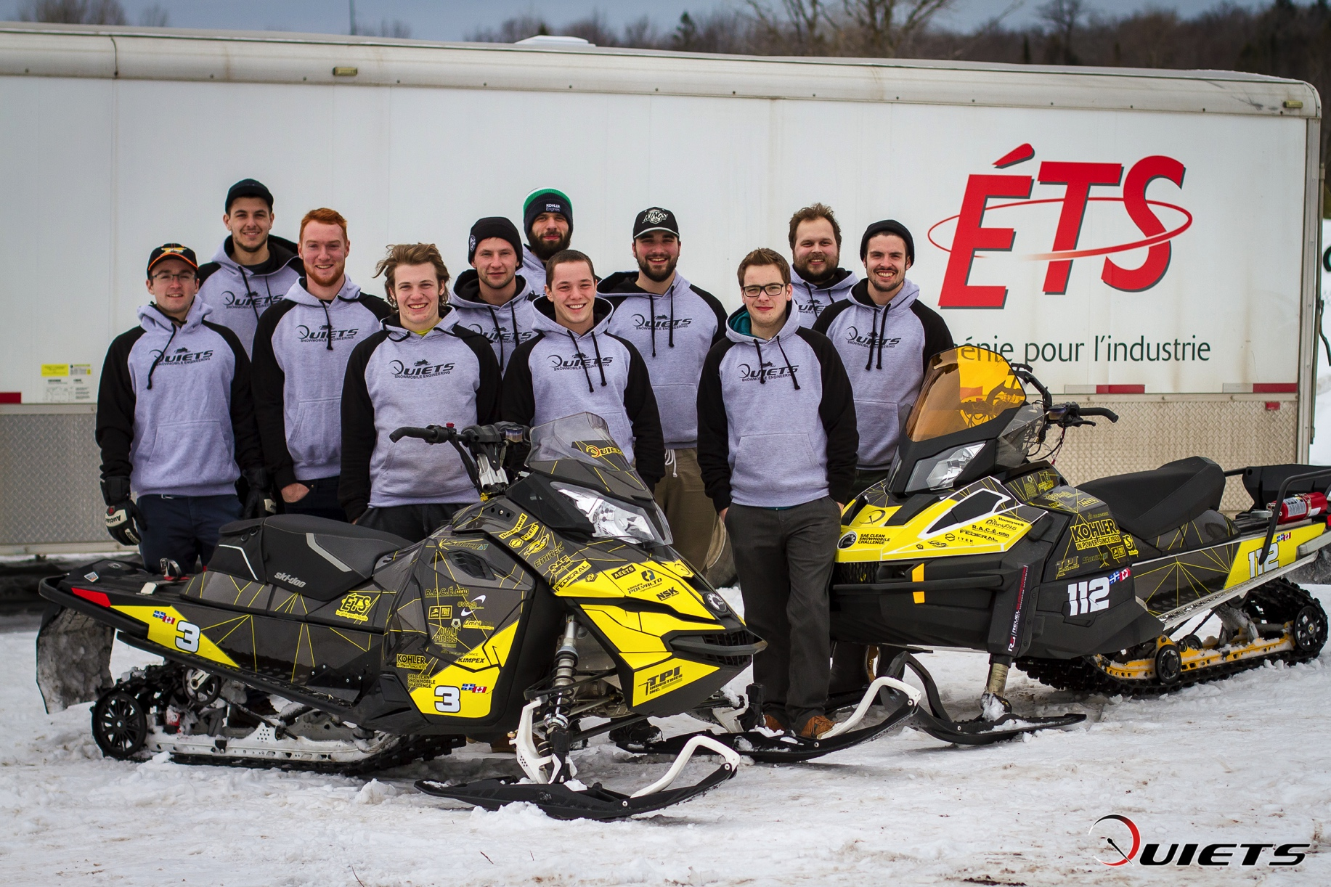
Questions?

