Slide 1

TEAM QUIETS-CI #103
2019
SAE CSC DESIGN PRESENTATION
By: Quentin Gravel and
Mathieu Verner

Slide 2
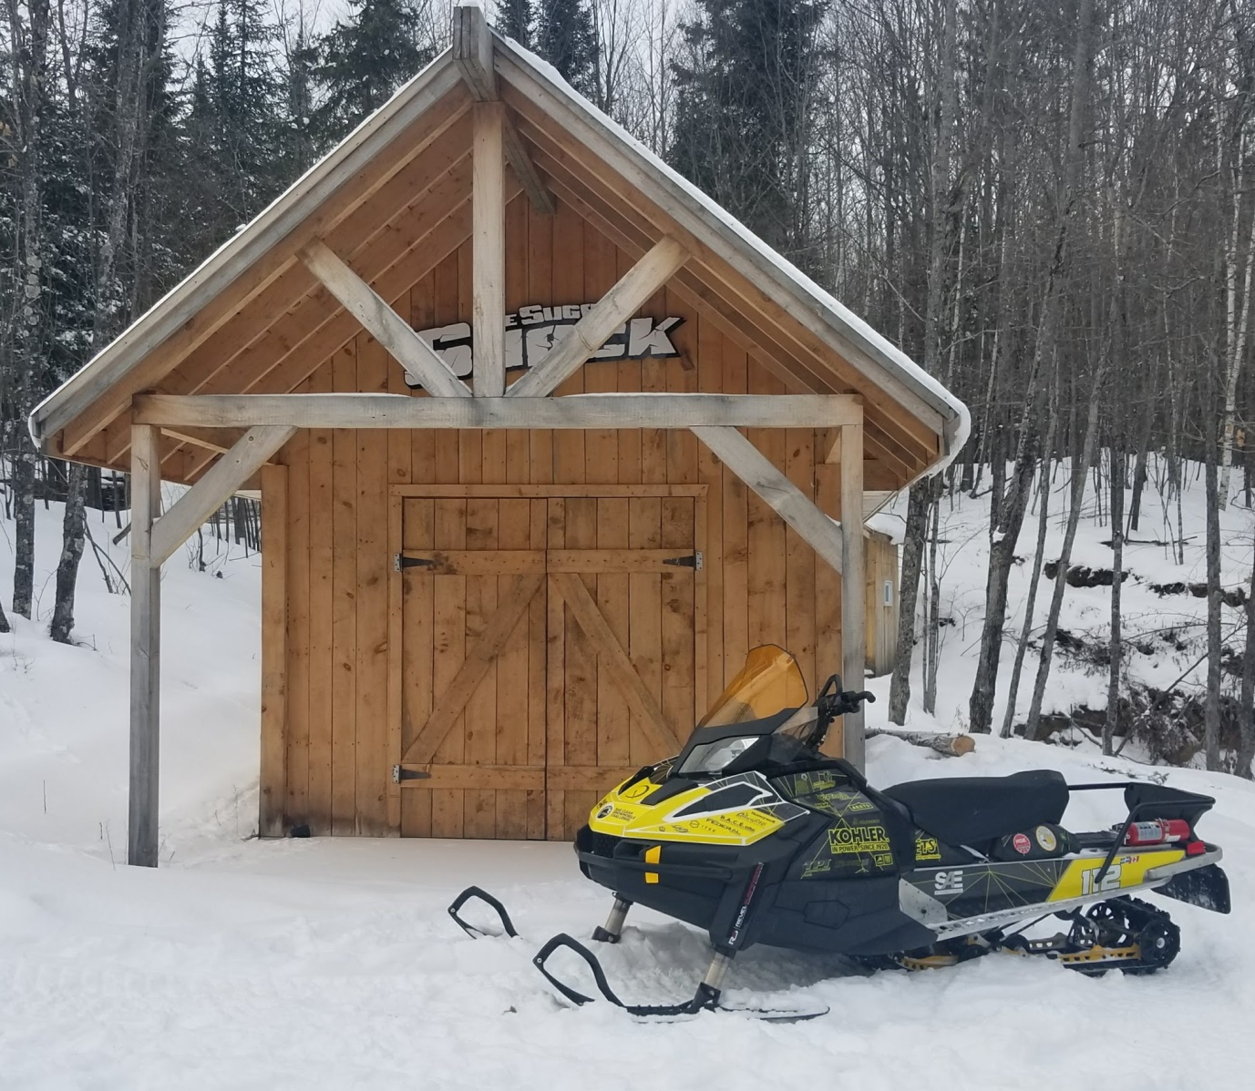
Presentation content
Overall packaging
Chassis modifications
Powerplant
Drivetrain modifications
Additional features
Driver features
Possible future upgrades
Notes:
Do

Slide 3
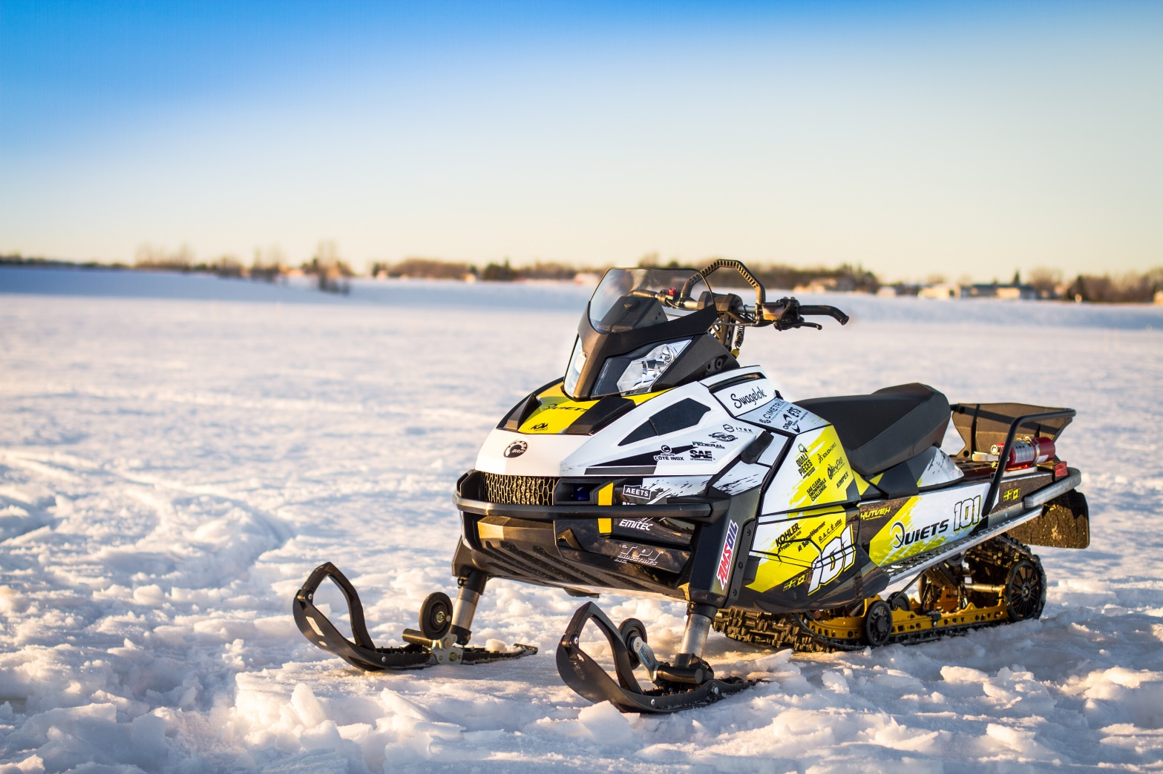
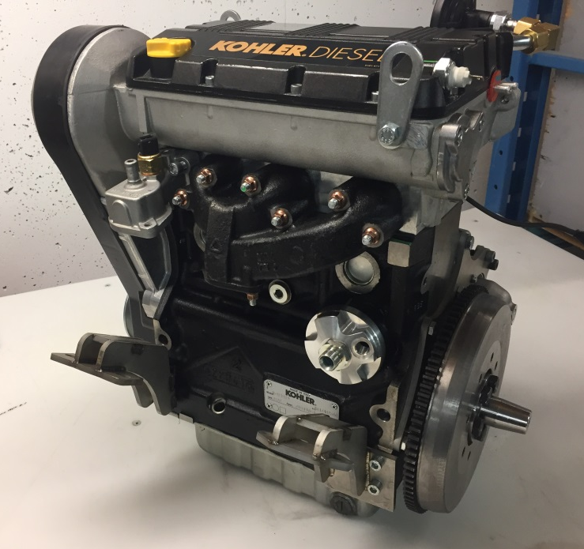
Overall packaging
Objective : Marketable utility snowmobile
2017 Ski-Doo Tundra Sport
Kohler KDW1003
Notes:
Do

Slide 4
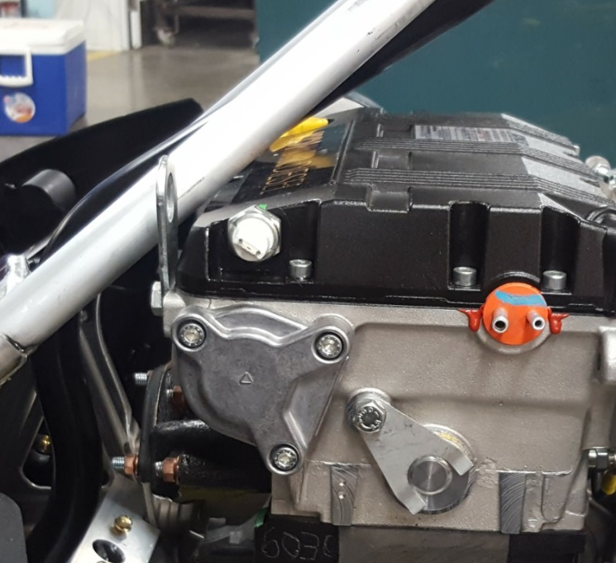
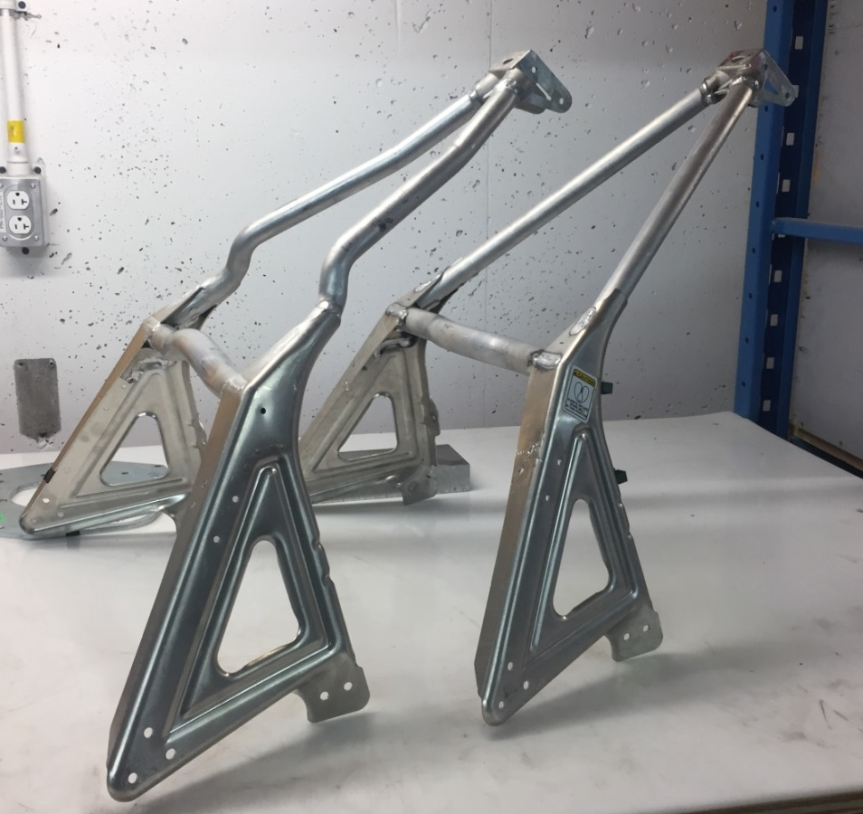
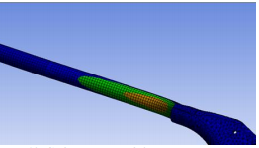
Chassis modifications (2017)
New S-module design
Simulated at 765 lbs (engine: 176 lbs)
Notes:
Gui

Slide 5
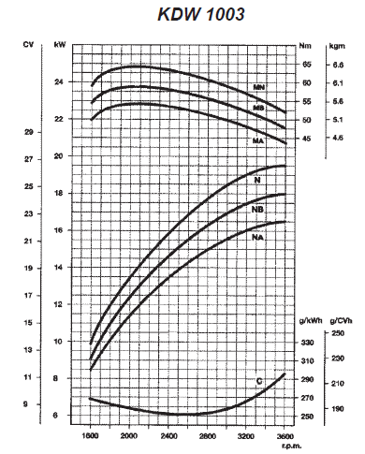
Powerplant
Stock engine specifications :
  Inline 3 cylinders
  1028 cc
  Mechanical fuel injection
  23.4 HP
  36.8 ft-lbs
Last year engine specifications:
  36 HP
  47 ft-lbs
  E-Score: 206
  Soot: 67
Notes:
Do

Slide 6
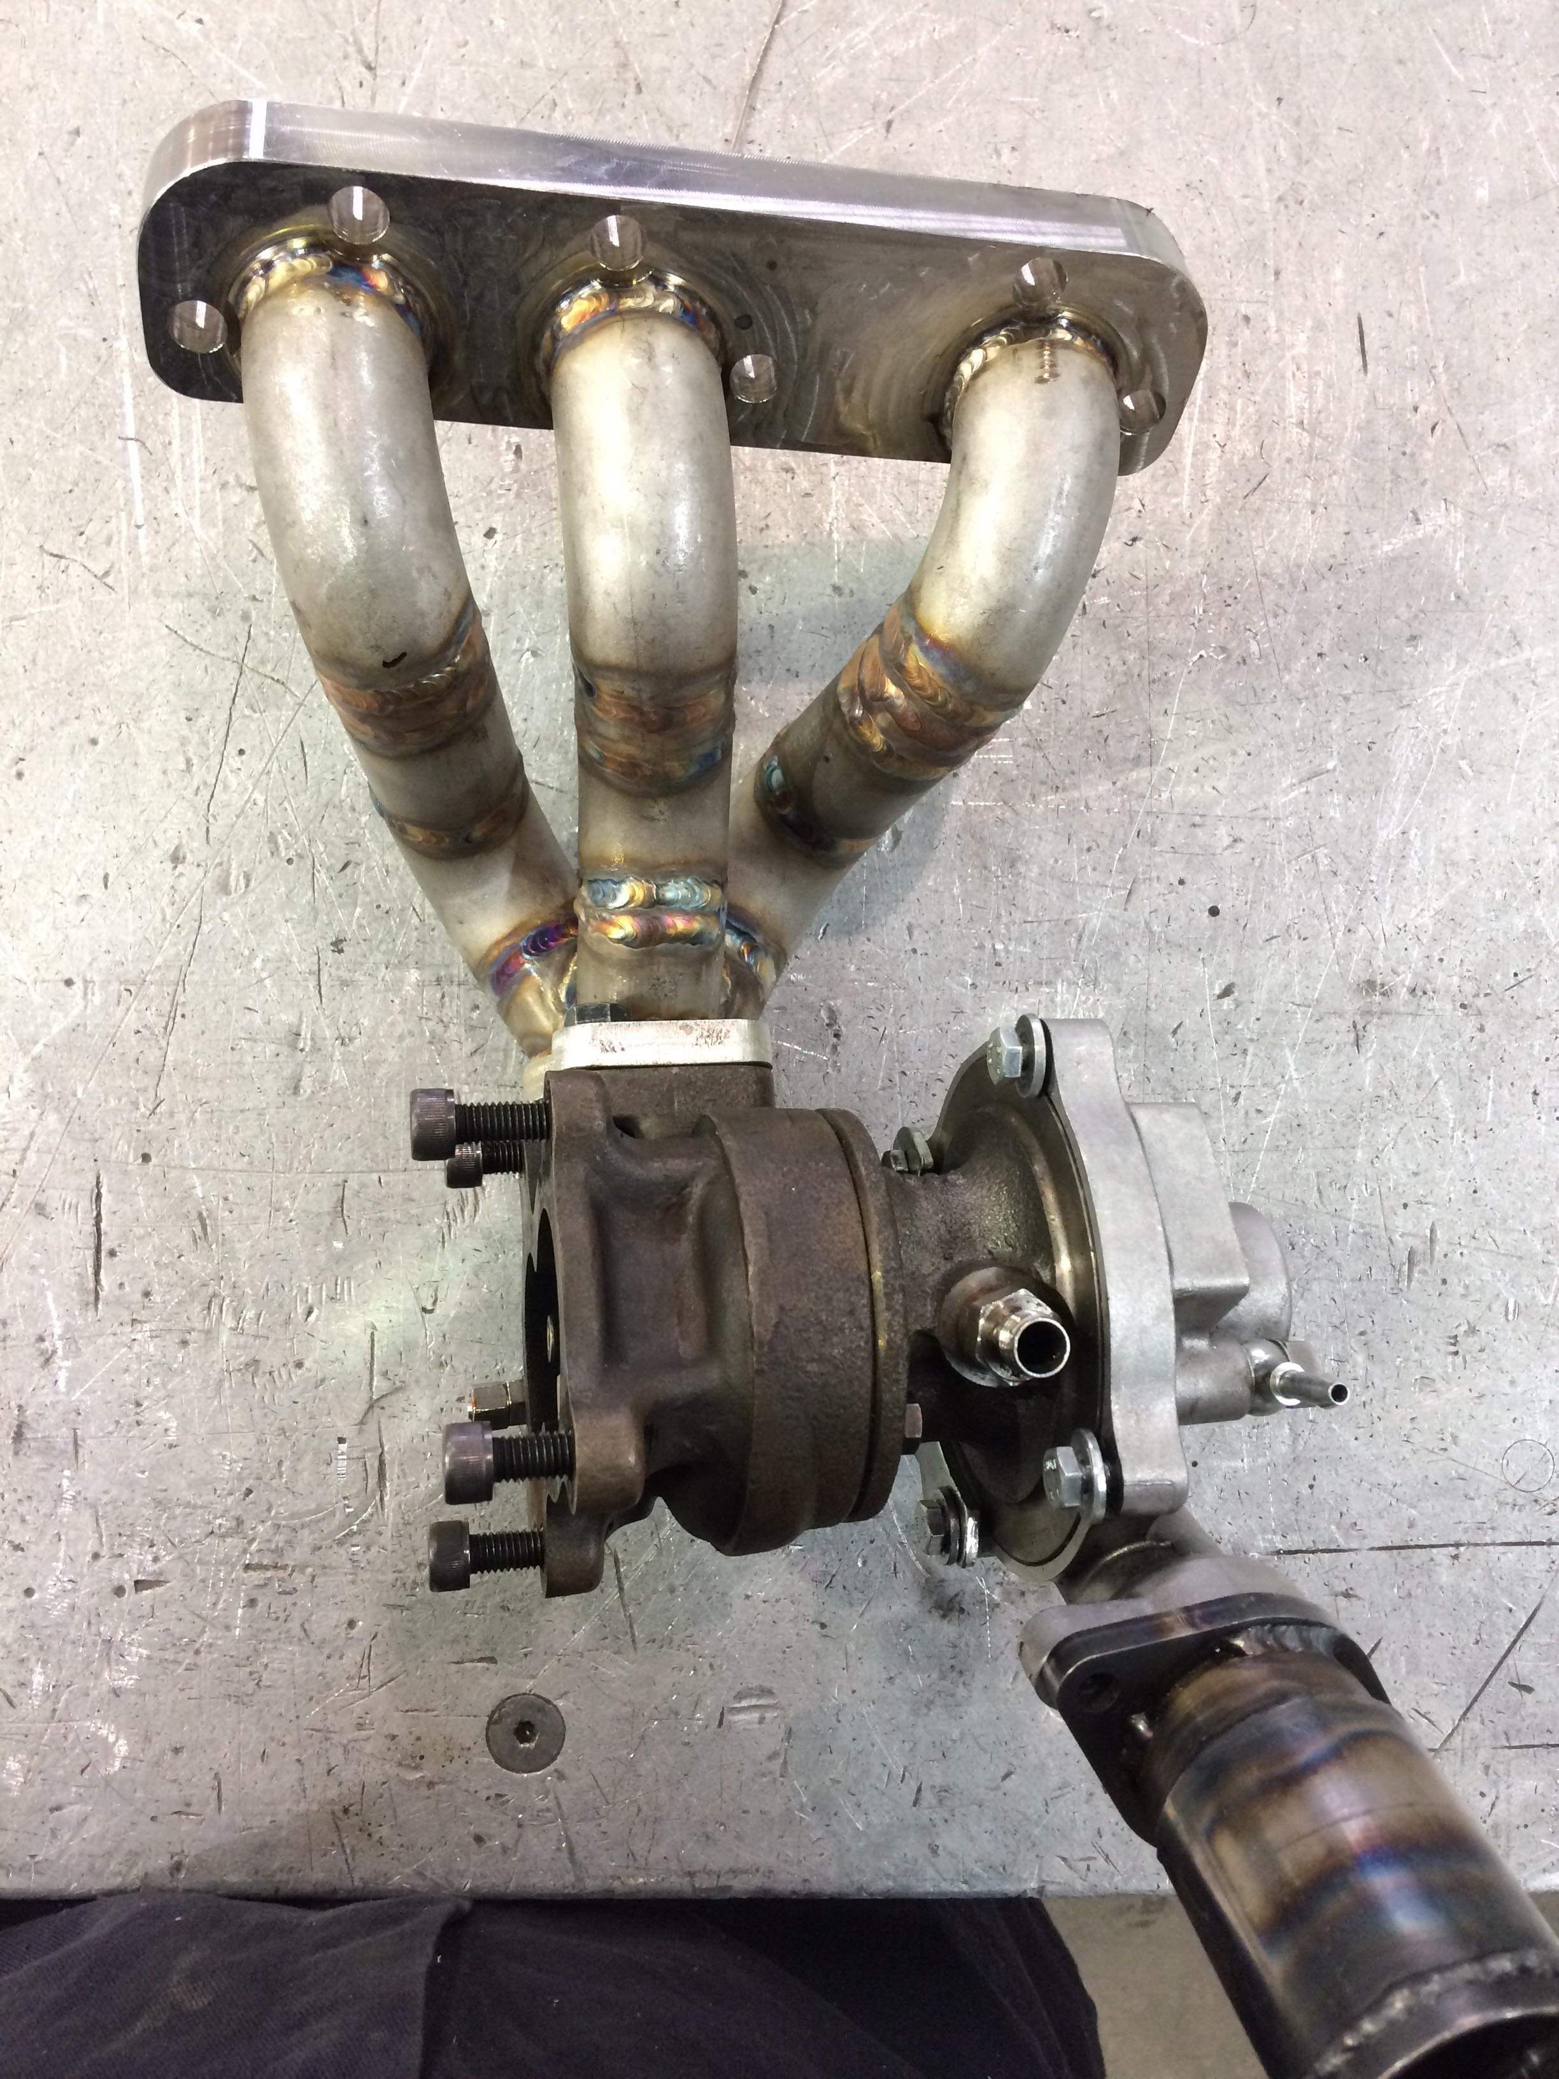
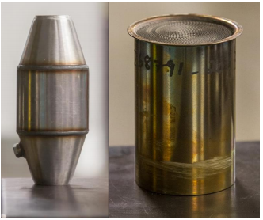
Powerplant
Exhaust design
  Turbo BorgWarner KP35
  Diesel Oxide Catalyst / Passive Diesel
  Particulate Filter
  900 ACE Ski-Doo Muffler
Notes:
Do

Slide 7
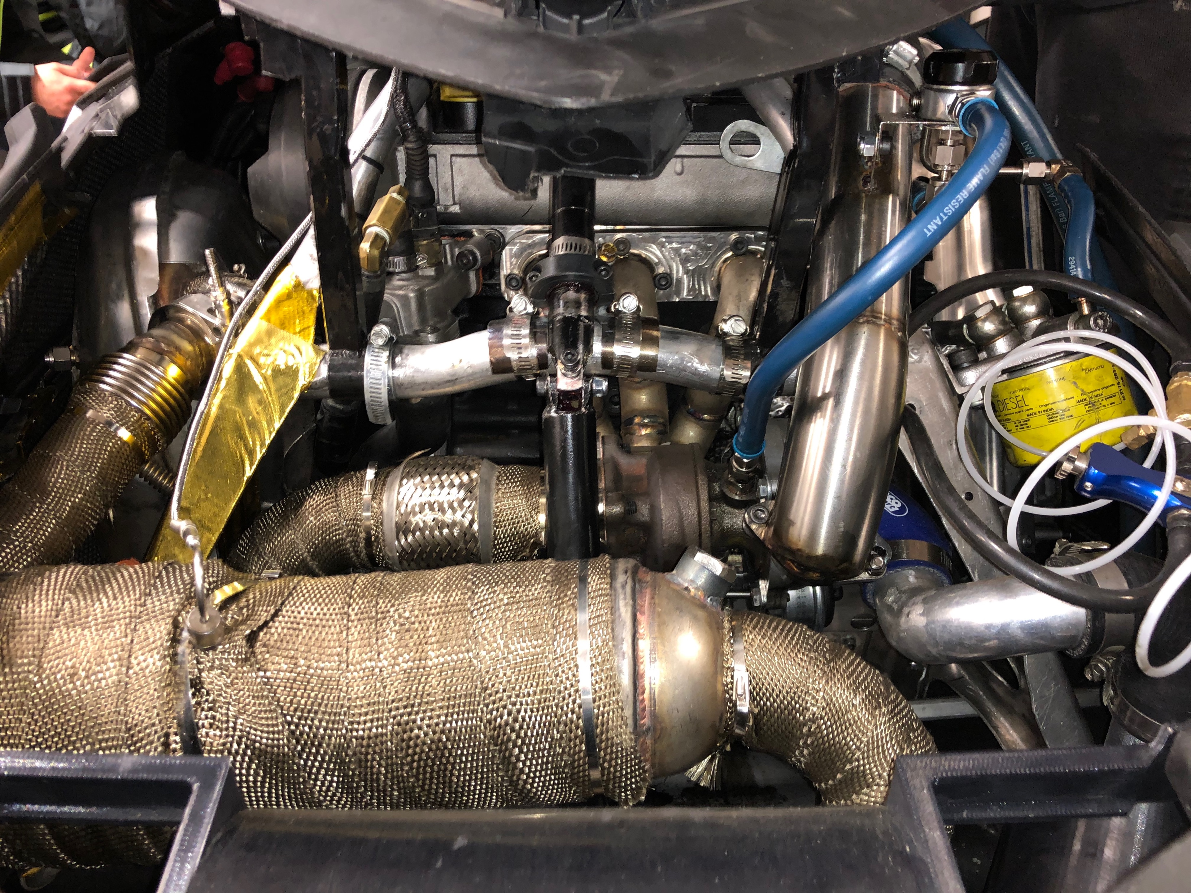
Powerplant

Slide 8
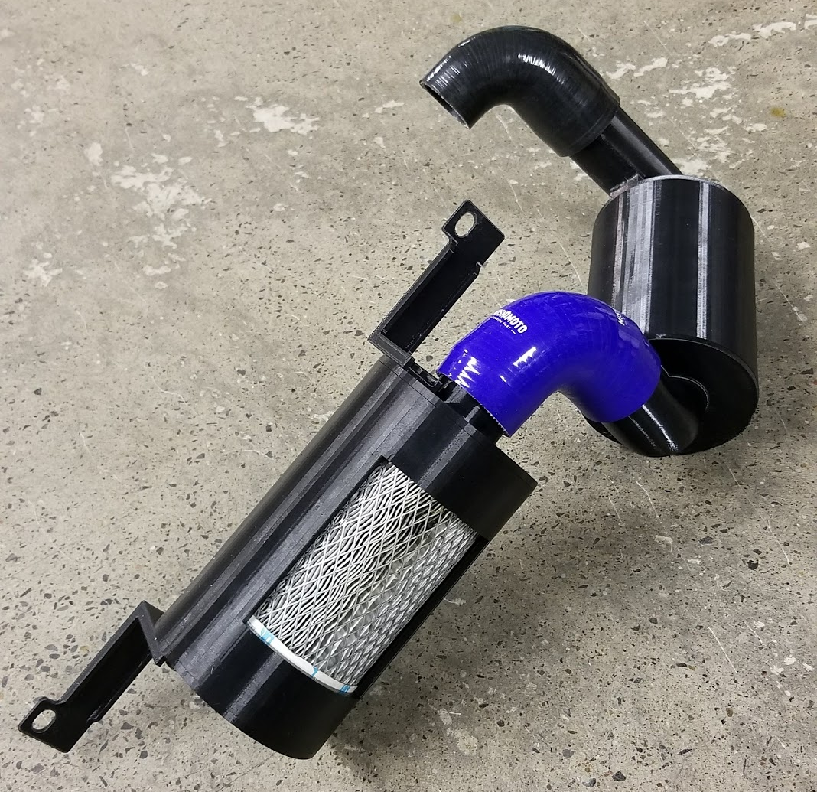
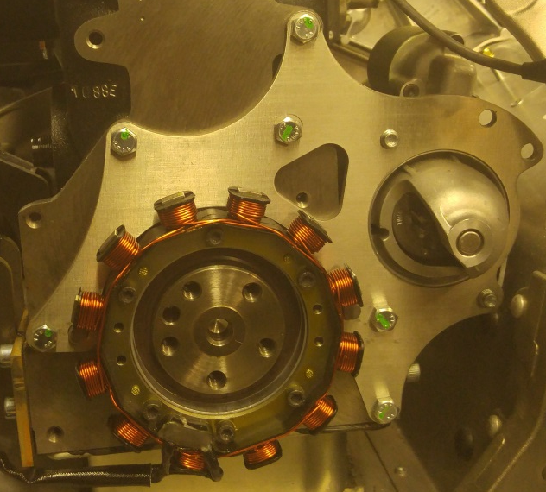
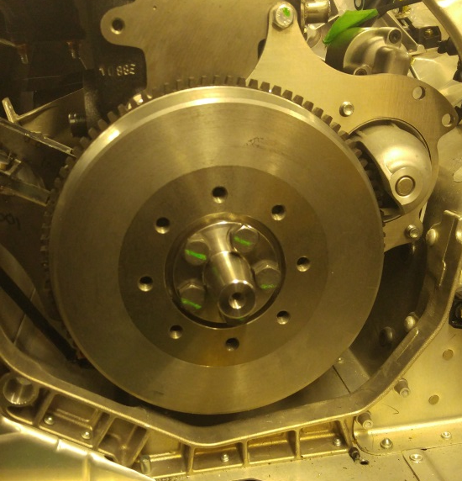
Powerplant
Flywheel alternator
Air intake muffler
Notes:
Do

Slide 9
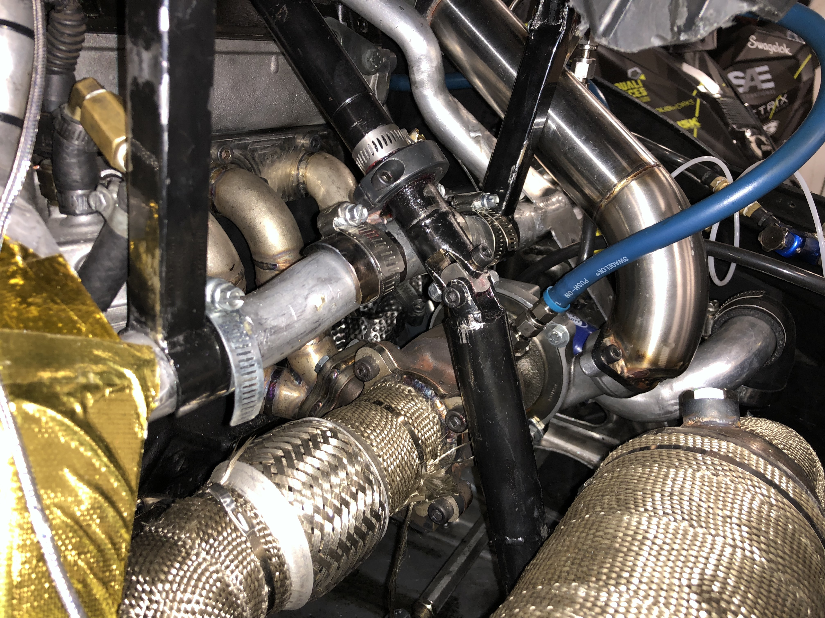
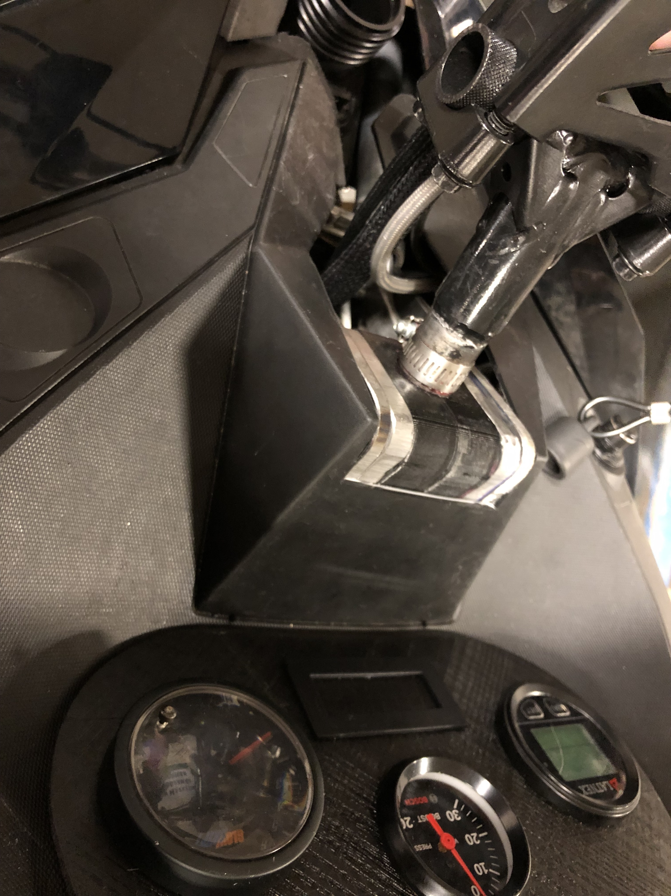
Steering column
Steering column redesign
Notes:
Gui

Slide 10
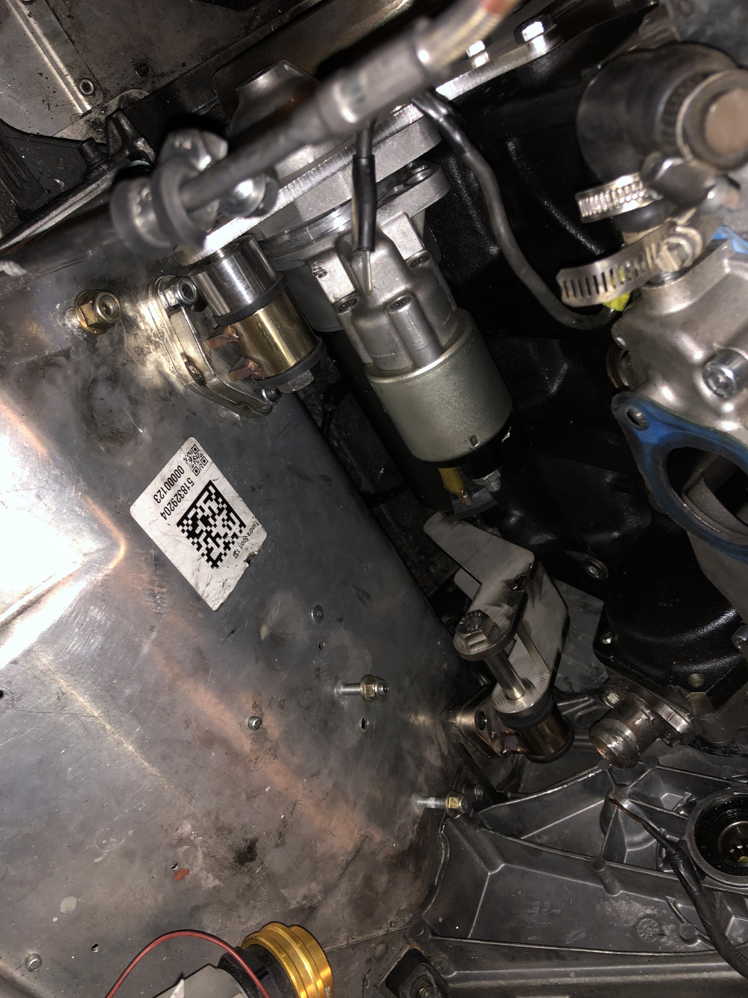
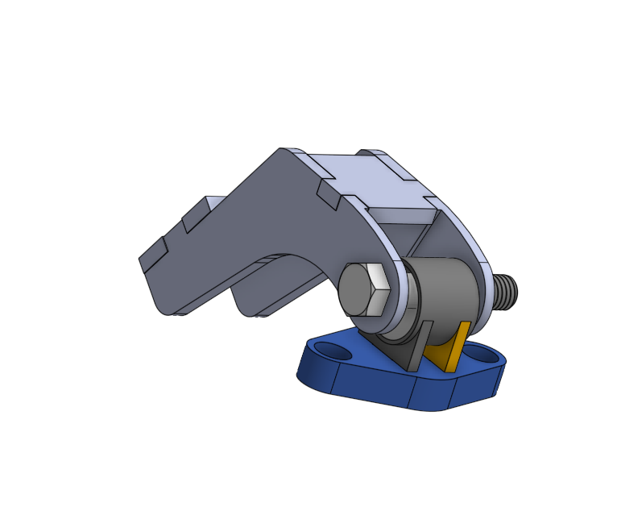
Engine mounts

Slide 11

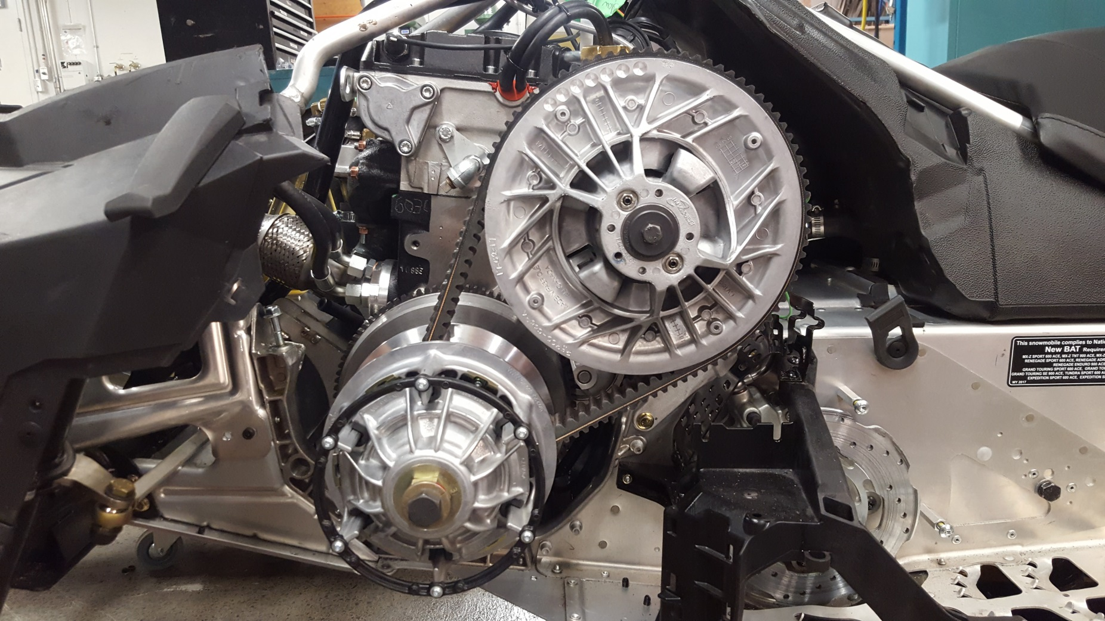
Drivetrain modifications
Clutches :
  Custom design
  for our application
  Operating range :
  900 to 3800 RPM
  Driving ratio :
  4:1 to 0.75:1
  Heavier weights (416g)
  and stiffer spring
Notes:
Gui

Slide 12
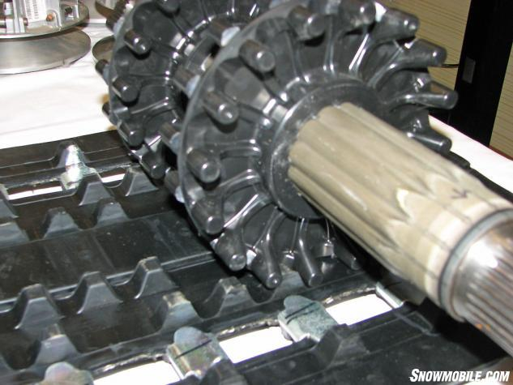
Drivetrain modifications
Silent Drive sprocket Chaincase ratio
Bottom chaincase gear:
  Stock : 51 tooth
    Top Speed = 45 mph
    RPM @ 35 mph = 3000
  New : 43 tooth
    Top Speed = 55 mph
    RPM @ 35 mph = 2400
Notes:
Gui

Slide 13
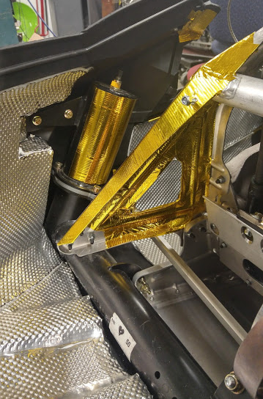
Additional features
Heat management
Stiffer front suspension springs
Lithium-Ion Battery
Notes:
Gui

Slide 14
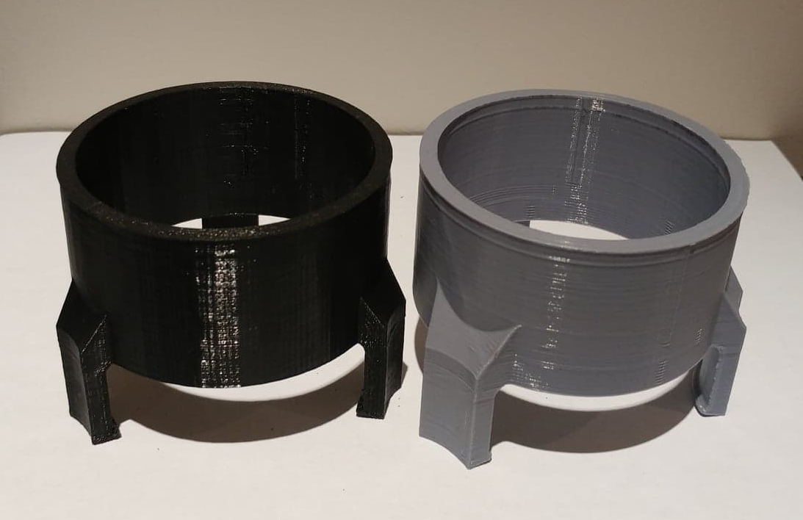
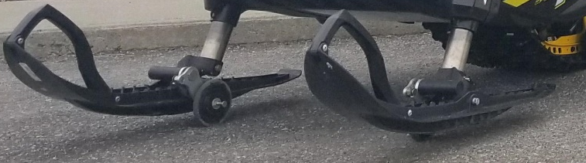
Driver features
Rollerskis by Qualipièces
Reverse
Ice scratchers
2 places seat
Stability and Turning Enhancement Kit
Clip-on 3D printed cup holder for Coca-Cola and Redbull
Notes:
Gui

Slide 15
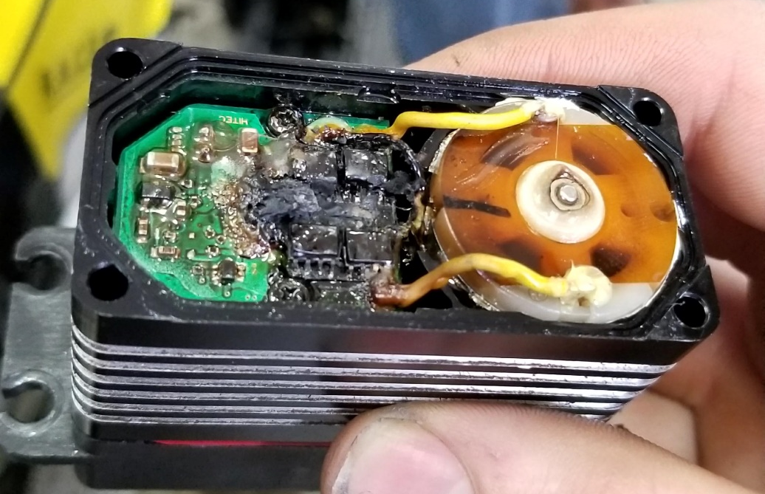
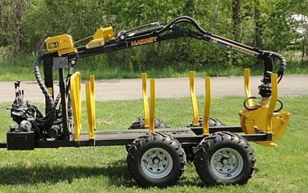
Possible future upgrades
Drive by wire throttle
110V power outlet
Oil pump with quick connects
for accessories
  Chainsaw and log splitter
  Grooming trails
  Logging trailer
  Dump trailer
  Winch

Slide 16
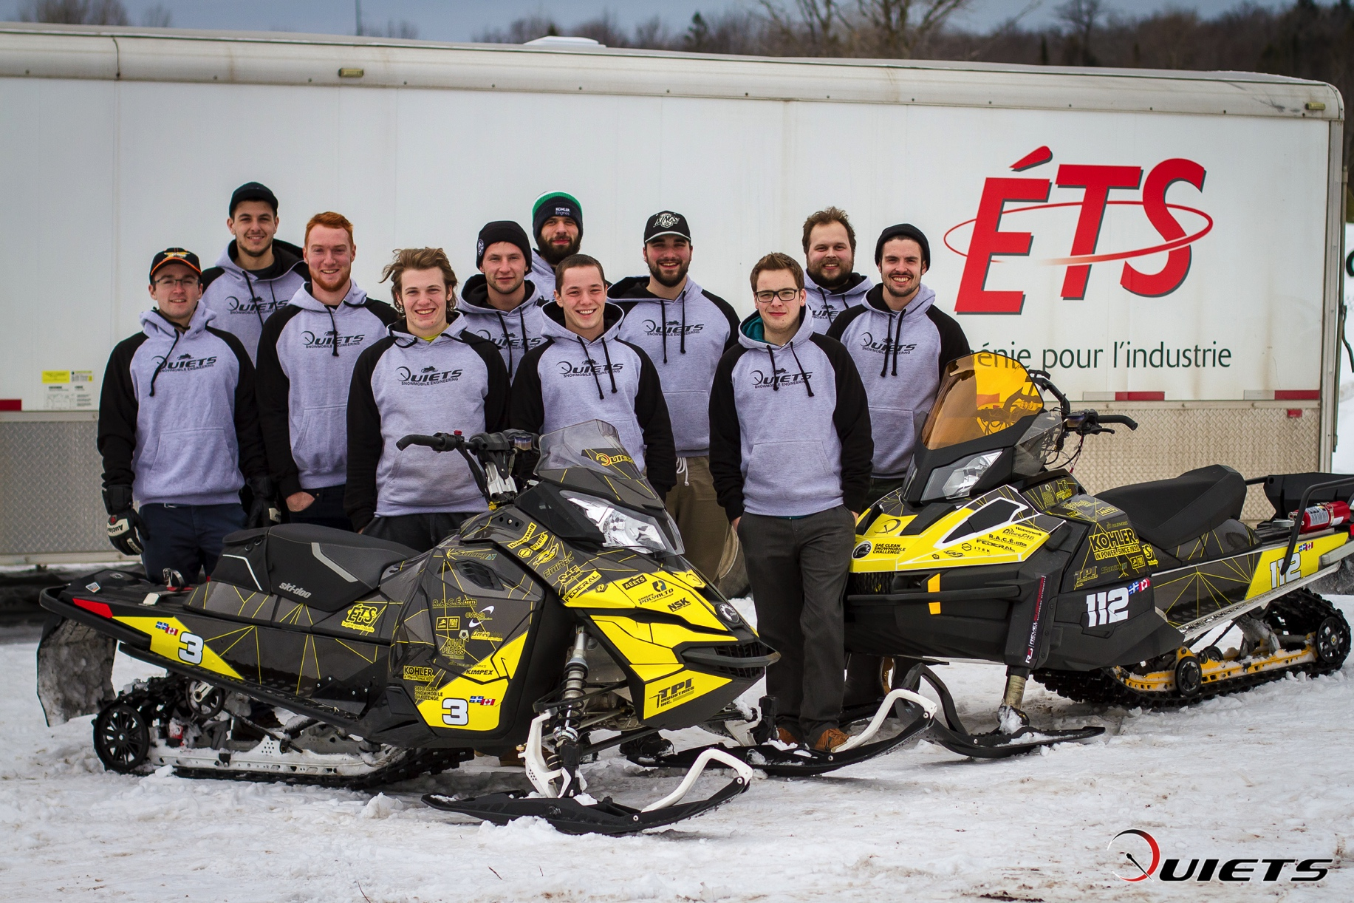
Questions?

