Slide 2
Vision
A new design cycle
Fun, marketable snowmobile
65 – horsepower class
Continue the practical, data-driven approach to innovation

Slide 3
Team Management
Two-Year Design Cycles
Project Manager with individual Team Leads
Sophomores and Juniors hold leadership positions

Slide 4
Innovations
Integration of the Polaris ProStar 1000 into the AXYS platform
Standalone MoTeC ECU
Electronic Throttle Control
Two-Chamber muffler design using destructive wave interference
Simulated Acoustic Imaging

Slide 5
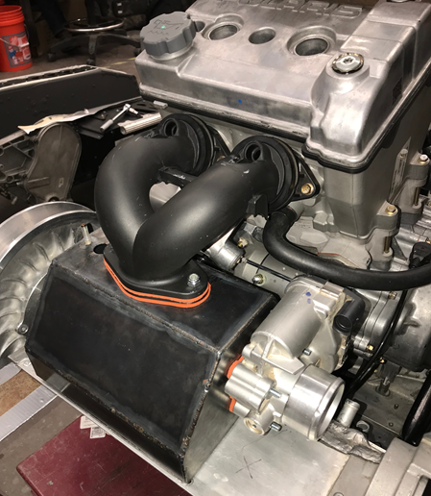
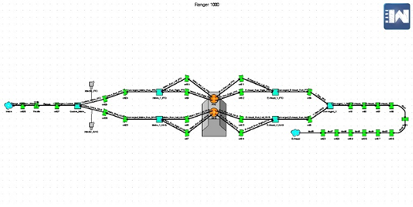
Engine Development
Polaris ProStar 1000
Ricardo WAVE Simulation
MoTeC M130 Standalone ECU
Electronic Throttle Control
Custom Intake and exhaust
3-way Catalyst

Slide 6
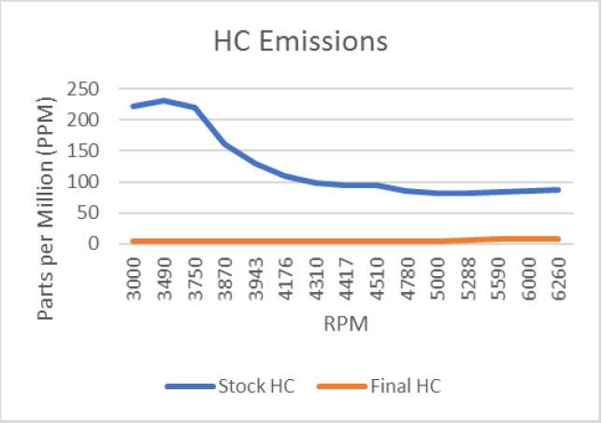
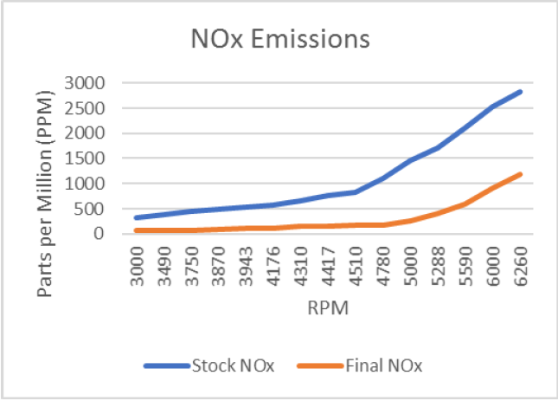
Dynamometer / Results
45 kW (60 hp)
Hydrocarbons (HC)
reduced 92%
Carbon Monoxide (CO) reduced 97%
Oxides of Nitrogen
(NOx) reduced 73%

Slide 7
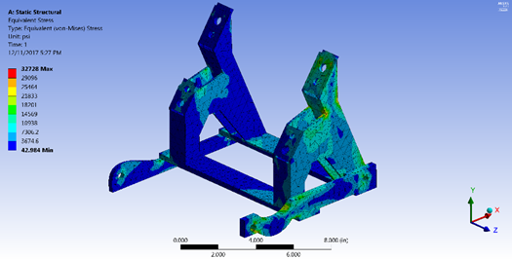
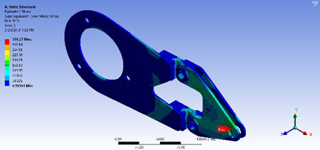
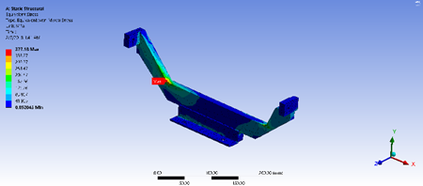
Drivetrain Integration
Maintained factory mounting locations
Integrated the front engine mounts with the overstructure
Redesigned front crossbar to keep the center of gravity of the snowmobile low

Slide 8
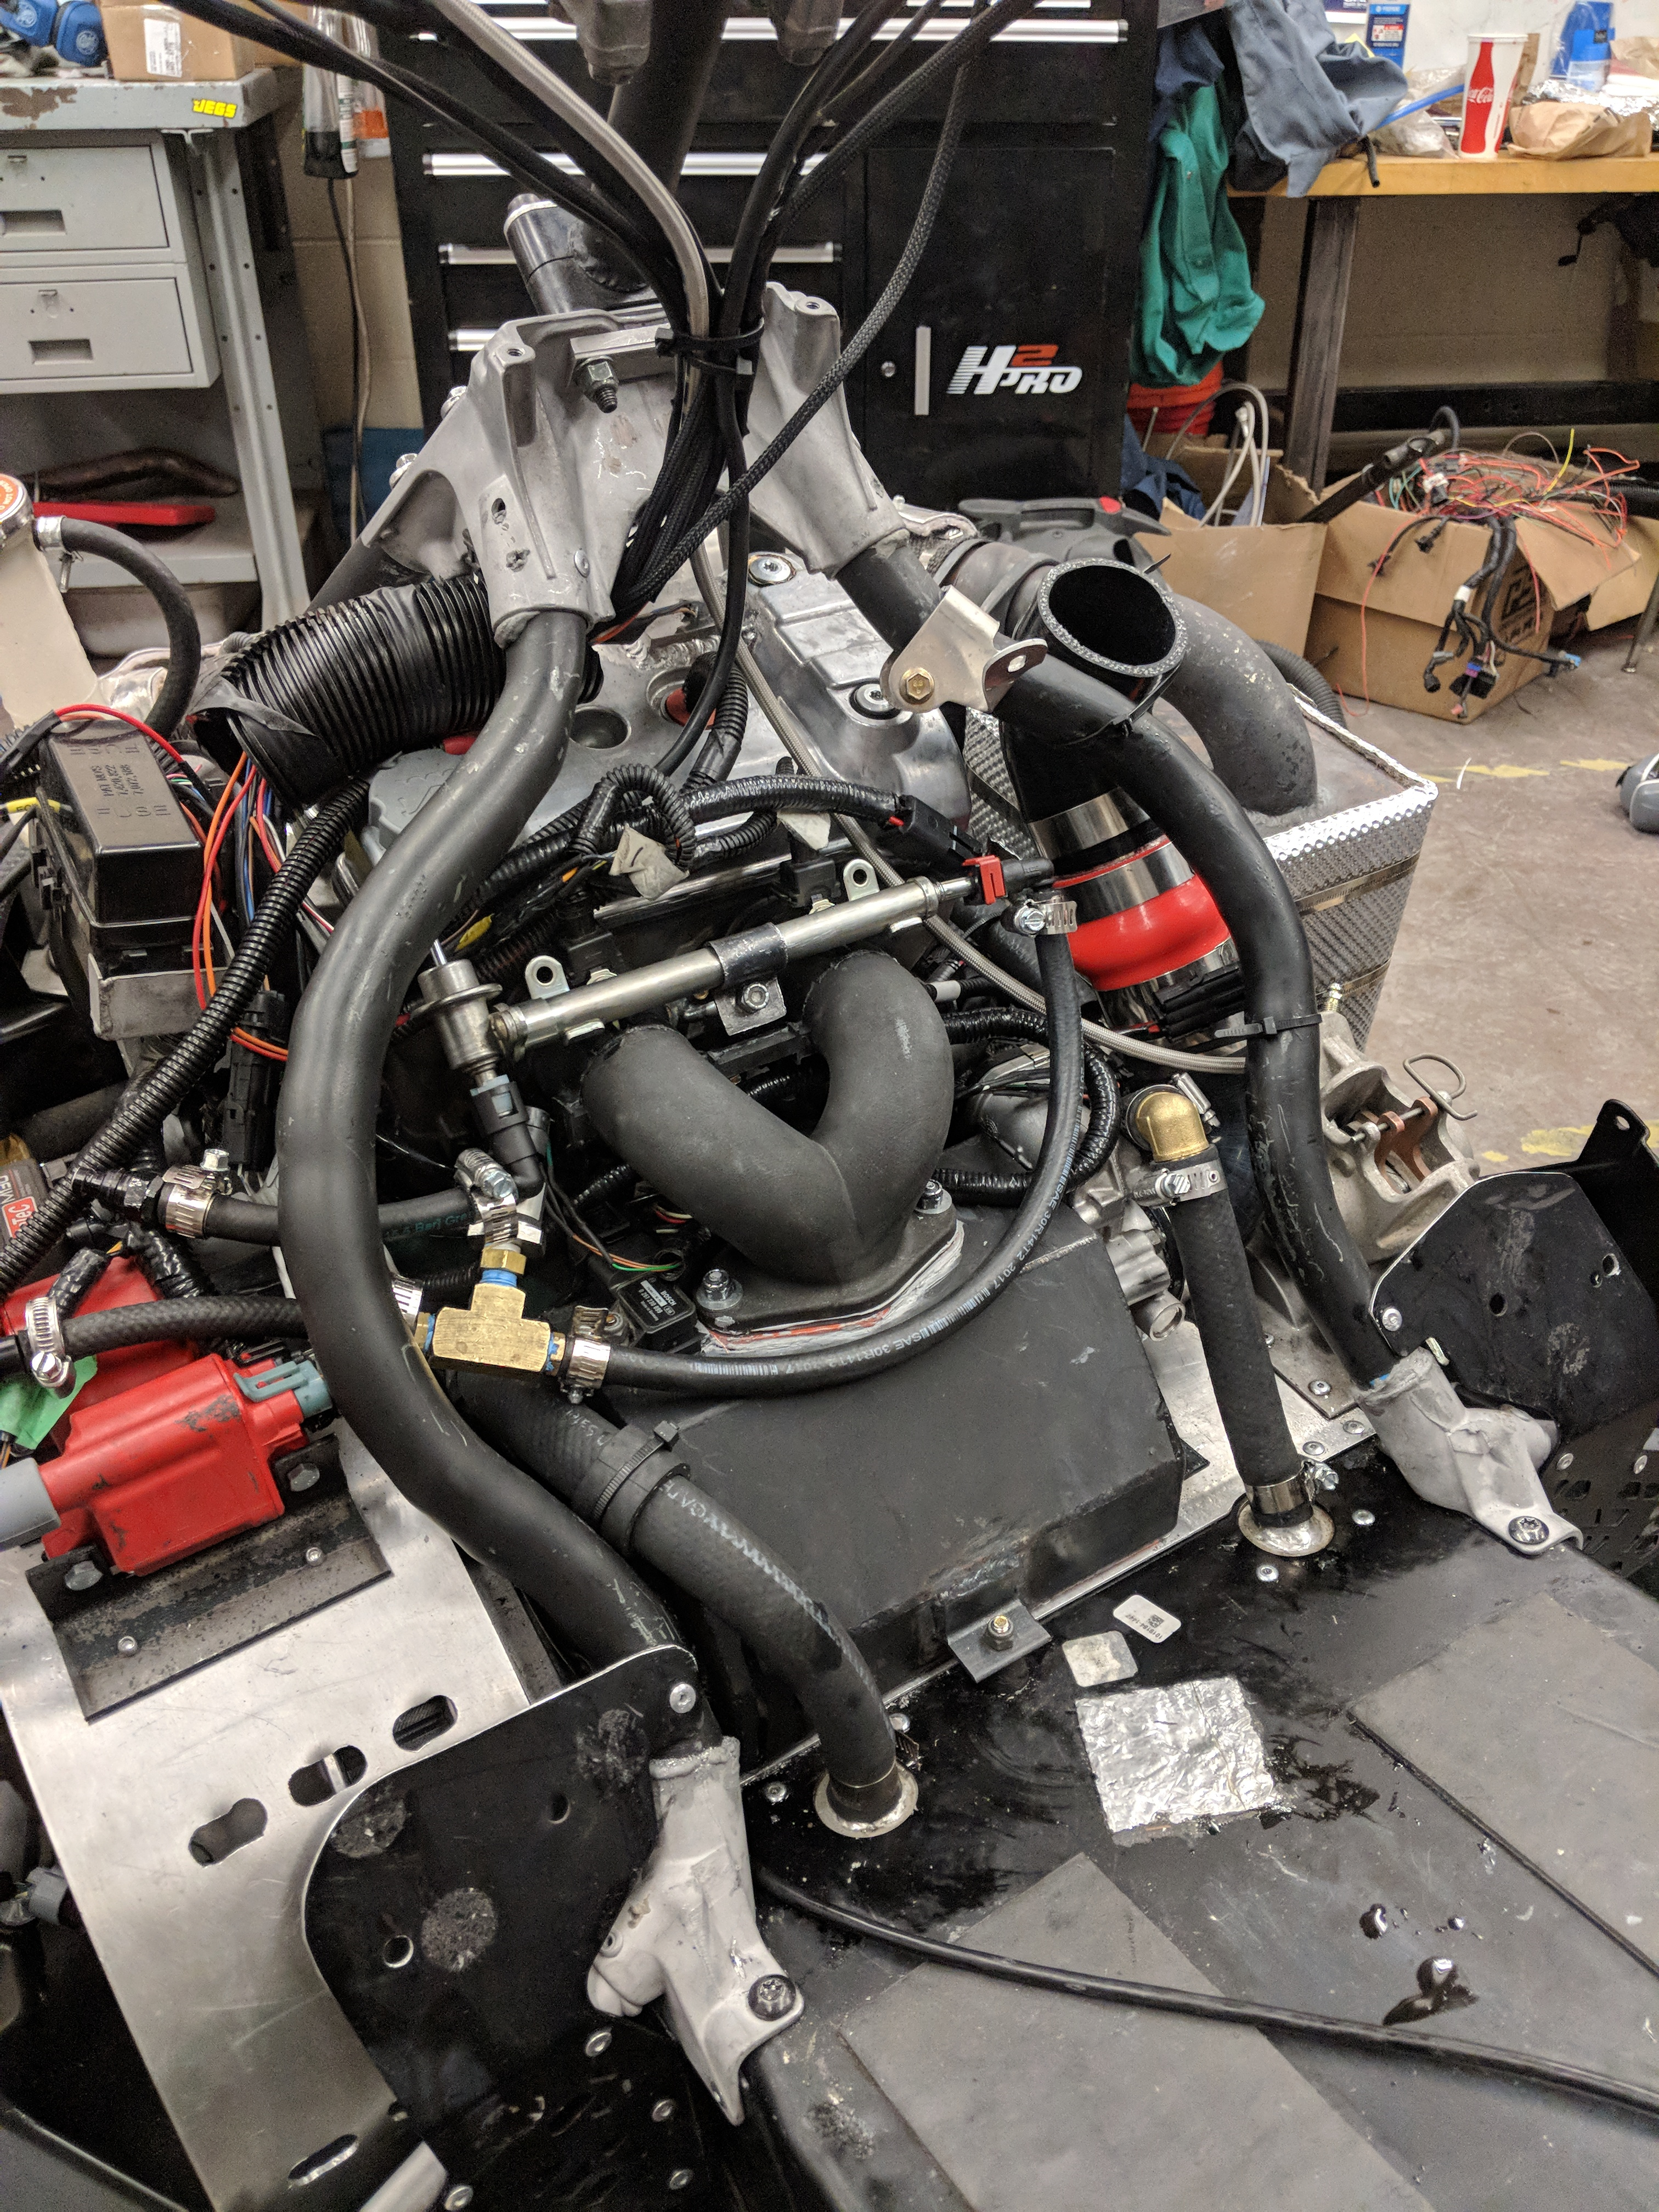
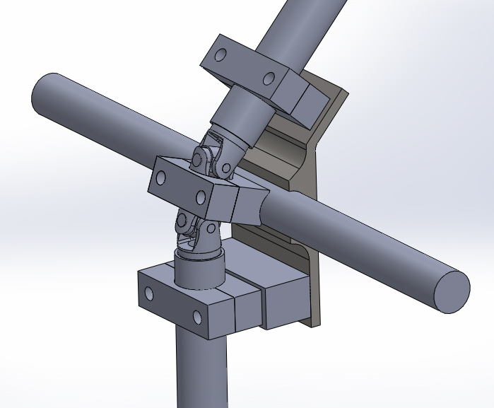
Drivetrain Integration
Double U-Joint steering system
Steering uses 5 separate mounts on the overstructure while maintaining relatively factory steering angle
1020 steel spars designed to accommodate the intake and fuel system

Slide 9
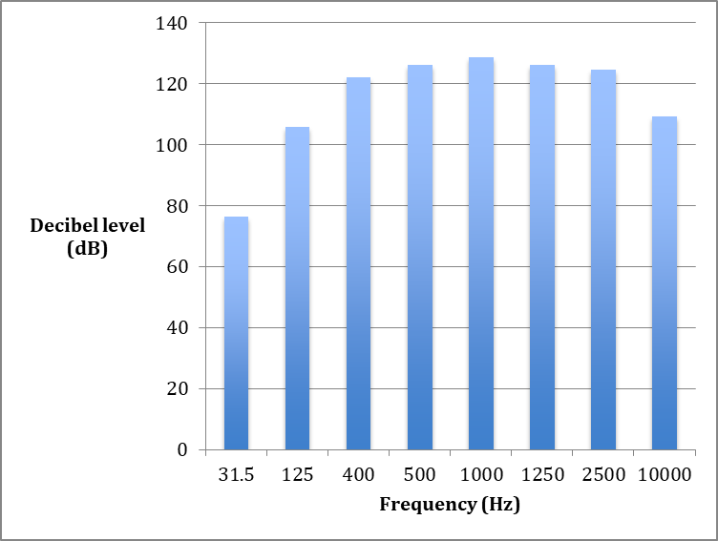
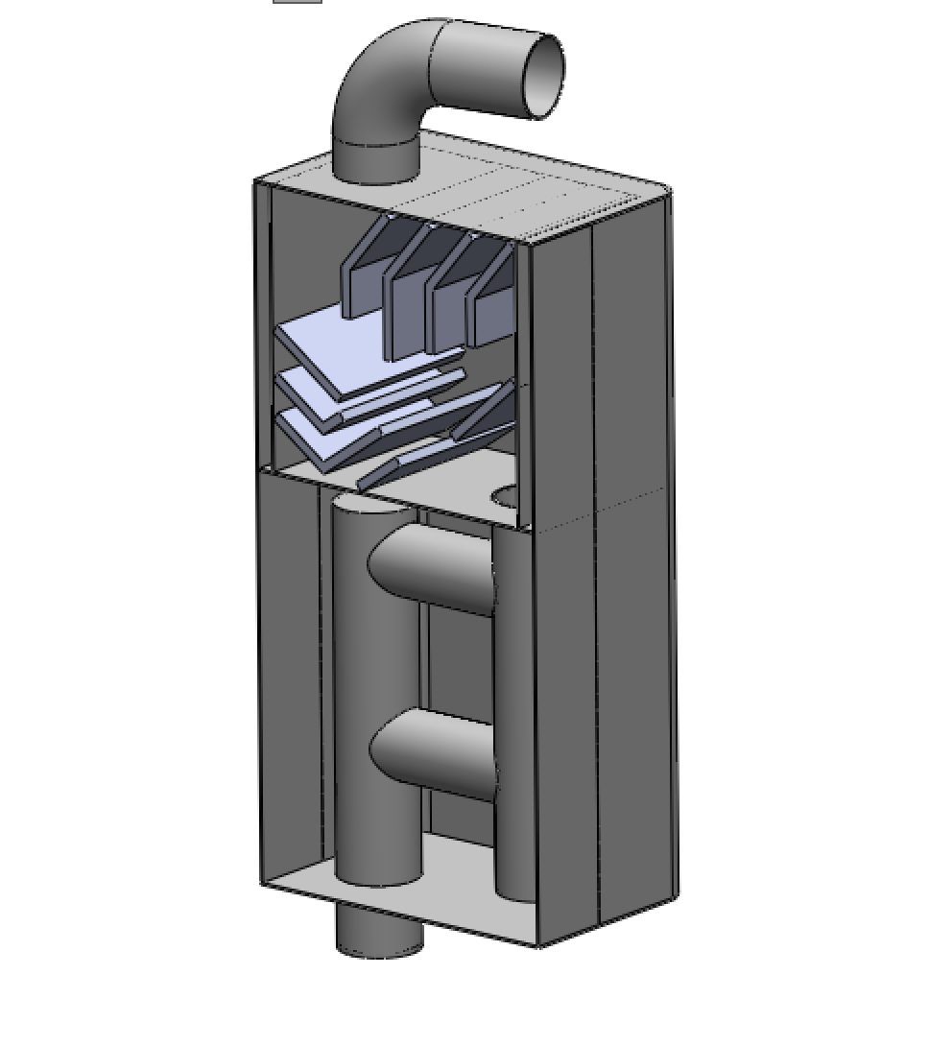
Muffler Development / Design
Dominant Frequency identification
Quarter wavelengths were used to dictate muffler design
Two chamber design
Destructive wave interference
Baffles and resonator tubes targeting dominant frequencies

Slide 10
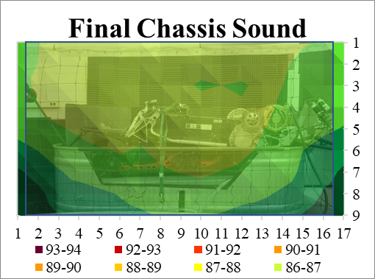
Simulated Acoustic Imaging

Slide 11
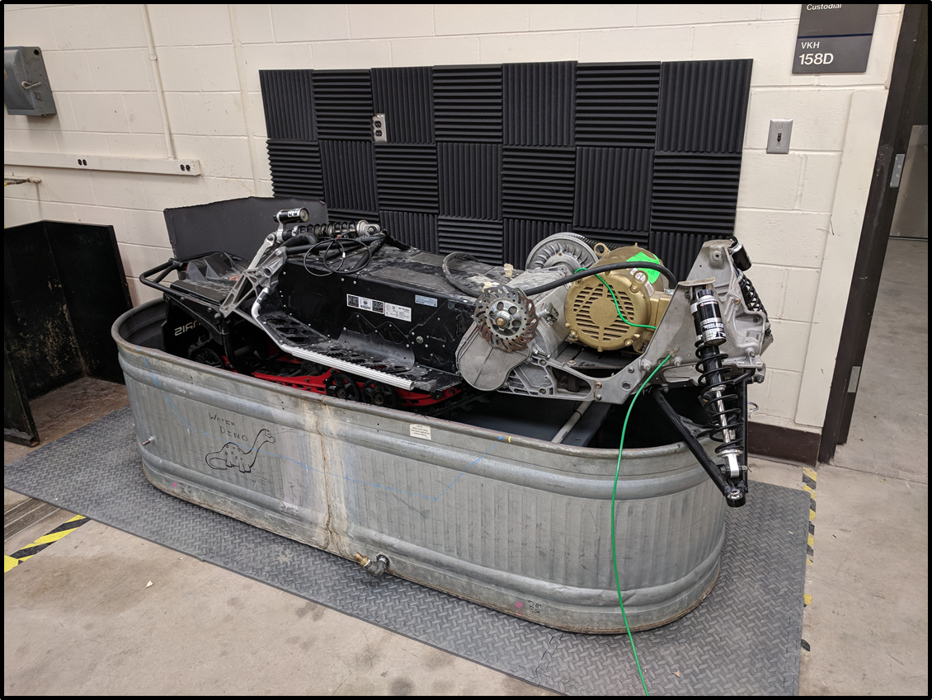
Sound Dyno
Repurposed water-dyno for sound
10 hp electric motor with VFD
Driveline Sound Improvements
Rear Shrouding
Removal of idler wheels
Graphite filled hyfax
Lizard Skin coating
Anti-Stab wheels
6 dBa decrease in sound
emissions in test simulation

Slide 12
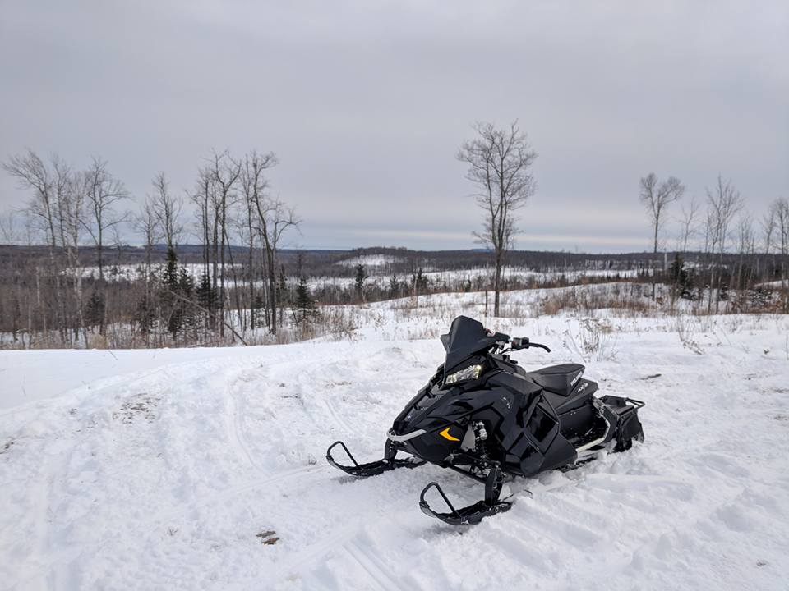
On-Snow Calibration / Testing
Through extensive on-snow testing, drivability and reliability were greatly increased
Full clutch and E-Throttle calibration using MoTeC data logging
Fuel-economy of 13
mpg on 91 octane
J1161 of 71.8 dBa
150 miles of validation

Slide 13
Summary
45 kW enjoyable trail snowmobile
80%+ reduction in emissions
6 dBa decrease in chassis sound emissions
J1161 test of 71.8 dBa
MSRP of $11,766
Well designed platform for the future.

Slide 14
Thanks!

