Slide 2
Team Members
Jacob Schofield - President
Nels Eide – Driveline / Testing
Mark Boeckmann - Engine
Keith Propson – Sound / Exhaust

Slide 3
Team Goals / Vision
Fun, marketable snowmobile
85-horsepower class
Trail / touring category
Best Available Technology for sound
E-score above 195
17+ MPG

Slide 4
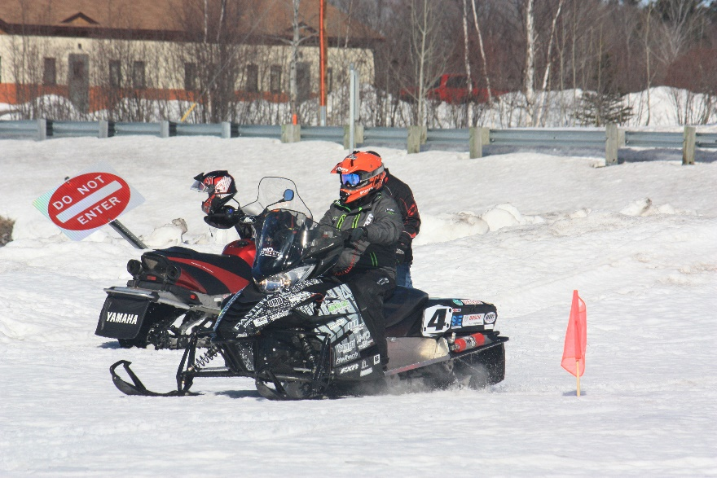
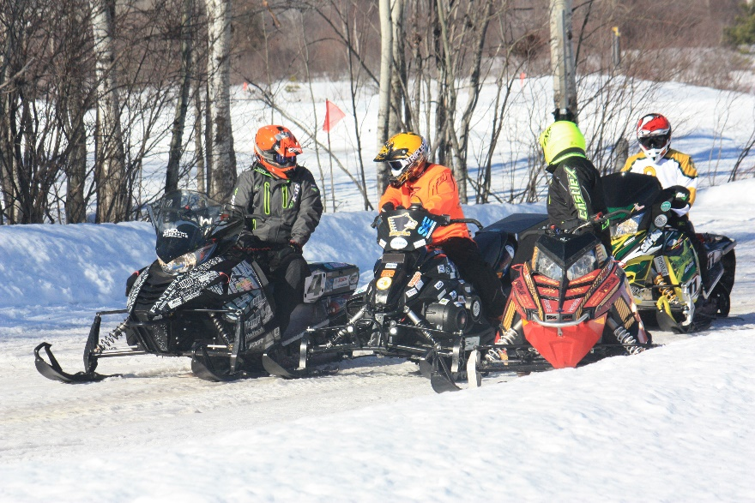
2016 Clean Snowmobile Challenge
20 Universities in Houghton, Michigan
Goal: Clean, Quiet, and Efficient
12th Overall
Award for Best Engine Design from Mahle Powertrain

Slide 5
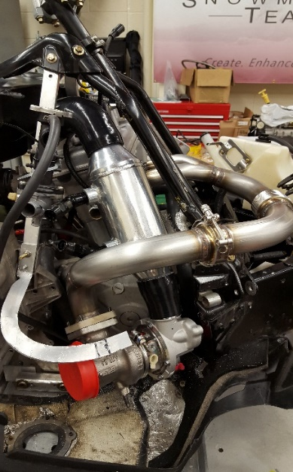
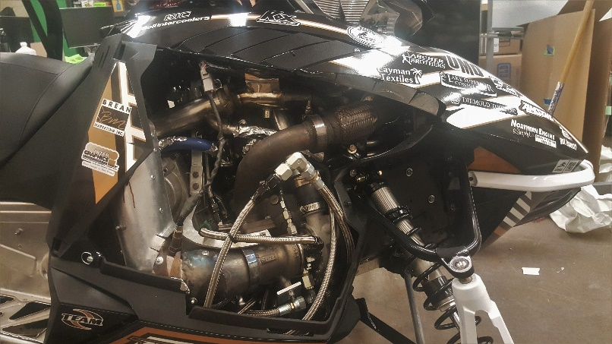
Build Comparison – 2016 vs. 2017
2016 Arctic Cat Pantera 3000
2017 Arctic Cat ZR3000
Kymco 700cc Twin
Haltech Elite 2500 ECU
Garrett Turbocharger
Cooled Exhaust Gas Recirculation (EGR)
Rear Exiting
Exhaust
Water to Air
Intercooler
Electronic
Throttle
MSRP: $12,692
Kymco 700cc Twin
Lightweight ZR Chassis
Advanced High-Flow EGR
Whisper-Drive System
Custom Intercooler Housed in Plenum
MSRP: $10,707

Slide 6
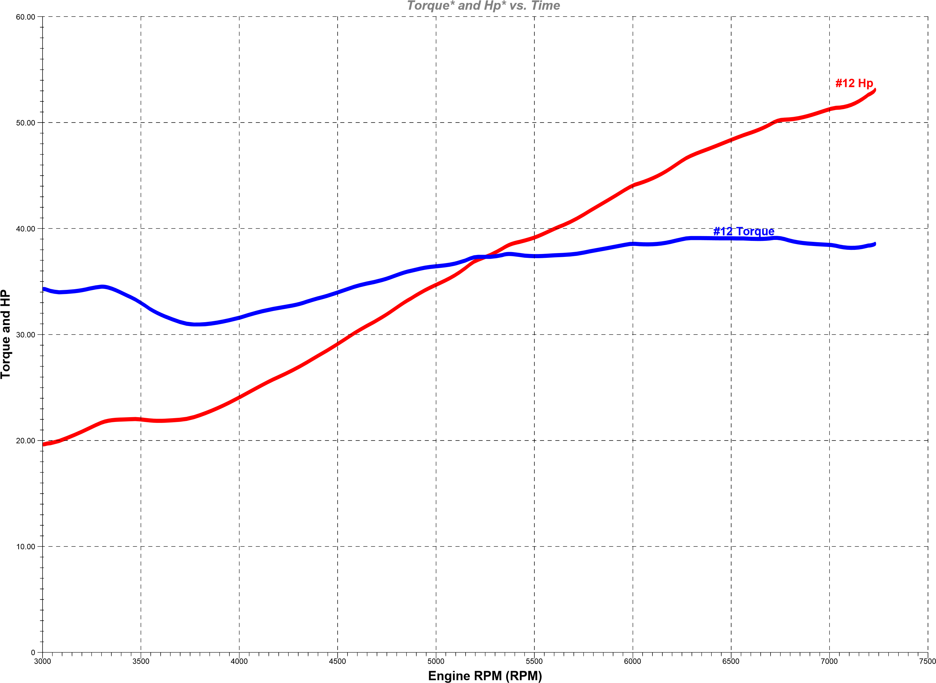
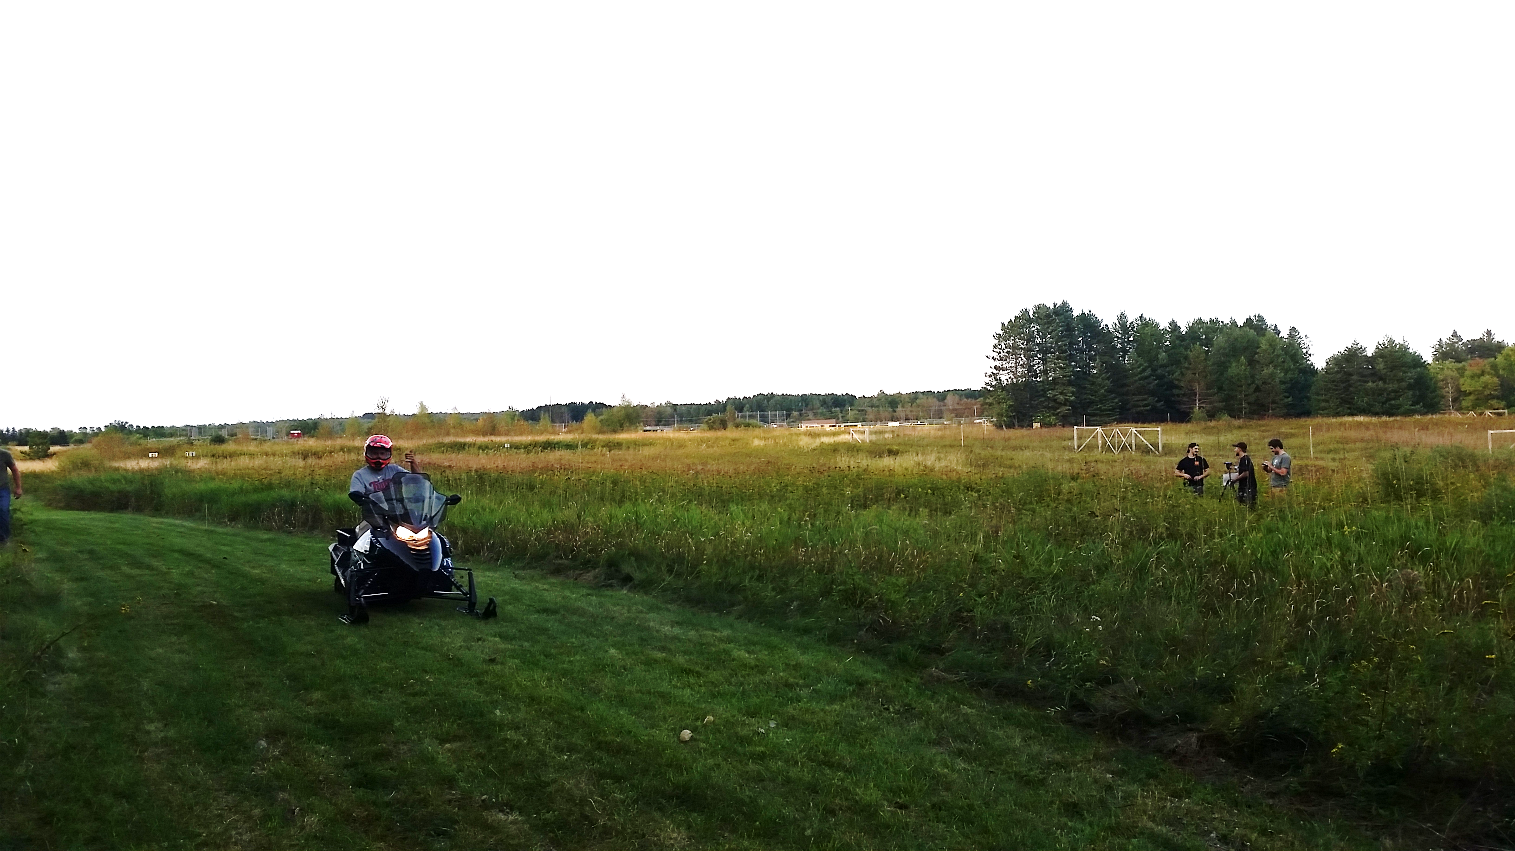
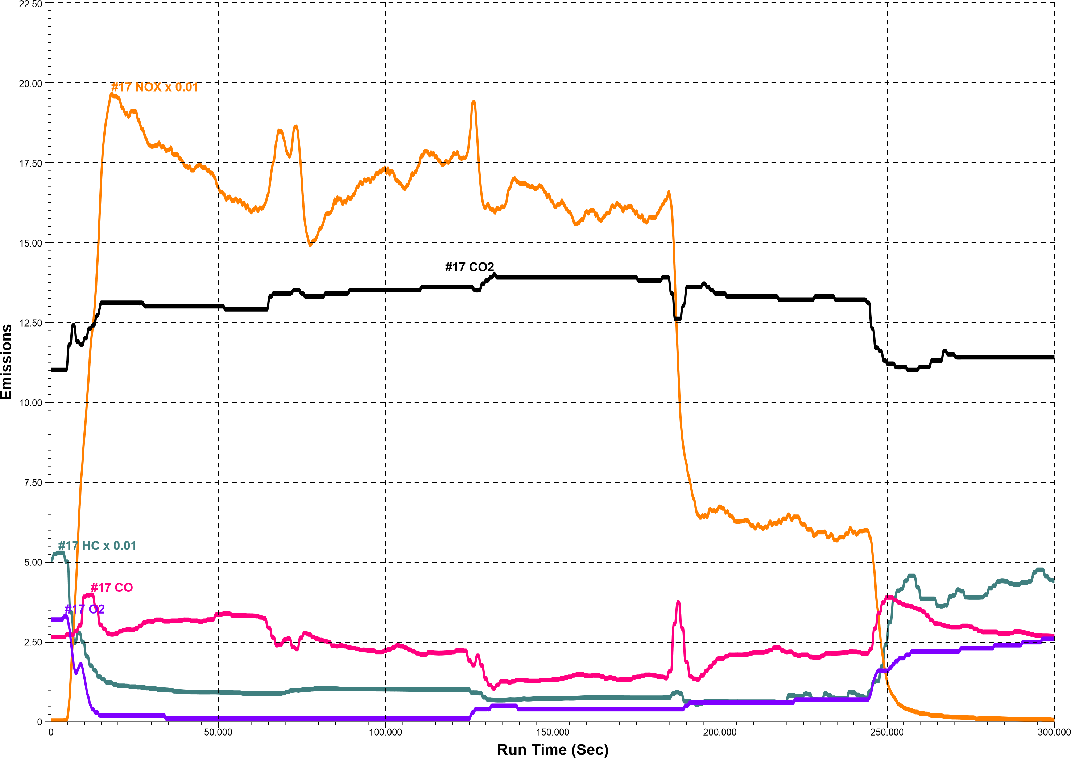
Baseline Testing
Engine / Emissions
Noise, Vibration, Harshness (NVH)
40.2 kW stock
E-score of approximately 191
Completed J1161 test
35 mph steady state at 50 feet
72 dBa in stock trim
Competition goal is 67 dBa

Slide 7
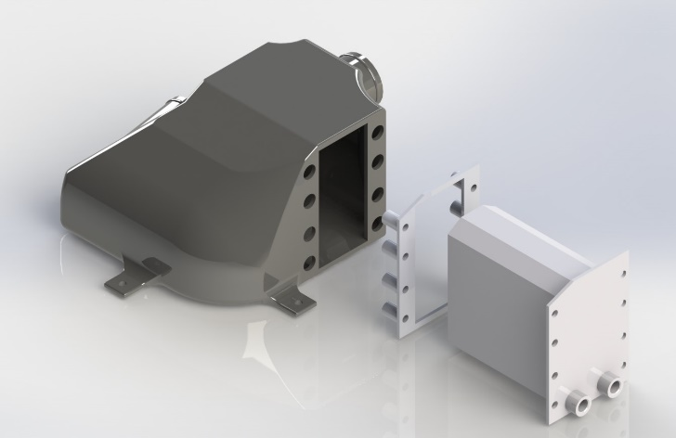
Engine Development
Ricardo WAVE Simulation
Low-pressure cooled EGR
Venturi drawn
Turbocharged – Garrett MGT1238
Intercooled
Integrated into intake plenum
Heraeus Catalyst
Electronic Throttle
Robust Control
Haltech 2500 Elite

Slide 8
Ricardo WAVE Simulation

Slide 9
Dynamometer / Results
63 kW
Approximate E-score
of 201
Hydrocarbons (HC)
reduced 79%
Carbon Monoxide (CO) reduced 96%
Oxides of Nitrogen
(NOx) reduced 88%

Slide 10
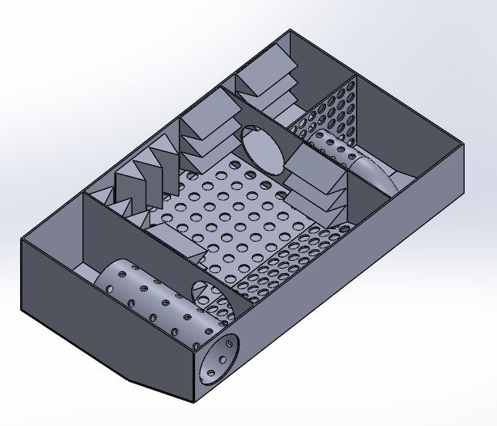
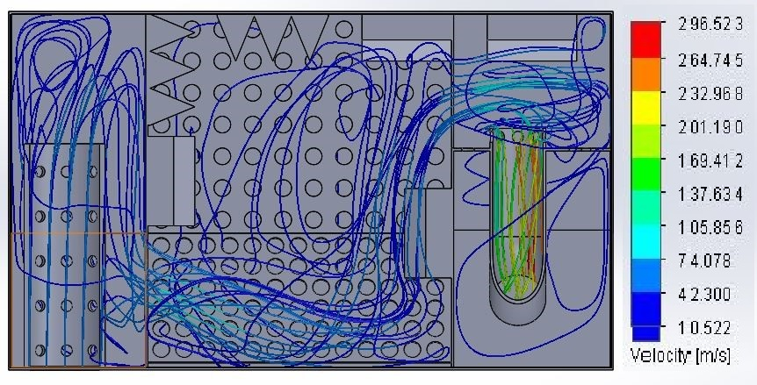
Muffler Development / Design
Relocate muffler based on packaging constraints
Under-tunnel muffler retains factory appearance
Design based on anechoic chamber
3-chamber design
Closed cell frequency simulation

Slide 11
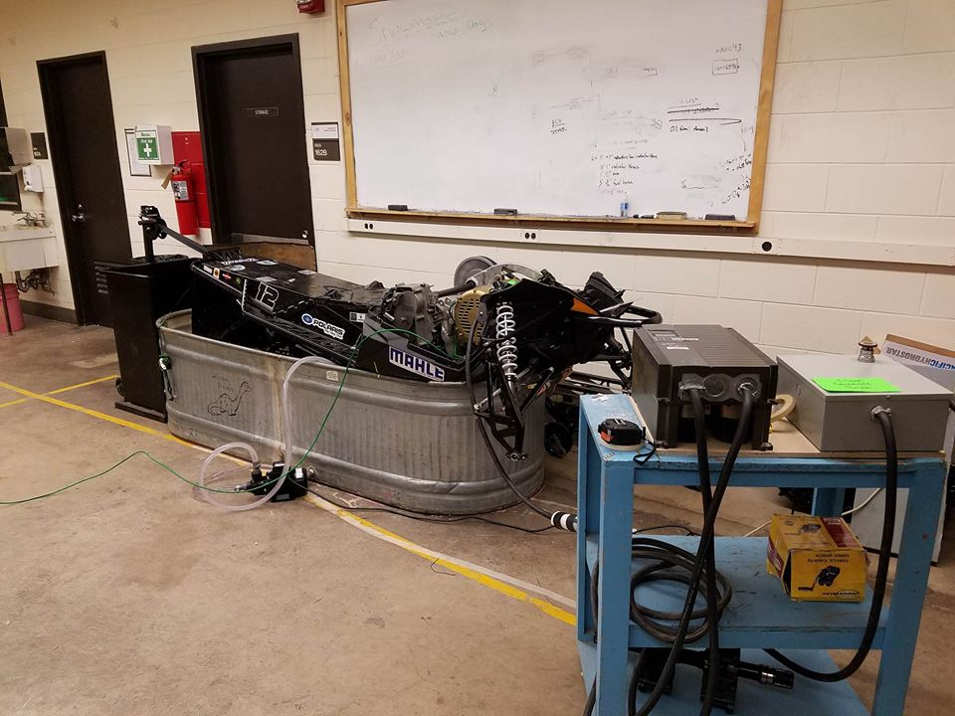
Whisper-Drive System
Repurposed water-dyno for sound
10 hp electric motor with VFD
Driveline Sound Improvements
Silent Drive track
Removal of idler wheels
Graphite filled hyfax
Lizard Skin coating
5 dBa decrease in sound
emissions in test simulation

Slide 12
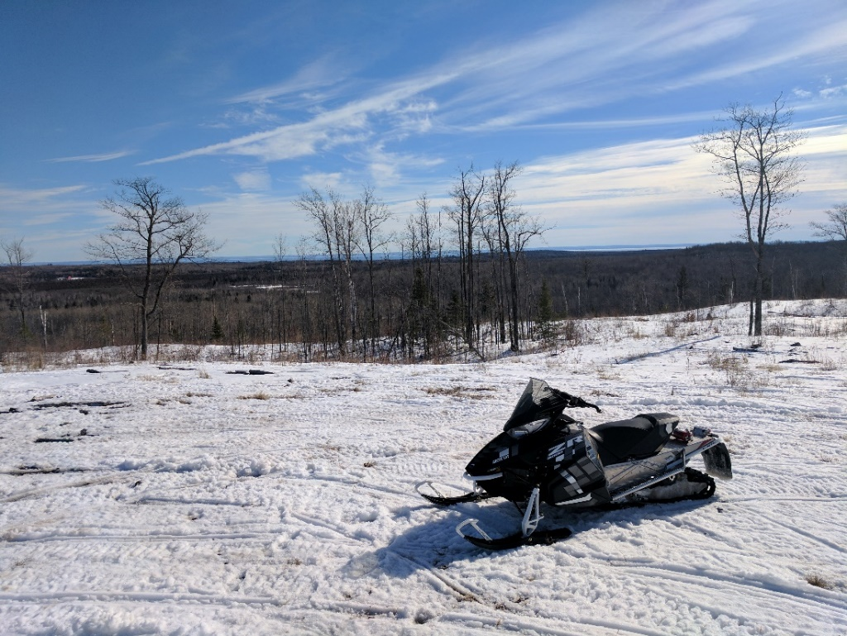
On-Snow Calibration
Through extensive on-snow testing, drivability and reliability were greatly increased
Full clutch and E-Throttle calibration using Haltech data logging
Fuel-economy of 18
mpg on 91 octane
250 miles of validation

Slide 13
Summary
Turbocharged engine with a 57% gain in power over stock, resulting in 63 kW
Cooled Exhaust Gas Recirculation system
70.6% decrease in NOx emissions
96% decrease in CO emissions
88% decrease in HC emissions
eScore of 201
Rear-exiting exhaust with a 4 dBa decrease in sound levels over stock
Calculated MSRP of $10,707

Slide 14
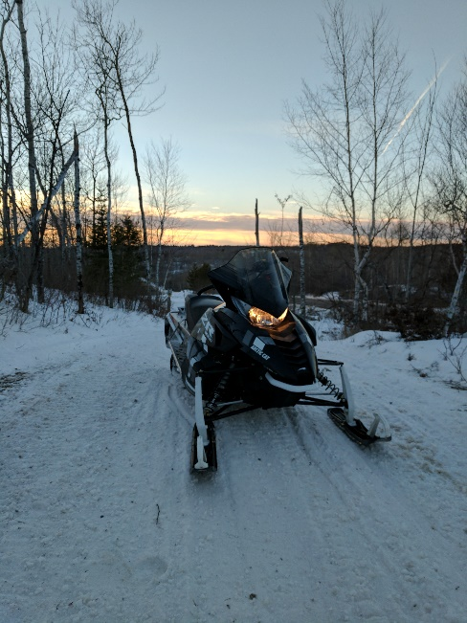
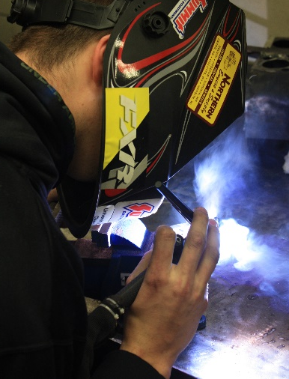
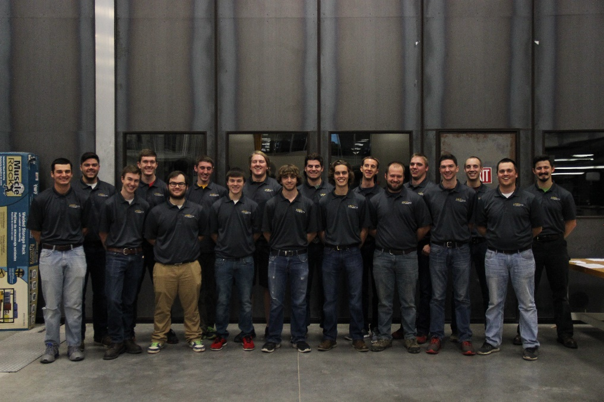
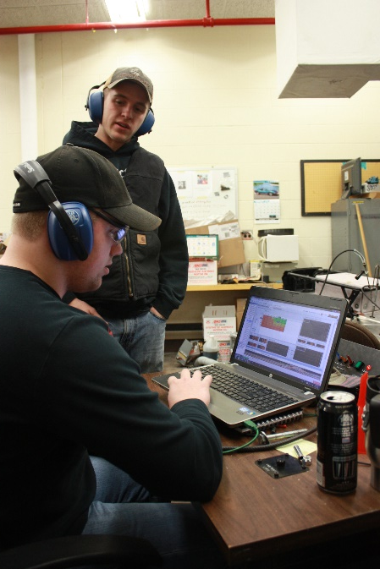
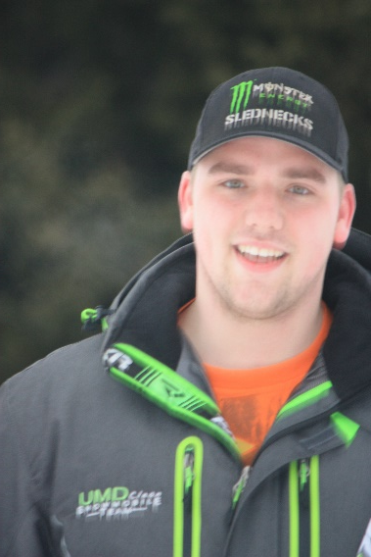
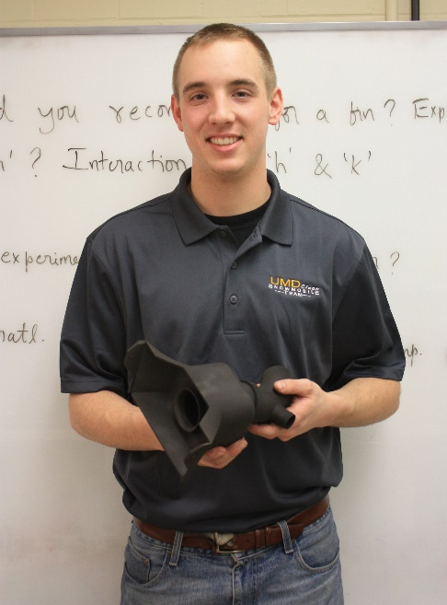
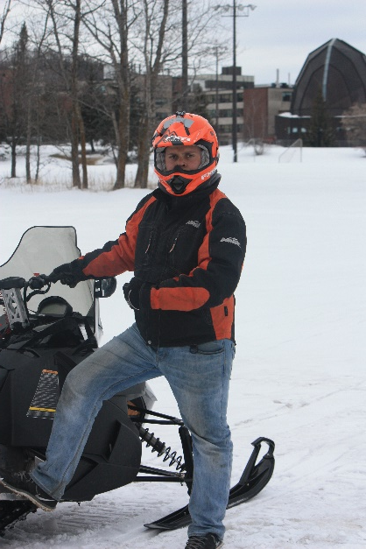
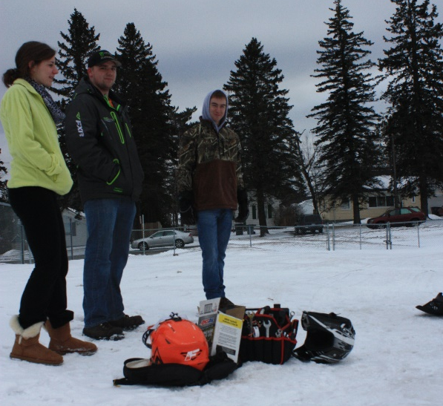
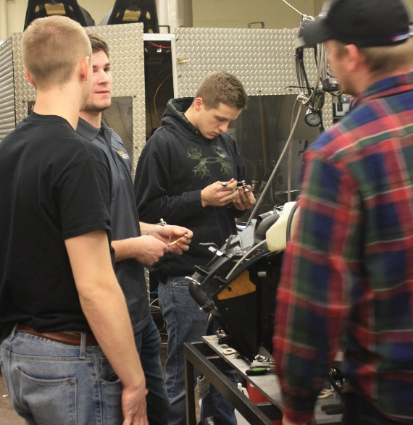
Thanks!

