Slide 1

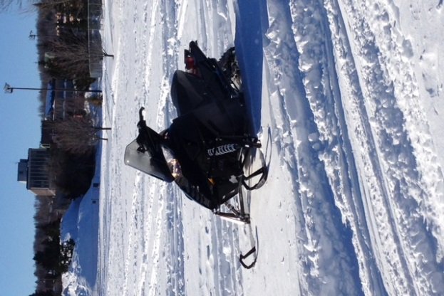
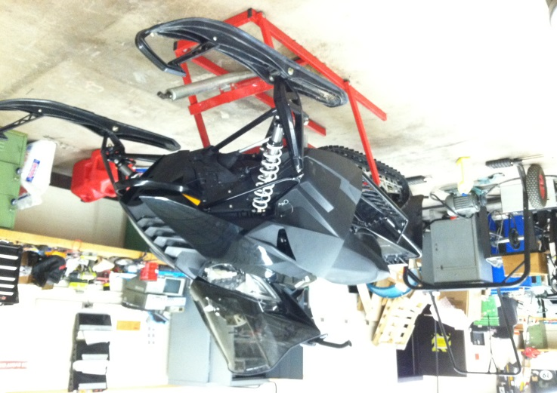
University of Minnesota Duluth
2014 SAE Clean Snowmobile Challenge
Joe Lofgren
Brandon Salaba
Kyle Schroer
Kyle Levanen
Dylan Dahlheimer
UMD
University of Minnesota Duluth
Notes:
Brandon

Slide 2
Agenda
Snowmobile Overview
Engineering Modifications
  Performance
  Driveline Efficiency
  Emissions & Noise Control
Benefits in Industry
UMD
University of Minnesota Duluth
Notes:
Brandon

Slide 3
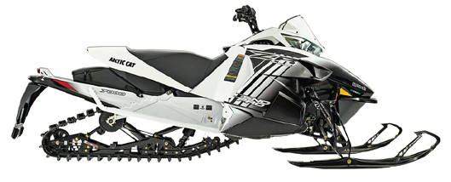
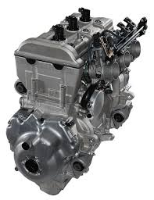
Snowmobile Overview
2014 Arctic Cat ZR 7000 LXR
C-TEC4 4-Stroke Engine
1049cc over 3-cylinders
EPA rated: 124 hp
UMD
University of Minnesota Duluth
Notes:
Joe

Slide 4
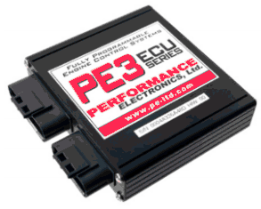
Engineering Modifications:
Performance
Standalone ECU
  Performance Electronics PE3 ECU
Wide-Band O2 Sensor
Flex Fuel Sensor
PE Monitor Software
Land and Sea Dynomite Dynamometer
UMD
University of Minnesota Duluth
Notes:
Kyle L

Slide 5
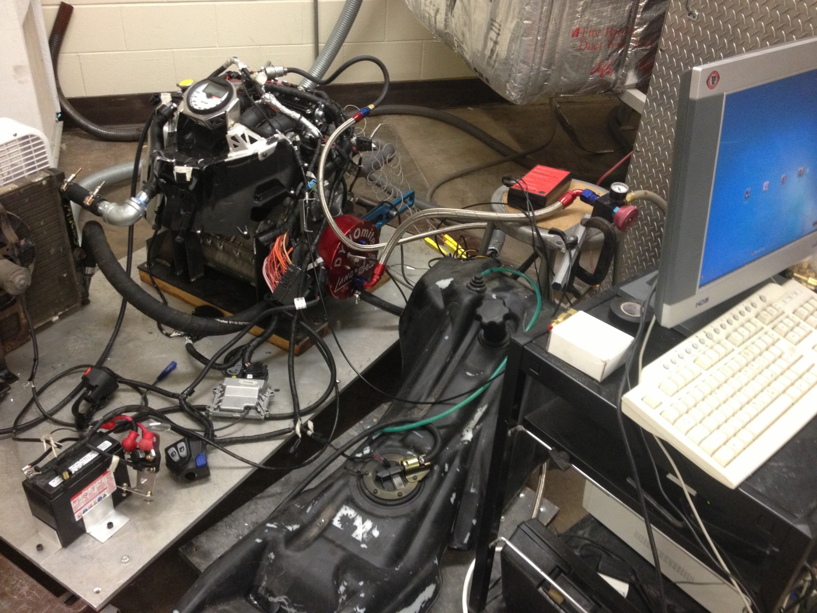
Dyno Setup
UMD
University of Minnesota Duluth
Notes:
Kyle L

Slide 6
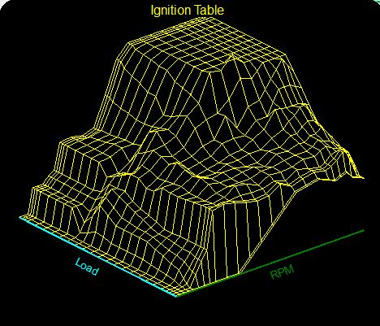
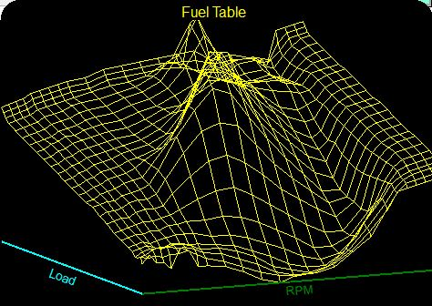
Fuel and Ignition Maps
UMD
University of Minnesota Duluth
Notes:
Joe

Slide 7
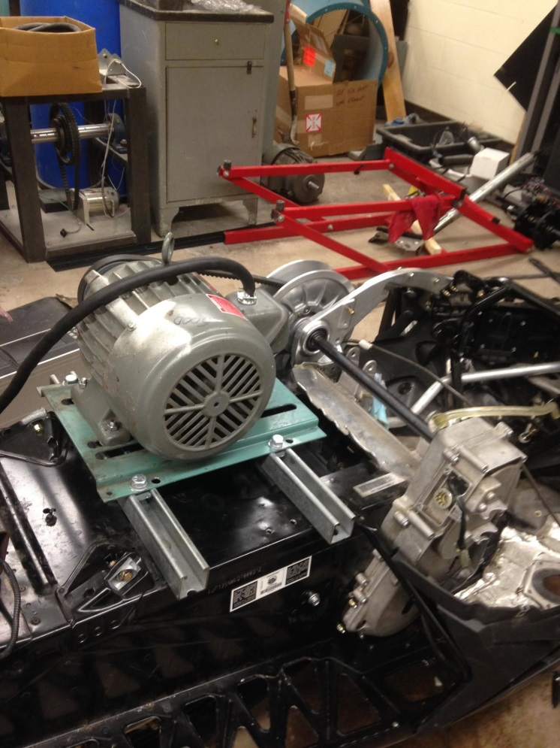
Chassis Dyno
3.5hp electric motor
No load was applied to the track
Power consumption with stock setup: 2.3hp
UMD
University of Minnesota Duluth
Notes:
Dylan

Slide 8
Reverse Removal
Electric actuating motor
Removed 8lbs of rotating mass
Decreased power required by 1.4%
UMD
University of Minnesota Duluth
Notes:
Dylan

Slide 9
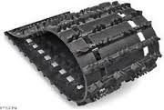
Quiet Drive Track
Hacksaw Quiet Drive Track
Donated by Camoplast
128” X 14” X 1.00”
Power decreased using the Silent Track and Standard 2.52” Drive Sprocket: 22.1%
Noise Reduction
  Stock Track: 96.6 dB output
  Quiet Track: 92.3 dB output
UMD
University of Minnesota Duluth
Notes:
Brandon

Slide 10
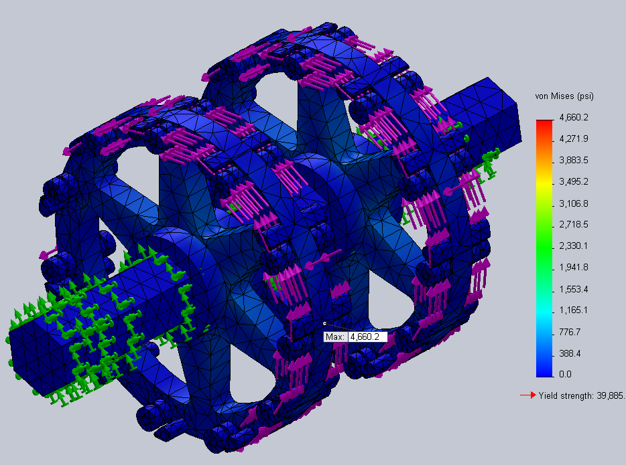
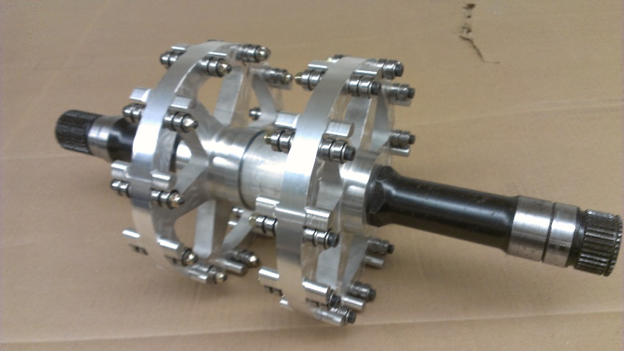
Drive Sprocket
6061-T6 Aluminum
88 Total Ball Bearings
0.25” Socket Head Cap Screws
2.52” Drive Pitch
11 teeth
Safety Factor of 10
Decrease of 27.1% in power consumption
UMD
University of Minnesota Duluth
Notes:
Brandon

Slide 11
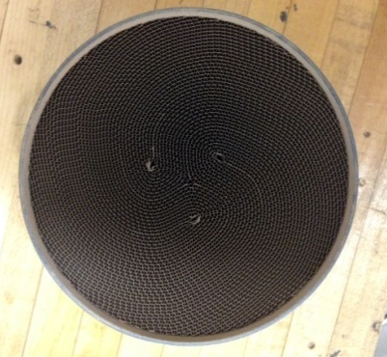
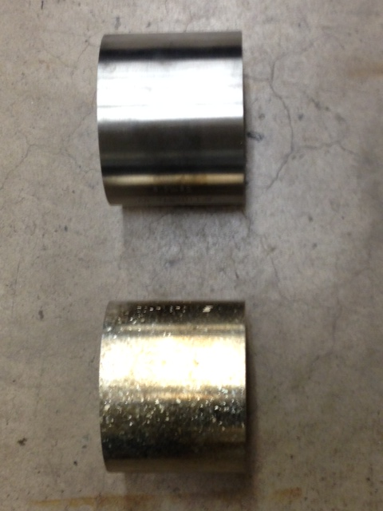
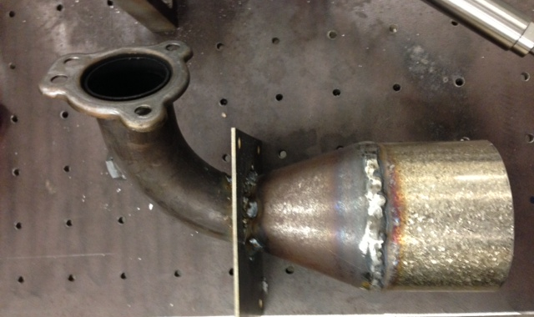
Emissions
Heraeus 3-way Catalyst
  HeraPur Coating
  Platinum, Palladium, and Rhodium
  105 mm Diameter, 74.5 mm Length
Muffler Inlet
UMD
University of Minnesota Duluth
Notes:
Kyle S

Slide 12
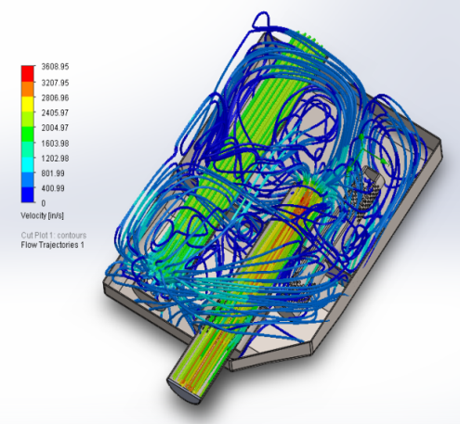
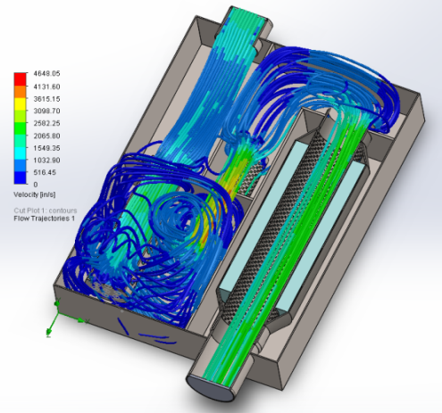
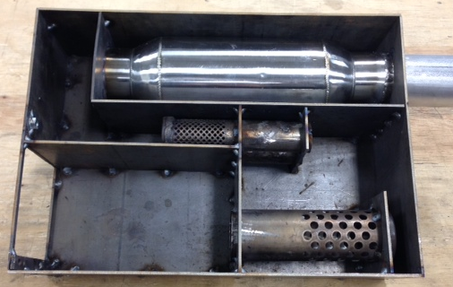
Noise Reduction
Stock:
New Design:
Muffler Redesign
  Resonating Chamber
  High frequency cancelation
  Similar backpressures
SAE J192 Results: 78 dBA
UMD
University of Minnesota Duluth
Notes:
Kyle S

Slide 13
Benefits in Industry
Snowmobilers – Performance and Efficiency
  Drive Sprocket
  Reverse Removal
Environmentalists – Noise and Emissions
  Three-way catalyst
  Fuel Economy
  Alternative Fuel Capability
Dealers/Outfitters – Cost and Durability
UMD
University of Minnesota Duluth
Notes:
Kyle L

Slide 14
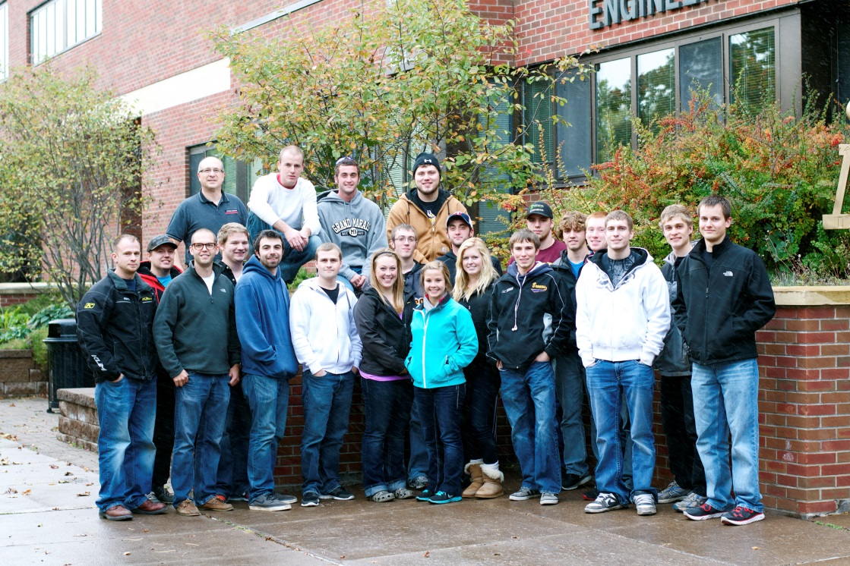
Thank You
UMD
University of Minnesota Duluth

