Slide 1
Clarkson University Electric Knights
SAE Clean Snowmobile Challenge 2016

Slide 2
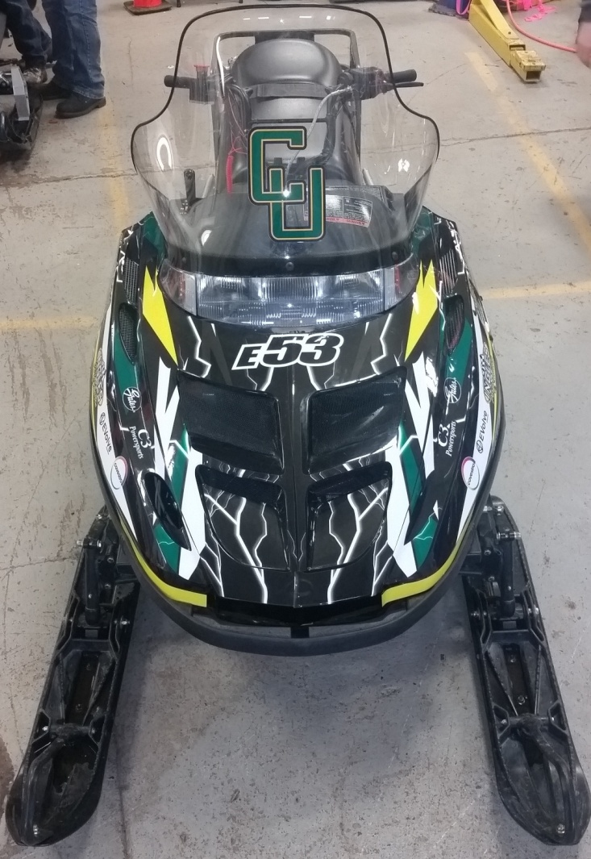
Overview
Design Goals
Specifications
Ergonomics and Emissions
Drive System
Motor/Motor Controller
Battery choice
Maintenance
Conclusion
Notes:
Today we are presenting to you our snowmobile as a viable solution for use at research stations in artic environments.

Slide 3
Design Goals
Maximum comfort and reliability to user
Sufficient power and range
Easy to maintain and operate in remote artic environments
Stock appearance and user controls
Reduce weight and better weight distribution for easy shipping, transport, and increased range
Reliable and simplified circuitry
Notes:
Serviceability
Rider comfort
power and range
Maintenance
Environmental impact

Slide 4
Specifications
2016 Polaris Widetrak LX
Direct drive from motor into two speed gearbox
Capacity of battery pack is 5.44 KWh
96 Lithium ion cobalt modules
Motor provides 10 HP continuous and 60 HP peak
Notes:
Small form factor and low weight to provide greater range and allow for easy transport
Capacity of battery pack provides maximum range within the constraints of space on the sled.
Chosen gear ratio provides necessary torque for use as a utility snowmobile.
It does this while keeping the motor at its most efficient RPM range. This leads to the snowmobile running most efficiently at typical in service speeds.

Slide 5
Ergonomics and Environment
Weight and form factor are similar to a stock snowmobile.
Familiar controls (i.e. throttle, brakes, lights, and speedometer) that any novice snowmobile rider can operate.
Still have stock hand warmers!
No effects to pristine environments
Stable battery chemistry
Notes:
Still have hand warmers

Slide 6
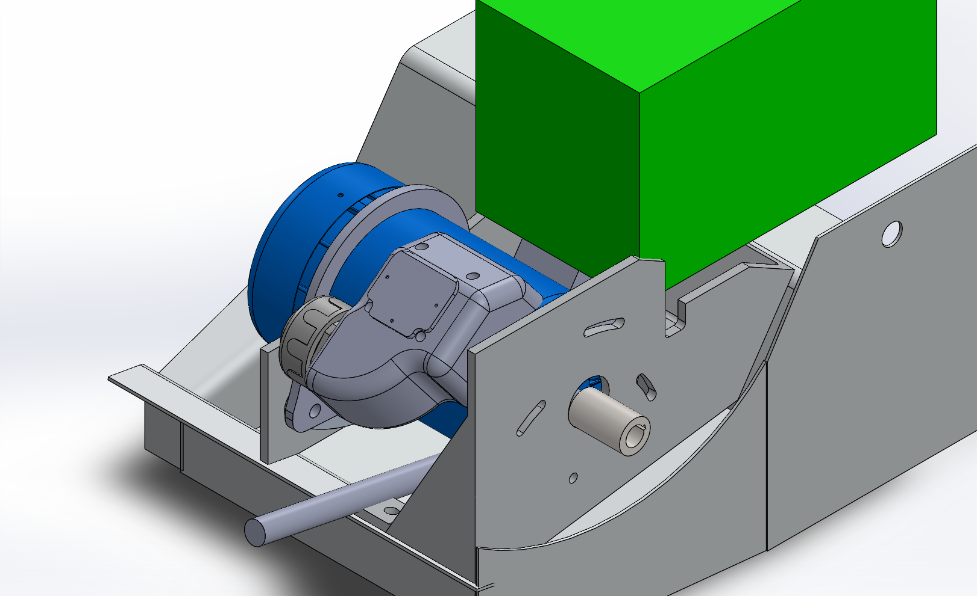
Drive System
Direct drive from motor into stock two speed gearbox
Gates Poly Chain GT Carbon belts
Overall gear ratio of
3.39:1 High gear
6.00:1 Low gear
Innovative motor mount with slot holes to allow easy tensioning
Notes:
Three aluminum sprockets used to reduce rotational inertia
Belts have higher power transmission efficency

Slide 7
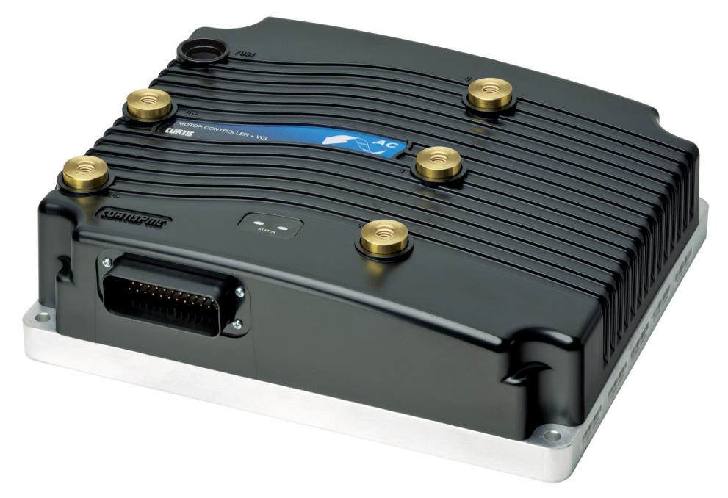
Motor/Motor Controller
Curtis 1239E controller
AC20 motor
Integrated three phase AC induction motor control
Highly configurable
Notes:
Adjustable motor mount allows for a wide range of gear selection through only pivoting the motor, changing belt and gear sizes.
Tensioning of belts done through pivoting motor mount and custom tensioner.

Slide 8
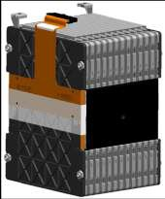
Batteries
Used Lithium ion Cobalt batteries
4 modules: 2S-2P configuration
Per module:
12S-2P
Energy Density: 85 Wh/kg
Peak Power: 22 kW
Nominal Voltage: 44 V
Cell life: >3000 cycles
Notes:
Superior energy and power density
Batteries have longer life due to greater amount of discharge cycles
Operate well in low temperatures.

Slide 9
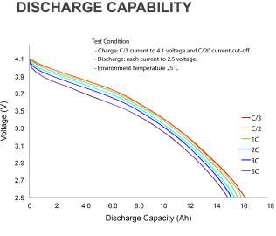
Battery
Discharge
Notes:
Manufacturer does not provide how batteries operate in temperatures below negative 20.
Therefore, our team ran its own tests on these batteries.

Slide 10
Maintenance
Durable batteries require no in service maintenance.
Use of Gates Poly Chain GT Carbon Drive lasts 3 times as long as a convectional chain drive.
Use of relay based safety system for simplicity.
Standard Polaris parts were kept on the snowmobile.
Snowmobile can be charged by a standard 120-240V / 60 Hz outlet, and SAE standard J1772 EV charging stations
Notes:
Design decisions have lead to a more rugged and durable snowmobile.
Analog safety system. Which is easy to maintain and diagnose.
GEARING: There is no metal on metal wear. Standard parts are more available.

Slide 11
Conclusion
Maintained stock parts to aid in ergonomics, structure, and aesthetics.
Provided sufficient power and range through a two speed transmission.
Easy to maintain and operate in remote artic environments by novice users.
Used relay control and simplified circuitry for dependability.

Slide 12
Questions??

