Slide 1
Clarkson University Electric Knights
SAE Clean Snowmobile Challenge 2015

Slide 2
Overview
Design Goals
Specifications
Snowmobile Modifications
Drive System
Battery choice
Maintenance
Conclusion
Notes:
Today we are presenting to you our snowmobile as a viable solution for use at research stations in artic environments.

Slide 3
Design Goals
Maximum comfort and reliability to user
Sufficient power and range
Easy to maintain and operate in remote artic environments
Minimize Environmental impacts
Stock appearance and user controls
Reduce weight for easy shipping, transport, increased range, and handling
Reliable and simplified circuitry
Notes:
Serviceability
Rider comfort
power and range
Maintenance
Environmental impact

Slide 4
Specifications
2012 Ski Doo MXZ Sport
Capacity of battery pack is 6 KWh
Directly Driven
4 packs (96 cells)
Motor provides 17.4 HP continuous and 49.6 HP peak
Notes:
Small form factor and low weight to provide greater range and allow for easy transport
Capacity of battery pack provides maximum range within the constraints of space on the sled.
Chosen gear ratio provides necessary torque for use as a utility snowmobile.
It does this while keeping the motor at its most efficient RPM range. This leads to the snowmobile running most efficiently at typical in service speeds.

Slide 5
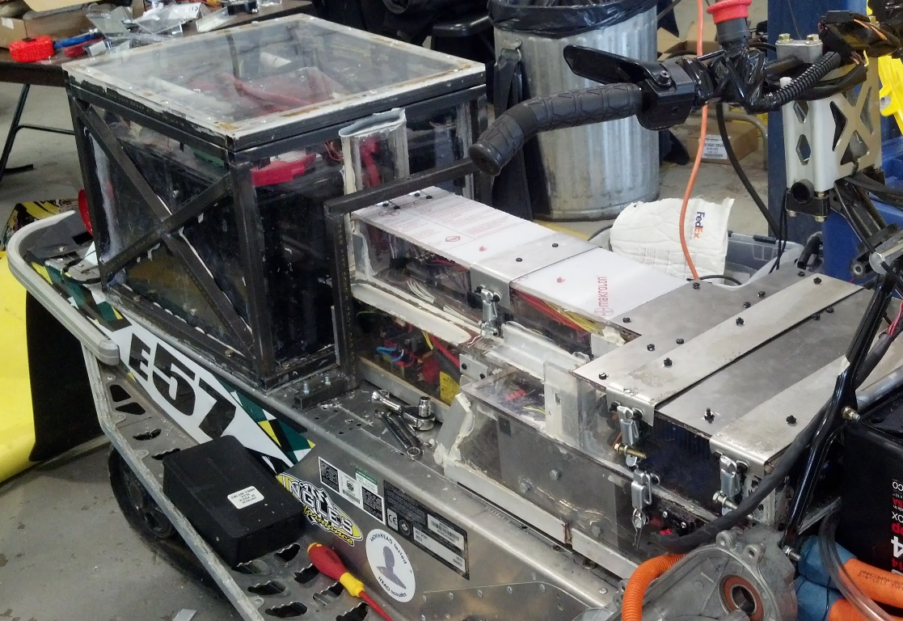
Snowmobile Modifications
Moderate increase in weight from a stock sled
Familiar controls
Electrical Housing
Drive System
Notes:
Still have hand warmers

Slide 6
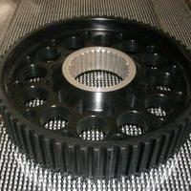
Drive System
Directly Driven gear
Gates Poly Chain GT Carbon belts
2.7:1 Gear ratio
Easily adjustable belt tensioning system
Notes:
Three aluminum sprockets used to reduce rotational inertia
Belts have higher power transmission efficency

Slide 7
Battery Choice
Used Li ion batteries
We chose Enerdel Modules
Maximum Voltage 196.8 VDC
Continuous 125 A output current
Nominal Cell Voltage 3.65 V
Notes:
Superior energy and power density
Batteries have longer life due to greater amount of discharge cycles
Operate well in low temperatures.

Slide 8
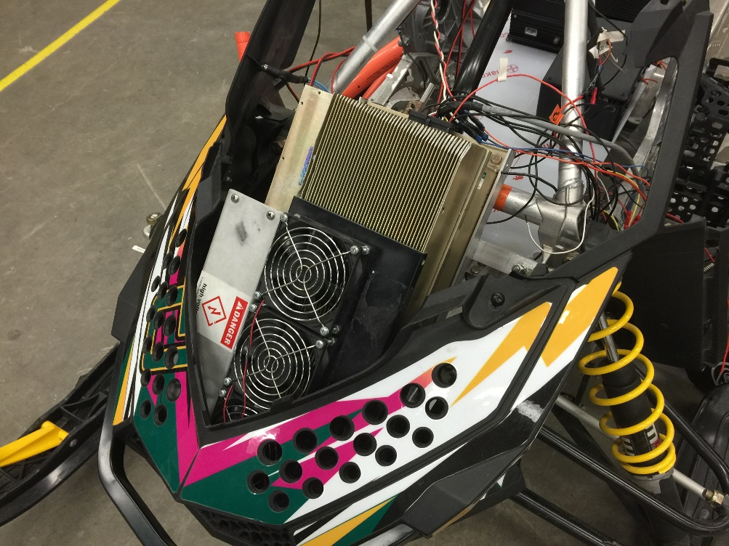
Motor and Motor Controller
Azure Dynamics
AC24 motor
DMOC445
Interoperability
Notes:
Superior energy and power density
Batteries have longer life due to greater amount of discharge cycles
Operate well in low temperatures.

Slide 9
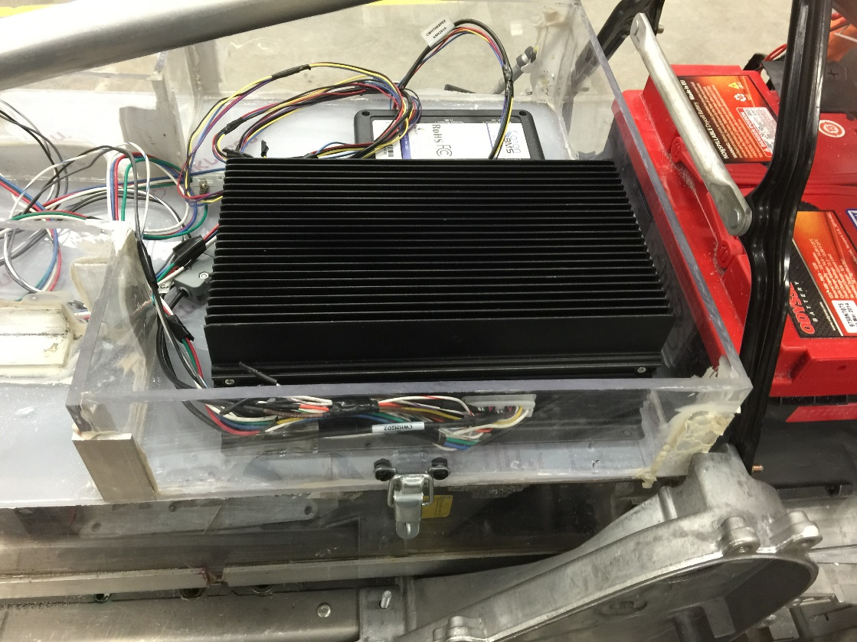
BMS
Orion centralized BMS
Cell bouncing
Temperature monitoring
Notes:
Superior energy and power density
Batteries have longer life due to greater amount of discharge cycles
Operate well in low temperatures.

Slide 10
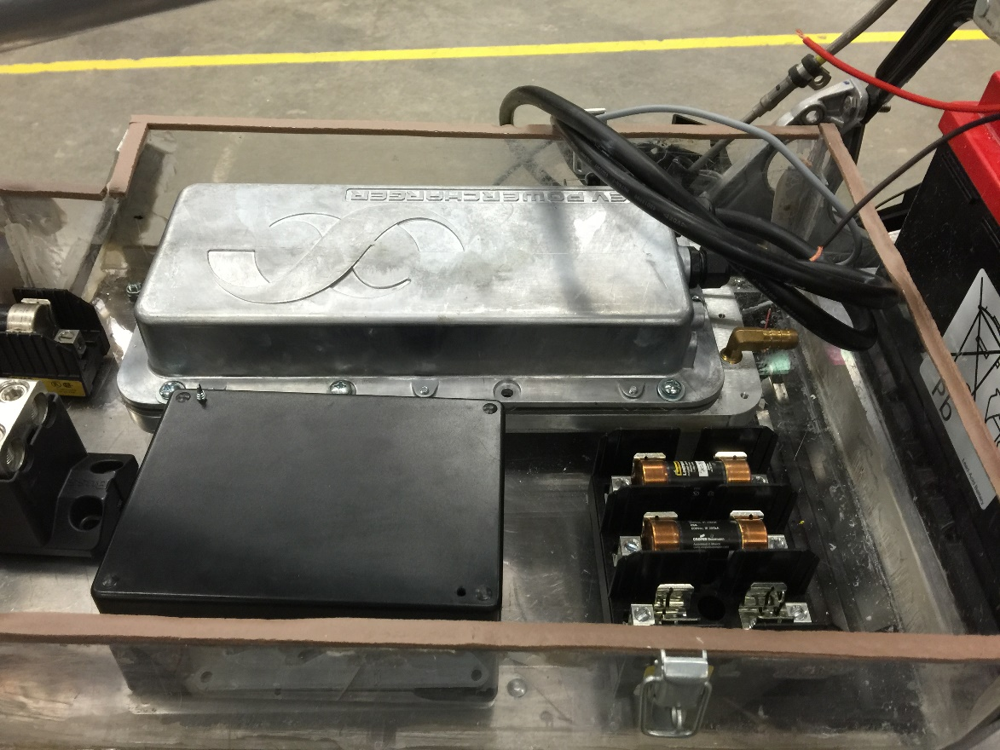
Charging
ELTEK charger
BMS interoperability
On board systems
Notes:
Superior energy and power density
Batteries have longer life due to greater amount of discharge cycles
Operate well in low temperatures.

Slide 11
Maintenance
Durable batteries require no in service maintenance.
Use of Gates Poly Chain GT Carbon Drive lasts 3 times as long as a convectional chain drive.
Use of analog safety system for simplicity.
Standard Ski Doo parts were kept on the snowmobile.
Snowmobile can be charged by a standard 120 V / 60 Hz outlet.
Notes:
Design decisions have lead to a more rugged and durable snowmobile.
Analog safety system. Which is easy to maintain and diagnose.
GEARING: There is no metal on metal wear. Standard parts are more available.

Slide 12
Conclusion
Maintained stock parts to aid in ergonomics, structure, and aesthetics.
Easy to maintain and operate in remote artic environments by novice users.
Used analog and simplified circuitry for dependability.
Low cost
Low Environmental Impacts

Slide 13
Questions?

