Slide 1
Clarkson Winter Knights
Austin Donhauser
Scott Deichmann

Slide 2
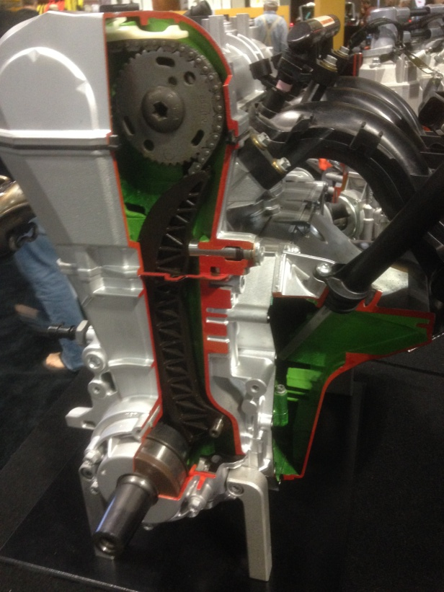
Design Intent
Reliability
Cost Effectiveness
Practicality
Increased Fuel Economy
Reduced Emissions
E00-E85

Slide 3
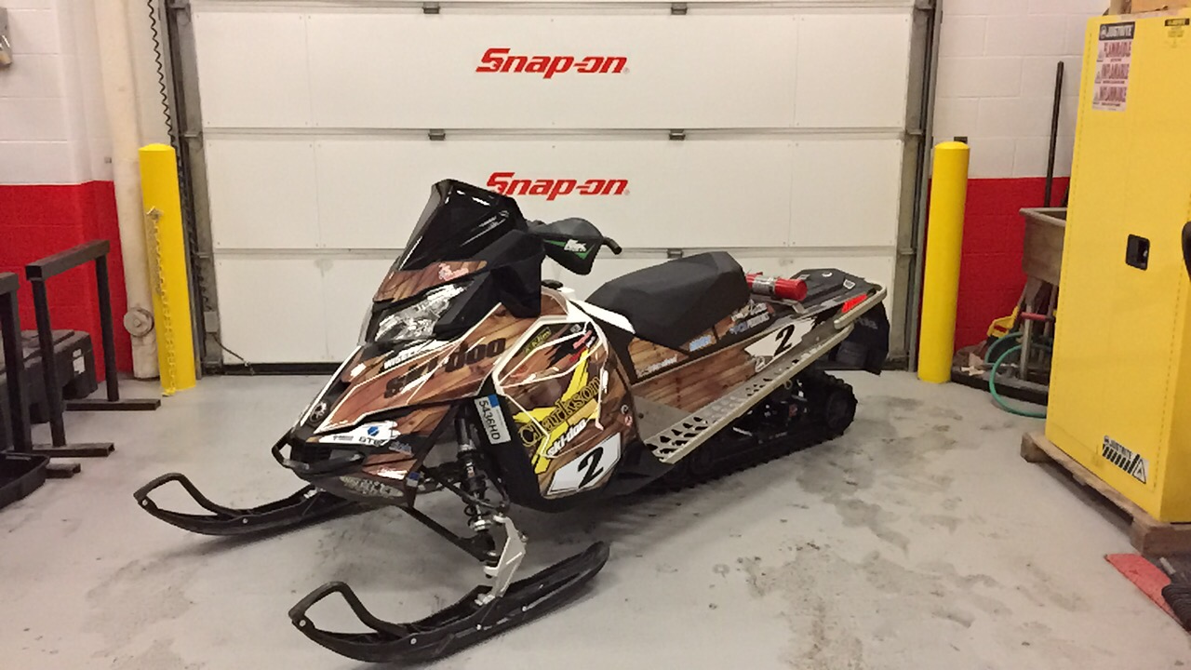
2017 Ski-doo Renegade Sport
Best Available Technology (BAT)
600 ACE has proven successful
Best in class fuel economy
Familiar chassis

Slide 4
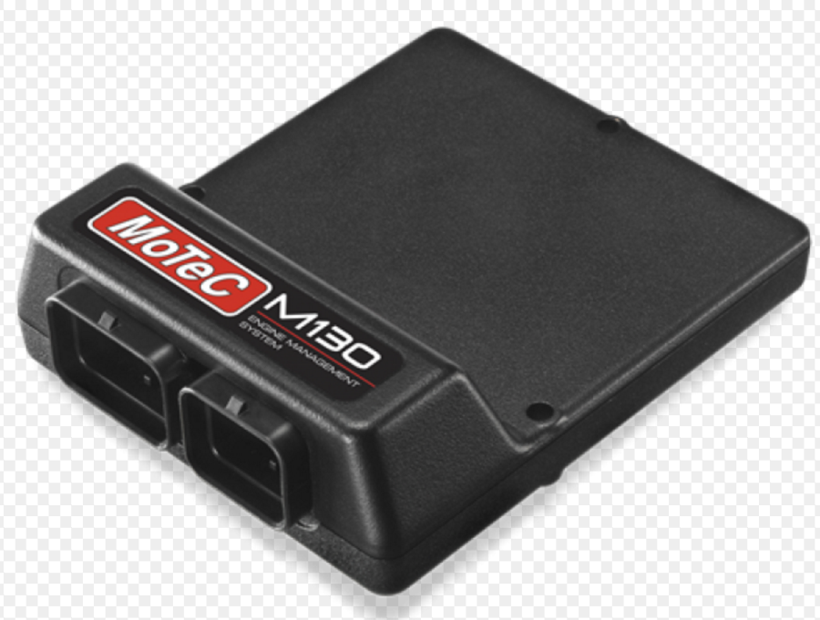
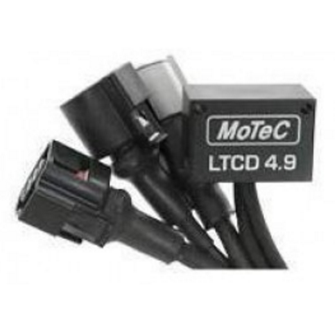
Engine Management
Motec M130
Exceptional customer support
Many inputs/outputs to support sled modifications
User friendly software – M1 Tune/Build
EGR control
Active Exhaust Valve Control
Motec LTCD Dual Lambda Controller
Individual cylinder fuel/timing trim
Bosch 4.9 LSU Oxygen Sensors

Slide 5
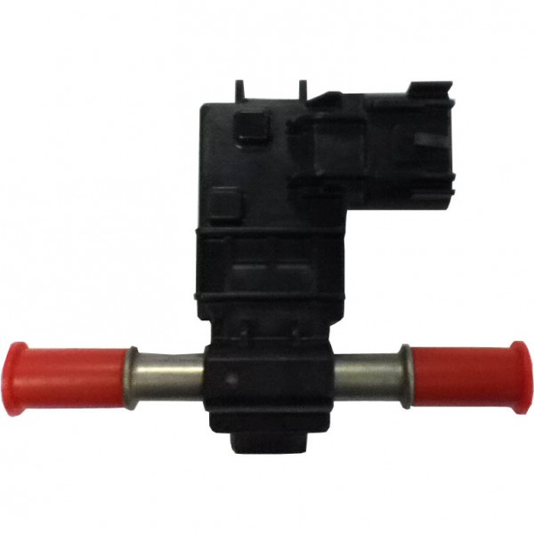
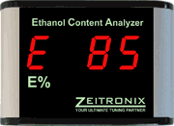
Ethanol Compatibility
GM Continental Flex Fuel Sensor
Frequency 50-150Hz Signal Output
Zeitronix ECA (Ethanol Composition Analyzer)
Output of 0-5V analog signal
M130 reads via analog input
Tables: 0% ethanol, 85% ethanol
Creates scaling table for values in between

Slide 6
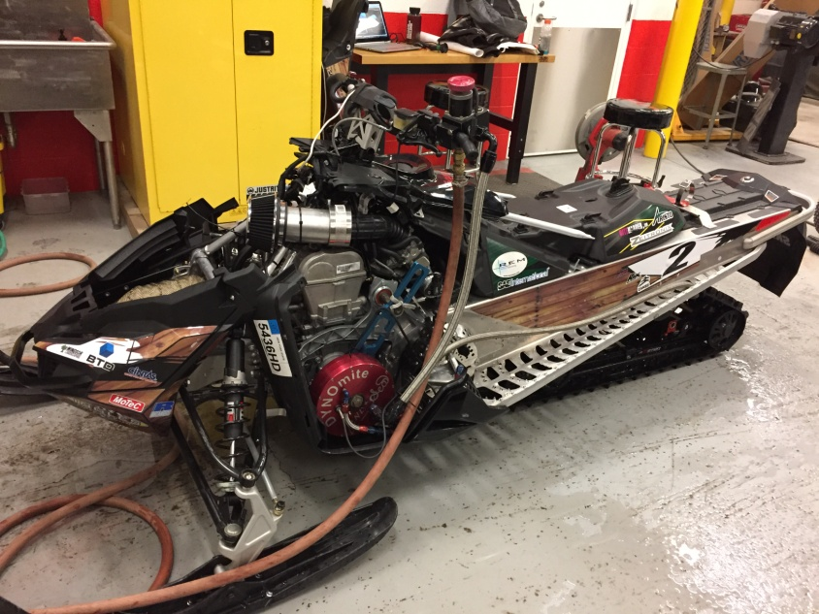
Engine Calibration
Land & Sea DYNOmite Dynamometer Water Brake
Changing loads and RPM to create engine efficiency table

Slide 7
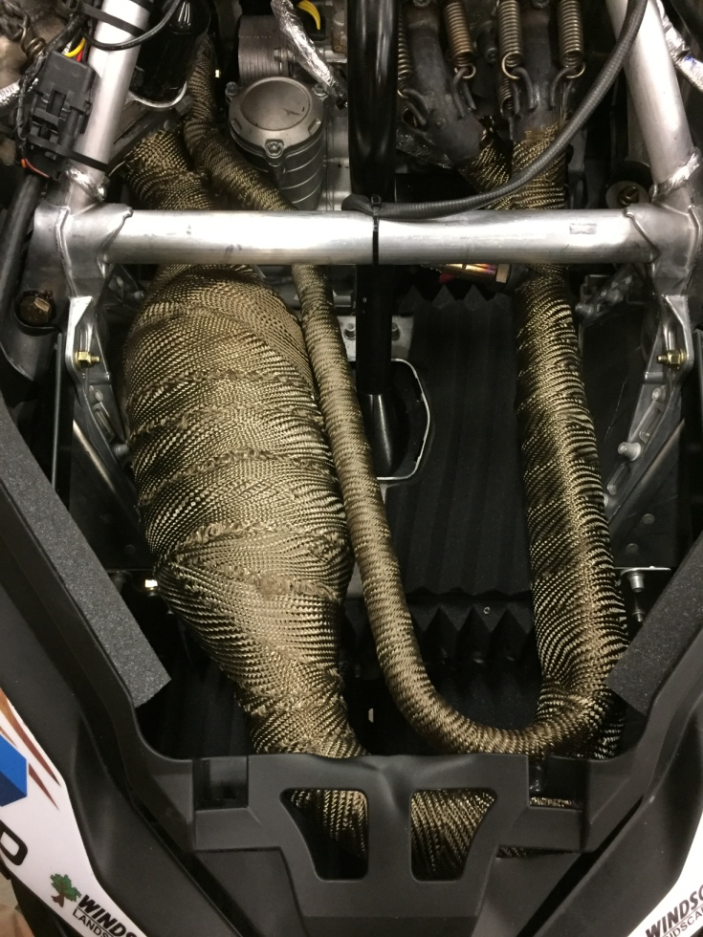
Exhaust
Emitec-Continental 3-Way catalyst
Designed specifically for ethanol based fuels
Custom 2 to 1 header pipe
Fiberglass packed muffler
Used inside stock shell to maintain stock fit
Exhaust output aimed at track
DEI Engineering Titanium Heat Wrap

Slide 8
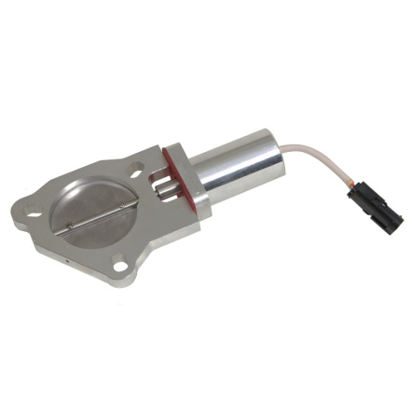
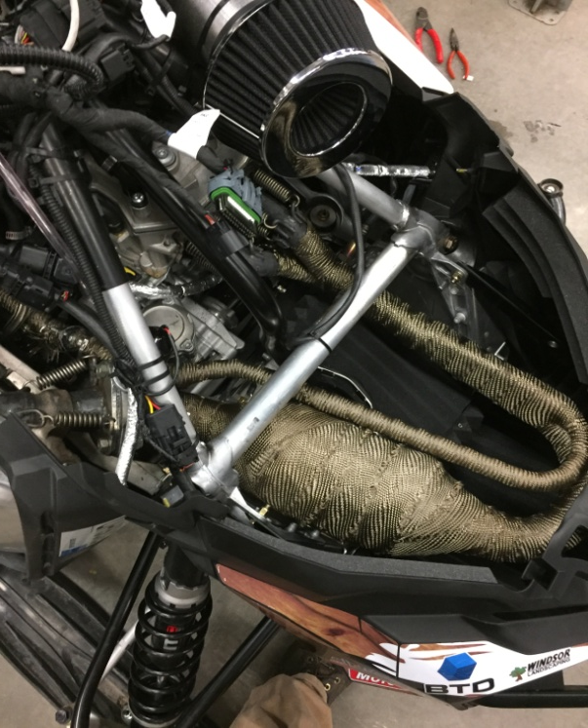
Active Exhaust Valve
2” Exhaust Cutout
Electronically controlled by M130
Based on throttle position
0% Throttle – 5% opened valve
Exponential curve to open valve for unaffected performance
Sound testing procedures
Idle (1800 rpm)
2 ft from open side panel, 2 ft from ground
Decrease of 5db on average using Larson Davis sound testing equipment

Slide 9
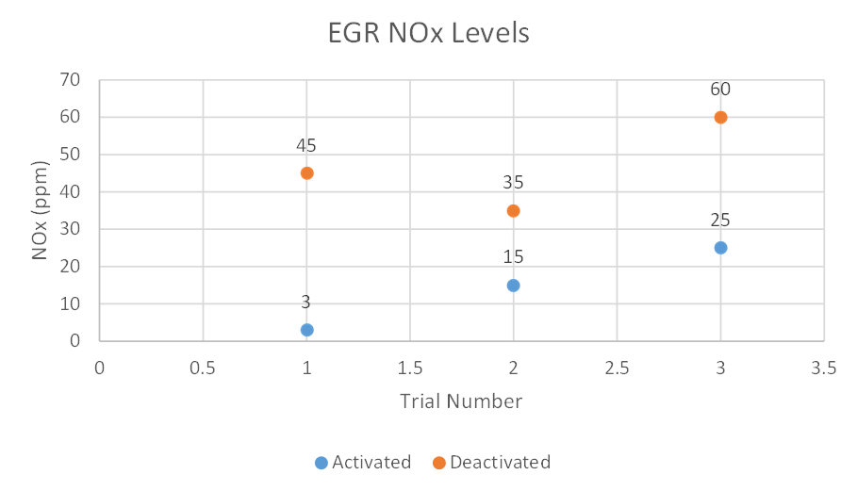
EGR (Exhaust Gas Recirculation)
Wells 4355 EGR valve
90º Angle for fitment
ECU Programming
Activate based on engine load
Removes fuel from tables for leaner mixture
EGR Testing
Testing using DYNOmite and Snap-On Gas Analyzer
Engine Speed maintained at 2500 rpm

Slide 10
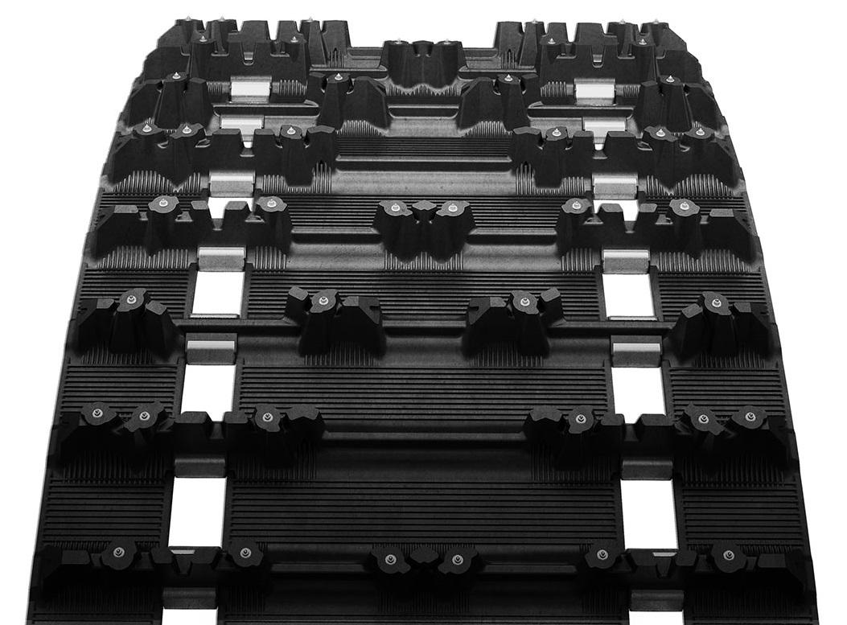
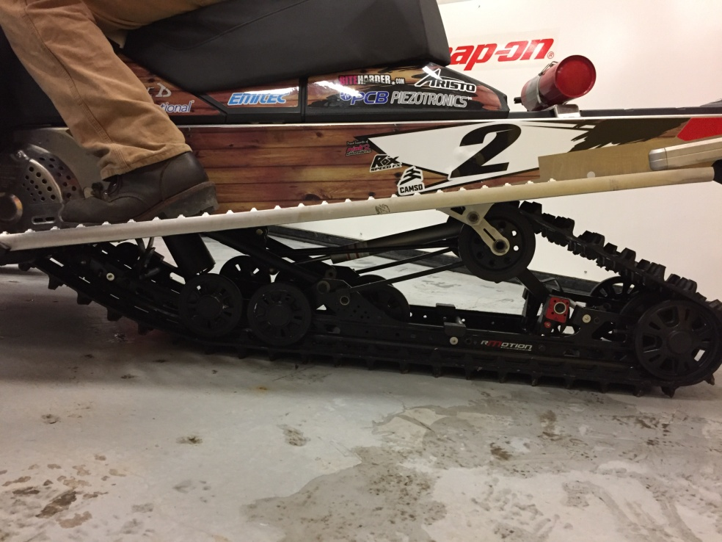
Driveshaft & Rear Suspension
R-Motion Rear Suspension
Camso Ice Attak 137” Track
Ski-Doo SilentDrive
Hiperfax Slides

Slide 11
Thank you
Questions?

