Slide 1
Eric Gleich
Jeff Robinson

Slide 2
Design Intent
Simple, cost effective and practical approach
Improve upon the Best Available Technology (BAT) standard of the powersports industry to enhance fuel efficiency while reducing emissions and noise harshness
Fully automatic tuning for flex-fuel blends from E00-E85
Maintain a stock ergonomics and appearance

Slide 3
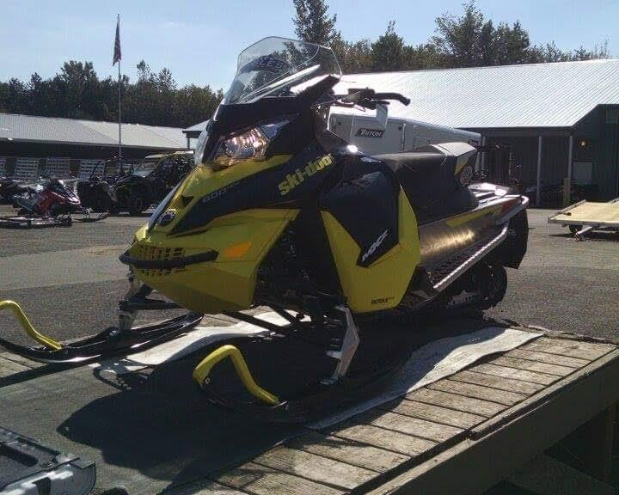
2016 Ski-doo MXZ 600 ACE
Weighted Design Matrix selection based on top 10 most efficient and lowest cost snowmobiles
Industry leading chassis
Economical

Slide 4
Consumer Appeal
Low maintenance 4-stroke motor
Familiar stock controls and ergonomics
Improved handling characteristics
Woody’s traction products
Hygear slicast
Power manageable to all levels of riders

Slide 5
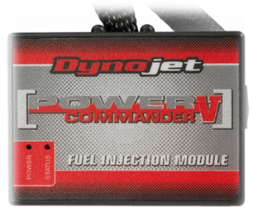
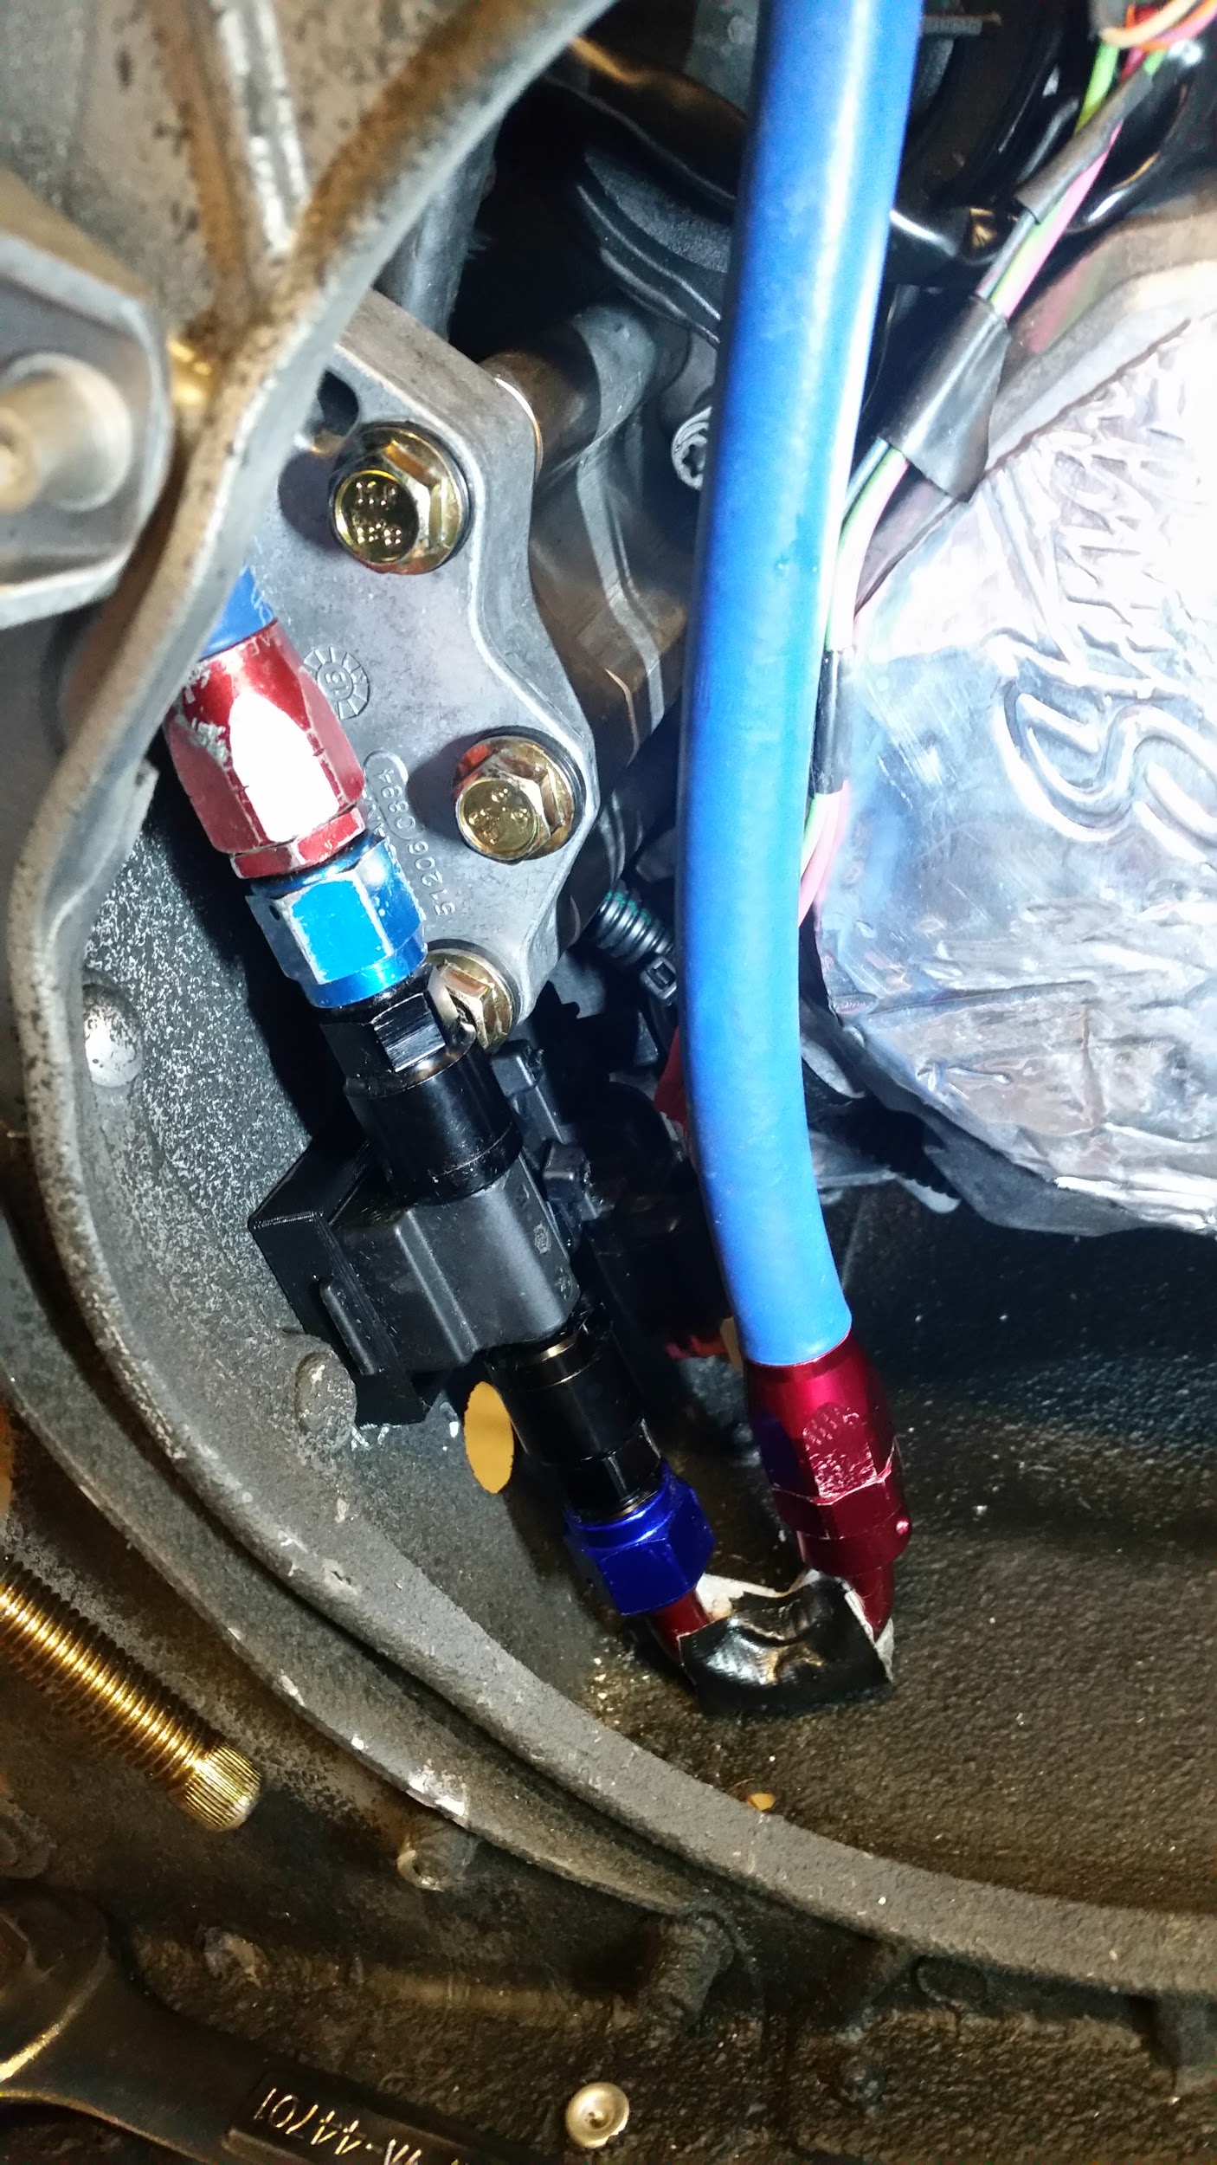
Engine Management
Dynojet Power Commander V with fuel and ignition control
Individual cylinder fuel trim control
Integrated with dual Wideband-2 O2 sensors for a closed loop system
Fuel trim via analog input from GM flex fuel sensor
Zeitronix ECA ethanol content analyzer/GM fuel composition sensor
0-100% ethanol content +-5%
0-5V analog signal output
Lowest cost and smallest flex fuel sensor available
Unrestrictive flow through design

Slide 6
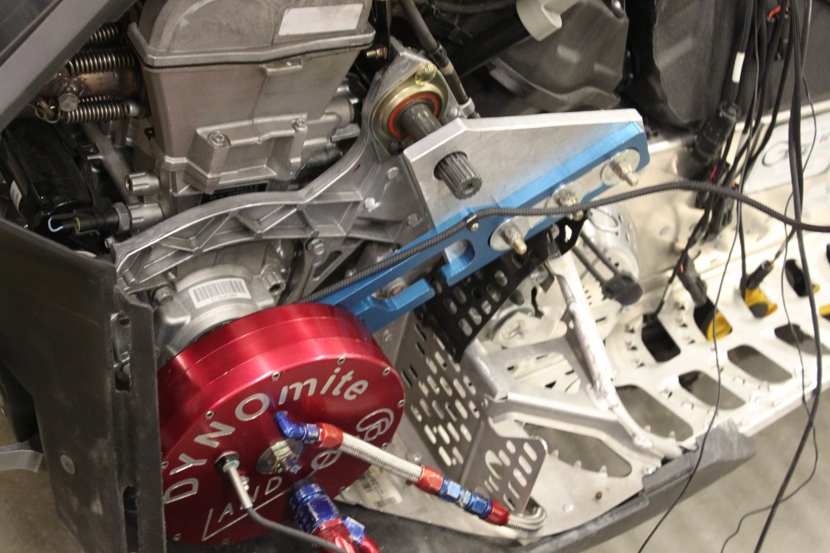
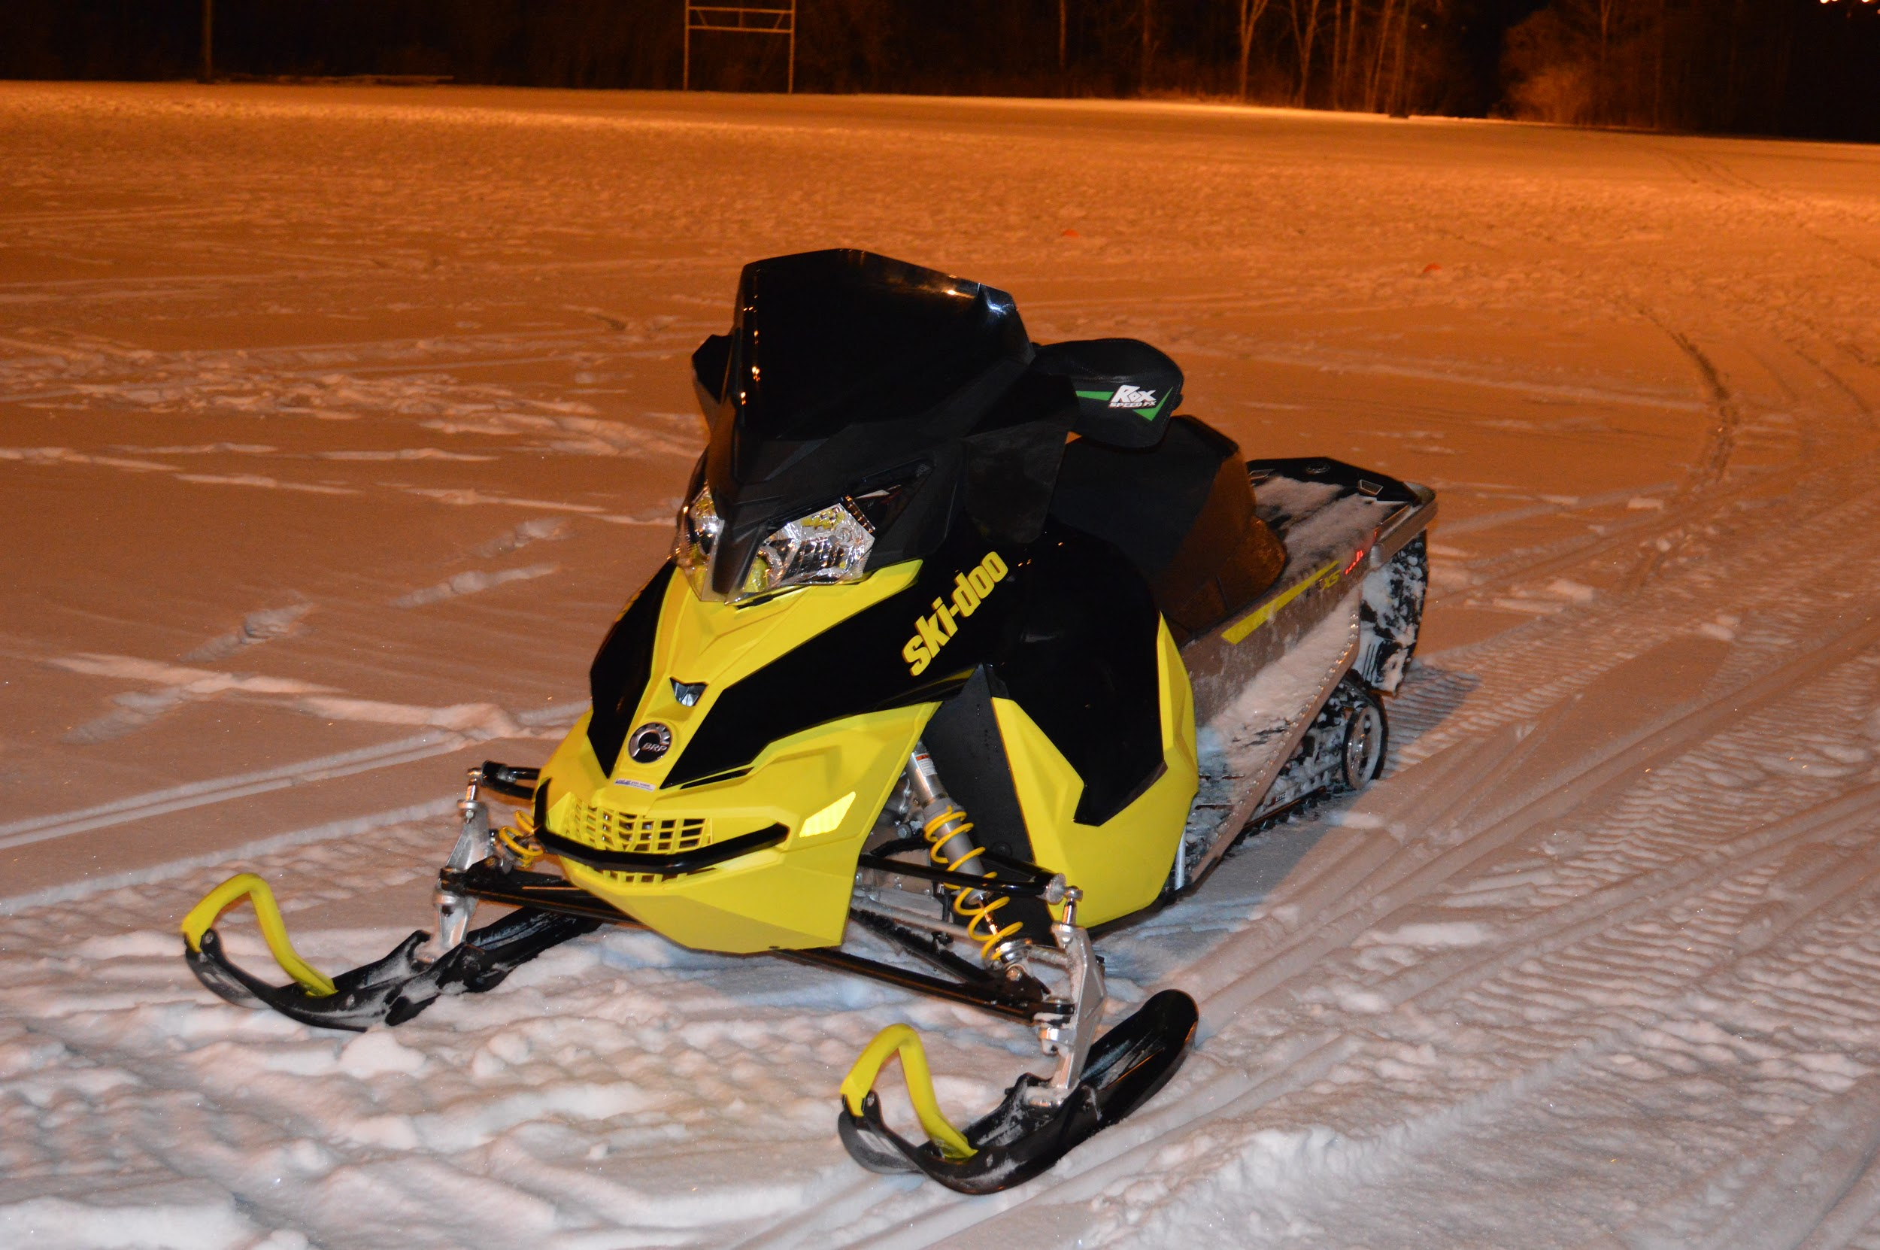
Engine Calibration
Land & Sea DYNOmite water brake dynamometer
200+ miles of trail testing under average conditions

Slide 7
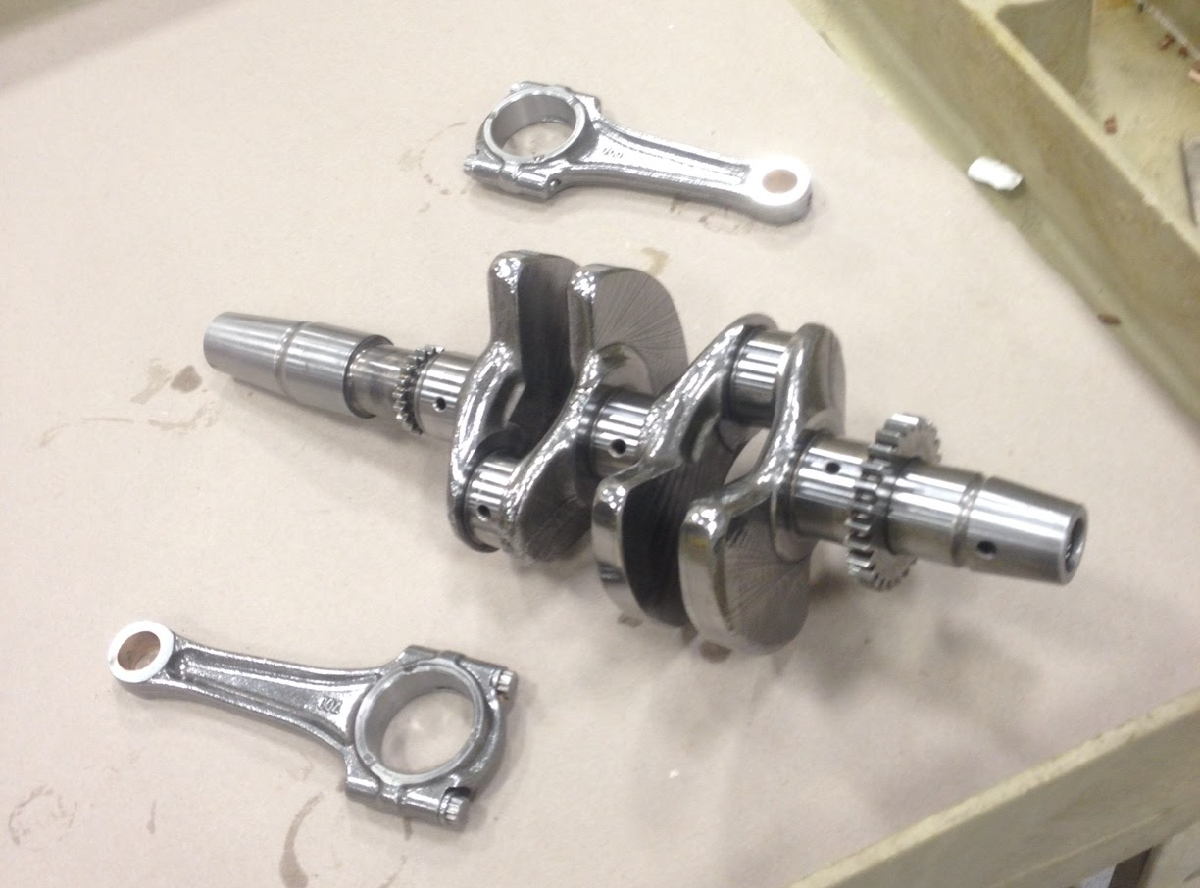
Internal Engine
Base stock Rotax 600 ACE engine
REM Chemical Isotropic Superfinishing Process
Reduces noise and friction
Increases reliability and lifetime
Before Processing
After Processing

Slide 8
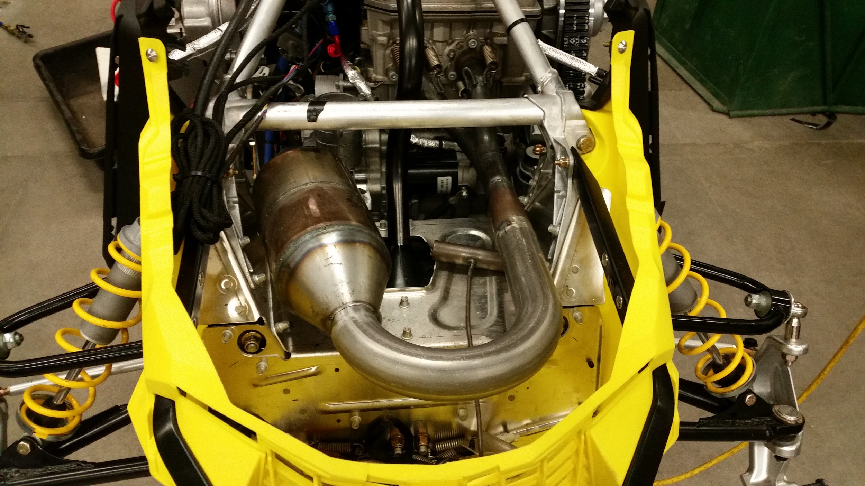
Exhaust and Catalyst
2-1 head pipe with dual wideband O2 sensors
Custom 6 inch inline resonator
3 way catalytic converter specific to ethanol based fuels
Multi-chamber muffler
Exit port routed into the track
Lava rock exhaust wrap

Slide 9
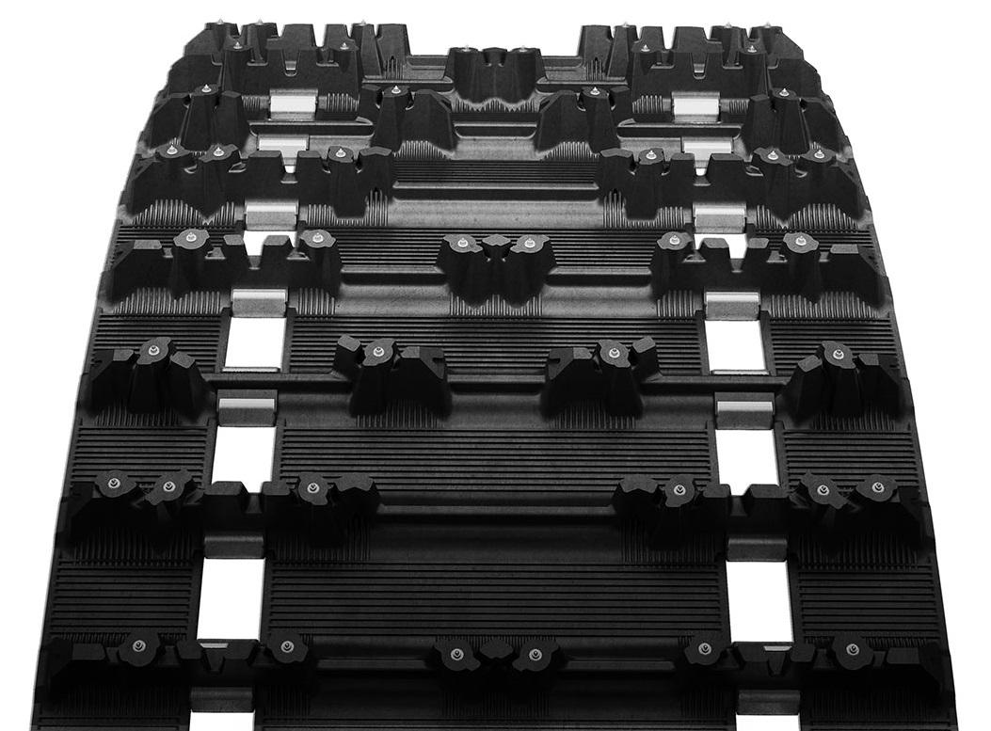
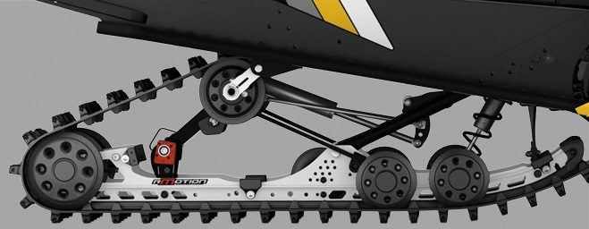
Driveline and Rear Suspension
R-motion 137 inch skid
137 inch Ice Ripper XT pre-studded track with silent-drive
Isotropic Superfinish bearings, drive chain and gears
Ultra low-drag bearing grease (Kluber Isoflex Topaz nb 52)

Slide 10
Thank You

