Slide 1
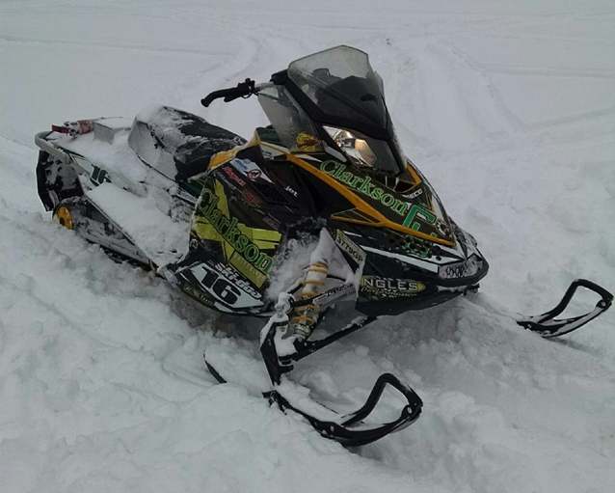
2015 Clarkson University
Winter Knights

Slide 2
Design Intent
Improve upon the Best Available Technology (BAT) standard of the power sports industry to enhance fuel efficiency while reducing emissions and noise
Fully automatic tuning for flex fuel blends from I16 to I32
Maintain a stock appearance and familiar rider ergonomics
Make the machine more appealing to consumers

Slide 3
Design Approach
Ski-Doo MXZ Sport 600 ACE with turbocharger
Closed loop fuel system to compensate for isobutanol fuel blends
Ski-Doo Quiet Drive system
Custom exhaust with integrated three way catalyst from Emitec

Slide 4
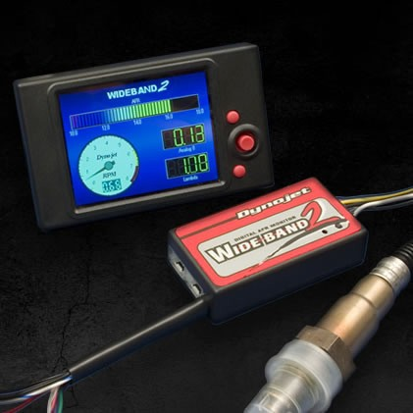
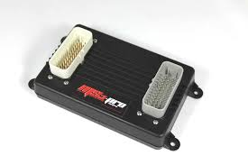
Engine Control
DIY Autotune Mega-Squirt 3 Pro
Closed loop fuel system with single Wideband 2 O₂ sensor and Delphi Flex Fuel Sensor
Target AFR table

Slide 5
Powertrain Modifications
Custom low compression pistons (10:1)
36 tooth Flywheel
2 into 1 custom exhaust
Garett GT-1241 Turbocharger
Bell intercooler
Custom air box and intake
manifold
Modified camshafts

Slide 6
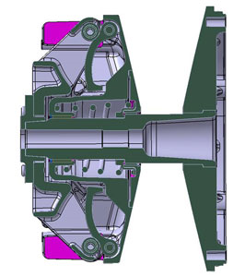
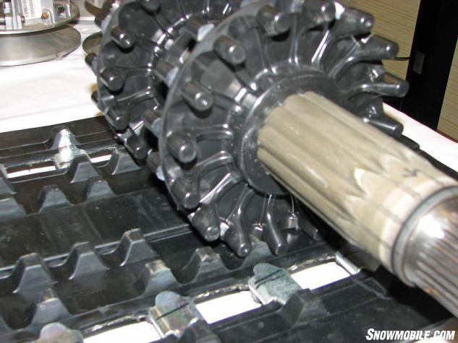
Powertrain Modifications
E-Drive 2 Primary Clutch with custom weights
Quiet Drive System
48 Woody’s Studs
This cutaway shows the revised ramp/roller design and the layout of the spring. With technology such as Vespel rollers the clutch is smooth, efficient and responsive.

Slide 7
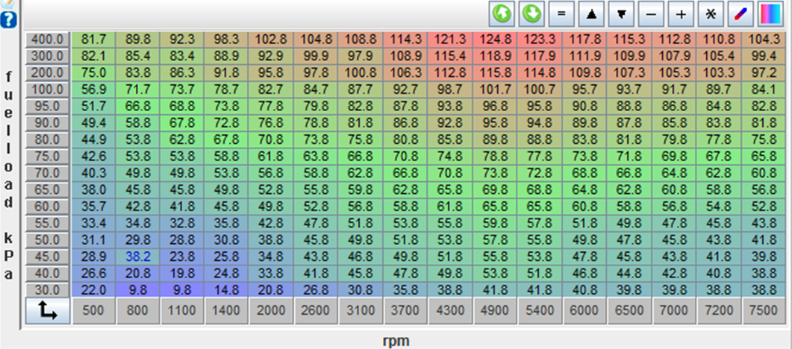
Calibrations
Land & Sea Dynamometer
Snap-On 5 gas analyzer
Example fuel table;

Slide 8
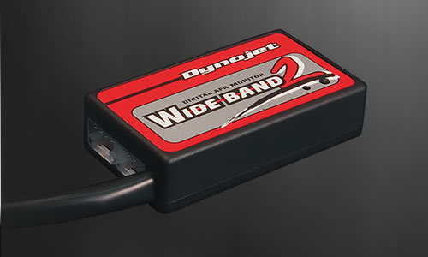
Emissions Strategy
Emitec high flow 3-way catalyst integrated into stock muffler
Closed loop fuel system to automatically adjust to target lambda values for varying blends of isubutanol
O₂ sensor with Dynojet Wideband 2 monitor

Slide 9
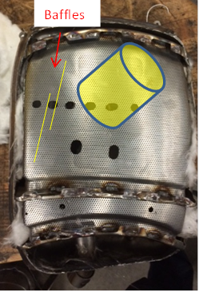
Muffler Design
Integrated 3-Way catalyst
Designed to be easily fitted onto stock 600 ACE to immediately improve emissions
Added baffles and packing to reduce noise output

Slide 10
Sound strategies
3D printed air box with tuned baffles to reduce intake and turbocharger noise
Custom muffler
Ski-Doo Quiet Drive System
Noise deadening foam
Custom clutch guard

Slide 11
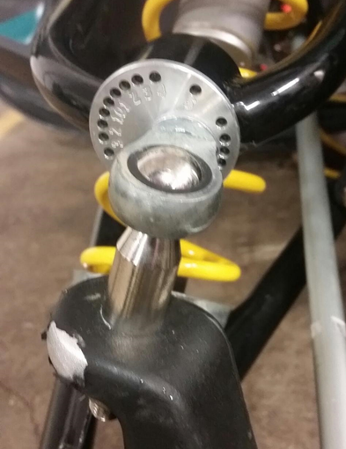
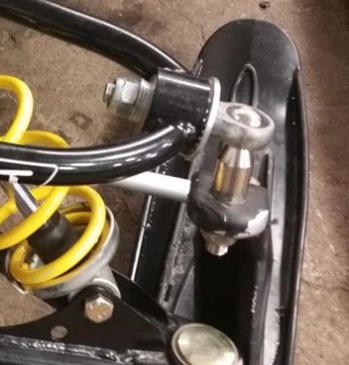
Suspension & Handling
Hygear Slicast front suspension, adjustable caster and camber
Pilot 5.7 skis with Dooly carbides
48 Woody’s studs, 137” track

Slide 12
Marketability
Established Ski-Doo brand
Familiar Stock Controls
Low maintenance, long lasting 4 stroke engine
Fully automated Flex Fuel capability
Fun to drive all around snowmobile
Enough power to be a viable options for riders of all levels
Cleaner and quieter than most snowmobiles in today’s market

Slide 13
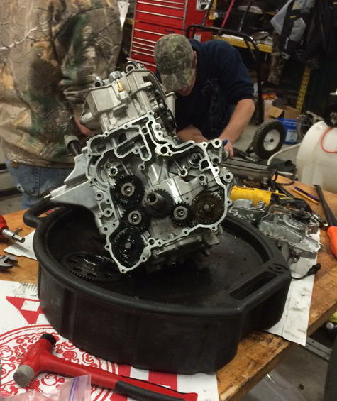
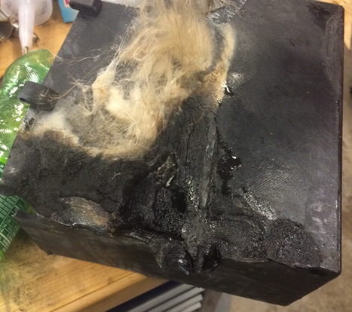
2015 Challenges
Troubleshooting specific ailments
Numerous engine failures
ECU failures
Limited time for data gathering

Slide 14
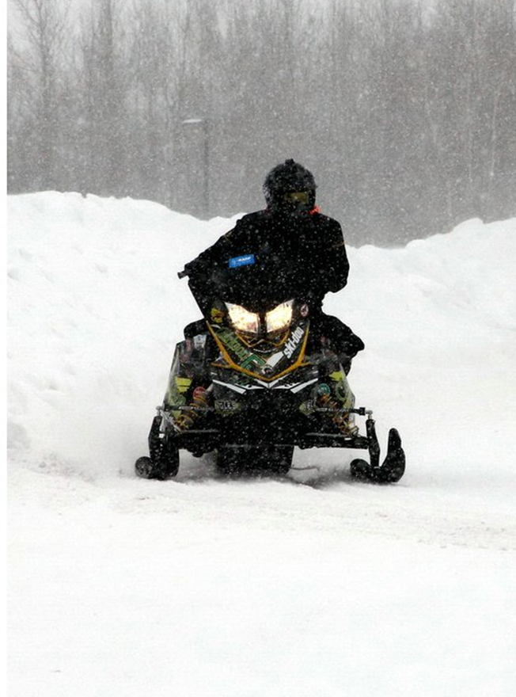
Questions?

