Slide 1
Clarkson Winter Knights
Austin Donhauser
Brad
Cyr

Slide 2
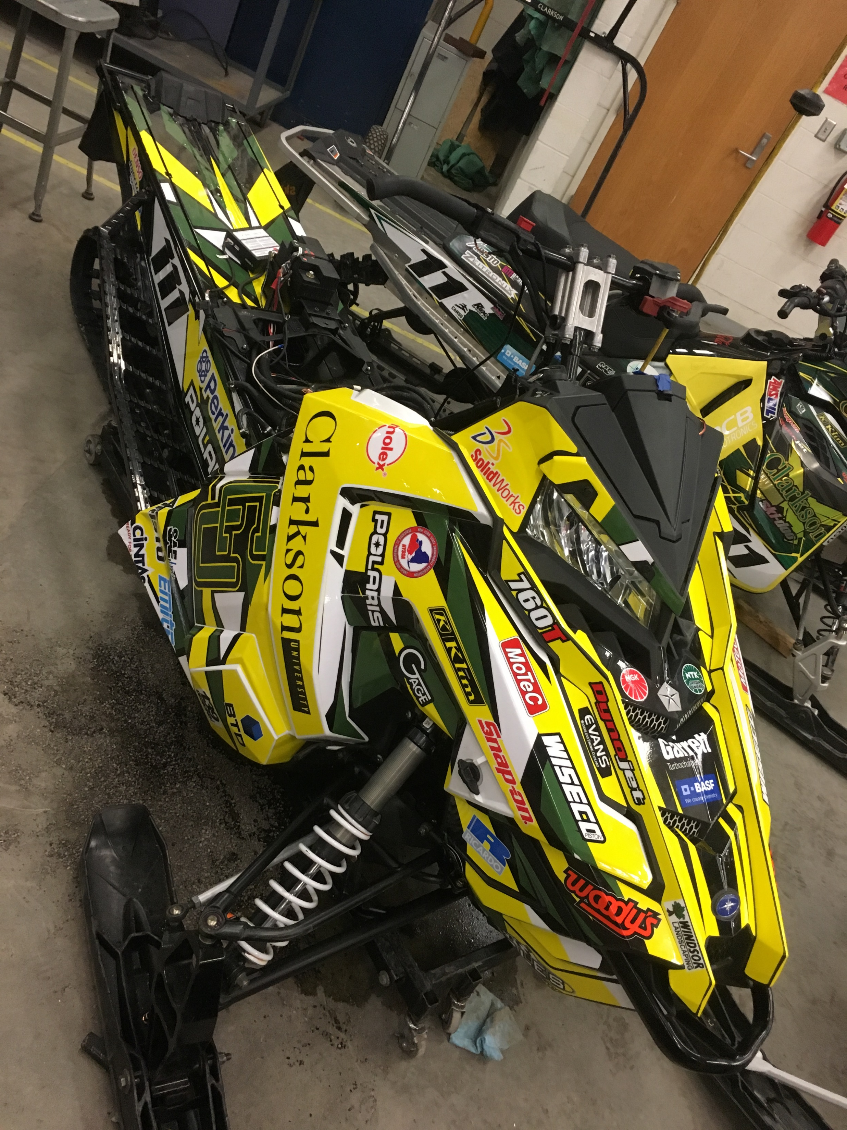
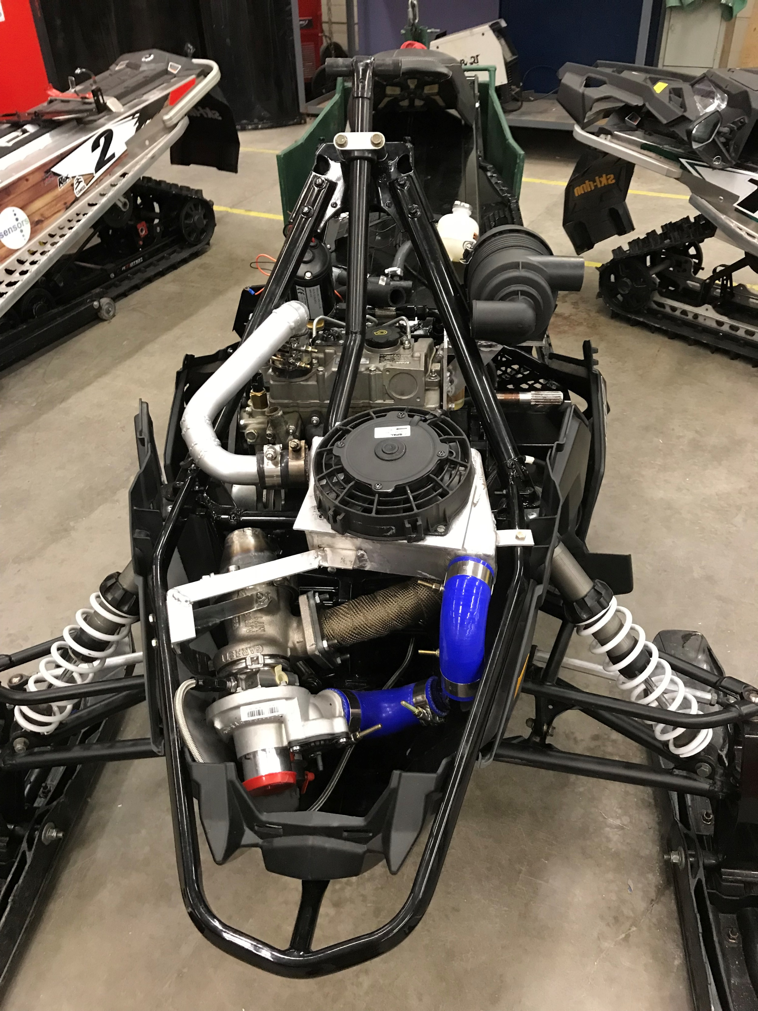
Design Intent
Reliability
Cost Effectiveness
Exceptional Fuel Economy
Reduced Emissions
Cold Start Ability
Low Weight

Slide 3
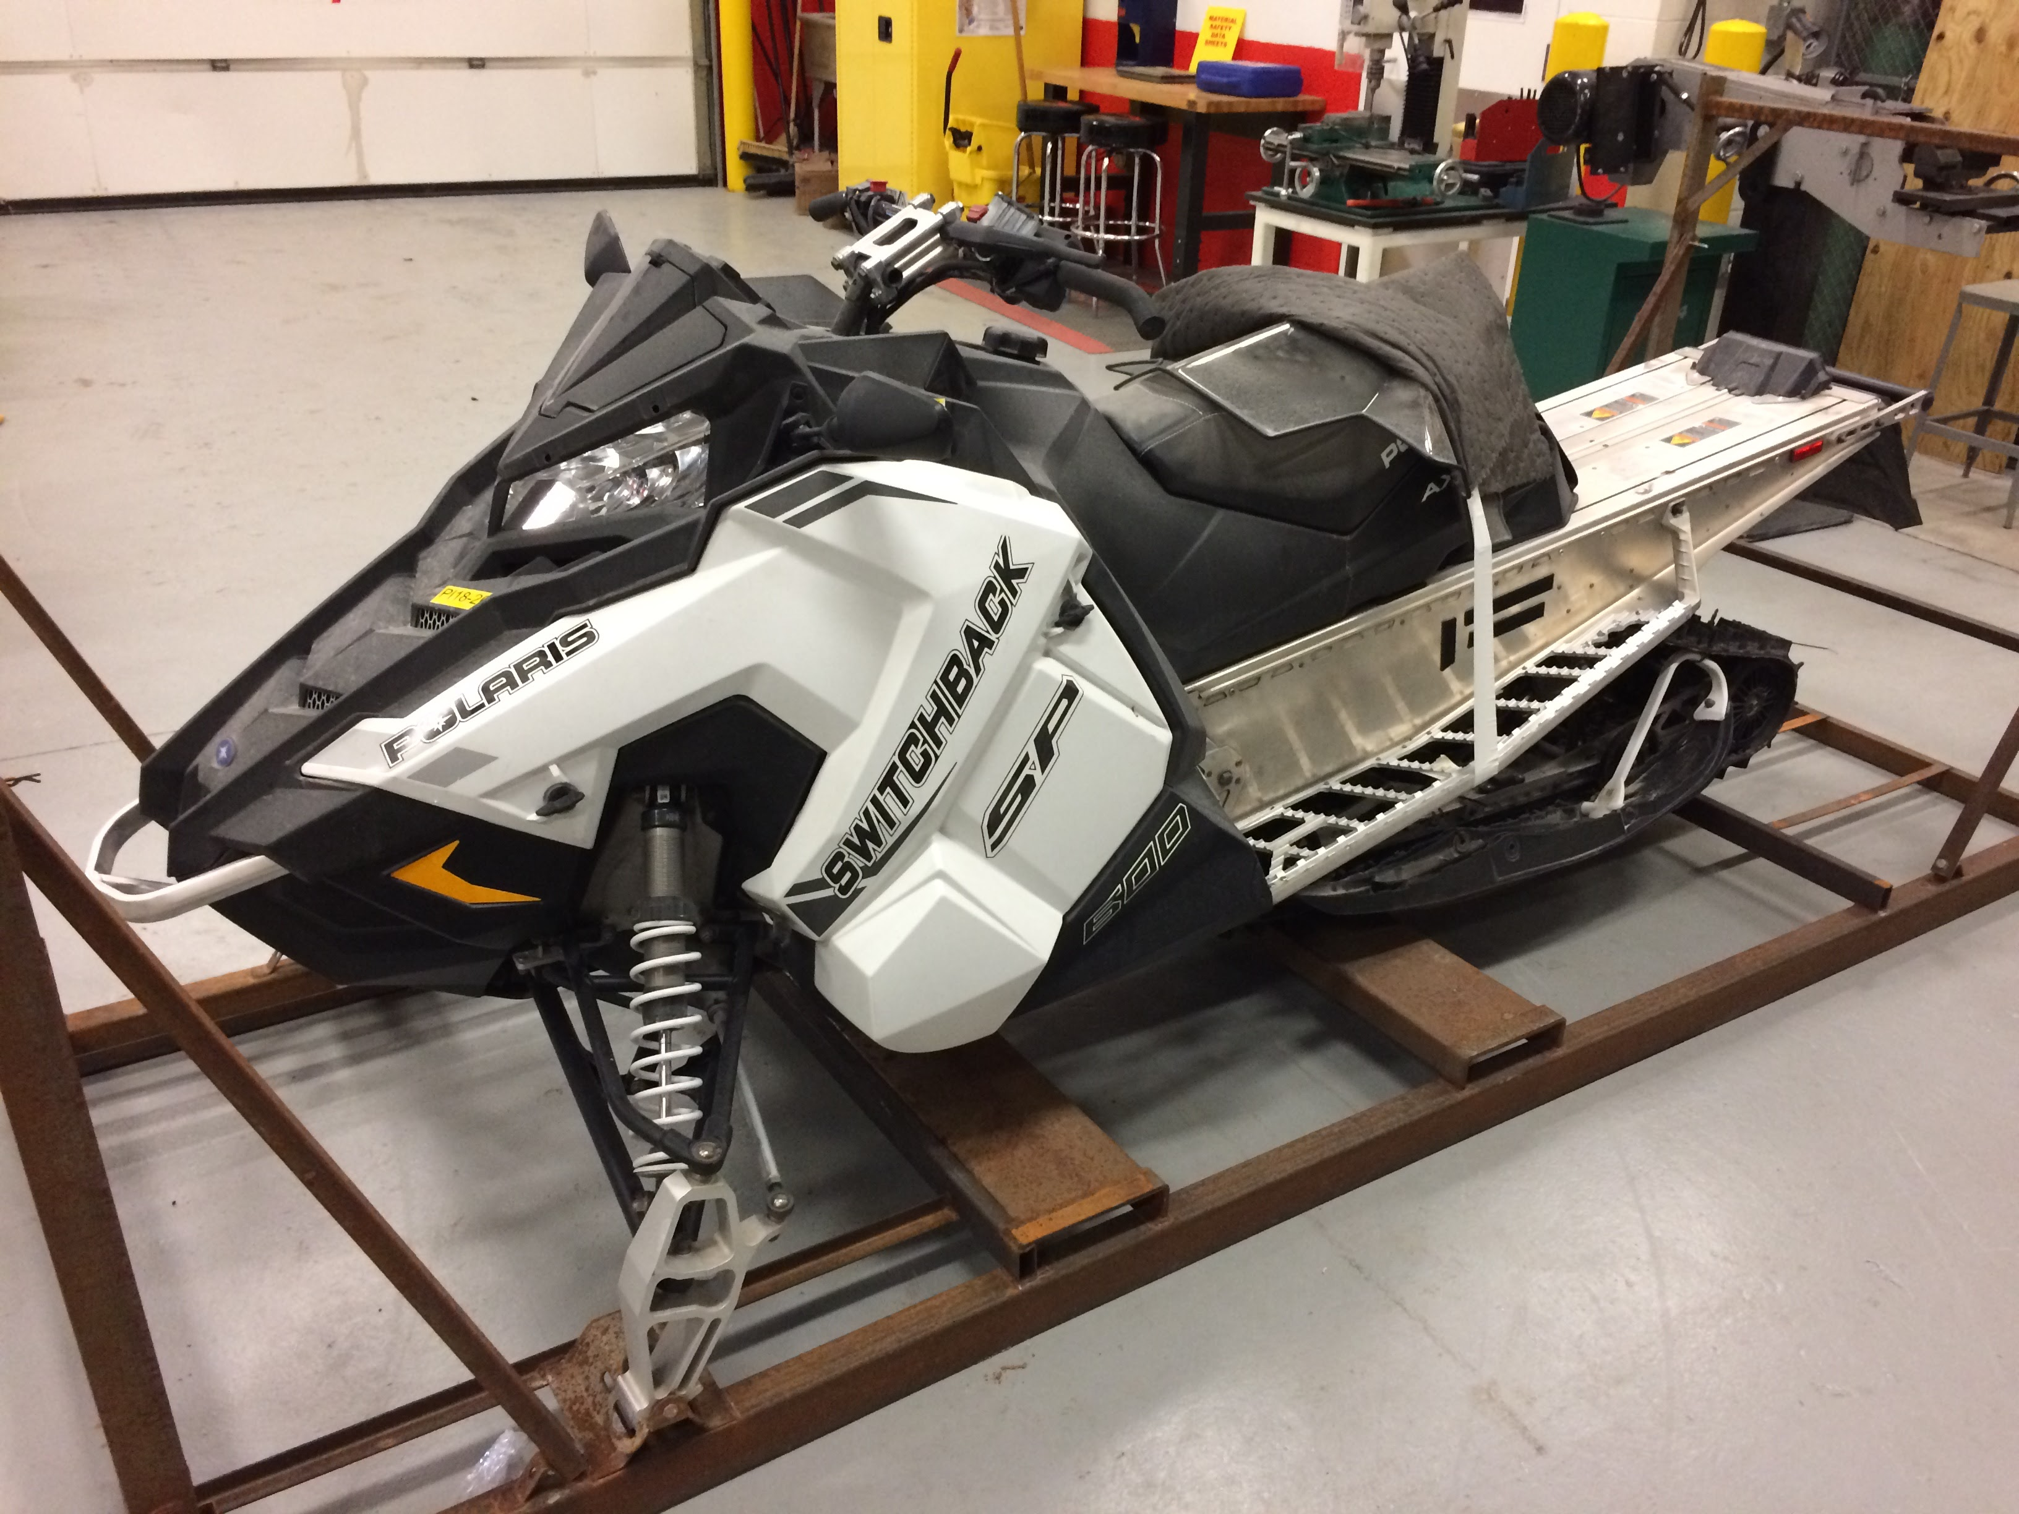
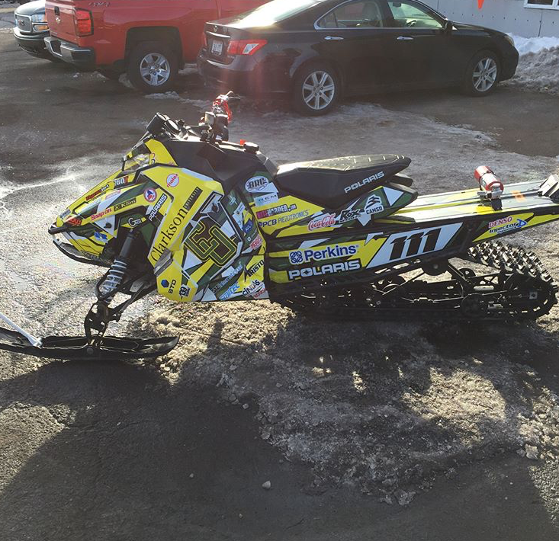
2018 Polaris Switchback SP
144” Long Track
Large Engine Bay
Low Weight
Superior Suspension and Handling

Slide 4
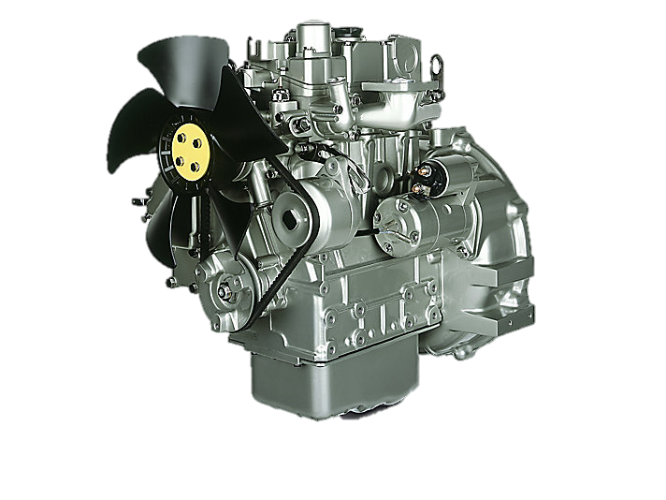
Diesel Engine Selection
Selection Matrix
Weights based on level of importance
Most Important: Availability, Size, HP
Perkins 403D-07 – Best Choice
Meets US EPA Tier 4 Emissions Standards
Specs
20.5 HP
32.8 lb-ft @ 2200 RPM
156.5 lbs Dry Weight
Relatively Small Diesel Engine Size

Slide 5
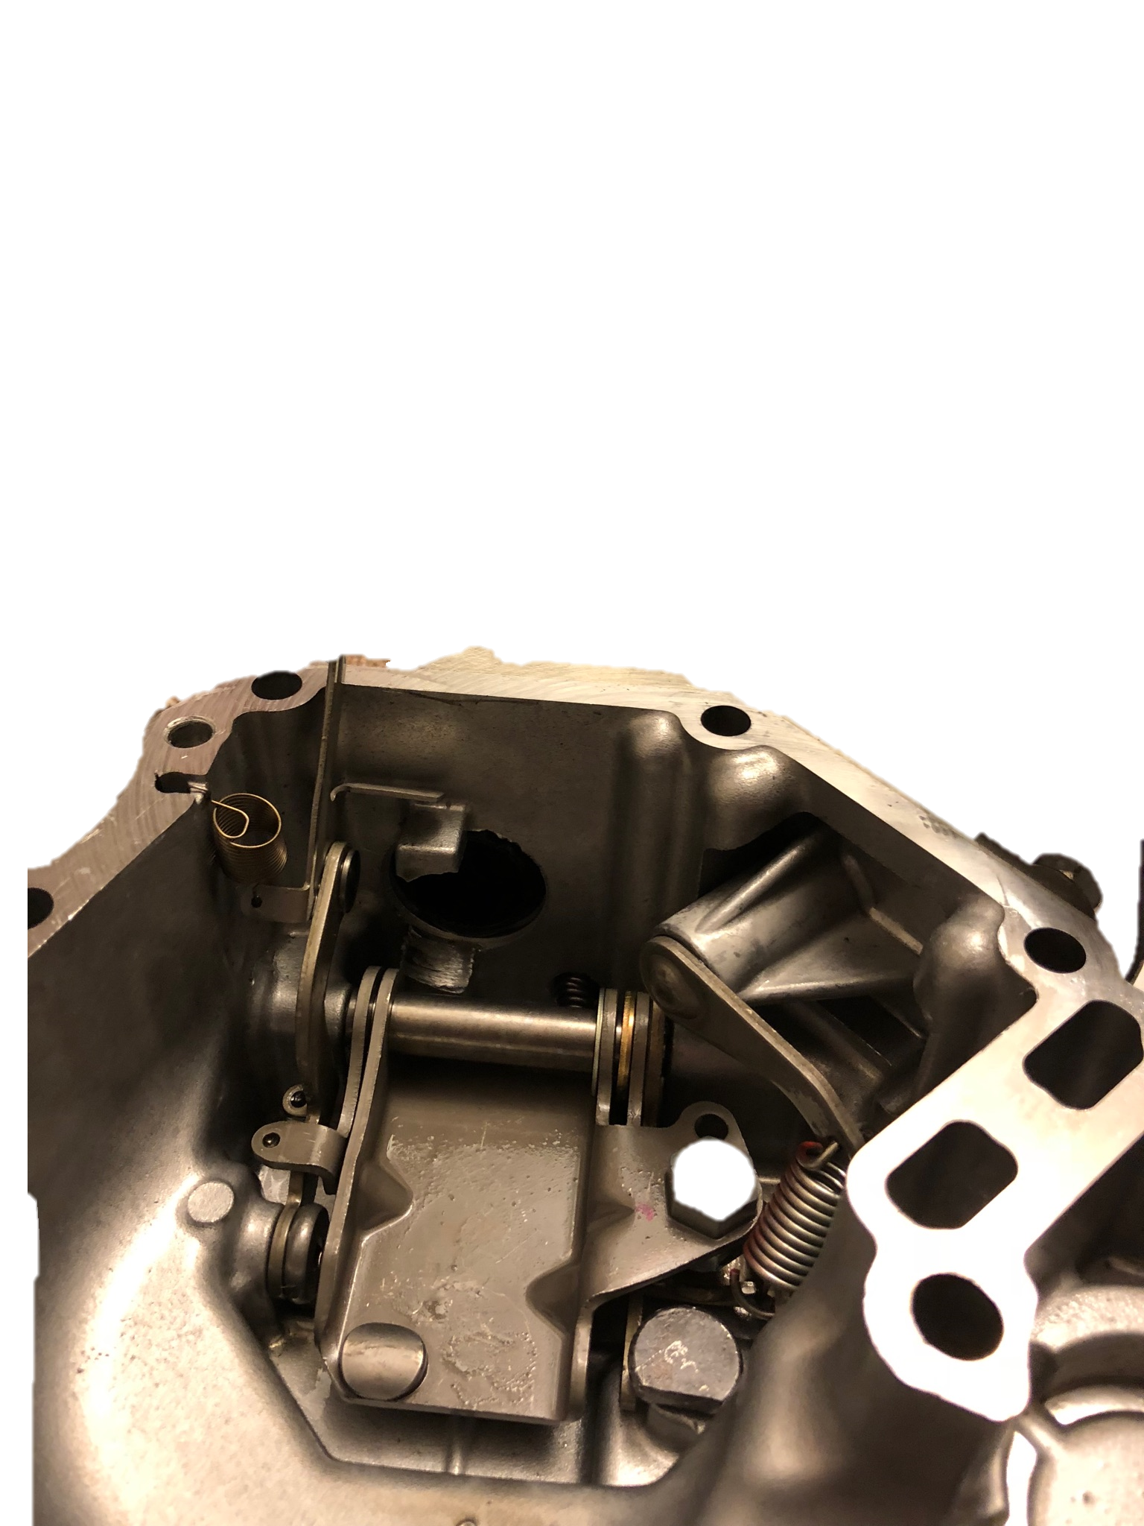
Governor Spring
Generator Model Engine (403D-07G)
Rated 1800 RPM, 10.5 HP
Engine Speed too low for application
Engine Speed Controlled by Governor
Stiffer Governor Spring →Increased RPM’s
Caterpillar C0.7 3600RPM Model Spring Installed

Slide 6
Performance Increases

Slide 7
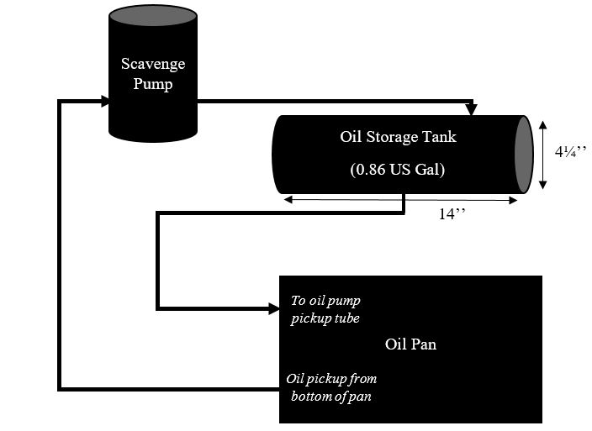
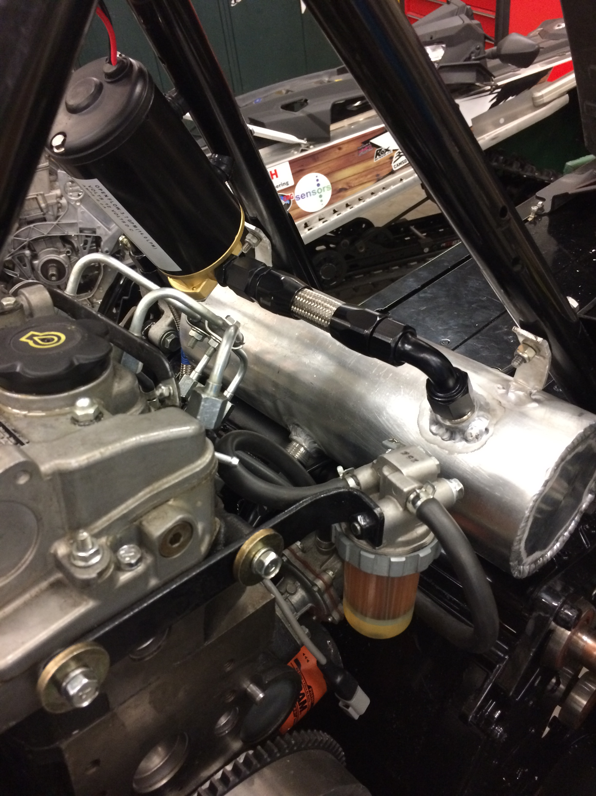
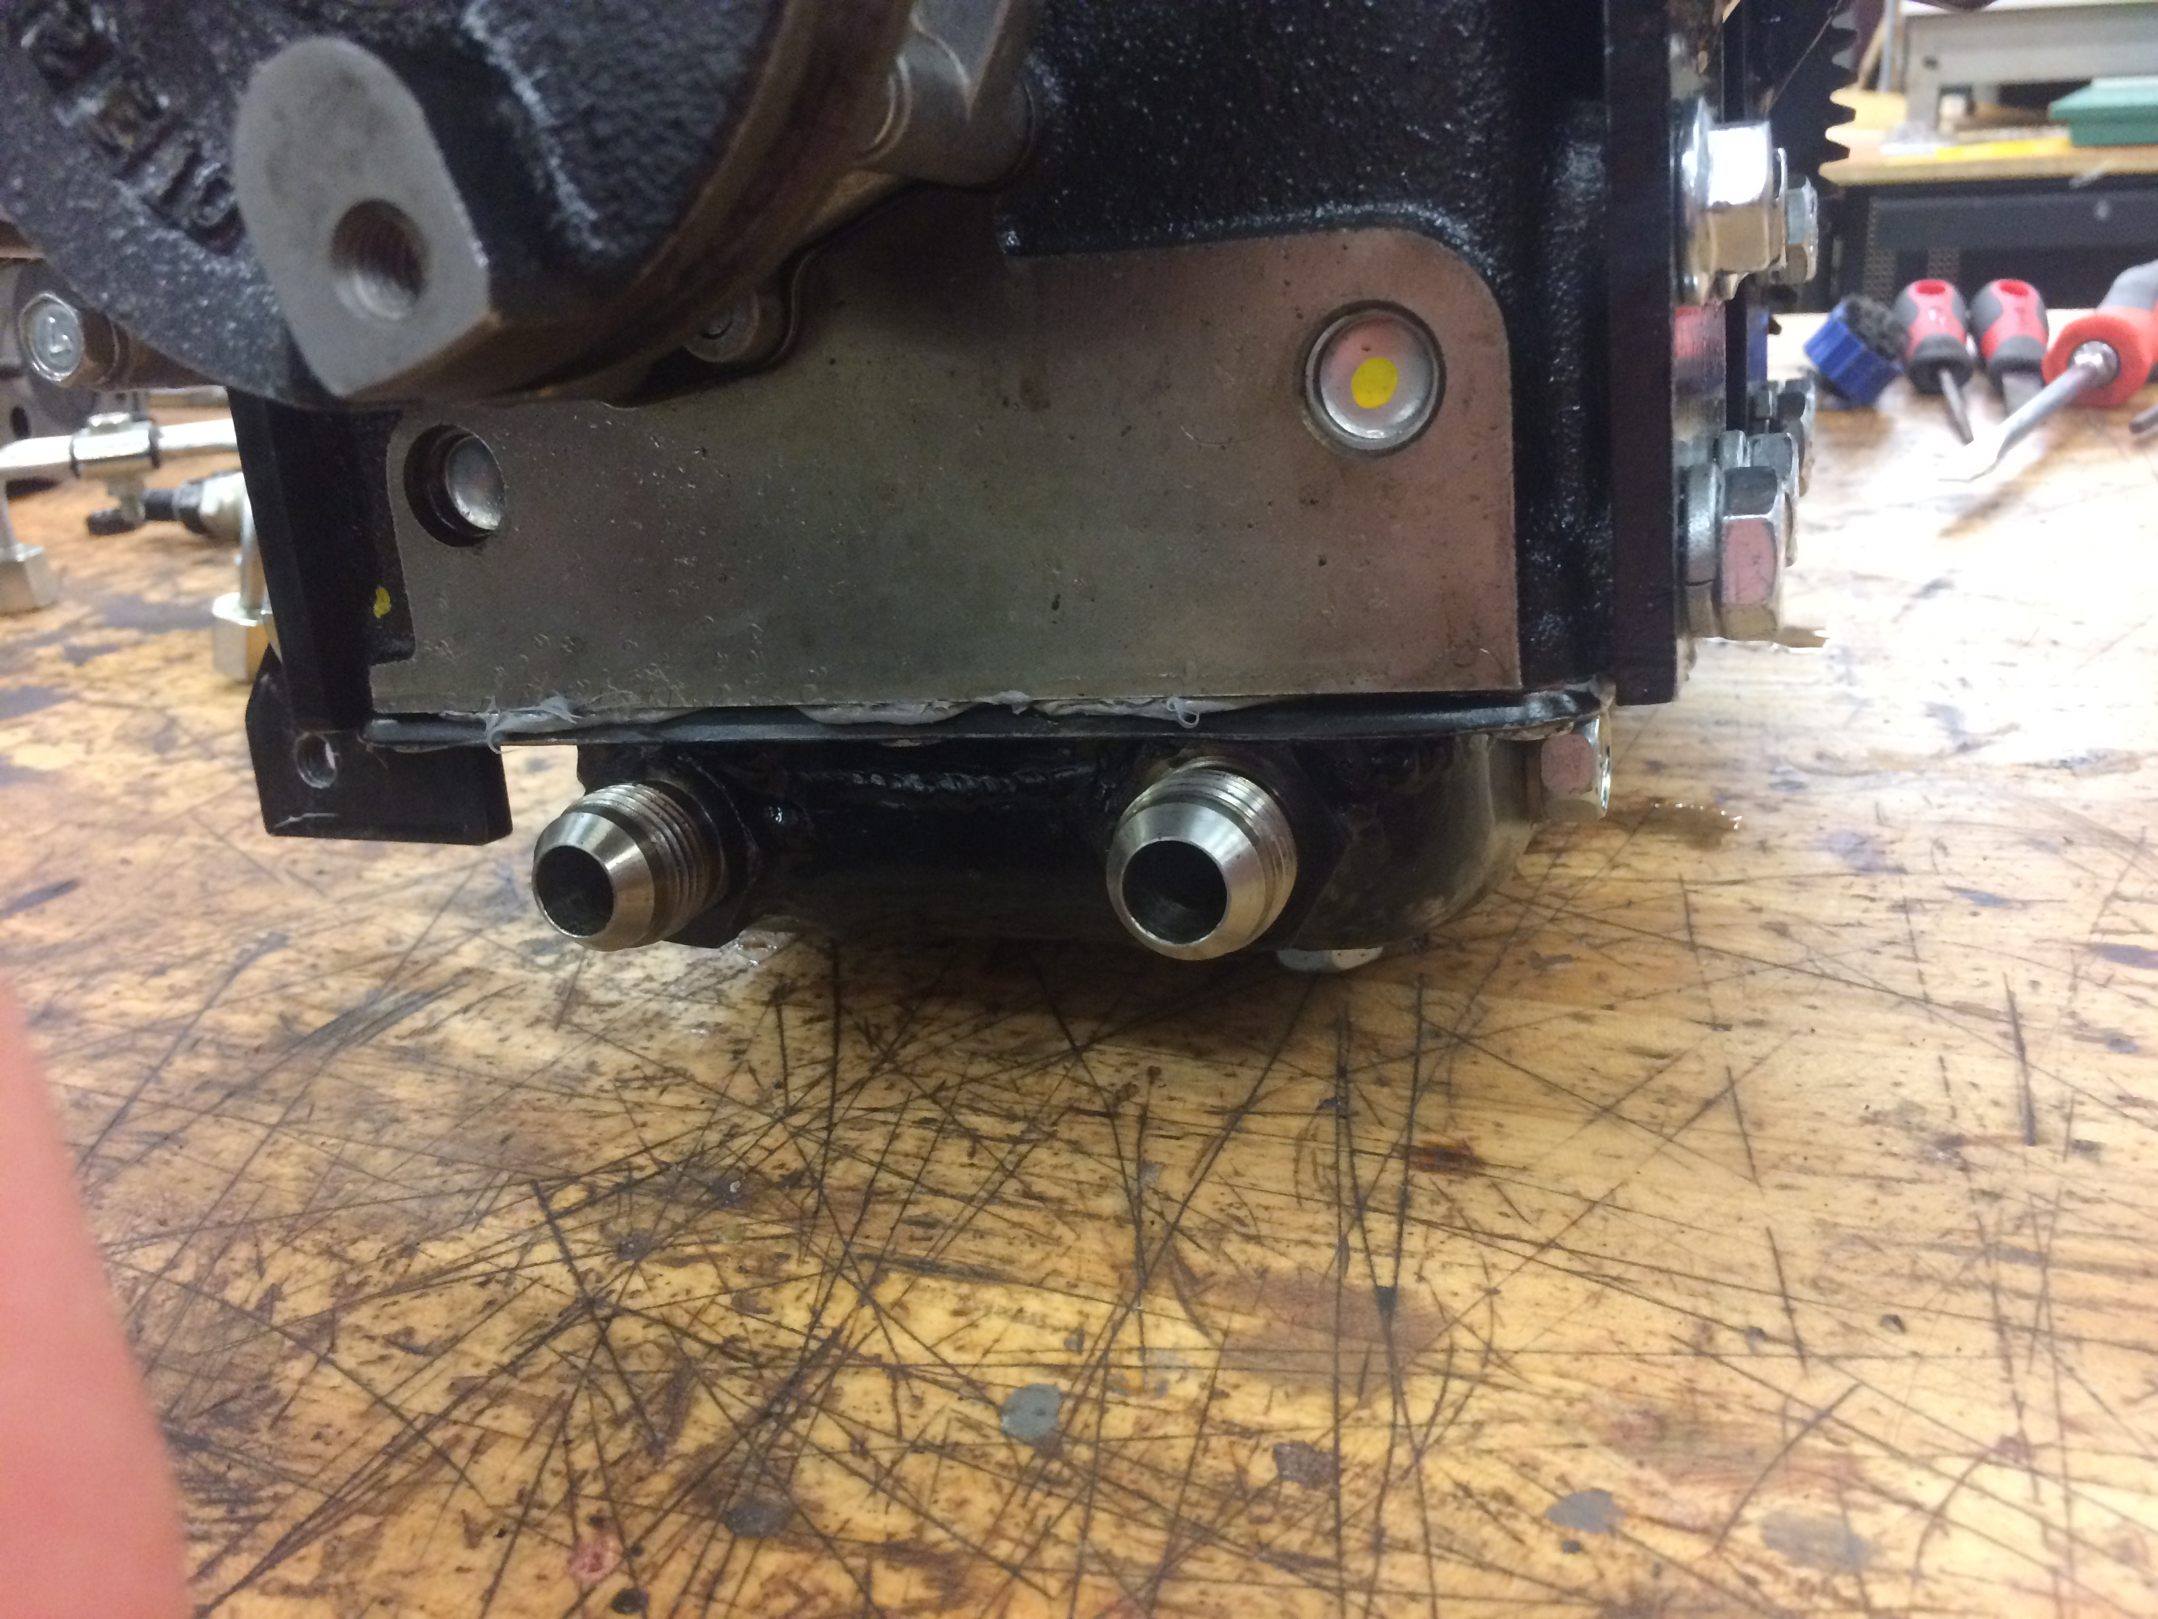
Dry Sump Oil System
Engine bay height constraints
Cut oil pan 2”
Reduction in oil capacity beyond safe limits
Stock Capacity: 0.75 Gal
Dry Sump Capacity: 0.86 Gal
Scavenge Pump
CXRacing 3.7GPM
Used in many race applications,
allows for steady oil supply at
all times

Slide 8
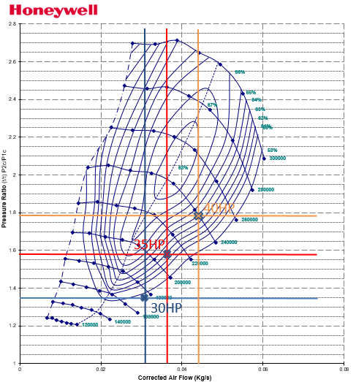
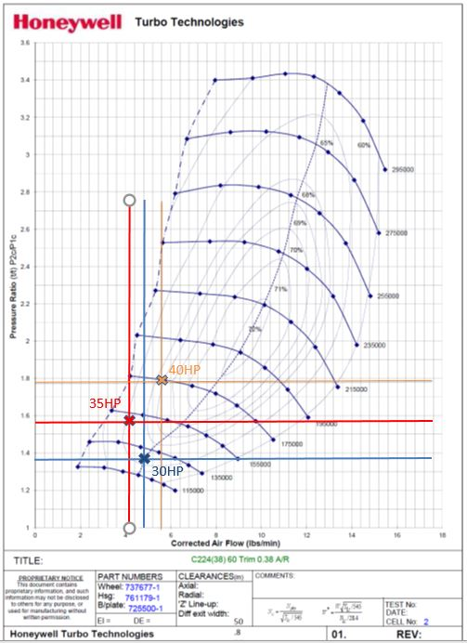
Turbocharger Selection
Garrett by Honeywell SAE Program
GT-12Z best fit for
application
65% Efficiency @ 35HP

Slide 9
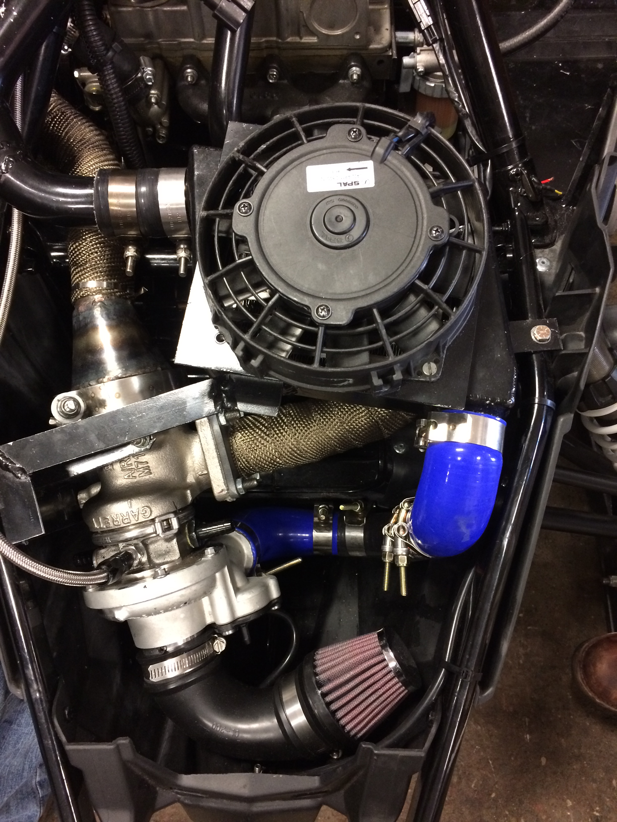
Turbocharger and Intercooler
Bell Intercooler w/ cooling fan
Efficiently cools compressed air from turbo
Turbocharger
Increase power output
Reduce emissions by leaning fuel/air mixture
Increase fuel economy

Slide 10
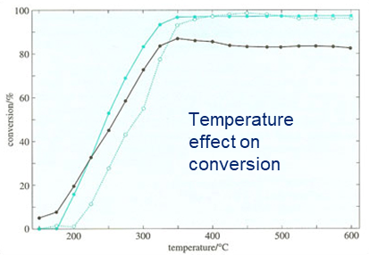
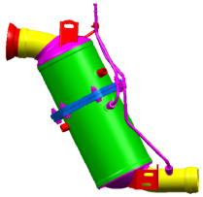
Diesel Oxidation Catalyst
Faurecia DOC (Diesel Oxidation Catalyst)
Oxidizes CO, HC, and small fractions of PM
High temperature increases efficiency
Placed as close as possible to manifold for highest temperatures

Slide 11
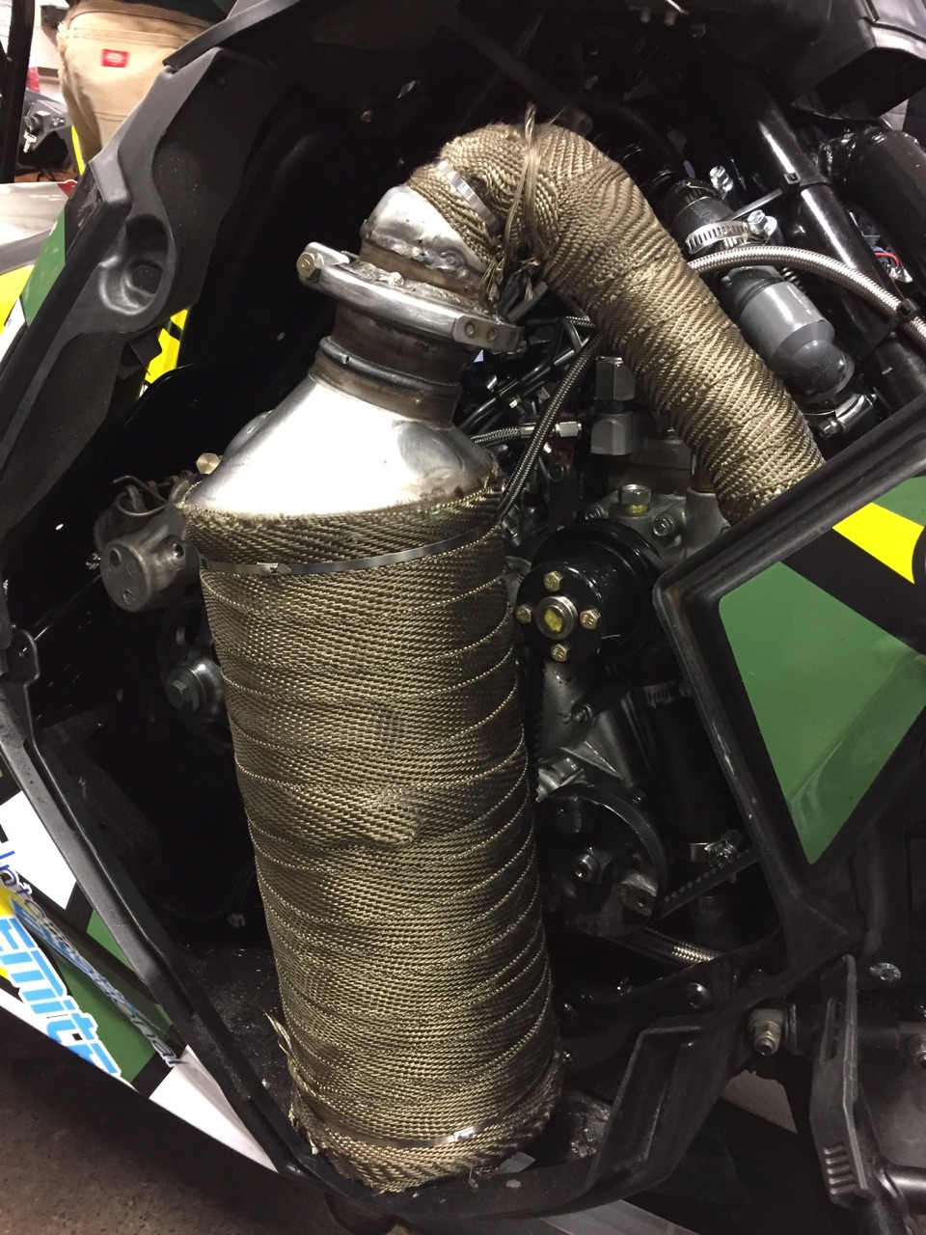
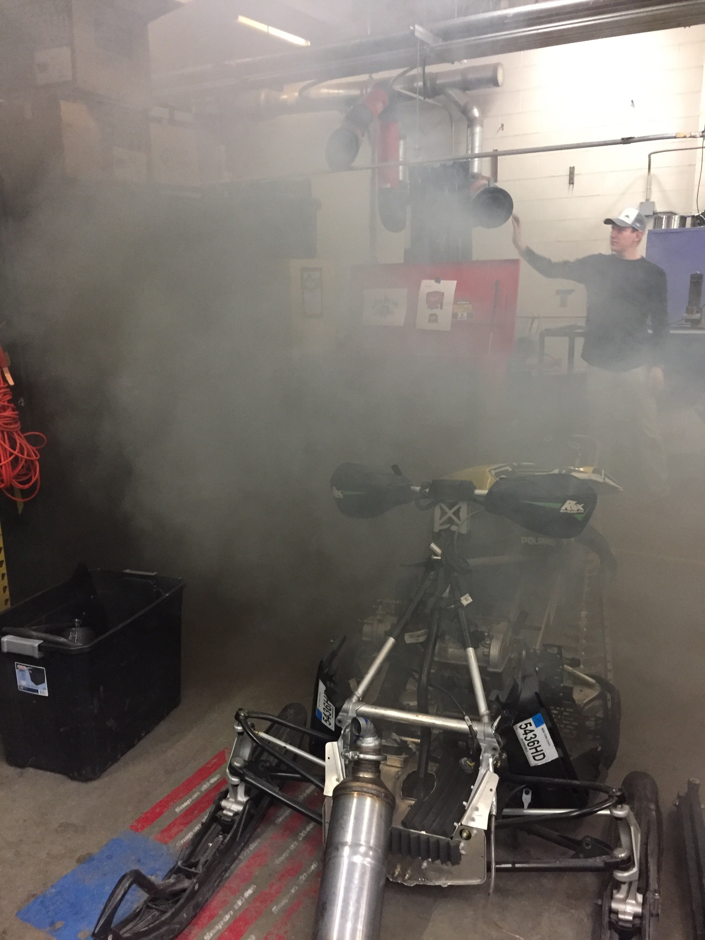
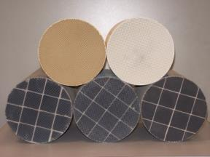
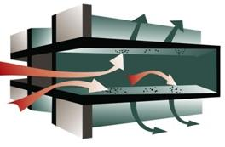
Diesel Particulate Filter
Faurecia PDPF (Partial Diesel Particulate Filter)
Downstream of DOC
Made from SiC or TiAl
Filtration is >99% efficient after soot coverage

Slide 12
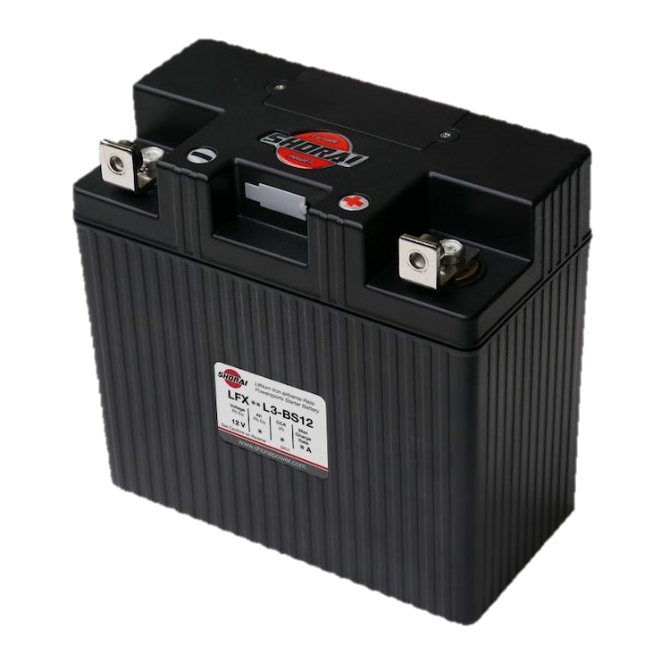
Cold Start Reliability
Stock Battery replaced with Shorai LFX Lithium Ion Battery
550 CCA allows for fast cold starts
Denso glow plugs
Increase pre-combustion chamber temperature to aid in cold start ignition

Slide 13
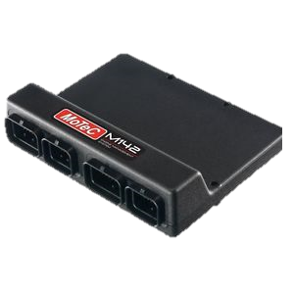
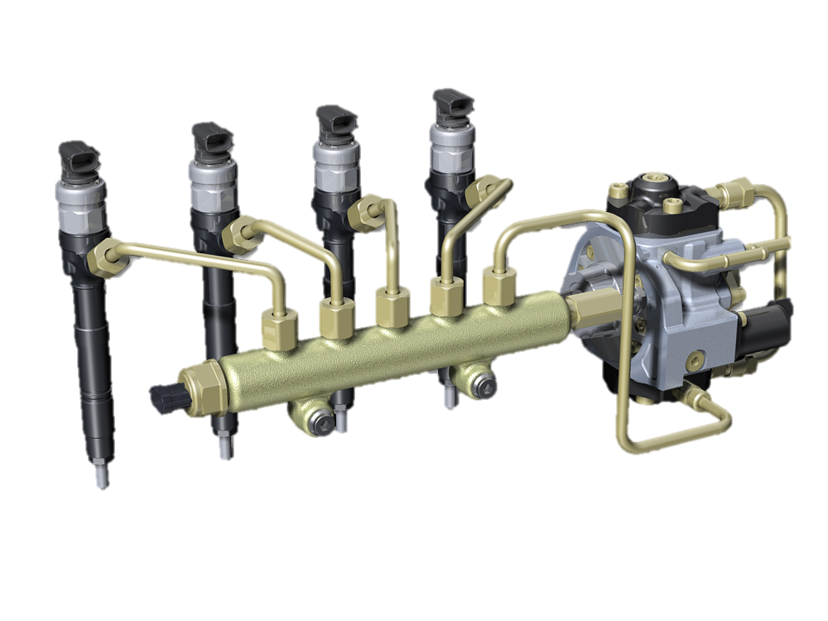
Future Plans
Future plans of SCR incorporation and Diesel Injection
Mechanical Fuel Injection → Electronic Common Rail Fuel Injection
Clutch calibration for higher speed

Slide 14
Thank you
Questions?

