Slide 1
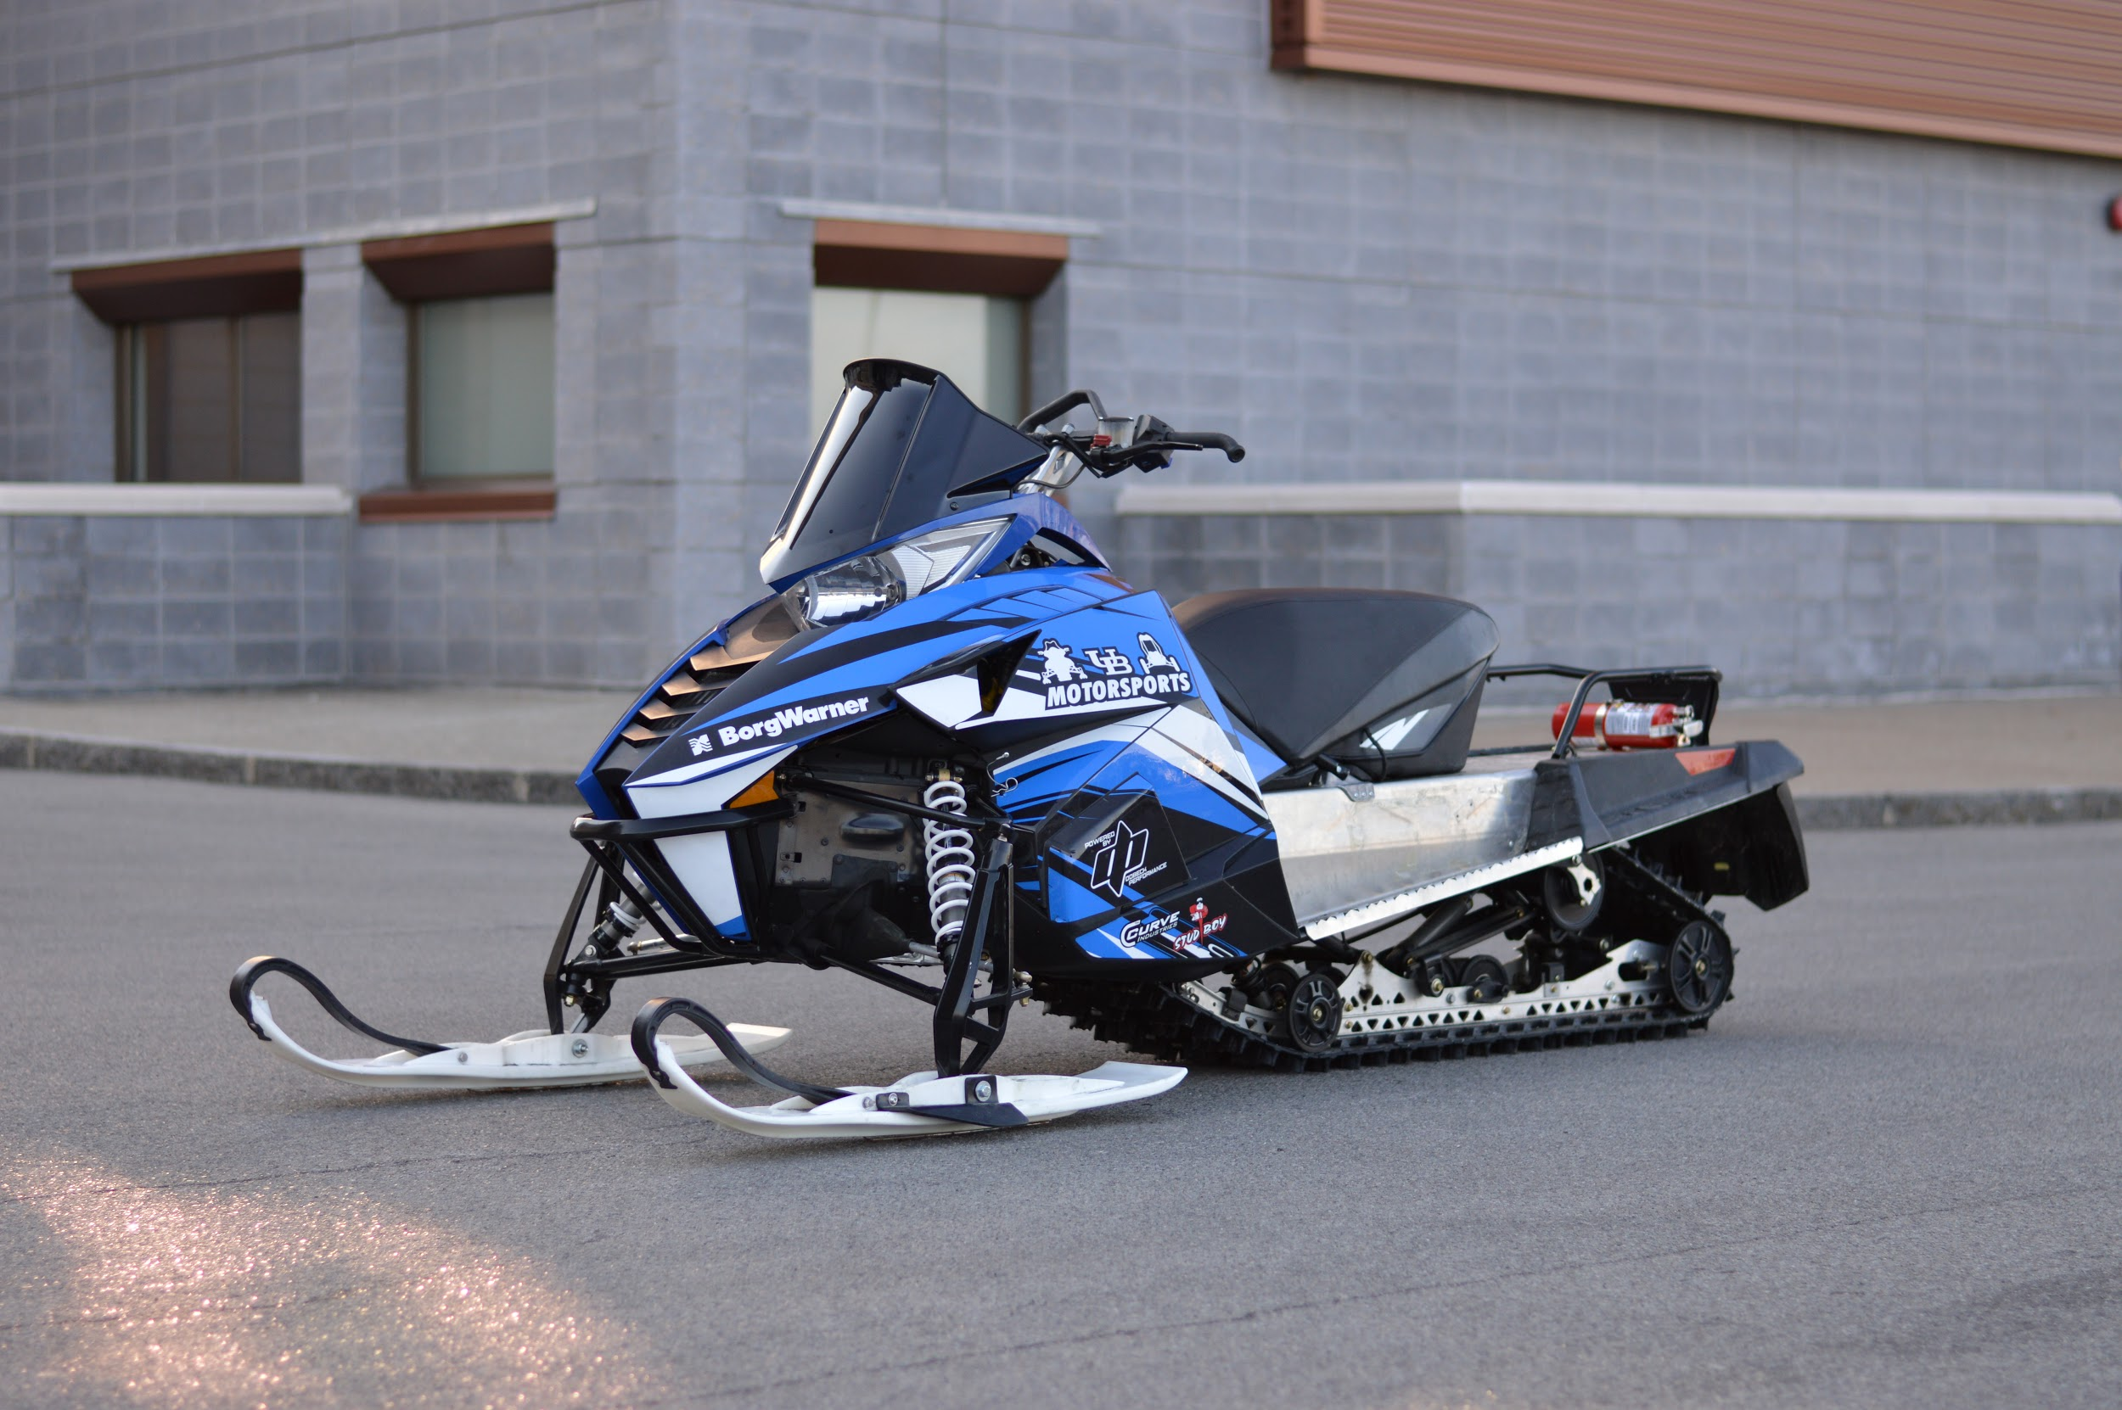
University at Buffalo SAE Clean Snowmobile Team
Presented By
Austin Keppler
Ethan Schonhaut

Slide 2
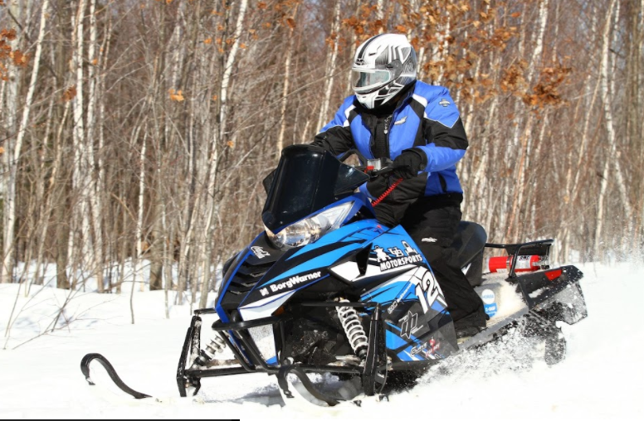
Design Considerations
Environment
Decreased Emissions
Quieter Operation
Lowered Fuel Consumption
Operator
Extended Operation Period
Increased Towing Capacity
Extended Fuel Range
Manufacturer
Low Cost/High Product Quality
System Simplicity
Increased Durability

Slide 3
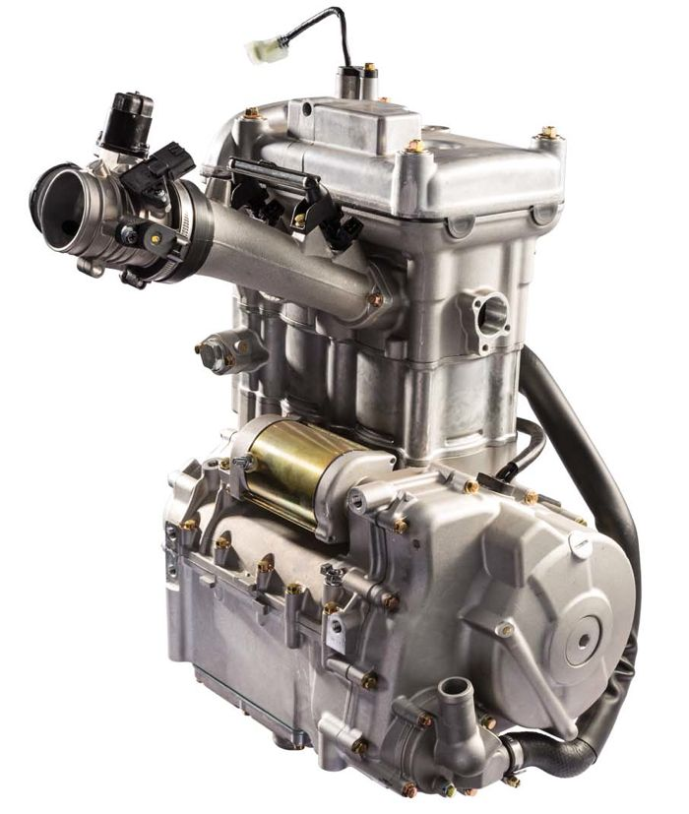
Engine/Chassis Selection
Bearcat 3000 Lt/Kymco 700cc 4-Stroke
Small Displacement/Low Emission/High power
Low BSFC
Engine Longevity and Reliability
Low WOT Exhaust Noise
Low Cost
Kymco 700 4-Stroke
2 cylinder
Fuel Injection System

Slide 4
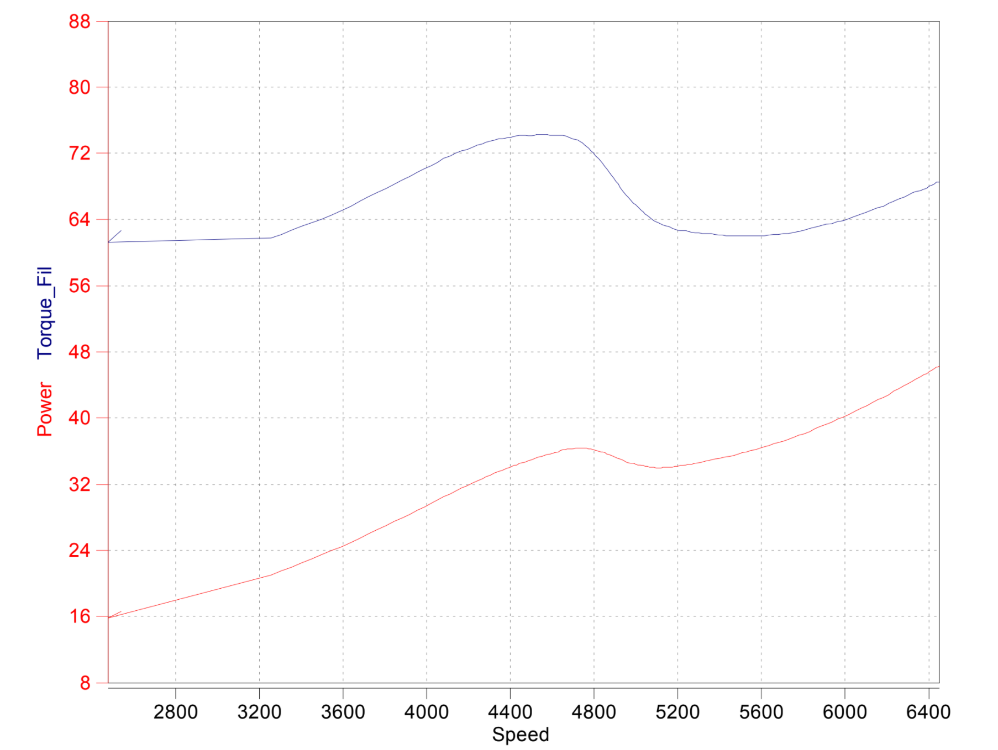
Engine Output
Arctic Cat AVL Dyno Emissions 2017
Power: 47 hp
Torque: 74 ft*lbs

Slide 5
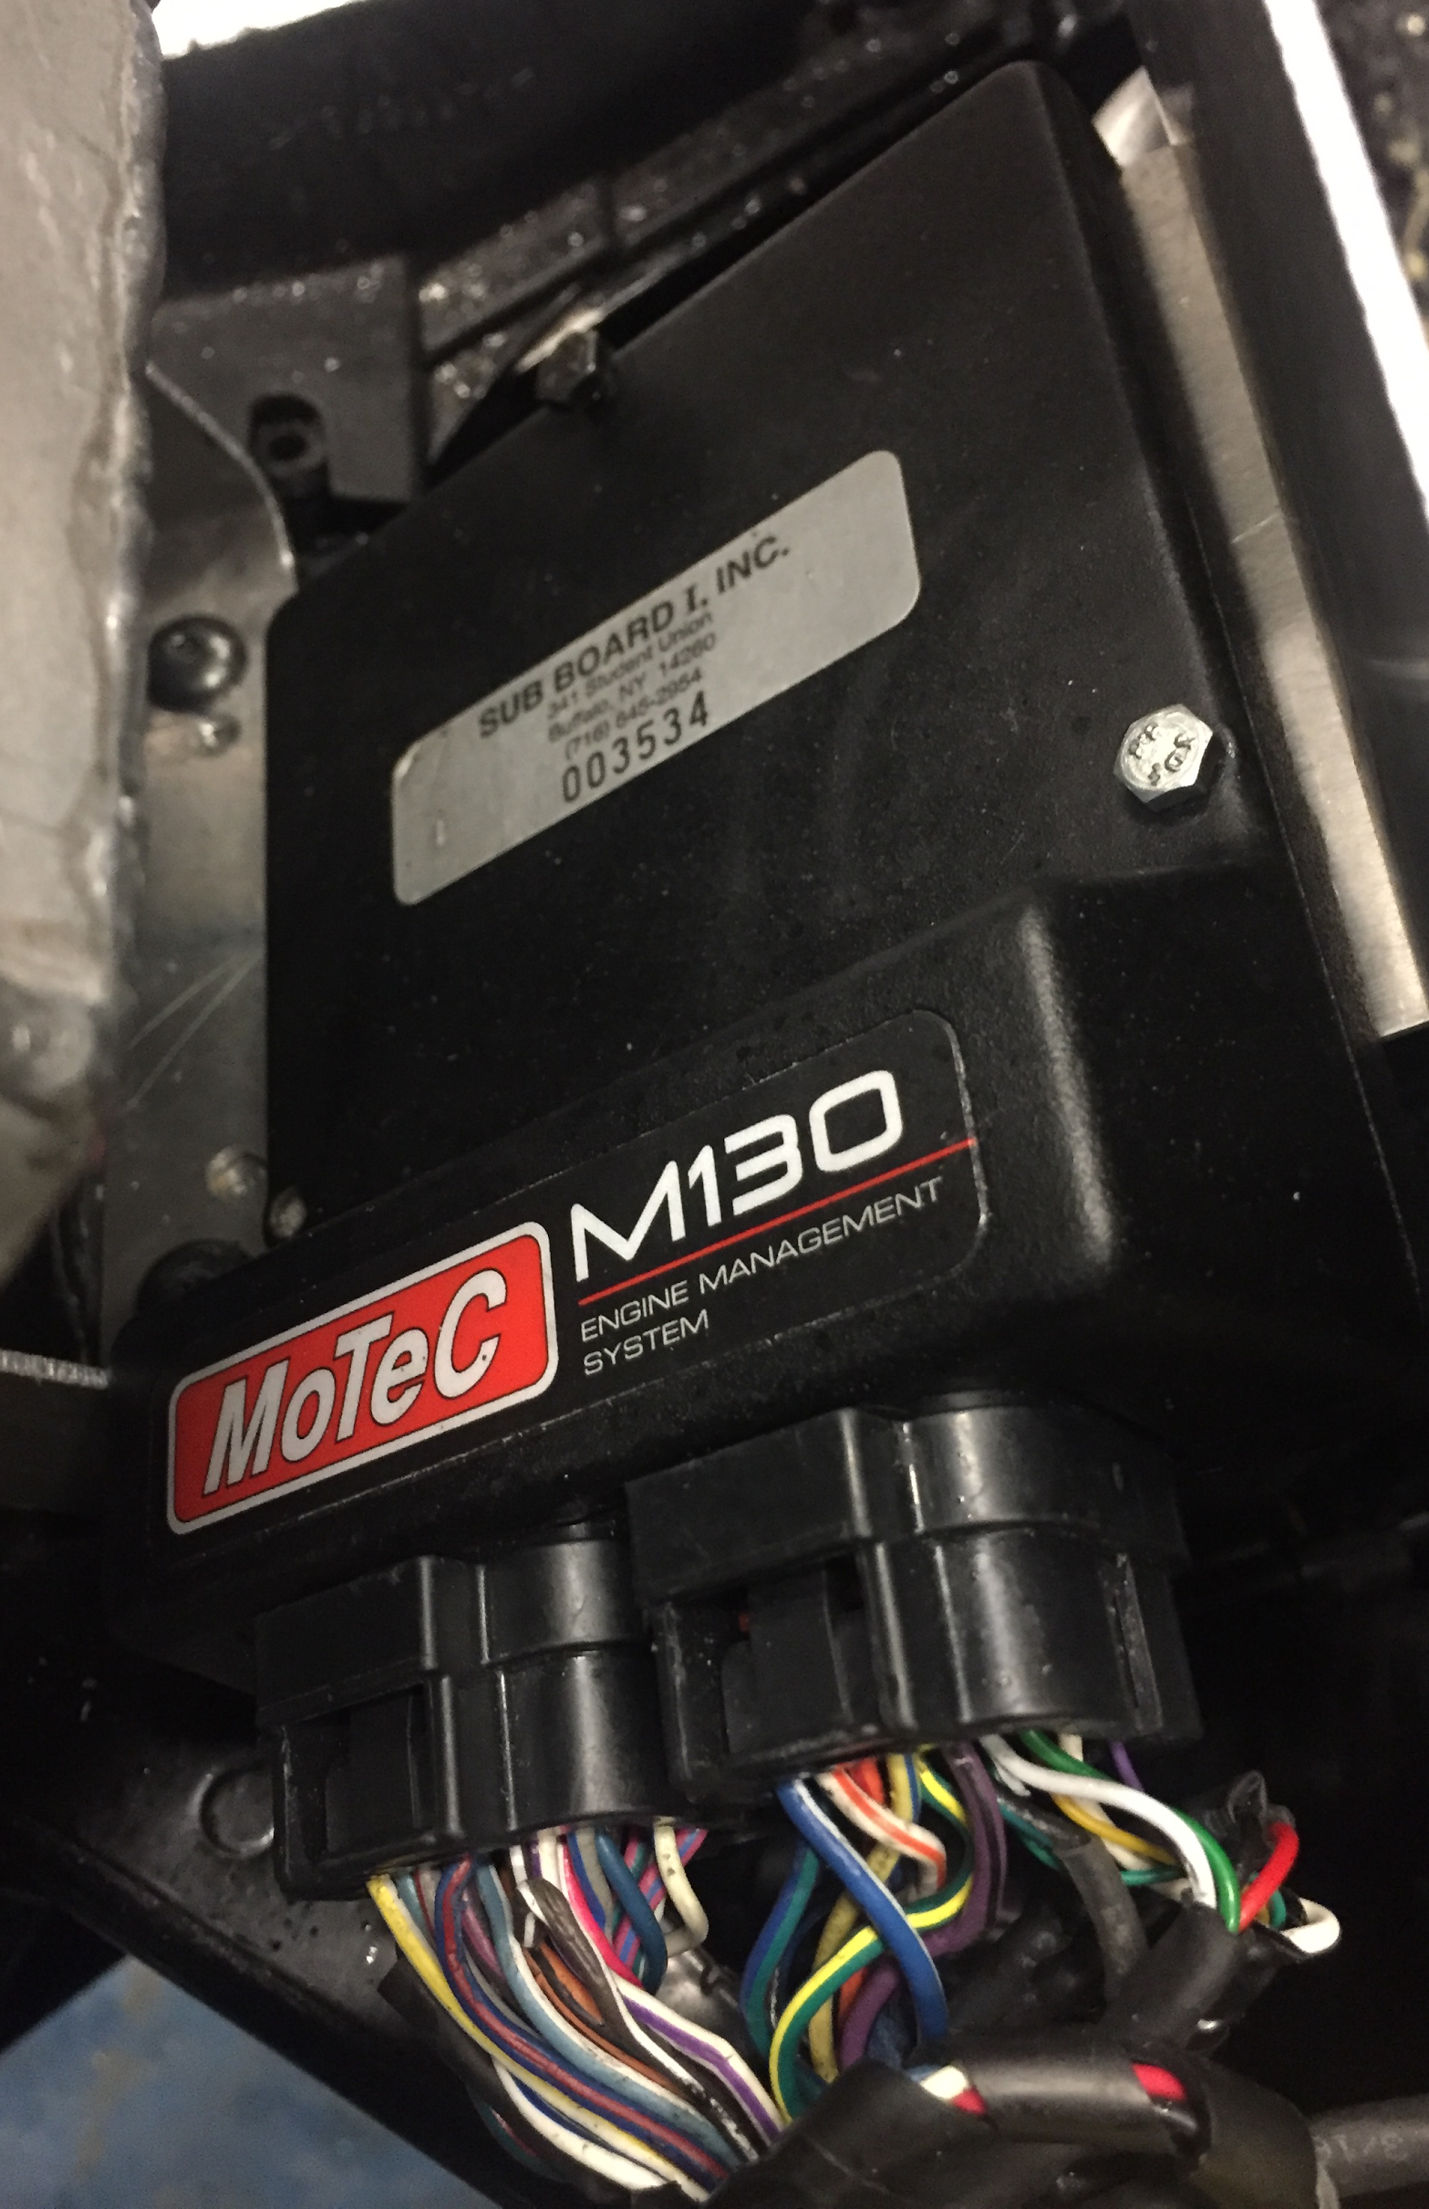
Engine Control
Replaced a piggy back system with MoTeC M130 ECU
Complete control over engine parameters

Slide 6
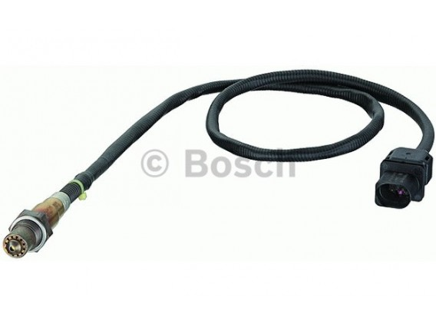
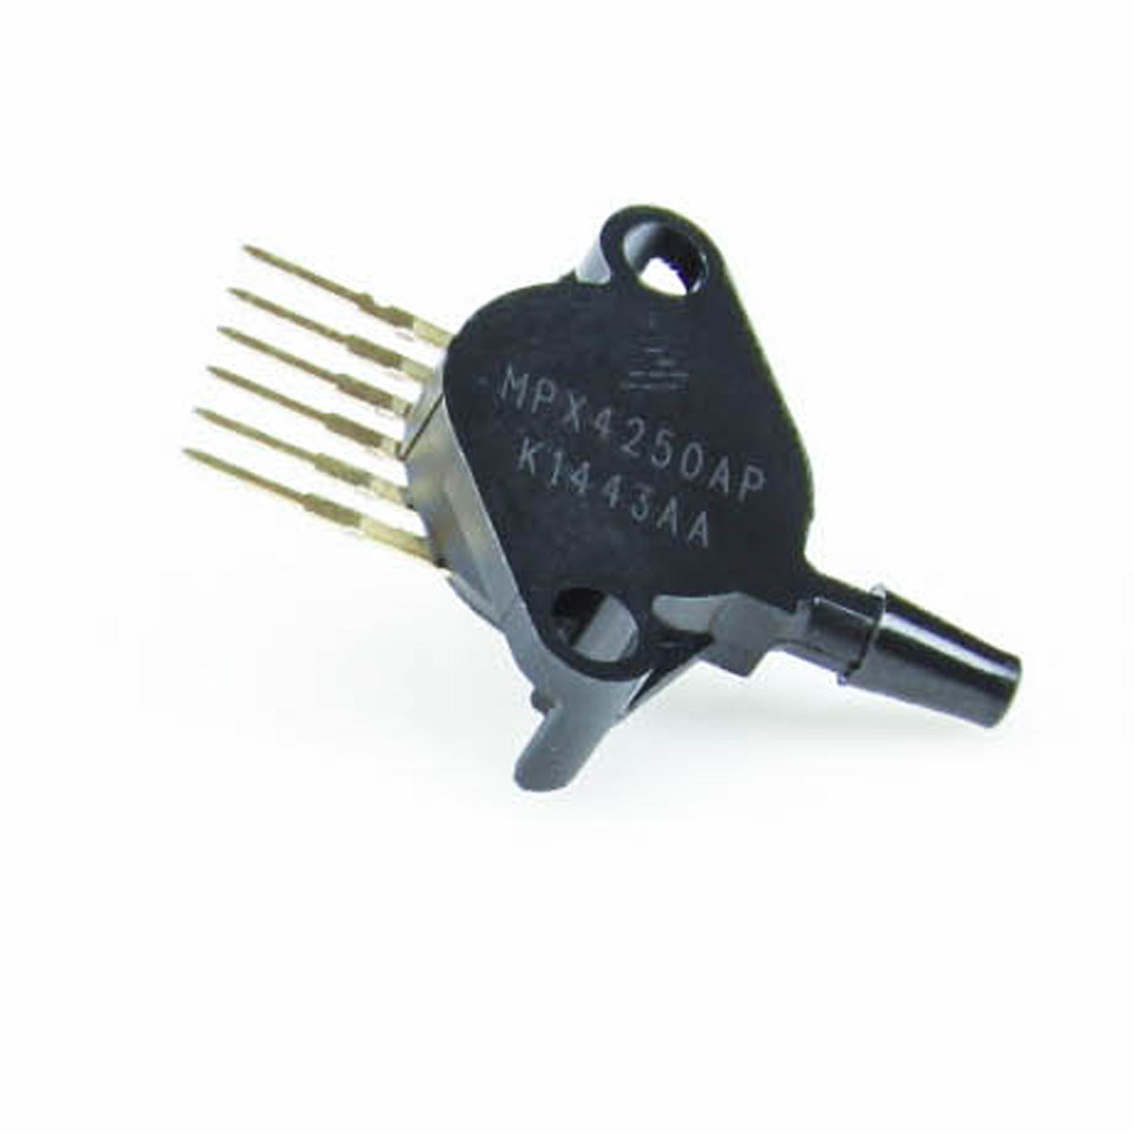
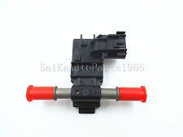
Sensors
Bosch LSU4.9 wideband O2 sensor
GM flex fuel sensor
Upgraded to a 2 bar MAP sensor

Slide 7
Tuning
Tuned to be sure engine was running close to stoichiometric (14.8 - 15.1) during operating conditions
Bosch LSU4.9 Wideband O2 sensor and gauge
Tuned to add more fuel during cold start and idle (12.5 - 13.2)

Slide 8
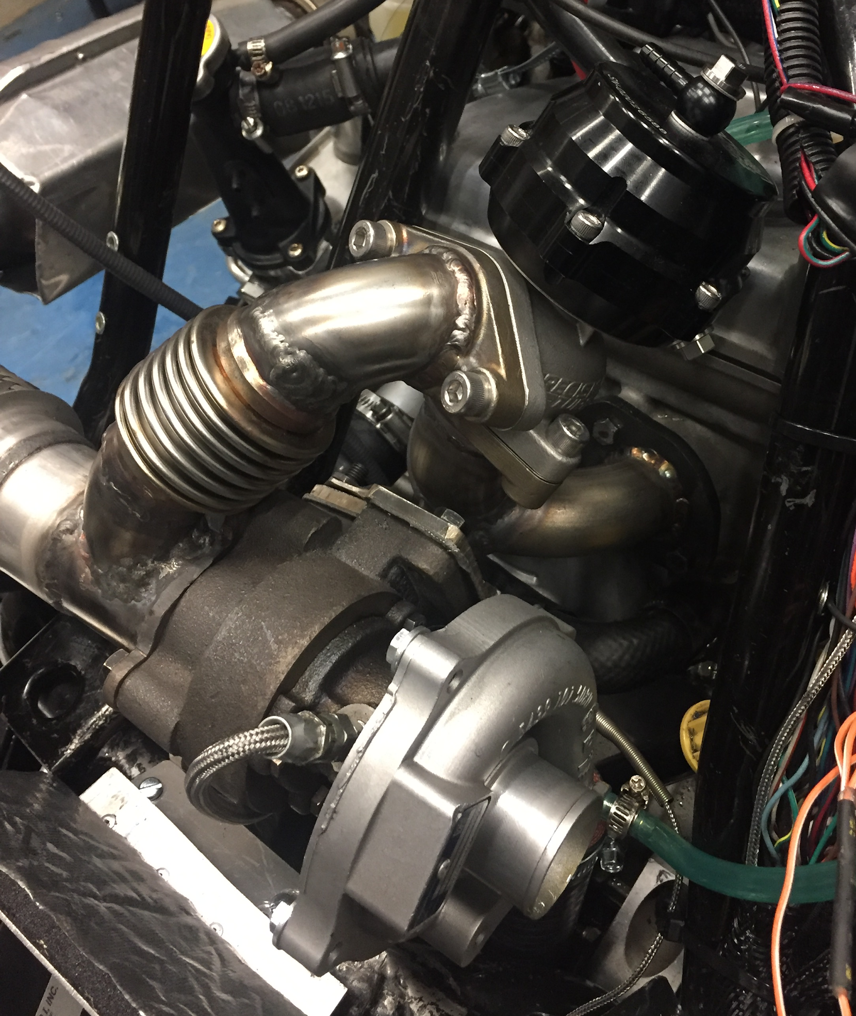
Turbo System
Design and Implementation
BorgWarner KP35
Precision Turbo 38mm external wastegate
Custom log manifold to fit space constraints
Cold air intercooler intake with heat exchanger
TurboSmart blow off valve

Slide 9
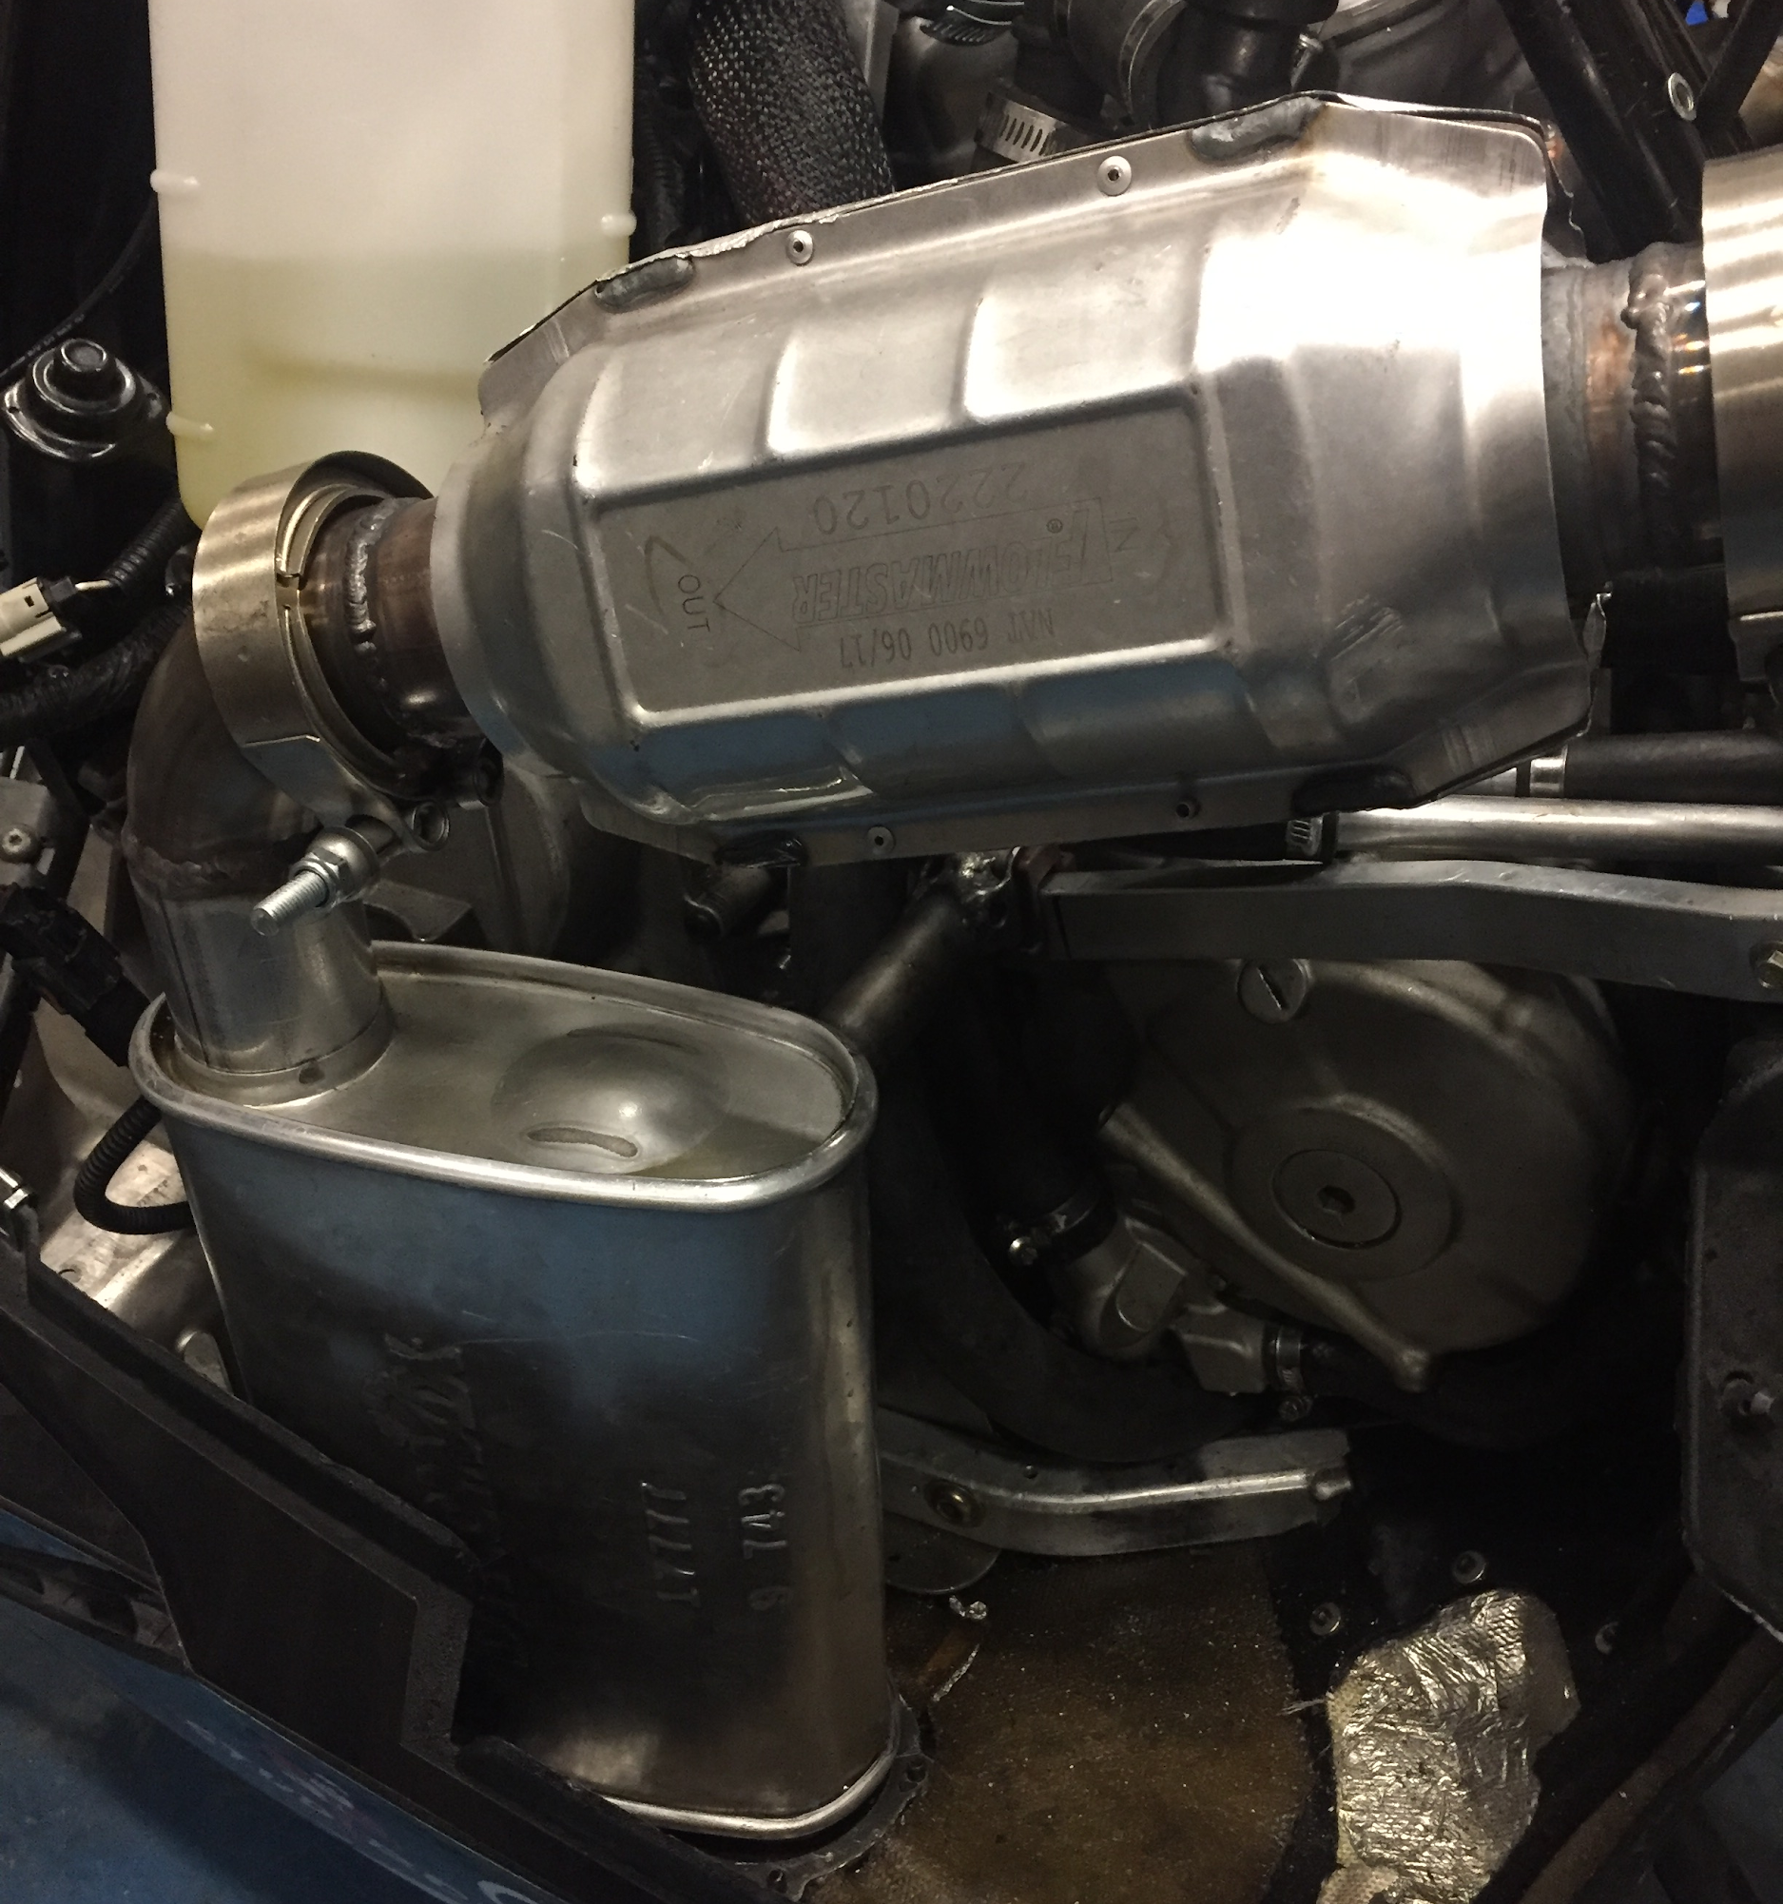
Exhaust System
Modular exhaust system
Flowmaster catalytic converter
Dynomax Performance muffler

Slide 10
Suspension, Track, and Steering
Design and Implementation
Curve Industries XS Skis
Woody’s studs for increased traction
Improved handling over stock utility skis and track

Slide 11
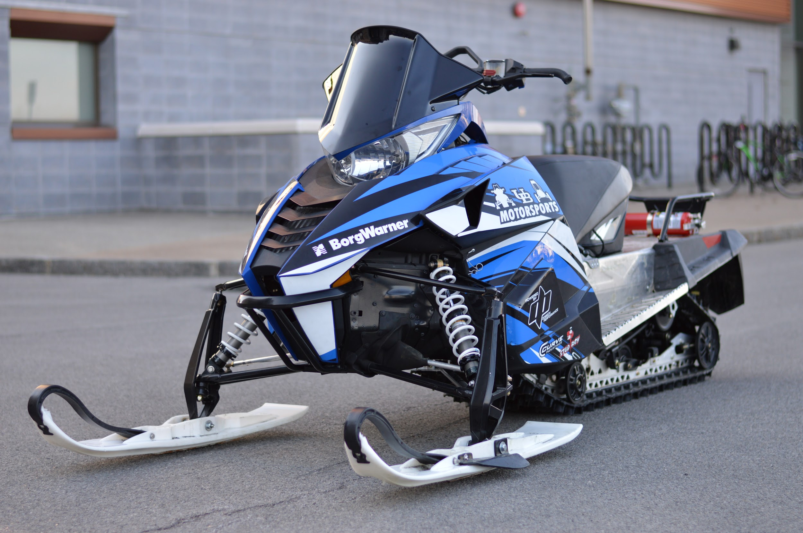
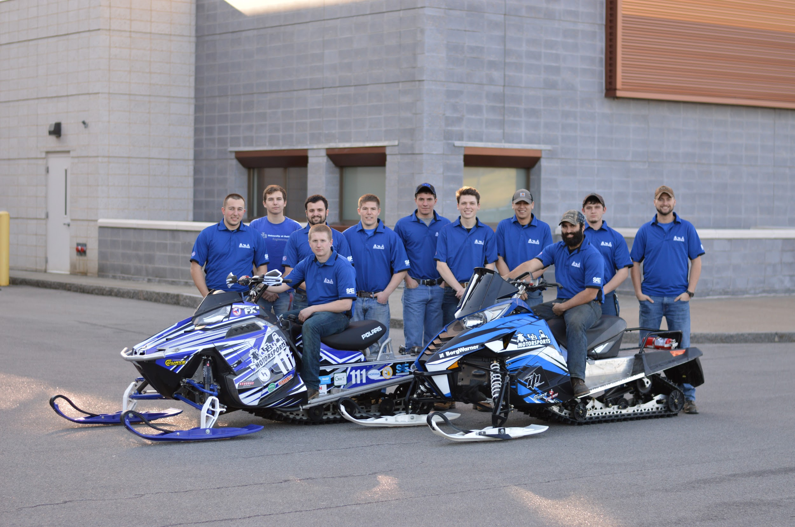
Sled Overview
Low HC, CO emissions
Quiet operation
Durable and simple design (cheap to manufacture)

Slide 13
Questions? Thank you for your time!

