Slide 1
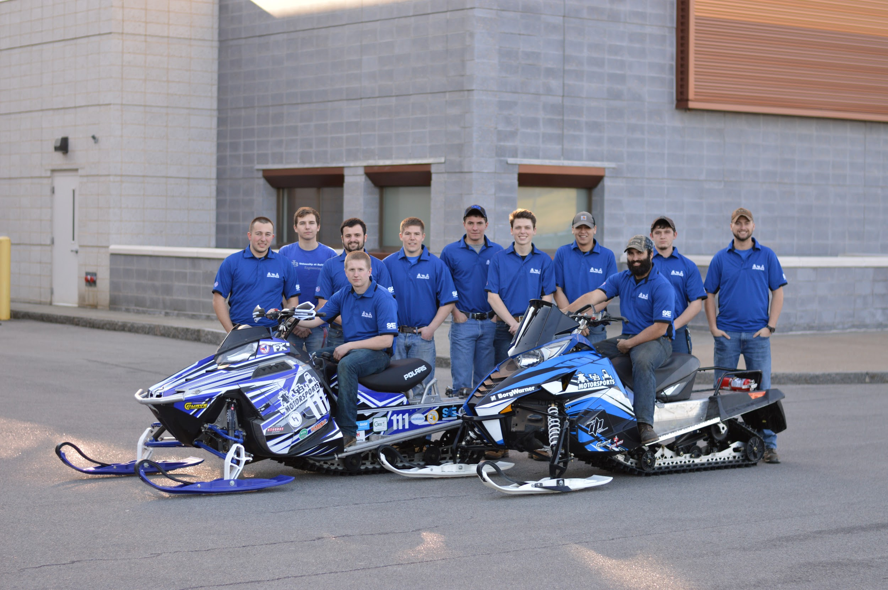
University at Buffalo SAE Clean Snowmobile Team
Presented By
Nick Marchesiello
Ethan Schonhaut
Andrew Kruger Jeff D’Angelo Casey Amidon

Slide 2
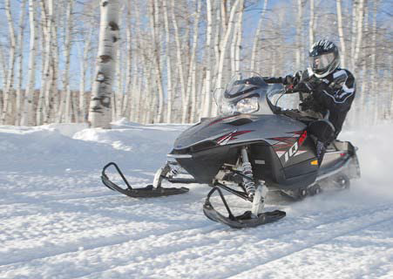
Design Considerations
Environment
Decreased Emissions
Quieter Operation
Lowered Fuel Consumption
Operator
Extended Operation Period
Increased Towing Capacity
Extended Fuel Range
Manufacturer
Low Cost/High Product Quality
System Simplicity
Increased Durability

Slide 3
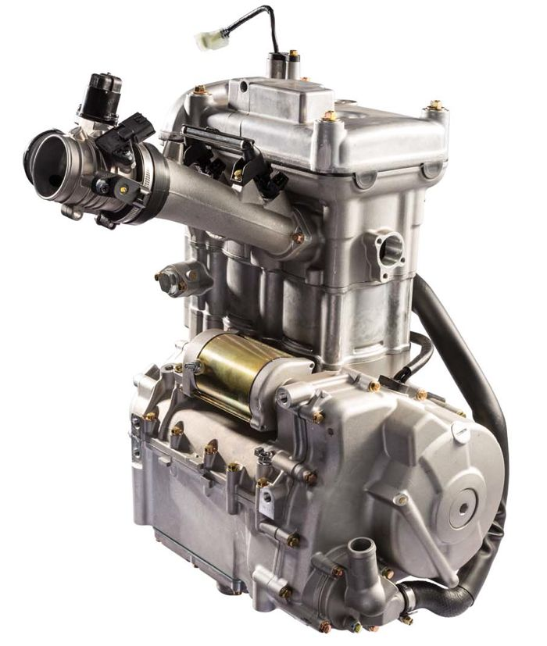
Engine/Chassis Selection
Bearcat 3000 Lt/Kymco 700cc 4-Stroke
Small Displacement/Low Emission/High power
Low BSFC
Engine Longevity and Reliability
Low WOT Exhaust Noise
Kymco 700 4-Stroke
2 cylinder
Fuel Injection System

Slide 4
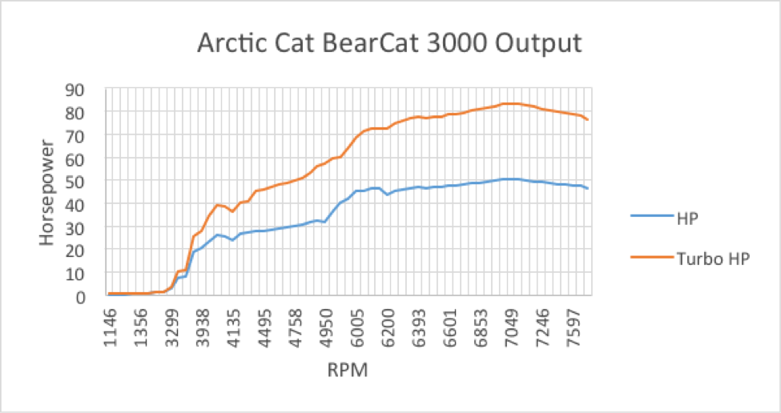
Engine Output

Slide 5
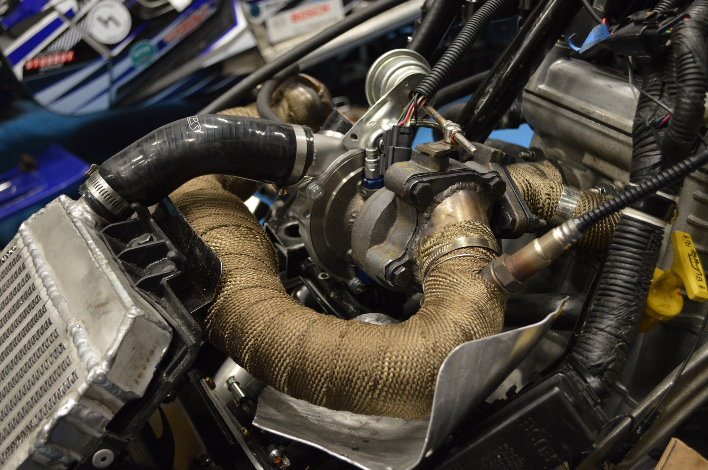
Turbo System
Design and Implementation
BorgWarner KP39
Flow Optimized Custom Manifold
Front-Mounted Intercooler
Magnaflow Catalytic Converter

Slide 6
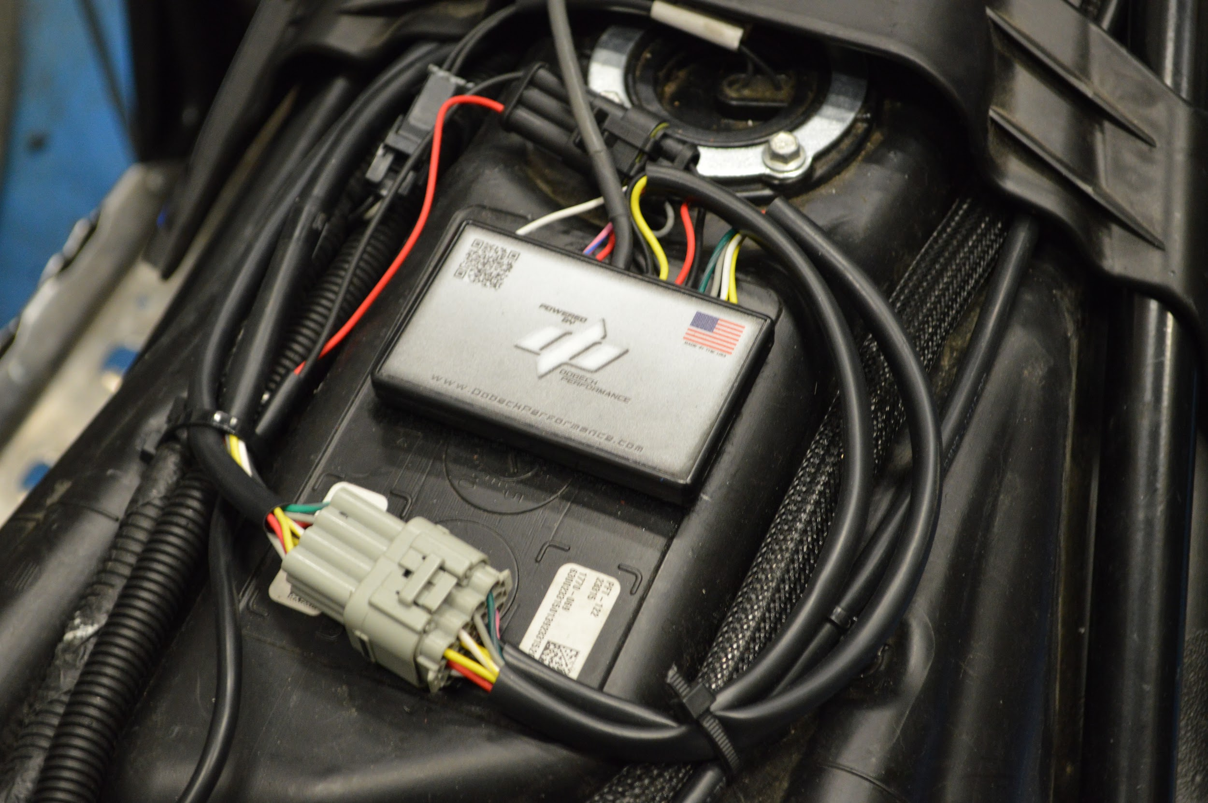
Engine Management
Dobeck AFR+
EFI Controller
Injector Piggy-back
AFR Goal Set Points
Bosch Wideband

Slide 7
Suspension System
Design and Implementation
Curve Industries XS Skis
Stud Boy 9” Shaper bars
Improved Handling Over Stock Utility Skis

Slide 8
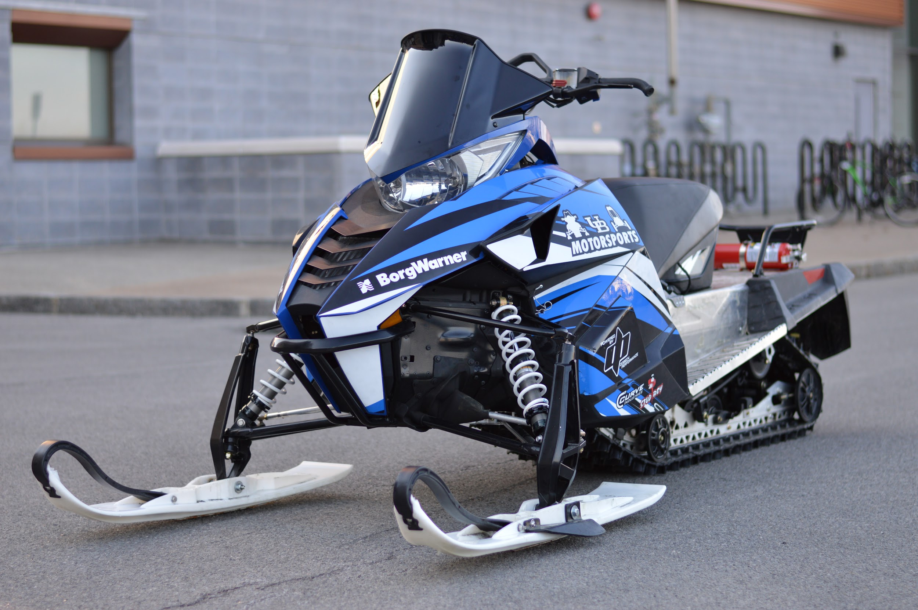
Sled Overview
Low HC, CO Emissions
Improved Fuel Economy
Improved Power Output
Quiet Operation
Durable and Simple Design

Slide 9
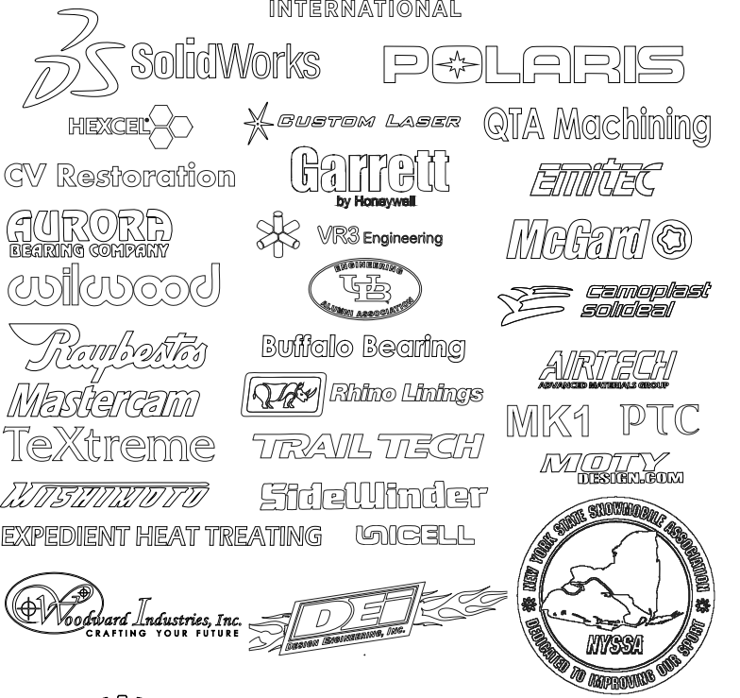
Sponsors

Slide 10
Questions? Thank you for your time!

