Slide 1
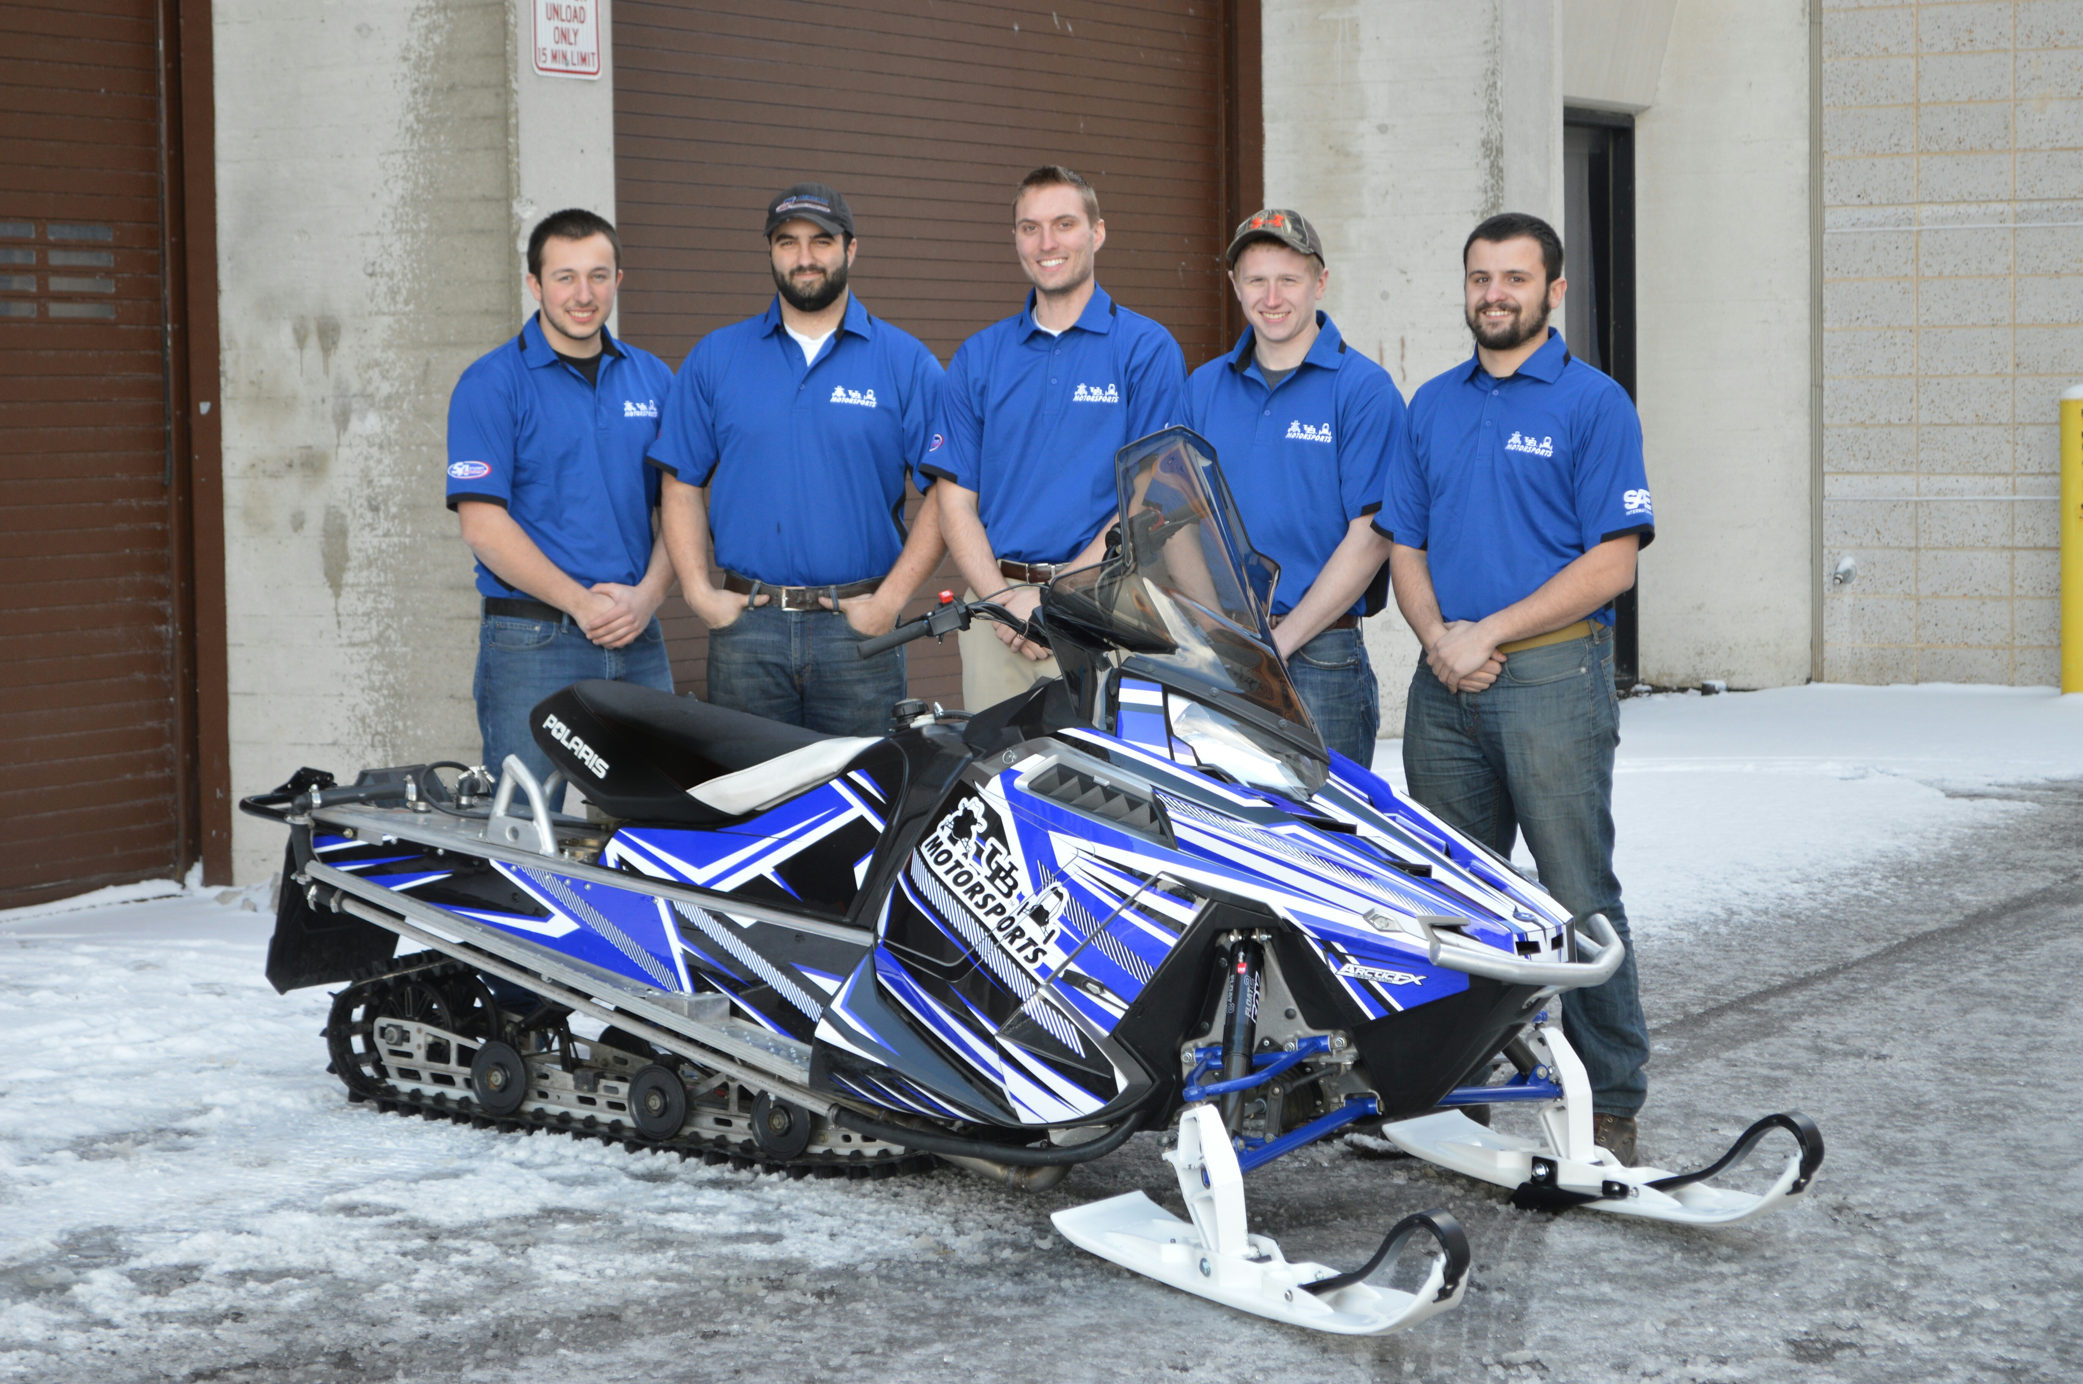
University at Buffalo SAE Clean Snowmobile Team
Presented By
Anthony Marchesiello
Nick Marchesiello
Andrew Kruger Jeff D’Angelo Casey Amidon

Slide 2
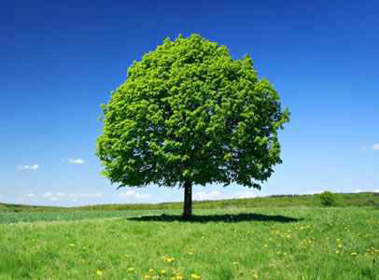
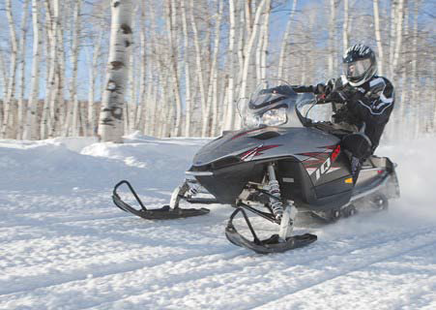
Design Considerations
Environment
Decreased Emissions
Quieter Operation
Lowered Fuel Consumption
Operator
Extended Operation Period
Increased Towing Capacity
Extended Fuel Range
Manufacturer
Low Cost/High Product Quality
System Simplicity
Increased Durability

Slide 3
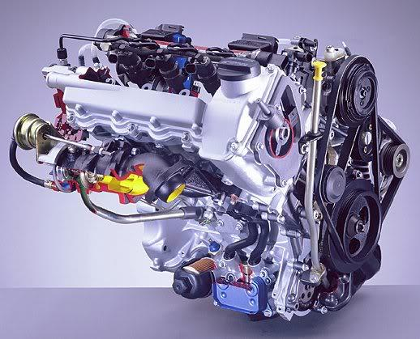
Engine Selection
Low HC, CO, and NOx emissions
High Torque Output
Low BSFC
Engine Longevity and Reliability
Low WOT Exhaust Noise
Mercedes-Benz/Smart OM 660
3 Cylinder Liquid Cooled Diesel
Direct Fuel Injection System
216 g/kW-hr BSFC

Slide 4
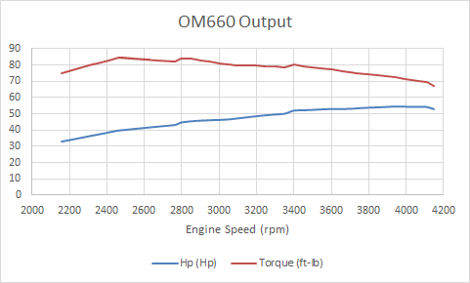
Engine Output
Horsepower | 54.5 @ 3942 rpm
Torque | 84.7 @ 2460 rpm

Slide 5
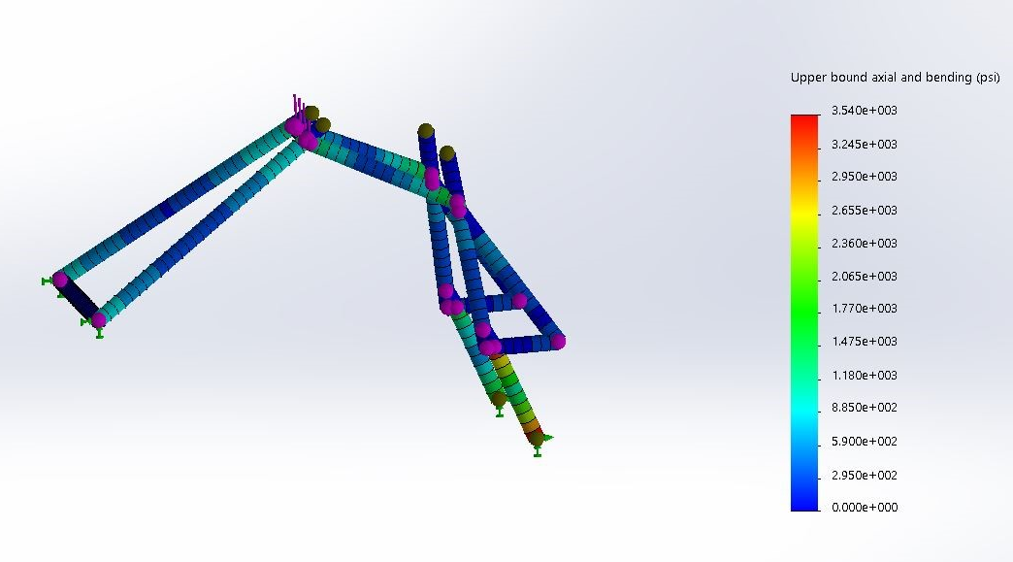
Engine Adaptation
6061 Aluminum Alloy
175 lb compressive force
FoS of 9.88

Slide 6
Emissions System
Design and Implementation
Emitec Diesel Particulate Filter (DPF) - Passive System
Emitec Diesel Oxidation Catalyst (DOC)
DOC optimized for NO₂ production, reducing HCs and CO
Both filters require higher EGTs
DPF
Exhaust Flow Direction
DOC
77% Reduction in particulate
90% reduction in HCs and CO

Slide 7
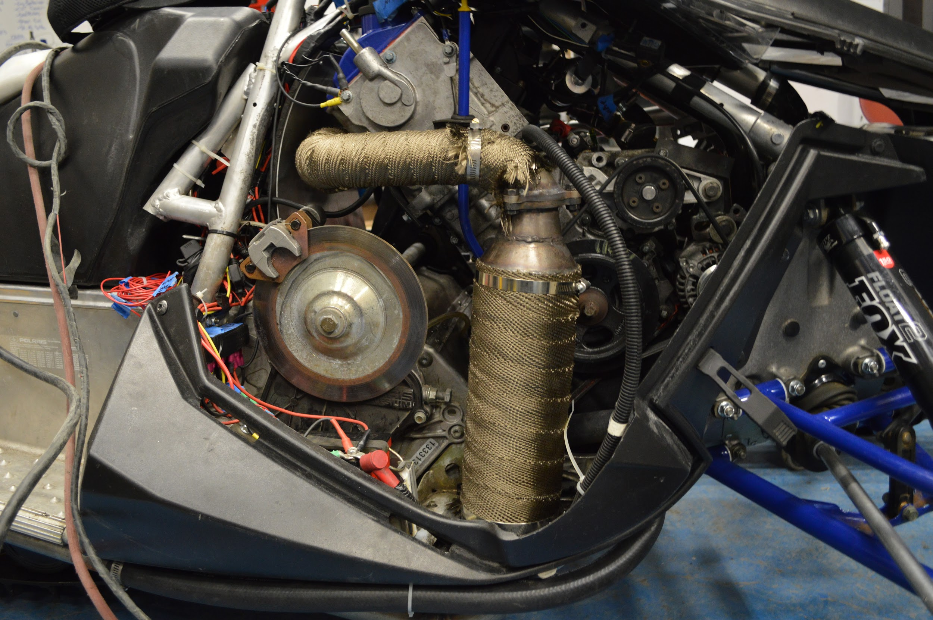

Slide 8
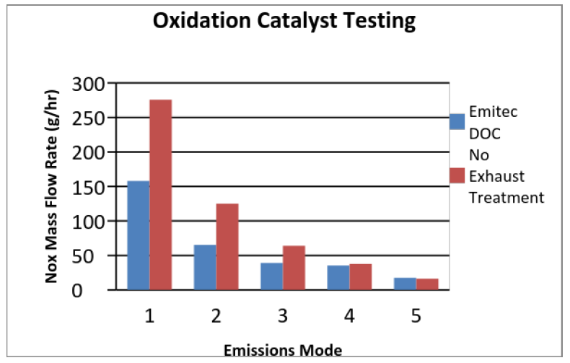
Emissions System
Testing and Validation

Slide 9
Suspension System
Design and Implementation
Fox Float II Front Shocks
Curve Industries XS Skis
Stud Boy 9” Shaper bars
Improved Towing Capacity Through Increased Traction

Slide 10
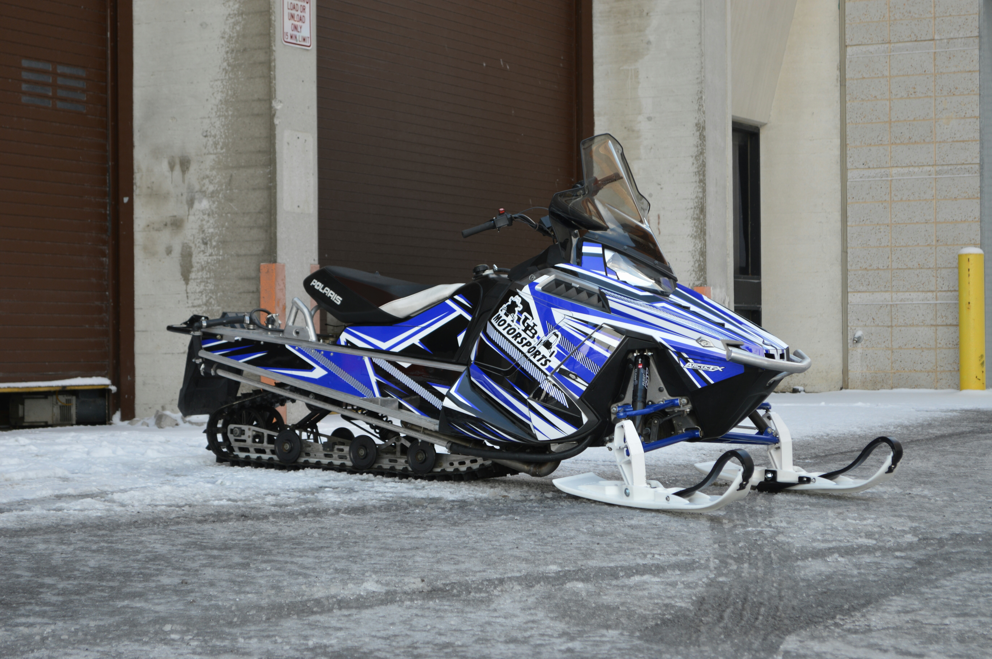
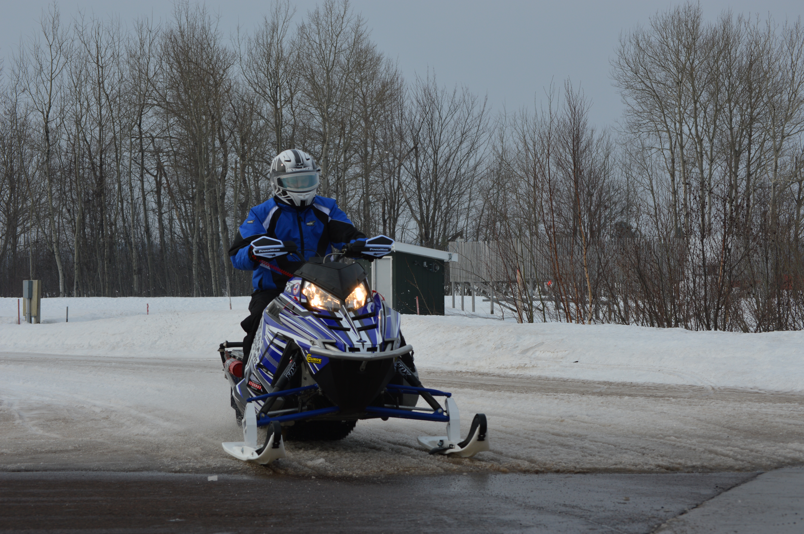
Sled Overview
Extremely low HC, CO and NOx Emissions
High Fuel Economy
Adequate Power Output for a Utility Snowmobile
Quiet Operation
Durable and Simple Design

Slide 11
Sponsors

Slide 12
Questions? Thank you for your time!

Slide 13
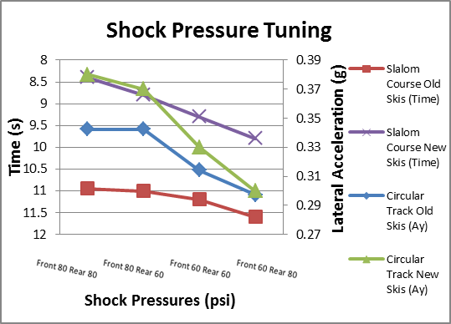
Suspension System
Design and Implementation
Testing and Validation
Team Fast M10 Rear Suspension System
Fox Float II Front Shocks
C&A Pro Skis
Improved handling by load transfer decrease
Shock Pressure tuning by slalom and circle testing

Slide 14
Suspension System
100 ft. Straight Acceleration Data
Lug Height | 1" | 1" tow | 1.5" | 1.5" tow
Trial 1 (sec) | 7.23 | 10.66 | 5.94 | 8.34
2 | 6.77 | 10.3 | 5.8 | 7.56
3 | 7.13 | 11.2 | 6.69 | 7.92
4 | 7.02 | 10.85 | 6.12 | 8.23
5 | 6.88 | 9.96 | 5.84 | 7.89
6 | 6.8 | 10.54 | 6.03 | 7.95
7 | 7.2 | 11.12 | 6.37 | 8.17
8 | 7.12 | 10.79 | 5.97 | 8.04
9 | 7.08 | 10.23 | 6.21 | 8.01
Trial 10 (sec) | 6.94 | 10.41 | 5.79 | 7.96
Avg. (sec) | 7.017 | 10.606 | 6.076 | 8.007

