Slide 1
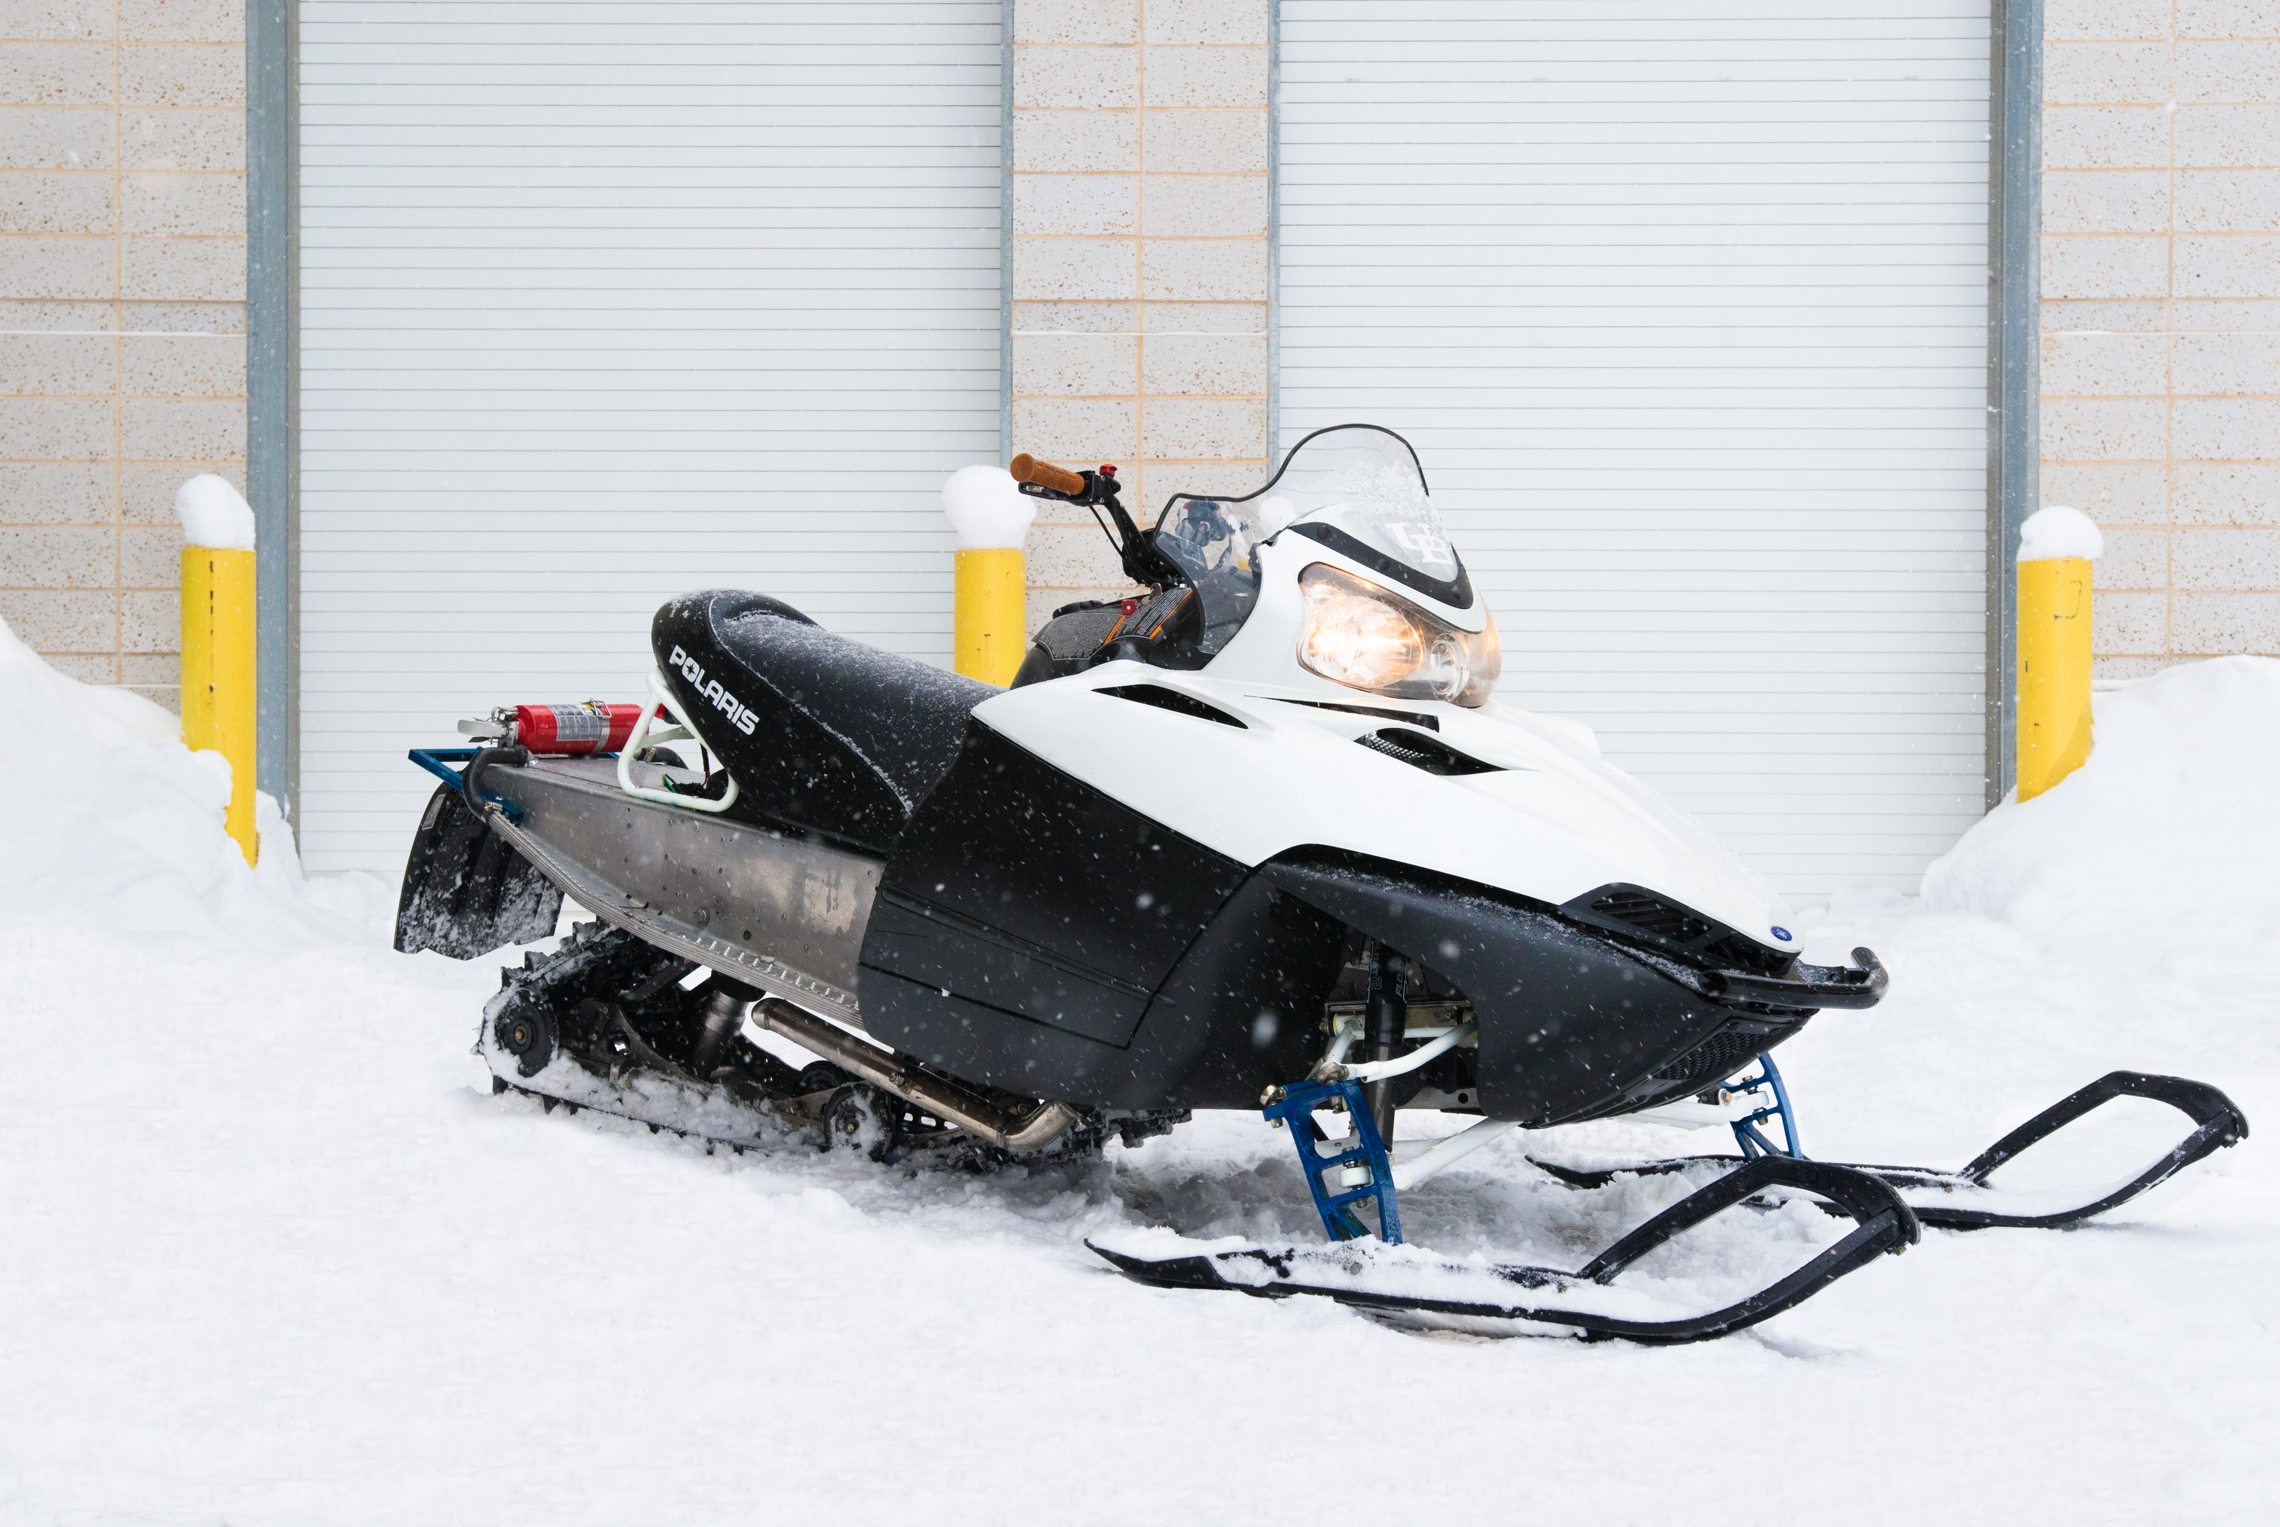
University at Buffalo SAE Clean Snowmobile Team
Presented By
Anthony Marchesiello
Nick Lanzano
Team Members
Nicholas Marchesiello Ryan Ball
Andrew Kruger Steven Widdis
Zachery Willis Alex Demay
Jeff D’Angelo

Slide 2
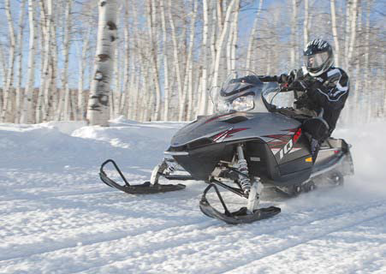
Design Considerations
Environment
Decreased Emissions
Quieter Operation
Lowered Fuel Consumption
Operator
Extended Operation Period
Increased Towing Capacity
Extended Fuel Range
Manufacturer
Low Cost/High Product Quality
System Simplicity
Increased Durability

Slide 3
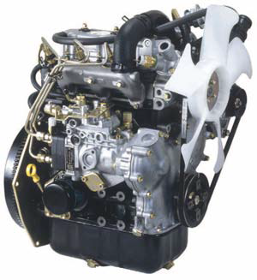
Engine Selection
Low HC, CO, and NOx emissions
High Torque Output
Low BSFC
Engine Longevity and Reliability
Low WOT Exhaust Noise
Briggs and Stratton DM-954DT
3 Cylinder Liquid Cooled Diesel
Indirect Fuel Injection System
Bosch VE Injection Pump
260 g/kW-hr BSFC

Slide 4
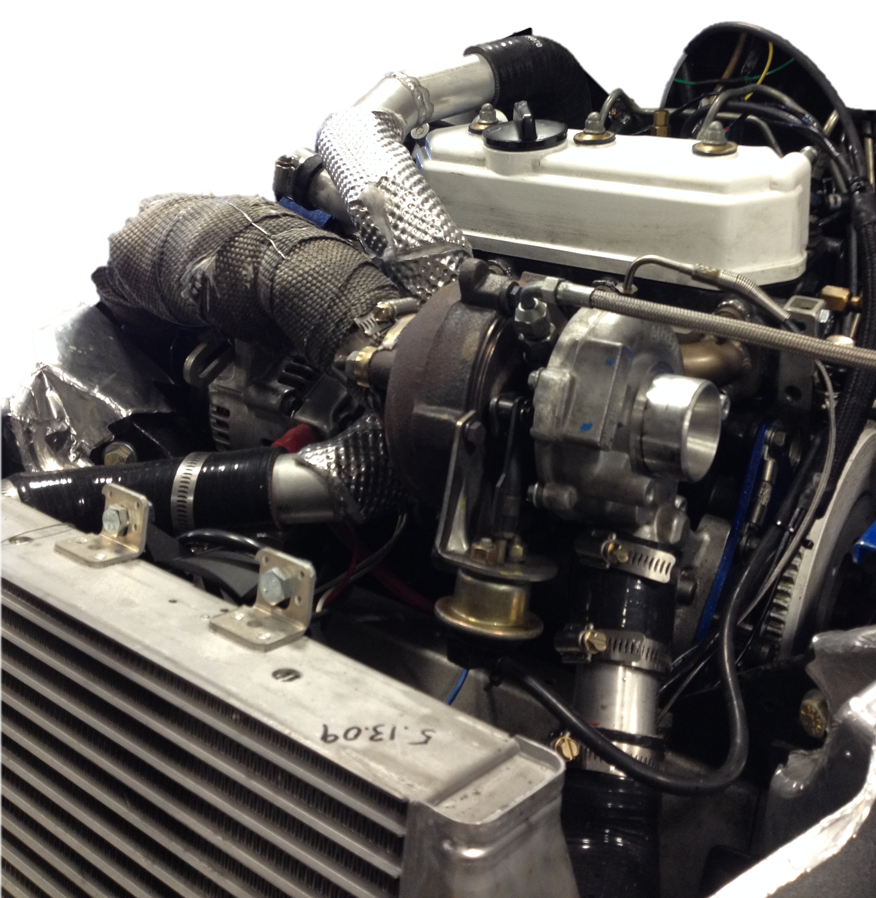
Turbocharger System
Design and Implementation
Garrett GT1541-V
Increased Compressor Efficiency and Turbine Flow Capability
Improved Exhaust Flow
Correct Turbocharger Orientation and Packaging

Slide 5
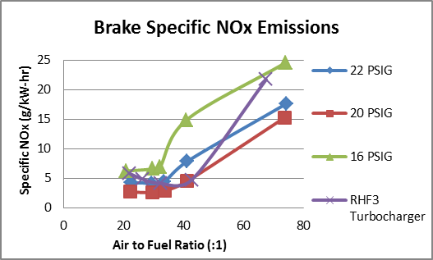
Turbocharger System
Testing and Validation

Slide 6
Belt Drive
Design and Implementation
Design Validation
Final Drive Calculations
Drive System | Chain (stock) | 2015 Belt Drive
Drive Teeth | 22 | 32
Driven Teeth | 43 | 53
Drive Ratio | 1.95 | 1.66
Top Speed | 48.7 | 60.7
Custom 6061 Aluminum Back Plate and Bracket
Increased Drivetrain Efficiency
Ease of Maintenance
Correct Final Drive Ratio

Slide 7
Cooling System
Design and Implementation
Stock Track Heat Exchangers
Removed Flow Restrictions by Streamlining Fluid Flow
Testing and Validation
Steady State Coolant Temperatures (*F)
Engine Load | CPC Quick Disconnects | No CPC Quick Disconnects | No CPC Quick Disconnects, Heat Exchangers
0% | 180 | 168 | 175
20% | 181 | 172 | 173
40% | 185 | 176 | 172
60% | 193 | 180 | 170
80% | 210 | 180 | 168
100% | 225 | 180 | 164

Slide 8
Suspension System
Design and Implementation
Testing and Validation
Team Fast M10 Rear Suspension System
Fox Float II Front Shocks
C&A Pro TRX Skis
Improved Towing Capacity Through Increased Traction
100 ft. Acceleration Test
Track Lug Height Comparison
Lug Height (Inch) | Unloaded Times (sec) | Loaded Times (sec)
1.063 | 7.017 | 10.606
1.5 | 6.076 | 8.007

Slide 9
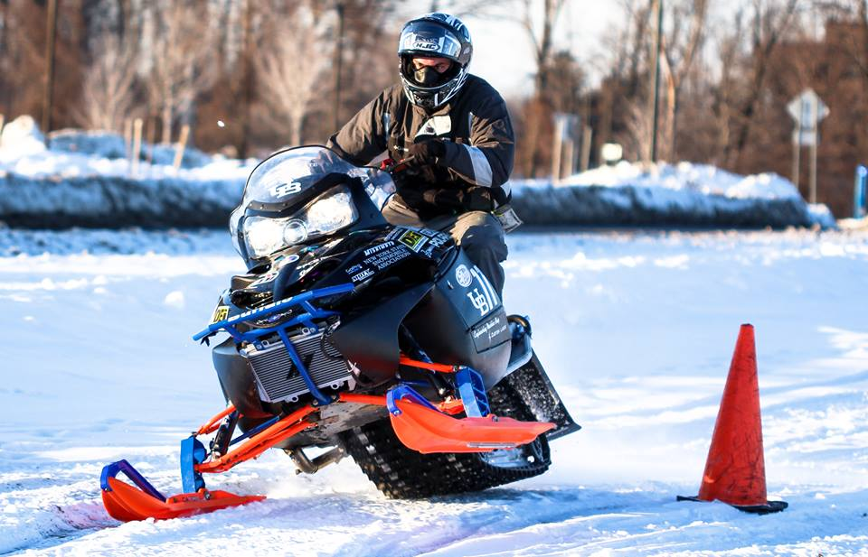
Sled Overview
Extremely low HC, CO and NOx Emissions
High Fuel Economy
Adequate Power Output for a Utility Snowmobile
Quiet Operation
Durable and Simple Design

Slide 10
Sponsors

Slide 11
Questions? Thank you for your time!

