Slide 1
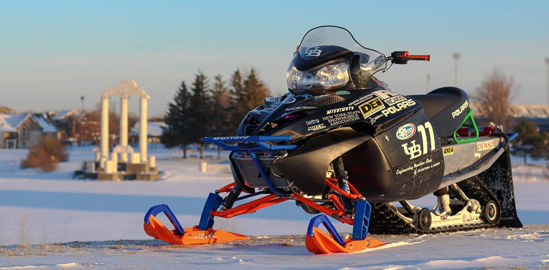
University at Buffalo SAE Clean Snowmobile Team
Presented By
Noor Jariri
Nick Lanzano
Team Members
Matt Egan Pete Casey
Nate Sutorious Anthony Marcheillo
Pat O’Byrne Dave Stedman

Slide 2
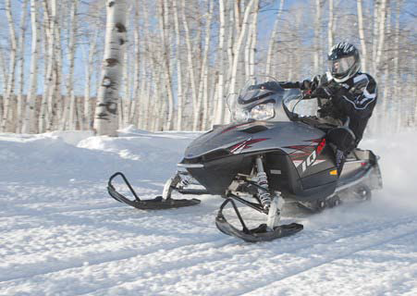
Design Considerations
Environment
Decreased Emissions
Quieter Operation
Lowered Fuel Consumption
Operator
Adequate Performance
Improved Handling
Enhanced Fuel Economy
Manufacturer
Low Cost/High Product Quality
System Simplicity
Durability

Slide 3
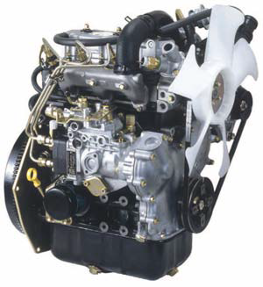
Engine Selection
Low HC, CO, and NOx emissions
High torque output
Low BSFC
Engine longevity and reliability
Low WOT exhaust noise
Briggs and Stratton DM-954DT
3 Cylinder Liquid Cooled Diesel
Indirect Fuel Injection System
Bosch VE Injection Pump
260 g/kW-hr BSFC

Slide 4
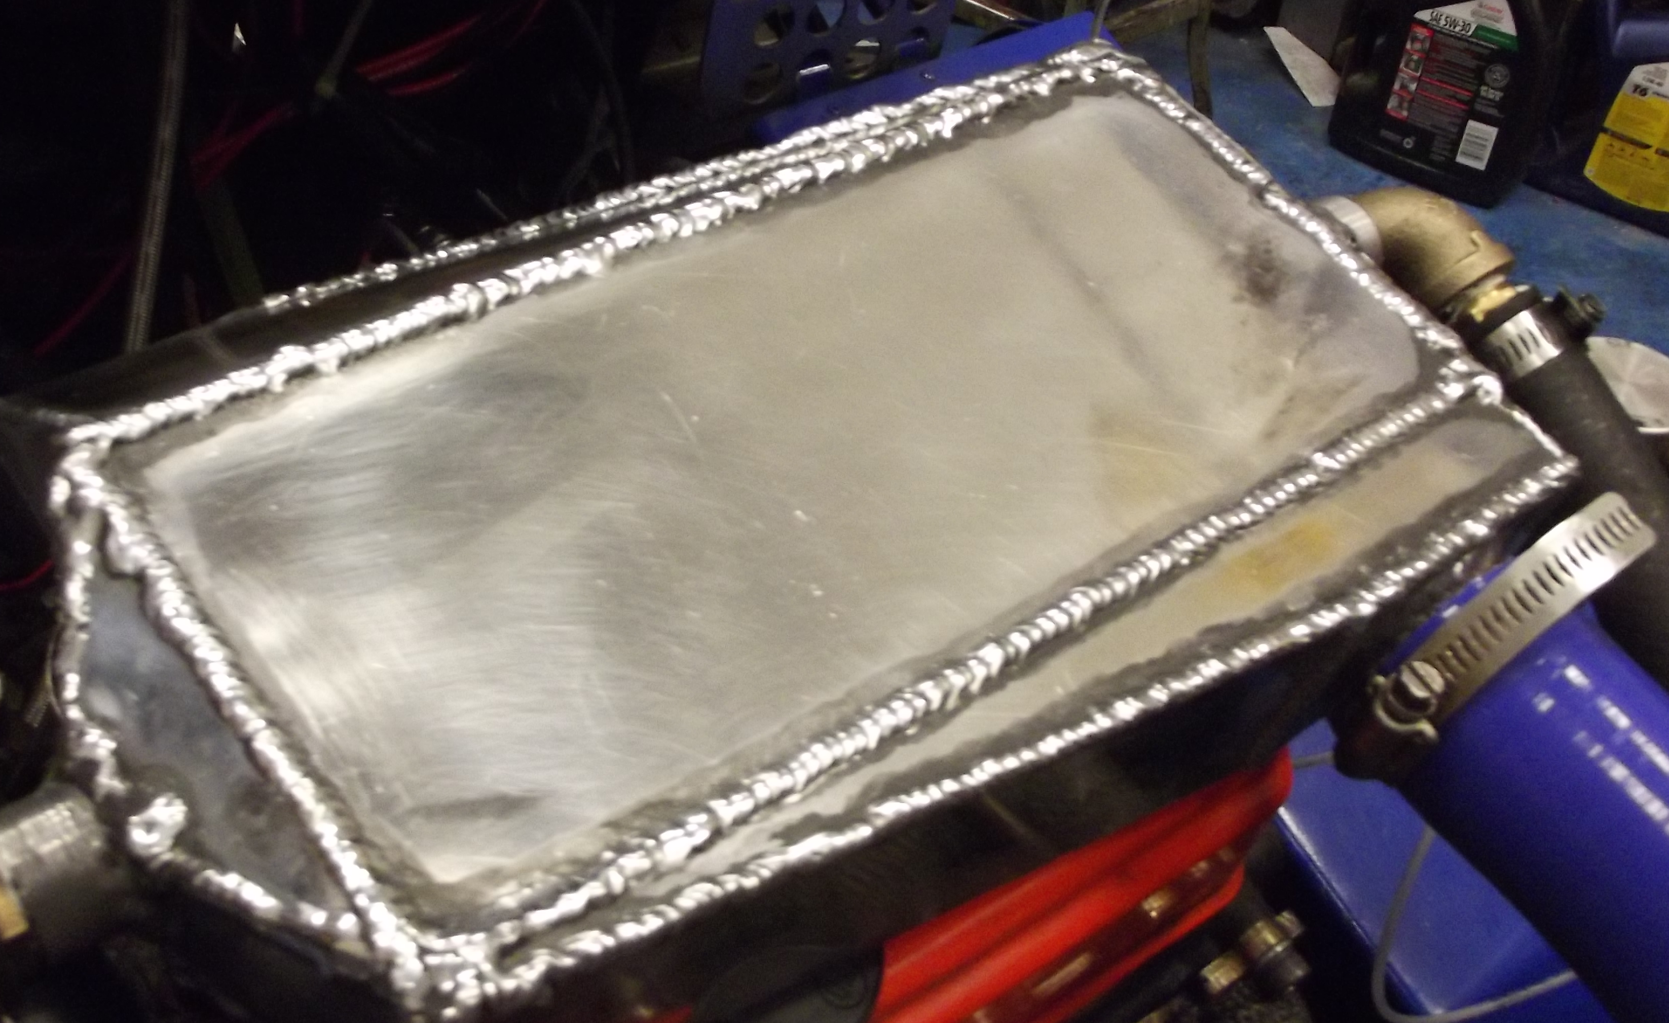
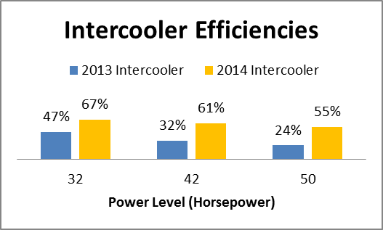
Intercooler System
Design and Implementation
Decrease IAT’s for lowered NOx emissions
Efficient Bell Intercoolers core
Low intake tract volume
Effective packaging
Testing and Validation

Slide 5
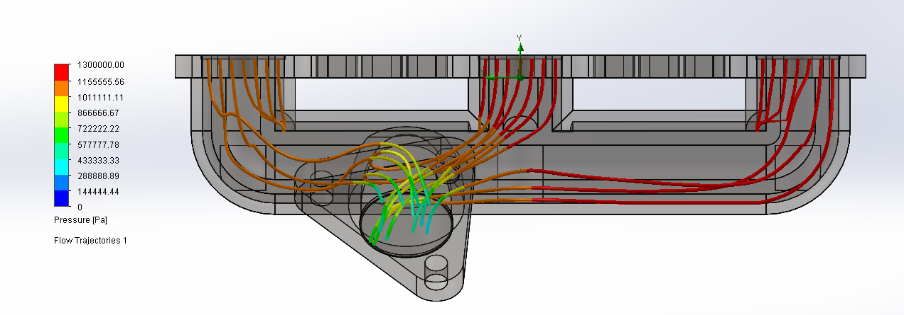
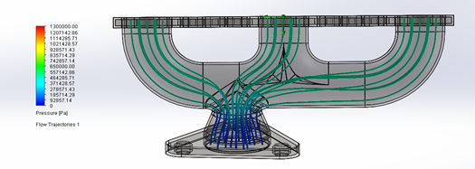
Turbocharger System
Design and Implementation
Garrett GT1541-V
Increase compressor efficiency and turbine flow capability
Improve exhaust flow
Correct turbocharger orientation and packaging
Factory Exhaust Manifold
Designed Exhaust Manifold

Slide 6
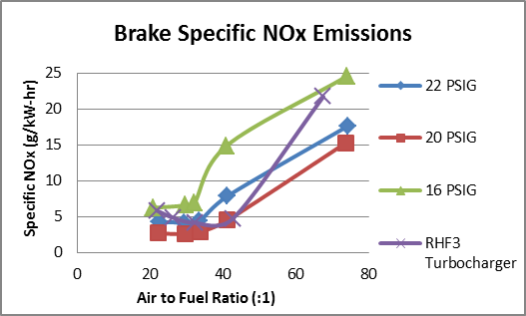
Turbocharger System
Testing and Validation

Slide 7
Cooling System
Design and Implementation
Testing and Validation
CPC ¾” Quick Disconnects impeded coolant flow
Mishimoto Aluminum Radiator
Quick Disconnects placed in parallel for easy system bleeding
Steady State Coolant Temperatures (*F)
Engine Load | With CPC Quick Disconnects | Without CPC Quick Disconnects
0% | 180 | 168
20% | 181 | 172
40% | 185 | 176
60% | 193 | 180
80% | 210 | 180
100% | 225 | 180

Slide 8
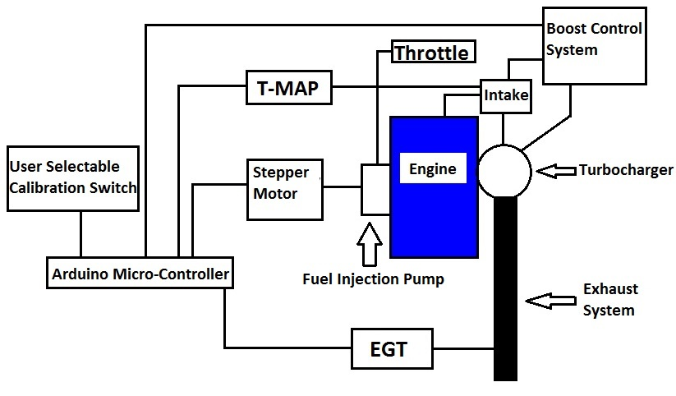
Eco-System
Design and Implementation
User selectable performance or economy mode
Arduino Microcontroller varies boost and fuel based upon mode, EGT and MAP

Slide 9
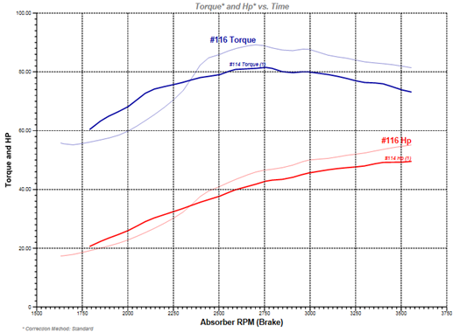
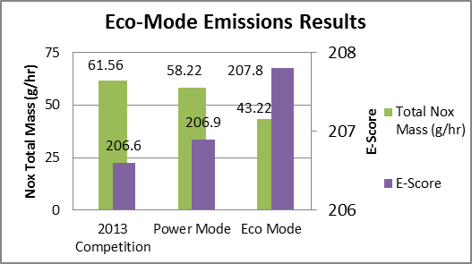
Eco-System
Testing and Validation
5-Mode Testing of Eco-System
Factory 32 hp increased to 48 hp in Eco-mode and 55 hp in Power-mode
Eco Mode attained E-score of 208

Slide 10
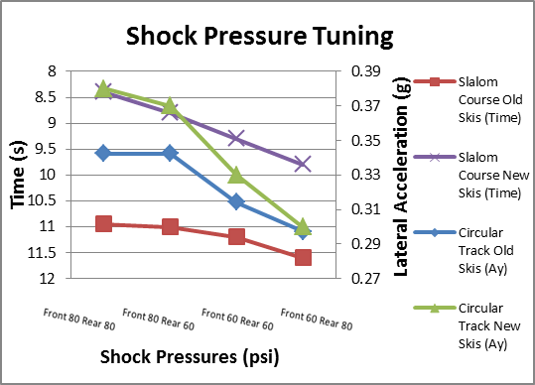
Suspension System
Design and Implementation
Testing and Validation
Team Fast M10 Rear Suspension System
Fox Float II Front Shocks
C&A Pro Skis
Improved handling by lateral load transfer decrease
Shock Pressure tuning by slalom and circle testing

Slide 11
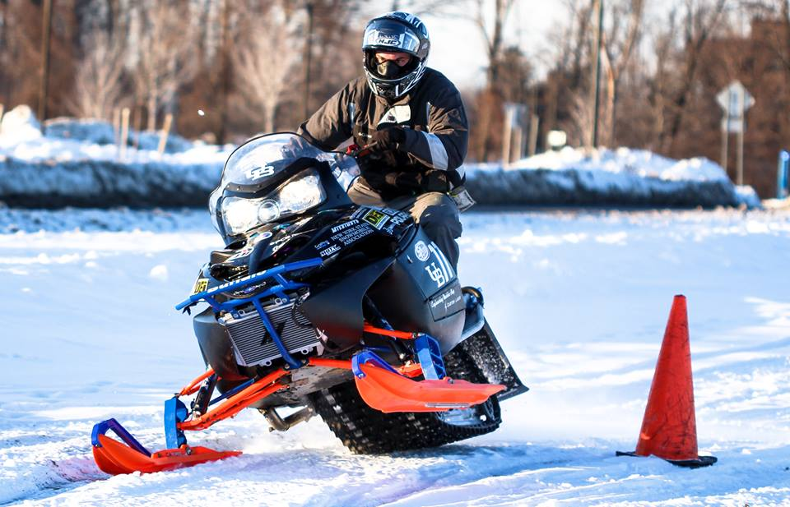
Sled Overview
Extremely low HC, CO and NOx emissions
High fuel economy
Adequate power output for a snowmobile
Quiet operation
Durable and simple design

Slide 12
Sponsors

Slide 13
Questions? Thank you for your time!

