Slide 1
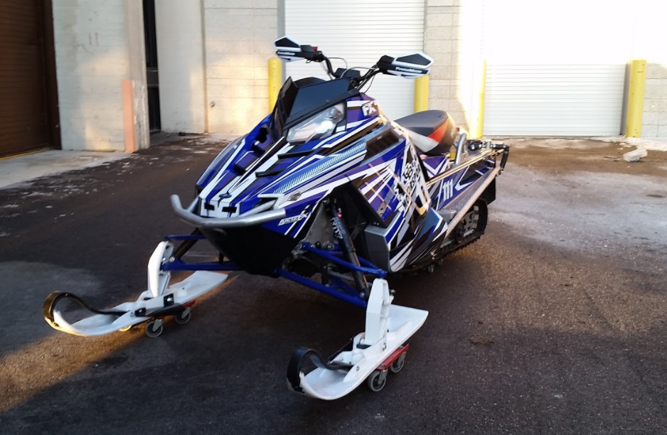
University at Buffalo
SAE Clean Snowmobile Team
Presented By
Austin Keppler
Ethan Schonhaut

Slide 2

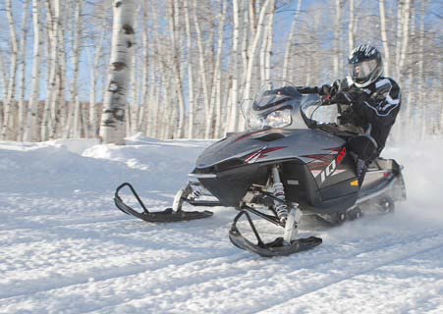

Design Considerations
Environment
Decreased Emissions
Quieter Operation
Lowered Fuel Consumption
Operator
Extended Operation Period
Increased Towing Capacity
Extended Fuel Range
Manufacturer
Low Cost/High Product Quality
System Simplicity
Increased Durability

Slide 3
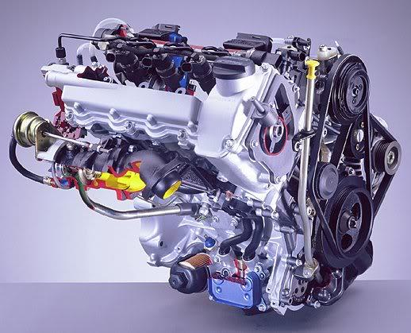
Engine Selection
Low HC, CO, and NOx emissions
High Torque Output
Low BSFC
Engine Longevity and Reliability
Low WOT Exhaust Noise
Mercedes-Benz/Smart OM 660
3 Cylinder Liquid Cooled Diesel
Direct Fuel Injection System
216 g/kW-hr BSFC

Slide 4
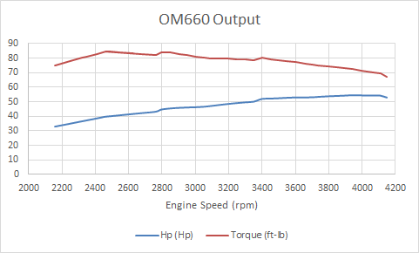
Engine Output
Horsepower | 54.5 @ 3942 rpm
Torque | 84.7 @ 2460 rpm

Slide 5
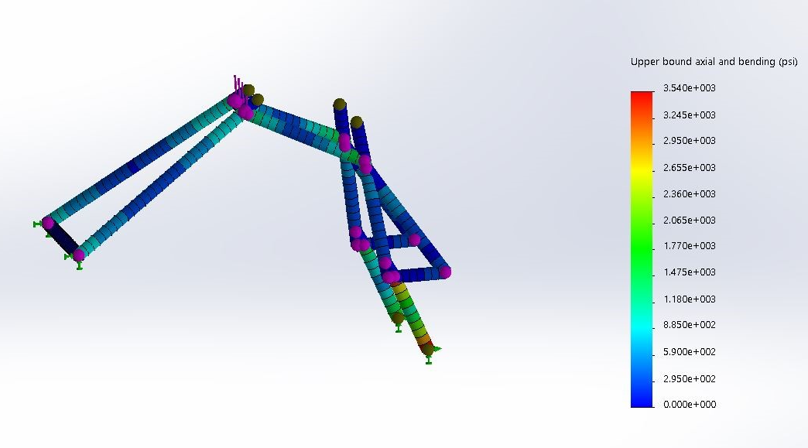
Engine Adaptation
6061 Aluminum Alloy
175 lb compressive force
FoS of 9.88

Slide 6
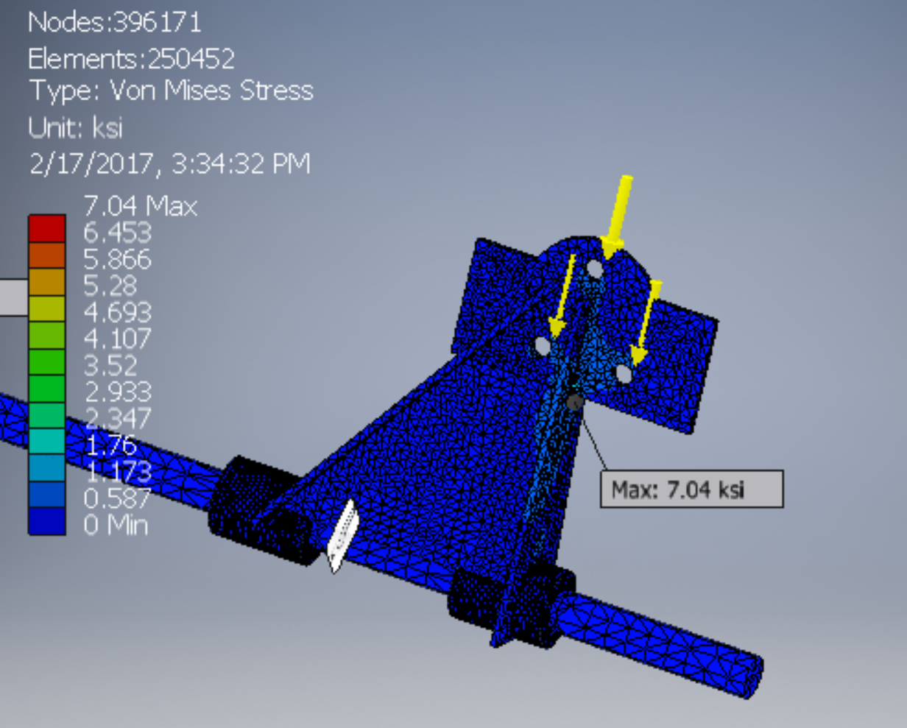
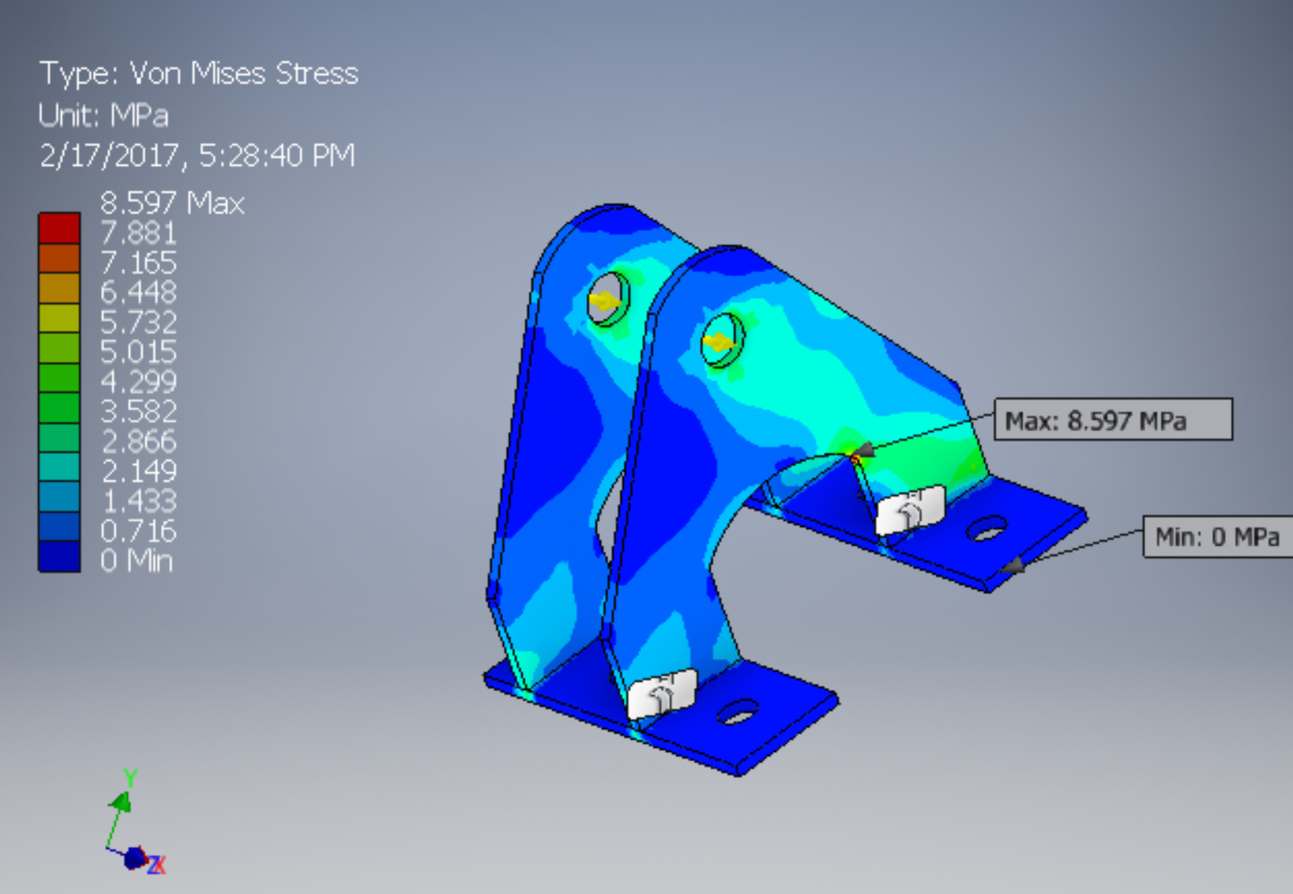
Engine Adaptation
Custom engine mounts
Front Engine Mount
FOS 4.97
Rear Engine Mount
FOS 28

Slide 7
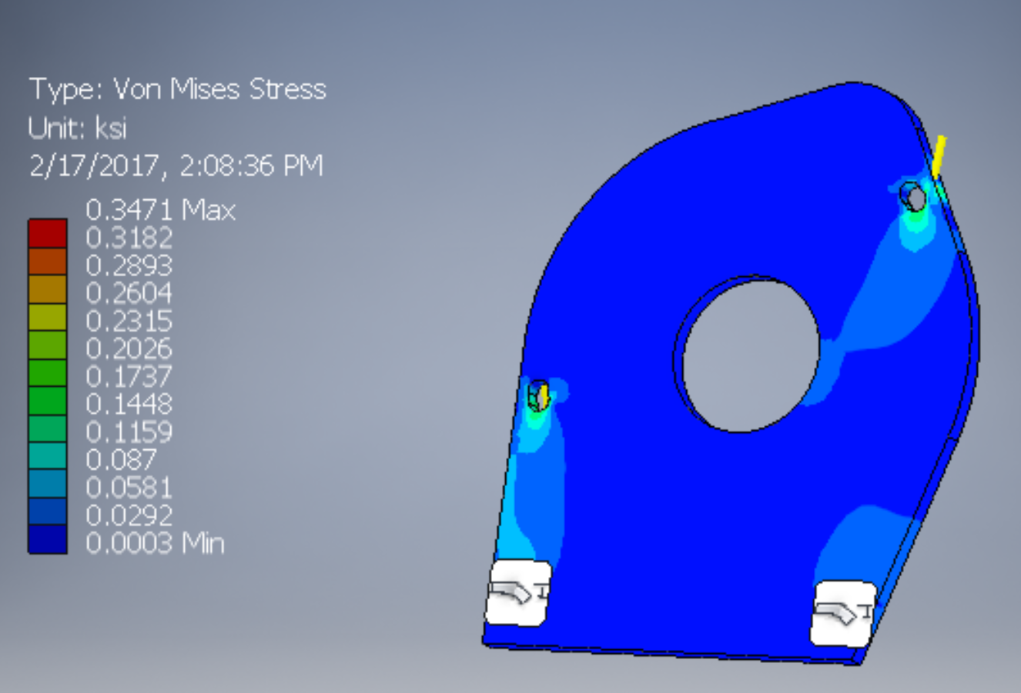
Engine Adaptation
Custom engine mounts
Side Plate Engine Mount
FOS >100

Slide 8
Emissions System
Design and Implementation
Emitec Diesel Particulate Filter (DPF) - Passive System
Emitec Diesel Oxidation Catalyst (DOC)
DOC optimized for NO₂ production, reducing HCs and CO
Both filters require higher EGTs
DOC
Exhaust Flow Direction
DPF
77% Reduction in particulate
90% reduction in HCs and CO

Slide 9
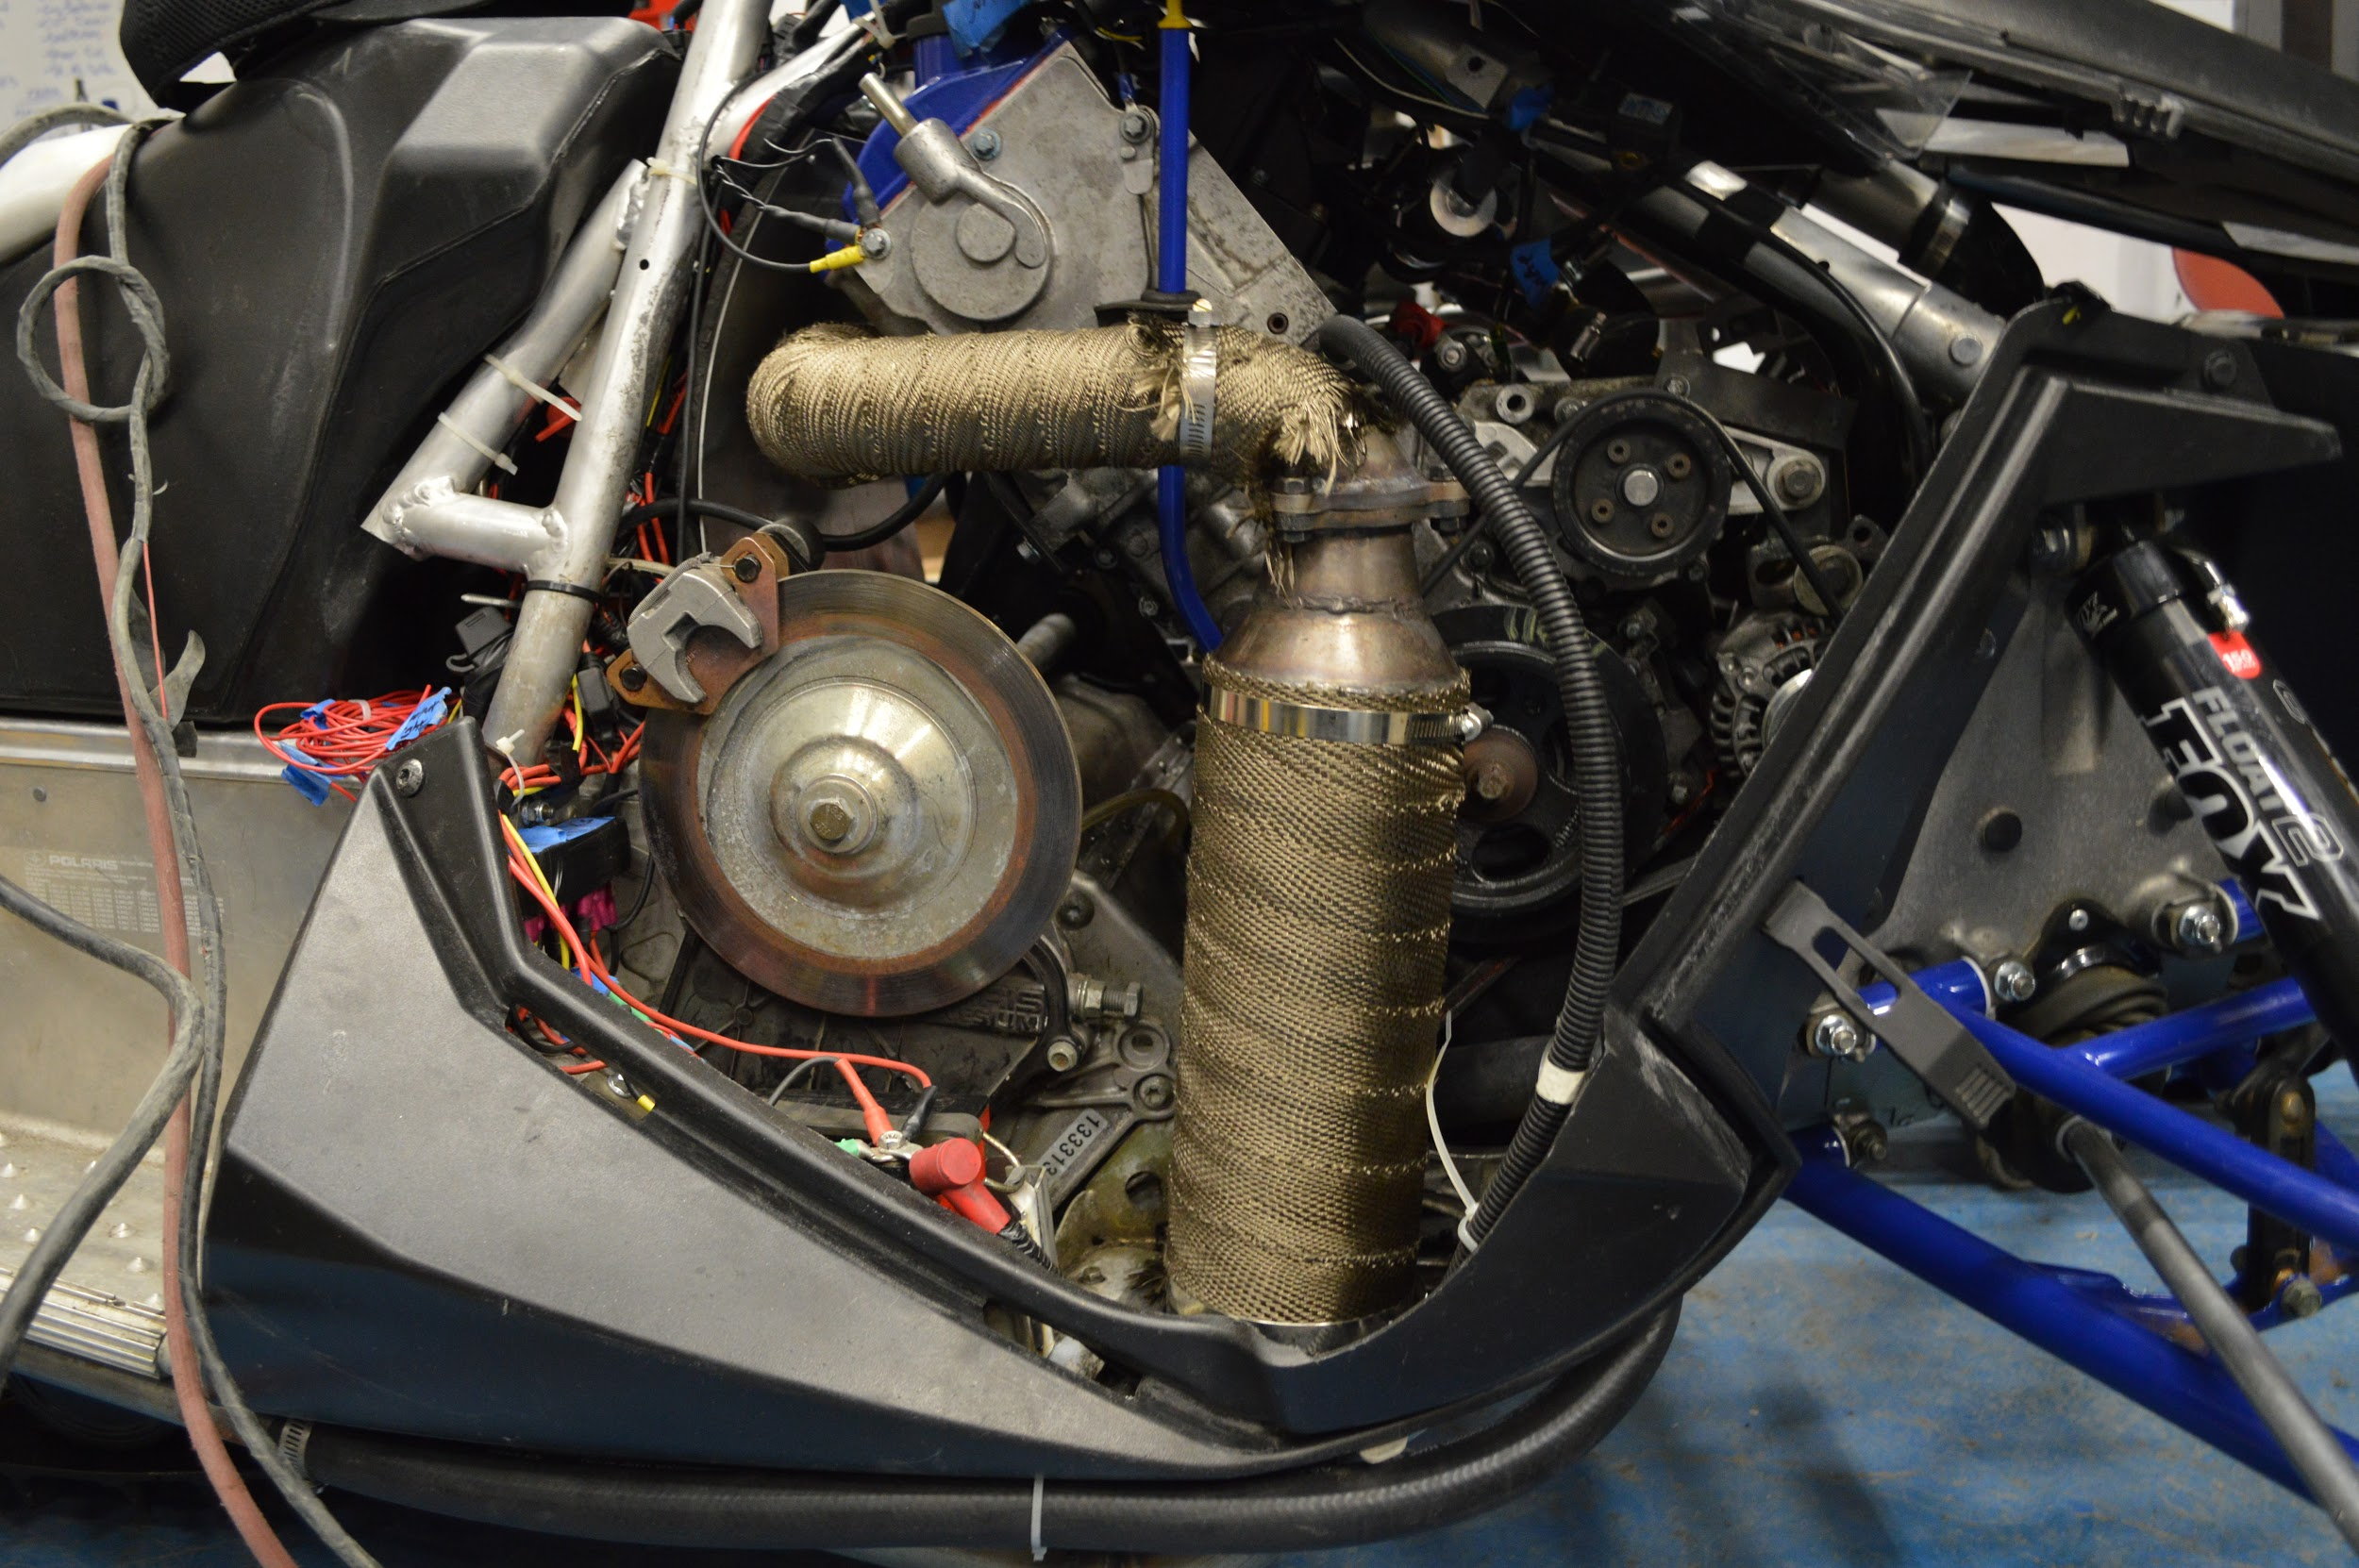

Slide 10
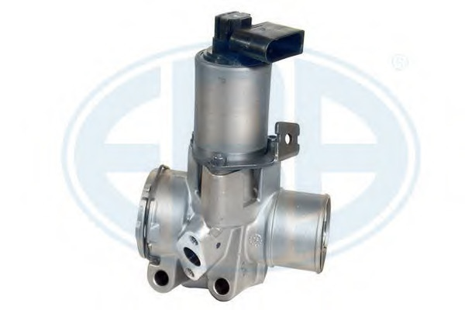
Emissions System
Exhaust Gas Recirculation (EGR)
Liquid cooled
Up to 49% return
Active from 1000 - 3250 rpm and 0 - 25% throttle
Map optimized for a balance of performance and emissions

Slide 11
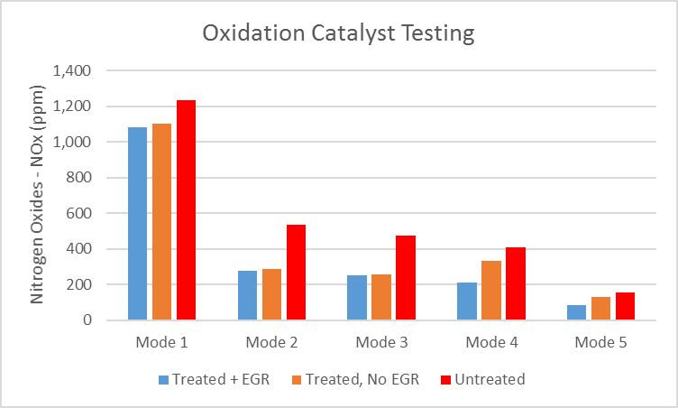
Emissions System
Testing and Validation
NOx outputs significantly reduced with implementation of DOC,DPF and EGR systems in place

Slide 12
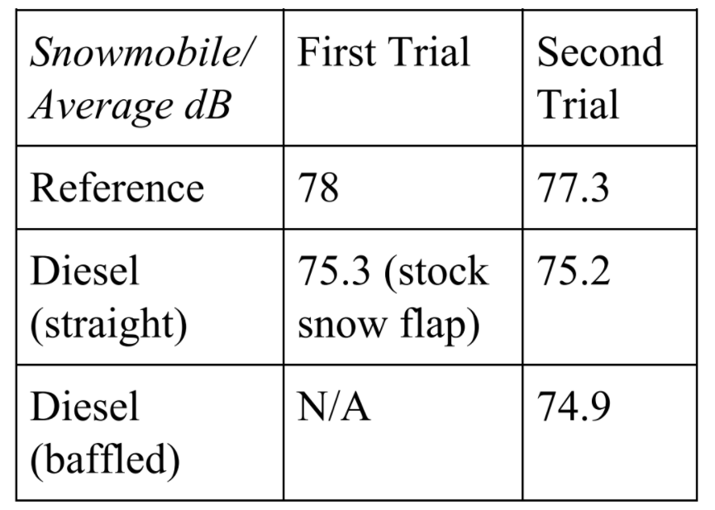
Noise Testing
Testing
Results
Two tests were conducted in late August and early February.
A reference sled was used for comparison

Slide 13
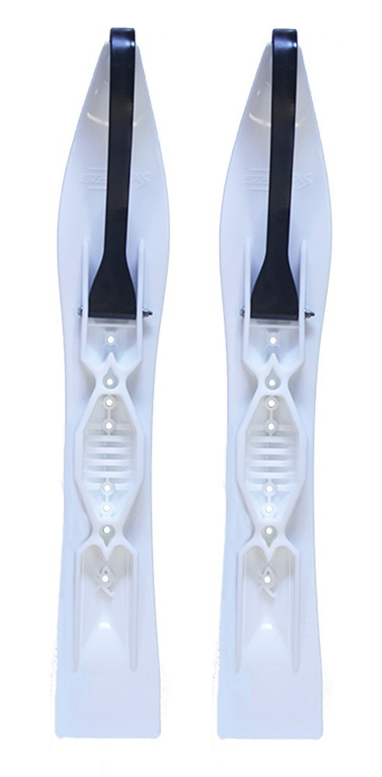
Suspension System
Design and Implementation
Fox Float II Front Shocks
Curve Industries XS Skis
Stud Boy 9” Shaper bars
Improved Towing Capacity Through Increased Traction

Slide 14
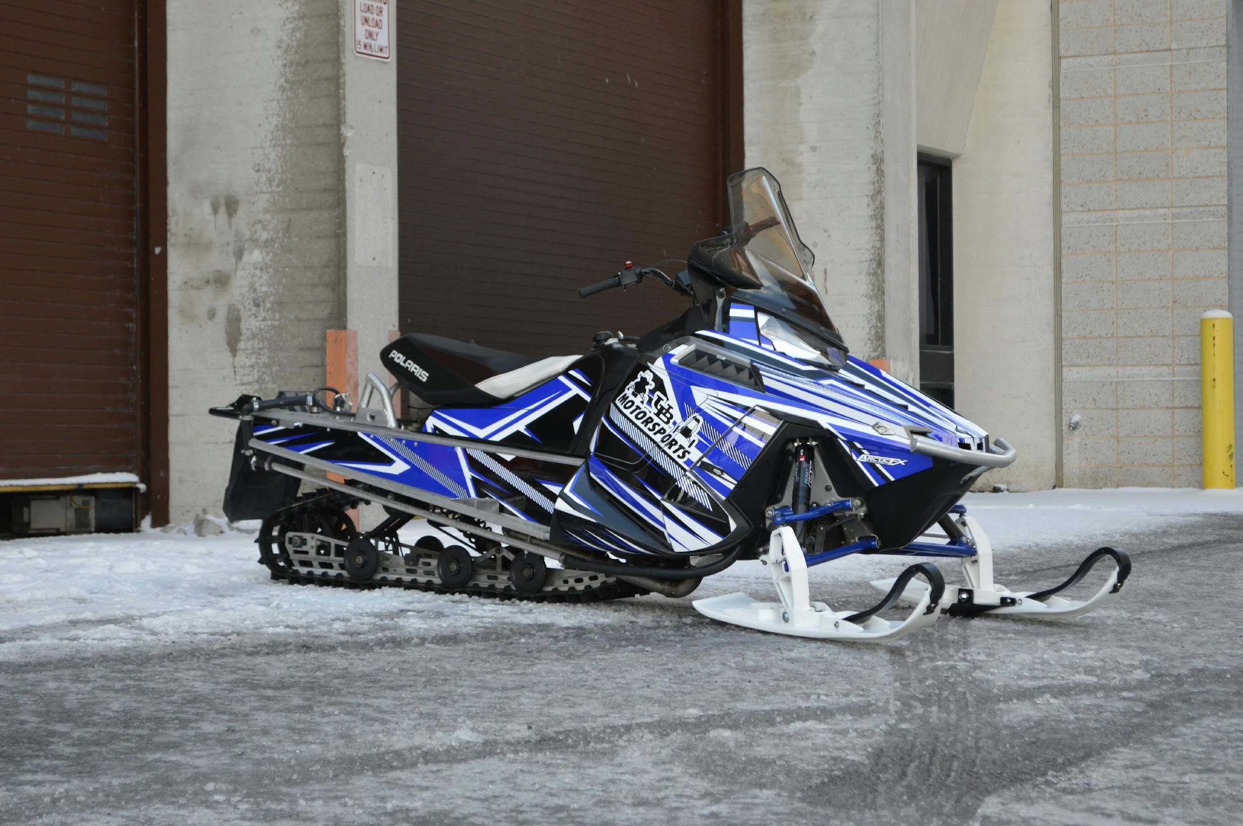
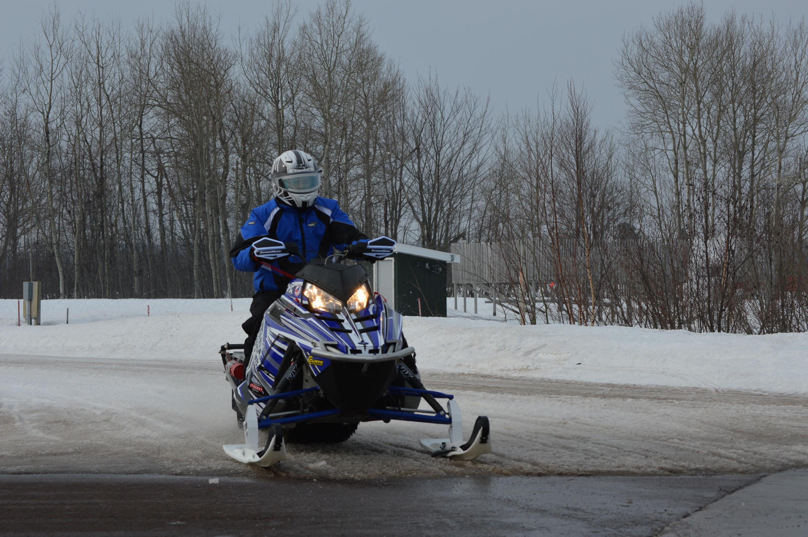
Sled Overview
Extremely low HC, CO and NOx Emissions
High Fuel Economy
Adequate Power Output for a Utility Snowmobile
Quiet Operation
Durable and Simple Design

Slide 15







Sponsors

Slide 16
Questions?
Thank you for your time!

Slide 17
Suspension System
100 ft. Straight Acceleration Data
Lug Height | 1" | 1" tow | 1.5" | 1.5" tow
Trial 1 (sec) | 7.23 | 10.66 | 5.94 | 8.34
2 | 6.77 | 10.3 | 5.8 | 7.56
3 | 7.13 | 11.2 | 6.69 | 7.92
4 | 7.02 | 10.85 | 6.12 | 8.23
5 | 6.88 | 9.96 | 5.84 | 7.89
6 | 6.8 | 10.54 | 6.03 | 7.95
7 | 7.2 | 11.12 | 6.37 | 8.17
8 | 7.12 | 10.79 | 5.97 | 8.04
9 | 7.08 | 10.23 | 6.21 | 8.01
Trial 10 (sec) | 6.94 | 10.41 | 5.79 | 7.96
Avg. (sec) | 7.017 | 10.606 | 6.076 | 8.007

