Slide 1
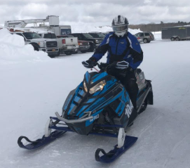
University at Buffalo SAE Clean Snowmobile Team
Presented By
Noah White

Slide 2
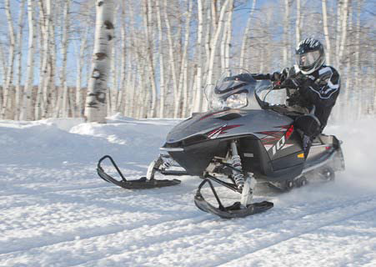
Design Considerations
Environment
Decreased Emissions
Quieter Operation
Lowered Fuel Consumption
Operator
Extended Operation Period
Increased Towing Capacity
Extended Fuel Range
Manufacturer
Low Cost/High Product Quality
System Simplicity
Increased Durability

Slide 3
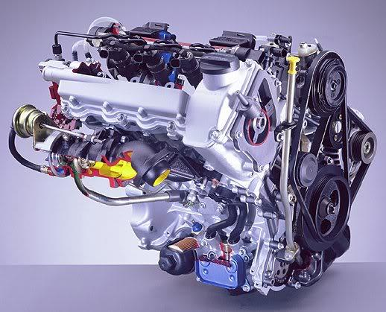
Engine Selection
Low HC, CO, NOx and soot emissions
High Torque Output
Low BSFC
Low WOT Exhaust Noise
Engine Longevity and Reliability
Mercedes-Benz/Smart OM 660
3 Cylinder, 0.8 Liter, Liquid Cooled Turbo Diesel
Direct Fuel Injection System
BorgWarner KP31 Turbocharger
216 g/kW-hr BSFC

Slide 4
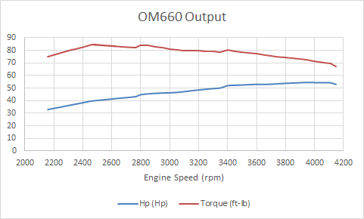
Stock Engine Output
Stock Horsepower | 54.5 @ 3942 rpm
Torque | 84.7 @ 2460 rpm
2019 Horsepower | 41 @ 3800 rpm
Torque | 58.25 @ 3800 rpm

Slide 5
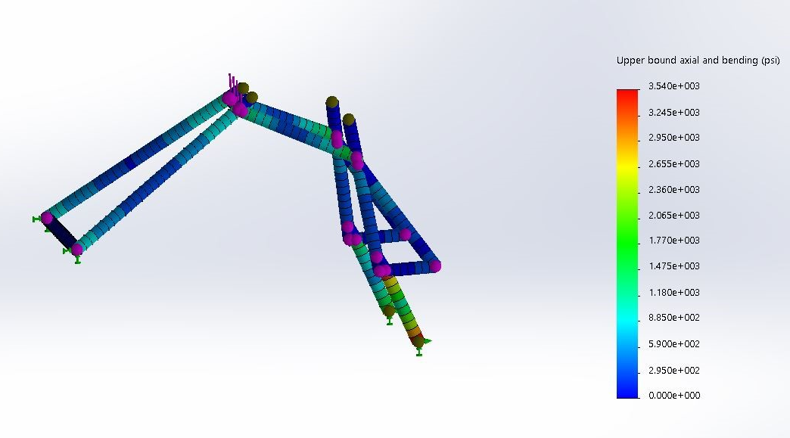
Engine Adaptation
6061 Aluminum Alloy
175 lb compressive force
FoS of 9.88

Slide 6
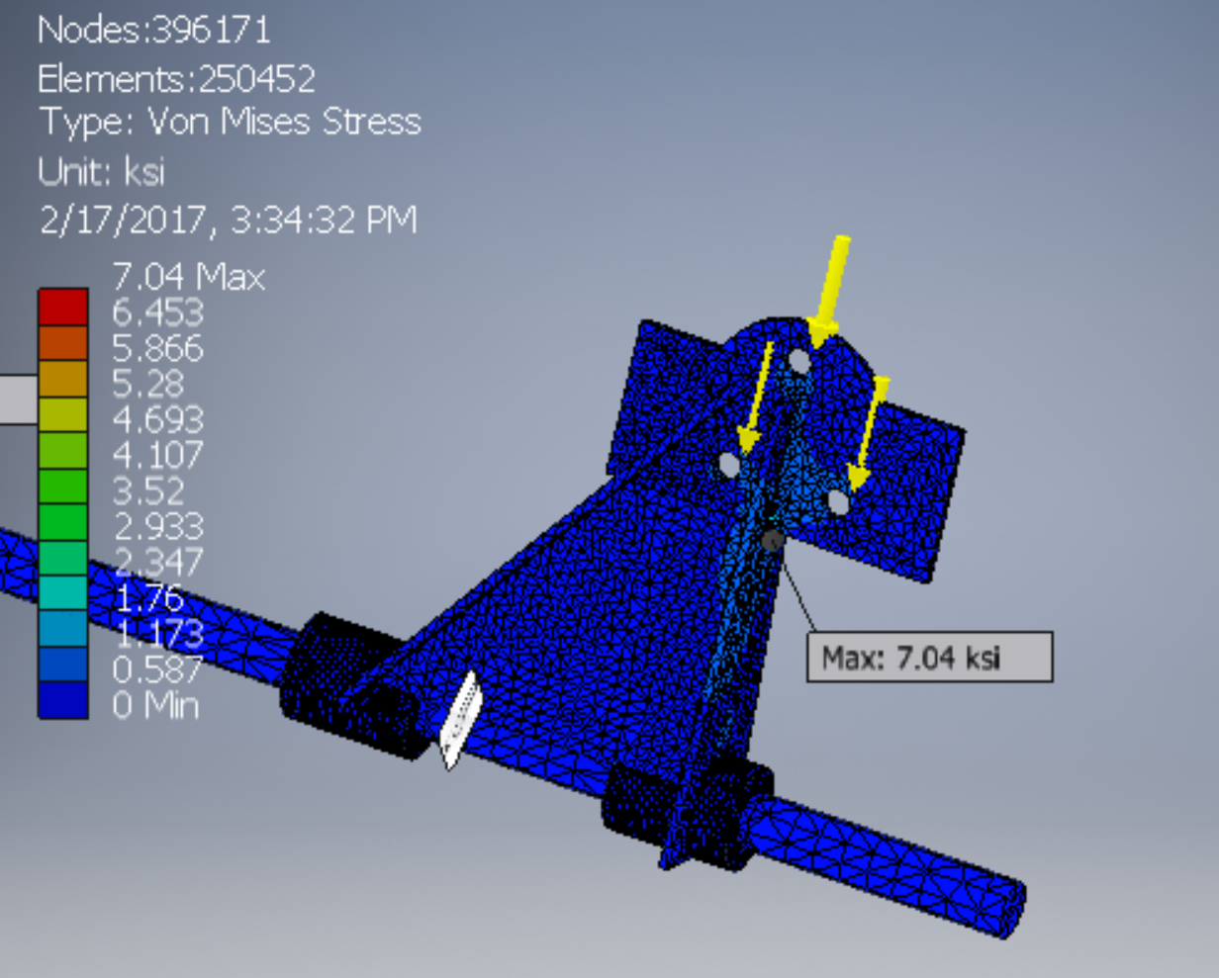
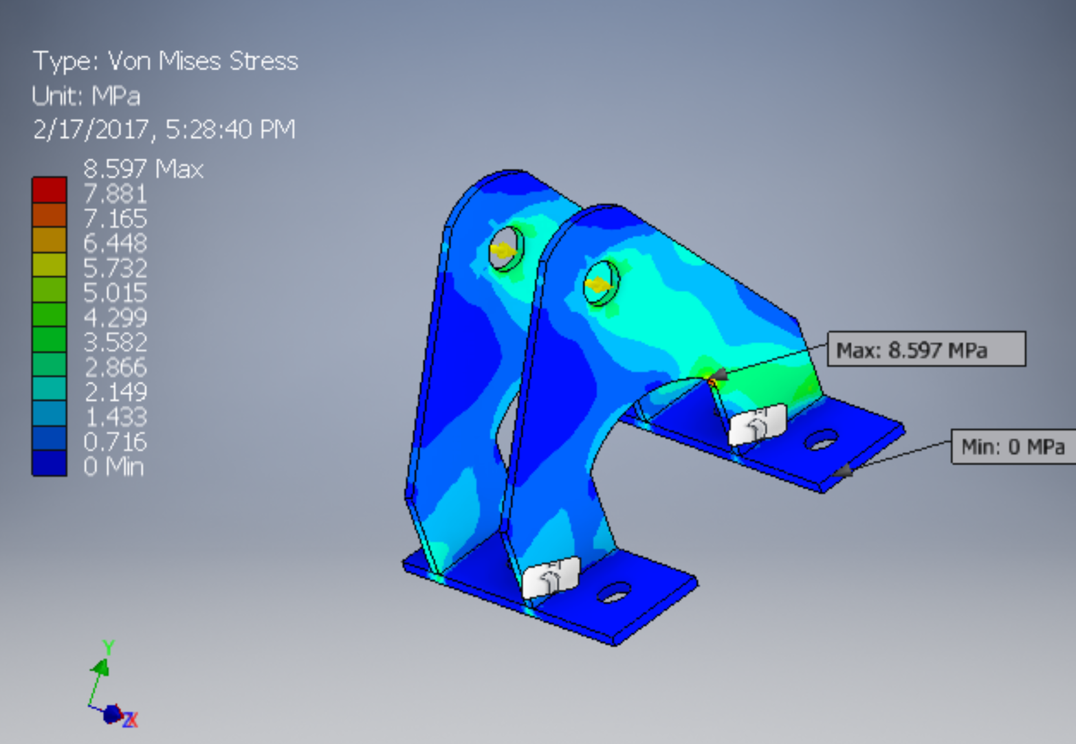
Engine Mount Adaptation
Custom engine mounts
Front Engine Mount
FOS 4.97
Rear Engine Mount
FOS 28

Slide 7
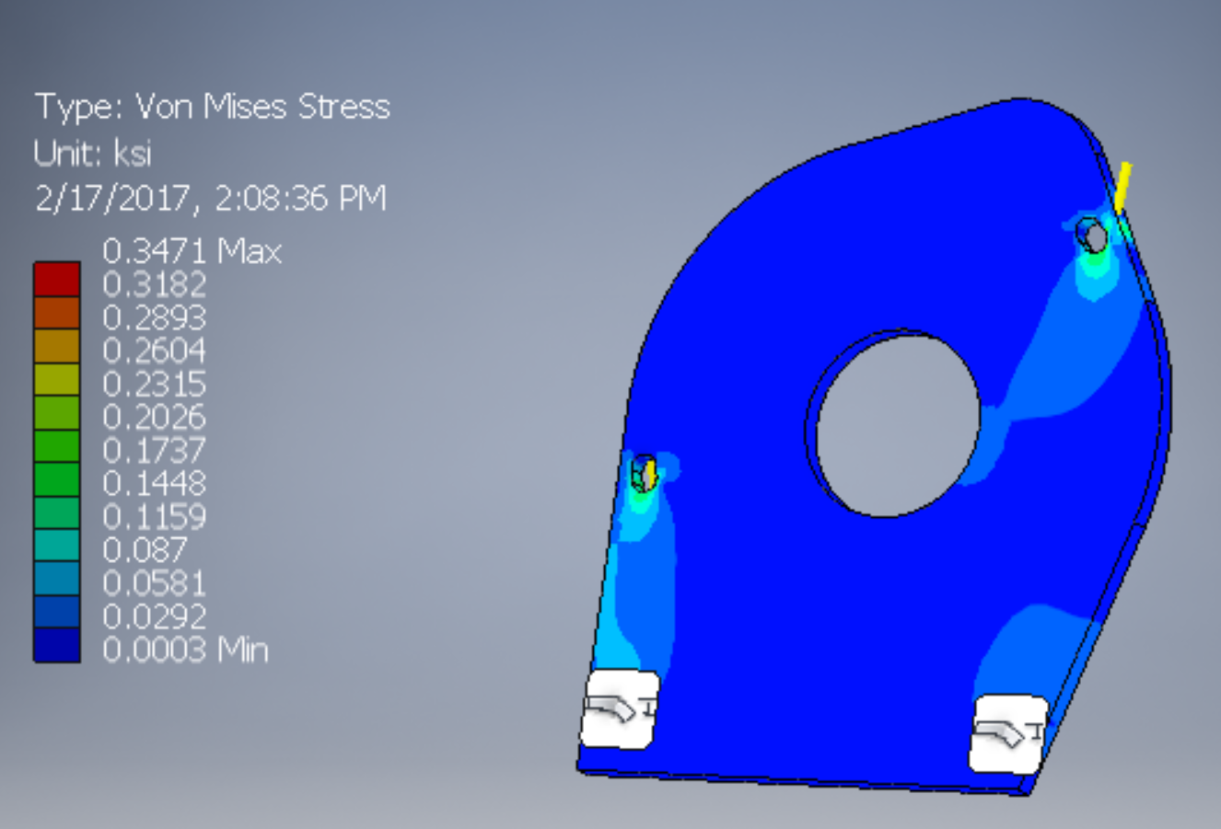
Engine Adaptation
Custom engine mounts
Side Plate Engine Mount
FOS >100

Slide 8
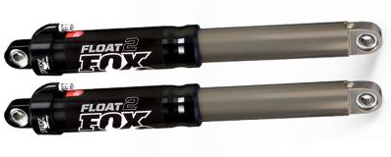
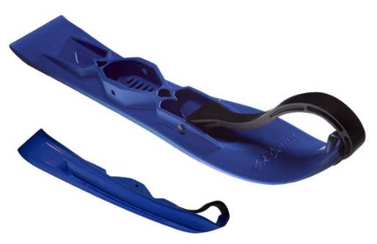
Suspension System
Design and Implementation
Fox Float II Front Shocks
Curve Industries XS Skis
Stud Boy 9” Shaper bars
Improved Towing Capacity Through Increased Traction

Slide 9
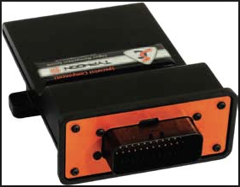
Engine Management
Stand Alone Programmable ECU
Variable control
Pulse Width
Fuel Pressure
Injection Timing
Pilot Injection
Real Time Variable Monitoring
Specialists Components
Typhoon II

Slide 10
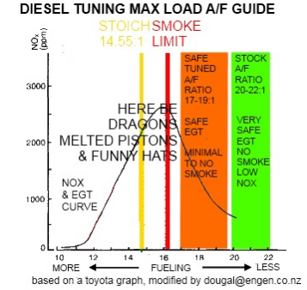
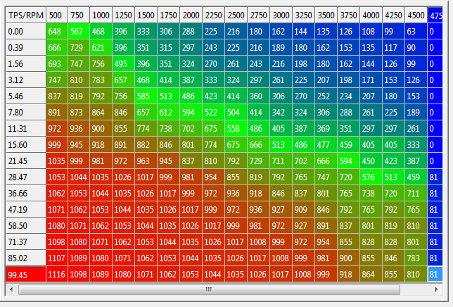
Tuning
Measurables
Air Fuel Ratio (AFR)
ExHaust Gas Temperature(EGT)
Manifold Absolute Pressure (MAP)
Exhaust gasses

Slide 11
Emissions System
Design and Implementation
2008 Ford F-250 Retrofitted Diesel Oxidation Catalyst (DOC)
2008 Ford F-250 Diesel Particulate Filter (DPF) - Passive System
Both filters require higher EGTs
DOC
Exhaust Flow Direction
DPF
99.9% Reduction in Particulate
100% Reduction in CO

Slide 12
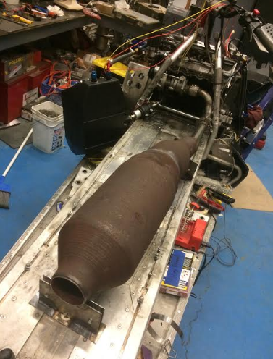
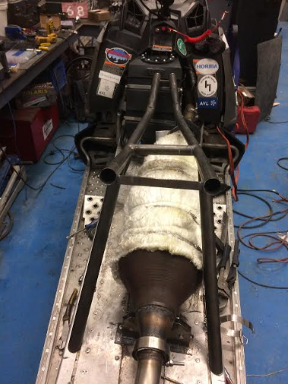
2008-2010 Ford F-250 DOC/DPF

Slide 13
Emissions System
Competition Year | 2018 | 2019
Diesel Particulate | 395.67 mg/kWh | 0.12 mg/kWh
HC+NOX | 6.64 g/kWh | 9.87 g/kWh
CO | 0.01 g/kWh | 0.00 g/kWh
Power | 28.88 kW | 30.8 kW
E-Score | 205.57 | 203.42

Slide 14
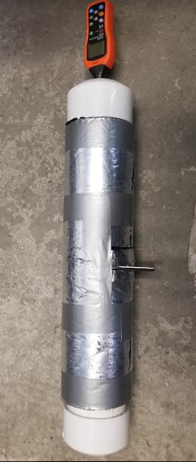
Sound Testing and Elimination
Sound Damping Test
Materials
Lizard Skin
Varius Foams
Spray Paint
Control

Slide 15
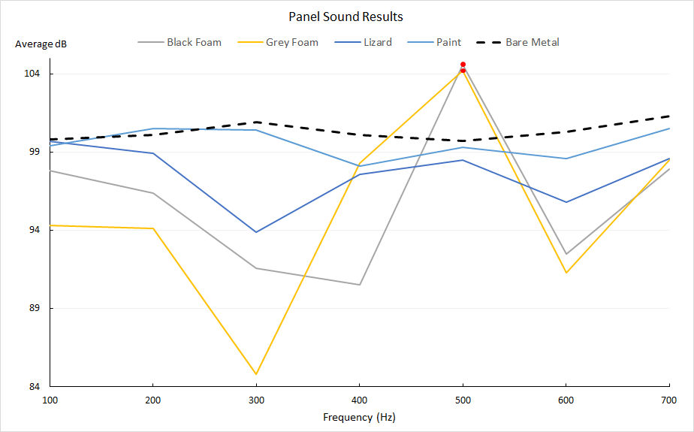
Sound Damping
Selection
Lizard Skin
Reasoning
Consistent
Durable
Easy application

Slide 16
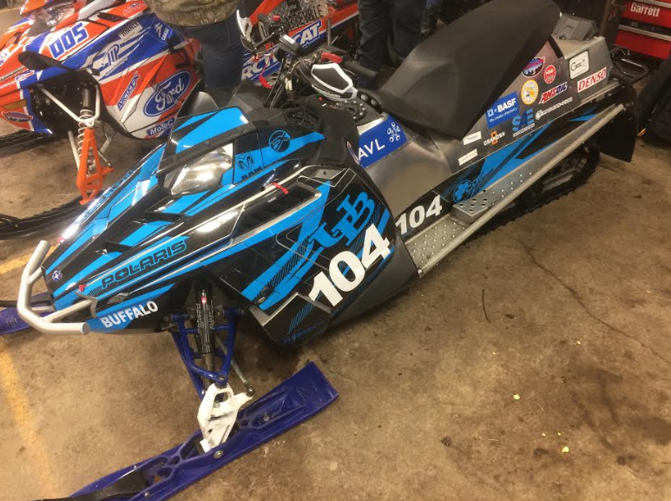
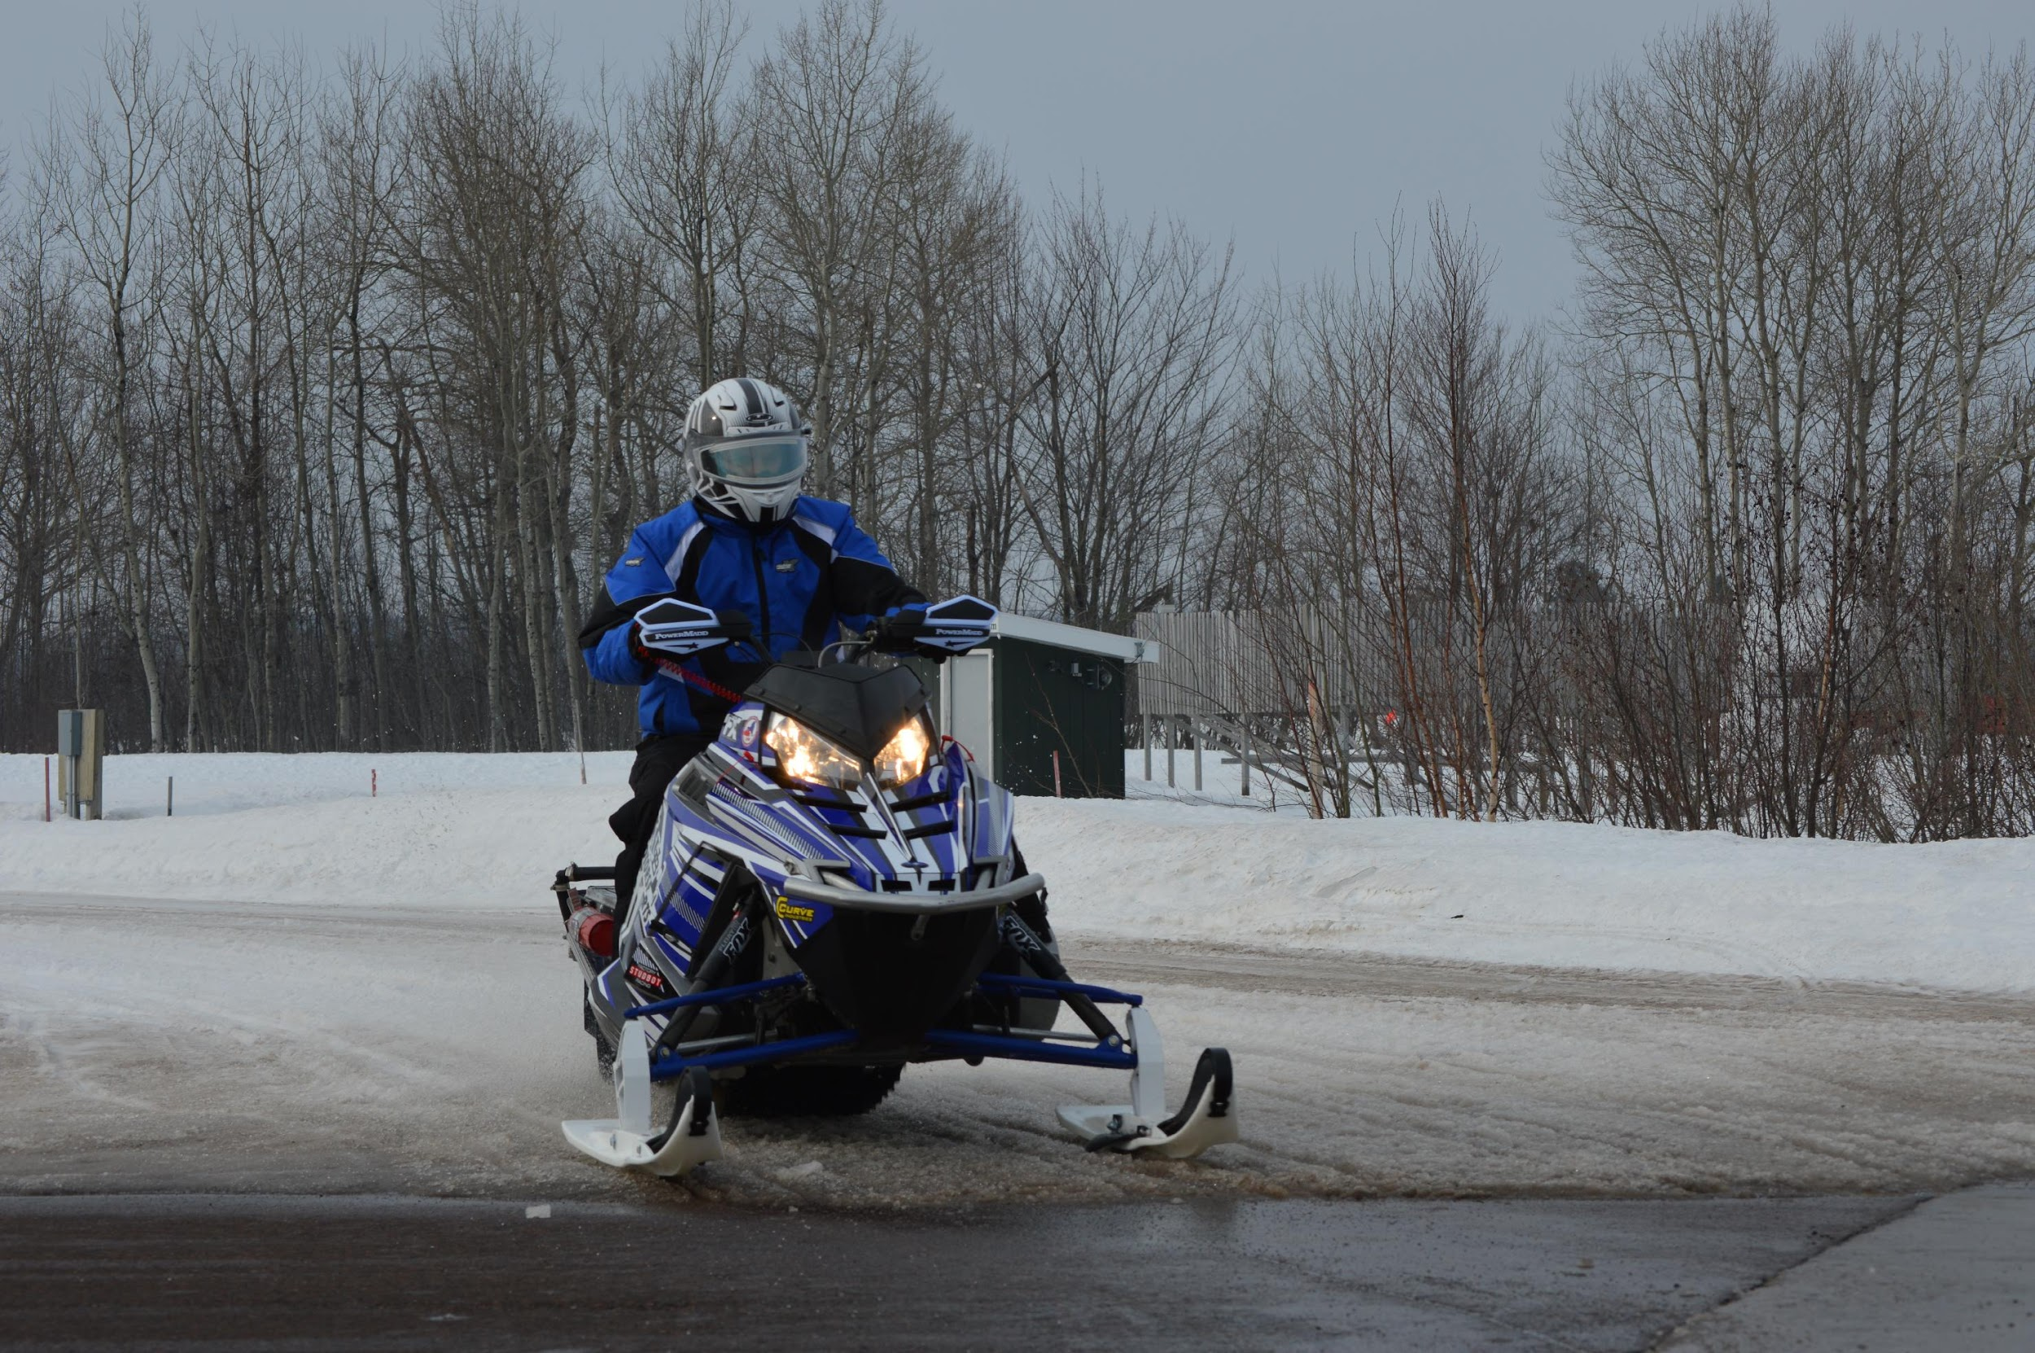
Sled Overview
Low HC, CO, NOx and Particulate Emissions
High Fuel Economy
Adequate Power Output for a Utility Snowmobile
Quiet Operation
Simple, Durable and Reliable Design

Slide 17
Sponsors

Slide 18
Noah White
njwhite2@buffalo.edu
Thank you for your time!

